Slide 1


Slide 2
41
Chapter
Gasoline Injection Fundamentals

Slide 3
Objectives
After studying this chapter, you will be able to:
List some of the advantages of direct fuel injection systems.
Describe the major assemblies of a modern gasoline injection system.
Compare the operation of indirect gasoline injection to direct electronic gasoline injection.

Slide 4
Objectives
Summarize the operating voltages, current levels, and other values of sensors and injectors that are important to technicians.
Summarize the operation of oxygen sensors to control an engine air-fuel ratio.
Correctly answer ASE certification test questions on gasoline injection systems.

Slide 5
Gasoline Injection Fundamentals
Gasoline injection system
  Uses pressure from electric or mechanical fuel pump to spray fuel into engine’s intake manifold
    Multiport or manifold injection
  Combustion chambers
    Direct injection

Slide 6
Gasoline Injection Fundamentals (Cont.)
Electronic fuel injection systems have five subsystems
Fuel delivery system
Air induction system
Sensor system
Computer control system
Fuel metering system

Slide 7
Gasoline Injection Fundamentals (Cont.)
Fuel delivery system
  Feeds clean, liquid gas from storage tank to engine
Air induction system
  Filters, routes, and controls outside air flowing into cylinders

Slide 8
Gasoline Injection Fundamentals (Cont.)
Sensor system
  Measures pressure, temperature, engine speed, and exhaust cleanliness for engine control module (ECM)
Computer control system
  ECM responds to sensor signals to control fuel injector and meter precise amount of fuel

Slide 9
Gasoline Injection Fundamentals (Cont.)
Fuel metering system
  Controls amount of fuel injected into engine

Slide 10
Gasoline Injection Fundamentals (Cont.)
Fuel delivery system of modern direct electronic fuel injection (DEFI) system
  Electric fuel pump
  Mechanical fuel pump
  Fuel filter
  Pressure regulator solenoid
  Electronic fuel injectors
  Fuel flow control valves
  Connecting fuel lines

Slide 11
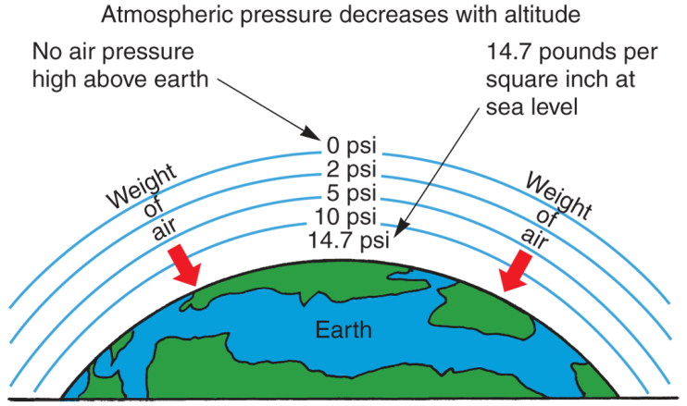
Atmospheric Pressure
Pressure formed by air surrounding earth
At sea level, atmosphere exerts 14.7 psi
At higher altitudes, air pressure and air density drop
  Lowers amount of fuel injected into engine

Slide 12
Vacuum
Pressure lower than atmospheric pressure formed in enclosed area
Many sealed parts in and on engine contain vacuum pressure
Vacuum measured in units of negative psi, inches of mercury, Pascals, or bars compared to outside atmospheric pressure

Slide 13
Differences in Pressure Cause Flow
Difference in pressure between two areas used to cause flow
Engine acts as vacuum pump, producing low-pressure area in intake manifold and cylinders
  This pulls air into engine to support combustion

Slide 14
Engine Throttle Valve
“Butterfly” or flap-type valve in throttle body assembly that controls airflow and engine power output
When closed, throttle valve restricts flow of air and fuel
  Keeps engine speed and power low for idling at low rpms

Slide 15
Engine Throttle Valve (Cont.)
Engine sensors
  Detect changes and adjust fuel flow through injectors
Engine idle speed
  Operating speed of engine when vehicle is in Park or Neutral

Slide 16
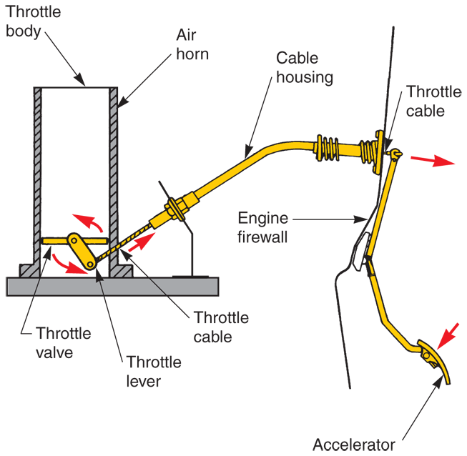
Engine Throttle Valve (Cont.)
When driver presses accelerator
  Throttle cable slides inside its housing and swings throttle valve open
  Atmospheric pressure pushes more air into engine intake manifold

Slide 17
Throttle-by-Wire Systems
Throttle-by-wire or drive-by-wire systems
  Moves throttle valves electronically instead of using mechanical linkage from accelerator pedal
Accelerator pedal sensor
  Feeds electric signal to ECM corresponding to pedal position
  ECM sends control current to servo motor actuator that opens and closes throttle valve

Slide 18
Throttle-by-Wire Systems (Cont.)
Engine throttle actuator
  Small, reversible servo motor with emergency release
Throttle safety release
  Used to return engine to idle even if engine throttle actuator fails

Slide 19
Gasoline Injection Timing
Older fuel injection systems
  Continuous fuel injection
    Injectors spray fuel whenever engine is running
  Intermittent fuel injection
    Injectors open and close regardless of intake valve positions
Timed injection system
  Sprays fuel during intake or compression strokes, in relation to piston and valve action

Slide 20
Injector Pulse Width
Indicates amount of time each injector is energized and kept open
ECM controls injector pulse width and amount of fuel sprayed into engine
  Using all power train sensors

Slide 21
Direct and Indirect Injection
Fuel injection systems
  Gasoline injection system often classified by where it injects fuel into engine
Indirect injection system
  Sprays fuel into engine intake manifold
Direct injection system
  Sprays high-pressure fuel into engine’s combustion chambers

Slide 22
Indirect Injection Systems
Throttle body injection system (TBI), or single point injection
  Injector nozzles mounted in throttle body assembly located on top of engine
Multiport injection system
  Has fuel injectors in intake ports
Cold-start fuel injector
  Used in early designs to richen fuel mixture for cold engine startup

Slide 23
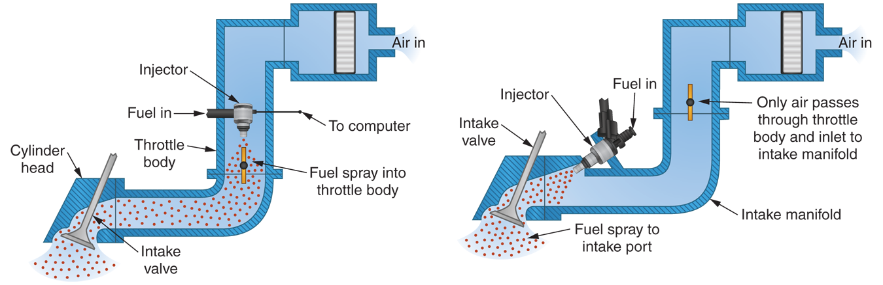
Indirect Injection Systems (Cont.)

Slide 24
Direct Fuel Injection
Direct fuel injection (DFI) systems
  Inject fuel directly into engine combustion chambers
Direct electronic fuel injection (DEFI)
  Uses electric fuel pump, mechanical fuel pump, and high-pressure injectors to spray fuel straight into combustion chambers

Slide 25
Direct Fuel Injection (Cont.)
Stratified charge mode
  Ultra-lean burn mode where small charge of fuel injects into combustion chambers during end of compression stroke
Stoichiometric mode
  Produces theoretically homogenous mixture of fuel and air
    Equally mixed and dispersed

Slide 26
Direct Fuel Injection (Cont.)
Full power charge mode
  Produces homogeneous, rich mixture that generates more combustion pressure and power
  Needed when engine accelerates quickly

Slide 27
Electronic Fuel Injector Types
Two common types of electronic fuel injectors
  Solenoid fuel injectors
    Electric current energized electromagnet pulls fuel valve open
  Piezo fuel injectors
    Electric current energized crystal expands to push fuel valve open

Slide 28
Solenoid Fuel Injectors
Used in multiport system
Typically consists of
  Electric terminals
  Injector solenoid
  Inlet screen
  Needle valve
  Needle seat
  Return spring
  O-ring seal
  Injector nozzle

Slide 29
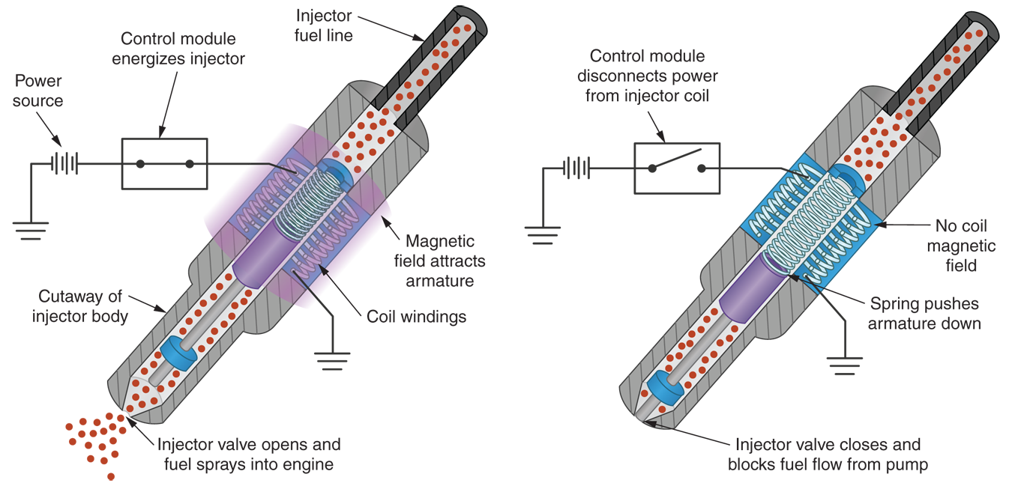
Solenoid Fuel Injectors (Cont.)

Slide 30
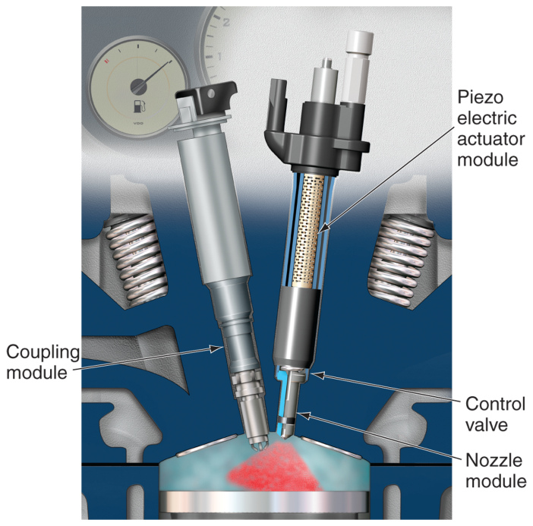
Piezo Fuel Injectors
Uses crystalline ceramic material instead of electromagnet to open injector valve
Converts electrical energy directly into motion
More precise

Slide 31
Fuel Pressure Regulator
Fuel pressure regulator
  Controls amount of fuel pressure in fuel rail
DEFI fuel pressure regulator
  Uses electric solenoid to bypass excess fuel pressure back to low pressure side of system

Slide 32
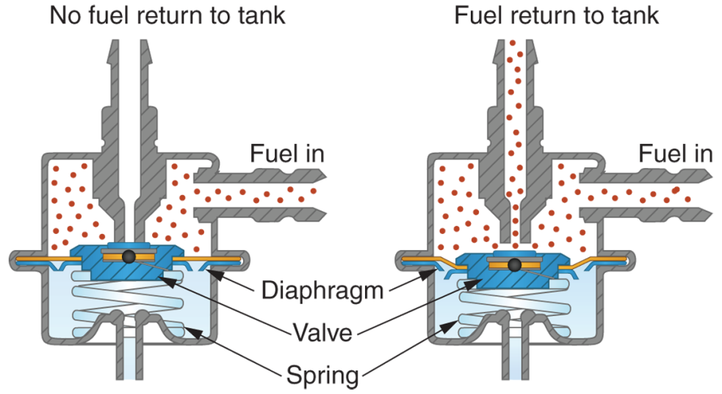
Fuel Pressure Regulator (Cont.)
EFI fuel pressure regulator
Engine vacuum, not ECM, controls fuel pressure in multiport fuel injection systems

Slide 33
Fuel Rail
Fuel rail or fuel log
  Large diameter steel tube feeds gasoline to inlet fittings of fuel injectors
Fuel system service fitting
  Often provided on low-pressure EFI systems for releasing and measuring fuel pressure

Slide 34
DEFI Amplifier Module
DEFI amplifier
  Increases voltage and current signal sent from ECM to operate high-pressure direct injectors
DEFI systems often require up to 100 volts dc for proper solenoid operation

Slide 35
Fuel Control Sensors
Oxygen
Manifold absolute pressure (MAP)
Throttle position
Accelerator pedal
Engine coolant temperature
Airflow
Intake air temperature
Crankshaft position
Camshaft position
High fuel-pressure

Slide 36
Fuel Control Sensors (Cont.)
Low fuel-pressure
Fuel tank temperature
Fuel temperature
Vehicle speed
Brake pedal switch
Hybrid control module
Traction control module

Slide 37
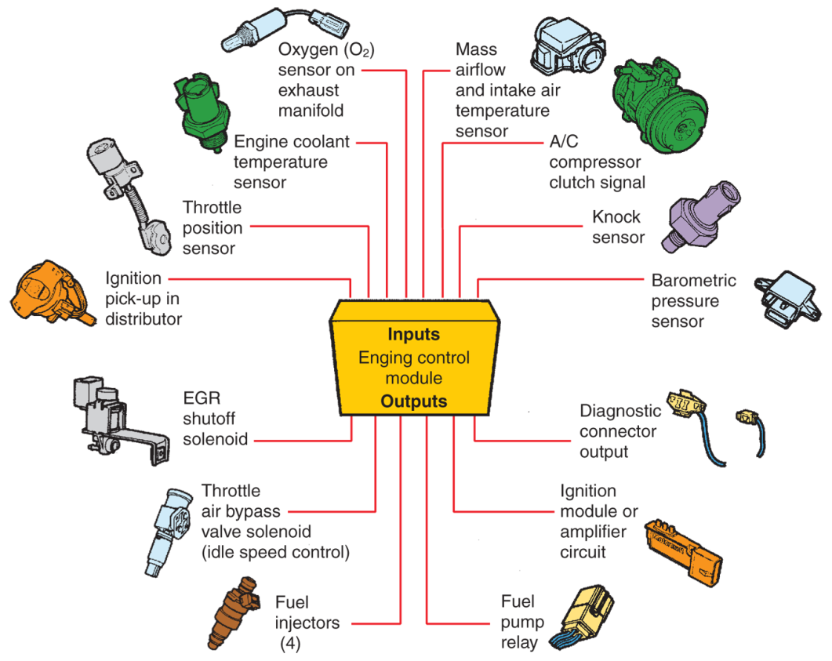
Fuel Control Sensors (Cont.)
(Ford)

Slide 38
Oxygen Sensor
Oxygen sensor, exhaust gas, or O₂ sensor
  Measures oxygen content in exhaust gases to check combustion efficiency
Primary oxygen sensor or front O₂ sensor
  Monitors oxygen in exhaust gases as it leaves engine

Slide 39
Oxygen Sensor (Cont.)
Secondary oxygen sensor or rear O₂ sensor
  Mounted downstream in exhaust system
  Primarily monitors catalytic converter
Catalyst monitor
  Any O₂ sensor mounted after catalytic converter

Slide 40
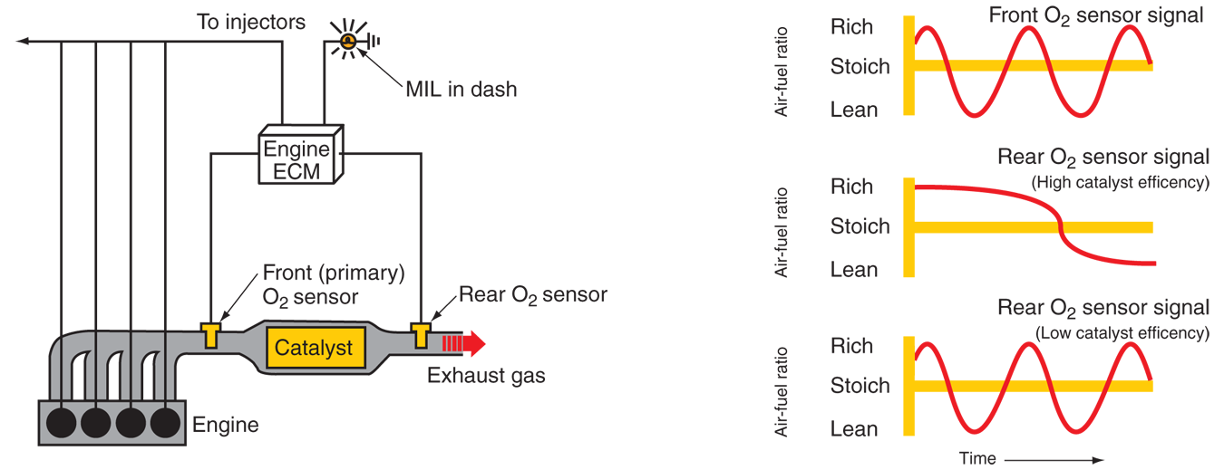
Oxygen Sensor (Cont.)

Slide 41
Oxygen Sensor Positions
Assigned number by its location and order in relation to engine’s banks
Sensor closest to number one cylinder denoted as Oxygen Sensor, Bank 1, Sensor 1

Slide 42
Open Loop and Closed Loop
Open loop
  Electronic fuel injection system does not use engine exhaust gas content as main indicator of air-fuel mixture
Closed loop
  Computer using information from oxygen sensor and other sensors
  Forms imaginary loop from ECM, through fuel system, into exhaust system, and back to ECM

Slide 43
Narrow Band Oxygen Sensors
Narrow band oxygen sensors
  Can only measure combustion efficiency near stoichiometric
    Chemically correct
Zirconia oxygen sensors
  Use zirconia and platinum to produce voltage output that represents oxygen in exhaust gases

Slide 44
Narrow Band Oxygen Sensors
(Cont.)
Planar zirconia oxygen sensors
  Similar to conventional zirconia sensors
  Zirconia element, electrodes, and heater combined in flat, laminated strip
Lean burn oxygen sensor
  Measures oxygen content in exhaust of lean-burn engines

Slide 45
Narrow Band Oxygen Sensors
(Cont.)
Titania oxygen sensor
  Uses thick film of titania to detect amount of oxygen present in exhaust gases
  Varies its internal resistance to signal ECM

Slide 46
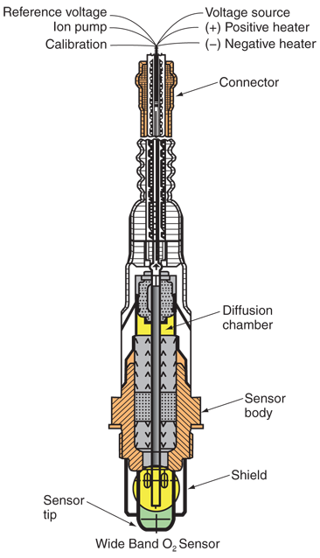
Wide Band Oxygen Sensors
Can change its output gradually and in direct proportion to oxygen content of exhaust gases
Produces small O₂ sensor pump current representing oxygen content

Slide 47
Manifold Absolute Pressure Sensor
Manifold absolute pressure (MAP) sensor
  Measures pressure, or vacuum, inside engine intake manifold
Excellent indicator of engine load
Varies resistance with changes in engine load
  Data is used by computer to alter fuel mixture

Slide 48
Throttle Position Sensor
Variable resistor connected to throttle plate shaft
Different current levels produced for different throttle positions

Slide 49
Engine Coolant Temperature Sensor
Monitors operating temperature of engine
Mounted so exposed to engine coolant
When engine warms, sensor’s resistance changes so ECM knows to make mixture leaner

Slide 50
Sensors
Airflow sensor
  Used in many EFI systems to measure amount of outside air entering engine
Intake air temperature sensor
  Measures temperature of air entering engine
Crankshaft position sensor
  Used to detect engine speed

Slide 51
Sensors (Cont.)
Fuel pressure sensor
  Mounts on fuel rail
  Sends electronic signal, proportional to pressure inside rail
Fuel temperature sensor
  Monitors temperature of fuel in fuel rail

Slide 52
Other Sensors
Other sensors affect fuel injection system operation
  A/C compressor sensor
  Transmission sensors
  EGR sensor
  Engine knock sensor
Provide additional data about operating conditions affecting engine fuel needs

Slide 53
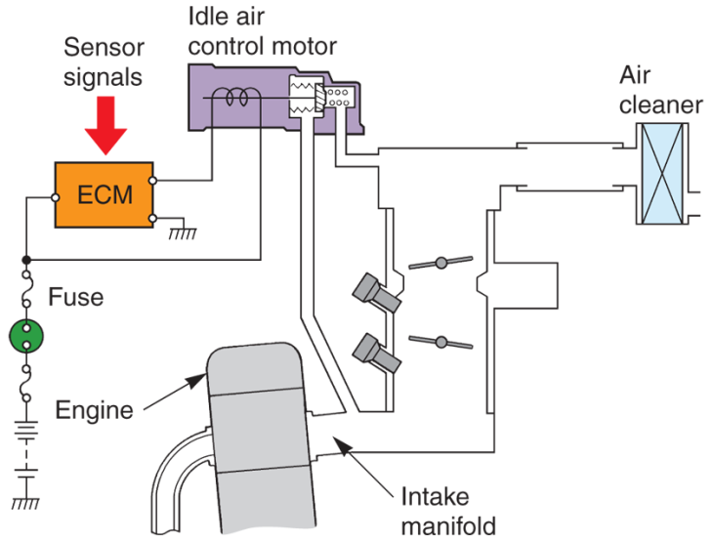
Engine Idle Speed Control
Idle air control motor
  Solenoid, or servo motor-operated air bypass valve
  Used to help control engine idle speed
Works like thermo or temperature-sensitive mechanical valve but ECM controlled
(Honda)

