Slide 1


Slide 2
42
Chapter
Gasoline Injection Diagnosis and Repair

Slide 3
Objectives
After studying this chapter, you will be able to:
Inspect a fuel injection system to identify fuel leaks, vacuum leaks, and disconnected wires.
Explain OBD II typical live sensor and injector readings for late-model fuel injection systems.
Diagnose problems in a gasoline injection system using a scan tool, multimeter, and scope.

Slide 4
Objectives
Compare the scope waveforms for common injector circuits.
Use a scan tool to relieve fuel pressure and to test fuel pumps, fuel pressure regulators, and high-pressure fuel injectors.
Perform a fuel injector balance test.
Perform on-car injector flow tests.

Slide 5
Objectives
Use a noid light and handheld scope to analyze fuel injector operation.
Replace multiport and direct fuel injectors.
Check EFI engine sensors with a scan tool.
Correctly answer ASE certification test questions about fuel injection system diagnosis, service, and repair.

Slide 6
Gasoline Injection Problem Diagnosis
Required to diagnose problems in gasoline injection system
Knowledge of EFI systems
Basic troubleshooting skills
  Reading scan tool trouble codes, measuring circuit electrical values with a meter, and interpreting scope waveforms from fuel injectors
Factory service information
Scan tool

Slide 7
On-Board Diagnostics
Modern EFI systems have extensive on-board diagnostic abilities
Engine ECM can detect out-of-spec circuit and produce trouble code pinpointing problem location
  Wrong voltage, current, or resistance

Slide 8
On-Board Diagnostics (Cont.)
Fuel injection systems monitor
  Engine manifold pressure
  Engine airflow into intake manifold
  Intake air temperature
  Engine coolant temperature
  Exhaust gas oxygen content
  Engine throttle position

Slide 9
On-Board Diagnostics (Cont.)
Reference voltage sent to sensors by ECM
Electric, in-tank fuel pump pressure
Engine driven, mechanical fuel pump pressure
Fuel tank pressure
Injector pulse width
Fuel trim

Slide 10
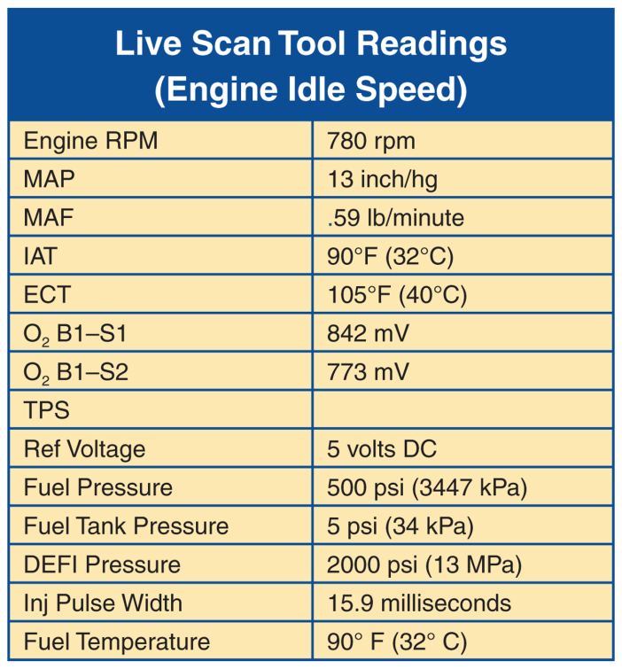
On-Board Diagnostics (Cont.)
Idle live readings
  Typical circuit values with engine running at curb idle speed and full operating temperature

Slide 11
On-Board Diagnostics (Cont.)
Examples of readings indicating trouble in fuel injection system
Long-term fuel trim trouble code from prolonged engine vacuum leak
Low oxygen reading for rear O₂ sensor might indicate failed catalytic converter
At room temperature, engine’s IAT and ECT readings should be about the same
  If one sensor shows wrong temperature reading, that circuit is at fault

Slide 12
Inspecting the Fuel Injection System
Inspect engine compartment for fuel leaks, air leaks, dirty air filter, and other obvious troubles
Without starting engine, raise hood and inspect all fuel lines to and on engine
Check around mechanical fuel pump and fuel rail to find smell and wetness of liquid gasoline
  Wear protection

Slide 13
Inspecting the Fuel Injection System
(Cont.)
Check condition of all vacuum hoses and wiring from ECM to injectors, fuel pressure sensor, and fuel pump
Look for vacuum leaks, kinked or rusted metal gas lines, loose electrical connections, and other problems
Check vacuum hose connection to MAP sensor

Slide 14
Inspecting the Fuel Injection System
(Cont.)
With scan tool connected, start engine and review live data readings for fuel pressures, injector pulse width, and other electrical values relating to fuel injection
If engine has a miss, listen for dead fuel injector with stethoscope

Slide 15
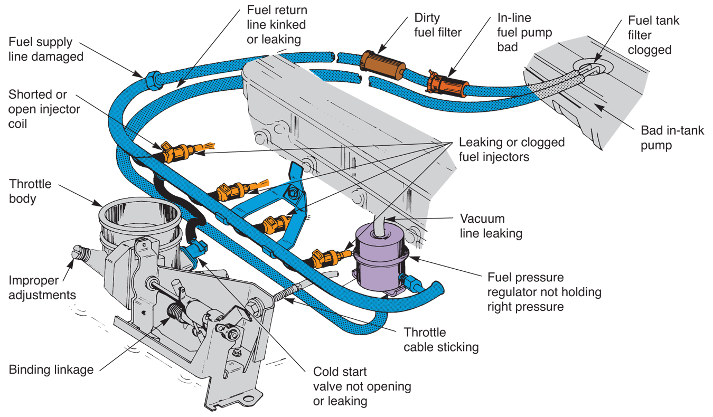
Inspecting the Fuel Injection System
(Cont.)
(Fiat)

Slide 16
Fuel Injector Sounds
Use stethoscope on top of fuel injector body
Working injector will make distinct, clicking sound
If injector rattles or is quiet, it may be sticking, have broken spring, or not opening at all
  Could mean bad ECM power transistor, break in wiring, or injector itself is bad

Slide 17
OBD II Fuel System Monitoring
Vehicle’s computer or ECM will record potential problems in its memory
Scan tool reads this data and converts it into a brief problem description
Fuel system monitoring
  Checking whether stoichiometric, or theoretically perfect, fuel mixture is being fed to engine

Slide 18
OBD II Fuel System Monitoring (Cont.)
Short-term fuel trim
  Temporary adjustment of injector pulse width to correct fuel mixture
Long-term fuel trim
  Permanent adjustment of injector pulse width for altered operating parameters

Slide 19
OBD II Oxygen Sensor Monitoring
Oxygen sensor monitoring
  Keeps normally closed loop mode of operation efficient
Heater monitor
  Checks action of heating element in sensor

Slide 20
Scan Tool Fuel Trim Data
Fuel trim malfunction trouble code
  Set if ECM has difficulty maintaining engine air-fuel ratio
Lean trouble code
  Set if O₂ sensor detects high amounts of oxygen in engine exhaust
Rich trouble code
  Too much fuel injected into cylinder for engine speed and load

Slide 21
OBD Fuel Injection System Tests
Measure injector pulse widths as numeric or scope readings in milliseconds
Injector balance test
  Measures pressure drop and flow from fuel injectors
Fuel pump tests
  Measures low- and high-fuel pump pressures

Slide 22
OBD Fuel Injection System Tests (Cont.)
Sensor tests
  Find problems with input devices that affect fuel injection
    Oxygen sensor, MAP sensor, etc.
Perform actuator tests
  Throttle control motor
  Accelerator pedal
  Other circuits

Slide 23
Fuel Injector Problems
Bad injector causes wide range of problems
  Rough idle
  Hard starting
  Poor fuel economy
  Engine miss
Each fuel injector must provide correct fuel spray pattern and equal charge of fuel in each cylinder

Slide 24
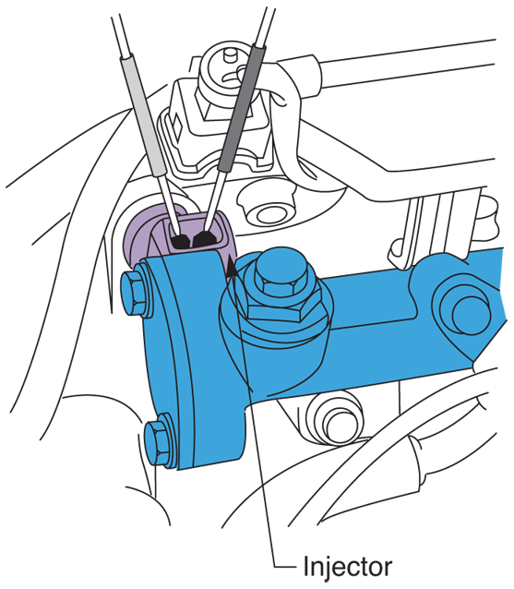
Fuel Injector Resistance
Touch ohmmeter leads across two pins or terminals inside fuel injector
Failed injector coil winding will have either infinite resistance or no resistance
(Honda)

Slide 25
Fuel Injector Resistance (Cont.)
Low impedance fuel injectors
  Internal resistance of about 0.5 to 3 ohms
High impedance fuel injectors
  Internal resistance between 10 and 12 ohms
Piezo fuel injectors
  Ohms reading of 150,000 ohms to 200 kilohms

Slide 26
Fuel Injector Operating Voltages
EFI injector operating voltage
  12.5–15 volts dc for non-direct or port injection systems
DEFI injector operating voltage
  Higher than battery voltage
    50–100 volts dc
To measure fuel injector operating voltage, place voltmeter across ground and power side terminal with injector still connected to ECM

Slide 27
Fuel Injector Scope Testing
When electronic fuel injector fires, it produces specific waveform as fuel nozzle snaps open and closed
Fuel injector scope test
  Measuring maximum and minimum injector voltages and time of injection in milliseconds

Slide 28
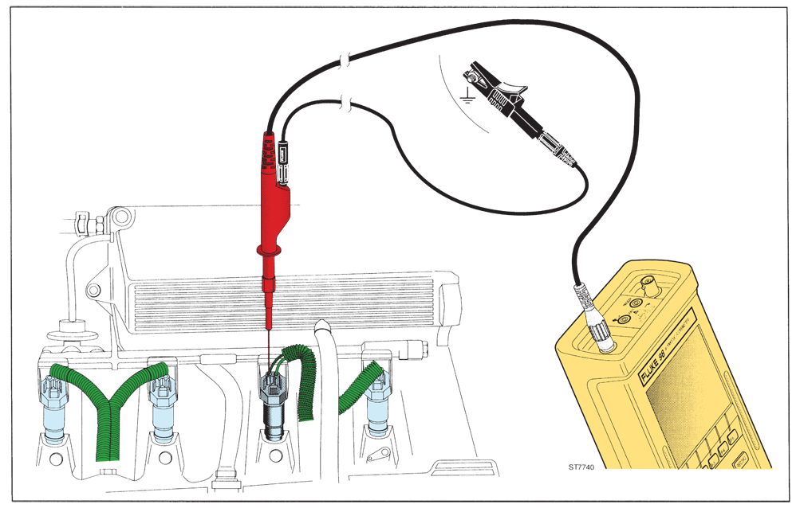
Fuel Injector Scope Testing (Cont.)

Slide 29
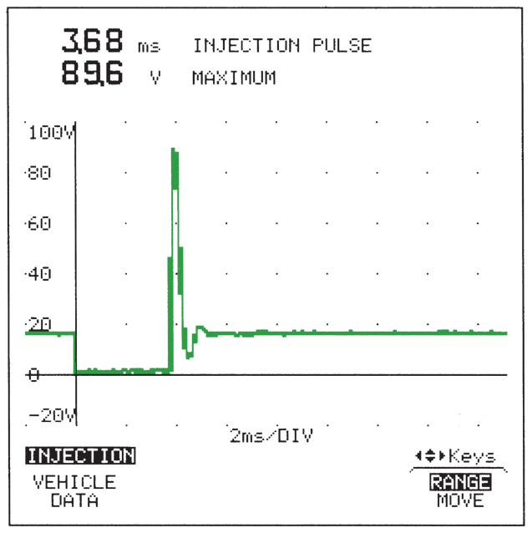
Fuel Injector Scope Waveforms
Properly functioning injector will produce scope waveform or trace as it opens for a few milliseconds and snaps closed
Rounded, malformed waveform without specific voltage variations over time is faulty

Slide 30
Fuel Injector Scope Test
Wear safety glasses and work gloves
Connect red scope lead to positive wire coming from injector amplifier or ECM
Refer to factory wiring diagram for wire color codes
Connect black scope lead to any good ground on engine

Slide 31
Fuel Injector Scope Test (Cont.)
Set scope to maximum injector circuit voltage
  Often above 100 volts for DEFI systems and 15 volts for port EFI systems
Set scope frequency to milliseconds, or thousandths of a second

Slide 32
Fuel Injector Scope Test (Cont.)
Block tires, shift gear to Park, and apply emergency brake
Start engine
Compare injector scope waveform to known good pattern for that make and model car

Slide 33
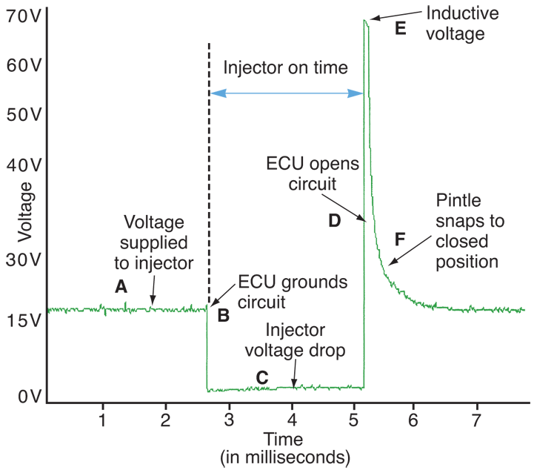
Saturated Switch Fuel Injector Waveform

Slide 34
Peak-and-Hold Fuel Injector Waveform
Peak-and-hold fuel injector circuit
  Uses high amount of current to open injector and low amount of current to hold injector open
Pintle bump
  Slight variation in injector waveform occurring when pintle opens or closes

Slide 35
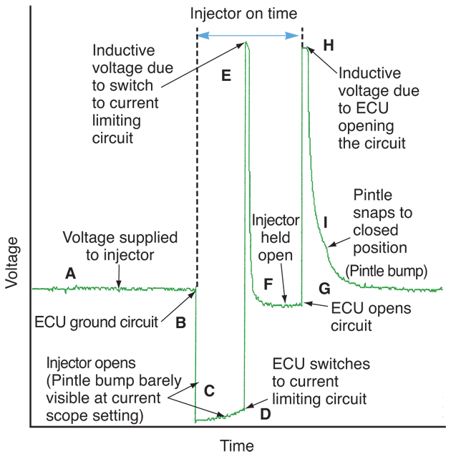
Peak-and-Hold Fuel Injector Waveform
(Cont.)

Slide 36
Testing Piezo Fuel Injectors
Both voltage supply and ground switch on and off at the same time by ECM
Requires higher applied voltage to hold nozzle open
  90–175 volts
Requires higher current levels to keep piezo crystal expanded in size to hold fuel needle open
  15–30 amps

Slide 37
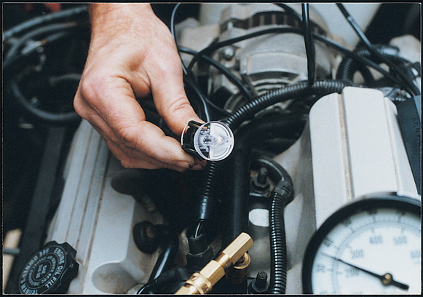
Fuel Injector Noid Light Test
Noid light
  Special test light used for checking electronic fuel injector feed circuits for battery power
Should be used if injector is not clicking and opening
(OTC/SPX Corp.)

Slide 38
Noid Light Test Procedure
Disconnect wiring harness from fuel injector
Fit correct noid light with matching connector configuration into injector harness connector
Start engine and observe small bulb inside noid light

Slide 39
Noid Light Test Procedure (Cont.)
If noid light flashes, ECM is sending voltage into injector circuit
If noid light does not flash, something keeps current from reaching injector
Repeat noid light test on any injector not clicking and operating properly

Slide 40
Fuel Injector Balance Testing
Uses scan tool, PC, or EFI tester to measure amount of fuel flowing through each injector
Tests if any injectors are clogged, cracked, shorted, or not opening fully

Slide 41
Relieving EFI System Pressure
Use scan tool to operate pressure relief valve in high-pressure mechanical pump
Pull fuse or relay for electric fuel pump and run engine until it stalls
For low-pressure fuel systems
  Open pressure relief valve on fuel rail and allow it to spray into shop towel

Slide 42
Relieving EFI System Pressure (Cont.)
Fuel pressure relief valve
  For “bleeding” gasoline pressure left in fuel rail and injectors
Schrader valve
  When tip of fuel pressure relief valve is depressed, fuel will spray out of valve to release pressure

Slide 43
Pre-OBD II Injector Balance Test
Connect tachometer to ignition system to read engine speed or rpms
Unplug idle speed motor or air bypass valve
Disconnect electrical connector for suspected bad fuel injector
  Engine speed should drop if injector is working normally

Slide 44
Pre-OBD II Injector Balance Test
(Cont.)
If engine speed stays the same, fuel injector or its supply circuit wiring is at fault
Test for power to injector using a noid light
If noid light fails to flash on and off, power signal is not reaching injector coil or crystal
Check for open wire or electrical connection between connector and ECM or amplifier circuit

Slide 45
Pre-OBD II Injector Balance Test
(Cont.)
Clogged or dirty injector will not cause any change in engine rpms
Either that engine cylinder is not getting proper charge of fuel, or it has distorted spray pattern
If needed, test other injectors
Reconnect all injector connectors and connector on throttle

Slide 46
Injector Balance Test with an EFI Tester and Pressure Gauge
Connect pressure gauge to test fitting on fuel rail
  Make sure all fittings are tight and not leaking
Close off valve for measuring fuel volume if provided on fuel gauge assembly
Connect tester wiring to injector in question

Slide 47
Injector Balance Test with an EFI Tester and Pressure Gauge (Cont.)
Turn ignition key on to pressurize system
Turn ignition key off
Press injector balance tester button while watching pressure gauge drop
Record pressure drop reading
Repeat test on other fuel injectors

Slide 48
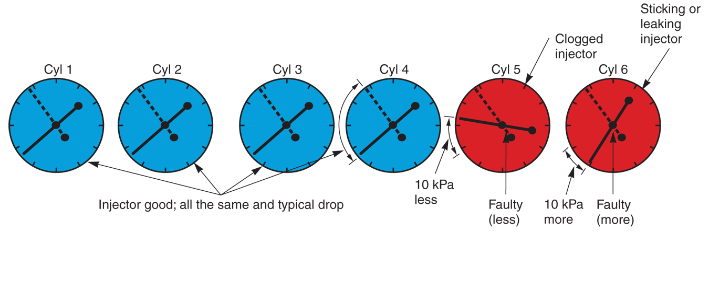
Injector Balance Test with an EFI Tester and Pressure Gauge (Cont.)

Slide 49
OBD II Injector Balance Test
Connect scan tool or injector tester and warm engine to full operating temperature
In Scan Tool or Tester menu, go to Injector Tests and follow menu screen directions
Start and idle engine to build fuel pressure

Slide 50
OBD II Injector Balance Test (Cont.)
Shut engine off and immediately press Yes for injector balance tests
Scan tool or tester will then fire each injector with same injector pulse width while recording pressure drop for each fuel injector

Slide 51
On-Car Injector Flow Tests
Use dedicated digital fuel injection system tester to properly test DEFI systems
Tester will use data from injector voltage waveforms, fuel pressure sensor signals, and other fuel control sensor signals to analyze problems and calculate fuel flow

Slide 52
On-Car Injector Flow Tests (Cont.)
Injector maximum flow test
  Fires each fuel injector for predetermined amount of time while measuring flow through injector
Fuel injector pulsed flow test
  Fires injector several times with normal pulse width to check pintle response
Pintle response
  How quickly pintle moves as magnetic field in injector coil builds

Slide 53
Fuel Injector Impedance Test
Measures internal resistance of injector coil windings while carrying full amp load
  Not piezo injectors
  Can find intermittent injector problems
  Weak, sticking injectors
  Shorted or fractured injector windings

Slide 54
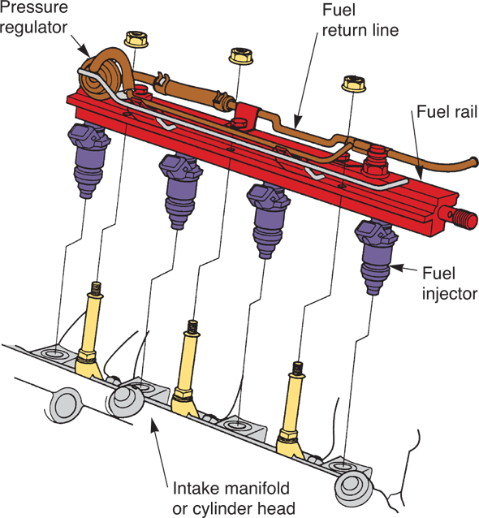
Replacing Multiport Fuel Injectors
Bleed off fuel pressure
Remove hose from injector and fuel rail
Unplug electrical connection
Remove fasteners
Pull injector out of engine
  Sometimes, fuel rail must be removed
(Honda)

Slide 55
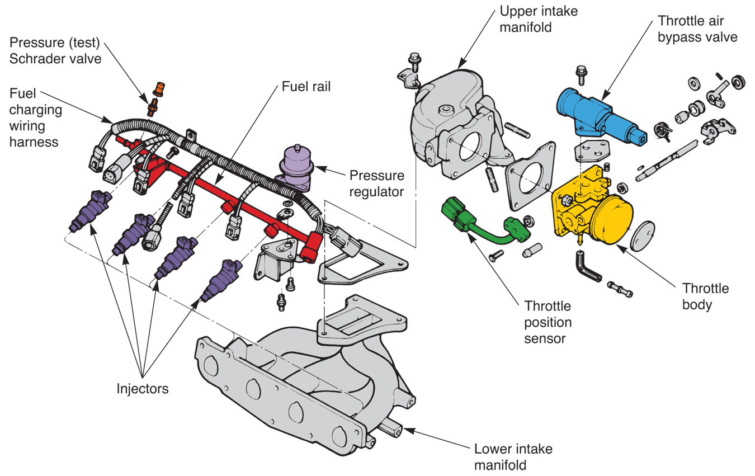
Replacing Multiport Fuel Injectors (Cont.)
(Ford)

Slide 56
Replacing Direct Fuel Injectors
Release residual fuel pressure using scan tool, laptop, or injector tester
With hybrid vehicle, disable HV battery by pulling its plug
Disconnect stainless steel fuel line between mechanical fuel pump and fuel rail
Remove bolts and hold-down plates securing high-pressure rail and injectors

Slide 57
Replacing Direct Fuel Injectors
(Cont.)
Pull fuel rail off injectors to prevent injectors from coming out with fuel rail
Install injector puller on rail or injector
  Tighten puller down to force fuel injector out of cylinder head
If needed, install new O-rings on high-pressure injector

Slide 58
Replacing Direct Fuel Injectors
(Cont.)
Install new plastic spacer, if used
Manufacturers recommend installing new gasket, seals, and bolts to ensure no high-pressure fuel leaks
Force new injector straight down into cylinder head
  Be careful not to break it

Slide 59
Replacing Direct Fuel Injectors
(Cont.)
Install any hold-down plates and torque fuel injector retaining bolts to specifications
  Overtightening or undertightening can result in costly or dangerous fuel leaks
Re-torque high-pressure fuel line using crow foot wrench and torque wrench

Slide 60
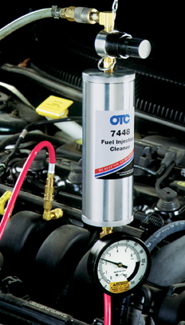
Electronic Fuel Injector Cleaning
Fuel injector cleaning tool
Uses shop air pressure to force cleaning solution through injectors to remove deposits
(OTC/SPX Corp.)

Slide 61
Fuel Pressure Regulator Service
Faulty fuel pressure regulator
  Cause extremely rich or lean air-fuel mixture
With modern EFI systems, scan tool will provide live data readings for high-pressure fuel rails, low-pressure fuel lines, and fuel tank pressure

Slide 62
Fuel Pressure Regulator Service
(Cont.)
Connect gauge to Schrader valve on fuel rail with steel lines
Torque fitting properly to avoid leakage
Start engine and note pressure gauge readings
Measure fuel pressure at idle and about 3000 rpms
  If readings not within specifications, pressure regulator, fuel filters, fuel pumps, fuel feed hoses, or other parts may be at fault

Slide 63
Fuel Pressure Regulator Service
(Cont.)
With engine idling, disconnect vacuum hose going to fuel pressure regulator
  Fuel system pressure should increase 8–12 psi over idle pressure
  No change indicates faulty pressure regulator or leaky or kinked vacuum line

Slide 64
Fuel System Sensor Service
Most EFI engine sensors can be checked with scan tool
Engine sensor can also be checked with digital meter or test light

Slide 65
Oxygen Sensor Service
Failed O₂ sensor will upset engine’s air-fuel ratio
  Usually making it run too lean, miss, and lack power
Voltage signal from sensor represents air-fuel ratio
If sensor produces faulty output, control module cannot precisely control how much fuel meters into engine

Slide 66
Oxygen Sensor Contamination
Causes
  Leaded fuel
  Silicone
  Carbon
Carbon and moderate lead contamination can sometimes be reversed
  Run engine at high speeds with large vacuum hose removed
  Sometimes burns off light lead and most carbon deposits

Slide 67
Oxygen Sensor Inspection
Check that outside of sensor and electrical connection are free of oil, dirt, undercoating, and other deposits
Oxygen sensor generates only tiny voltage
  Poor electrical connection prevents this voltage from reaching control module

Slide 68
Oxygen Sensor Testing
Many systems have limp-in mode
If oxygen sensor or other sensor fails and produces incorrect output, system will go into emergency mode
Control module will simulate predetermined oxygen sensor voltage to keep engine running well enough to drive in for repairs

Slide 69
Oxygen Sensor Testing (Cont.)
Use digital voltmeter to test oxygen sensor’s output
Warm engine to full operating temperature to shift system into closed loop

Slide 70
Oxygen Sensor Output Voltage
Oxygen sensor output voltage cycles up and down from about 0.2–0.8 volts
0.2 volt or low reading shows lean air-fuel ratio
0.8 volt or high reading shows richer condition
High or low reading does not always mean bad oxygen sensor

Slide 71
Testing the Oxygen Sensor Circuit
If oxygen sensor has normal voltage, check circuit leading to sensor
Measure resistance of wires leading to oxygen sensor
Ground one end of sensor wire and check it for continuity at other end

Slide 72
Reading an Oxygen Sensor
Light gray tip
  Normal for oxygen sensor
White sensor tip
  Might indicate lean mixture or silicone contamination
  Usually, sensor must be replaced
Tan sensor tip
  Could be lead contamination
  Can be cleaned away, but new sensor usually needed

Slide 73
Reading an Oxygen Sensor (Cont.)
Black sensor tip
  Indicates rich mixture and carbon contamination
  Can sometimes be cleaned after correcting cause
Some manufacturers recommend oxygen sensor replacement after only 12,000 miles

Slide 74
Oxygen Sensor Signal Generator
Tool for sending false 200–800 mV signal to control module for testing purposes
Allows you to test without control module tripping a trouble code

Slide 75
Oxygen Sensor Replacement
Disconnect negative battery cable
Separate sensor from wiring harness by unplugging connector
May have permanently attached pigtail
  Never attempt to remove it
Use wrench to unscrew sensor

Slide 76
Oxygen Sensor Replacement
(Cont.)
Coat new sensor’s threads with anti-seize compound
Start sensor by hand, then tighten it with wrench
Do not touch sensor element with anything
  Water, solvents, etc.

Slide 77
Oxygen Sensor Replacement
(Cont.)
Do not use silicone-based sealers on or around exhaust system components
Before sensor replacement, repair any engine oil or coolant leaks
Hand start sensor to prevent cross threading
  Overtightening causes damage

Slide 78
Oxygen Sensor Replacement
(Cont.)
Make sure outside vents are clear so air circulates through sensor
Make sure wiring reconnects securely to sensor
Check oxygen sensor output and fuel system operation after installing sensor

Slide 79
Throttle Position Sensor Service
Throttle position sensor (TPS)
  Signals control module when accelerator pedal is depressed
TPS sensor is variable resistor
Faulty TPS trip several trouble codes on some systems and cause wide range of performance problems

Slide 80
Testing a Throttle Position Sensor
Check resistance of throttle position sensor at different throttle openings
  Idle, half throttle, and full throttle
Compare readings to specifications to determine condition

Slide 81
Throttle Position Sensor Adjustment
Some throttle position sensors must be adjusted
  Others cannot be adjusted
Many mounted so they can rotate on throttle body
Use special tester or ohmmeter to adjust throttle position sensor
Rotate TPS until correct ohms reading obtained

Slide 82
Throttle Position Sensor Removal
File or grind off stakes on sensor screws
  Small welds
  May have to drill into screws from bottom of throttle body assembly
This lets you turn and remove screws and TPS
Refer to service manual for details

Slide 83
Manifold Absolute Pressure Sensor Service
Manifold absolute pressure (MAP) sensor
  Provides electric signal proportional to pressure or vacuum inside engine intake manifold
Helps keep fuel mixture adjusted properly as engine accelerates and decelerates

Slide 84
Testing a MAP Sensor
Apply specified vacuum levels while measuring voltage output of the MAP sensor
  Sensor values must be within limits at various vacuum levels
Scan tool can be used to check MAP sensor operation
  Compare scan tool’s live values readings to factory specifications

Slide 85
Testing a MAP Sensor
Faulty MAP sensor usually locked or sluggish
Bad MAP sensor often outputs weak voltage signal which affects engine’s air-fuel mixture

Slide 86
Engine Coolant Temperature Sensor Service
Engine coolant temperature (ECT) sensor
  Allows ECM to richen fuel mixture on cold engine
  Usually thermistor
Most ECT sensors are fed 5 volts dc reference voltage signal from ECM
  Any change in internal resistance will weaken or strengthen electrical signal returning to ECM

Slide 87
Engine Coolant Temperature Sensor Service (Cont.)
Partially failed ETC sensor prevents ECM from adjusting fuel injection system with engine operating temperature
Bad ECT sensor may give ECM false signal representing inaccurate reading of actual engine operating temperature
  Affects air-fuel ratio and ignition timing

Slide 88
Testing an ECT Sensor
Use digital ohmmeter for pinpoint testing if on-board diagnostics indicate a problem
Service manual will give resistance values for various temperatures
If ohmmeter test readings not within specifications, sensor is bad and must be replaced

Slide 89
Replacing an Engine Coolant Temperature Sensor
Use deep socket or six-point wrench to unscrew old unit
Coat sensor threads with approved sealer
Start sensor by hand, then tighten with wrench
Do not overtighten sensor
  It could bottom out in engine and be ruined

Slide 90
Intake Air Temperature Sensor Service
Intake air temperature (IAT) sensor
  Measures temperature of outside air entering engine
Failed sensor normally triggers a trouble code, signaling you to test it and its circuit
Faulty air temperature sensor can make engine hard to start or run lean after warming up

Slide 91
Intake Air Temperature Sensor Service
(Cont.)
Other sensors can compensate for partially failed or slightly out-of-spec IAT sensor
Scan tool or ohmmeter commonly used for checking intake air temperature sensor
  Resistance must be within specifications for certain temperatures

Slide 92
Mass Airflow Sensor Service
Digital mass airflow (MAF) sensor
  Produces ac signal that changes in frequency as airflow into engine changes
Bad mass airflow sensor can make engine run lean or rich
  May also cause system to go into limp-in mode

Slide 93
Testing a Mass Airflow Sensor
Refer to shop manual for exact testing procedures for different types of airflow sensors
If new MAF sensor does not correct problem and code, check for good ground circuit to sensor and spec reference voltage from ECM

Slide 94
Replacing a Mass Airflow Sensor
Make sure to use the correct unit
Tighten all fittings carefully
  Air leak after airflow sensor upsets operation and triggers trouble codes

Slide 95
Servicing other EFI Sensors
Other sensors tested using the same general procedures
Use self-diagnosis mode, special analyzer, or digital meter to check each sensor
Refer to service manual for exact procedures

Slide 96
Control Module Service
When diagnostic trouble codes and pinpoint tests indicate faulty control module, replace module
Procedures for replacing control module vary from manufacturer to manufacturer
  Refer to service manual for specific instructions

Slide 97
ECM Scan Tool Data
Scan tool will produce ECM trouble code from any ECM in multi-ECM equipped vehicle
Even basic scan tool will indicate if any ECMs are malfunctioning

Slide 98
Idle Speed Motor Testing
Bad idle speed motor may not be able to maintain correct engine idle speed
Servo motor problems
  Shorted windings
  Open windings
  Worn internal parts

Slide 99
Idle Speed Motor Testing (Cont.)
To check idle speed motor
  Jump battery voltage to specific terminals on servo motor
  Idle speed motor plunger retracts and extends as connections are reversed
Idle air control motor tester
  Energizes solenoid or servo motor to check effect on engine idle speed

Slide 100
Idle Air Control Valve Service
Bad idle air control valve upset engine idle speed like bad idle speed motor
If it fails, engine rpms will be constant and may not increase with cold engine or decrease as it warms

Slide 101
Idle Air Control Valve Service (Cont.)
To check idle air control valve
  Jump battery voltage to windings
  Should trigger solenoid and change engine speed
If engine speed does not change, check for carbon buildup and blockage in passage at idle air control valve before replacing unit

Slide 102
Multiport Throttle Body Service
Remove throttle body from engine
  Disassemble unit while keeping all parts organized
Inspect moving parts for wear
  Throttle shaft and bushings can wear with prolonged service, requiring replacement
Install new gaskets and seals
Reassemble unit in reverse order of disassembly

