Slide 1


Slide 2
45
Chapter
Exhaust System Technology and Repair

Slide 3
Objectives
After studying this chapter, you will be able to:
Describe the basic parts and construction of an exhaust system.
Compare exhaust system design differences.
Perform exhaust system inspection and repairs.
Demonstrate an understanding of proper procedures and safety precautions for exhaust system service.
Correctly answer ASE certification test questions on exhaust system operation and service.

Slide 4
Exhaust System Operation
Exhaust system performs several important functions
  Quiets engine operation
  Carries exhaust gases from engine to rear of vehicle
  Treats and purifies toxic fumes
  Gives feedback on percentage of oxygen in burned gases

Slide 5
Exhaust System Parts
Exhaust manifold
Header pipe
Catalytic converter
Intermediate pipe
Muffler
Tailpipe
Hangers
Heat shields
Exhaust system clamps

Slide 6
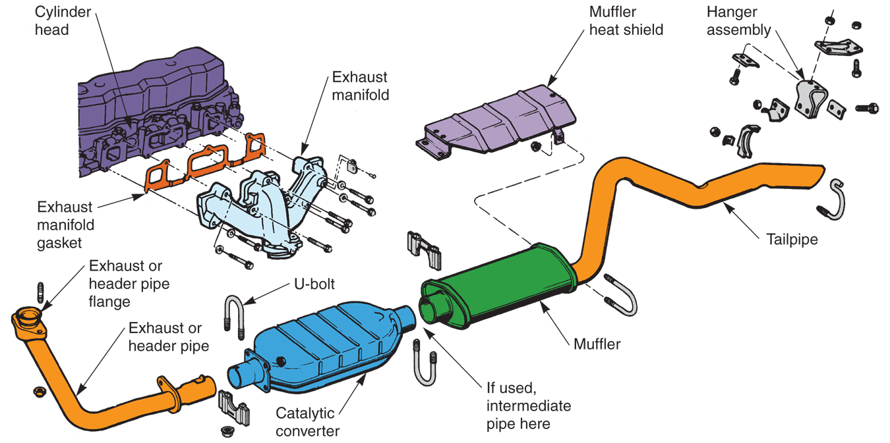
Exhaust System Parts (Cont.)
(Chrysler)

Slide 7
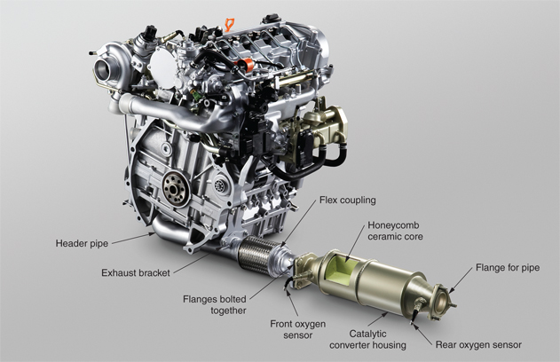
Exhaust System Parts (Cont.)
(Honda)

Slide 8
Exhaust Back Pressure
Exhaust back pressure
  Pressure developed in exhaust system when engine is running
High back pressure
  Indicates restriction in system, usually clogged catalytic converter
Low back pressure
  Indicates well-designed exhaust system

Slide 9
Single and Dual Exhaust Systems
Single exhaust system
  One path for exhaust flow through system
Dual exhaust system
  Two separate exhaust paths to reduce exhaust back pressure
Crossover pipe
  Used on some dual exhaust systems to connect right and left header pipes together

Slide 10
Exhaust Manifold
Bolts to cylinder head to enclose exhaust port openings
Headers
  High-flow, high-performance manifolds
Exhaust manifold doughnut
  Gasket or O-ring that seals connection between exhaust manifold outlet and header pipe

Slide 11
Exhaust Pipes
Header pipe, intermediate pipe, and tailpipe
Made of rust-resistant steel tubing
One end of each pipe may be enlarged to fit over end of next pipe
Inlet end of header pipe has flange for securing pipe to exhaust manifold studs

Slide 12
Heat Shields
Located in areas where exhaust system components are close to vehicle body or near ground
  Especially catalytic converter and muffler
Shields reduce amount of heat transferred into body and protect items under vehicle

Slide 13
Catalytic Converter
Afterburner used to reduce amount of exhaust pollutants entering atmosphere
One or more catalytic converters can be located in exhaust system

Slide 14
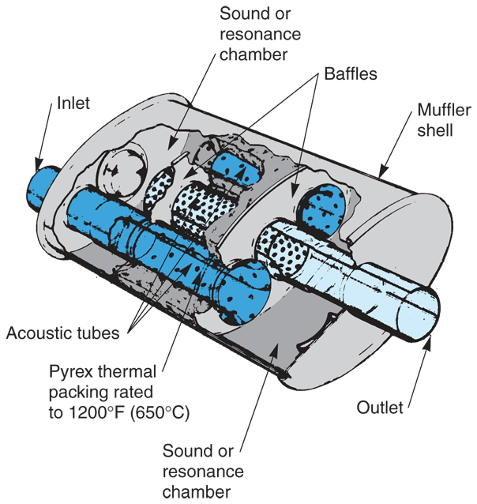
Muffler
Reduces pressure pulses
Quiets noise produced by engine exhaust when a engine is running
Without a muffler, exhaust gas pulsations roar very loudly
(American Exhaust Industries)

Slide 15
Exhaust System Service
Exhaust system service usually needed when a system component rusts and begins to leak
Leaking exhaust can allow toxic gases to flow through any opening in car’s body and into passenger compartment

Slide 16
Exhaust System Inspection
Raise car on lift
Closely inspect underside of exhaust parts for problems such as rusting, loose pipe connections, and gas leaks
Pay particular attention to muffler and all pipe connections, gaskets, and pipe bends
Exhaust leaks often show up as gray or white carbon lines coming from openings

Slide 17
Exhaust System Inspection (Cont.)
To check exhaust system for leaks
Start and idle engine
Raise vehicle on lift
Use stethoscope, with only plastic tube attached, to listen for leaks
Pass hose around any point of possible gas leakage
When stethoscope hose moves next to leak, sound will amplify to a roar

Slide 18
Catalytic Converter Temperature Check
Catalytic converter temperature check
  Quickly tests for inoperative converter catalyst
“Dead cat” means that catalytic agent is no longer re-burning exhaust fumes and treating engine’s exhaust gases

Slide 19
Catalytic Converter Temperature Check (Cont.)
Attach shop vent hose to tailpipe(s)
Warm engine and catalytic converter to full operating temperature
Place and secure vehicle on lift
Touch temperature probe on front or inlet end of suspect catalytic converter
  Record temperature

Slide 20
Catalytic Converter Temperature Check (Cont.)
Touch your temperature probe on rear of converter near outlet pipe
  Record temperature
Subtract rear temperature reading from front temperature reading
Good catalytic converter will have approximately 100°F (38°C) difference in temperature, front to rear

Slide 21
Exhaust System Back Pressure Test
Exhaust system back pressure test
  Measures amount of resistance to gas flow in vehicle
Performed when scan tool indicates something is wrong with O₂ sensor or catalytic converter
High exhaust back pressure
  Indicates catalytic converter is plugged and burning internally

Slide 22
Exhaust System Back Pressure Test
(Cont.)
Remove front oxygen sensor before catalytic converter
Install test pressure gauge in threaded hole for oxygen sensor
  If engine has air injection, you can also install test gauge in metal lines in air injection system going to exhaust manifold

Slide 23
Exhaust System Back Pressure Test
(Cont.)
Measure and record exhaust back pressure at idle
  Pressure should be less than about 1 psi
  Higher reading means something is blocking exhaust gas flow at low engine speeds
Increase engine speed and note any increase in exhaust pressure gauge reading
At about 2000 rpms, exhaust back pressure should be less than approximately 3 psi

Slide 24
Engine Vacuum Test
Connect test vacuum gauge to any vacuum line on engine that pulls suction at idle
Start and idle engine while reading vacuum gauge
As you watch vacuum gauge, use throttle lever on engine to increase engine speed to about 2,500 rpms

Slide 25
Engine Vacuum Test
(Cont.)
Vacuum reading should initially drop and then rise if no restrictions in exhaust system
Vacuum drop at higher engine speed indicates high exhaust back pressure and restriction or gas flow problem
Find and replace restricted exhaust system part

Slide 26
Exhaust System Repairs
Use rust penetrant on all threaded fasteners to be reused
  Especially important on exhaust manifold flange nuts or bolts
Use air chisel, cut-off tool, cutting torch, or hacksaw to remove faulty parts
Use six-point socket and ratchet or impact wrench for fastener removal

Slide 27
Exhaust System Repairs (Cont.)
Wear safety glasses or goggles to keep rust and dirt from entering your eyes
Obtain correct replacement parts
Use pipe expander to enlarge pipe ends as needed
Position all clamps properly
Install any necessary adapters

Slide 28
Exhaust System Repairs (Cont.)
Make sure all pipes are fully inserted
Double-check routing of exhaust system
  Keep adequate clearance between exhaust system components and vehicle body and chassis
Tighten all clamps and hangers evenly

Slide 29
Exhaust System Repairs (Cont.)
When replacing exhaust manifold, use gasket and check sealing surface flatness
Always use new gaskets and O-rings
Check heat valve operation using service manual
Install all heat shields
Check system for leaks and rattles after repairs

Slide 30
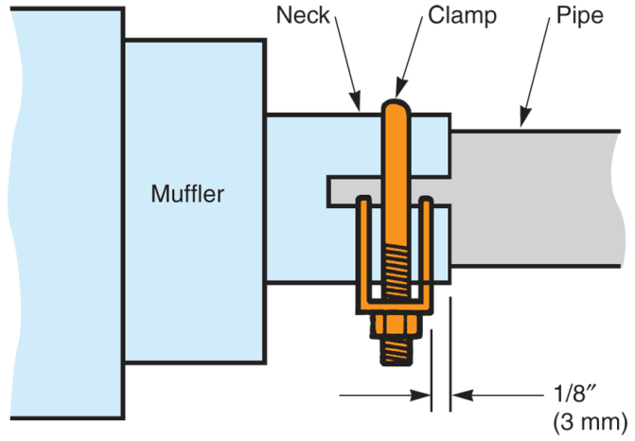
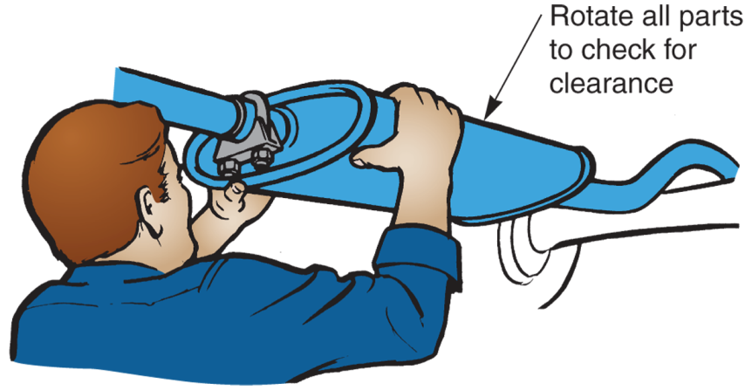
Exhaust System Repairs (Cont.)
(Florida Dept. of Voc. Ed.)
(AP Parts)

Slide 31
Stainless Steel
Exhaust System Repairs
Stainless steel will not rust and provides much longer service life than ordinary steel systems
When servicing, use heavy-duty clamps designed for this system type
When cutting or welding stainless steel, use correct rod or wire material

