Slide 1
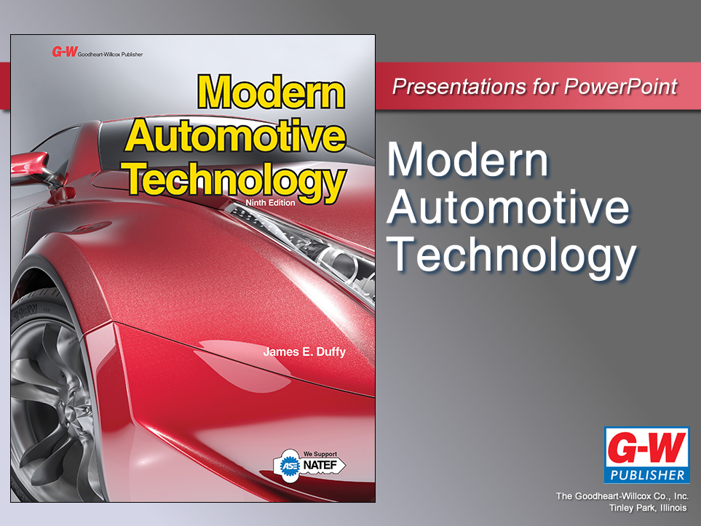

Slide 2
47
Chapter
Cooling System Technology

Slide 3
Objectives
After studying this chapter, you will be able to:
Summarize the functions of engine, supercharger, turbocharger, DEFI, and HV (hybrid vehicle) cooling systems.
Explain the operation and construction of major cooling system components found in modern vehicles.
Compare cooling system design variations.

Slide 4
Objectives
Explain the function of antifreeze.
Identify safety procedures to follow when working with any engine, supercharger, HV motor-generator, HV battery, HV transmission, or HV engine control module.
Compare hybrid air and liquid cooling systems.
Correctly answer ASE certification test questions on cooling systems found in modern passenger vehicles.

Slide 5
Vehicle Cooling Systems
Modern passenger vehicles can have several cooling system types
Designed to control operating temperatures of mechanical and electrical assemblies

Slide 6
Vehicle Cooling Systems (Cont.)
Many assemblies generate internal heat during operation
Internal combustion engine
Supercharger
Turbocharger
HV battery
Hybrid drive motor-generator
Without properly operating cooling systems, engines “self-destruct” in minutes

Slide 7
Specific Cooling Systems
Engine cooling system
Controls operating temperature of cylinder heads and cylinder block
Supercharger cooling system
Must keep blower intercooler temperature cooler than engine’s operating temperature

Slide 8
Specific Cooling Systems (Cont.)
Turbocharger cooling system
Forces coolant through turbo bearing housing to keep turbo from overheating under prolonged high boost
HV battery cooling system
Air or liquid removes battery cell heat when under prolonged high amperage draw

Slide 9
Specific Cooling Systems (Cont.)
HV motor-generator cooling system
Liquid coolant prevents motor-generator overheating in full-electric and hybrid gas-electric vehicles
HV engine control module cooling system
Forces air or liquid through or over aluminum heat sink surrounding high-power transistors for each leg of three-phase

Slide 10
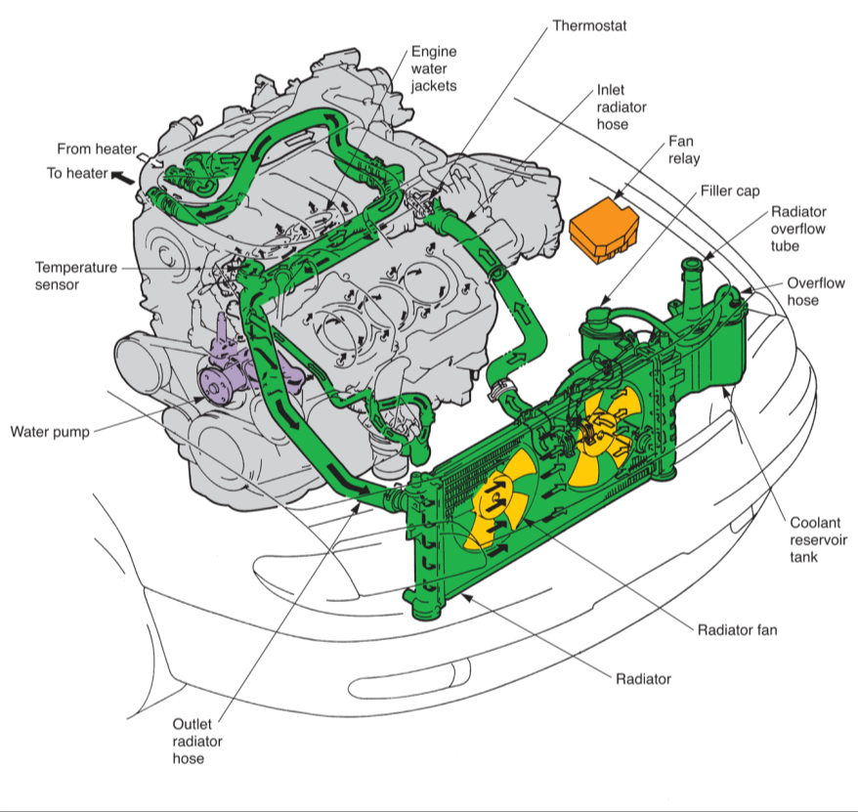
Cooling System
(Mazda)

Slide 11
Cooling System Functions
Removes excess heat from engine
Maintains constant engine operating temperature
Helps cold engine quickly reach operating temperature
Provides heat for passenger compartment

Slide 12
Removing Engine Heat
Some combustion heat flows out with exhaust gas or flows into engine’s metal parts
If not removed, excess heat will seriously damage engine in minutes
Combustion flame temperature can reach 4500°F

Slide 13
Maintaining Operating Temperature
Engine operating temperature
Temperature engine coolant reaches under normal running conditions
Between 180°F and 210°F
Engine parts expand at operating temperature
Ensures correct part clearances

Slide 14
Reaching Operating Temperature Quickly
Engine must warm up rapidly to prevent poor combustion
Cold engine suffers from several problems
Aluminum pistons will not be expanded by heat
Causes too much clearance between pistons and cylinder walls
Oil in cold engine will be very thick
Reduces lubrication and increases engine wear

Slide 15
Heater Operation
Cooling system commonly circulates coolant to heater
Heater core
Small liquid-to-air heat exchanger mounted under dash in passenger compartment
Since engine coolant is warm, it can warm passenger compartment

Slide 16
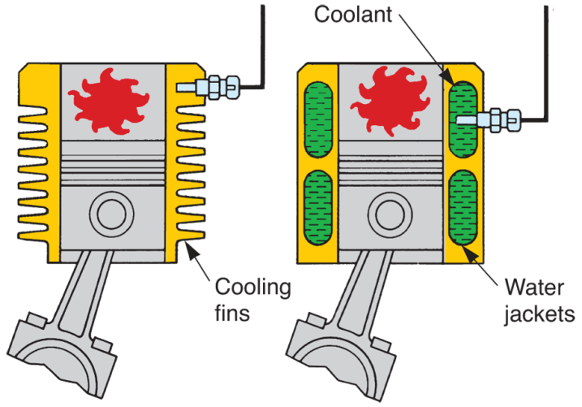
Cooling System Types
Air cooling system
Large cylinder cooling fins and outside air remove excess heat from engine
Shroud (routes air over cylinder fins)
Liquid cooling system
Circulates coolant through water jackets in engine’s cylinder block and cylinder head
(Robert Bosch)

Slide 17
Liquid Cooling Systems
Several advantages over air cooling systems
More precise control of engine operating temperature
Less temperature variation inside engine
Reduced exhaust emissions due to better temperature control
Improved heater operation to warm passengers

Slide 18
Conventional- and Reverse-Flow Cooling
Conventional-flow cooling
Hot coolant flows from cylinder head to radiator
Once cooled in radiator, coolant flows back into engine block
Reverse-flow cooling
Follows opposite course
Cool coolant enters head and hot coolant exits block back to radiator

Slide 19
Closed Cooling System
Uses expansion tank, or reservoir, and radiator cap with pressure and vacuum valves
Overflow tube routed into bottom of reservoir tank
Pressure and vacuum valve action pull coolant in and out of reservoir tank as needed
This keeps cooling system correctly filled at all times

Slide 20
Open Cooling System
Does not use coolant reservoir
Overflow tube allows excess coolant to leak onto ground
Does not provide means of adding fluid automatically
No longer used on automobiles

Slide 21
Cooling System Parts
Basic parts of engine cooling system
Water pump
Radiator hoses
Radiator
Fan
Thermostat

Slide 22
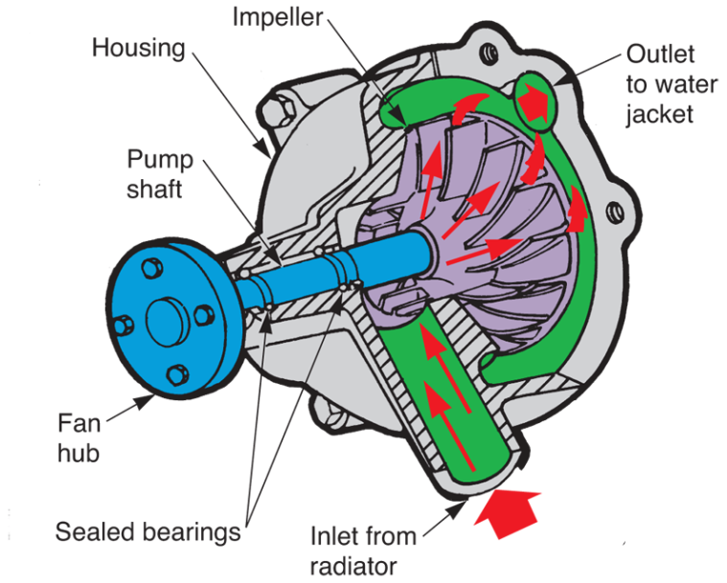
Water Pump
Impeller
Shaft
Water pump seal
Water pump bearings
Pump hub
Pump housing
Pump gasket
(Chrysler)

Slide 23
Water Pump Operation
Spinning engine crankshaft pulley causes drive belt to turn water pump pulley, pump shaft, and impeller
Coolant trapped between impeller blades is thrown outward by centrifugal force
Electric water pump
Large dc motor and impeller force coolant through water jackets or through HV cooling system

Slide 24
Radiator and Heater Hoses
Radiator hoses carry coolant between engine water jackets and radiator
Molded hose
Manufactured in a special shape with bends to clear cooling fan and other parts
Must be purchased to fit exact year and make of car

Slide 25
Radiator and Heater Hoses (Cont.)
Flexible hose
Accordion shape that can be bent to different angles
Hose spring
Frequently used in lower radiator hose to prevent collapsing
Heater hoses
Small-diameter hoses that carry coolant to heater core

Slide 26
Radiator and Heater Hoses (Cont.)
Hose clamps
Hold radiator hoses and heater hoses on their fittings
Worm-drive hose clamp
Uses worm gear that engages slots in clamp strap to allow tightening around hose
Most common type of replacement hose clamp

Slide 27
Radiator
Radiator core
Fragile center section of radiator made up of tubes and cooling fins soldered or bonded together
Radiator tanks
Metal or plastic ends fit over core tube ends to provide storage for coolant and fittings for hoses

Slide 28
Radiator (Cont.)
Radiator filler neck
Opening for adding coolant that also holds removable radiator pressure cap
Transmission oil cooler
Inner tank for cooling automatic transmission or transaxle fluid
Radiator petcock
Fits on bottom of tank for draining coolant

Slide 29
Radiator (Cont.)
Radiator cap
Pressurizes water and antifreeze solution so it does not boil when operating above 212°F
Downflow radiator
On top and bottom of core
Core tubes run vertically between tanks
Crossflow radiator
Modern design with tanks on sides of core
Core tubes arranged for horizontal coolant flow

Slide 30
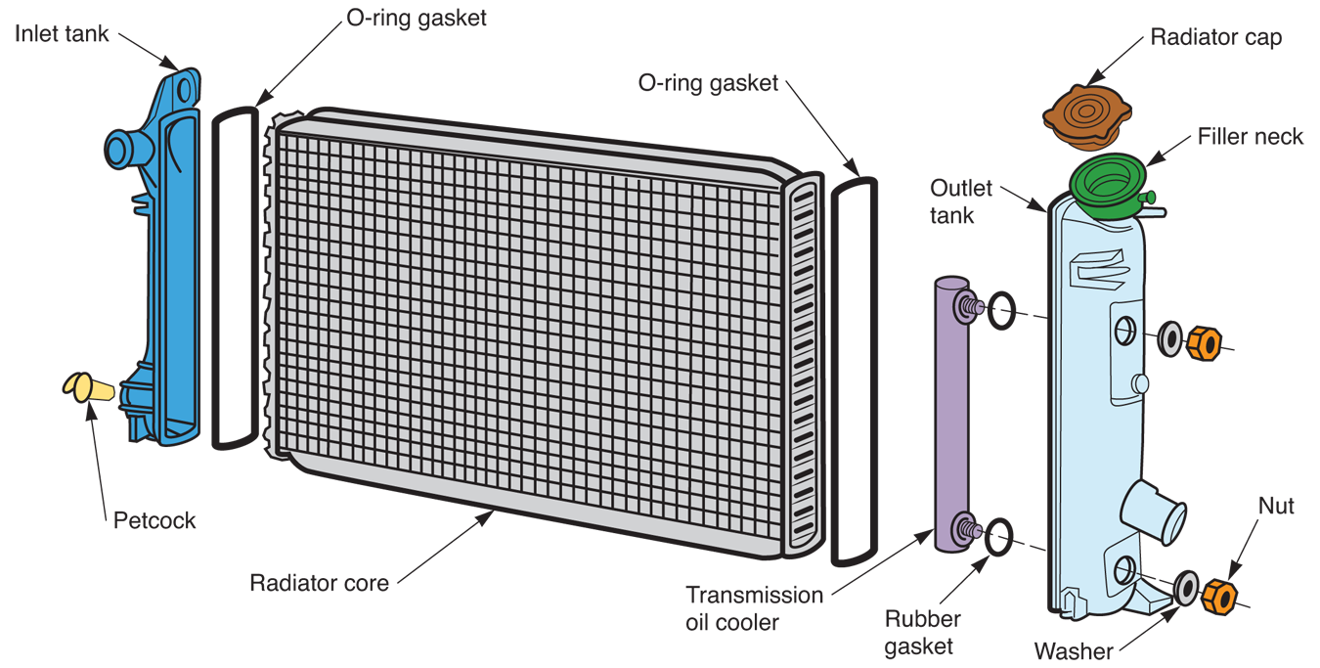
Major Parts of a Radiator

Slide 31
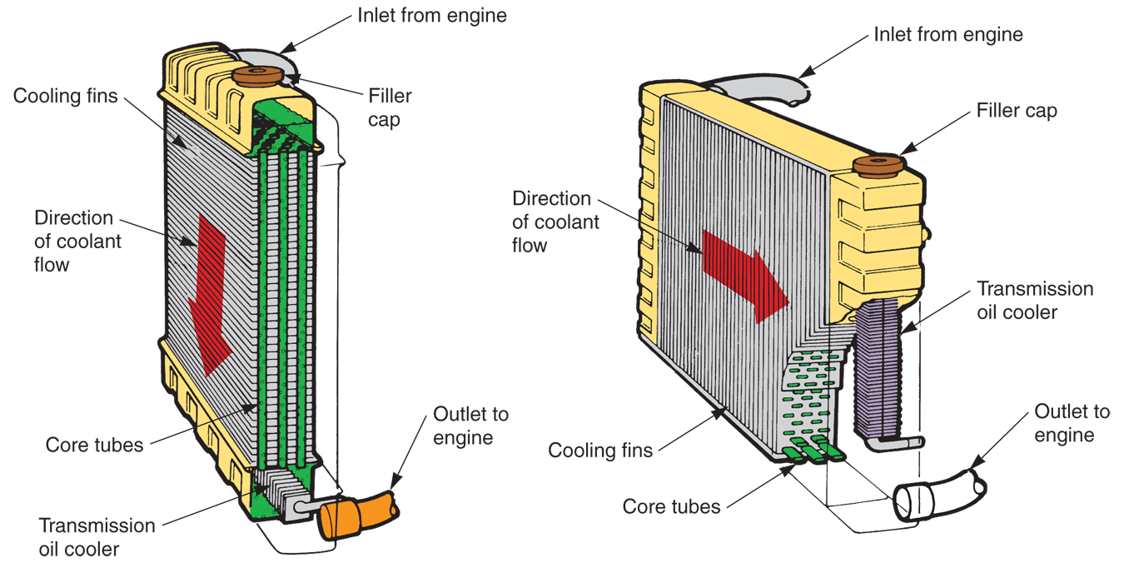
Types of Radiators
(Chrysler)

Slide 32
Transmission Oil Cooler
Often placed in radiator on cars with automatic transmissions or transaxles to prevent transmission fluid from overheating
Small tank enclosed in one of main radiator tanks
Removes heat from fluid as it passes through radiator and cooler

Slide 33
Radiator Cap
Seals top of radiator filler neck to prevent leakage
Pressurizes system to raise boiling point of coolant
Keeps coolant from boiling and turning to steam
Relieves excess pressure to protect against system damage
In closed systems, it allows coolant flow between radiator and coolant reservoir

Slide 34
Radiator Cap (Cont.)
Radiator cap pressure valve
Spring-loaded disk that contacts filler neck
Spring pushes valve into neck to form a seal
Radiator cap vacuum valve
Opens to allow flow back into radiator when coolant temperature drops after engine operation

Slide 35
Cooling System Fans
Pulls air through radiator core and over engine to remove heat
Engine-powered fan
Bolts to water pump hub and pulley
Sometimes, a fan spacer fits between fan and pulley to move fan closer to radiator

Slide 36
Cooling System Fans (Cont.)
Flex fan
Thin, flexible blades that alter airflow with engine speed
Fluid coupling fan clutch
Designed to slip at higher engine speeds
Performs same function as flexible fan
Thermostatic fan clutch
Temperature sensitive, bimetal spring that controls fan action

Slide 37
Cooling System Fans (Cont.)
Electric cooling fan
Electric motor, coolant temperature sensor, and engine ECM to provide airflow and heat transfer out of radiator
Fan motor
Small dc motor with brushes
Mounts on bracket secured to radiator

Slide 38
Cooling System Fans (Cont.)
Fan switch or thermo switch
Temperature-sensitive switch that controls fan motor operation
Coolant temperature sensor
Sensor, fuse box relays, and engine ECM operate cooling fan motors by using temperature sensor in radiator

Slide 39
Radiator Shroud
Helps ensure that fan pulls air through radiator
Fastens to rear of radiator and surrounds area around fan
Results in huge volume of air flowing through (not around) radiator core

Slide 40
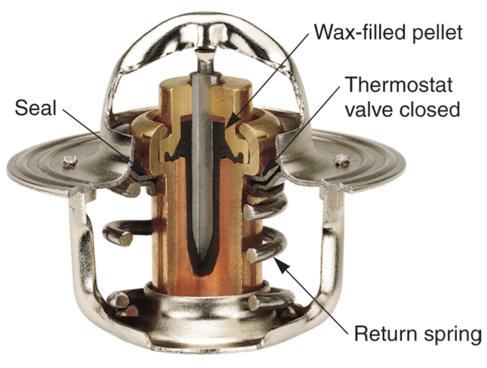
Thermostat
Expands and contracts with changes in engine temperature
Controls coolant flow through radiator
Reduces coolant flow when engine is cold
Increases coolant flow when engine is hot
(Gates)

Slide 41
Thermostat (Cont.)
Thermostat rating
Stamped on thermostat to indicate its operating (opening) temperature
High thermostat heat ranges are used because they reduce exhaust emissions and increase combustion efficiency

Slide 42
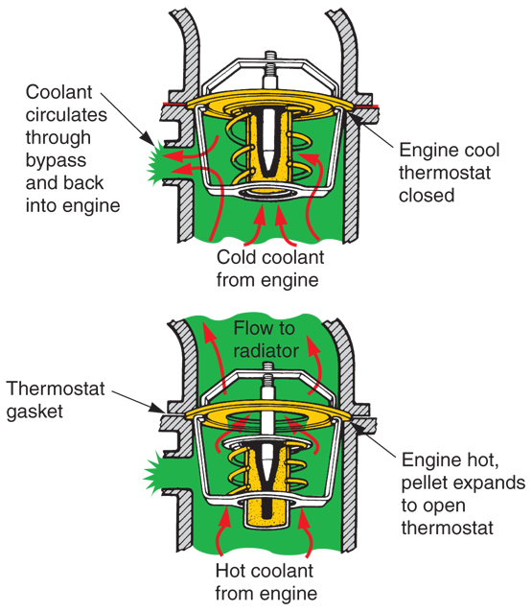
Thermostat Operation
(Chrysler)

Slide 43
Thermostat Operation (Cont.)
Bypass valve and bypass hose, or passage
Permit coolant circulation through engine when thermostat is closed
If coolant cannot circulate, hot spots develop inside engine
Bypass thermostat
Has second valve for routing hot coolant through radiator

Slide 44
Temperature Warning Light
Informs driver when engine is overheating
When coolant becomes too hot
Temperature sending unit is closed
When engine is cold or at normal operating temperature
Temperature sending unit is open
In many late-model vehicles
Engine temperature warning light is energized by engine control module

Slide 45
Engine Temperature Gauge
Shows exact operating temperature of engine coolant
As engine temperature increases
Resistance drops in sending unit
Current increases in gauge circuit
Causes gauge needle to deflect to right, showing engine temperature

Slide 46
Antifreeze
Mixes with water to produce engine coolant
Usually ethylene glycol
Prevents winter freeze up
Prevents rust and corrosion
Lubricates water pump
Cools engine

Slide 47
Antifreeze/Water Mixture
50/50 mixture of water and antifreeze usually recommended
Equal mix of glycol antifreeze and water provides protection from ice formation to about –34°F

Slide 48
Block Heater
May be used on engine to help with starting in cold weather by heating coolant
Most commonly used on diesel engines
120-volt heating element mounted in block water jacket

Slide 49
Supercharger Cooling Systems
Uses its own electric water pump, hoses, and radiator to pump cool antifreeze through supercharger intercooler
Air-to-liquid heat exchanger (radiator) mounted under or at outlet of compressor rotors

Slide 50
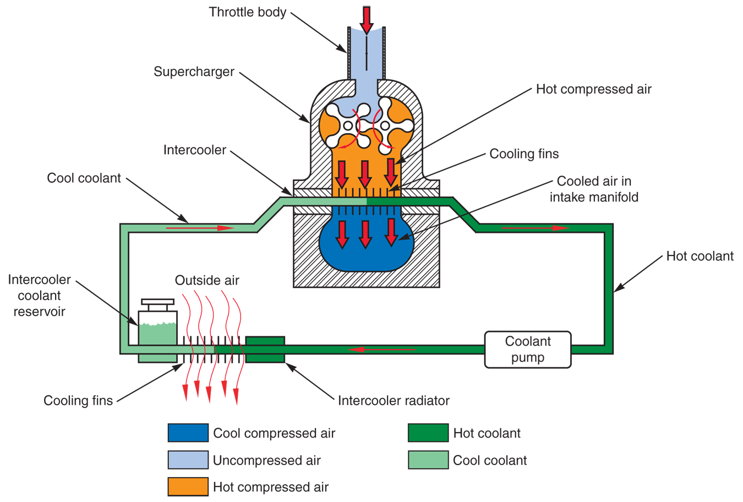
Supercharger Cooling Systems (Cont.)

Slide 51
Hybrid Cooling Systems
Either circulated air or circulated liquid coolant remove excess heat from components in electric powertrain
Hybrid air cooling system
Electric blower fan and system of ducts route cool passenger compartment air around high-voltage battery pack

Slide 52
Hybrid Cooling Systems (Cont.)
Hybrid liquid cooling system
Electric water pump, small diameter hoses, and separate radiator or heat exchanger pull heat out of HV battery, HV PCM, and motor-generator

Slide 53
Hybrid Cooling Systems (Cont.)
High temperatures develop in several areas within hybrid’s electric powertrain
HV battery cells
HV motor-generator
HV PCM

Slide 54
HV Battery Cooling Systems
HV battery radiator or small air-to-liquid heat exchanger mounted in battery housing
HV battery fan
Energized by HV ECM to force fresh air through air-to-liquid heat exchanger and over battery pack outer surfaces for cooling

Slide 55
Motor-Generator Cooling Systems
Motor-generator water jackets
Carry liquid coolant
Formed or machined inside stator housing during manufacture
Motor-generator coolant hoses
Carry cooled coolant to, and heated coolant from, motor-generator water jackets

Slide 56
Motor-Generator Cooling Systems (Cont.)
Motor-generator coolant fittings
Allow rubber hoses to be clamped around hose for leak-proof antifreeze connections
Motor-generator water pump
Electric coolant pump mounted between system radiator and stator housing

Slide 57
HV PCM Cooling Systems
Often uses same electric water pump and circulated liquid coolant as motor-generator and HV battery
HV PCM water jacket
Formed between inner and outer housings that surround high-power, control circuit boards mounted on heat sink

Slide 58
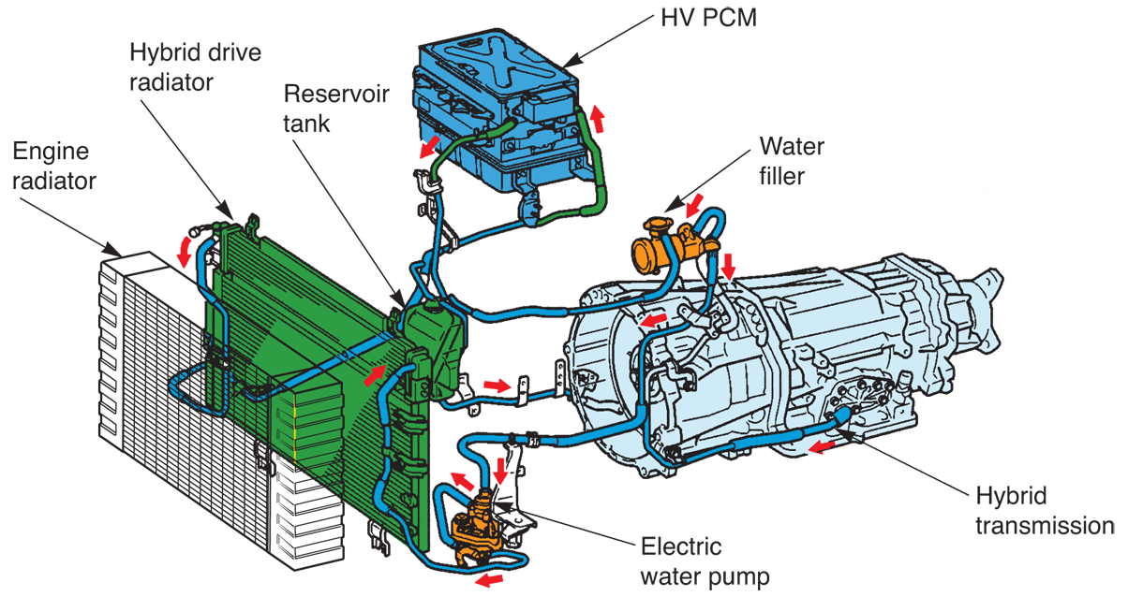
HV PCM Cooling Systems (Cont.)
(Toyota)

Slide 59
Coolant Heat Storage System
Needed to help keep hybrid’s piston engine warm when not running and vehicle is in full electric propulsion
Required on gasoline engine hybrids equipped with port fuel injection

