Slide 1
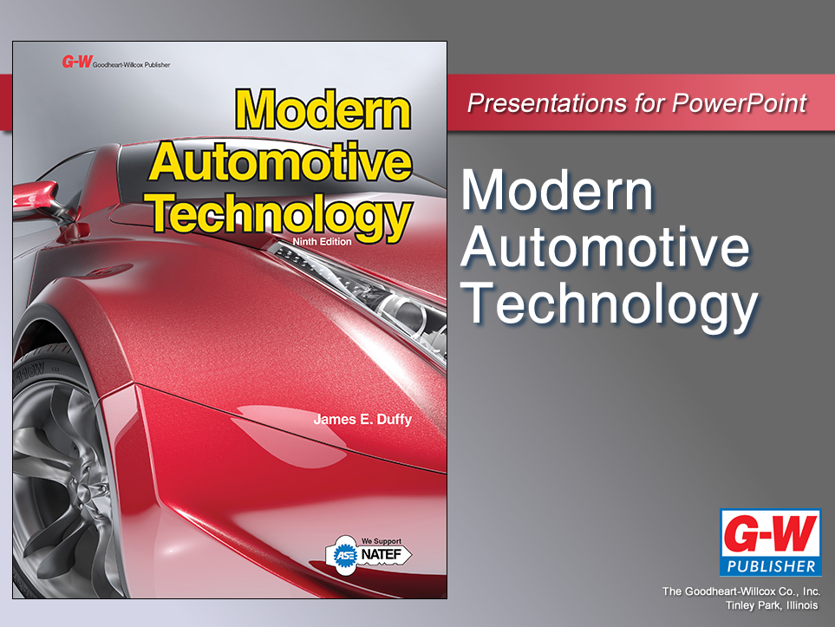

Slide 2
48
Chapter
Cooling System Testing, Maintenance, and Repair

Slide 3
Objectives
After studying this chapter, you will be able to:
List common cooling system problems and their symptoms.
Describe the most common causes of system leakage, overheating, and overcooling.
Perform a combustion leak test and a system pressure test.
Check the major parts of a cooling system for proper operation.

Slide 4
Objectives
Replace faulty cooling system components.
Drain, flush, and refill a cooling system.
Describe safe working practices to use when testing, maintaining, or repairing a cooling system.
Correctly answer ASE certification test questions on cooling system troubleshooting and repair.

Slide 5
Cooling System Testing, Maintenance, and Repair Introduction
Excess heat causes engine damage
Melted pistons
Cracked or warped cylinder heads
Burned exhaust valves
Burned or “blown” head gaskets
Damaged radiator and heater hoses
Cracked engine exhaust manifolds
Cracked or warped plastic intake manifolds

Slide 6
Cooling System Troubleshooting
Can you describe the cooling system problem?
Temperature light on, overheating, visible steam, or coolant loss
When does the problem seem to occur?
All the time, at highway speeds, when idling, in all-electric mode, when engine starts, when engine is hot or cold
When did the problem begin?

Slide 7
Cooling System Troubleshooting (Cont.)
Have any other engine or electric powertrain repairs been performed?
Have you noticed any coolant leaks?
If so, where are leaks located?
Are there any unusual noises that might be related to the cooling system?
Engine grinding, hissing of steam, HV electrical humming

Slide 8
Cooling System On-Board Diagnostics
Trouble codes trip when circuits operate out of range
Engine cooling
Transmission cooling
Motor-generator cooling
Power control circuit cooling for electric drive train

Slide 9
Cooling System On-Board Diagnostics (Cont.)
Circulation of air and coolant required to keep mechanical and electronic systems working properly
Vehicle diagnostic systems monitor coolant and air temperatures in all systems that generate high heat levels

Slide 10
Diagnosis Charts
Cooling system diagnosis chart
Use when problems are difficult to locate
Contain very accurate chart for particular design and type of engine and cooling system

Slide 11
Cooling System Inspection
Trouble Signs
Coolant leaks
Loose or missing fan belt
Low coolant level
Abnormal water pump noises
Leaves and debris covering outside of engine radiator
Coolant in oil
Combustion leakage into engine coolant

Slide 12
Cooling System Problems
Coolant leaks
Cracks or ruptures in system allow pressure cap action to push coolant out of system
Overheating
When engine operating temperature is too high
Overcooling
Engine fails to reach full operating temperature

Slide 13
Combustion Leak Test
Checks for presence of combustion gases in coolant
Place block and head tester in radiator filler neck or reservoir
Start engine
Squeeze and release tester bulb
This will pull air from cooling system through tester

Slide 14
Combustion Leak Test (Cont.)
Fluid in block tester is normally blue
Chemicals in exhaust gases react in test fluid, changing its color
Combustion leak will turn fluid yellow
If fluid remains blue, no combustion leakage

Slide 15
Coolant in Oil
When water, antifreeze, and oil mix, solution turns milky white in color
Milky white solution found in engine oil or in valve covers, indicates coolant leak

Slide 16
Cooling System Pressure Test
Quickly locates leaks in radiator, water pumps, hoses, engine, or HV component
Disconnect or disable battery for safety
Make sure cooling system has had enough time to cool down before opening system to release pressure
Slowly remove radiator pressure cap

Slide 17
Cooling System Pressure Test (Cont.)
Find correct size tester cap to fit radiator filler neck
Press correct test cap straight down with both hands while turning it clockwise
Make sure test cap sealed properly over both lugs on radiator filler neck
Attach hand pump to test cap on cooling system radiator

Slide 18
Cooling System Pressure Test (Cont.)
Pump maximum rated pressure into system by pumping tester handle
Do not exceed maximum factory-rated cooling system pressure or you could cause damage
Use shop light to inspect for coolant leakage around and under engine or major hybrid cooling system parts

Slide 19
Cooling System Pressure Test (Cont.)
With pressure in system, inspect all parts for coolant leakage
Check all hose fittings, gaskets, and engine freeze plugs
Look under water pump and around radiator
If coolant leak is found, tighten, repair, or replace parts and gaskets, as needed

Slide 20
Radiator Cap Pressure Testing
Make sure system is not under pressure
Carefully remove radiator cap
Inspect cap and filler neck sealing surfaces
Install radiator cap on pressure tester using adapter
Pump tester to pressurize cap
Cap should release air when rated pressure is exceeded

Slide 21
Causes of Engine Overheating
Low coolant level
Rust or scale
Stuck thermostat
Retarded ignition timing
Loose fan belt
Bad water pump
Collapsed lower hose
Missing fan shroud
Ice in coolant
Engine fan problems
Open temperature sensor

Slide 22
Causes of Cooling System Overcooling
Conditions that cause cooling system overcooling
Thermostat stuck open
Thermostat stuck closed
Locked fan clutch
Shorted fan switch
Shorted temperature sensor

Slide 23
Water Pump Service
Bad water pumps
Leak coolant
Worn seal
Fail to circulate coolant
Broken shaft or damaged impeller
Produce grinding sound
Faulty pump bearings
Rust in cooling system and lack of coolant are common reasons for pump failure

Slide 24
Checking a Water Pump
Check for bad water pump seal
Pressure test system and watch for leakage at pump
Leaking water pump must be replaced
If pump shaft is loose in its housing, pump bearings are badly worn
Pump replacement is usually necessary

Slide 25
Removing a Water Pump
Make sure cooling system is not under pressure and battery is disconnected
Carefully remove radiator cap
Place drain pan under radiator
Open drain valve
Allow radiator to completely drain
Close drain valve

Slide 26
Removing a Water Pump (Cont.)
Remove fan belt(s)
Unbolt all brackets and other components preventing pump removal
Remove radiator hose(s) from water pump
Remove bolts holding water pump to engine

Slide 27
Removing a Water Pump (Cont.)
Make sure all bolts are out and lightly tap rear or side of pump housing with mallet to free pump
Scrape off all old gasket or sealer material from engine

Slide 28
Installing a Water Pump
Install water pump gasket
Use approved sealer to adhere new gasket to pump
Use chemical gasket
Apply 1/8″ continuous bead around pump sealing surface
If water pump uses O-ring seal, work new seal down into bottom of groove in pump or engine

Slide 29
Installing a Water Pump (Cont.)
Fit pump onto engine and move it straight into place
Do not shift gasket or break sealant bead
Start all bolts by hand
Screw them in two turns
Check that all bolt lengths are correct

Slide 30
Installing a Water Pump (Cont.)
Tighten all fasteners to 1/2 of full torque in crisscross pattern
Tighten all fasteners to 3/4 of full torque in crisscross pattern
Tighten all fasteners to full torque in crisscross pattern
Tighten all fasteners to full torque one more time to ensure proper torque

Slide 31
Installing a Water Pump (Cont.)
Reinstall hose(s) onto water pump
Reattach any removed brackets or components
Reinstall fan belt(s), as needed
Fill radiator with coolant
Start engine and look for leaks
Verify coolant flow through radiator
Install radiator cap

Slide 32
Thermostat Service
Stuck thermostat can cause engine overheating or sometimes engine overcooling
Stuck shut
Very little coolant will circulate through radiator
Stuck open
Too much coolant may circulate through radiator

Slide 33
Thermostat Testing
Watch coolant through opening in radiator neck (if provided)
When engine is cold, coolant should not flow through upper area of radiator
When engine warms, thermostat should open and coolant should circulate past opening in top of radiator
If coolant does not start circulating and engine overheats, thermostat is bad

Slide 34
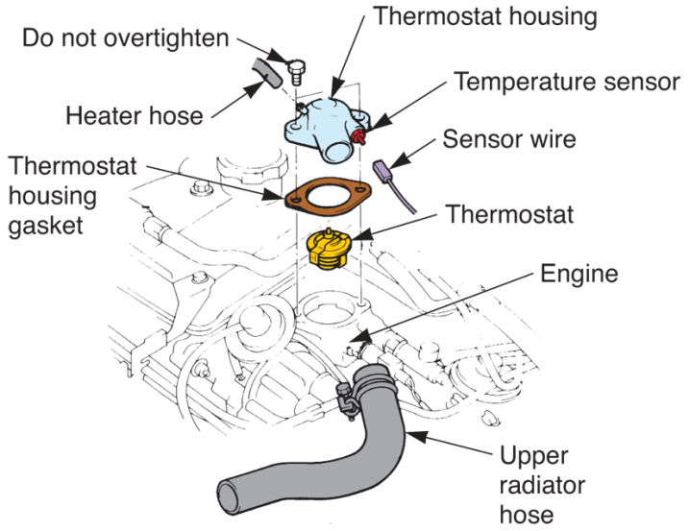
Thermostat Replacement
Thermostat housing
Pot metal, aluminum, or plastic enclosure that holds thermostat in place
Remove thermostat by unbolting thermostat housing
(Toyota)

Slide 35
Thermostat Removal
Make sure cooling system is not under pressure
Carefully remove radiator cap
Place drain pan under radiator
Remove upper radiator hose by loosening its clamp
Pull and twist on hose to free it from thermostat housing

Slide 36
Thermostat Removal (Cont.)
Remove any wiring connector or vacuum hose going to thermostat housing
Remove bolts holding thermostat housing to engine
Note any difference in bolt lengths
Lift off housing
May have to tap housing free with rubber or plastic mallet

Slide 37
Thermostat Removal (Cont.)
Insert rag into housing and scrape all old gasket material off thermostat housing and sealing surface on engine
Make sure thermostat housing is not warped
If warped, file or sand surface flat to prevent coolant leakage
Wipe all engine and housing mating surfaces clean with shop towel

Slide 38
Thermostat Installation
Make sure temperature rating of new thermostat is correct
Install any O-ring into its groove in engine or thermostat housing
Normally, rod (pointed end) on thermostat should face radiator hose and away from inside of engine

Slide 39
Thermostat Installation (Cont.)
Position new gasket with approved sealer
Slowly torque thermostat housing bolts to specifications in crisscross pattern
Fill radiator with coolant
Start engine and check for leaks
Verify that no coolant flows in radiator while engine is cool

Slide 40
Thermostat Installation (Cont.)
Verify coolant flow through radiator once engine reaches operating temperature
Reinstall radiator cap
Once pressure builds in cooling system, check again for leaks

Slide 41
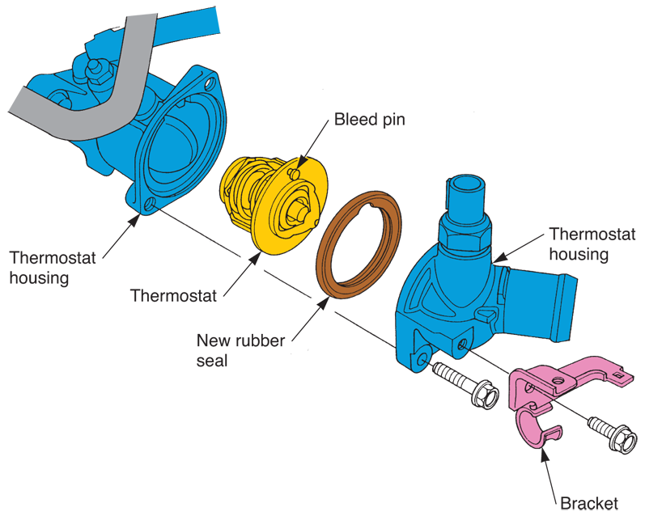
Thermostat Installation (Cont.)
(Honda)

Slide 42
Bleeding the Cooling System
Cooling system bleed screw or bleed valve
Sometimes provided to help remove trapped air when refilling cooling system
Fill system with coolant
Start engine and warm to full operating temperature
Crack open bleed screw until all air is purged from system, and coolant leaks from valve

Slide 43
Bleeding the Cooling System (Cont.)
After system cools again, remove radiator cap
Coolant level should be at top of filler neck
If not, add coolant
Install radiator cap
Watch for coolant leaks until engine warms to full operating temperature again

Slide 44
Cooling System Hose Service
Inspect radiator and heater hoses
Cracks
Bulges
Cuts
Any sign of deterioration or damage
Squeeze hoses to check whether hardened or softened
Replace affected hoses

Slide 45
Coolant Hose Replacement
Make sure cooling system is not under pressure
Remove radiator cap slowly and carefully
Place drain pan under radiator
Open drain valve
Allow coolant to flow into drain pan until empty
Close drain valve
Loosen hose clamps

Slide 46
Coolant Hose Replacement (Cont.)
Pull hose off fitting
May need to cut slit in old hose to aid removal
Clean metal hose fittings with scuff pad
If corroded, coat metal hose fittings with non-hardening sealer
Apply new hose onto fitting
Position hose clamps so fully over metal hose fitting

Slide 47
Coolant Hose Replacement (Cont.)
Tighten clamps just enough to prevent coolant leakage
Fill cooling system with antifreeze
Replace radiator cap
Inspect for coolant leaks as engine warms, or perform leak test

Slide 48
Freeze Plug Service
Drive drift or large full-shank screwdriver through plug
Pry plug sideways without scraping engine block or cylinder head
Pop core plug out by pushing on backside of plug with pry bar
Sand core plug hole in engine by hand with 120 grit sandpaper

Slide 49
Freeze Plug Service (Cont.)
Wipe off sealing surface with clean towel
Coat and plug the plug hole with non-hardening sealer
Drive new freeze plug squarely into position
Expansion freeze plugs are available for tight quarters

Slide 50
Radiator Service
When tests reveal that radiator is leaking, it must be removed for service
Most radiator repair work performed in specialized radiator repair shops
Radiator in many late-model vehicles designed to be replaced rather than rebuilt

Slide 51
Radiator Removal and Installation
Disconnect battery to prevent engine starting or shorting wires
Make sure cooling system has cooled down and is not under pressure
Carefully remove radiator cap to relieve any residual pressure
Drain all coolant from system into catch pan

Slide 52
Radiator Removal and Installation (Cont.)
Loosen radiator hose clamps and pull off radiator hoses and oil cooler lines
Unplug any sensor wiring
Radiator tanks
Electric cooling fans
Remove all fasteners holding radiator to its supports and to vehicle
Carefully lift out radiator

Slide 53
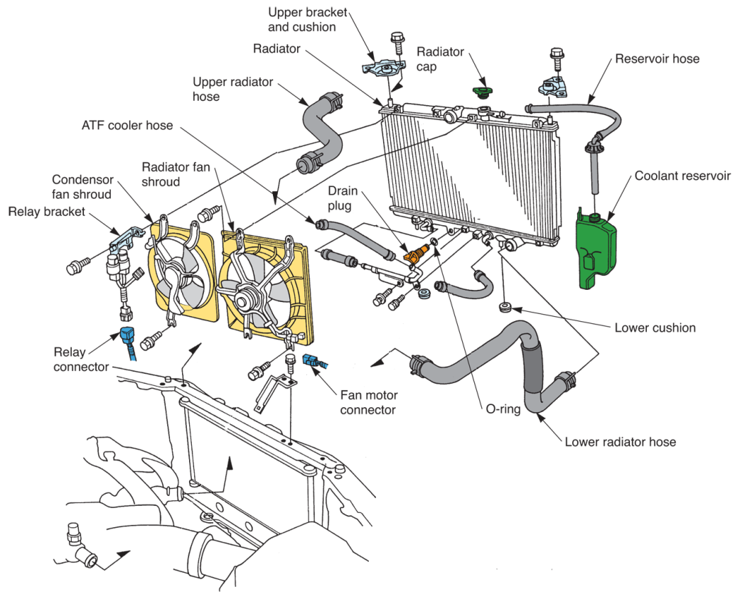
Radiator Removal and Installation (Cont.)
(Honda)

Slide 54
Radiator Repair
Radiator shops have facilities to properly disassemble, repair, reassemble, and pressure test any radiator
Special cleaning tanks for loosening and removing scale built up inside radiator
Also remove tanks and solder in new core, if needed

Slide 55
Engine Fan Service
Faulty engine fan can cause
Overheating
Overcooling
Vibration
Water pump damage
Check fan for
Bent blades
Cracks
Other problems

Slide 56
Electric Fan Service (Cont.)
Most electric cooling fans controlled by heat-sensitive switch or sensor located somewhere in cooling system
Many now controlled by engine ECM and temperature sensor on radiator

Slide 57
Testing an Electric Fan
Verify that fan stays off when engine and cooling system are cool or cold
Start and idle engine
Cooling fan(s) should begin spinning when engine reaches full operating temperature
Make sure fan motor spins at normal speed and forces air through radiator

Slide 58
Testing an Electric Fan (Cont.)
If fan does not function when engine is warm
Check fuse, electrical connections, fan relay, and motor supply voltage
If power is applied across fan motor windings by ECM and/or its relay, and motor fails to spin
Fan motor needs to be replaced

Slide 59
Testing an Electric Fan (Cont.)
If engine is warm and voltage not supplied across fan motor
Check action of radiator temperature sensor or switching sensor with multimeter
Make sure ground circuit for fan motor has almost zero resistance

Slide 60
Belt-Driven Fan Service
Loose fan belt will slip and squeal, and may rotate water pump and fan too slowly
May result in engine overheating
Loose fan belt could also fly off its pulleys
If fan belt is cracked, frayed, glazed, or oil soaked, replace it
Belt tension gauge
Measures belt tightness

Slide 61
Testing a Fan Clutch
Spin fan with engine off
Fan should turn without fan shaft turning
Start engine
When engine warms, clutch should engage
Verify that air flows through radiator and over engine

Slide 62
Coolant Service
Coolant, or antifreeze solution, should be checked and changed at regular intervals
After prolonged use, coolant will break down and become very corrosive
Rust will form and attempt to clog small internal coolant passages in radiator and heat core

Slide 63
Visual Coolant Inspection
Rub your finger inside radiator filler neck or reservoir tank
Check
Rust
Oil
Internal engine leak
Scale
Transmission fluid
Leaking oil cooler in radiator
Check coolant level during visual inspection

Slide 64
Coolant Voltage Testing
Touch black multimeter test lead to any metal ground
Dip red multimeter test lead into coolant
Read voltage generated by coolant
Voltage of “good” coolant almost zero, or less than 0.5 volts dc when measured coolant to ground
Voltage of “bad” coolant is any reading above 0.5 volts dc

Slide 65
Changing Coolant
When system is cool, slowly remove pressure cap
Place large, shallow catch pan under radiator
Loosen drain plug on bottom of radiator tank
Allow old coolant to drain into catch pan

Slide 66
Changing Coolant (Cont.)
Study condition of old coolant
If coolant is acidic or filled with rust
Flush system before refilling it
If coolant looks and smells okay
Refill system
Pour old antifreeze into recycling drum
Reinstall lower radiator hose or tighten radiator drain plug

Slide 67
Changing Coolant (Cont.)
Refill cooling system
Start and warm engine with radiator cap off
Coolant level may drop when thermostat opens
Add more coolant until liquid stays even with filler neck

Slide 68
Changing Coolant (Cont.)
Install radiator or reservoir cap
As engine warms and pressurizes cooling system, check for leaks at lower radiator hose and drain plug

Slide 69
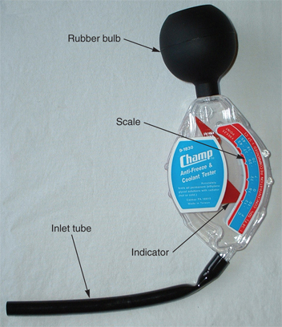
Testing Coolant Strength
Coolant strength
Measurement of coolant’s antifreeze/water ratio
Determines freeze-up protection of coolant
Cooling system hydrometer
Quickly measures coolant’s freezing point

Slide 70
Testing Coolant Strength (Cont.)
Refractometer
Another type of coolant strength measuring device seldom used anymore
Minimum coolant strength
Should be several degrees lower than lowest normal temperature for area climate
50/50 mix of antifreeze and water commonly used to provide protection for most weather conditions

Slide 71
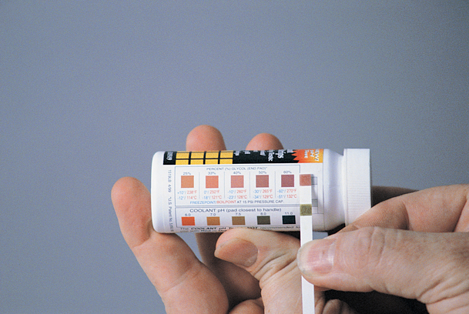
Coolant Test Strips
Coolant test strips can check coolant strength and pH level
Dip reactive end of strip
Compare to test strip color key

Slide 72
Corrosion of Aluminum
Radiators, water pumps, cylinder heads, blocks, and intake manifolds can be made of aluminum
Antifreeze designed for aluminum components must be used in these systems
Some types of antifreeze corrode aluminum

Slide 73
Flushing a Cooling System
Flushing or cleaning
Should be done when rust or scale is found in system
To manually flush cooling system
Drain old coolant
Add cooling system cleaning chemical to system and fill radiator with water
Replace radiator cap, start engine, and set heater controls to their hottest setting

Slide 74
Flushing a Cooling System (Cont.)
Allow car to run for 10–15 minutes and shut it off
After allowing engine to cool, drain contents of cooling system into container
Refill system with clean water and run engine for another 10–15 minutes
Shut off engine and allow it to cool
Drain water from cooling system
Finally, refill cooling system with fresh coolant

Slide 75
Flushing a Cooling System (Cont.)
Coolant flushing machine
Automatically drains, flushes, and refills engine cooling system
These machines speed repair and to reduce consumption, waste, or improper disposal of antifreeze solution

Slide 76
Temperature Gauge Service
Testing temperature gauge
Disconnect wire going to temperature gauge sending unit
Sending unit is normally located on engine
Using jumper wire, ground gauge wire to engine block
Turn ignition key switch on and watch temperature gauge
It will normally swing to hot when wire is grounded

Slide 77
Temperature Gauge Service (Cont.)
Gauge tester
Can also be used to check gauge and sending unit operation
Special testing device with variable resistor
To test temperature indicating light, set tester to specified resistance and temperature gauge should read as specified

Slide 78
Supercharger Coolant Service
Many superchargers have separate cooling system
Independent of engine cooling system
Service methods are the same
Supercharger cooling systems often operate at much lower pressures and temperatures
Never exceed radiator cap or reservoir pressure limits when hand-pressure-testing these systems

Slide 79
Hybrid Cooling System Service
Hybrid cooling system service is very similar to servicing engine cooling system
Instead of belt-driven water pump, hybrid cooling systems use small electric water pump
Some hybrid battery packs have electric fan that blows air over battery packs
Other hybrid cooling systems use air and liquid cooling

Slide 80
Hybrid Cooling System Service (Cont.)
Check
Proper coolant level in HV coolant reservoir
Obstructions of inlet and outlet air ducts to HV battery
Proper scan tool temperature readings for HV battery, HV motor-generator, and HV PCM

Slide 81
Hybrid Cooling System Service (Cont.)
Proper operation of sensors and automatic fans that should turn on when battery current load is high
Blower motor circuit problems or mechanical problems
Leaks by performing pressure test
Acid deterioration by performing voltage test
Normal electric coolant pump operation

Slide 82
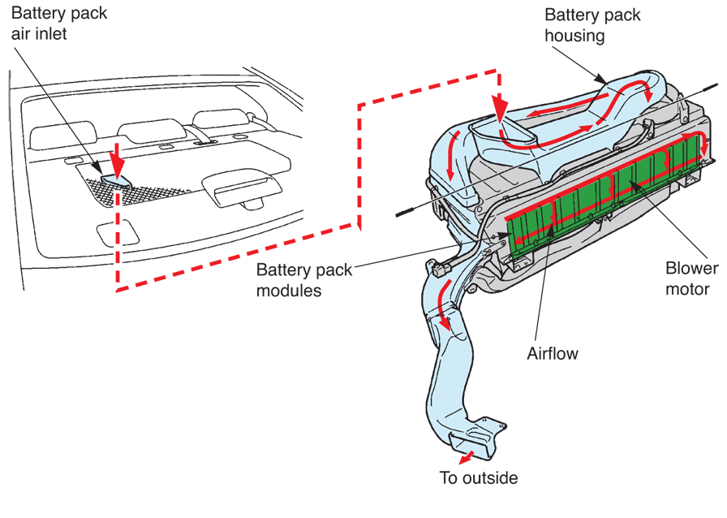
Hybrid Cooling System Service (Cont.)

