Slide 1


Slide 2
51
Chapter
Emission Control System Technology

Slide 3
Objectives
After studying this chapter, you will be able to:
Define the fundamental terms relating to automotive emission control systems.
Explain the sources of air pollution.
Describe the operating principles of emission control systems.
Compare design differences in emission control systems.
Explain how a computer or engine control module can be used to operate emission control systems.

Slide 4
Objectives
Explain the operation of exhaust gas sensors as a primary control of exhaust emissions and engine air-fuel ratio control.
Summarize how OBD II systems use multiple oxygen sensors to check air-fuel mixture and catalytic converter efficiency.
Correctly answer ASE certification test questions that require a knowledge of emission control system operation and construction.

Slide 5
Emission Control System Technology
Introduction
Emission control systems
  Used on motor vehicles to reduce amount of harmful chemicals released
These systems help to keep air clean
This chapter introduces emission control terminology and the systems and parts that control automobile emissions

Slide 6
Air Pollution
Air pollution caused by excess amount of harmful chemicals in atmosphere
Caused by number of factors, some natural and some man-made

Slide 7
Air Pollution (Cont.)
Federal government passed strict laws aimed at reducing air pollution
  Enforced by Environmental Protection Agency and local authorities
Laws limit amount of emissions emitted by automobiles, factories, and other man-made sources

Slide 8
Smog
Nickname given to visible cloud of airborne pollutants
Derived from “smoke” and “fog”
Common in large cities and industrialized areas

Slide 9
Motor Vehicle Emissions
Burned and unburned pollutants produced by car, truck, bus, and motorcycle engines and their fuel systems
Four basic types of vehicle exhaust emissions
  Hydrocarbons
  Carbon monoxide
  Oxides of nitrogen
  Particulates

Slide 10
Motor Vehicle Emissions (Cont.)
  Hydrocarbons (HC)
  Result from release of unburned fuel into atmosphere
Carbon monoxide (CO)
  Extremely toxic emission resulting from release of partially burned fuel
  Result of incomplete combustion of petroleum-based fuel

Slide 11
Motor Vehicle Emissions (Cont.)
Oxides of nitrogen (NO_{x})
  Produced by extremely high temperatures during combustion
  Contributes to ozone and dirty brown color in smog
Particulates
  Solid particles of carbon soot or ash and fuel additives blown out tailpipe

Slide 12
Sources of Vehicle Emissions
Engine crankcase blowby fumes
  Chemicals form in engine bottom end
  By-products blow past piston rings and into crankcase
Fuel vapors
  Various chemicals enter air as fuel evaporates

Slide 13
Sources of Vehicle Emissions (Cont.)
Exhaust gases
  Harmful chemicals produced and blown out tailpipe when engine burns hydrocarbon-based fuel
  Engine modifications and emission control systems used to reduce air pollution from these sources

Slide 14
Engine Modifications Related to
Emission Control
Lower compression ratios
Smaller combustion chamber surface volumes
Reduced quench areas in combustion chambers
Decreased valve overlap
Hardened valves and seats

Slide 15
Engine Modifications Related to
Emission Control (Cont.)
Higher operating temperatures
Leaner air-fuel mixtures
Wider spark plug gaps
Alcohols and clean-burning substances added to gasoline during the refinement process
  Oxygenated gasoline

Slide 16
Vehicle Emission Control Systems
Positive crankcase ventilation system
  Recirculates engine crankcase fumes back into combustion chamber
Evaporative emissions control system
  Closed vent system that stores fuel vapors and prevents them from entering atmosphere
Exhaust gas recirculation system
  Injects burned exhaust gases into engine to lower combustion temperatures and prevent formation of NO_{x}

Slide 17
Vehicle Emission Control Systems
(Cont.)
Air injection system
  Forces outside air into exhaust system to help burn unburned fuel
Catalytic converter
  Chemically changes combustion by-products into harmless substances
Computer control system
  Electronic controls that monitor and interface with various systems to increase overall engine efficiency and reduce emissions

Slide 18
Blowby Gases
Unburned fuel (HC)
Partially burned fuel (CO)
Particulates
Small amounts of water, sulfur, and acid
Result in
  Air pollution if released into atmosphere untreated
  Corrosion of engine parts from acid buildup in used oil
  Engine oil dilution from fuel contamination
  Sludge formation from oil breakdown

Slide 19
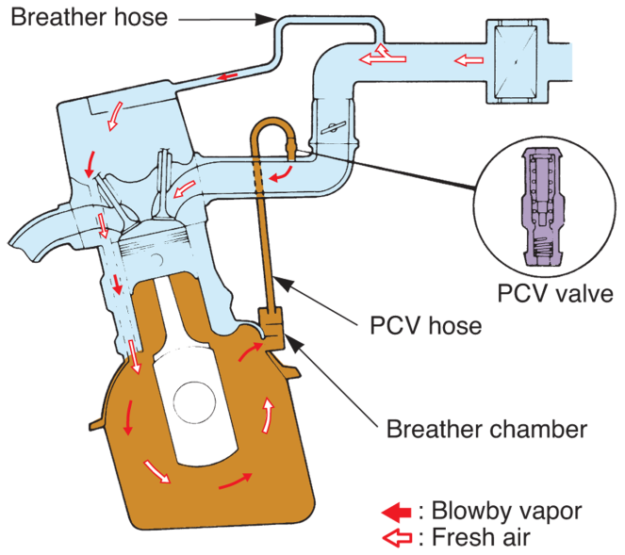
Positive Crankcase Ventilation (PCV)
Engine vacuum draws blowby gases into intake manifold for reburning in combustion chambers
(Honda)

Slide 20
Positive Crankcase Ventilation (Cont.)
Closed PCV system
  Sealed oil filler cap, sealed oil dipstick, ventilation hoses, and either PCV valve or flow restrictor
  Gases drawn into engine and burned
  System stores gases when engine is not running

Slide 21
PCV System Operation
Hose usually connects intake manifold to PCV valve
With engine running, vacuum acts on engine’s crankcase
Air drawn in through engine’s air cleaner, through vent hose into valve cover, and down into crankcase

Slide 22
PCV System Operation (Cont.)
After fresh air mixes with crankcase gases, mixture is pulled by vacuum past PCV valve, through hose, and into engine intake manifold
Crankcase gases then drawn into combustion chambers for burning

Slide 23
PCV Valve
Controls flow of air through PCV system
May be located in rubber grommet in valve cover, in breather opening in intake manifold or plenum, or on side of engine block
PCV valve varies flow of air for idle, cruise, acceleration, wide open throttle, and engine-off conditions

Slide 24
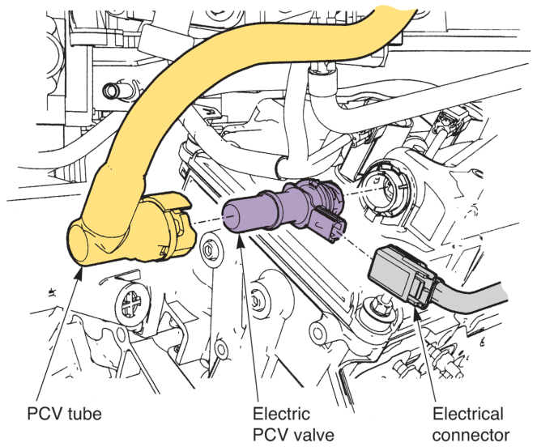
Electric PCV Valve
Most late-model vehicles use electronically controlled crankcase ventilation systems
Electric PCV valve
Contains small solenoid and air valve
ECM-controlled to regulate engine crankcase ventilation
(Ford)

Slide 25
Oil/Air Separators
Device that makes oil vapors condense and flow back into oil pan
Can be used instead of PCV system to reduce emissions and prevent oil sludging
Separator allows oil mists and vapors to settle into a liquid and not continue to circulate through engine

Slide 26
Evaporative Emissions Control
Systems
Evaporative emissions control system (EVAP)
  Prevents toxic fuel system vapors from entering atmosphere
Non-vented fuel tank cap
  Prevents fuel vapors from entering atmosphere through tank’s filler neck

Slide 27
Evaporative Emissions Control
Systems (Cont.)
Air dome
  Hump formed in top of fuel tank to allow for fuel expansion and tank filling without spillage
Liquid-vapor separator
  Sometimes used to keep liquid fuel from entering evaporative emission system

Slide 28
Evaporative Emissions Control
Systems (Cont.)
Rollover valve
  Used in vent line from fuel tank
  Keeps liquid fuel from entering vent line if vehicle rolls over in an accident
Charcoal canister
  Stores fuel vapors when engine is not running
  Metal or plastic canister filled with activated charcoal granules
  Charcoal capable of absorbing fuel vapors

Slide 29
Evaporative Emissions Control
Systems (Cont.)
Purge line
  Removes stored vapors from charcoal canister
Purge valve
  Controls flow of vapors from canister to intake manifold

Slide 30
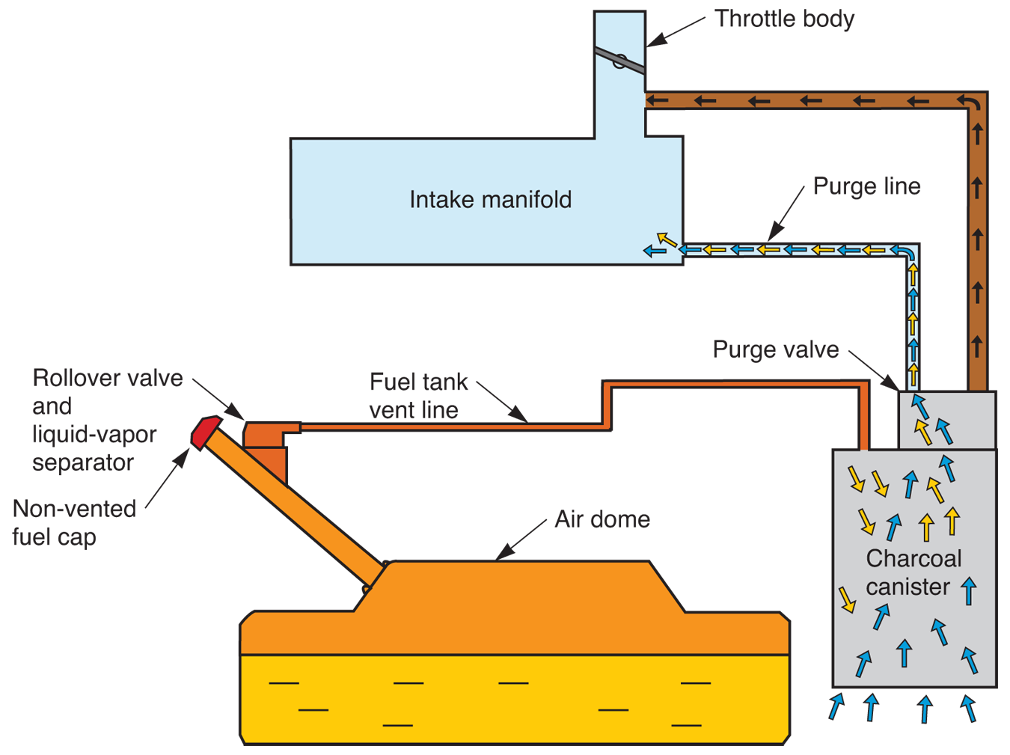
Evaporative Emissions Control System
Operation

Slide 31
Electronically-Operated
Purge Valve
Purge solenoid normally closed
ECM energizes solenoid only after following conditions have been met
  Vehicle operating in closed loop for specified period of time
  Coolant temperature within manufacturer’s specifications
  Vehicle speed above approximately 15 mph
  Engine operating above idle speed

Slide 32
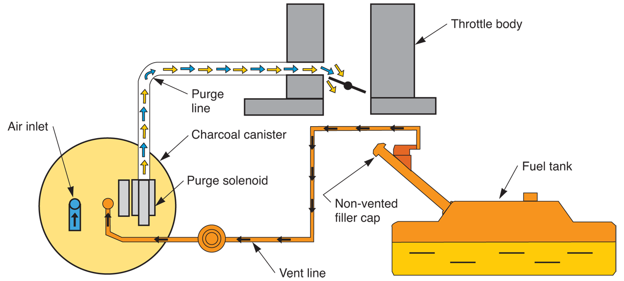
Electronically-Operated
Purge Valve (Cont.)

Slide 33
Enhanced Evaporative Emissions Control System
Has several components and features not found on conventional EVAP systems
  Fuel tank pressure sensor
  Canister vent solenoid
  Service port

Slide 34
Enhanced Evaporative Emissions Control System Operation
Enhanced EVAP system often uses normally closed, pulse-width modulated purge solenoid
Control module can send different length electrical pulses to solenoid to precisely control vapor flow

Slide 35
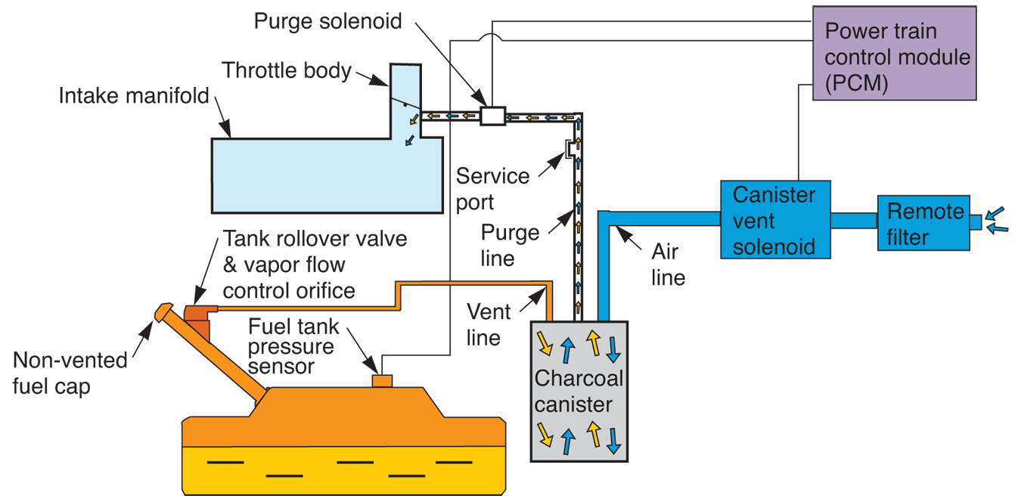
Enhanced EVAP System Diagram

Slide 36
Air Cleaner Carbon Element
Absorbs fuel vapors when engine is shut off
After hot engine is turned off, hot soak fumes can collect in throttle body
  Excess fuel vapors caused by engine heat
Carbon element attracts and stores these fumes

Slide 37
Exhaust Gas Recirculation (EGR)
Allows burned exhaust gases to enter engine intake manifold to reduce NO_{x} emissions
Decrease peak combustion pressure
EGR systems can be controlled by engine vacuum or engine control module

Slide 38
Vacuum-Controlled EGR
Vacuum-controlled EGR system
  Uses engine vacuum to operate EGR valve
Found in millions of older vehicles still on the road
EGR valve consists of vacuum diaphragm, spring, plunger, exhaust gas valve, and diaphragm housing
Designed to control exhaust flow into intake manifold

Slide 39
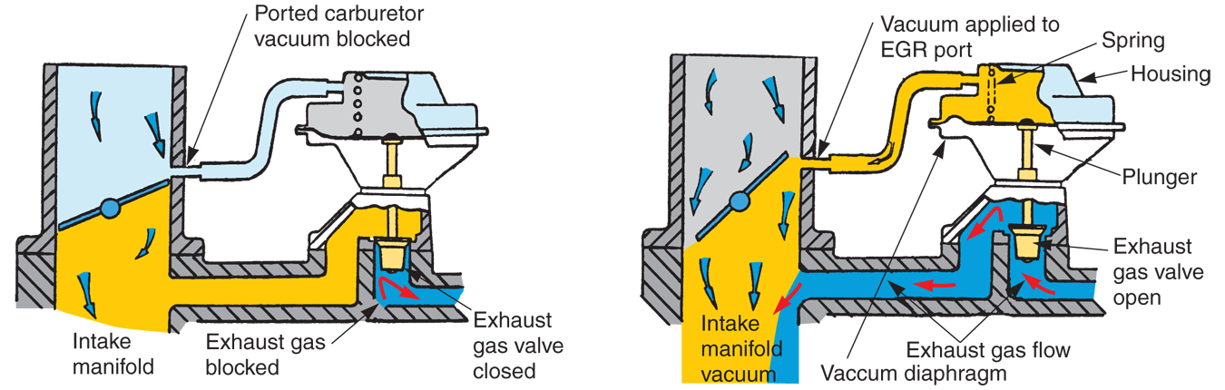
Vacuum EGR Operation

Slide 40
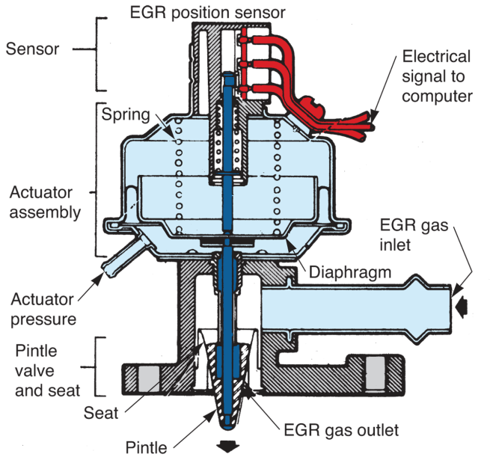
Electronic-Vacuum EGR Valves
Uses both engine vacuum and electronic control for better exhaust gas metering
EGR position sensor located in top of valve and sends data back to ECM
  Allows ECM to determine how much EGR valve is opened
(Ford)

Slide 41
EGR System Variations
Back pressure EGR valve that uses engine vacuum and exhaust back pressure to control valve action
Engine coolant temperature switch used to prevent exhaust gas recirculation when engine is cold

Slide 42
EGR System Variations
(Cont.)
Vacuum line to EGR valve sometimes connected to wide, open throttle valve
WOT valve
Small EGR jets have been used in bottom of a few intake manifolds to replace EGR valve

Slide 43
Electronic EGR System
Vehicle sensors, ECM, and solenoid-operated exhaust gas recirculation valve reduce NO_{x} emissions
EGR duty cycle
  Measurement of control current on and off time sent from ECM

Slide 44
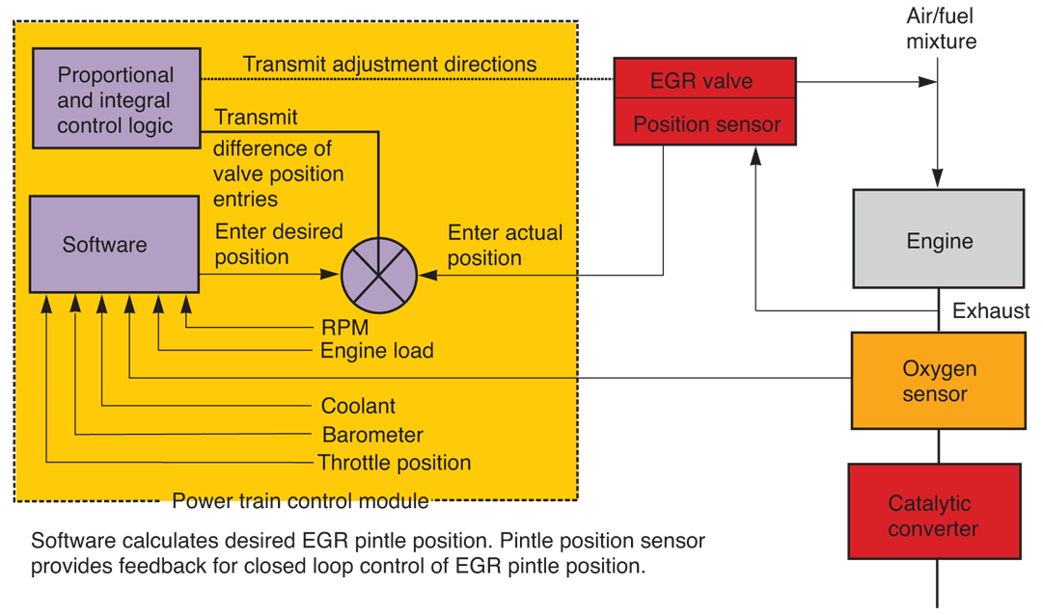
Electronic EGR System (Cont.)
(Mazda)

Slide 45
Electronic EGR Valves
Electronic EGR valve or digital EGR valve
  One or more electric solenoids opens and closes exhaust passages
  Works without engine vacuum
Single-stage EGR valve
  Uses only one solenoid and valve
Multi-stage EGR valve
  Uses more than one solenoid valve to more closely match exhaust gas flow to engine needs

Slide 46
Air Injection System
Forces fresh air into exhaust ports and, in some cases, catalytic converter to reduce HC and CO emissions
Oxygen from air injection system causes this fuel to continue to burn in exhaust manifold or catalytic converter

Slide 47
Air Injection System Components
Air injection pump
  Belt-driven and forces air at low pressure into system
Electric air injection pumps
  Driven by small dc motor, instead of engine driven
Diverter valve
  Keeps air from entering exhaust system during deceleration
  Prevents backfiring

Slide 48
Air Injection System Components (Cont.)
Air distribution manifold
  Used in air injection systems to direct stream of air toward each engine exhaust valve
Air check valve usually located in line between diverter valve and air distribution manifold
  Keeps exhaust gases from entering air injection system

Slide 49
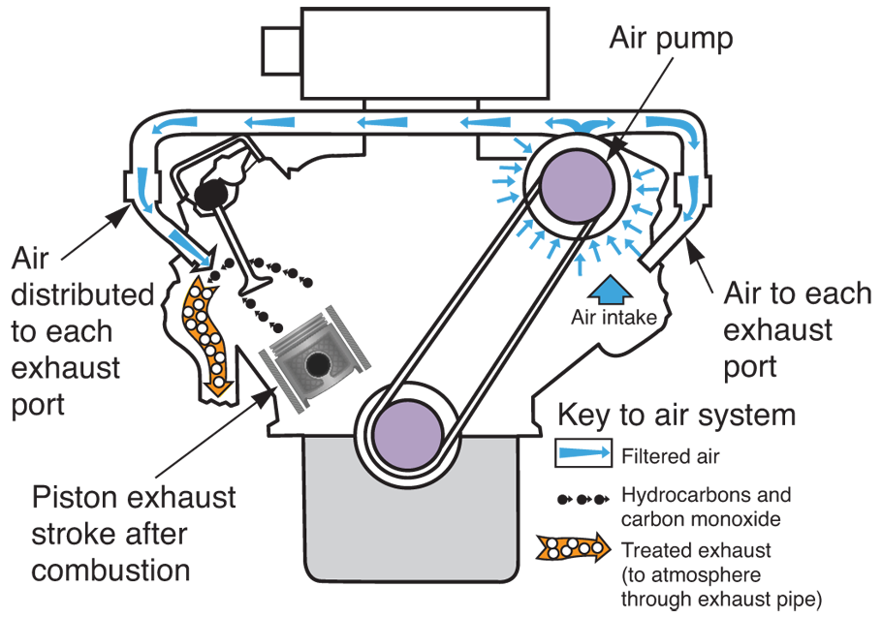
Air Injection System Operation

Slide 50
Pulse Air System
Performs same function as air injection system
Instead of air pump, it uses natural pressure pulses in exhaust system to operate aspirator valves
Aspirator valves, check valves, gulp valves, or reed valves
  Block airflow in one direction
  Allow airflow in other direction

Slide 51
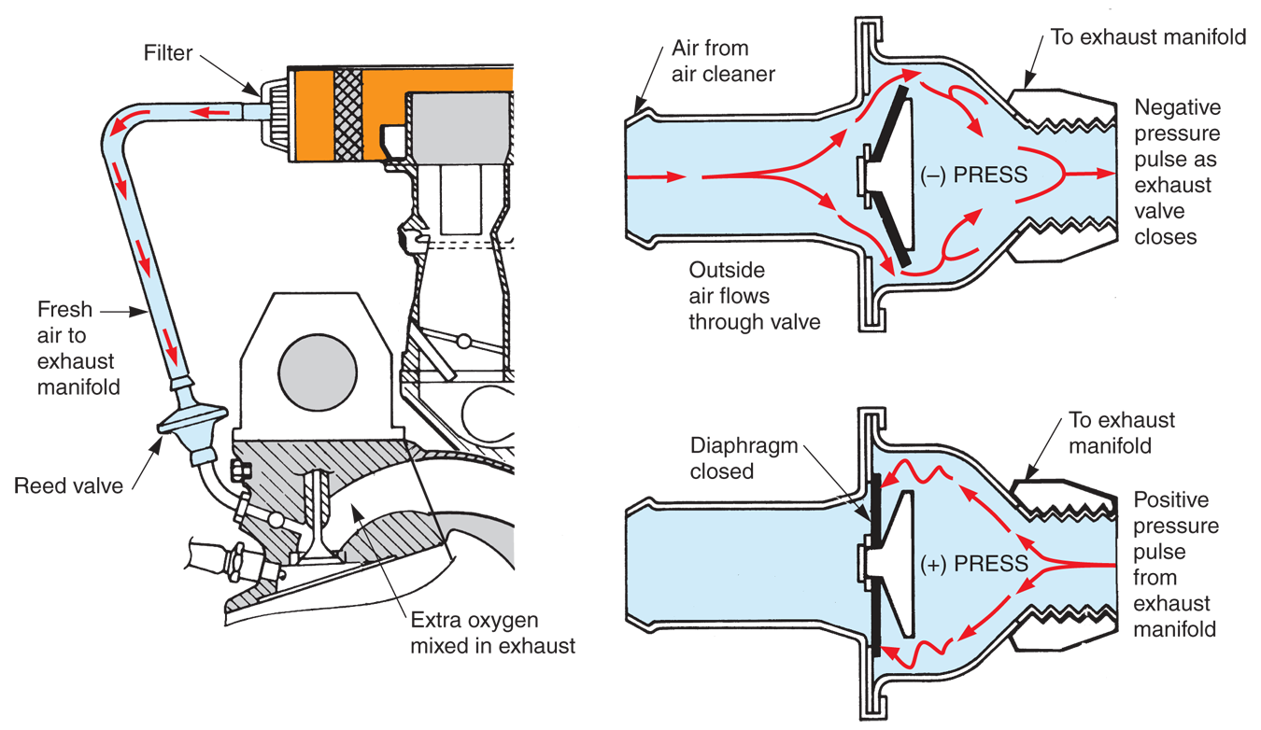
Pulse Air System Operation

Slide 52
Catalytic Converter
Changes exhaust by-products into harmless substances
Catalyst
  Any substance that speeds chemical reaction without itself changing
Contains a catalyst agent, usually elements platinum, palladium, rhodium, or mixture of these materials

Slide 53
Types of Catalytic Converters
Mini catalytic converter
  Small converter placed close to exhaust manifold
Two-way catalytic converter or oxidation converter
  Can only reduce two types of exhaust emissions
  HC and CO

Slide 54
Types of Catalytic Converters
(Cont.)
Three-way catalytic converter or reduction-type converter
  Capable of reducing all three types of exhaust emissions
  HC, CO, and NO_{x}
Dual-bed catalytic converter
  Contains two separate catalyst units enclosed in single housing

Slide 55
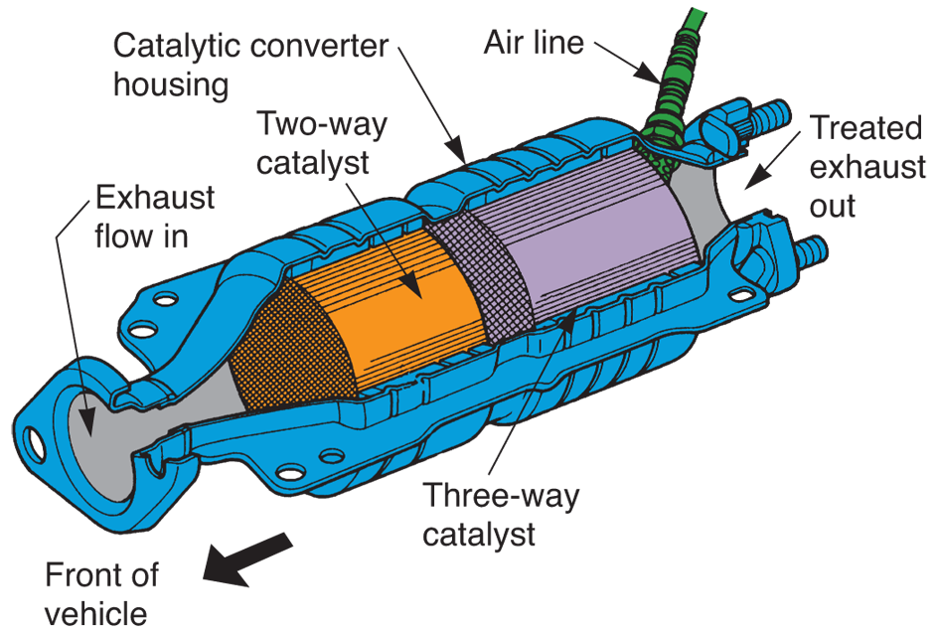
Dual-Bed Catalytic Converter Operation
(Honda)

Slide 56
Computerized Emission Control
Systems
Use
  Various engine, exhaust, and fuel system sensors
  Three-way catalytic converter
  Dual-bank O₂ sensors
Reduce pollution levels emitted from vehicle

Slide 57
Oxygen Sensors
Critical to engine performance and gas mileage
Engine ECM uses at least two oxygen sensors as main control of fuel injection system
  ECM tries to keep engine running on stoichiometric fuel mixture with changes in speed and load
  Theoretically perfect 14.7:1 air-fuel by weight

Slide 58
Primary and Secondary Oxygen Sensors
Primary oxygen sensor or front O₂ sensor
  Monitors oxygen in exhaust gases leaving engine
Secondary oxygen sensor or rear O₂ sensor
  Mounted downstream in exhaust system
  Checks oxygen content of exhaust gases entering catalytic converter or monitors converter’s operation

Slide 59
Oxygen Sensor Position
Oxygen sensor position in vehicle assigned a number by its location and order in relation to engine’s banks
Sensor closest to number one cylinder denoted Oxygen sensor, Bank 1, Sensor 1
In almost all cases, sensor with highest number, such as Sensor 3, is catalyst monitor

Slide 60
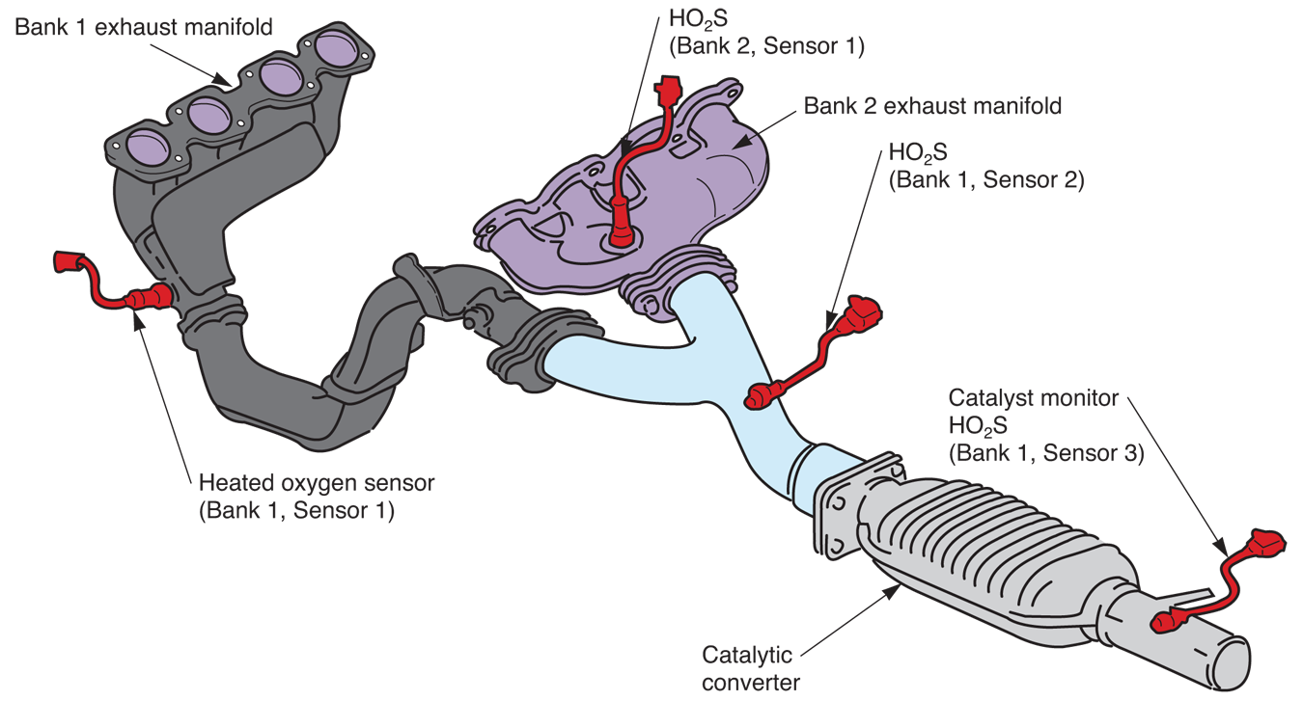
Oxygen Sensor Position (Cont.)

Slide 61
Types of Oxygen Sensors
Heated oxygen sensor
  Abbreviated HO₂S
  Uses electric heating element to quickly warm sensor to operating temperature
Zirconia oxygen sensors
  Most heated O₂ sensors are also called zirconia oxygen sensors because of active materials

Slide 62
Types of Oxygen Sensors (Cont.)
Planar zirconia oxygen sensors
  Work the same way as conventional zirconia sensors, but zirconia element, electrodes, and heater are combined in flat, laminated strip
Titania oxygen sensors
  Vary internal resistance to modify reference voltage

Slide 63
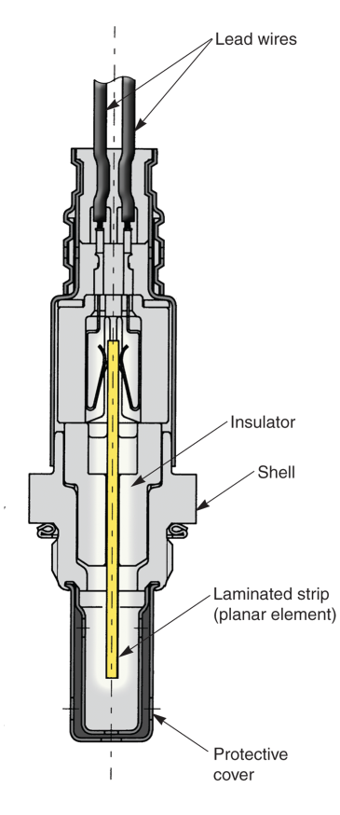
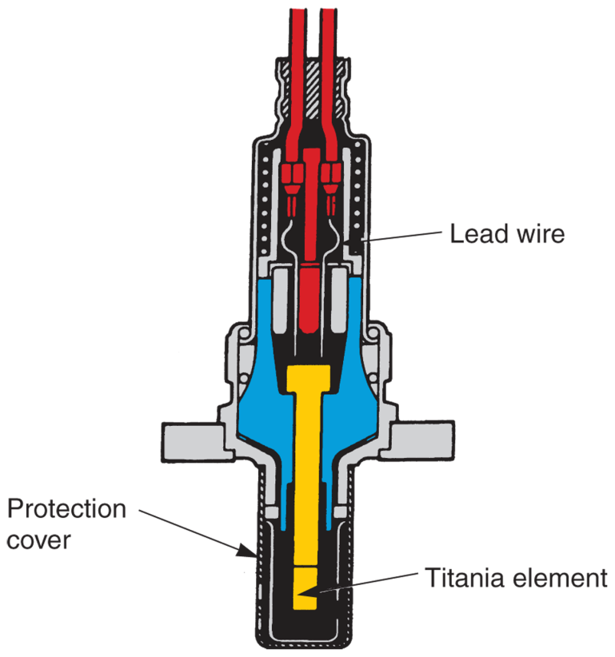
Planar Sensor and Titania Sensor
(Snap-On Tool Corp.)
(Toyota)

Slide 64
Wide-Band and Narrow-Band
Oxygen Sensors
Wide-band oxygen sensors
  Generates variable voltage/current output signal proportional to engine’s present air-fuel ratio
  Used in modified racing and high-performance engine and fuel injection systems for years
Narrow-band oxygen sensors
  Toggle their output voltage abruptly to indicate lean or rich condition

Slide 65
OBD II Emission System Monitoring
Functions monitored
Catalytic converter efficiency
Engine misfire
O₂ sensor output
EGR valve action
Fuel injection system performance
Air injection system operation
Evaporative emissions system operation

Slide 66
Evaporative Emissions System Monitoring
Checks components for leakage and restrictions that could increase emissions
ECM energizes solenoid valves to seal system
  Allows computer to detect leaks or blockages in hoses and components

Slide 67
EGR Monitoring
Done when ECM turns EGR off while checking O₂ sensor readings
Changes in EGR valve that do not affect O₂ sensor readings, trigger trouble code

Slide 68
Air Injection System Monitoring
Data from rear O₂ sensor determines if right amount of air is injected into engine’s exhaust stream
Low amount of air would trip trouble code

Slide 69
Catalyst Monitor
OBD II systems use at least two oxygen sensors
  One before catalytic converter and one after it
If signal from catalyst monitor becomes too similar to engine-mounted oxygen sensor, it is not cleaning exhaust gases as it should
ECM would turn on malfunction indicator light and set trouble code

Slide 70
Engine Misfire Monitoring
Engine crankshaft position sensor detects changes in crankshaft speed, which may indicate engine is missing and not firing air-fuel mixture properly
If crankshaft speed fluctuations are detected, ECM trips trouble code

Slide 71
Sensor Monitoring
Uses ECM data to compare known normal sensor signal variations to actual sensor signals while operating
If sensor signal goes out of range or normal parameter, trouble code will be set in ECM’s memory and displayed on dash

Slide 72
Actuator Monitoring
ECM digital data determines if actuator draws too little or too much current
ECM system detects problems in actuators and actuator circuits
  Fuel injectors
  Electronic EGR valves
  Evaporative solenoids
  High-pressure mechanical fuel pumps

Slide 73
Diesel Particulate Filter
Diesel particulate filter or particulate converter
  Stores and burns ash and soot trying to leave diesel exhaust system
ECM alters diesel engine operating parameters to blow flame out of engine exhaust ports to heat and burn crude oil soaked soot inside particulates filter

