Slide 1


Slide 2
52
Chapter
Emission Control System Testing, Service, and Repair

Slide 3
Objectives
After studying this chapter, you will be able to:
Explain the use of exhaust gas analyzers.
Inspect and troubleshoot emission control systems.
Perform periodic service operations on emission control systems.
Test individual emission control components.

Slide 4
Objectives
Replace or repair major emission control components.
Demonstrate and practice safe work procedures when working on emission control systems.
Correctly answer ASE certification test questions on emission control system testing and service.

Slide 5
Computer-Controlled Emission System
Service
ECM controls
  Fuel injection system
  EGR valve
  Evaporative emissions control
Any of these systems can affect vehicle’s operation and increase emissions

Slide 6
Scanning Emission Systems
Check for stored trouble codes
Retrieve scan tool information
If no trouble codes are set, review live data readings for both oxygen sensors
Check for bad O₂ sensor
Look at secondary oxygen sensor reading for failed catalytic converter
Fouled oxygen sensors or clogged catalytic converter are common problems on high mileage vehicles

Slide 7
Emission Maintenance Reminder
Circuit automatically turns on dash light to indicate need for emission control system service
After making prescribed adjustments and repairs, turn off emission maintenance reminder

Slide 8
Inspecting Emission Control Systems
Inspect all engine vacuum hoses and wires
Check
  Disconnected wires
  Oil leaks onto the oxygen sensor
  Extremely dirty engine oil
  Blowby
All can trip trouble codes or increase air pollution

Slide 9
Engine Exhaust Gases
Harmful
  Hydrocarbons (HC)
  Carbon monoxide (CO)
  Oxides of nitrogen (NO_{x})
Other by-products of combustion
  Carbon dioxide (CO₂)
  Oxygen (O₂)
  Water (H₂O)

Slide 10
Exhaust Gas Analyzer
Indicates excessive emissions
Fuel metering problems
Engine mechanical problems
Vacuum leaks
Ignition system problems
PCV troubles
Faulty air injection system
Evaporative emissions control system problems
Computer control system troubles
Catalytic converter condition

Slide 11
Types of Exhaust Gas Analyzers
Two-gas exhaust analyzer
  Measures amount of hydrocarbons (HC) and carbon monoxide (CO) in exhaust gases
Four-gas exhaust analyzer
  Measures quantity of hydrocarbons (HC), carbon monoxide (CO), carbon dioxide (CO₂), and oxygen (O₂) in engine’s exhaust

Slide 12
Types of Exhaust Gas Analyzers
(Cont.)
Five-gas exhaust analyzer
  Measures hydrocarbons, carbon monoxide, carbon dioxide, oxygen, and oxides of nitrogen
  Latest and most informative type of exhaust gas analyzer

Slide 13
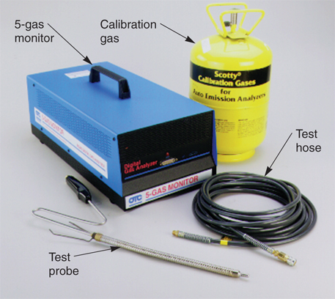
Using an Exhaust Gas Analyzer
Calibration
  Zeroing meter scales while sampling clean air with analyzer
Calibration gas
  Mixture of several gases
  Sample used by newer analyzers to adjust meter readings for accuracy
(OTC)

Slide 14
Using an Exhaust Gas Analyzer
(Cont.)
Plug machine in and allow it to warm up as described by manufacturer
After warm-up, zero and calibrate analyzer
To begin test, install probe in vehicle’s tailpipe
If working in enclosed shop, slide probe through hole in shop’s vent hose

Slide 15
Exhaust Gas Analyzer Readings
Exhaust gas analyzer readings determine chemical content of engine’s exhaust gases
Test readings must be within state-regulated specifications for geographic area and vehicle year
Generally, new vehicles have stricter specifications

Slide 16
Hydrocarbon Readings
Causes of higher-than normal HC readings
  Fuel system malfunction
  Improper ignition timing
  Engine problems
  Faulty emission control system
  Ignition system troubles
  Computer control system problems

Slide 17
CO Readings
High carbon monoxide results from incomplete burning of fuel
Causes of high carbon monoxide readings
  Fuel system problems
  Emission control system troubles
  Incorrect ignition timing

Slide 18
Oxides of Nitrogen Readings
Since oxides of nitrogen are toxic, some state air quality agencies have made exhaust emission measurements with five-gas analyzer mandatory
Typical causes of high NO_{x} emissions
  High combustion chamber temperatures
  EGR system problems

Slide 19
Carbon Dioxide Readings
Carbon dioxide is by-product of combustion
  Produced when one carbon molecule combines with two oxygen molecules in combustion chamber
CO₂ readings provide data for checking and adjusting air-fuel ratio
Oxygen and carbon dioxide levels are compared when evaluating content of engine exhaust

Slide 20
Oxygen Readings
Oxygen needed for catalytic converter to burn HC and CO emissions
Without oxygen in engine exhaust, exhaust emissions can pass through converter and out tailpipe
Oxygen level in engine exhaust sample is accurate indicator of vehicle’s air-fuel mixture

Slide 21
State Emissions Testing Programs
Emissions testing programs or inspection and maintenance programs
  Take exhaust gas readings as vehicle’s engine operates at idle and at set rpms
May check vehicle for presence of catalytic converter and fuel inlet restrictor
Test procedures vary from state to state

Slide 22
IM 240
Enhanced emissions test that requires vehicle to be operated on dynamometer at speeds of up to 55 mph for 240 seconds while exhaust gas emissions are measured
Two additional tests may be required in some areas
  Evaporative emissions system purge test
  Evaporative emission system pressure test

Slide 23
IM 240 (Cont.)
Evaporative emissions system purge test
  Measures flow of fuel vapors into engine while performing IM 240 test
Evaporative emissions system pressure test
  Checks system for leaks into atmosphere
  Performed during IM 240 test

Slide 24
Smoke Generator Testing
Smoke generator
Testing tool that produces smoke and injects it into any sealed system to find leaks
Before smoke testing, inspect for obvious problems that could cause leakage
Smoke leakage test safety rules
Engine must be off when smoke testing
Do not leave vehicle unattended
Do not bring ignition source close to vehicle
Work in a well ventilated area and wear eye protection

Slide 25
Smoke Generator Testing (Cont.)
To perform smoke leakage test
Use scan tool or diagnostic tablet to close evaporative vent valve to seal system
Fill smoke generator with the recommended test oil for generating smoke
Connect generator vacuum line to evaporative hose running to engine intake manifold or vacuum brake booster
Use T-fitting to test whole system at once
Seal engine air intake duct with large foam rubber cone or plastic bag and tape

Slide 26
Smoke Generator Testing (Cont.)
Turn generator on so that smoke is injected into test vacuum hose and system
Adjust smoke generator flow control valve so that flow indicator is about halfway up on its clear plastic graduated scale
Remove gas cap until smoke comes out of filler neck
Reinstall and tighten gas cap
Keep injecting smoke into system until the pressure reads maximum allowable pressure
Observe flow control meter

Slide 27
Smoke Generator Testing (Cont.)
Any further flow into system indicates leakage
Look very closely near gas tank, vent lines, and engine compartment for smoke
Halogen light will help you see smoke leakage
Repair leak and smoke test system again
Cracked, leaking, vacuum hose, rusted metal evaporator line, or similar problem
Erase trouble codes and test-drive vehicle to verify your repairs

Slide 28
Vehicle Inspection Reports
Summarizes why vehicle either passed or failed state-mandated emission test
Vehicle information section
  Identifies type of motor vehicle
  Lists license plate number, VIN, year, make, model, engine type, fuel type, test number, and type of emission test needed
    OBD or non-OBD

Slide 29
Vehicle Inspection Reports
(Cont.)
Repair information section
  Provides vehicle owner with instructions for having vehicle repaired if it fails
Inspection facility information
  Section identifies inspections facility and inspectors, as well as test date and time
Exhaust emission readings section
  Gives readings for HC, CO, and NO_{x}, and OBD results, if applicable

Slide 30
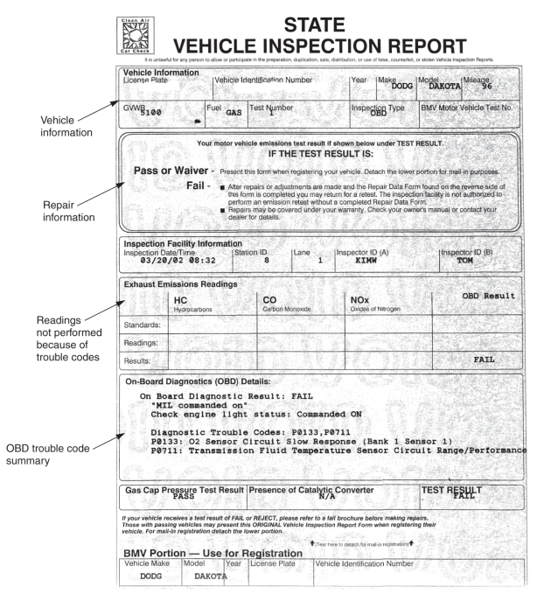
Vehicle Inspection Report

Slide 31
Drive Trace Report
Printed out to help technician find and repair problems causing increased air pollution
Drive trace
  Graph showing emission levels over test time
  Five drive traces normally given on each report
    HC, CO, NO_{x}, CO₂, and purge

Slide 32
Drive Trace Report (Cont.)
Emission standard base line or cut point
  Average allowable emission level for specific model year
Use this information and knowledge of engine, fuel, ignition, and emission control system operation to pinpoint and repair problem sources

Slide 33
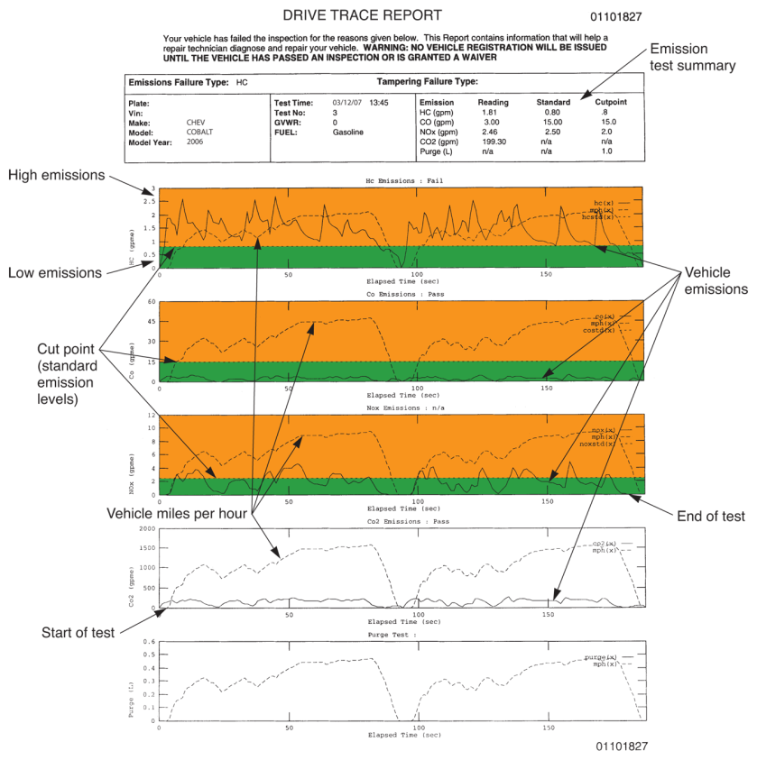
Drive Trace Report (Cont.)

Slide 34
Vacuum Solenoid Service
Various vacuum solenoids used to interface emission system electronics with devices that operate off of engine vacuum
Vacuum hose diagram
  Shows routing of all vacuum hoses
When troubleshooting vacuum solenoids, check for hard, brittle hoses that can leak and prevent normal operation

Slide 35
Vacuum Solenoid Service
(Cont.)
Connect voltmeter to solenoid terminals and start engine
  Make sure voltage gets to unit when needed
Check that solenoid valve opens and blocks vacuum
Connect vacuum gauge or hand pump to vacuum connections on unit

Slide 36
PCV System Service
Inoperative PCV system
  Increases exhaust emissions
  Causes engine sludging and wear
  Rough engine idle
Leaking PCV system
  Causes vacuum leak
  Produces lean air-fuel mixture
    Causing rough engine idle
Restricted PCV system
  Enriches fuel mixture
    Affecting engine idle and causing engine to surge and emit black smoke

Slide 37
PCV System Testing
To quickly test PCV valve, pull valve out of engine and shake it
  If PCV valve does not rattle when shaken, replace valve

Slide 38
PCV System Testing
(Cont.)
With engine idling, place your finger over end of valve
  You should feel suction
  Engine idle speed should drop about 40–80 rpms
  If you cannot feel vacuum, PCV valve or hose might be plugged with sludge
PCV valve tester will measure exact amount of airflow through system

Slide 39
PCV System Testing
(Cont.)
Four- or five-gas exhaust analyzer can also be used to check general condition of PCV system
  Plugged PCV system will show up on exhaust analyzer when oxygen and carbon monoxide do not change
Crankcase dilution
  Excessive blowby or fuel in oil
  Will show up as excessive (1% or more) increase in oxygen or 1% or more decrease in carbon monoxide

Slide 40
Evaporative Emissions
System Service
Faulty evaporative emissions control system
  Fuel odors
  Fuel leakage
  Fuel tank collapse
  Excess pressure in fuel tank
  Rough engine idle

Slide 41
Evaporative Emissions
System Service (Cont.)
Cause of these problems
  Defective fuel tank pressure-vacuum cap
  Leaking charcoal canister valves
  Deteriorated hoses
  Incorrect hose routing

Slide 42
EGR System Service
EGR system malfunctions cause
  Engine stalling at idle
  Rough idle
  Detonation
  Poor fuel economy
If EGR valve sticks open, it causes
  Lean air-fuel mixture
  Engine will run rough at idle or stall

Slide 43
EGR System Service
(Cont.)
If EGR fails to open or exhaust passage is clogged, higher combustion temperatures can cause abnormal combustion and knocking
Check that vacuum hoses in EGR system are in good condition
  They can become hardened, which causes leakage
Check for proper wire routing and good electrical connections on digital EGR valves

Slide 44
EGR System Testing (Vacuum Type)
Allow engine to warm
Operating accelerator linkage by hand, increase engine speed to 2000–3000 rpms very quickly
If visible, observe movement of EGR valve stem
Stem should move as engine is accelerated
  If it does not move, EGR system is not functioning

Slide 45
EGR System Testing (Vacuum Type) (Cont.)
To test EGR valve, idle engine
Connect hand vacuum pump to EGR valve
Plug supply vacuum line to EGR valve
When vacuum is applied to EGR valve with pump, engine should begin to miss or stall
  This lets you know that EGR valve is opening

Slide 46
EGR System Testing (Electronic Type)
Most problems with late-model electronic, or digital, EGR valves will trip trouble code
  Scan tool will quickly and easily isolate problems
To pinpoint test a digital EGR valve, connect handheld scope to wires going to valve
  Scope’s waveform will measure voltage applied to EGR from ECM and will also check condition of EGR windings

Slide 47
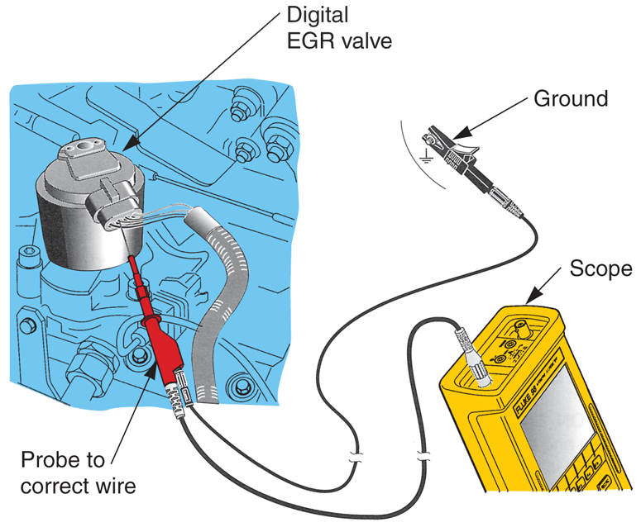
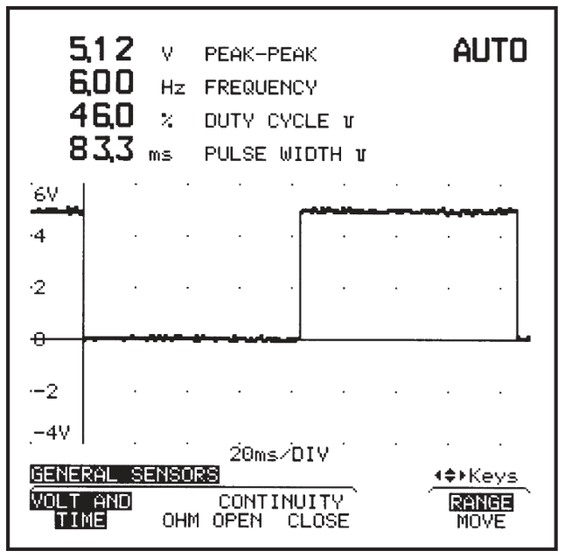
EGR System Testing (Electronic Type)
(Cont.)
(Fluke)

Slide 48
Air Injection System Service
Air injection system problems can cause engine backfiring, other noises, and increased HC and CO emissions
Air injection system maintenance includes
  Replacing pump inlet filter
  Adjusting pump belt tension
  Inspecting condition of hoses and lines

Slide 49
Testing Air Injection Systems
Four- or five-gas exhaust analyzer provides quick and easy method of testing air injection system
Disable air injection system
  Remove air pump belt or use pliers to pinch hoses to air distribution manifold
Without air injection, exhaust analyzer’s oxygen reading should drop approximately 2%–5%, while hydrocarbon and carbon monoxide readings should increase

Slide 50
Pulse Air System Service
Inspect all hoses and lines and measure exhaust’s oxygen content with four- or five-gas analyzer
Exhaust analyzer oxygen readings should drop with pulse air system disabled
  If readings do not drop, check action of aspirator valves

Slide 51
Catalytic Converter Service
Catalytic converter problems caused by
  Contamination
  Overheating
  Extended service
Clogged catalytic converter, resulting from deposits or overheating, can increase exhaust system back pressure

Slide 52
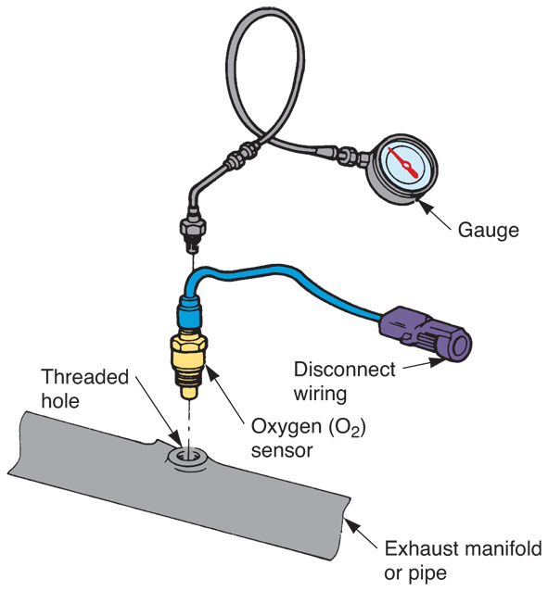
Catalytic Converter Service (Cont.)
Exhaust back pressure test will check for clogged catalytic converter
Remove front oxygen sensor and install pressure gauge into threaded hole
(Snap-on Tool Corp.)

Slide 53
Catalytic Converter Service (Cont.)
Start engine
If pressure gauge reads too high, converter, muffler, or exhaust pipe is restricted
Disconnect parts one at a time
  When back pressure drops, you have found source of restriction

Slide 54
Testing Catalytic Converter Efficiency
Exhaust gas analyzer can be used to check general condition of catalytic converter
  May need to disable air injection or pulse air system before performing this test
Measure oxygen and carbon monoxide at tailpipe
Oxygen readings should be above 5%

Slide 55
Catalyst Replacement
To install new pellets in older catalytic converter, follow service manual instructions
Use special vibrating tool to shake old pellets out of a hole in converter
Install new pellets and replace service plug
Procedure not used frequently
  Faster and easier to simply replace catalytic converter

Slide 56
Catalytic Converter Replacement
Remove clamps that secure converter to exhaust pipes
Use muffler cutter or chisel to cut and loosen old converter from exhaust pipes
  Hammer blows to converter should free it from vehicle

Slide 57
Catalytic Converter Replacement
(Cont.)
Sometimes catalytic converter is integral part of the header pipe
With this design, converter and pipe may have to be replaced together
When installing new converter, use new gaskets and reinstall all heat shields

Slide 58
Oxygen Sensor Service
If gas mileage is 10% to 15% lower than normal, suspect a lazy oxygen sensor
Lazy O₂ sensor
  Will not alter output signal fast enough to maintain efficient air-fuel ratio
Dead O₂ sensor
  Has little or no resistance or voltage output change

Slide 59
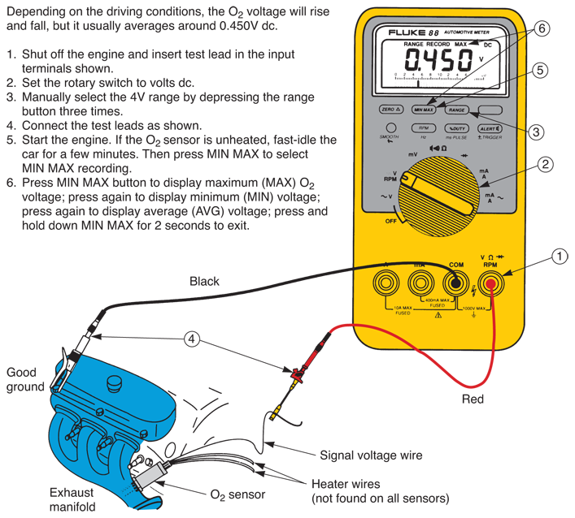
Testing Oxygen Sensors
(Fluke)

Slide 60
Testing Oxygen Sensors (Cont.)
Depending on driving conditions, O₂ voltage will rise and fall but usually averages around 0.450V dc
To test
  Shut off engine and insert test lead in input terminals
  Set rotary switch to volts dc
  Manually select 4V range by depressing range button three times

Slide 61
Testing Oxygen Sensors (Cont.)
Connect test leads
Start engine
  If O₂ sensor unheated, fast-idle the car for a few minutes
  Then press MIN MAX to select MIN MAX recording
Press MIN MAX button to display maximum O₂ voltage
  Press again to display minimum voltage
  Press again to display average voltage; press and hold down MIN MAX for 2 seconds to exit

Slide 62
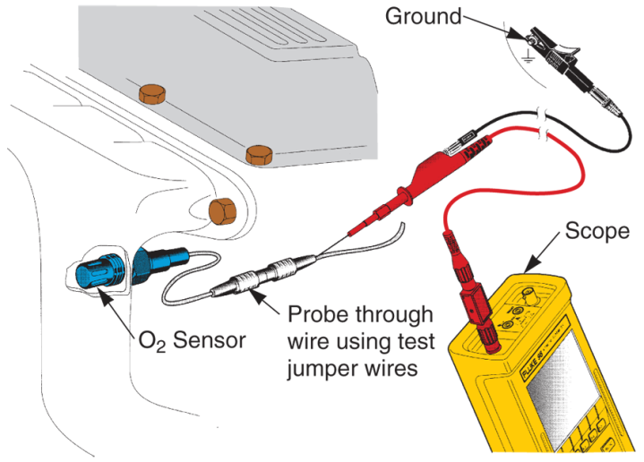
Testing Oxygen Sensors (Cont.)
Use oscilloscope to check signal leaving O₂ sensor
Compare actual voltage or resistance levels to scan tool readout values and manufacturer’s specifications
(Fluke)

Slide 63
Oxygen Sensor Replacement
Disconnect negative battery cable
Separate sensor from wiring harness by unplugging connector
  Never pull on wires themselves, as damage may result
Spray sensor threads with generous coat of penetrating oil

Slide 64
Oxygen Sensor Replacement
(Cont.)
Use special sensor socket to remove sensor from exhaust system
Inspect sensor for signs of contamination
Obtain and install correct replacement oxygen sensor
Start sensor by hand then carefully tighten sensor with wrench or socket
Reconnect wire connector and check system operation

Slide 65
OBD II Drive Cycle
Normally performed whenever battery or ECM has been disconnected, or after diagnostic trouble codes have been erased
Some states require drive cycle to be performed before emissions test
Drive cycle is different for each vehicle, so check service manual for specific instructions

Slide 66
OBD II Drive Cycle
(Cont.)
Check that coolant temperature is low enough to allow ECM to start in open loop mode
Attach scan tool, and set tool to record ECM status as engine operates
  Some scan tools have dedicated drive cycle option

Slide 67
OBD II Drive Cycle
(Cont.)
Drive cycle will cover
  Engine warm-up
  Idling
  Accelerating
  Decelerating
  Cruising
Typical drive cycle will take from 8–15 minutes to complete

Slide 68
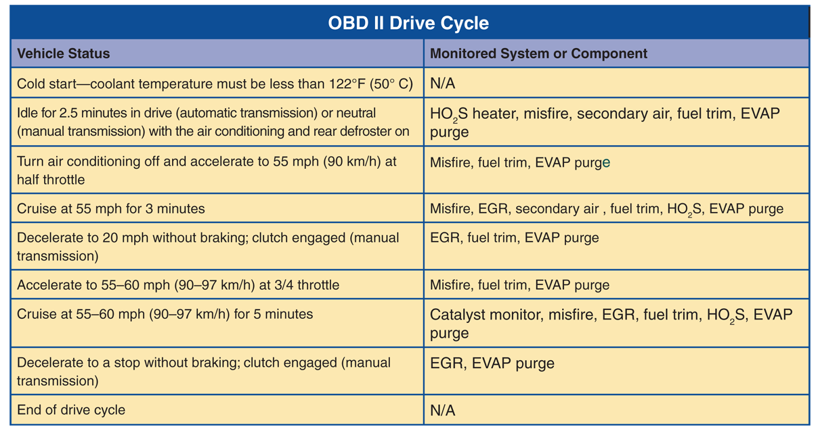
OBD II Drive Cycle
(Cont.)

Slide 69
Emission Control Information Sticker
Emission control information sticker, or label gives
  Important engine data
  Evaporative emissions information
  Schematics
  Specifications for complying with EPA regulations

