Slide 1


Slide 2
53
Chapter
Engine Performance and Driveability

Slide 3
Objectives
After studying this chapter, you will be able to:
List the most common engine performance problems.
Describe the symptoms for common engine performance problems.
Explain typical causes of engine performance problems.

Slide 4
Objectives
Use a systematic approach when diagnosing engine performance problems.
Use scan tool data to find mechanical and electrical problems that adversely affect gasoline engine smoothness, efficiency, power, and emissions.
Correctly answer ASE certification test questions on problems affecting engine performance.

Slide 5
Engine Performance and Driveability
Introduction
Engine performance problem
  Any trouble that affects vehicle’s power, acceleration, fuel economy, emissions, and dependability
Driveability problem
  Any problem that affects powertrain performance

Slide 6
Locating Engine Performance Problems
Systematic approach or strategy-based diagnostics
  Involves using knowledge of automotive system theory and logical process of elimination
Problem symptoms
  Noticeable changes in performance to system or part

Slide 7
Strategy-Based Diagnostics
Verify customer’s concern
Perform preliminary checks
Check for technical service bulletins (TSBs)
Determine most probable cause
Perform pinpoint test
Isolate root cause of problem
Correct problem
Recheck system operation to verify fix

Slide 8
Questions to Ask
What are the symptoms?
  Noise, miss, smoke, etc.
When do the symptoms occur?
  At idle, when accelerating, when engine is cold or hot, etc.
What system could be producing symptoms?
  Ignition, fuel, engine, etc.
Where is the most logical place to start testing?
Which part is most likely to cause symptoms?

Slide 9
Locating the Problem Source
Root cause of failure
  Electrical component or mechanical part at fault
Logical thought will help find most likely problem source
If first idea is incorrect, rethink problem and check next most likely trouble source

Slide 10
Performance Problem Troubleshooting Charts
Troubleshooting chart lists problem causes and corrections
Manufacturer or auto maker diagnostic chart is written for particular make and model vehicle

Slide 11
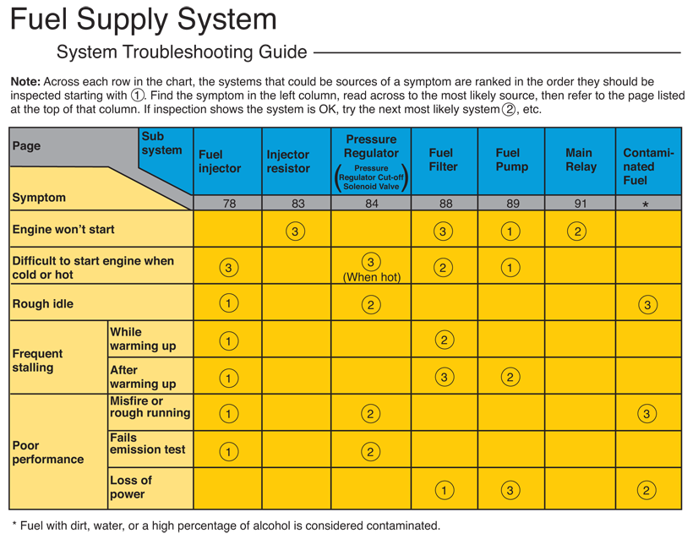
Performance Problem Troubleshooting Charts (Cont.)
(Honda)

Slide 12
Technical Service Bulletins
Technical service bulletins (TSBs)
  Explain problems that frequently occur in one make or model vehicle
Published by auto manufacturers
Explain symptoms of, as well as tests and corrections for, common problems

Slide 13
Other Sources of Service Information
Trade magazines
  Often discuss common and difficult-to-locate failures
  Always read these types of magazines
Internet
  Search for service information and review problems encountered by other technicians
  Type in information about vehicle or problem and quickly search for more information
  Some vehicle and part manufacturers provide service data on the Internet

Slide 14
Other Sources of Service Information
Trade magazines
  Often discuss common and difficult-to-locate failures
  Always read these types of magazines
Internet
  Search for service information and review problems encountered by other technicians
  Type in information about vehicle or problem and quickly search for more information
  Some vehicle and part manufacturers provide service data on the Internet

Slide 15
Typical Performance Problems
No-crank problem
No-start problem
Hard starting
Stalling
Misfiring

Slide 16
No-Crank Problem
No-crank problem
  Occurs when starter fails to turn crankshaft
First, check starter and solenoid circuits as well as all related wiring
Gear grinding noise suggests
  Starter drive pinion may not be engaging with flywheel
  Engine flywheel teeth may be broken off or damaged

Slide 17
No-Start Problem
Occurs when engine cranks but fails to start
Most obvious performance problem
Defective mechanical part or electric component prevents engine from igniting and burning its gasoline or diesel fuel
First step in diagnosing no-start problem is to check for strong spark

Slide 18
No-Start Problem (Cont.)
To check for spark
  Disconnect spark plug wire or ignition coil from one of spark plugs on top of engine
  Connect spark testing tool to high-voltage secondary conductor or direct ignition coil secondary terminal
  Ground tester black lead to bare metal on unpainted engine bracket
  Have another mechanic crank engine or fire ignition coil with scan tool while you watch for bright spark inside tester’s air gap

Slide 19
No-Start Problem (Cont.)
If ignition system does not produce strong spark across air gap, problem is in ignition system
  Ignition coil
  Coil wire
  Spark plug wire
  Pickup coil
  Crankshaft sensor
  Ignition module
  Engine ECM, but not engine

Slide 20
No-Start Problem (Cont.)
If you have spark, check for fuel by making sure fuel system is feeding gasoline to engine
  If you do not have fuel, then something is wrong with fuel system
Check wiring harness going to injectors for pulse from ECM

Slide 21
No-Start Problem (Cont.)
Disconnect wiring harness from one of injectors and install noid light
  If light flashes, ECM is sending signal to injectors
  If noid light does not flash, there is a problem in computer control system, its inputs, or wiring

Slide 22
No-Start Problem
(Cont.)
By checking for fuel and spark, you narrow down cause of problem to two major engine systems
If you don’t have spark but you have fuel pressure
  Might be bad relay or connection
  Something not feeding voltage to ignition system

Slide 23
No-Start Problem (Cont.)
If you have spark but no fuel pressure
  Check for fuel in tank, clogged fuel filters, or inoperative fuel pumps
If you have both fuel and spark
  Check engine compression
  Excessively low compression will prevent engine from starting
    Badly worn rings or valves

Slide 24
Hard Starting
Due to partial failure of system and its component, part, or circuit
  Battery may be depleted
  Starting motor could be dragging
  Vacuum leak
  Mechanical problem
  Fuel or ignition system malfunction
  Sensor problem
  Worn engine timing chain

Slide 25
Hard Starting (Cont.)
When encountering hard starting
  Check scan tool readouts for camshaft versus crankshaft timing
  Stretched or worn timing chain or adjusters
MAP sensor readings
  Look for low vacuum at idle
    Burned engine intake valves
  Other engine-related circuit readings

Slide 26
Stalling
Many causes of engine stalling
Severe engine vacuum leak causes idle or low engine speeds
  Bad intake manifold gasket or disconnected large diameter PVC vacuum hose
Open or loose electrical connection in ignition system
Engine misfire due to fouled or eroded spark plug electrodes
Low fuel pressures
Computer glitches electronically shut off engine

Slide 27
Misfiring
Engine misfiring
  Performance problem from one or more spark plugs failing to ignite and burn air-fuel charges to produce normal combustion power
Engine mechanical problems
  Low cylinder compression trip engine misfire code
  Low compression will keep spark plugs from igniting air-fuel gas cloud in cylinder

Slide 28
Misfiring (Cont.)
Fuel system problems
  Improper fuel delivery can prevent normal combustion and cause misfire
Ignition system problems
  Weak electric arc at spark plugs can prevent normal combustion
Intake or exhaust system problems
  Restriction in engine intake tract or exhaust system can cause poor combustion

Slide 29
OBD II Cylinder Misfire Monitoring
Type A misfires
  Severe enough to cause catalytic converter damage
Type B misfires
  Less severe, causing increase in emissions but not catalytic converter damage

Slide 30
OBD II Cylinder Misfire Monitoring (Cont.)
Single cylinder misfire code
  Indicates there is a problem in one cylinder
Random cylinder misfire code
  Indicates a problem occurring in all cylinders

Slide 31
OBD II Cylinder Misfire Monitoring (Cont.)
OBD II scan tool
Misfire data values
Misfire history
Misfire passes
Misfire failures
Misfire rev. status
Total misfires
Misfiring cylinder
RPM at misfire
Load at misfire

Slide 32
Engine Load
Percentage measurement represents how hard engine is working
During quick acceleration, engine load would be around 80%
Coasting during vehicle deceleration, engine load should be 0%

Slide 33
Rough Idle
Occurs when engine seems to vibrate on its mounts at very low rpms
Low frequency exhaust note
  Sound of engine exhaust gases as all cylinders produce normal combustion

Slide 34
Rough Idle (Cont.)
Caused by
Dead cylinder
Vacuum leak
Fouled spark plugs
Bad secondary wire insulation
Open high voltage conductors
Failing direct ignition coil
Lean air-fuel mixture

Slide 35
Hesitation
Condition where engine does not accelerate normally when gas pedal is pressed
Usually caused by temporarily lean air-fuel mixture as engine speed increases
Check whether hesitation more pronounced with engine cold, warm, or hot
Determine if engine hesitates upon initial movement or during acceleration

Slide 36
Stumbling
Similar to hesitation, but engine repeatedly loses power and causes jerking motion upon acceleration or highway cruising
Caused by
  Slow oxygen sensors
  “Dead spot” in throttle position sensor
  Engine temperature sensor failure
  Any part that leans or richens air-fuel mixture too little or too much
  Intermittent electrical problems

Slide 37
Surging
Condition in which engine power slowly fluctuates up and down with continuous, soft jerking motion
Caused by
  Extremely lean fuel injection setting
  Ignition or computer control system problems
  Electronically controlled automatic transmission changing gears abruptly
  Intermittent electrical troubles

Slide 38
Backfiring
Fuel vapors igniting and exploding in intake manifold or exhaust system
Engine cough
  Mild backfire in engine intake manifold
  Due to backfire pressure wave trying to rotate engine crankshaft backwards

Slide 39
Backfiring (Cont.)
Caused by
Incorrect ignition timing
Crossed spark plug wires
Defective ignition coil
Bad throttle position sensor
Exhaust system leakage
Faulty air injection system
Computer system malfunction

Slide 40
Dieseling
Dieseling, after-running, or run-on
  Occurs when engine fails to shut off
  Engine keeps firing, coughing, and producing power
Caused by
  Leaking injectors
  Low octane fuel
  Overheated engine

Slide 41
Pinging
Pinging or spark knock
  Metallic tapping or light knocking sound that usually occurs when engine accelerates under load
Caused by
  Abnormal combustion
  Low-octane fuel
  Advanced ignition timing
  Carbon buildup in combustion chambers and pistons
  Engine overheating

Slide 42
Vapor Lock
Occurs when fuel overheats, forming air bubbles that upset air-fuel mixture
Can cause
  Engine stalling, lack of power, hard starting, and no starting
Caused by
  Too much engine heat transferring into fuel

Slide 43
Fuel Line Freeze
Results when moisture in fuel turns to ice
Usually occurs with diesel fuel
With diesel fuel, overcooled fuel can form wax, which completely blocks fuel filters
  Replace clogged fuel filters
  You may need to place vehicle in warm garage until water in gasoline or diesel fuel thaws

Slide 44
Poor Fuel Economy
Condition causing vehicle to use too much fuel for miles driven
Caused
  Rich air-fuel mixture
  Engine miss
  Incorrect ignition timing
  Worn timing chain
  Worn piston rings
  Burned valves
  Leakage in the fuel system

Slide 45
Lack of Engine Power
Lack of engine power or sluggish engine
  Causes vehicle to accelerate slowly
Primary causes include
  Fuel system problems
  Ignition system problems
  Emission control system problems
  Engine mechanical problems

Slide 46
Scanning Diesel Engine Problems
Diesel engines can suffer from many of the same performance problems as gasoline engines
In most cases, visual and physical engine/system checks, diagnosis, and symptoms are similar for both types of engines
Connect diagnostic tool and check ECM for stored trouble codes

Slide 47
Vacuum and Pressure Gauge Tests
Vacuum gauge
  Measures negative air pressure produced by engine, fuel pump, vacuum pump, and other components
    Pressure lower than atmospheric pressure
Vacuum-pressure gauge or vacuum gauge
  Reads both negative and positive pressures

Slide 48
Vacuum and Pressure Gauge Tests
(Cont.)
Pressure gauge
  Measures positive pressures produced by engine, turbocharger, fuel pump, or other device
Used to check for
  High exhaust system back pressure
  Abnormal fuel pressure
  Incorrect turbocharger boost pressure

Slide 49
Vacuum and Pressure Gauge Tests
(Cont.)
To use vacuum-pressure gauge to check engine
Connect gauge to vacuum fitting on intake plenum or manifold
Start engine and note reading on gauge
Compare gauge readings to normal readings

Slide 50
Vacuum Pump Tests
Hand vacuum pump
  Used to check vacuum-actuated devices and vacuum diaphragms
To check vacuum-actuated device
  Connect vacuum pump to fitting
  Pump handle and see if device will hold vacuum
  If it leaks, diaphragm or device should be replaced

Slide 51
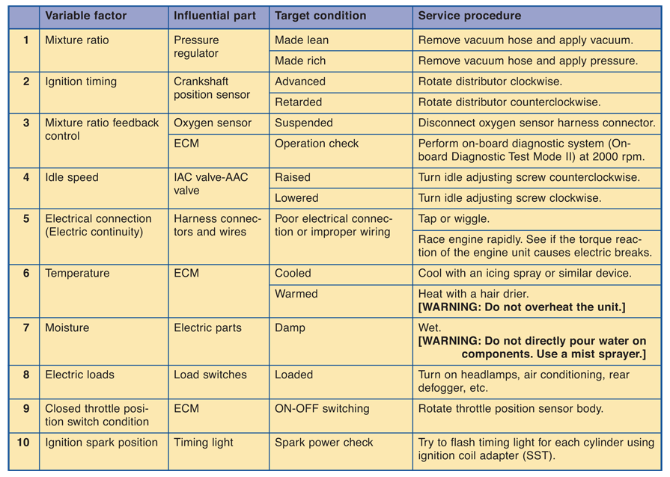
Other Engine Performance
Problems
(Nissan)

