Slide 1


Slide 2
54
Chapter
Advanced Diagnostics

Slide 3
Objectives
After studying this chapter, you will be able to:
Use advanced diagnostic techniques to troubleshoot difficult problems.
Use scan tool snapshot and datastream values to find problems not tripping trouble codes.
Use a breakout box to measure circuit values.

Slide 4
Objectives
Identify electromagnetic interference (EMI).
Use an oscilloscope on any type of analog sensor or digital sensor.
Evaluate waveforms from scope test patterns to analyze the operation of sensors, actuators, and other electrical-electronic devices.

Slide 5
Advanced Diagnostics
Strategy-based diagnostics
  Involves using a consistent, logical procedure to narrow down possible problem sources
  Verify the complaint
  Make preliminary checks
  Scan for codes
  Read service bulletins
  Performing service manual-recommended checks
  Repair the problem
  Recheck system operation

Slide 6
Advanced Scan Tool Tests
Modern scan tools used for many advanced diagnostic procedures, including retrieving trouble codes
  Display live electrical circuit values with engine running
  When engine hesitates, misfires, surges, or runs poorly, advanced scan tool displays real-time operating values, and stores data in memory
  Study “live” operating values that occurred while test-driving vehicle

Slide 7
Scan Tool Snapshot
Snapshot
  Instantaneous reading of operating parameters present when problem occurs
Often used when problem is hard to find or when intermittent troubles are present

Slide 8
Scan Tool Datastream Values
“Live” electrical values measured with vehicle running and, in some cases, being driven
Almost eliminate need for breakout box or pinpoint measurements of electrical values
Read scan tool screen to see weak values or values almost out of specs

Slide 9
Scan Tool Actuator Tests
Most scan tools can switch computer-controlled actuators on and off
  Allows technician to verify operation of these components

Slide 10
Checking ECM Terminal Values
Computer terminal values tested at metal pins of ECM
Digital VOM used to read terminal voltage and resistance values
Service manual usually specifies electrical values that should be present at each terminal of multi-pin computer or ECM connector

Slide 11
Using a Breakout Box
Breakout box
  Checks electrical values at specific pins on ECM or in wiring harness
  One of the last tools used in diagnostics, time-consuming
Connected in parallel with ECM wiring harness, usually at ECM connector
Multimeter used to touch specific terminals on breakout box

Slide 12
Isolating Electromagnetic
Interference
Electromagnetic interference or radiation interference
  EMI
  Occurs when induced voltage enters another system’s wiring
Sources of EMI include loose, misrouted, or unshielded spark plug wires, police and CB radios, failed alternators, ac electric drive train components, and aftermarket accessories

Slide 13
Isolating Electromagnetic
Interference (Cont.)
In the past, electromagnetic interference limited to noise in radio speakers
In late-model vehicles, EMI can cause computer-controlled system to malfunction
To isolate source of electromagnetic interference, try turning off or disabling circuits or devices

Slide 14
Radio Interference Testing
Small transistor radio can find induced voltage sources
Turn radio on and set it on AM band, but do not tune it to a station
Turn off fluorescent lights or test vehicle outside
Move radio around engine compartment, hybrid drive components (if applicable), and under dash with engine running
If EMI noise is present, radio will produce popping or cracking noise

Slide 15
Radio Interference Testing
(Cont.)
To correct an EMI problem, stop source of interference
  Or shield affected system’s wiring from interference

Slide 16
Digital Thermometer Tests
Digital thermometer
  Electronic device that measures temperature
Can be used to measure
  Engine operating temperature
  Exhaust manifold temperature
  Radiator and thermostat housing temperature
  Actual coolant temperature
  Sensor temperature
  Ambient room temperature

Slide 17
Finding Temperature-Related Problems
When engine or hybrid electric drive performance problem occurs only at specific temperature
  Suspect electronic parts first
  Electronic circuits and components
  Ignition control modules
  Hybrid PCMs and ECMs
  HV batteries

Slide 18
Finding Temperature-Related Problems (Cont.)
To check component for problems affected by temperature, use heat gun to warm component or can of freeze spray to cool unit
  If problem occurs with temperature change, unit at fault and should be replaced

Slide 19
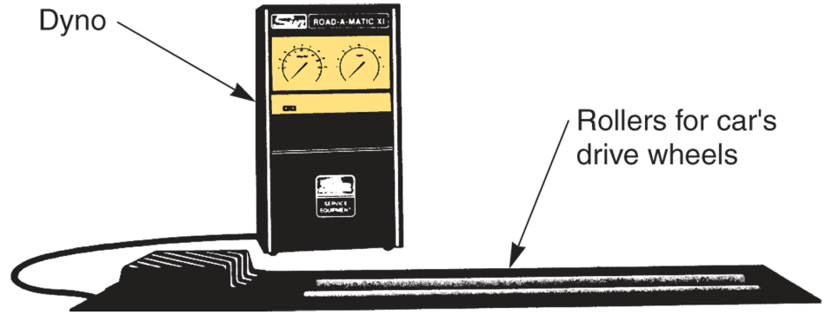
Dynamometer Testing
Dynamometer or dyno
  Measures engine’s power output and performance
By loading engine, dynamometer can check
  Engine acceleration
  Maximum power output
  On-the-road performance characteristics
(Sun Electric Corp.)

Slide 20
Using an Oscilloscope
Oscilloscope or scope
  Piece of test equipment that displays voltages in relation to time
When connected to circuit voltage, scope produces a line on screen that moves up and down with changes in voltage
By comparing scope pattern to known good pattern, technician can determine whether something is wrong in circuit

Slide 21
Reading the Scope Screen
Scope screen can give instructions, display voltages as a trace, or give other values as digital displays
Scope voltage
  Shown on scope screen along vertical axis, or scale
Scope time
  Given on horizontal scale of scope screen in degrees, milliseconds, or duty cycle

Slide 22
Scope Sweep Rate
Frequency or time division shown on screen during each test
Sweep rate adjustment affects horizontal, or time, measurement
Scope sweep rate must be set to match waveform frequency to be analyzed
Sweep rate commonly given in milliseconds

Slide 23
Ignition System Patterns
Primary scope pattern
  Shows low-voltage, or primary-voltage, changes in ignition system or ignition coil
Secondary scope pattern
  Shows high voltages needed to fire spark plugs

Slide 24
Secondary Firing Section
Secondary pattern starts on left with firing section
Firing section
  Pinpoints problems with spark plugs, plug wires, and ignition coils
Firing line
  Tall spike or line representing voltage amount needed to cause electric arc to jump across spark plug gap

Slide 25
Secondary Firing Section
(Cont.)
Spark line
  Shows voltage used to maintain arc across spark plug electrodes
  Once spark is started, less voltage needed to maintain arc
  Spark line should be almost straight, clean, and about one-fourth as high as firing line

Slide 26
Secondary Intermediate Section
Intermediate section or coil oscillations section
  Shows voltage fluctuations after spark plug stops firing
This section of pattern will indicate problems with ignition coil or coil pack

Slide 27
Secondary Dwell Section
Dwell section
  Starts when ignition module conducts primary current through ignition coil
Will indicate problems such as faulty ignition module

Slide 28
Scope Test Patterns
Primary superimposed pattern
  Shows low voltages in primary system
Secondary superimposed pattern
  Most commonly used scope pattern
  It places all cylinder waveforms on top of each other, but it also shows high voltages produced by ignition coils

Slide 29
Scope Test Patterns
(Cont.)
Parade or display pattern
  Lines up a waveform for each cylinder, placing one next to the other across screen
  Number one cylinder on left
  Other cylinders displayed in firing order going to the right
Raster or stacked pattern
  Voltage waveforms placed one above the other

Slide 30
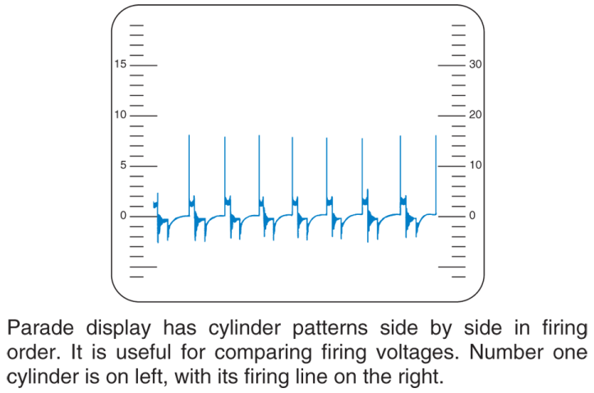
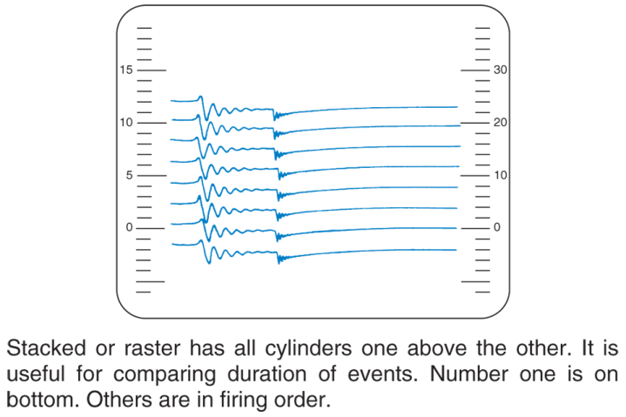
Scope Test Patterns
(Cont.)
(FMC)

Slide 31
Scope Test Patterns
(Cont.)
Expanded display or cylinder select
  Some oscilloscopes have a control that allows one cylinder waveform to be displayed above parade pattern
If problem is located in one trace, that trace can be expanded for closer inspection

Slide 32
Reading Oscilloscope Patterns
With many variations of ignition waveforms, refer to scope operating manual or another reference
Analog scope pattern
  Smooth, gradual change in voltage over time
Digital scope pattern
  Very short, repeating changes in voltage

Slide 33
Analyzing Square and Sine Wave Signals
When analyzing a square wave, check
  Baseline
    Reference line, or zero volts
  Rising edge, or leading edge
    Where square wave goes from zero to high voltage
  On-time or high-time
    Portion of square wave that stays at maximum voltage

Slide 34
Analyzing Square and Sine Wave Signals (Cont.)
Trailing or falling edge
  Drop in voltage back to zero
Off or low-time
  Where square wave stays on baseline
Amplitude or peak-to-peak voltage of square wave
  Determined by horizontal distance from baseline to high-time

Slide 35
Analyzing Square and Sine Wave Signals (Cont.)
Common problems affecting digital or square waves include
  Low or high resistance in circuit or its components
  Faulty electronic circuit
  Circuit contaminated by moisture

Slide 36
Analyzing Square and Sine Wave Signals (Cont.)
When analyzing sine waves, check
  Analog peak-to-peak voltage
  Analog wave shape
  Analog wave frequency
  Analog wave smoothness

Slide 37
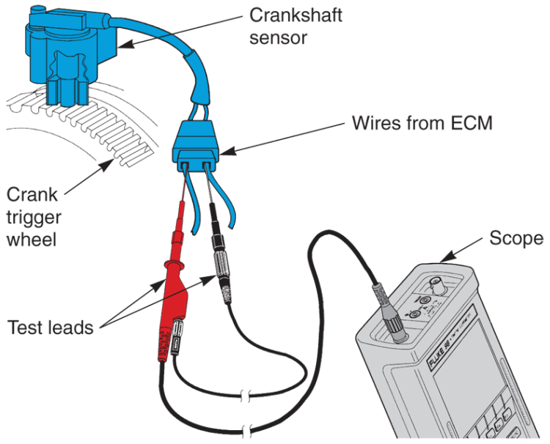
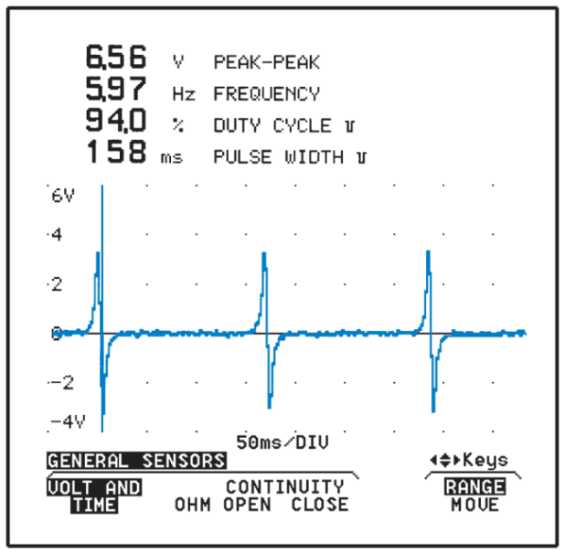
Crankshaft Position Sensor Scope Testing
Use needle probe on scope lead to check for output signal without disconnecting wires
(FMC)

Slide 38
Computer System Scope Tests
Throttle position sensor scope testing
  Open and close throttle, smooth curve in waveform with no spikes
Accelerator pedal sensor scope testing
  Accelerator sensor signals engine ECM to control engine speed and power by operating engine air throttle valve in throttle body
  Most accelerator sensors produce similar but opposite polarity signals as fail-safe system

Slide 39
Computer System Scope Tests (Cont.)
Manifold absolute pressure sensor scope testing
  Accelerate engine and note changes in airflow signals going to ECM
Mass airflow sensor scope testing
  To test analog or digital mass airflow sensors using scope, probe connector as recommended in service manual

Slide 40
Computer System Scope Tests (Cont.)
Knock sensor scope testing
  Connect scope test leads to sensor
  Tap lightly on metal bracket or cylinder block next to sensor with small hammer or wrench
Oxygen sensor scope testing
  Oscilloscope used to check signal produced by oxygen sensor

Slide 41
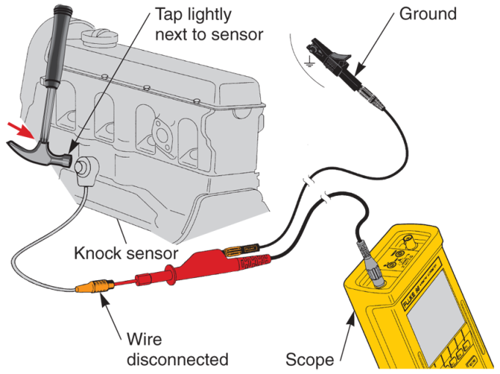
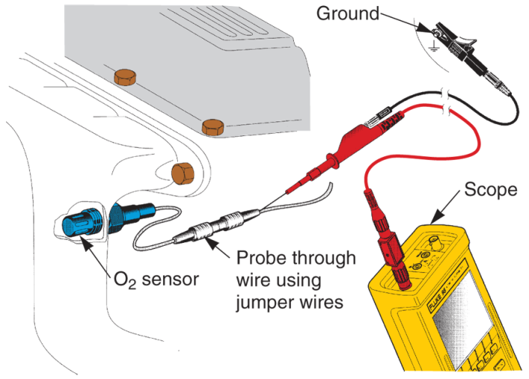
Computer System Scope Tests (Cont.)
(Fluke)

Slide 42
Computer System Scope Tests (Cont.)
ECM scope testing
  Scope can be used to check ac and dc voltages leaving electronic control module or ECM
Reference voltage test
  Involves using multimeter to measure actual voltages sent out by ECM to resistive sensors

Slide 43
ECM Reference Voltage Test
Remove any lower plastic covers or body trim pieces blocking access to engine ECM
Place needle probes on ends of voltmeter or scope test leads
Ground black test lead on good, bare metal ground near ECM
Use appropriate service manual illustration of ECM harness connector to find wires that should be carrying reference voltage

Slide 44
ECM Reference Voltage Test
(Cont.)
Turn ignition key in passenger compartment to Run so that 12 volts dc feeds to ECM from relay
Touch needle probe on your instrument to correct metal wire terminal inside ECM harness connector
Note exact reference voltage and condition of dc on waveform for each circuit

Slide 45
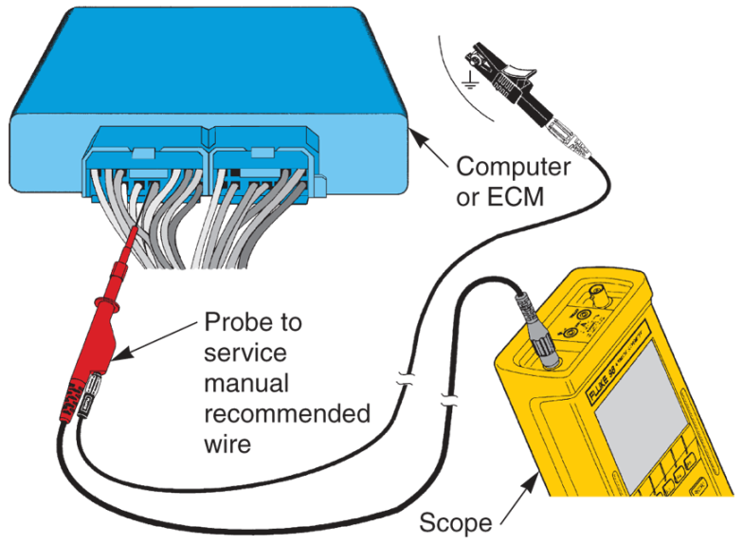
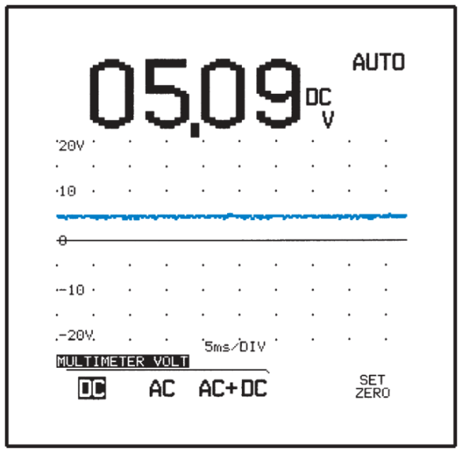
ECM Reference Voltage Test
(Cont.)
(Fluke)

Slide 46
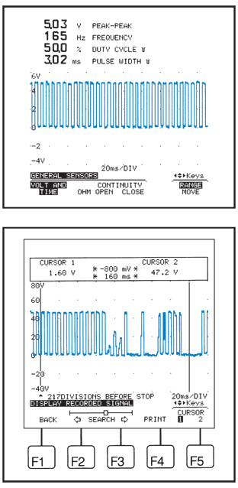
Flight Record Test
Flight record test
  Stores sensor or actuator waveform in scope’s memory when a problem occurs
(Fluke)

Slide 47
Diagnostic Laptop Computers and Tablets
Most advanced tool for diagnosing difficult-to-find problems on today’s vehicles
Combines many different diagnostic tools into a single application with computer interface
Scan tool, scope, etc.
Ignition load or acceleration test
  Measures spark plug firing voltages when engine speed rapidly increases

