Slide 1
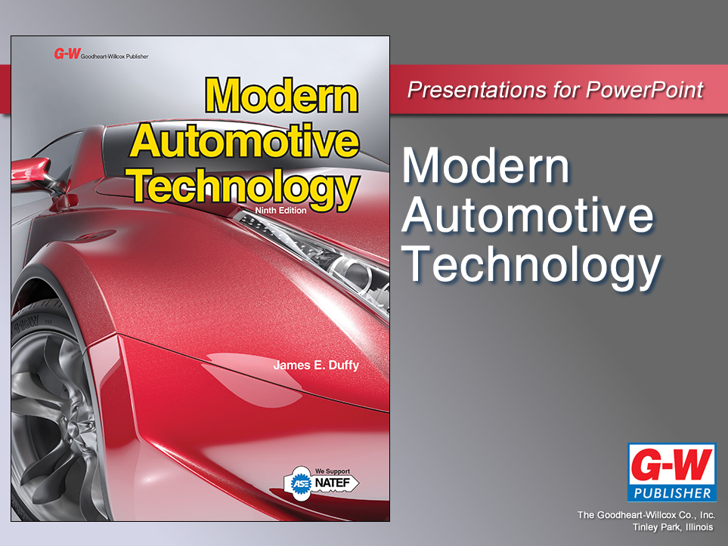

Slide 2
73
Chapter
Tire, Wheel, and Wheel Bearing Fundamentals

Slide 3
Objectives
After studying this chapter, you will be able to:
Identify the parts of a tire and wheel assembly.
Describe different methods of tire construction.
Explain types and sizes of tires.
Describe tire ratings and designations.
Describe different types of wheels.

Slide 4
Objectives
Define valve stems, valve cores, lug nuts, lug studs, and lug bolts.
Identify the parts of driving and nondriving hub and wheel bearing assemblies.
Correctly answer ASE certification test questions requiring a knowledge of tires, wheels, hubs, and wheel bearings.

Slide 5
Tires
Automobile tires perform two basic functions
Act as soft cushion between road and metal wheel
Provide adequate traction with road surface
Today’s automotive tires are pneumatic, or filled with air

Slide 6
Tires (Cont.)
Today’s vehicles use tubeless tires, which have no separate inner tube
Tire and wheel form airtight unit
Older vehicles used inner tubes
Soft, thin, leakproof rubber liners that fit inside tire and wheel assemblies

Slide 7
Parts of a Tire
Even with several designs, all tires have same basic parts
Beads
Two rings made of steel wire encased in rubber
Hold tire sidewalls snugly against wheel rim
Body plies
Rubberized fabric and cords wrapped around beads
Form carcass, or body, of tire

Slide 8
Parts of a Tire (Cont.)
Tread
Outer surface of tire that contacts road
Sidewall
Outer part of tire that extends from bead to tread
Markings on sidewall provide information about tire

Slide 9
Parts of a Tire (Cont.)
Belts
Strengthen body plies and stiffen tread
Lie between tread and plies
Liner
Thin layer of rubber bonded to inside of plies
Provides leakproof membrane for modern tubeless tire

Slide 10
Tire Construction
Many construction and design variations in tires
Different number of plies may be used
Plies may run at different angles
Different materials may be used
Rolling resistance
Measurement of friction produced as tire operates on road surface

Slide 11
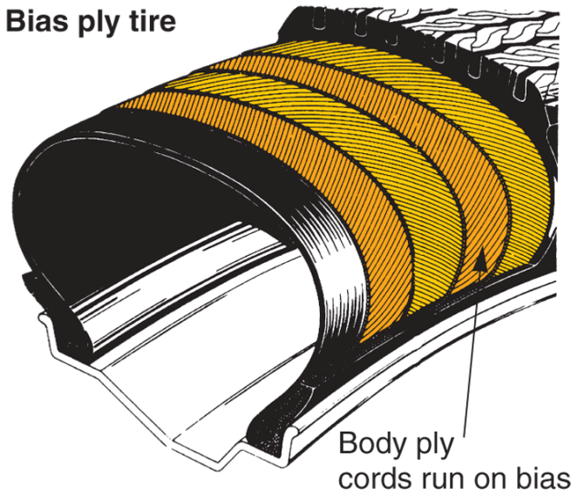
Bias Ply Tire
Plies run at angle from bead to bead
Angle reverses from ply to ply
Tread bonds directly to top ply
(Firestone)

Slide 12
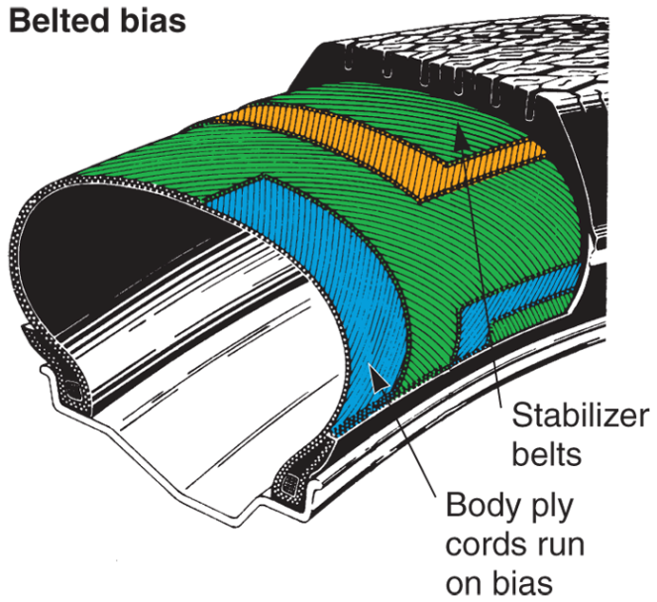
Belted Bias Tire
Bias ply tire with belts added to increase tread stiffness
Plies and belts normally run at different angles
Belts do not run around to sidewalls
They lie under tread area only
(Firestone)

Slide 13
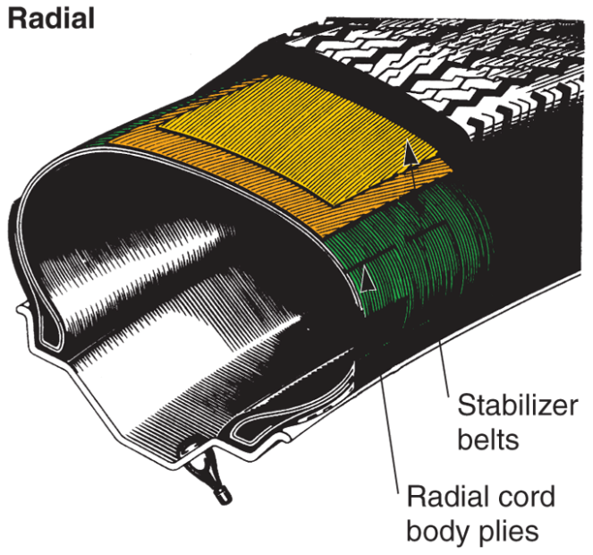
Radial Ply Tire
Plies running straight across from bead to bead, with stabilizer belts directly beneath tread
Very flexible sidewall and stiff tread for very stable footprint
Shape and amount of tread touching road surface
(Firestone)

Slide 14
Tire Markings
Tire markings on its sidewall give information
Tire size
Tire model
Load-carrying ability
Inflation pressure
Number of plies
Speed rating
Manufacturer

Slide 15
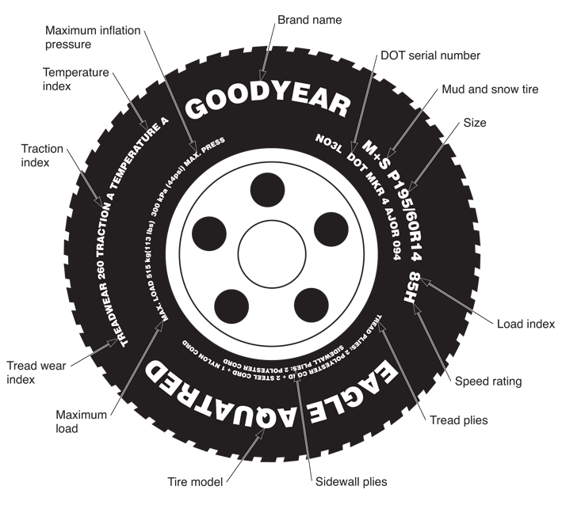
Tire Markings (Cont.)

Slide 16
Tire Size
Given on sidewall as letter-number sequence
Two common size designations
Alpha-numeric and P-metric
P-metric
Size designation is newest tire identification system
It uses metric values and international standards

Slide 17
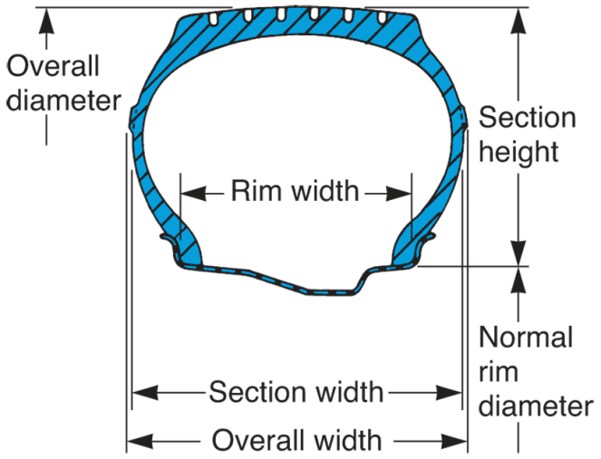
Tire Size (Cont.)
Alpha-numeric
Tire size designation uses letters and numbers to denote tire size in inches and its load-carrying capacity in pounds
Points of measure for tire are shown on right
(B.F. Goodrich)

Slide 18
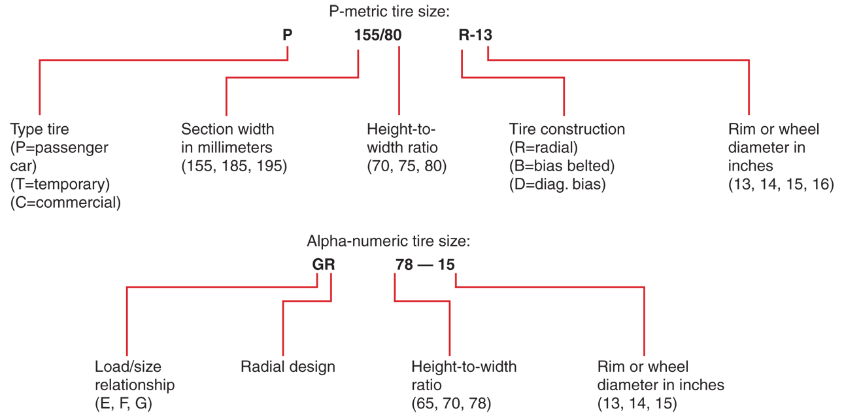
Tire Size (Cont.)

Slide 19
Aspect Ratio
Height-to-width ratio
As number becomes smaller, tire becomes more squat
Wider and shorter
Aspect ratio compares tire’s height and width

Slide 20
Aspect Ratio (Cont.)
70-series tire, for example, has aspect ratio of 70
Height of tire is 70 percent of width
60 series tire would be “short” and “fat”
78 tire would be “narrow” and “tall”

Slide 21
Maximum Load Rating
Indicates weight tire can carry at recommended inflation pressure
Printed on sidewall
P-metric ratings given in kilograms and pounds
Alpha-numeric load rating indicated by letter
Most are load range B.
C or D have greater load carrying ability

Slide 22
Maximum Inflation Pressure
Maximum inflation pressure
Highest air pressure that should be pumped into tire
Most have maximum recommended inflation pressure of 32 psi
Tires with higher load ranges can hold higher pressures and carry more weight

Slide 23
Tread Plies
Plies and ply ratings shown on sidewall
Tire may be 2-ply tire, 2-ply with 4-ply rating, or 4-ply tire
Greater number of plies or higher ply rating generally indicate greater load-carrying ability
Number of sidewall plies also shown on tire sidewall

Slide 24
DOT Serial Number
DOT stands for Department Of Transportation
“DOT” on tire sidewall indicates tire passed prescribed safety tests
Following letters DOT is DOT serial number
Identifies particular tire manufacturer, plant location, construction, and date of manufacture
DOT serial number stamped into tire sidewall

Slide 25
Tire Grades
Tread wear
Ratings range from 100 to 500
Tires with higher numbers = more resistant to wear
Tire traction
A, B, or C rating with “A” providing most traction “C” providing least
Tire temperature resistance
A, B, or C rating, “A” resists temperature buildup better than “B” or “C” tires

Slide 26
Speed Rating
Tire speed rating
Maximum allowable sustained road speed a tire can safely withstand without failure
Range from B (31 mph) to Z (149 mph)
Tire’s speed rating of tire must be higher than speed at which vehicle will be driven

Slide 27
Special Tires and Tire Features
Be familiar with several types of special tires and tire features
Compact spare tires
Self-sealing tires
Retreads
Run-flat tires

Slide 28
Asymmetric Tires
Different tread pattern on inner edge than outer edge
Outer tread pattern designed to improve cornering on dry surfaces
Inner tread pattern designed to improve traction on wet surfaces

Slide 29
Directional Tires
High-performance tires designed to rotate in specific direction to minimize hydroplaning
Hydroplaning
Loss of control that occurs when layer of water prevents tire tread from contacting road surface
Directional tires have arrow and the word rotation molded onto sidewalls

Slide 30
Spare Tires
Spare tire or spare
Extra wheel and tire assembly that can be installed in case of flat tire
Full-size spare
Tire of same size and type used on other four wheels of vehicle
Can be mounted and used like any other tire
Compact or space saver spare
Much smaller than normal tire used on vehicle
Saves space in trunk or storage area

Slide 31
Spare Tires (Cont.)
High-pressure spare
Compact spare tire that holds higher-than-normal air pressure
About 60 psi
Lightweight spare tire
Very thin sidewall and tread construction
Driving range and maximum speed rating are generally lower than compact spare

Slide 32
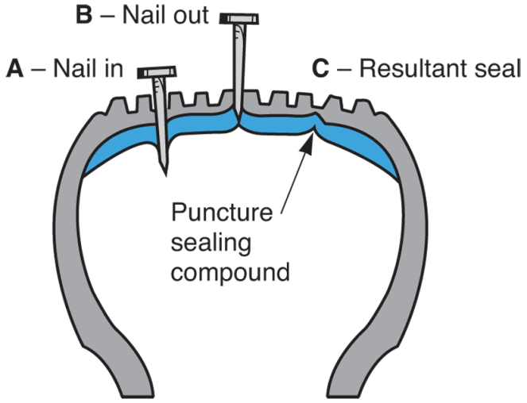
Self-Sealing Tires
Have coating of sealing compound applied to liners
When punctuated, air pressure pushes soft compound into hole to stop air leakage

Slide 33
Retreads
Used tires with new tread vulcanized to old carcass, or body
Retreads, also called recaps, seldom used on passenger cars
Large truck tires frequently recapped because of high cost of new tires

Slide 34
Run-Flat Tires
Are still usable with loss of air pressure
If tire leaks, you can drive vehicle to repair shop without tire and wheel damage
Tire uses special rubber compound and thick rubber sidewall support insert that helps support weight of vehicle

Slide 35
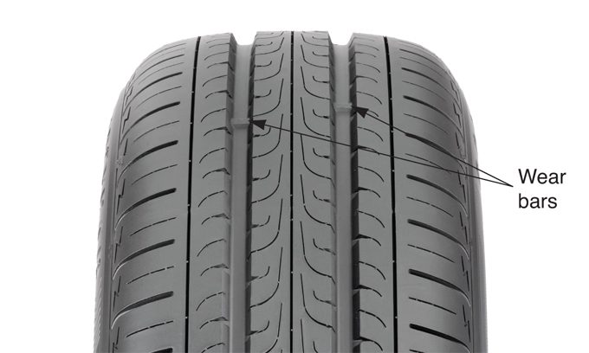
Wear Bars
Indicate critical amount of tread wear
Tell customer and technician that tire replacement is needed
(Goodyear)

Slide 36
Tire Pressure Monitoring Systems
Alert driver if one or more tires are underinflated
Direct tire pressure monitoring systems
Use pressure sensor/transmitter mounted at each wheel
Sensors are attached to tire valves or held to wheel with metal or plastic strap

Slide 37
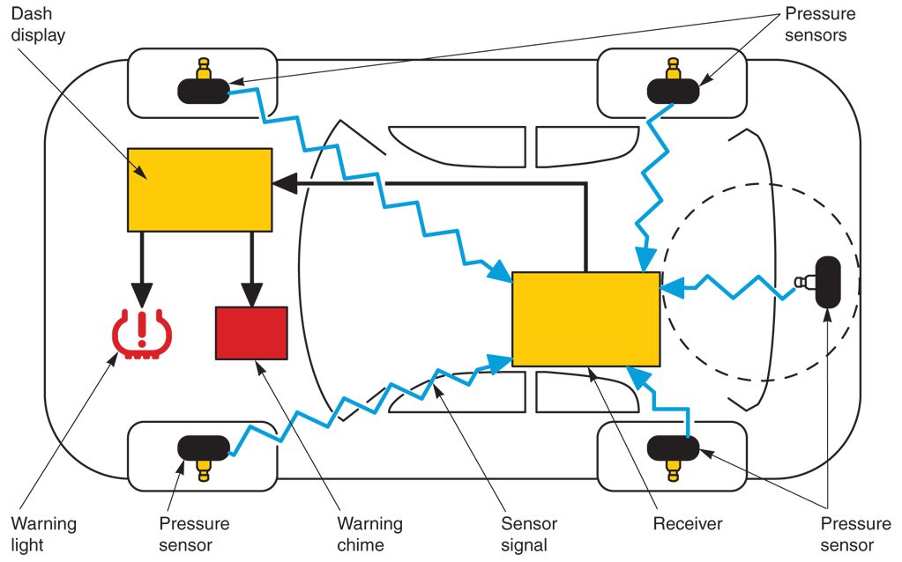
Tire Pressure Monitoring Systems (Cont.)
(Toyota)

Slide 38
Tire Pressure Monitoring Systems (Cont.)
Indirect tire pressure monitoring system
Anti-lock brake system components monitor tire pressure
When pressure in tire drops, tire’s circumference is reduced
This causes wheel and tire assembly to spin faster than other tires
Computer interprets speed sensor signal and triggers warning light

Slide 39
Wheels
Designed to support tire while withstanding loads from acceleration, braking, and cornering
Mag wheels, or mags
Nickname for aluminum or magnesium wheels
These wheels do not need wheel covers
Drop-center wheel
Commonly used on passenger vehicles
Allows for easier installation and removal of tire

Slide 40
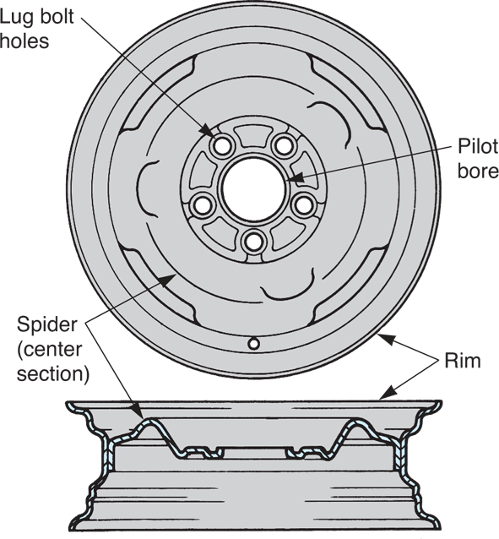
Wheels (Cont.)
Outer lip that contacts tire bead
Spider
Center section that bolts to vehicle hub
Normally, spider is welded to rim

Slide 41
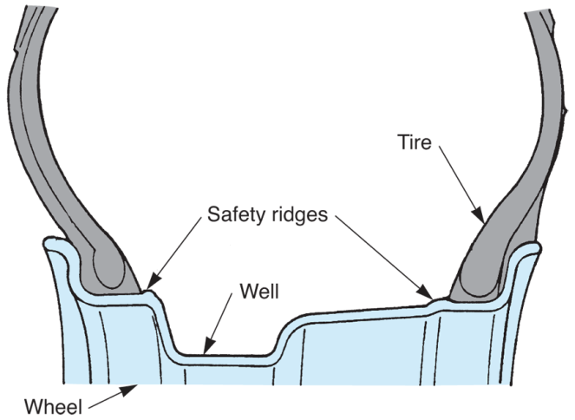
Safety Rims
Has small ridges that hold tire beads on wheel during tire blowout or flat
Blowout
Instant rupture and air loss
Flat
Slow leak reduces inflation pressure
(Chrysler)

Slide 42
Valve Stems and Cores
Valve stem
Pressed into hole in wheel of tubeless tire to allow inflation and deflation
Valve core
Spring-loaded air valve threaded into valve stem
Allows air to be added to tire when air chuck is placed over valve stem

Slide 43
Valve Stems and Cores (Cont.)
Air chuck
Tool for filling tire with air
Valve stem cap
Screws over threaded valve stem to protect air valve and stem threads from dirt, moisture, and damage
Prevents accidental depression of valve and resulting loss of air pressure

Slide 44
Lug Nuts, Studs, and Bolts
Lug nuts
Hold wheel and tire assembly on vehicle
They fasten to special studs
Lug studs
Special studs that accept lug nuts
Studs are pressed through back of hub or axle flange

Slide 45
Lug Nuts, Studs, and Bolts (Cont.)
Lug nuts and studs normally have right-hand threads (turn clockwise to tighten)
Left-hand threads will be marked with “L”
Metric threads will be identified with “M” or word “Metric”
A few cars use lug bolts instead of lug nuts
Bolts screw into threaded holes in hub or axle flange

Slide 46
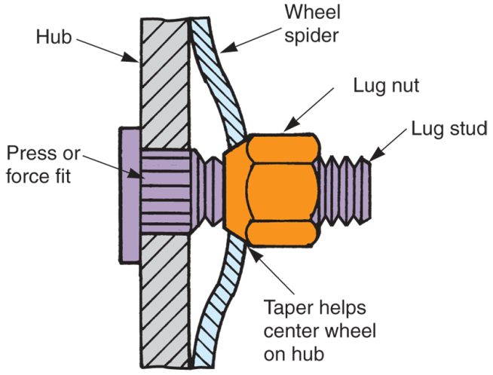
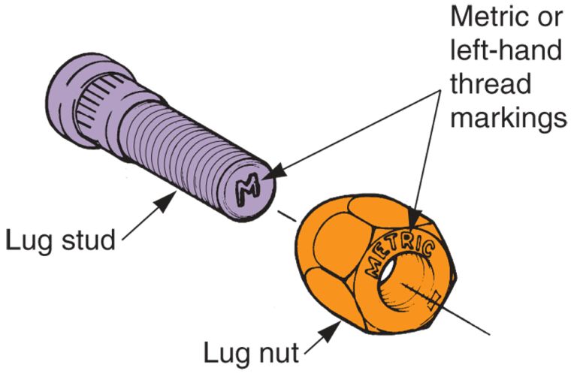
Lug Nuts, Studs, and Bolts (Cont.)

Slide 47
Wheel Weights
Small lead weights attached to wheel rim to balance wheel-and-tire assembly, preventing vibration
Weights offset a heavy area of wheel and tire
Aluminum wheels require stick-on lead weights with adhesive backing

Slide 48
Hub and Wheel Bearing Assemblies
Wheel bearings
Allow wheel to turn freely around spindle, in steering knuckle, or in bearing support
Two basic assembly designs
Tapered roller bearing assemblies
Ball or straight roller bearing assemblies
Wheel bearings are lubricated with heavy, high-temperature grease

Slide 49
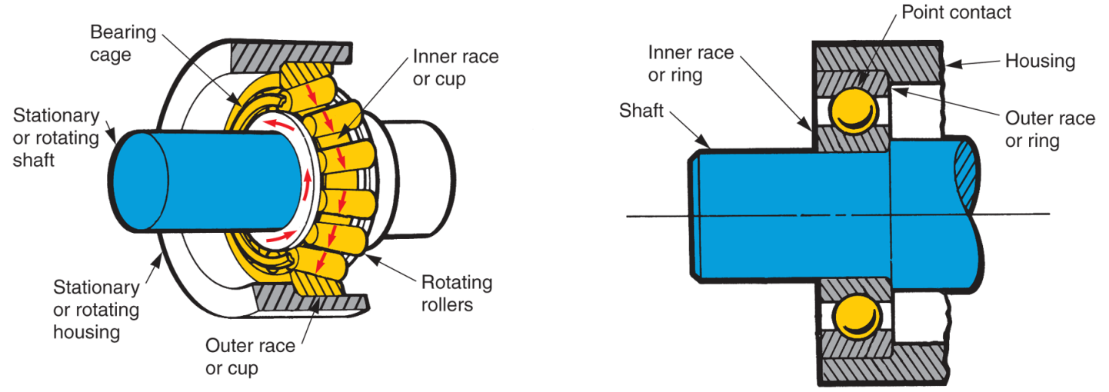
Hub and Wheel Bearing Assemblies (Cont.)
(Federal Mogul)

Slide 50
Hub and Wheel Bearing Assemblies (Cont.)
Basic parts of wheel bearing
Outer race
Steel cup or cone pressed into hub, steering knuckle, or bearing support
Balls or rollers
Antifriction elements between inner and outer races
Inner race
Another steel cup or cone that rests on spindle or drive axle shaft

Slide 51
Hub and Wheel Bearing Assembly: Tapered Roller Bearings
Basic parts of hub and tapered roller bearing assembly for non-driving wheels include
Spindle
Stationary shaft extending outward from steering knuckle or suspension system
Wheel bearings
Tapered roller bearings mounted on spindle and in wheel hub

Slide 52
Hub and Wheel Bearing Assembly: Tapered Roller Bearings (Cont.)
Hub
Outer housing that holds brake disc or drum, front wheel, grease, and wheel bearings
Grease seal
Prevents loss of lubricant from inner end of spindle and hub
Safety washer
Flat washer that keeps outer wheel bearing from rubbing on and turning adjusting nut

Slide 53
Hub and Wheel Bearing Assembly: Tapered Roller Bearings (Cont.)
Spindle adjusting nut
Threaded on end of spindle for adjusting wheel bearing
Nut lock
Thin, slotted nut that fits over spindle adjusting nut
Cotter pin
Fits through hole in spindle, adjusting nut, and nut to lock to keep adjusting nut from turning in service
Dust cap
Metal cap that fits over outer end of hub to keep grease in and road dirt out of bearings

Slide 54
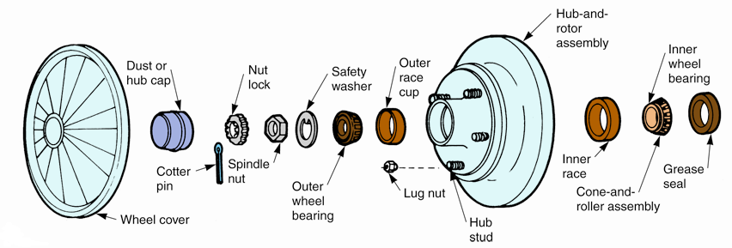
Hub and Wheel Bearing Assembly: Tapered Roller Bearings (Cont.)
(Chrysler, Florida Dept. of Voc. Ed.)

Slide 55
Hub and Wheel Bearing Assembly: Ball or Straight Roller Bearings
Basic parts found in hub and wheel bearing assembly for driving wheel of front-wheel-drive vehicle
Outer drive axle
Stub axle shaft that extends through bearings and splines to hub
Ball bearings
Antifriction elements that allow drive axle to turn in steering knuckle or bearing support

Slide 56
Hub and Wheel Bearing Assembly: Ball or Straight Roller Bearings (Cont.)
Steering knuckle or bearing support
Steering or suspension component that holds wheel bearings, axle stub shaft, and hub
Driving hub
Mounting surface for wheel
Transfers driving power from stub axle to wheel
Axle washer
Special washer that fits between hub and locknut

Slide 57
Hub and Wheel Bearing Assembly: Ball or Straight Roller Bearings (Cont.)
Hub or axle locknut
Screws on end of drive axle stub shaft to secure hub and other parts of assembly
Grease seal
Prevents lubricant loss between inside of axle and knuckle or bearing support

Slide 58
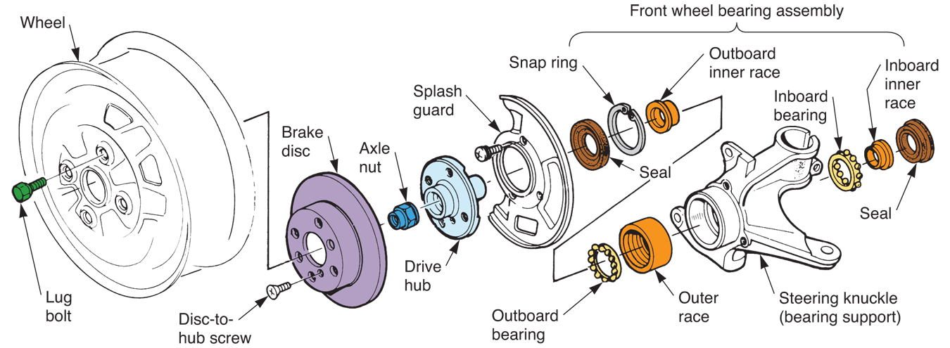
Hub and Wheel Bearing Assembly: Ball or Straight Roller Bearings (Cont.)
(Honda)

Slide 59
Other Hub and Wheel Bearing Assemblies
Modern vehicles use wide variation of hub and wheel bearing assemblies
Many late-model vehicles use sealed hub and bearing assembly that contains ball bearings, straight roller bearings, or tapered roller bearings
These self-contained units are not serviceable

