Slide 1
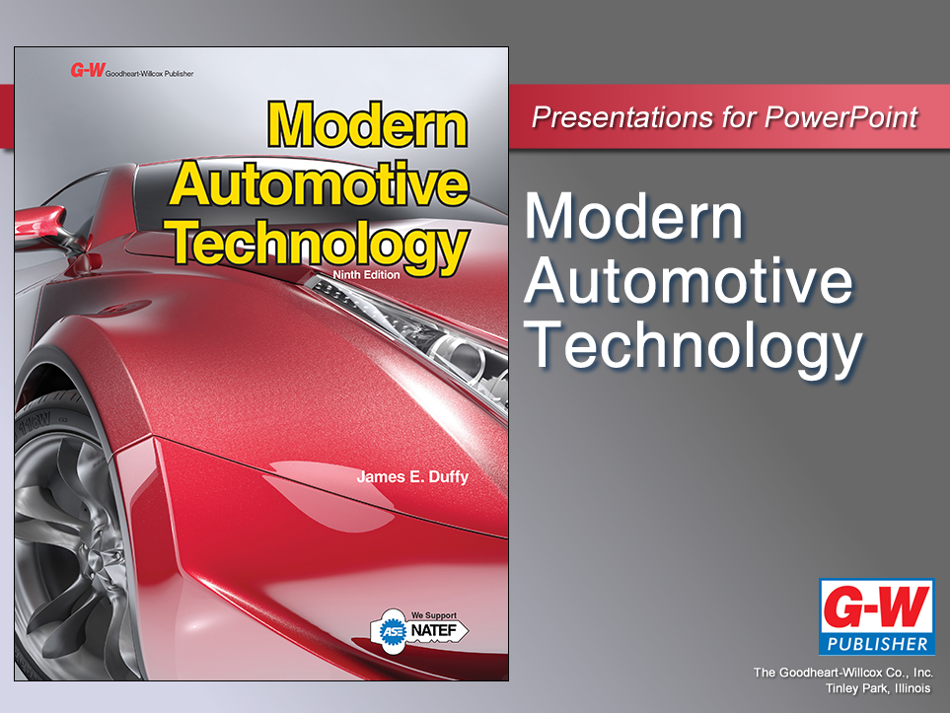

Slide 2
74
Chapter
Tire, Wheel, and Wheel Bearing Diagnosis, Service, and Repair

Slide 3
Objectives
After studying this chapter, you will be able to:
Diagnose common tire, wheel, and wheel bearing problems.
Describe tire inflation and rotation procedures.
Measure tire and wheel runout.
Explain static and dynamic wheel balance.
Summarize different methods of balancing wheels and tires.

Slide 4
Objectives
Use safe practices while servicing tires and wheels.
Replace and reprogram tire pressure sensors.
Explain service procedures for wheel bearings.
Correctly answer ASE certification test questions requiring a knowledge of the service and repair of tires, wheels, and wheel bearings.

Slide 5
Tire, Wheel, and Wheel Bearing Diagnosis
Tire problems usually show up as vibrations, abnormal tread wear patterns, steering wheel pull, abnormal noises, and other symptoms
Test drive vehicle to verify customer complaint
Make sure symptoms are not caused by steering, suspension, or front wheel alignment problems

Slide 6
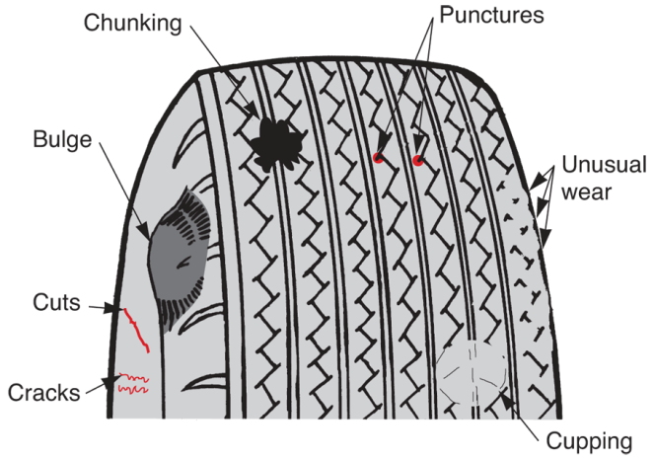
Tire, Wheel, and Wheel Bearing Diagnosis (Cont.)
Inspect tires
Bulges
Splits
Cracks
Chunking
Cupping of tread
Signs of damage or abnormal wear
(Florida Dept. of Voc. Ed.)

Slide 7
Tire, Wheel, and Wheel Bearing Diagnosis (Cont.)
Look closely at outer sidewall, tread area, and inner sidewall
Tire tread measuring less than about 1/8″ is considered worn
Both dry and wet stopping distances increase with tread this shallow

Slide 8
Tire Impact Damage
Tire impact damage or road damage includes
Punctures
Cuts
Tears
Physical tire injuries
Drivers often run over road debris, potholes, hit curbs, and impact other objects that cause premature tire failures

Slide 9
Tire Wear Patterns
Area of tread worn off
Can usually be studied to determine cause of abnormal wear
Causes of excessive tire wear
Improper tire inflation
Ply separation
Incorrect wheel alignment
Lack of periodic tire rotation
Out of balance condition
Worn steering and suspension parts should be repaired before tire replacement

Slide 10
Tire Inflation Problems
Correct tire inflation pressure is important to tire’s service life
Underinflation
Common and destructive problem that wears outer corners of tread area
Ply separation
Ply separation causes tire sidewalls to bulge outward and form air bubble in sidewall

Slide 11
Tire Inflation Problems (Cont.)
Overinflation
Causes center area of tread to wear
High pressure causes body of tire to stretch outward
Steering wheel pull
Caused by uneven tire inflation
If left front tire is underinflated, car will pull to left

Slide 12
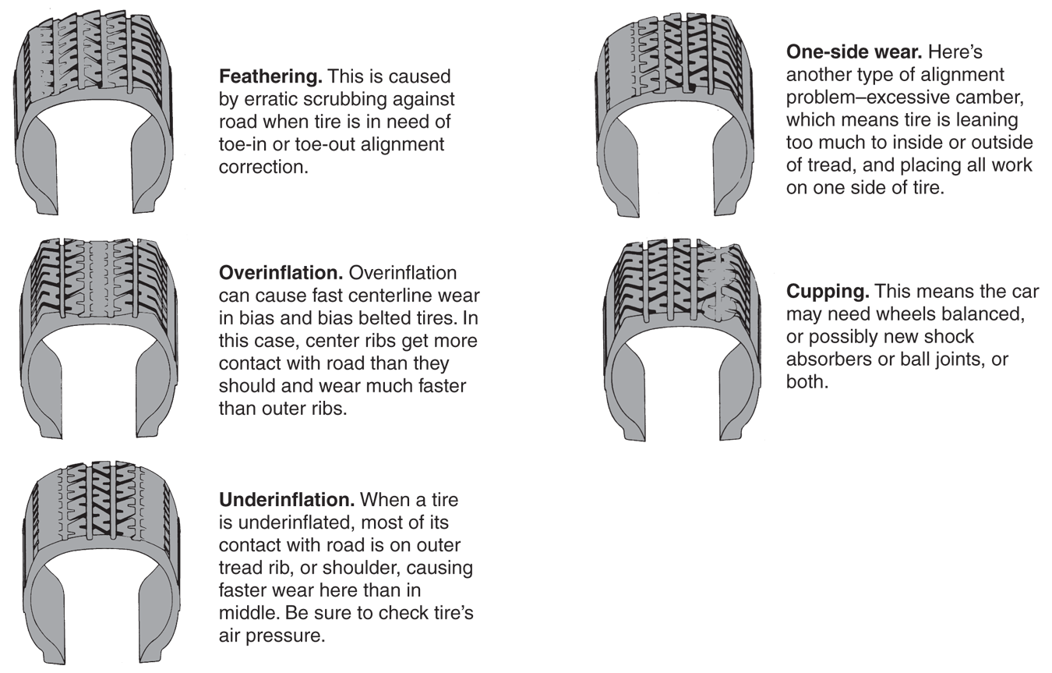
Tire Inflation Problems (Cont.)
(Goodyear)

Slide 13
Tire Vibration Problems
Out-of-balance condition
Ply separation
Excessive tire runout
Bent wheel
Tire stiffness variation
Tire cupping

Slide 14
Tire and Wheel Bearing Noise
Two tire noises
Thumping sound caused by ply separation
Whine due to abnormal tread wear
Inspect tire for out-of-round condition or tread cupping
Replace tires to correct these problems

Slide 15
Tire and Wheel Bearing Noise (Cont.)
Wheel bearing noise
Normally produced by dry, worn, or damaged wheel bearing
To check for worn or loose wheel bearing
Raise and secure vehicle
Rotate tire by hand while listening to it with a stethoscope
Feel and listen carefully for bearing roughness
Wiggle tire back and forth to check for bearing looseness

Slide 16
Wheel Cover and Cap Service
Wheel cover
Large metal or plastic decorative cover for the wheel
Press-fit over the wheel rim to hide the lug nuts, dust cap, and other parts
Wheel cap
Small metal or plastic cover in the center of a wheel
Commonly used on aluminum wheels to hide the spindle nut and cap

Slide 17
Tire Maintenance
Tire maintenance involves
Periodic inspection
Checking of inflation pressure
Rotation
These preventive maintenance steps will help ensure vehicle safety and longer tire life

Slide 18
Periodic Inspection
Periodic tire inspection involves visually checking condition of tires
Look for anything that could affect dependability of tires
Raise vehicle
Most tire damage and normal wear is on inner edge of tread, which is impossible to see with vehicle on ground

Slide 19
Checking Tire Inflation Pressure
Unscrew and remove valve stem cap
Press tire pressure gauge squarely over valve stem
Use your fingers to hold tool square as you push down to compress valve core spring
Read air pressure indicated on gauge

Slide 20
Checking Tire Inflation Pressure (Cont.)
Compare reading to recommended maximum tire pressure printed on tire’s sidewall or given by vehicle manufacturer
If tire pressure is low, add air
If pressure is high, press in on valve core pin to release air from tire
Recheck tire pressure and add or release air as necessary
Reinstall valve stem cap snugly

Slide 21
Rotating Tires
Tire rotation
Involves changing location of tires on vehicle to ensure maximum tire life
Rotation helps even out tire wear and prevents premature failure of any one tire
Generally, tires should be rotated at intervals suggested by tire manufacturer
Typically every 3000 miles

Slide 22
Torquing Lug Nuts
Lug nut torque (tightening force) is very important, especially on vehicles equipped with mag wheels and lightweight hubs
Overtorquing
Can cause wheel or hub distortion, excessive runout, and vibration
Undertorquing
Might allow lug nuts to loosen and wheel to fall off

Slide 23
Replacing Lug Studs
Force out old stud with pressing tool or hydraulic press
Do not use a hammer, it could damage wheel bearing
Install new stud using flat washers and lug nut
Draw new stud into place by tightening nut on washers
Make sure stud is fully seated

Slide 24
Measuring Tire and Wheel Runout
Tire runout or wobble
Caused by faulty tire
Ply separation or manufacturing defect
Wheel runout or wobble
Caused by impact damage or incorrect welding of the spider and rim
When you suspect minor runout problem, use dial indicator to measure tire and wheel runout
Turn tire by hand, note indicator reading

Slide 25
Measuring Tire and Wheel Runout
Lateral runout
Side-to-side movement
Measured by placing dial indicator against side of rim or on tire sidewall
Radial runout
Caused by difference in radius from center axis of rotation
Measured by placing dial indicator on tire tread and on inner part of rim

Slide 26
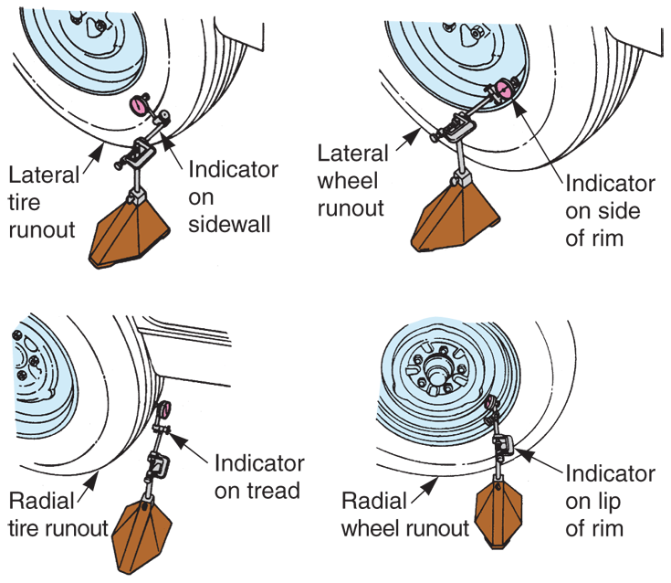
Measuring Tire and Wheel Runout (Cont.)
(Florida Dept. of Voc. Ed.)

Slide 27
Wheel Balance
Improper wheel balance
One of most common causes of tire and steering wheel vibration
Static imbalance
Called wheel tramp or hop
Causes tire to vibrate up and down
Dynamic imbalance
Causes
Wheel hop
Wheel shimmy (side-to-side movement)

Slide 28
Wheel Balancing
Involves adding wheel weights to side opposite heavy area found on wheel/tire assembly
To static balance wheel and tire assembly, add wheel weights opposite heavy area of wheel
To dynamically balance wheel and tire, add weights exactly where needed

Slide 29
Wheel Balancing (Cont.)
When balancing wheel assembly, follow these safety rules
Wear eye protection when spinning wheel and tire assembly
Remove rocks and other debris from tire tread before balancing wheel assembly
Follow operating instructions provided with wheel balancing equipment

Slide 30
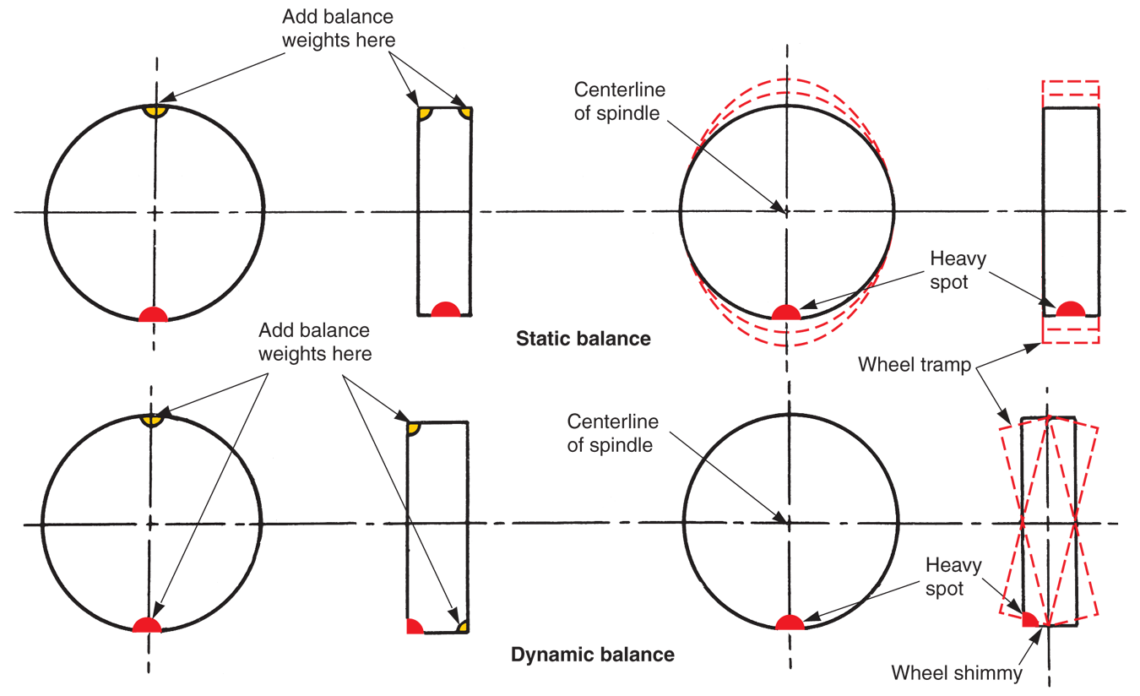
Wheel Balancing (Cont.)
(Chrysler)

Slide 31
Wheel Balancing Machines
Wheel balancing machine
Used to determine which area of wheel/tire assembly is heavy
Bubble balancer
Will static balance wheel and tire assembly
Wheel and tire assembly must be removed from car and placed on balancer
Indicating bubble on machine is then used to locate heavy area of assembly

Slide 32
Wheel Balancing Machines (Cont.)
Off-car balancer
Can either be static- or dynamic-type machine
Wheel and tire assembly mounted on balancer and spun

Slide 33
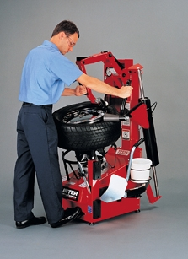
Mounting and Dismounting Tires
Tire changing machine or tire changer
Used to force rubber tire on and off metal wheel
Pneumatic bead breaker is used first to force tire bead away from wheel rim
(Hunter Engineering Co.)

Slide 34
Mounting and Dismounting Tires (Cont.)
Rules to follow when mounting or dismounting tires include
Wear eye protection and remove valve core before breaking bead away from wheel
Keep your fingers out of the way when removing tire from wheel
Never mount tire on rim that is not smooth and clean

Slide 35
Mounting and Dismounting Tires (Cont.)
Always lubricate tire bead and wheel flange with proper before mounting tire
Use care when mounting or dismounting tires on wheels equipped with air pressure sensors
Do not inflate tire when it is lying on floor
Stand away from tire when adding air after mounting

Slide 36
Mounting and Dismounting Tires (Cont.)
Do not exceed 40–50 when initially inflating tire
After initial inflation, install core and inflate tire to recommended pressure

Slide 37
Tire Puncture Repair
Remove tire from rim
After dismounting tire, inspect inside surface carefully to locate puncture and to determine nature and extent of damage
Fill injury using recommended plug or liquid sealant

Slide 38
Tire Puncture Repair (Cont.)
Select patch that extends well beyond damaged area, so it will adhere properly to inner liner and withstand heat and mechanical stresses of tire use
Scuff area that patch will cover, so that it will adhere tightly
Apply proper cement to inner liner, following repair kit directions

Slide 39
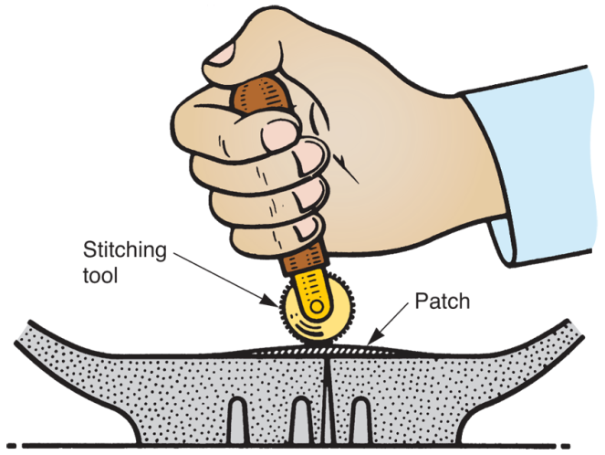
Tire Puncture Repair (Cont.)
Remove covering from adhesive side of patch and carefully place patch on inner liner
Use stitcher tool to tightly bond patch to inner liner
(Hunter Engineering Co.)

Slide 40
Tubeless Tire Repair
Basic rules for tubeless tire repair
Do not attempt to repair puncture by plugging it from outside of tire
Always dismount tire and patch inner liner
Never attempt to repair sidewalls or tires with punctures larger than 1/2″ in diameter
When removing an object from tire, reduce air pressure to at least 15 psi

Slide 41
Tubeless Tire Repair (Cont.)
Broken strands in steel belted tires may indicate serious damage
Broken strands could puncture patch or plug, causing serious tire failure
Follow exact procedures given with tire repair kit

Slide 42
Tire Pressure Monitoring System Service
Two types of tire pressure monitoring systems
Direct systems
Indirect systems
If tire in direct system has low air pressure but system does not activate, suspect tire pressure sensors
These sensors are battery operated and batteries can become drained after long period of service

Slide 43
Tire Pressure Monitoring System Service (Cont.)
In most cases, sensor must be replaced when its battery becomes discharged
If sensors are working properly, problem may be in receiver, warning light, or wiring between receiver and warning light
When installing new drop center-mounted sensor, position new sensor 180° from valve stem

Slide 44
Tire Pressure Monitoring System Service (Cont.)
When installing valve-mounted sensor, use new stem seals and torque stem retaining nut to specifications to prevent leaks and damage to sensor
After sensor is replaced or vehicle’s tires are rotated, sensors must be calibrated using dedicated calibration tool so receiver recognizes which sensor is at which wheel

Slide 45
Tire Pressure Monitoring System Service (Cont.)
Problems in indirect tire pressure monitoring systems are often caused by faulty wheel speed sensors
Malfunctions in indirect systems generally also cause anti-lock brake system malfunctions
In most cases, these systems can be diagnosed using scan tool

Slide 46
Wheel Bearing Service
Wheel bearings are normally filled with grease
If this grease dries out, bearing will fail
Check wheel bearings for wear when performing wheel- or tire-related service
Some wheel bearings can be disassembled and packed with grease
Others are sealed units that require replacement when worn

Slide 47
Servicing Tapered Roller Bearings
Partially loosen lug nuts
Raise vehicle and secure it on jack stands
Remove wheel, grease cap, cotter pin, nut lock, adjusting nut, and safety washer
Wiggle hub and pull out outer wheel bearing

Slide 48
Servicing Tapered Roller Bearings (Cont.)
Screw adjusting nut back onto spindle
Unbolt brake caliper and secure it to one side, if needed
Slide hub outward on spindle
Wipe bearings and races clean
Keep bearings in order, because they must be reinstalled in same races

Slide 49
Servicing Tapered Roller Bearings (Cont.)
Inspect bearings and races for damage
If problems are found, you must replace both bearing and race as a set
Wipe out all old grease from inside of hub
Partially fill cavity with new wheel bearing grease
To pack bearings, use your hands or bearing packer

Slide 50
Servicing Tapered Roller Bearings (Cont.)
Place inner bearing into its race
Using seal driver, install new grease seal in hub
If seal driver is not available, drive seal into hub with light taps from hammer
Wipe spindle clean
Slide hub into position and install outer bearing

Slide 51
Servicing Tapered Roller Bearings (Cont.)
Fit safety washer against bearing and screw on adjusting nut
Tighten adjusting nut as described in service manual
Install nut lock
Install and bend new cotter pin
Force dust cap back into hub to protect bearings for road dirt or water

Slide 52
Servicing Ball or Straight Roller Bearings
Loosen wheel lug nuts and spindle nut
Raise vehicle and secure it on jack stands
Remove lug nut or bolts, wheel, and axle nut
Remove caliper and hang it to one side
Unbolt brake disc from hub, if needed

Slide 53
Servicing Ball or Straight Roller Bearings (Cont.)
Remove steering knuckle and hub assembly from vehicle
Depending on design of hub, remove hub either before or after removing steering knuckle
After hub removal, remove bearing using hydraulic press or driver
Before installing new bearings, pack them with grease if not sealed units

Slide 54
Servicing Ball or Straight Roller Bearings (Cont.)
Force new bearings into place with press or driving tool
After pressing or driving bearings into steering knuckle or bearing support, install new grease seal
Coat inner lip of grease seal with grease and outer diameter with sealer
Use seal driving tool and light hammer taps to force seal into hub

Slide 55
Servicing Ball or Straight Roller Bearings (Cont.)
Press hub into steering knuckle and wheel bearing assembly, if needed
When pressing wheel bearing in or out, apply force to correct bearing race
Bearing damage will result if incorrect race is pressed and jammed into bearings
After assembling wheel bearings, install steering knuckle assembly on vehicle

Slide 56
Servicing Ball or Straight Roller Bearings (Cont.)
Install brake disc, caliper, and other components
Make sure spindle nut is tightened to specifications
You may need to stake spindle nut or install new lock nut and new cotter pin

Slide 57
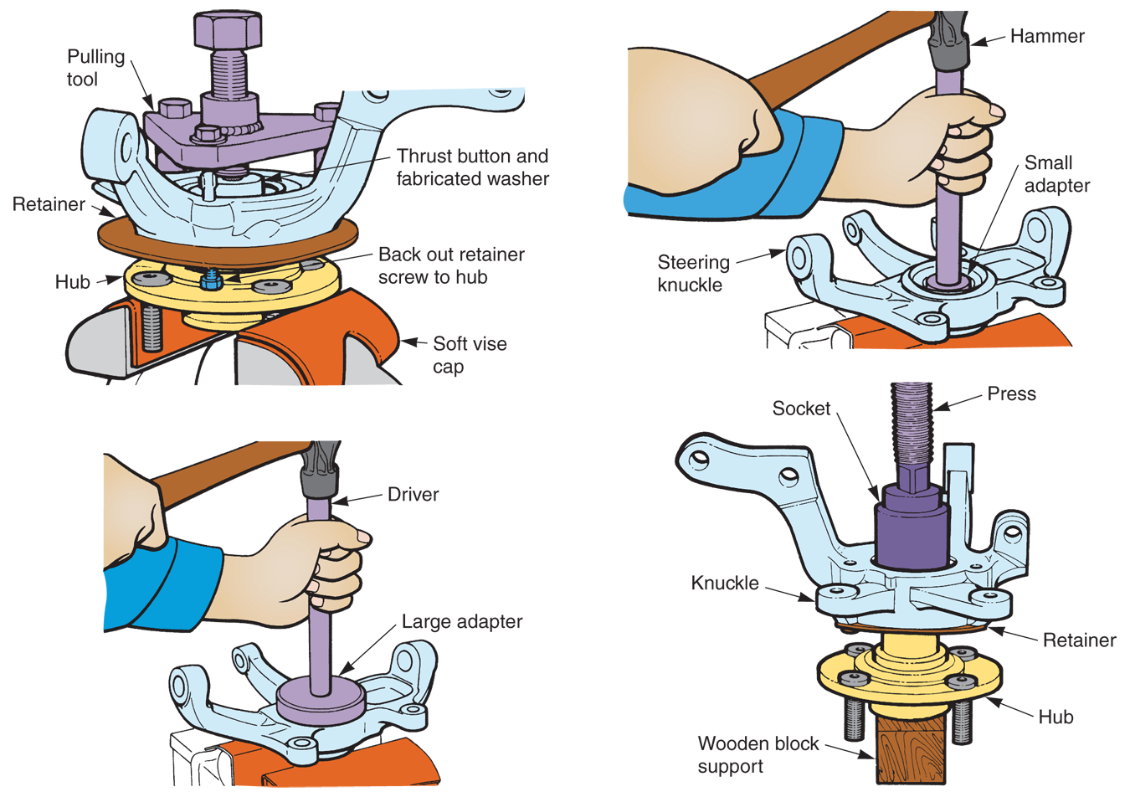
Servicing Ball or Straight Roller Bearings (Cont.)

Slide 58
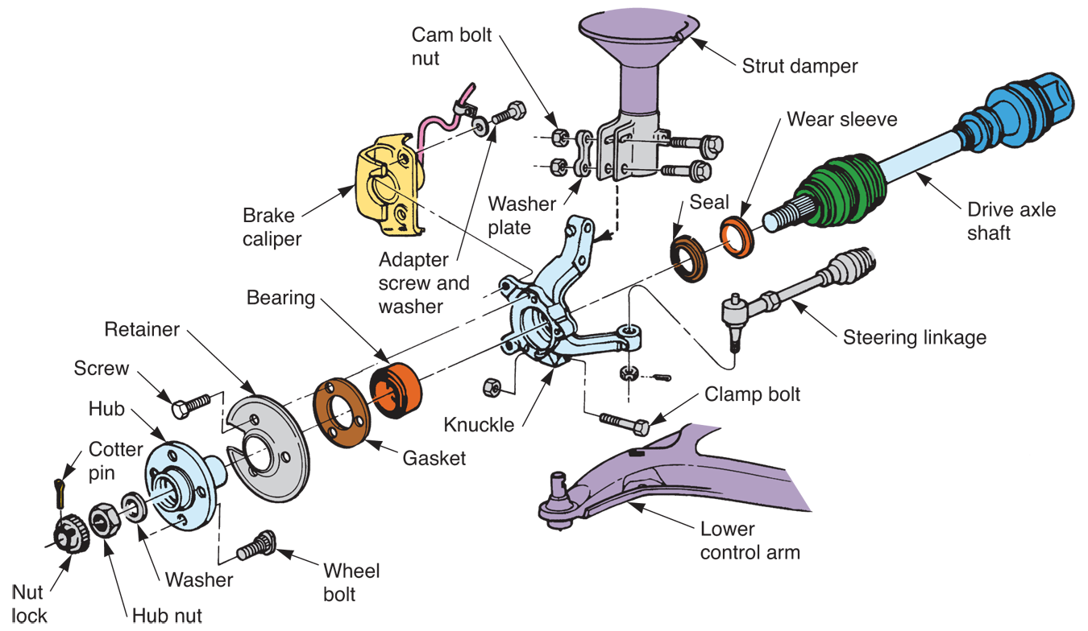
Driving Hub Assembly
(Chrysler)

Slide 59
Replacing Nonserviceable Hub and Bearing Assembly
Remove bolts holding bearing and hub assembly to vehicle
When installing new hub and bearing assembly, torque bolts to specifications

