Slide 1
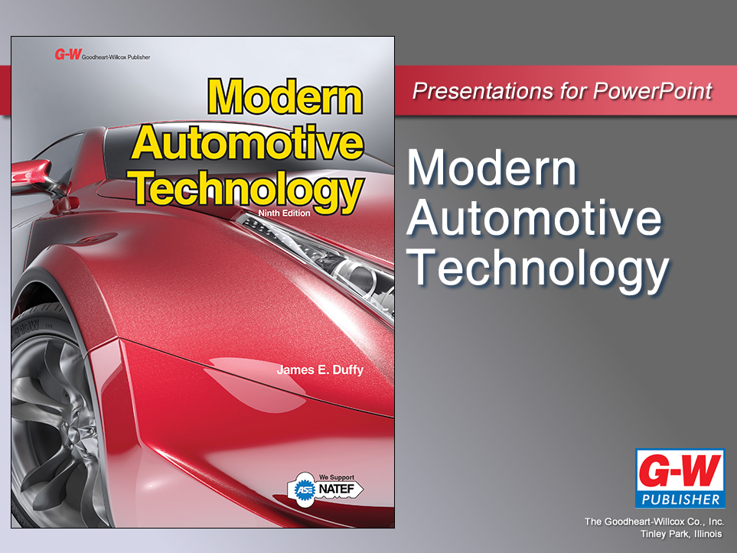

Slide 2
76
Chapter
Suspension System Diagnosis and Repair

Slide 3
Objectives
After studying this chapter, you will be able to:
Diagnose problems relating to a suspension system.
Replace shock absorbers and ball joints.
Describe the removal and replacement of springs.
Replace control arm bushings.

Slide 4
Objectives
Service a strut assembly.
Use safe work procedures while repairing suspension systems.
Diagnose and repair electronically-controlled suspension systems.
Correctly answer ASE certification test questions about the diagnosis and repair of suspension systems.

Slide 5
Suspension System Diagnosis
Suspension system problems
Abnormal noises
Pops, squeaks, and clunks from suspension parts
Tire wear
Worn suspension system parts allow wheels to go out of alignment

Slide 6
Suspension System Diagnosis (Cont.)
Steering wheel pull
Part wear and incorrect wheel alignment make vehicle wander or veer to one side of road
Front end shimmy
Side-to-side vibration of front wheels caused by part wear in suspension system
Make sure trouble is in suspension system, not in steering system, wheel bearings, tires, or other related parts

Slide 7
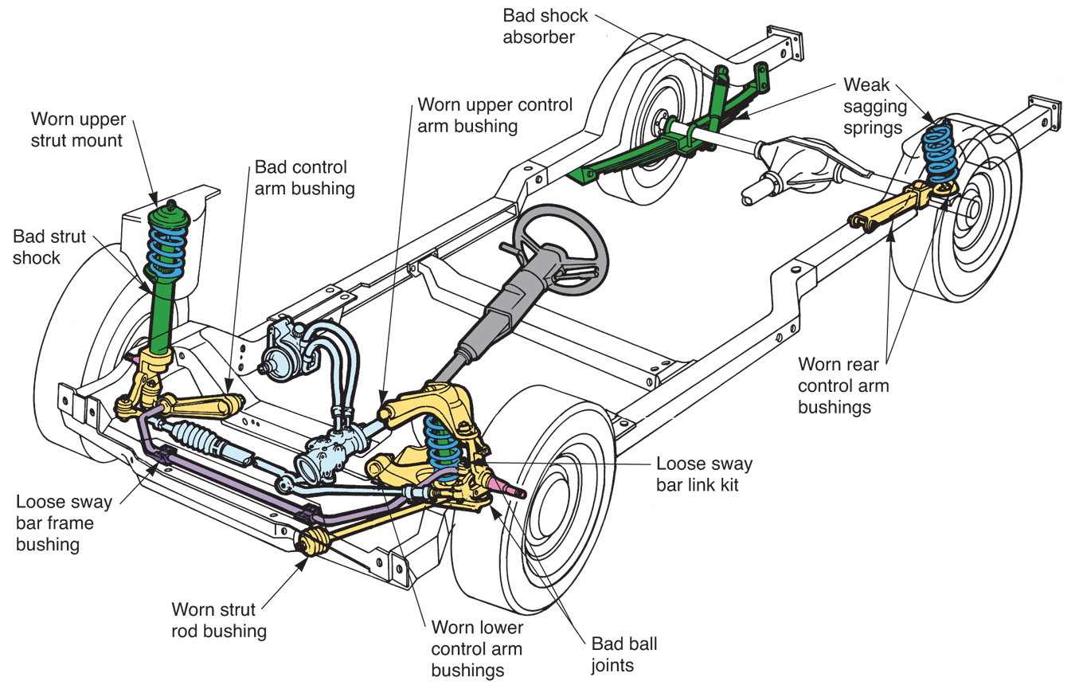
Suspension System Diagnosis (Cont.)
(Moog)

Slide 8
Shock Absorber Service
Worn shock absorbers will cause vehicle to ride poorly on rough roads
Bad shocks will not dampen spring oscillations
Suspension system will continue to jounce and rebound
Loose or damaged shock absorber may produce loud clanking or banging sound

Slide 9
Checking Shock Absorber Condition
Perform shock absorber bounce test
Push down on one corner of vehicle’s body
Release body and count number of times vehicle rebounds
Repeat on each corner of vehicle
Good shock absorbers should stop body movement in one or two rebounds

Slide 10
Checking Shock Absorber Condition (Cont.)
Inspect shock absorbers for signs of leakage and damage
Check rubber bushings on each end of shock
They should not be smashed or split
Make sure shock absorber fasteners are tight

Slide 11
Replacing Shock Absorbers
Place vehicle on jack stands or on lift
Remove wheel-and-tire assemblies
Place jack stands or other lifting devices under control arms or axle housing, if necessary
Raise control arm or axle just enough so shock rod is not fully extended

Slide 12
Replacing Shock Absorbers (Cont.)
Using air impact gun, remove fasteners securing old shock absorbers
If fasteners are rusted, spray rust penetrant on threads to ease removal of nuts and bolts
Install new shock in reverse order of removal

Slide 13
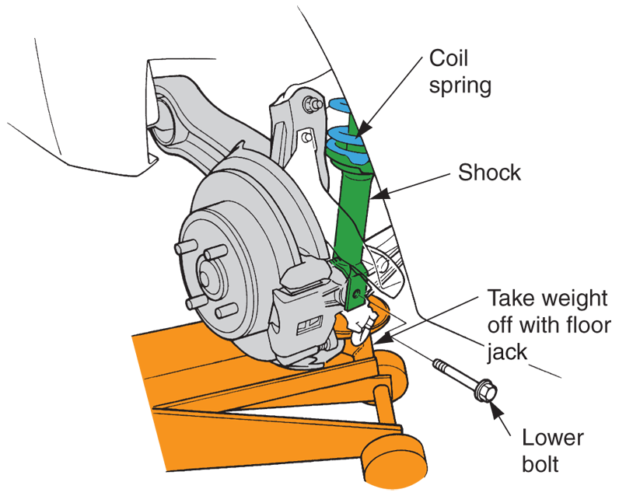
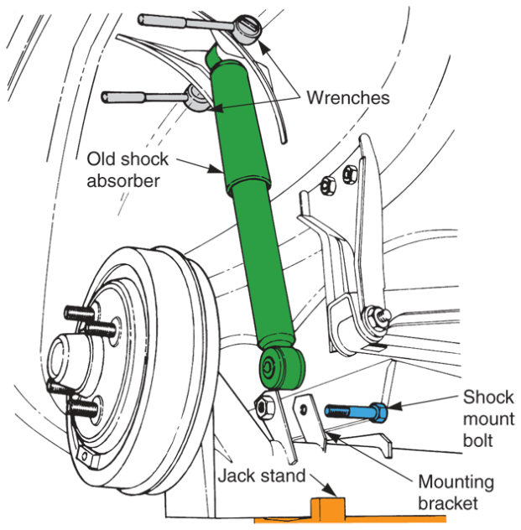
Replacing Shock Absorbers (Cont.)
(Honda and Chrysler)

Slide 14
Air- and Gas-Charged Shock Service
Replace gas-filled shocks when faulty
Air shocks may be repairable
Air lines, air valve, or shocks can develop pinhole leaks that allow air pressure to bleed off
Wipe on soap-and-water solution at possible leakage points
Bubbles are signs of leakage

Slide 15
Suspension Spring Service
Spring fatigue
Allows vehicle’s body to settle toward axles, lowering vehicle height
This settling or sagging changes position of control arms, resulting in misaligned wheels
Affects ride and appearance of vehicle

Slide 16
Curb Height and Curb Weight
Curb height
Distance from specific point on vehicle to ground
Curb weight
Weight of vehicle with full tank of fuel and no passengers or luggage
If curb height is too low, replace fatigued springs

Slide 17
Coil Spring Replacement
Fatigued coil springs lower ride height of vehicle and throw off suspension geometry
Coil spring compressor
Needed to remove and install coil spring
Screw-type compressor squeezes spring coils closer together, reducing overall height of coil spring

Slide 18
Coil Spring Replacement (Cont.)
To remove coil spring
Place vehicle on jack stands and remove shock absorber
Install spring compressor over coil spring
Follow tool directions
Oil tool threads to ease spring removal
Tighten tool down to compress and shorten spring

Slide 19
Coil Spring Replacement (Cont.)
You may have to separate lower or upper ball joint
Use fork tool, or ball joint separator, and hammer blows to remove ball joint from steering knuckle
Remove any other components that could be damaged when control arm is lowered
Pull spring and compressor out as unit

Slide 20
Coil Spring Replacement (Cont.)
To install new coil spring
Compress new spring with spring compressor
Slip spring into place and position coil ends in same location as ends of old spring
Reassemble ball joint and other components
Unscrew spring compressor while guiding coil into its seats

Slide 21
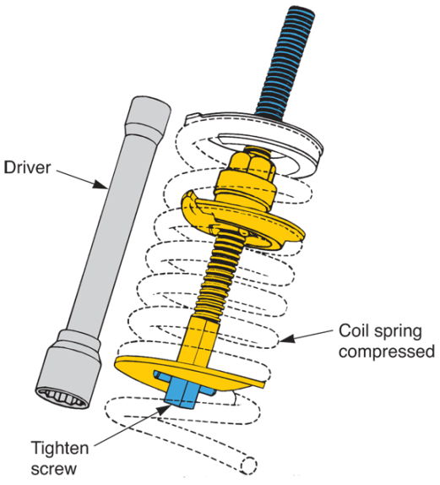
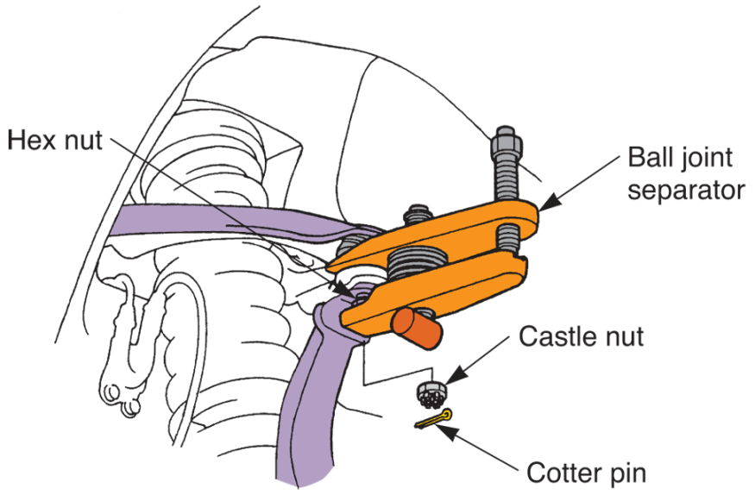
Coil Spring Replacement (Cont.)
(OTC Div. of SPX Corp.)
(Honda)

Slide 22
Leaf Spring Service
Place jack stands under frame and use floor jack to raise weight of rear axle off leaf spring
Use box wrench and impact wrench to remove nuts on each end of leaf spring
Leave through-bolts installed

Slide 23
Leaf Spring Service (Cont.)
Remove U-bolts that clamp around middle of spring and axle
Through-bolts should now slide out with little resistance
Lift old leaf spring off vehicle
Install new leaf spring in opposite order
Make sure you position axle assembly on leaf spring correctly

Slide 24
Torsion Bar Service
Most torsion bars are adjustable
Torsion bar replacement is not frequently needed To adjust torsion bar, you must usually turn bolt to increase or decrease tension, or twist, on bar
When curb height is too low, tension must be increased to raise vehicle

Slide 25
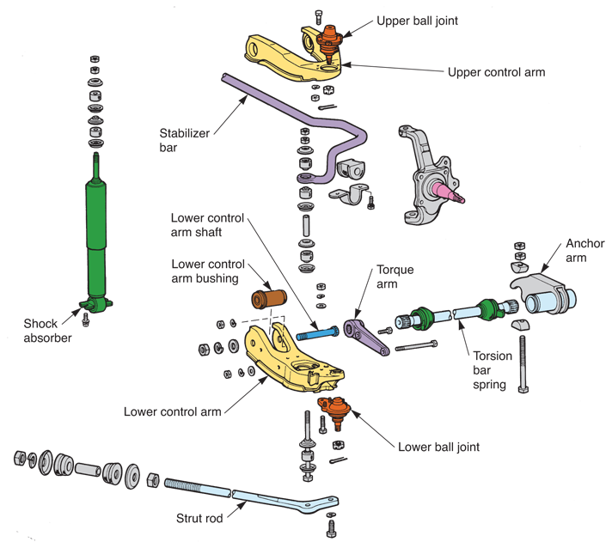
Torsion Bar Service (Cont.)
(Toyota)

Slide 26
Ball Joint Service
Worn ball joints cause steering knuckle and wheel assembly to be loose on control arms
Worn ball joint might make clunking or popping sound when turning or when driving over a bump
Dry ball joint is easily identified because its rubber boot is collapsed inward
It is not swollen with grease

Slide 27
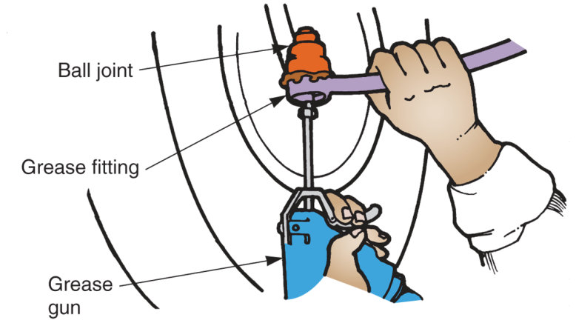
Ball Joint Service (Cont.)
Grease fittings or lube plugs are provided for ball joint lubrication
Use grease gun to inject chassis grease into ball joint grease fittings
Too much grease can rupture some types of boots
(Florida Dept. of Voc. Ed.)

Slide 28
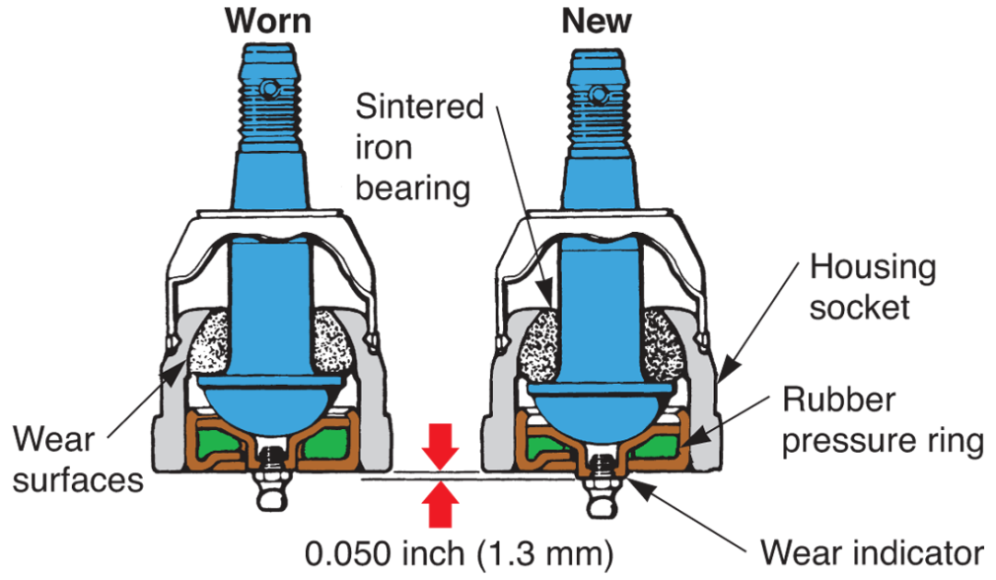
Checking Ball Joint Wear
With ball joint wear indicator, inspect shoulder on joint to determine ball joint’s condition
If shoulder on joint is recessed, replace joint
(Moog)

Slide 29
Ball Joint Replacement
To replace a ball joint:
Place the vehicle on jack stands.
Remove the shock absorber and install a spring compressor on the coil spring.
Remove the nut securing the ball joint to the steering knuckle and separate the knuckle and the joint.

Slide 30
Ball Joint Replacement (Cont.)
If ball joint is pressed in, hammer or drive it out with special tool
If ball joint is riveted in place, drill out old rivets with correct diameter drill bit
Use hardened bolts to secure new unit
If ball joint is screwed into place, use large wrench to unscrew it

Slide 31
Ball Joint Replacement (Cont.)
If it is rusted, free threads with rust penetrant or heat from torch first
Clean threads in control arm before threading in new ball joint
Torque ball joint properly

Slide 32
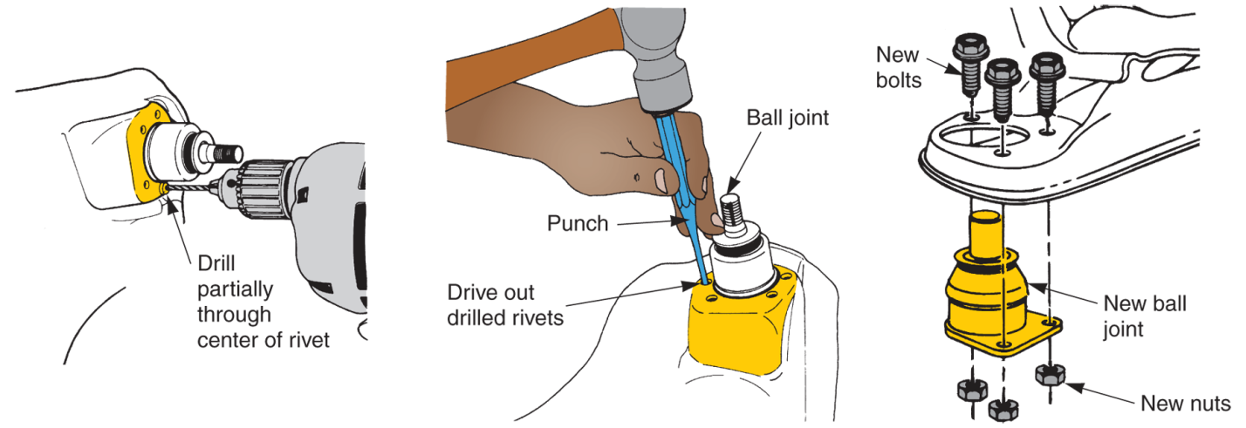
Ball Joint Replacement (Cont.)

Slide 33
Suspension Bushing Service
Rubber bushings are commonly used in inner ends of front control arms, rear control arms, and other parts
These bushings are wear prone and should be inspected periodically
Worn control arm bushings can let control arms move sideways, causing tire wear and steering problems

Slide 34
Checking Bushing Wear
Try to move control arm against normal movement while watching bushings
If arm moves in relation to its shaft, bushings are worn and must be replaced

Slide 35
Sticktion
Describes initial resistance to movement between rubber seals or bushings and metal parts
Afflicts suspension system bushings and shock absorber seals
Resists initial motion and affects ride smoothness
Causes old, dry, hardened bushings to make loud squeaking noise when moved

Slide 36
Bushing Replacement
Remove control arm when replacing bushings in front suspension
Usually requires ball joint separation and compression of coil spring
Unbolt stabilizer bar and strut rod from control arm
Remove bolts that pass through bushings

Slide 37
Bushing Replacement (Cont.)
Mount control arm in vise
Either press or screw out old bushings
Install control arm in reverse order of removal
Torque all bolts properly
Install ball joint cotter pin and other components

Slide 38
MacPherson Strut Service
Raise and secure car on stands or lift to remove vehicle weight from suspension system
Unbolt steering knuckle or bearing support from strut
Mark cam bolt with scratch awl or marker to help during reassembly

Slide 39
MacPherson Strut Service (Cont.)
Disconnect brake line if needed to avoid hose damage
Separate bottom end of strut from its knuckle
Swing it to one side of knuckle so it can drop down

Slide 40
MacPherson Strut Service (Cont.)
Unscrew upper strut-to-body fasteners on side of engine compartment
Remove strut assembly as single unit
Do not remove nut on end of the shock rod, or unit could fly apart

Slide 41
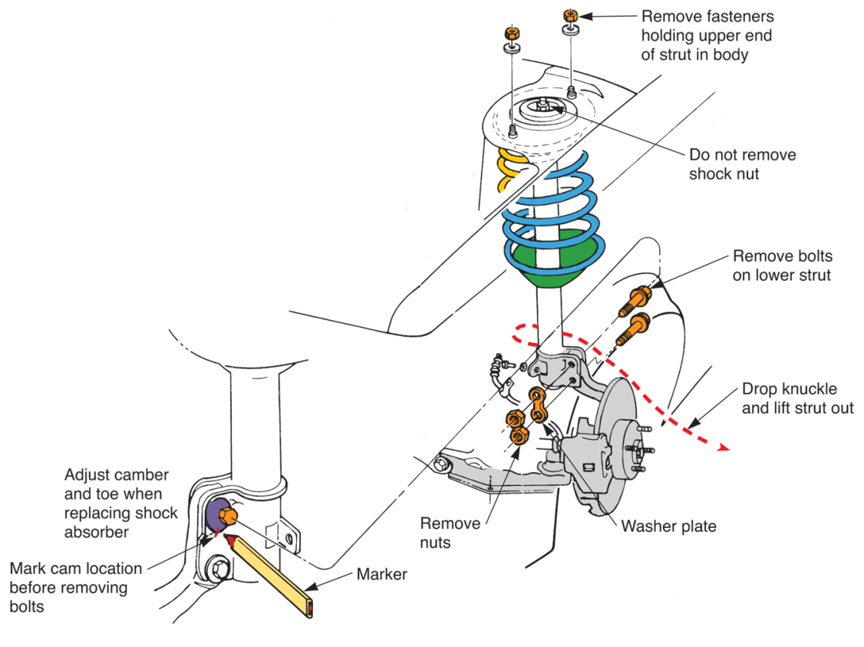
MacPherson Strut Service (Cont.)
(Chrysler)

Slide 42
Strut Assembly Service
Before removing strut shock absorber, use strut spring compressor to collapse spring
Remove coil spring from strut
After coil spring has been squeezed together, remove upper damper assembly
Release spring tension and lift spring off strut

Slide 43
Strut Assembly Service (Cont.)
Most automakers recommend replacing faulty strut shock absorber
New shock simply screws into strut’s outer housing
Spanner wrench may be needed to turn nut on top of cartridge

Slide 44
Strut Assembly Service (Cont.)
After replacing or rebuilding strut shock absorber, fit strut into compressor and compress coil spring
Install upper spring seat and related components
After releasing spring compressor, strut can be installed on vehicle

Slide 45
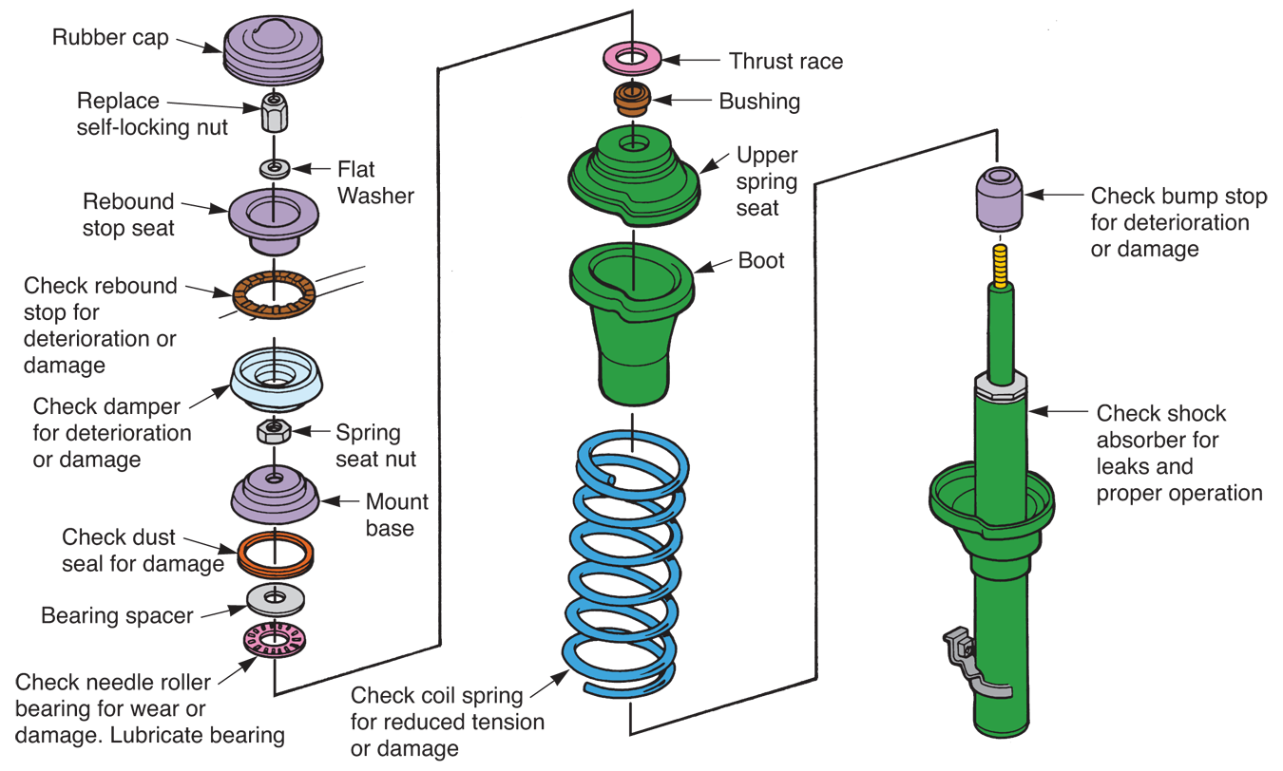
Strut Assembly Service (Cont.)
(Honda)

Slide 46
Strut Installation
Install strut assembly in reverse order of removal
Lift strut into position in upper body mount
Attach lower end of the strut to steering knuckle or bearing support
Align your reference marks
Install fasteners and torque them to specifications

Slide 47
Wheel Alignment Is Needed
After servicing suspension parts, wheel alignment must be checked and adjusted
Never let vehicle leave shop without checking alignment
Rapid tire wear or handling problems could occur

Slide 48
Computerized Suspension Diagnosis
To start troubleshooting computer-controlled suspension, connect scan tool to vehicle’s diagnostic connector
If scan tool indicates possible problem with certain part or circuit, use pinpoint multimeter tests to verify exact source of trouble

Slide 49
Height Sensor Service
Sensor can fail mechanically due to worn parts, bent arm, or broken parts
It can fail electrically, ceasing to produce normal signal
Replace sensor if it does not work properly and cannot be adjusted

Slide 50
Electronically-Controlled Shock Service
Some of electronic parts from old shocks may transfer onto new ones
Installing conventional shocks could confuse the computer and cause constant trouble codes and other problems
Do not try to modify electronic suspension systems without manufacturer’s guidance

