Slide 1
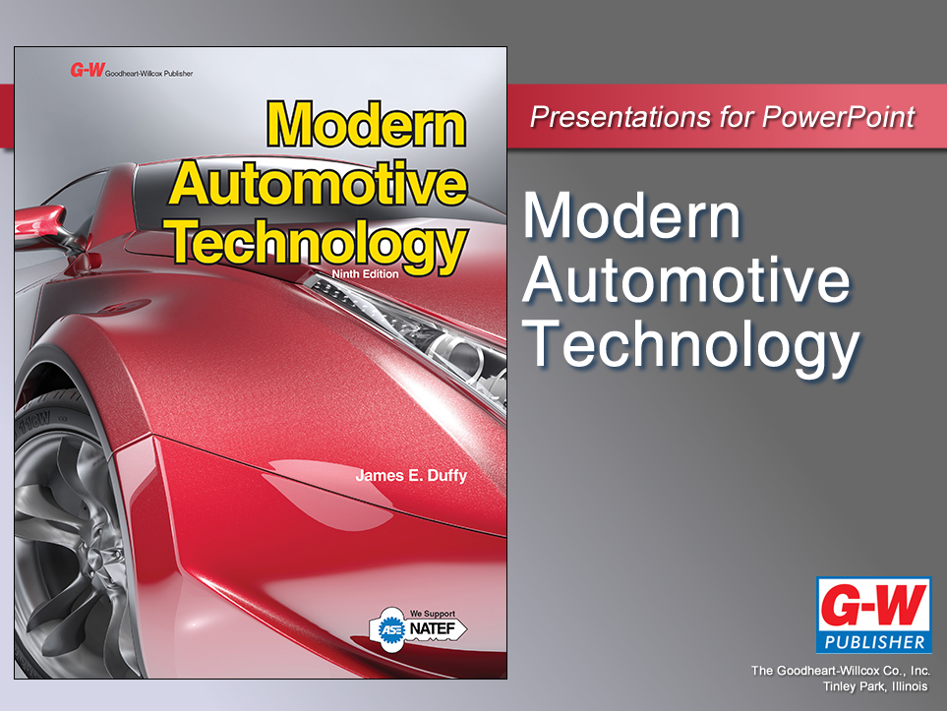

Slide 2
78
Chapter
Steering System Diagnosis and Repair

Slide 3
Objectives
After studying this chapter, you will be able to:
Describe common steering system problems.
Properly inspect and determine the condition of a steering system.
Service power steering belts, hoses, and fluid.
Explain basic steering column repair operations.
Adjust rack-and-pinion gears.
Describe service and repair procedures for a rack-and-pinion steering gear.

Slide 4
Objectives
Explain how to complete basic power steering tests.
Describe power steering gear and pump service practices
Diagnose electronic assist power steering systems
Correctly answer ASE certification test questions about the diagnosis and repair of today’s steering systems.

Slide 5
Steering System Problem Diagnosis
Most common steering system problems
Play in the steering wheel
Hard steering
Abnormal noises when turning wheel
These problems point to
Part wear
Lack of lubrication
Incorrect adjustment

Slide 6
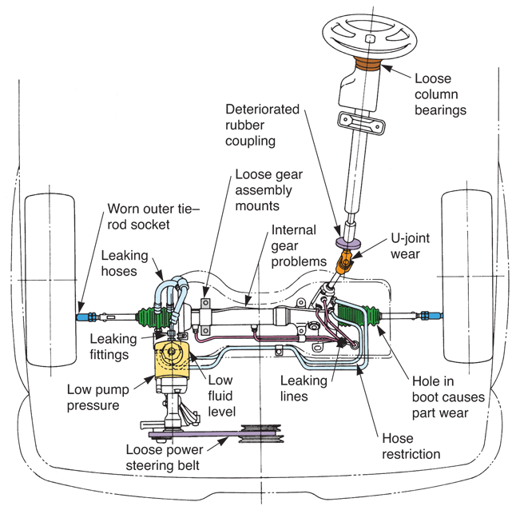
Steering System Problem Diagnosis (Cont.)

Slide 7
Steering Wheel Play
Most frequent steering system problem is excessive play in steering wheel
Causes of steering wheel play
Worn ball sockets
Worn idler arm
Too much clearance in steering gearbox

Slide 8
Steering Wheel Play (Cont.)
Dry park test
With full weight of vehicle on wheels, ask someone to rock steering wheel back and forth while you look for looseness in steering system
Look for ball studs that wiggle in their sockets
With rack-and-pinion steering, squeeze rubber boots and feel inner tie rods to detect wear and play

Slide 9
Hard Steering
Steering that requires excessive effort
Caused by problems with
Steering gearbox
Rack-and-pinion steering gear
Power steering components
Ball sockets
Suspension system
Check fluid level, inspect system for leaks, and check power steering pump belt

Slide 10
Steering System Noise
Sources of steering system noise
Worn parts
Unlubricated bearings or ball sockets
Loose parts
Slipping belts
Low power steering fluid
Belt squeal
Loud screeching sound produced by slipping belt

Slide 11
Steering System Noise (Cont.)
Power steering pump noise is usually loud whine that only occurs when steering wheel turns
Often due to low fluid level and air in system
When fluid is added, noise should go away

Slide 12
Steering System Maintenance
Steering system maintenance typically involves checking for
Low fluid level
Belt problems
System leaks
May also include lubricating ball sockets

Slide 13
Checking Power Steering Fluid
To check level of fluid in power steering system, engine should not be running
If vehicle is equipped with see-through reservoir
Compare fluid level to markings on side of reservoir

Slide 14
Checking Power Steering Fluid (Cont.)
In some vehicles, level must be checked using dipstick attached to power steering reservoir cap
Most power steering dipsticks have markings for checking fluid when hot and cold
Add only enough fluid to reach correct mark on dipstick or side of reservoir

Slide 15
Servicing Power Steering Belts
Loose belt can slip, squeal, and cause erratic or high steering effort
Worn or cracked belt may snap, causing a loss of power assist
To remove serpentine belt
Use breaker bar to swing the belt tensioner sideways and release tension
Pull the belt off its pulleys
Check condition of all idler pulleys
If any feel dry and rough, replace pulley

Slide 16
Servicing Power Steering Belts
Before installation
Compare lengths/widths of old belt and new belt
See vehicle service information or belt diagram sticker on engine bay frame for correct belt path
Pull belt over its pulleys
After you position belt
Use breaker bar to swing belt tensioner sideways so new belt will fit over the tensioner pulley
Double-check belt is tight and properly installed
Start engine and check belt operation

Slide 17
Steering Column Service
Steering column service needed after collision or when internal parts of column fail
Crushing of collapsible steering column
Follow service manual directions to replace worn or damaged parts in steering column
Upper steering shaft bearing, turn signal assembly, etc.

Slide 18
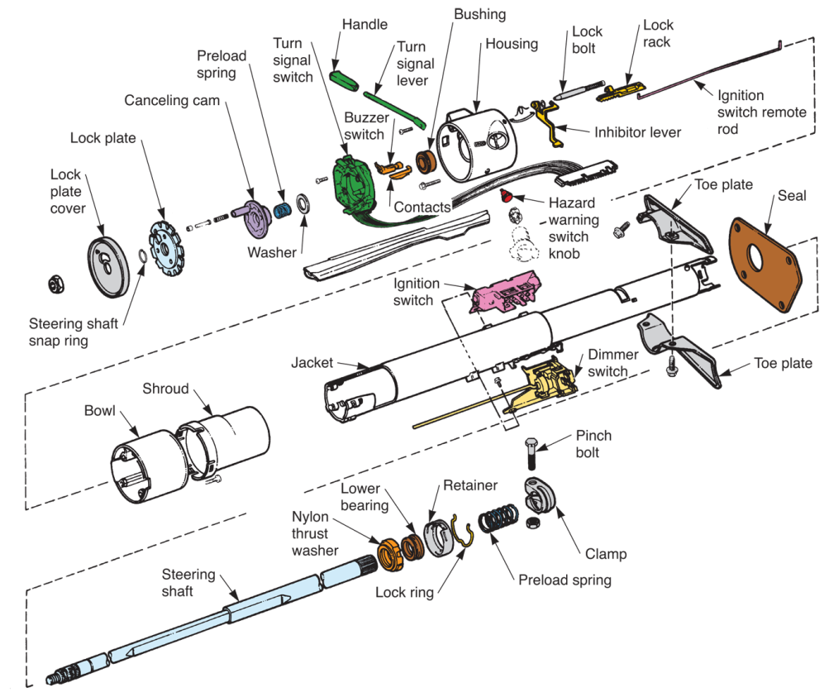
Steering Column Service (Cont.)
(Chrysler)

Slide 19
Steering Column Joint Replacement
Many steering column assemblies use flexible coupling or universal joint on lower part of steering shaft
Rubber coupling can deteriorate after prolonged service or long-term exposure to engine heat or oil
Metal universal joint can wear and develop play after prolonged service

Slide 20
Steering Linkage Service
Signs of wear
Excessive play in idler arm
Looseness in ball sockets
Worn tie-rods
Damaged adjuster tube
Bent center link
Worn pitman arm splines
Misadjusted nut
Worn joint in tie-rods
Loose mounting bolts

Slide 21
Idler Arm Service
Worn idler arm
Most common cause of play in steering wheel
Front wheels, mainly right wheel, can turn without causing movement of steering wheel
To check idler arm for wear
Grasp outer end of arm
End opposite of frame

Slide 22
Idler Arm Service (Cont.)
Force idler arm up and down by hand
Note amount of movement at end of arm
Idler arm should not wiggle up and down more than about 1/4″
Worn idler arm must be replaced

Slide 23
Idler Arm Service (Cont.)
To replace idler arm
Remove cotter pin and castle nut from outer end of idler arm
Use fork tool or puller to force arm’s ball stud out of hole in center link
Unbolt idler arm from frame
Install new idler arm in reverse order of removal

Slide 24
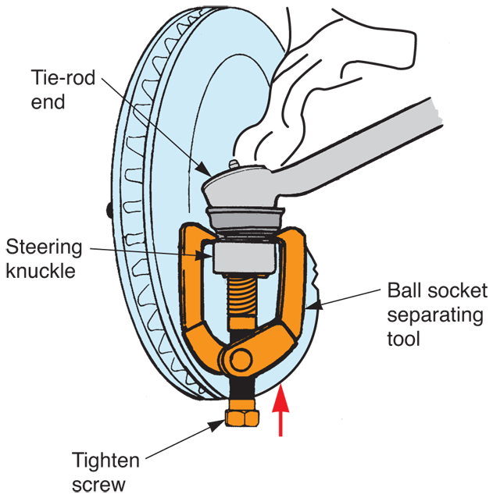
Tie-Rod Service
Worn tie-rod will also cause steering play
When you detect movement between ball stud and its socket, install new tie-rod
To replace tie-rod
Separate tie-rod from steering knuckle or center link
Use fork or puller

Slide 25
Tie-Rod Service (Cont.)
Before loosening adjustment sleeve, measure or mark tie-rod length
This will allow you to set new tie-rod at about approximately the same length as old one
Loosen tie-rod adjustment sleeve and unscrew tie-rod end
Turn new tie-rod end into sleeve until exact length of old tie-rod

Slide 26
Tie-Rod Service (Cont.)
Install tie-rod ball stud in center link or steering knuckle
Tighten fasteners to specifications
Install new cotter pins and bend them correctly
Tighten adjustment sleeve and check steering action

Slide 27
Inner Tie-Rod End Service— Rack-and Pinion Steering
Service is similar to that for conventional tie-rod end
Inner tie-rod end on rack-and-pinion assembly is enclosed in rubber boot
Remove boot straps
Cut them off with side cut pliers
Unscrew inner end of the tie-rod from rack

Slide 28
Inner Tie-Rod End Service— Rack-and Pinion Steering (Cont.)
When installing new inner tie-rod end, install all flat and lock washers in their original locations
Torque tie-rod nut to factory specs
Replace boot and boot straps
Make sure they are secured into any grooves formed in tie-rod end and rack

Slide 29
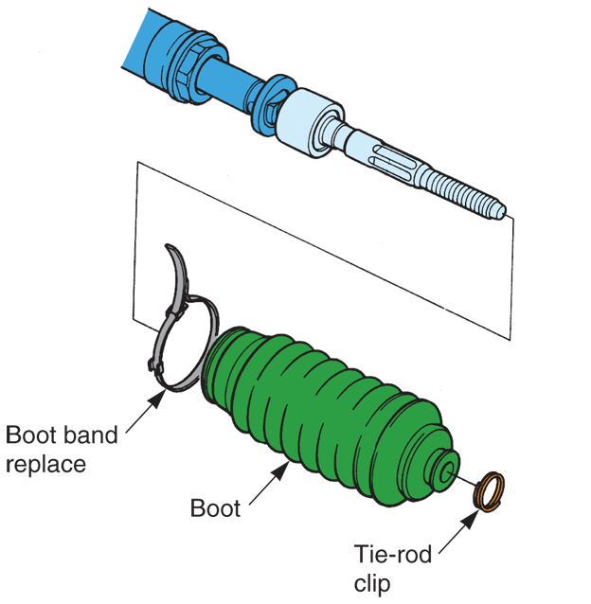
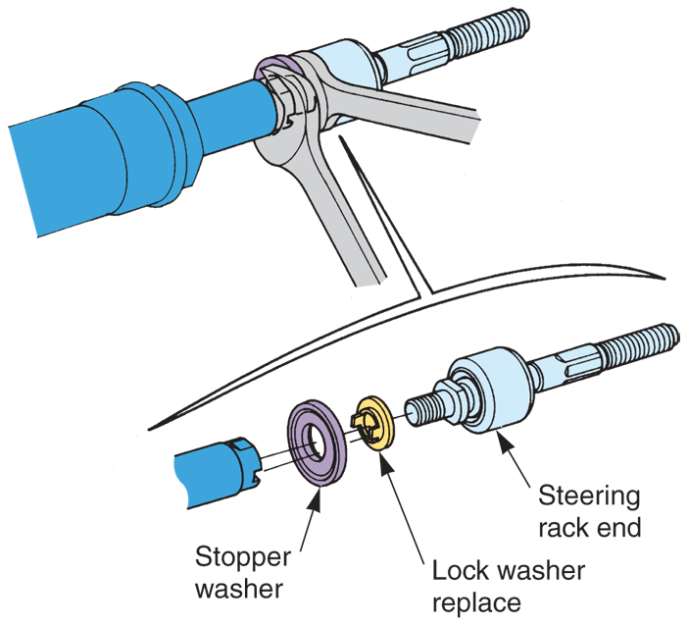
Inner Tie-Rod End Service— Rack-and Pinion Steering
(Honda)

Slide 30
Manual Rack-and-Pinion Service
When problems develop, they are frequently in tie-rod ends
Rack-and-pinion gear may also wear and cause problems when not properly lubricated
Since so many cars use rack-and-pinion steering, learn common service and repair procedures for this type of system

Slide 31
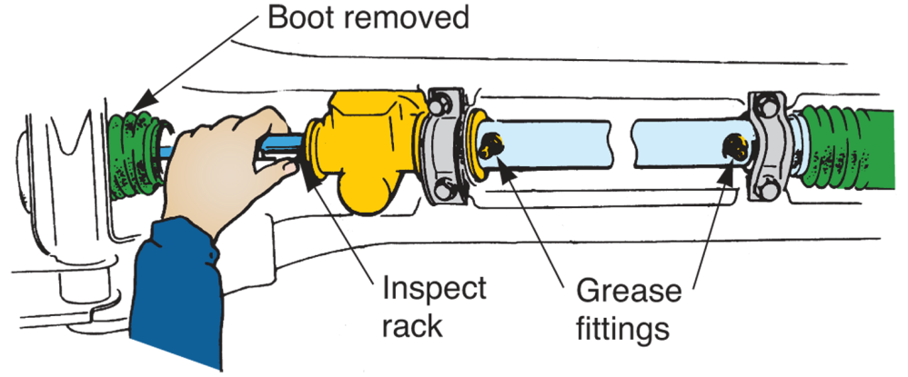
Manual Rack-and-Pinion Lubrication
Some manual rack-and-pinion steering gears require periodic lubrication
Use grease gun to place chassis grease into fittings
(Honda)

Slide 32
Manual Rack-and-Pinion Gear Adjustment
Most manual rack-and-pinion steering gears have rack guide adjustment screw
To adjust rack guide screw
Loosen locknut on screw
Turn rack guide screw in until it bottoms lightly
Back off screw recommended amount or until prescribed turning effort is obtained
Tighten locknut

Slide 33
Manual Rack-and-Pinion Gear Removal
Separate outer tie-rods from steering knuckles
Unbolt steering gear mounting brackets from frame or cross member
Disconnect steering column coupler or universal joint
Rotate steering gear and slide it out of chassis

Slide 34
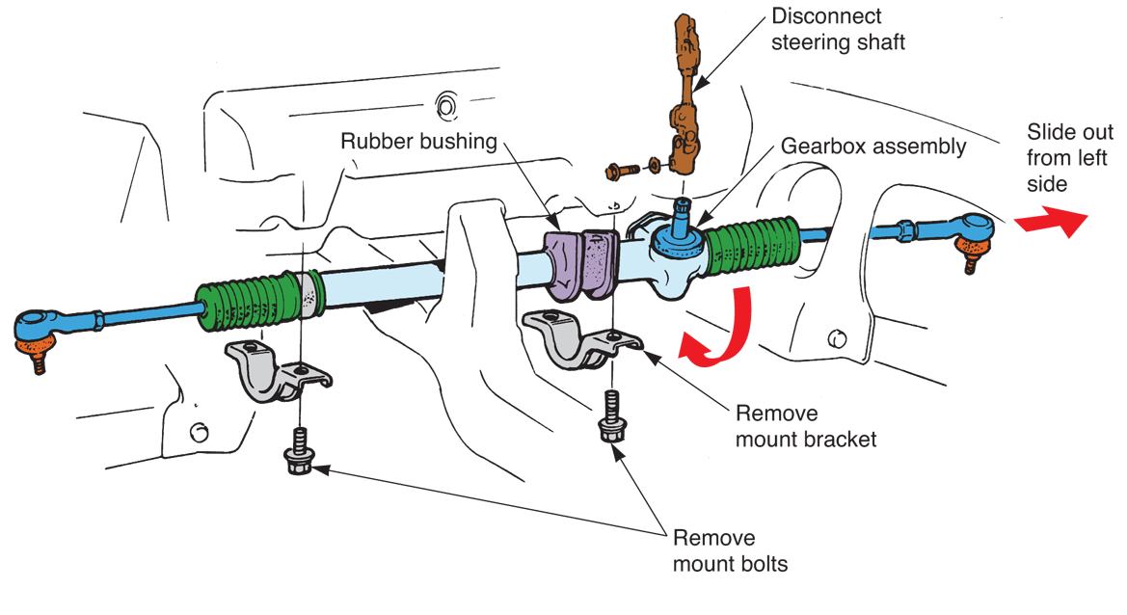
Manual Rack-and-Pinion Gear Removal (Cont.)
(Honda)

Slide 35
Manual Rack-and-Pinion Gear Overhaul
Exact procedures will vary with vehicle make and model
Disassemble unit and check each part closely
Replace any part that shows signs of wear
Replace all seals and other rubber or plastic parts
Use service manual to obtain exact procedures for rebuilding particular units

Slide 36
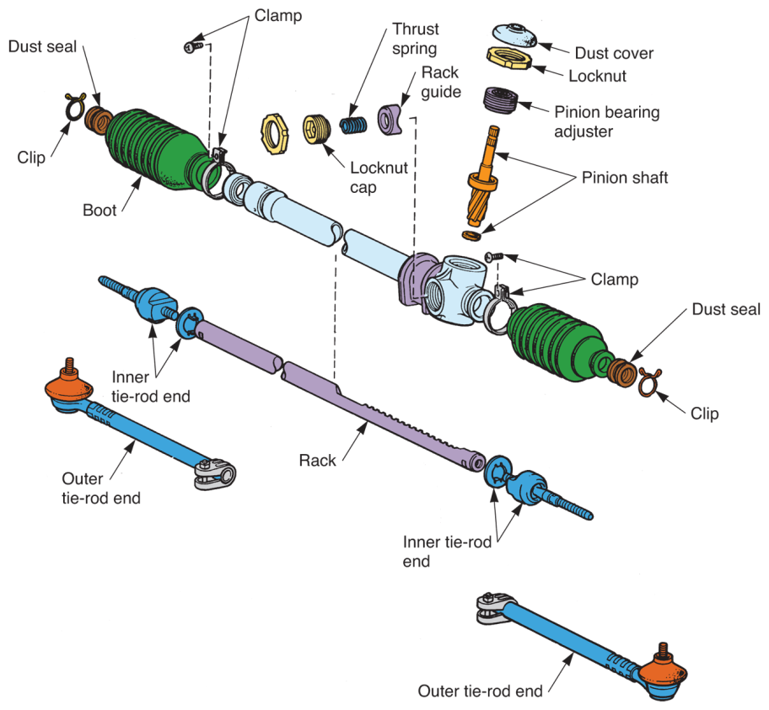
Manual Rack-and-Pinion Gear Overhaul (Cont.)
(Toyota)

Slide 37
Power Steering System Service
Many power steering system parts are the same as those used on manual steering system
Pump, power piston, control valve, and hoses are added
These parts can also fail, requiring repair or replacement

Slide 38
Power Steering Leaks
With over 1000 psi produced in power steering systems, leaks develop in fittings, hoses, gearbox seals, or at rack-and-pinion assembly
To check for leaks
Wipe fluid-soaked areas clean
Have helper start and idle engine
Watch for leaks as your helper turns steering wheel to right and left

Slide 39
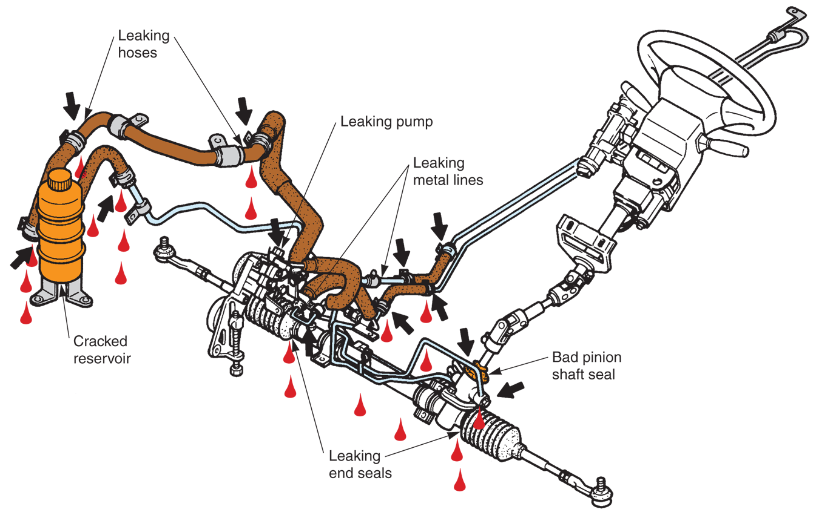
Power Steering Leaks (Cont.)
(Honda and Ford)

Slide 40
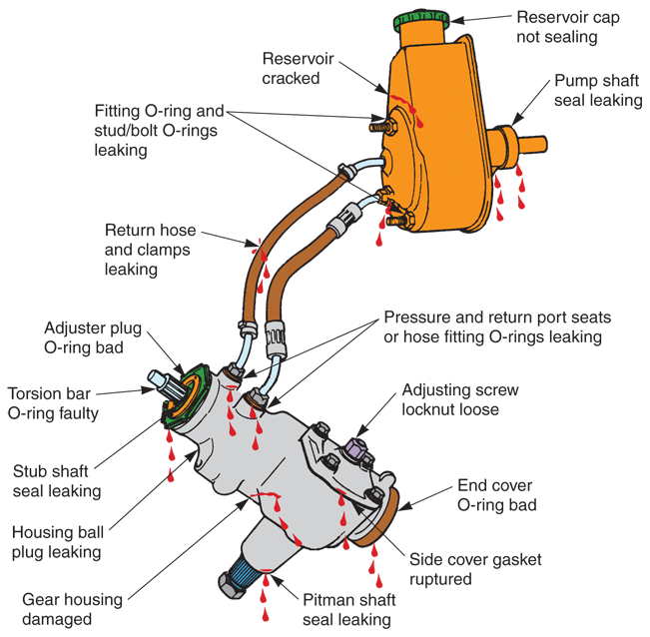
Power Steering Leaks (Cont.)
(Honda and Ford)

Slide 41
Servicing Power Steering Hoses
If high-pressure hose ruptures, sudden and dangerous loss of power assist can occur
Start new hose fittings by hand to avoid cross threading
Use tubing wrench to tighten hose fittings properly
Make sure hose does not contact moving or hot parts

Slide 42
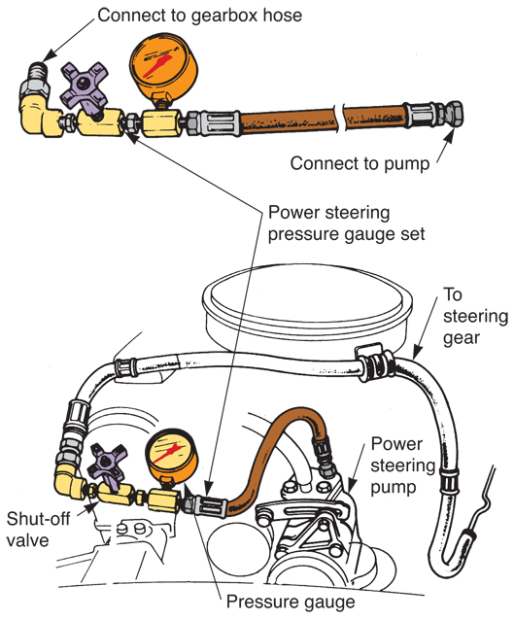
Power Steering Pressure Test
Checks operation of power steering pump, pressure relief valve, control valve, hoses, and power piston
Connect pressure gauge and shutoff valve into high-pressure hose
Torque hose fittings properly
(Honda)

Slide 43
Power Steering Pressure Test (Cont.)
Make sure system is full of fluid
Start engine and allow it to idle with test valve open
Turn steering wheel back and forth to bring fluid up to operating temperature
To check system pressure, close test valve
Compare reading with specifications
If pressure not within specs
Check condition of pressure relief valve and pump

Slide 44
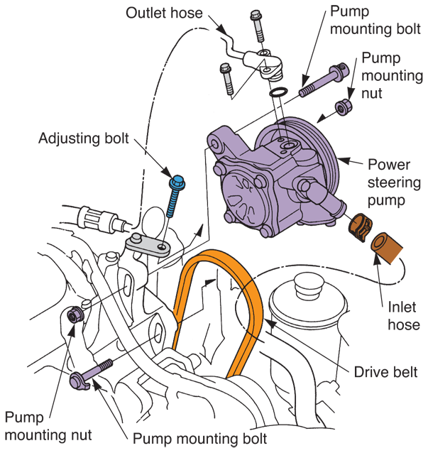
Power Steering Pump Service
Most shops replace bad power steering pump with new or factory rebuilt unit
Before attempting to rebuild power steering pump, make sure rebuild kit is available for particular unit
(Honda)

Slide 45
Power Steering Gear Service
Procedures for servicing power steering gears vary with vehicle make and model and type of gear assembly
Follow service manual directions
Note measurements used to check part wear
Replace all worn parts and every seal
Use special drivers or pullers to replace worn bushings, if needed

Slide 46
Bleeding a Power Steering System
Bleeding ensures all air is out of lines, pump, and gearbox.
Air can cause power steering system to buzz
Start engine
Turn steering wheel fully from side to side
Check fluid level often and add fluid as needed
This forces air into reservoir and out of system

Slide 47
Electronic Assist Steering Service
Service procedures for electronic assist power steering systems are about same as procedures described earlier
Since circuit designs vary, refer to shop manual for wiring diagrams, part locations, and electrical values
Scan tool will read operating values in steering system and quickly isolate problem area

Slide 48
Electronic Assist Steering Service (Cont.)
Scan tool might show codes
Steering sensor circuit
Power steering pump pressure
Fluid pressure control solenoid
Lateral acceleration sensor
Rack motor circuit
Use pinpoint tests with multimeter to verify problem source

