Slide 1
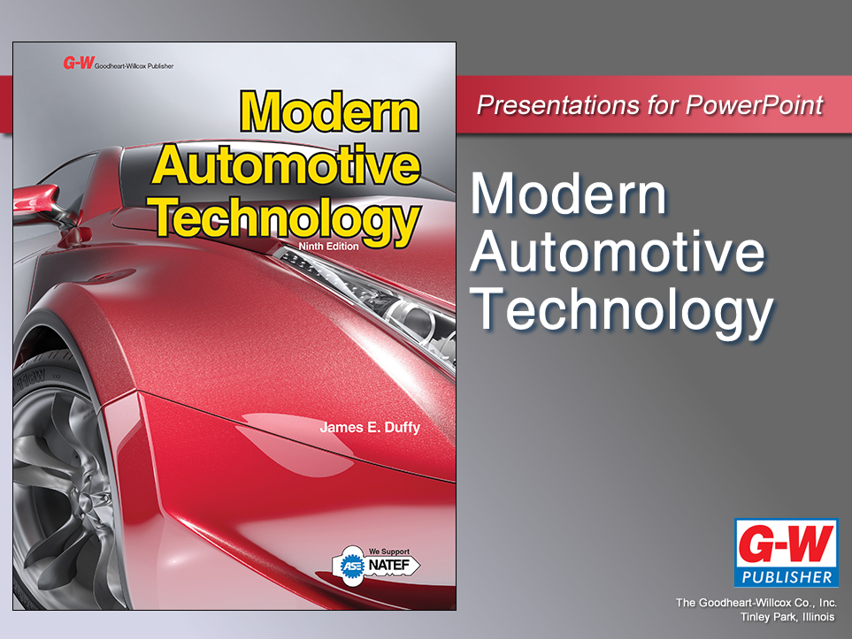

Slide 2
82
Chapter
Anti-Lock Brakes, Traction Control, and Stability Control

Slide 3
Objectives
After studying this chapter, you will be able to:
Identify the major parts of a typical anti-lock brake system.
Describe the operation of anti-lock brake systems.
Compare anti-lock brake design variations.
Describe the purpose and operation of traction control and stability control systems.

Slide 4
Objectives
Diagnose problems in anti-lock brake systems.
Repair anti-lock brake systems.
Diagnose and repair traction control and stability control systems.
Correctly answer ASE certification test questions requiring a knowledge of anti-lock brake systems, traction control systems, and stability control systems.

Slide 5
Anti-Lock Brakes, Traction Control, and Stability Control−Introduction
Anti-lock brake systems or ABS
Increase safety by reducing stopping distances compared to manual brakes on both wet and dry pavement
Traction control systems (TCS)
Electronically controls brakes, differential, engine, and transaxle to help reduce tire spin upon acceleration on slippery pavement

Slide 6
Anti-Lock Brakes, Traction Control, and Stability Control−Introduction (Cont.)
Stability control systems
Electronically link steering, suspension, braking, and traction control systems together to prevent loss of vehicle control and skidding when cornering at high speed
This chapter will introduce additional parts needed to provide computer control of complete chassis and driveline

Slide 7
Anti-Lock Brake Systems (ABS)
Uses wheel speed sensors, ABS control module, electro-hydraulic brake actuator, and conventional hydraulic brake circuits to prevent wheel lockup during hard braking
Improves driver and passenger safety by reducing stopping distances and increasing directional stability under panic stop conditions

Slide 8
ABS Components
Major parts of anti-lock braking system
Wheel speed sensors
Magnetic pickups for detecting rotating speed of each tire and wheel assembly
Sensor trigger wheels
Toothed wheels that rotate at same rpms as wheel and tire
ABS control module
Small computer, or processor, that uses sensor inputs to control electro-hydraulic modulator

Slide 9
ABS Components (Cont.)
Electro-hydraulic modulator
Cycles pressure to each wheel brake cylinder if speed begins to slow down too much, indicating tire skid or wheel lockup
Brake warning light
Informs driver of problems in anti-lock brake system circuits

Slide 10
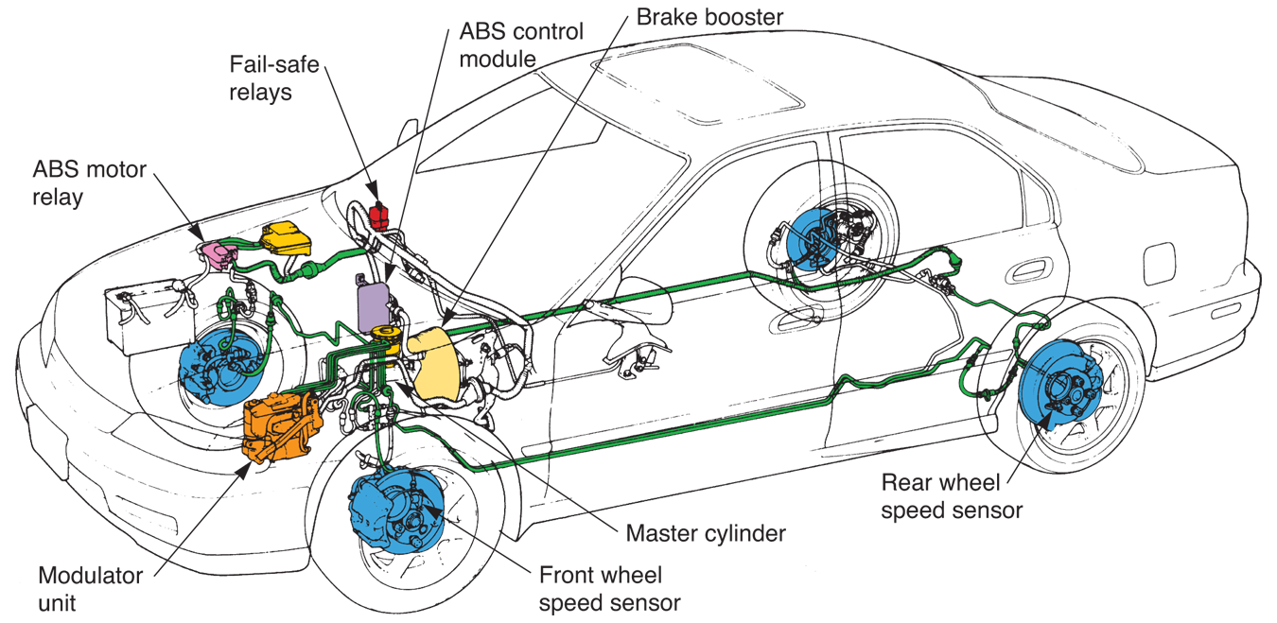
ABS Components (Cont.)
(Honda)

Slide 11
Wheel Speed Sensors
Produce ac signals that correspond to wheel and tire speed
These signals feed into ABS control module
With rear-wheel anti-lock brakes, wheel speed sensors are only on rear wheels
With four-wheel antilock brakes, wheel speed sensors needed on all wheels

Slide 12
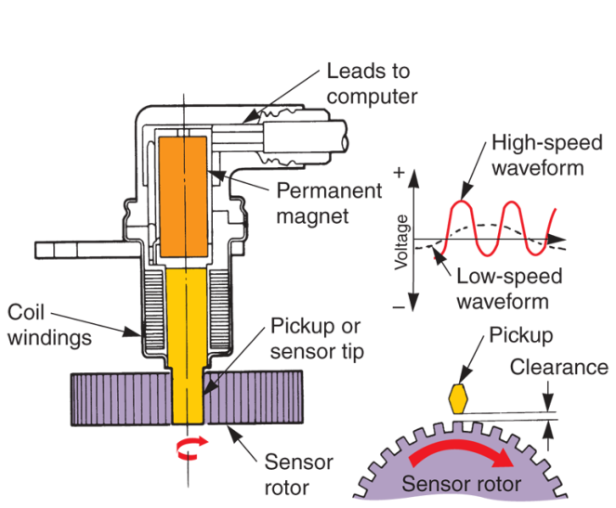
Wheel Speed Sensors (Cont.)
Sensor rotor or trigger wheel
Toothed ring that rotates with wheel hub
Magnetic sensor tip located next to sensor rotor teeth
Only small air gap separates sensor tip from spinning teeth
(Saab)

Slide 13
Wheel Speed Sensors (Cont.)
Frequency of wheel speed sensors ac signal depends on tire and wheel speed
ABS control module uses ac signal to check for tire skid
Rapid decrease in sensor ac signal frequency would indicate that tire is starting to lock up and skid

Slide 14
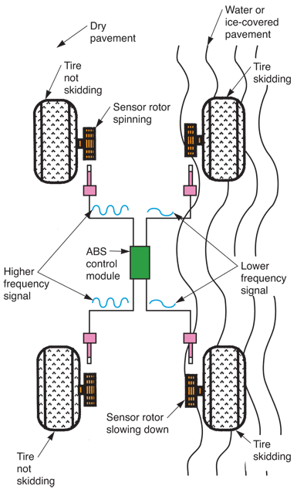
Wheel Speed Sensors (Cont.)

Slide 15
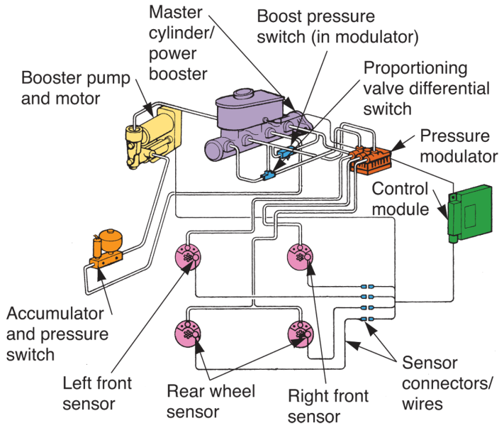
ABS Control Module
Small computer that uses wheel speed sensor inputs to control operation of electro-hydraulic modulator
(Chrysler)

Slide 16
ABS Electro-Hydraulic Modulator
ABS electro-hydraulic modulator or ABS actuator
Regulates fluid pressure applied to each wheel brake assembly during periods of hard braking
ABS control module controls modulator

Slide 17
ABS Electro-Hydraulic Modulator (Cont.)
Major parts of ABS modulator
Brake fluid reservoir
Container for holding extra supply of brake fluid
Brake solenoid valve block
Electro-hydraulic device with coil-operated valves that control brake fluid flow to each wheel brake cylinder

Slide 18
ABS Electro-Hydraulic Modulator (Cont.)
Brake accumulator
Chamber for storing extra fluid under high pressure
Brake fluid pump and motor
High-pressure pump operated by small electric motor
It provides brake fluid pressure for ABS system

Slide 19
ABS Electro-Hydraulic Modulator (Cont.)
Brake pressure switch
Sensor that monitors brake fluid pressure and controls operation of electric motor for hydraulic pump
Brake master cylinder-booster assembly
Conventional master cylinder with power assist for operating brakes under normal conditions

Slide 20
ABS Electro-Hydraulic Modulator (Cont.)
Integrated ABS
Combines power booster, master cylinder, and modulator units into one assembly
Nonintegrated ABS
Major units are separated
Conventional booster and master cylinder are used with separate electro-hydraulic modulator

Slide 21
ABS Electro-Hydraulic Modulator (Cont.)
Hydraulic pressure modulation
Refers to electro-hydraulic unit’s ability to rapidly cycle pressure to wheel cylinders or calipers on and off, preventing wheel lockup and skidding

Slide 22
ABS Electro-Hydraulic Modulator (Cont.)
Three modes of ABS pressure modulation
Isolation mode
ABS control module detects that tire is starting to skid and energizes modulator to isolate that hydraulic circuit from other brake lines

Slide 23
ABS Electro-Hydraulic Modulator (Cont.)
Dump mode
ABS releases hydraulic pressure to one or more of brake wheel cylinders or calipers
Done to stop tire skidding
Reapply mode
ABS applies hydraulic pressure to one or more of wheel brake assemblies
Done to reapply brakes during pressure modulation

Slide 24
ABS Warning Light
Light mounted in dash used to alert driver to ABS malfunction
Light glows during engine cranking and stays on for several seconds after engine starts
Informs you that system is armed and functioning

Slide 25
ABS Channels
Separate hydraulic circuit that feeds out to one or more wheel cylinders or caliper pistons
Anti-lock brake systems have from one to four channels
One-channel ABS
Operates rear wheel brakes together
Only one channel is provided for both rear wheels

Slide 26
ABS Channels (Cont.)
Two-channel ABS
Two separate hydraulic circuits controlled by electro-hydraulic modulator
With rear-wheel ABS, each rear brake has its own hydraulic control circuit
Four-channel ABS
Separate hydraulic control circuit for each wheel
Most effective and common anti-lock brake system

Slide 27
ABS Operation
Under normal braking conditions, ABS is not used
If brakes are applied in panic stop and wheel begins to lock up, ABS is activated
Wheel sensor on slowing wheel instantly reduces frequency of ac signal sent to ABS control module

Slide 28
ABS Operation (Cont.)
Control module detects that wheel is slowing down more than others and is getting ready to slide or skid
Module then sends electrical current to correct solenoid on electro-hydraulic modulator assembly to bleed pressure from that channel

Slide 29
Traction and Stability Control Systems
Most traction control systems work with antilock brake system to cycle hydraulic pressure to wheel spinning fastest
Control module is capable of applying one wheel brake at a time
Some systems also reduce engine power output to reduce skidding
Indicator light comes on when traction control system is activated

Slide 30
Traction and Stability Control Systems (Cont.)
Designed to make vehicle more stable under emergency handling situations, such as when trying to avoid collision
If understeer is detected, control module applies braking force to rear inside wheel
If oversteer is detected, additional braking force is automatically applied to outside front wheel

Slide 31
Traction and Stability Control Systems (Cont.)
Stability control system may use inputs from these sensors
Steering angle sensor
Measures how sharply steering wheel is rotated to right or left
Lateral acceleration sensor
Measures how much side force is generated by turn

Slide 32
Traction and Stability Control Systems (Cont.)
Yaw sensor
Measures direction of thrust generated by vehicle movement
Throttle position sensor
Measures how far driver has pressed down on accelerator to control engine power output

Slide 33
Traction and Stability Control Systems (Cont.)
Brake pressure sensor
Measures amount of hydraulic pressure produced by driver pressing on brake pedal
Other sensors
Give control module information about driver’s actions and resulting vehicle motion

Slide 34
ABS Service
Before servicing an anti-lock brake system, be familiar with how an operating system works and feels
Since designs and repair procedures vary, read service manual for vehicle
This gives you information needed
Diagnosis charts, part locations, specifications, procedures, etc.

Slide 35
ABS Service (Cont.)
Check
ABS indicator light on
Low or contaminated brake fluid
Brake fluid leaks, especially at modulator seals, gaskets, and lines
Worn or damaged brake pad linings and rotors
Tires that will not rotate freely

Slide 36
ABS Service (Cont.)
Loose or worn wheel bearings, which could affect wheel speed sensor operation
Badly worn tires or tires of unequal size, which could upset ABS operation
Damaged or improperly mounted speed sensors and trigger wheels

Slide 37
Scanning ABS
Typical ABS diagnostic system can produce over 50 trouble codes to help find cause of malfunction
If ABS light stays on more than several seconds after vehicle is started, ABS control module has detected abnormal operating condition

Slide 38
Scanning ABS (Cont.)
Use scan tool to check code history
List of stored codes with number of times each has occurred
This will let you know how often problem occurs
Review all trouble codes
May help you quickly find bad ABS component or circuit

Slide 39
Scanning ABS (Cont.)
Scan tool will normally indicate problems with the following
Wheel speed sensor circuits
ABS warning light circuit
System relays
Low system voltage
Modulator motors

Slide 40
Scanning ABS (Cont.)
Solenoid circuits
Brake switch circuit
Calibration memory in the ABS control module
Other circuits and components
Scan tool can perform several manual and automatic tests and obtain system values

Slide 41
ABS Pinpoint Tests
If scan tool indicates malfunction, still use pinpoint tests to determine exact problem source
Use multimeter to check circuit or component
Compare meter readings to factory specifications to verify trouble

Slide 42
ABS Speed Sensor Service
If scan tool points to problem with wheel speed sensor
Make sure sensor is mounted securely
Check that all wire connectors are tight
Check for chipped or broken trigger wheel teeth
Check air gap between speed sensor and its trigger wheel

Slide 43
ABS Speed Sensor Service (Cont.)
Handheld scope will check exact signal output from suspicious wheel speed sensor
Unplug wiring to sensor and connect scope to sensor’s output leads
To generate waveform, spin wheel by hand
Compare actual sensor waveform to known good waveform
If sensor is bad, replace it

Slide 44
ABS Modulator Check
Place vehicle on jack stands so all four tires are equally off ground
Release parking brake
Rotate each wheel by hand
Make sure no wheels drag.
Connect jumper wire to correct terminals on vehicle’s diagnostic connector or use scan tool to energize modulator to apply hydraulic pressure to one of wheels

Slide 45
ABS Modulator Check (Cont.)
Press down and hold brake pedal while you have a helper make sure that wheel will not rotate
Using service manual instructions, energize modulator to dump pressure to wheel
Make sure modulator relieves pressure from wheel cylinder so tire will rotate freely

Slide 46
ABS Modulator Service
If ABS modulator is faulty, most shops install new or factory-rebuilt unit
Modulators are very complex and time-consuming to rebuild
If vehicle is under warranty, some dealerships repair or rebuild modulators in-house

Slide 47
ABS Modulator Service (Cont.)
General rules when repairing or replacing ABS modulator include
Always install all parts included in rebuild kit
If installing new unit, make sure part number is correct
Always lubricate rubber parts with clean brake fluid of appropriate type

Slide 48
ABS Modulator Service (Cont.)
Work on clean, uncluttered workbench to avoid contamination
Avoid using compressed air on hydraulic parts
Oil from compressor may deteriorate rubber parts
Prevent brake fluid from contacting electrical connections, painted surfaces, and electronic parts

Slide 49
ABS Modulator Service (Cont.)
Use correct torque values when tightening fasteners
Refer to service manual for detailed procedures, specifications, and safety precautions

Slide 50
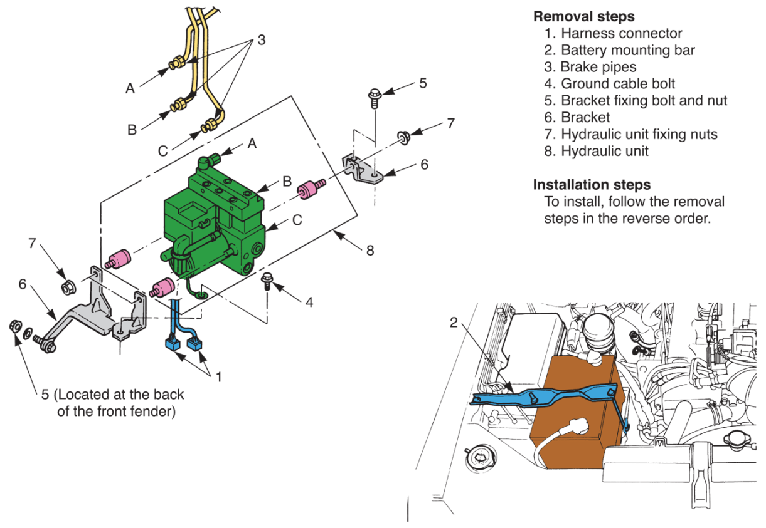
ABS Modulator Service (Cont.)

Slide 51
Regenerative Braking Safety
Pull out HV battery disconnect
Disconnect 12-V battery negative cable
Pull off ABS control module connector
Remove related fuses or circuit breakers to keep all sources of power from reaching ABS control module

Slide 52
Regenerative Braking Safety (Cont.)
If you accidentally reconnect battery power to ABS control circuit, it might perform automatic pressure test to check brake fluid leakage
During pressure test, ABS pump motor applies full hydraulic pressure to all four brake calipers
Your fingers could be crushed if hydraulic piston shoots from its bore at full brake line pressure!

Slide 53
ABS Bleeding
When master cylinder is formed as integral part of modulator, use very specific bleeding procedure
Electrical breakout box and electronic unit might be required to properly energize solenoids when bleeding some systems

Slide 54
ABS Wet Pavement Test
Wet pavement test is performed with two tires on wet pavement and other two tires on dry pavement
Position vehicle so that only right or left tires ride on wet area
Drive vehicle across strip of wet pavement at about five miles per hour
Hit brakes hard to try to make tires skid on pavement

Slide 55
ABS Wet Pavement Test (Cont.)
Ask a helper to watch tire contact on wet pavement and let you know if either tire is totally locking up or not modulating upon hard brake application
As you brake and two of tires try to skid, you should feel pedal modulate
Helper should not see tires lock up or continue to rotate freely
ABS system should modulate hydraulic pressure so tires almost skid

Slide 56
Traction and Stability Control System Service
Diagnosis and repair procedures for traction and stability control systems are similar to methods described for ABS
Use initial inspection and scan tool to find any obvious problems or trouble codes
If you have trouble codes, use pinpoint tests to verify problem

Slide 57
Final System Check
Clear trouble codes and re-scan system for problems
Check brake fluid level in system
Test-drive vehicle in area without traffic
Simulate panic stop several times in large parking lot
Make sure ABS indicator light stays off

