Slide 1


Slide 2
87
Chapter
New and Future Technology

Slide 3
Objectives
After studying this chapter, you will be able to:
Summarize developments in vehicle security technology.
Explain how servo motors have been incorporated into vehicle operation.
Describe how kinetic energy storage systems work.
Discuss the various alternate power sources in use and in development for vehicles.
Explain how composite plastics and metals may be used in future vehicle construction.

Slide 4
Security Technologies
Advancements in electronics and computer technology enable many on-vehicle security features
Civilian access to GPS satellites granted in 1990s
In no time, GPS technology incorporated into everyday devices, including cell phones, tracking devices, and vehicle and pedestrian navigation applications

Slide 5
Vehicle Tracking Systems
Security system that tracks location of car or truck if stolen
One system uses on-board security control module, miniature transmitter and receiver, global positioning satellite (GPS) system, and 24-hour monitoring/response center

Slide 6
Vehicle Tracking Systems
(Cont.)
Some tracking systems provide added security for driver during carjacking or kidnapping
Driver can press emergency call button on key ring, which allows people at response center to listen to conversation in vehicle and to take action as needed
Response center can call police and tell them exact location and description of vehicle
  Other systems enable vehicle to be remotely disabled

Slide 7
Night Vision Systems
Use infrared camera and monitor system to help driver’s view in fog, snow, rain, and other vision-impairing atmospheric conditions
This lets driver see longer distances through outside conditions, like fog, to detect oncoming vehicles, people, curves in road, and other dangers

Slide 8
Vehicle Operation Technologies
Advancements in both electronics technology and environmental consciousness have prompted changes in how vehicle operates, as well as features offered to consumers

Slide 9
Electric Brake Calipers
Uses one or more servo motors to force brake pads into rotating brake disc to slow and stop vehicle
This type of caliper eliminates need for brake system hydraulic components

Slide 10
Electric Parking Brake
Electric parking brake or electric emergency brake
  Uses dash-mounted switch and electric servo motor to mechanically apply rear brake
When parking brake servo motor is energized, it rotates worm gear that acts on lever mechanism to pull on mechanical arm and cable mechanism
Cable mechanism forces brake pads or shoes into rotors or drums to keep vehicle from rolling

Slide 11
Kinetic Energy Recovery System (KERS)
Capture kinetic energy generated during vehicle braking and store energy to assist in vehicle acceleration from standstill
Kinetic energy generated during vehicle braking spins composite steel flywheel mounted in vehicle’s hub at speeds up to 100,000 rpms
When acceleration boost is needed, energy of flywheel connects to rear wheels to temporarily supplement engine power

Slide 12
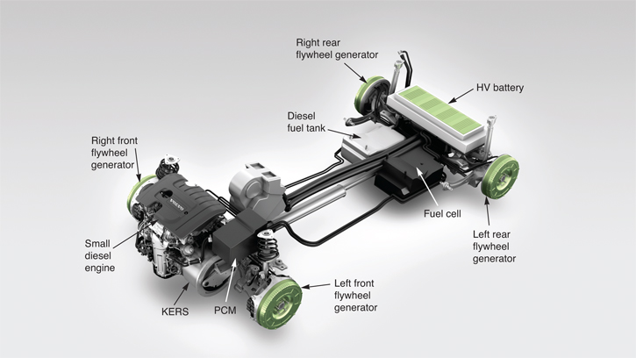
Kinetic Energy Recovery System
(Cont.)
(Volvo)

Slide 13
Automatic Tire Wear Adjustment
Could eliminate need to rotate tires
If one tire is worn, it would be slightly smaller in diameter than others
Computer would detect higher signal frequency from wheel sensor monitoring rotation of worn tire
Computer could then adjust differential solenoids to apply more pressure to one side of differential clutch pack upon acceleration

Slide 14
Alternate Power Sources
Alternate power sources are other methods of producing energy to propel motor vehicle
  Other than from gasoline and diesel oil
Most promising include electric vehicles, hybrid vehicles, hydrogen fuel engines, and flexible-fuel vehicles

Slide 15
Electric Vehicles
Electric vehicle uses large, high efficiency electric motor and large storage batteries to power automobile and reduce air pollution from burning fossil fuels
Provide viable, alternate means of vehicle propulsion for short trips
One drawback is environmental pollution from building large number of power generating stations needed to recharge millions of batteries every night

Slide 16
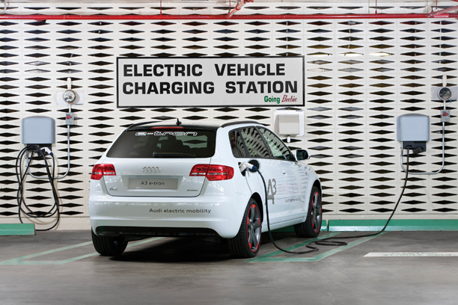
Electric Vehicles (Cont.)
(Audi)

Slide 17
Flywheel Generator Hybrids
Flywheel generator drive system is direct electric wheel drive design that eliminates power lost from having to spin or rotate transmission gearset and differential assembly in heavy gear oil
Four flywheel generators are used to rotate or stop four wheels and tires directly

Slide 18
Flywheel Generator Hybrids
(Cont.)
This system eliminates need for friction brake pads and large rotors that waste energy needed to bring car to stop by generating heat
Problem with flywheel generator drive systems is they increase unsprung weight and ride harshness on rough roads

Slide 19
Solar Vehicles
Uses solar panels to generate electricity for propulsion
Someday whole surface of hood, roof, and trunk could be covered with solar panels
This would eliminate need to recharge vehicle at charging station
Battery would charge for free

Slide 20
Hydrogen Fuel
Hydrogen burns with no harmful emissions
Water vapor is only by-product of combustion
Process of electrolysis can convert ocean salt water into pure hydrogen and oxygen
Electrolysis
  Sends electric current through water, which separates two atoms of hydrogen from one atom of oxygen into separate gases

Slide 21
Hydrogen Fuel (Cont.)
Producing hydrogen fuel is currently too expensive using conventional sources of energy
Hydrogen fuel production using low-cost wind or solar energy to process salt water would create very desirable new fuel source
Engines would be just as powerful but would operate much more cleanly, with no adverse effects on atmosphere and climate

Slide 22
Fuel Cell
Combines hydrogen and oxygen to produce electrical energy
Electrolysis in reverse
When current is drawn out of fuel cell, oxygen molecules separate and combine with hydrogen ions to form water and heat

Slide 23
Flexible-Fuel Vehicles
Flexible-fuel vehicles (FFV)
  Designed to operate on different types of fuel
Sensors monitor contents of fuel through measurement of combustion efficiency, and engine functions are adjusted for maximum efficiency for type fuel being consumed

Slide 24
Gas Turbine
Alternate types of engines that burn wide variety of fuels
  Gasoline, kerosene, or oil
Gas turbine produces tremendous power for its size
Because of spinning action, its power output is very smooth
Gas turbines are not currently in use due to high manufacturing costs and poor fuel efficiency

Slide 25
Plant Fuels and Lubricants
Plant fuel research led to development of biodiesel fuel
Biodiesel can be created from animal fats or vegetable oils
  Including waste oils and grease from restaurants
Biodiesel can be used in current diesel engines without modification

Slide 26
Plant Fuels and Lubricants
(Cont.)
Ethanol is another plant fuel already in wide use
Currently, small quantities of ethanol are blended with gasoline to increase octane and reduce emissions
Synthetic motor oil has been created from farm grown plants and vegetables, and performs as well as crude oil based lubricants

Slide 27
Future Vehicle Construction
Vehicle curb weight reduction is most important factor in further improving fuel economy
Engine block strength increased by casting composite webbing into cast iron and aluminum parts
Body panels on cars now made from lightweight aluminum, fiberglass, or carbon fiber

Slide 28
Future Vehicle Construction
(Cont.)
A-pillars on side of windshield can be made of high-strength steel with carbon fiber core tubes for added stiffness during vehicle roll-over accident
Inflatable door impact beams
  Powerful pyrotechnic charge is used to expand metal beam so it balloons out to larger diameter
  Withstands more violent collisions from side without intrusion into driver or passenger seat area

Slide 29
Future Systems
What automotive design changes will we see in next century or two?
Just look at the advances humans have made in the past 100 years!
We have gone from horseless carriage to hybrid passenger vehicle, and from experimenting with human flight to traveling beyond the moon in one human lifetime

Slide 30
Future Systems (Cont.)
We have technology to reduce impact of passenger vehicles on environment and atmosphere
Hybrid gas/electric propulsion systems are big step in right direction for our planet’s future and our driving experience

Slide 31
Future Systems (Cont.)
Recycling is becoming more standard in practice in the automotive industry
It may increase to the point that whole car bodies are built out of recycled aluminum cans
Car body made out of “old soda pop cans” will be strong, lighter vehicle that resists corrosion much better than steel

