Slide 1
BATTERY
State of Charge
SC1
By
Vance Bloom

Slide 2
Objective
    Student will determine the “State of Charge”
    of a battery using the “Voltage Method” and
    document results. Student will also be aware
    of two other methods of determining
    “State of Charge”.
    Remember, this test does not tell you if the battery
    is good or bad, only how fully the battery is charged.
Just How Much Power
is in That Battery?

Slide 3
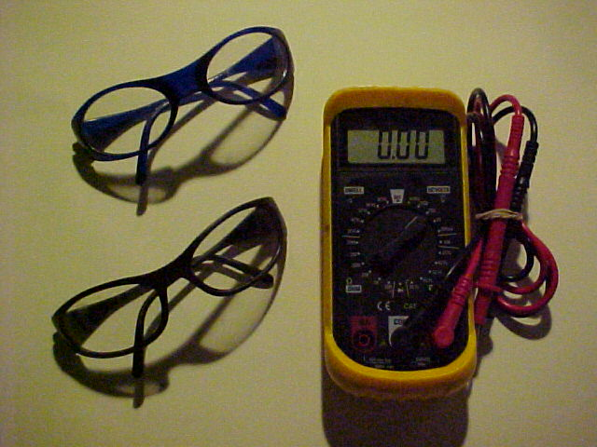
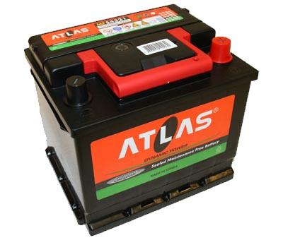
MATERIALS REQUIRED
1. EYE PROTECTION
2. VOLT-OHM-METER
3. BATTERY

Slide 4
Procedure

Slide 5
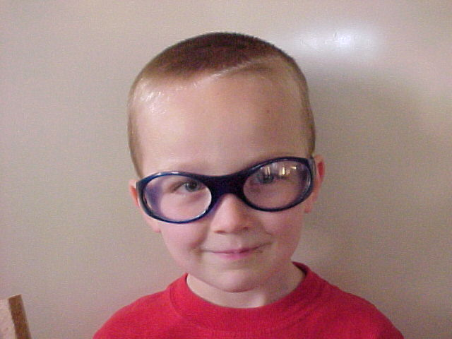
WEAR EYE PROTECTION!

Slide 6
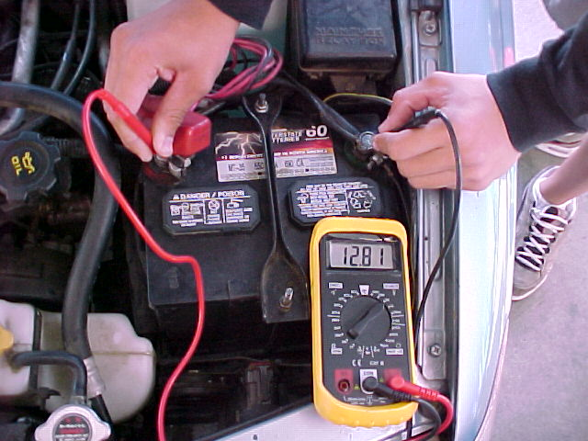
Voltage Method
Determine battery voltage
(Use 20 Volt DC Scale)
Write It Down!

Slide 7
RESULTS
Record Battery Voltage Measured &
Estimate % of Charge Using Chart Below
Fill in voltage chart on skill sheet
11.80 or Lower…………………0% Charge
12.00 ………………………………….25% Charge
12.20 ………………………………….50% Charge
12.40 ………………………………….75% Charge
12.60 or Higher …………….100% Charge

Slide 8
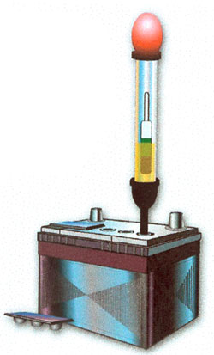
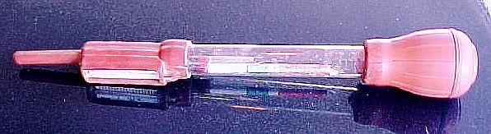
  SPECIFIC GRAVITY METHOD
(When applicable)
SPECIFIC GRAVITY REFERENCE CHART
Red 1.000 Water (dead)
White 1.225 Recharge
Green 1.250 - 1.300 Full Charge
    IF READINGS VARY BY MORE THAN 0.050 REPLACE BATTERY

Slide 9
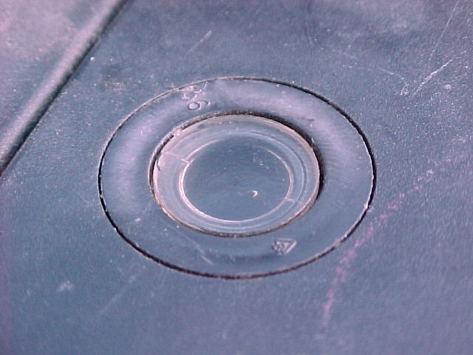
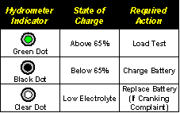
BATTERY EYE METHOD
(When applicable)
Observe the color of the indicator (EYE)
and record the result: __________
    Green or Blue = 65-100 percent charge.
    The battery is adequately charged for further testing.
    Dark or Black = 0-65 percent charge.
    The battery is NOT ADEQUATELY
    charged and must be charged.
Yellow, Clear, or Bright
COLOR = Battery must be replaced.

Slide 10
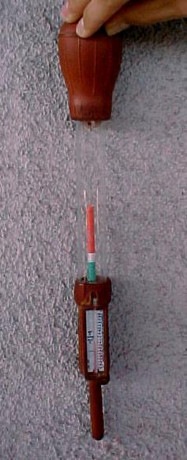
  SPECIFIC GRAVITY METHOD
(When the battery has removable caps)
Specific Gravity Tester
Red means “Dead”
White means “Charge”
Green means “Full”

Slide 11
  SPECIFIC GRAVITY METHOD
(When applicable)
Specific Gravity Tester
Drawbacks
1. Easily Broken (Glass)
2. Messy, Gets Acid all over
3. Some Batteries do not have
access to acid (sealed caps)

Slide 12
Recommendations?
Does the Battery need to be Charged?
How much charge was in it?
Does anything need to be done?
(Cleaning , Water Added, ETC…)
Record Your Recommendations
On Your Skill Sheet!

Slide 13
NOW, CLEAN UP!
CLEAN, SHUT OFF
& PUT AWAY
VOLT-OHM-METER
FILL OUT YOUR
SKILL SHEET COMPLETELY
& GET IT SIGNED!

Slide 14
QUESTIONS?
CONTACT
VANCE BLOOM
vbloom@hemetusd.k12.ca.us

Slide 15
THE END

