Slide 1
BATTERY DRAW TEST
SC10
By
Vance Bloom

Slide 2
Objective
    Student will determine if an abnormal
    “Key OFF Battery Drain” is present.

Slide 3
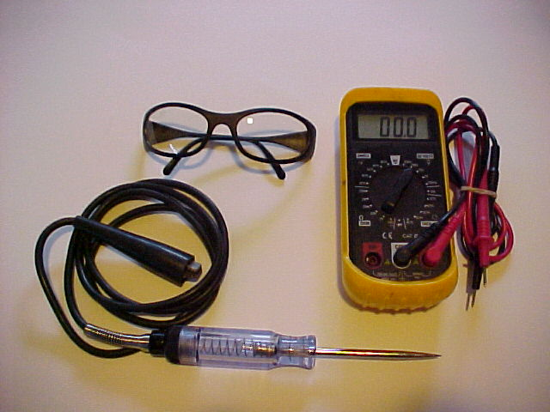
MATERIALS REQUIRED
1. EYE PROTECTION
2. HAND TOOLS
3. VOLT-OHM-METER
3. TEST LAMP
4. VEHICLE WITH GOOD BATTERY

Slide 4
Procedure

Slide 5
Before Starting
Turn ignition key OFF and remove keys from ignition.
Make sure all electrical devices and lights are OFF.
Make sure all doors are closed and hood light
is disconnected. (where applicable)

Slide 6

STEP 1
WEAR EYE PROTECTION!

Slide 7
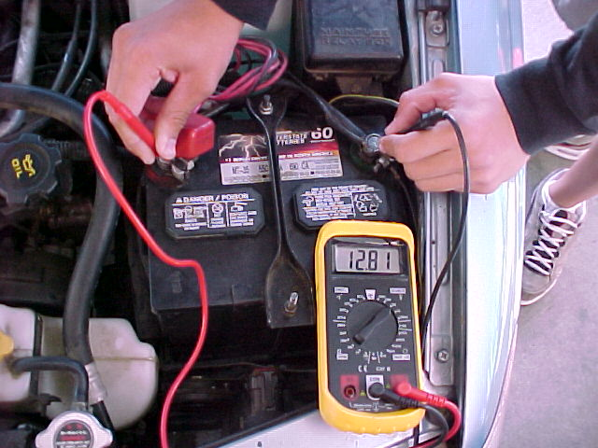
STEP 2
Determine battery voltage
If Above 12.4 Volts, Then Proceed
If Below 12.4 Volts,
Then Charge Battery.
Recheck Battery Voltage.
If Still Below 12.4 Volts,
Replace Battery, Then Proceed

Slide 8
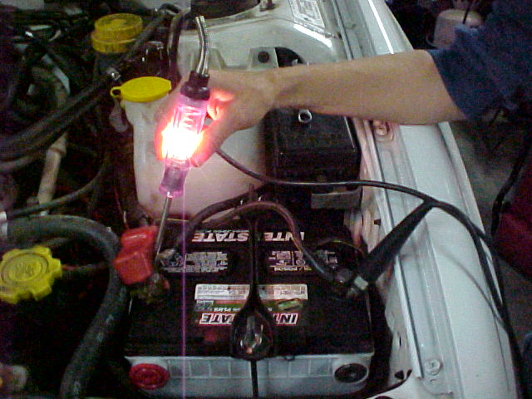
STEP 3
Check Test Lamp Operation
Be Sure It Lights Up!

Slide 9
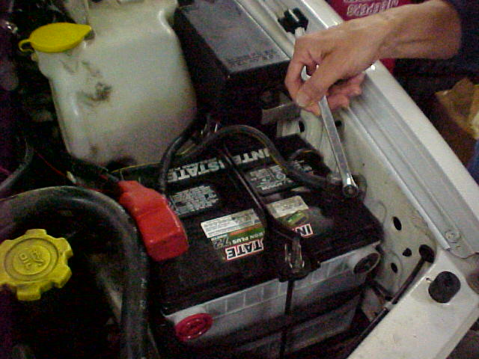
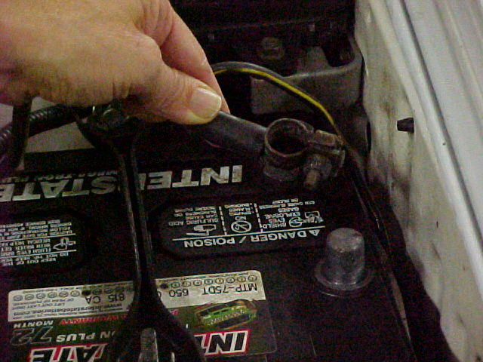
STEP 4
Disconnect Battery
Negative Ground Cable

Slide 10
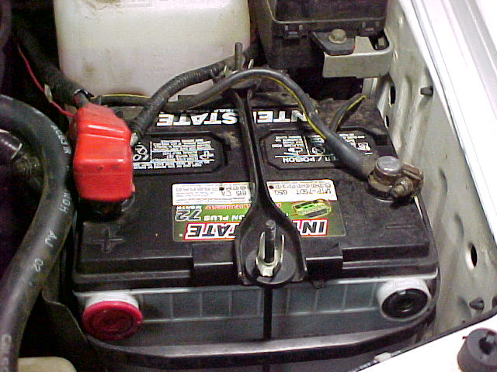
Never Disconnect Positive First!
It Could Cause The Airbag To Deploy!

Slide 11
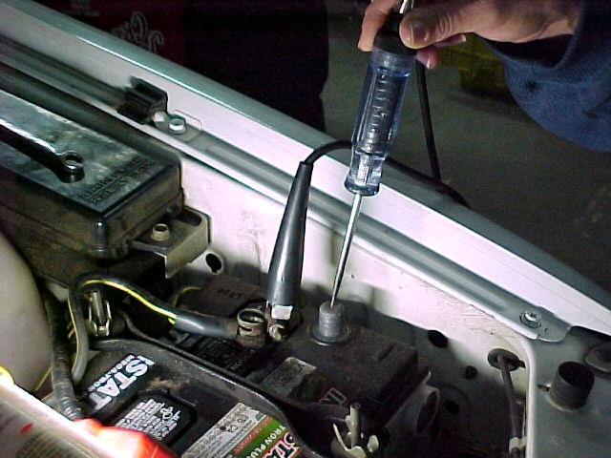
STEP 5
CONNECT TESTER
Hook Up Test Lamp
Between Battery Negative
Post & Cable End

Slide 12
STEP 6
RESULTS
Test light does not light
PASS NO BATTERY DRAIN PRESENT
Test light lights brightly
FAIL ABNORMAL DRAIN PRESENT
Test light lights dimly
PASS NORMAL MEMORY DRAIN
(From Clock or Radio Memory)

Slide 13
STEP 7
Record Your Data
Is there an abnormal
Draw Present?
(Test Lamp Lights Brightly)
Does the Battery Draw Test
PASS or FAIL?
Record Your Results !

Slide 14
STEP 8
Recommendations?
Does anything need to be done?
Does a Draw need to be repaired?
Record Your Recommendation
On Your Skill Sheet!

Slide 15
NOW,
CLEAN UP YOUR MESS!
CLEAN & PUT AWAY
ALL TOOLS & EQUIPMENT
FILL OUT YOUR
SKILL SHEET COMPLETELY
& GET IT SIGNED!

Slide 16
QUESTIONS?
CONTACT
VANCE BLOOM
@
1-909-696-1081
vbloom@murrieta.k12.ca.us

Slide 17
THE END

