Slide 1
Charging a Battery
SC2
By
Vance Bloom

Slide 2
Objective
    Student will determine the
    state of charge of a battery
    and charge a battery
    in or out of the vehicle.

Slide 3
MATERIALS REQUIRED
1. EYE PROTECTION
2. VOLT-OHM-METER
3. BATTERY CHARGER
4. BATTERY

Slide 4
Procedure

Slide 5
CAUTION!
Never Make Sparks or Flame by Battery
The Hydrogen Gas Given Off by the Battery is
Explosive!

Slide 6

STEP 1
WEAR EYE PROTECTION!

Slide 7
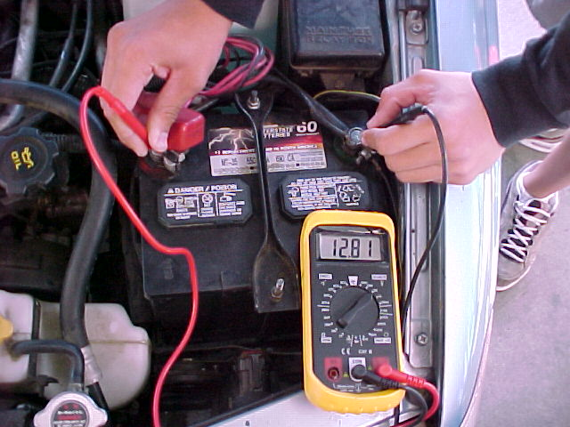
STEP 2
Determine battery voltage
(Use 20 Volt DC Scale)
Write It Down!

Slide 8
STEP 3
Determine State of Charge
Document Battery Voltage
Record Battery Voltage &
Estimate Percentage of Charge & Record
11.7 or Lower…………………0% Charge
12.0 ………………………………….25% Charge
12.2 ………………………………….50% Charge
12.4 ………………………………….75% Charge
12.6 or Higher …………….100% Charge

Slide 9
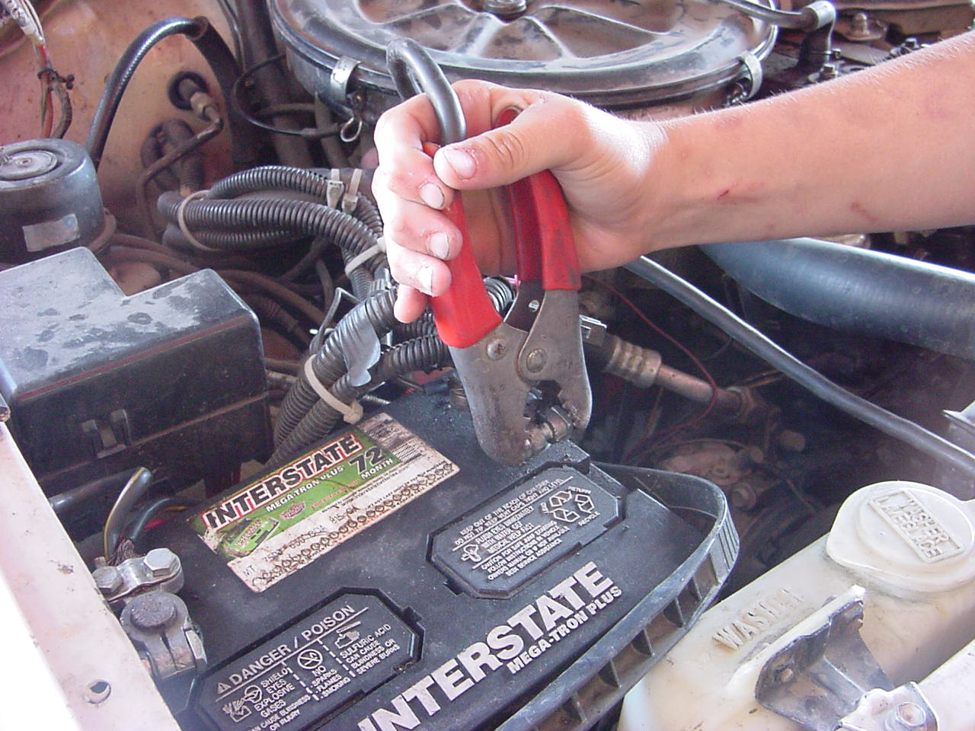
STEP 4
Hook Up Battery Charger (+)
Hook up Positive (+) Clamp
to Positive Post on Battery

Slide 10

STEP 5
Hook Up Battery Charger (-)
Hook up Negative (-) Clamp
to Engine Block Ground

Slide 11
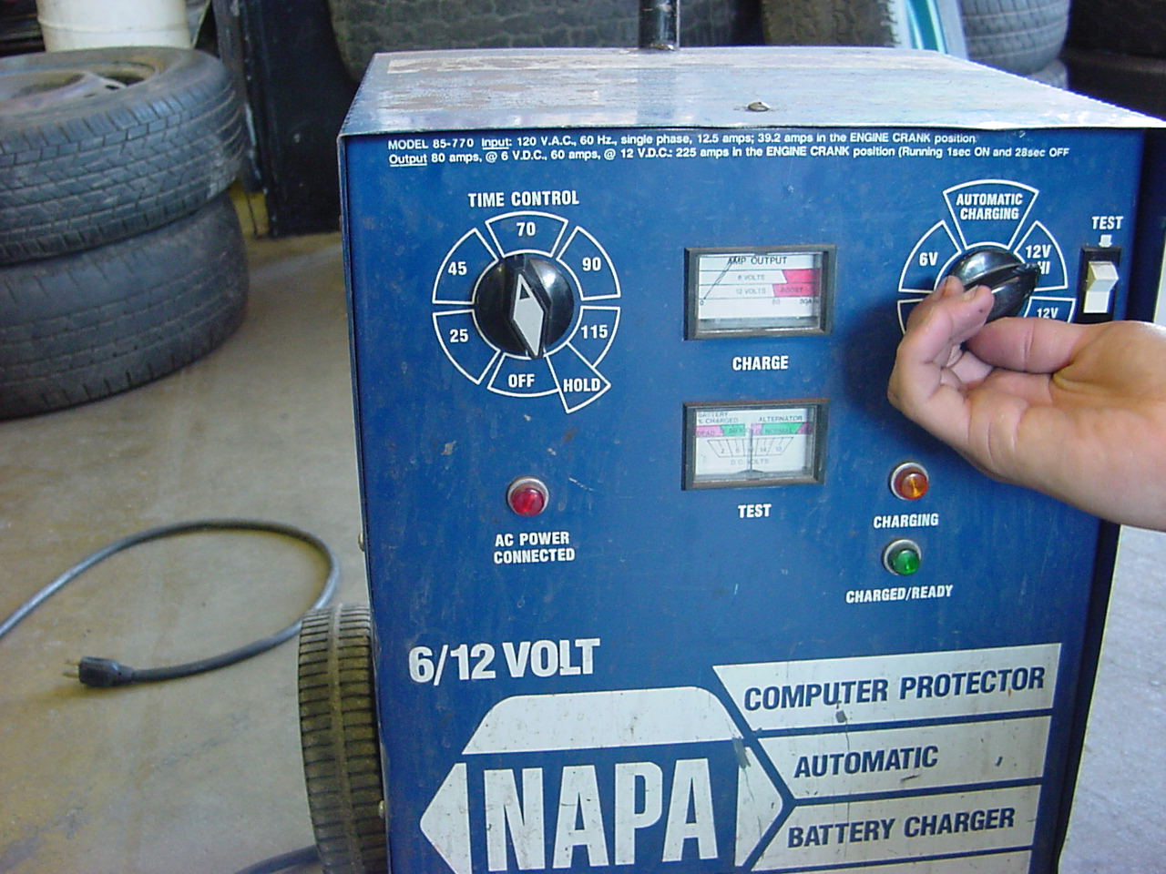
STEP 6
Set Battery Charger Settings
For most batteries
12Volt Hi for 60 Minutes

Slide 12
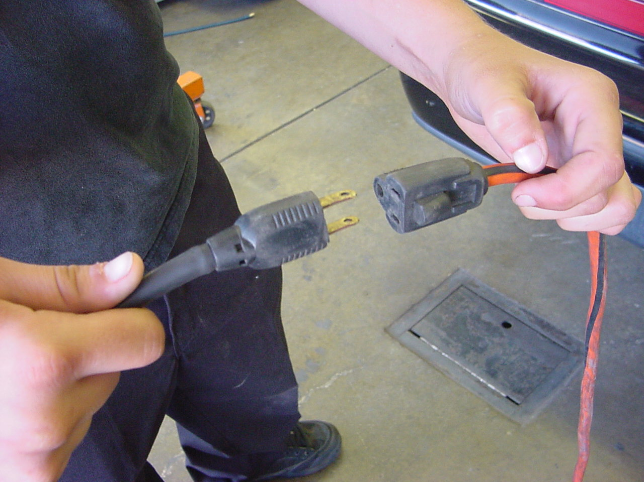
STEP 7
Plug In Battery Charger
When time is up
Unplug Charger FIRST!

Slide 13
REVERSE PROCEDURE
TO DISCONNECT CHARGER
WHEN FINISHED CHARGING

Slide 14
NOW, CLEAN UP!
CLEAN, SHUT OFF
& PUT AWAY
VOLT-OHM-METER
AND BATTERY CHARGER
FILL OUT YOUR
SKILL SHEET COMPLETELY
& GET IT SIGNED!

Slide 15
QUESTIONS?
CONTACT
VANCE BLOOM
@
1-909-696-1081
vbloom@murrieta.k12.ca.us

Slide 16
THE END

