Slide 1
Boost/Jump Starting
SC3B
Jump Starting a Vehicle
With Jumper Cables
By
Vance Bloom

Slide 2
Objective
    Student will safely
    boost/jump start a vehicle
    using jumper cables.

Slide 3
MATERIALS REQUIRED
1. EYE PROTECTION
2. JUMPER CABLES
3. VEHICLES/(SEE INSTRUCTOR)

Slide 4
Procedure
Read the entire task sheet after watching this power point!

Slide 5

CAUTION!
Never Make Sparks or Flame by Battery
The Hydrogen Gas Given Off by the Battery is
Explosive !

Slide 6

STEP 1
WEAR EYE PROTECTION!

Slide 7
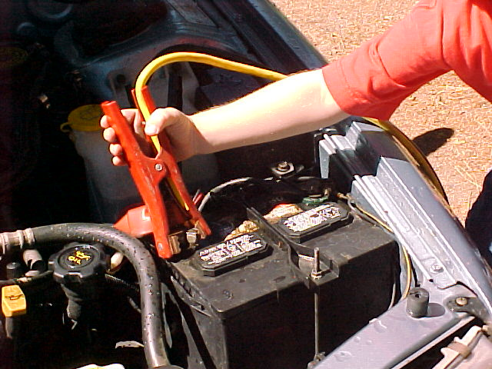
STEP 2
Hook up Positive(+) Clamp
To Positive Post on
“Dead” Battery

Slide 8
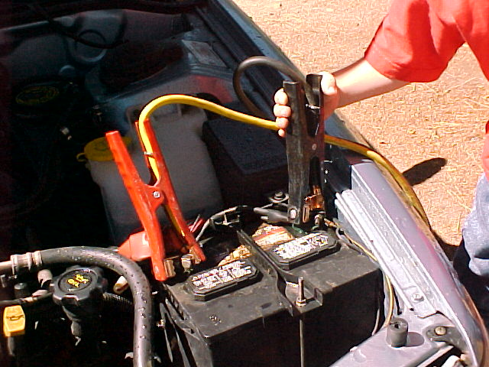
STEP 3
Hook up Negative(-) Clamp
To Negative Post on
“Dead” Battery

Slide 9
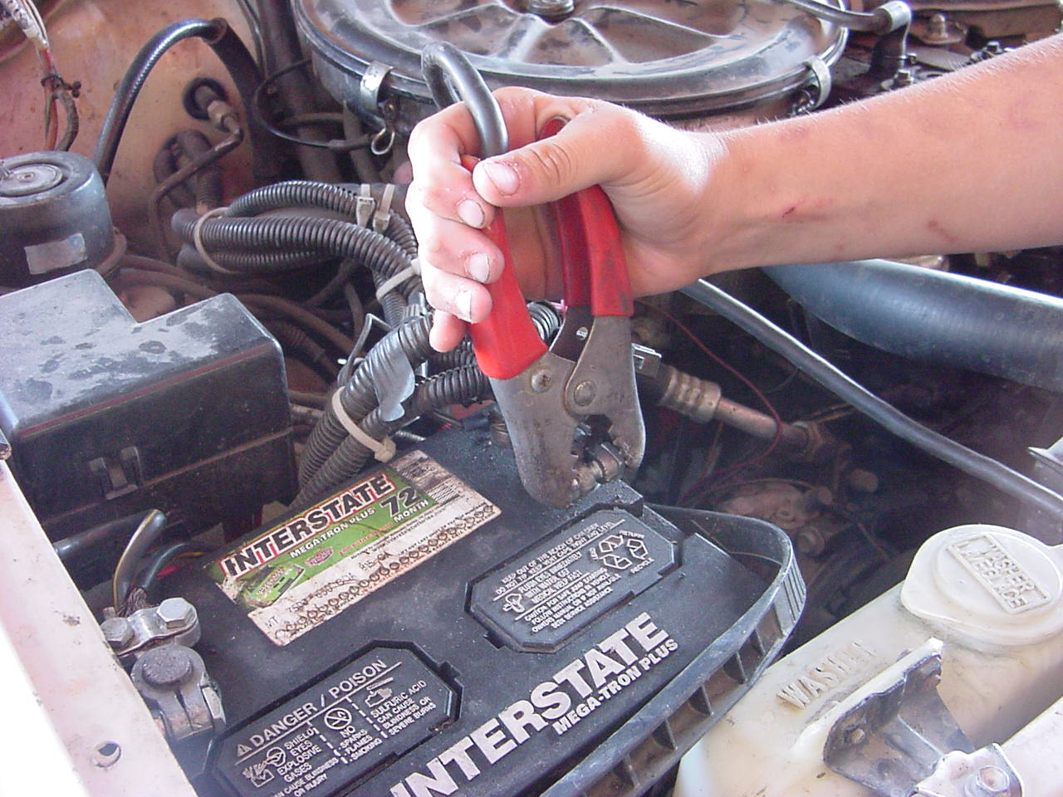
STEP 4
Hook up Positive(+) Clamp
To Positive Post on
“Good” Battery

Slide 10
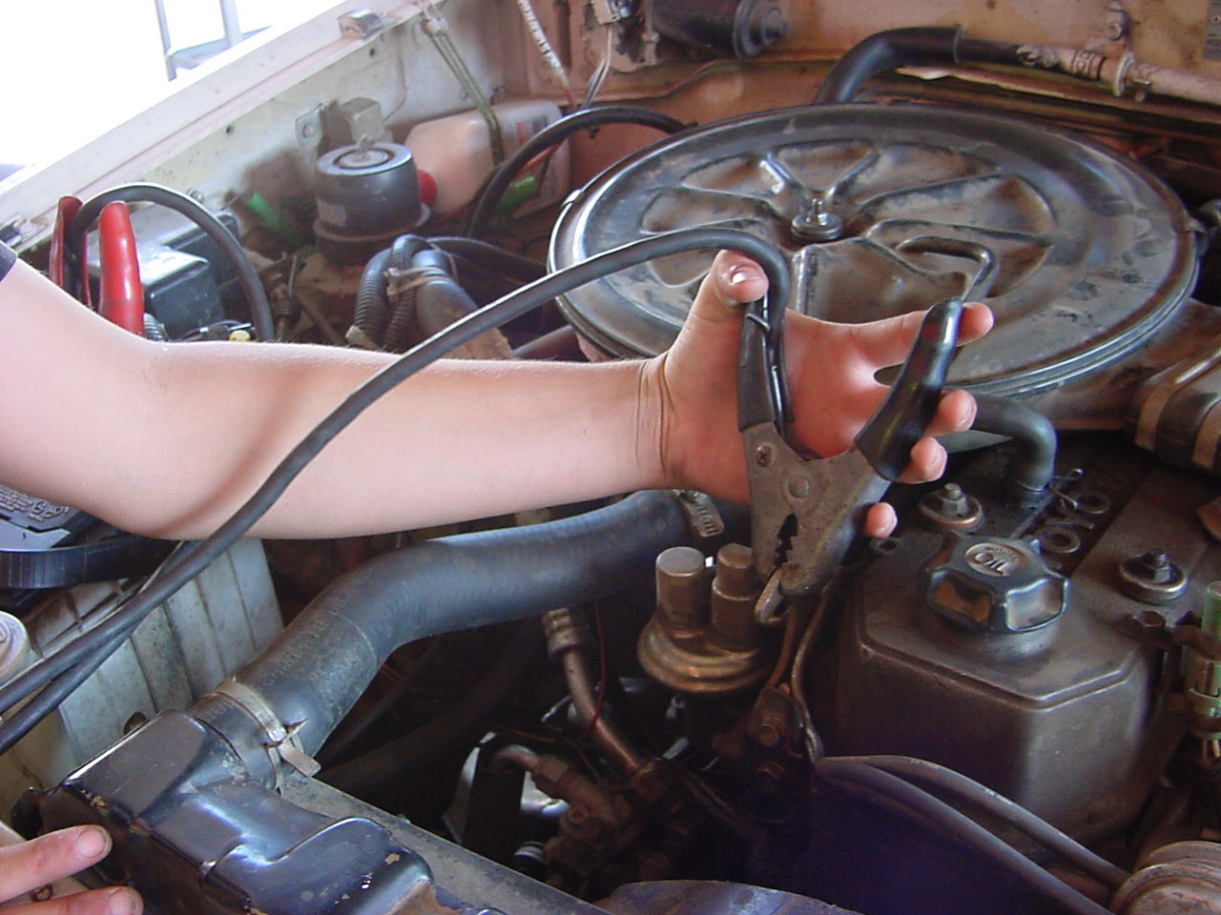
STEP 5
Hook up Negative (-) Clamp
To Engine Block Ground
On “Good” battery

Slide 11
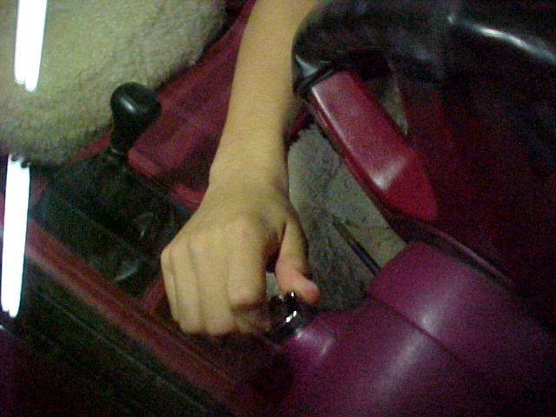

STEP 6
Start Engine on
“Running” Vehicle

Slide 12
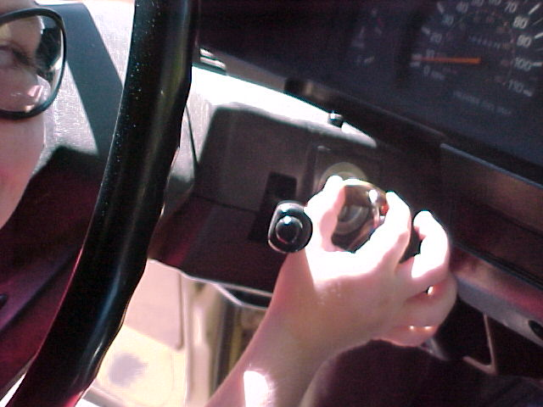
STEP 7
Wait 5-10 Minutes,
Start Engine on
“Dead” Vehicle

Slide 13
REVERSE PROCEDURE
DISCONNECT CABLES IN
REVERSE ORDER OF CONNECTTING

Slide 14
NOW, CLEAN UP!
CLEAN & PUT AWAY
JUMPER CABLES
FILL OUT YOUR
SKILL SHEET COMPLETELY
& GET IT SIGNED!

Slide 15
QUESTIONS?
CONTACT
Vance Bloom
@
1-951-765-9112
vbloom@hemetusd.k12.ca.us

Slide 16
THE END

