Slide 1
Battery Conductance Test
SC4A
By Michael Figueroa
Assisted by Taylor Bover

Slide 2
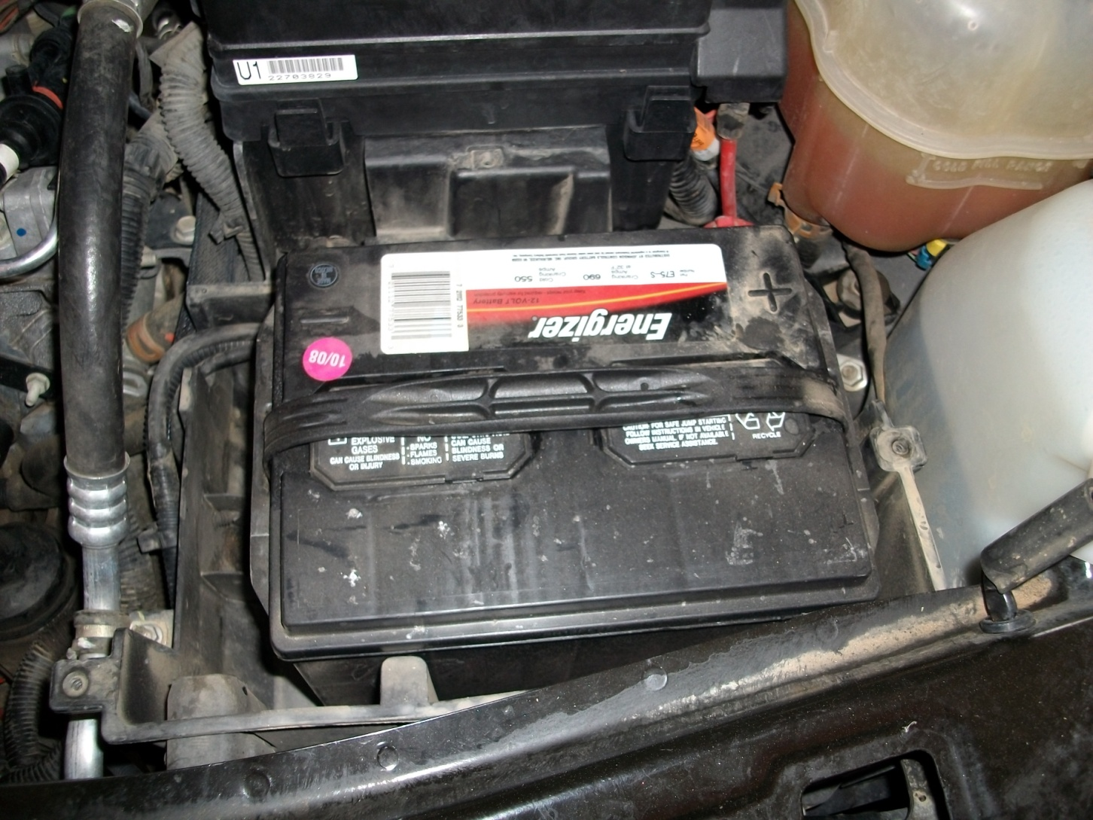
Is the battery any good?

Slide 3
Materials
1.EYE PROTECTION
2. Battery Conductance Tester
3. Vehicle or Battery (see instructor)

Slide 4
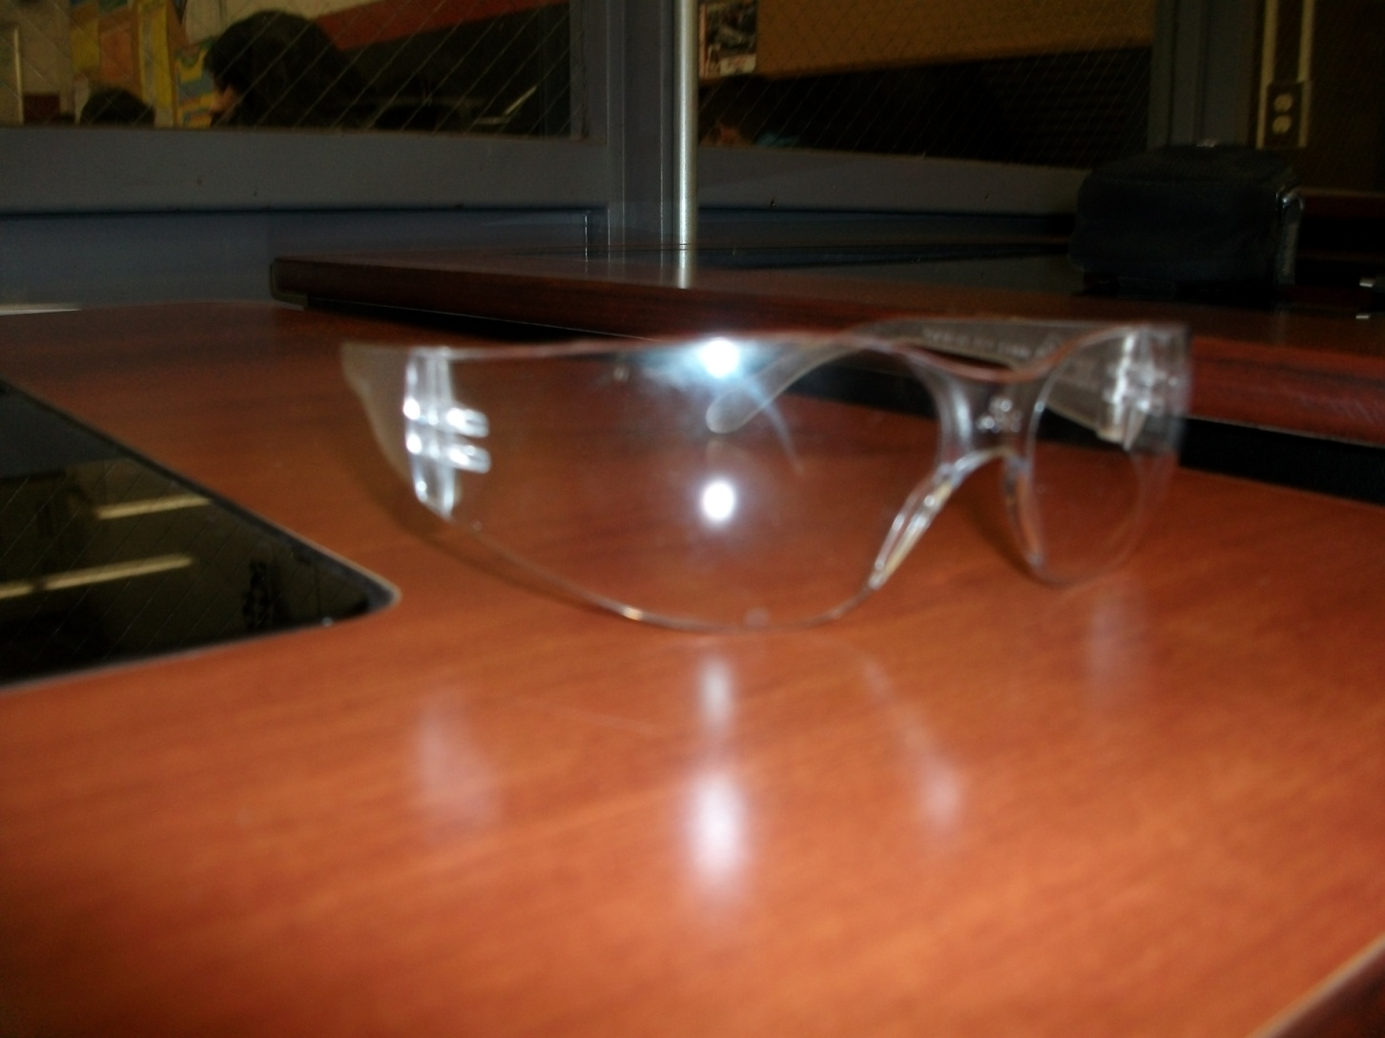
EYE PROTECTION

Slide 5
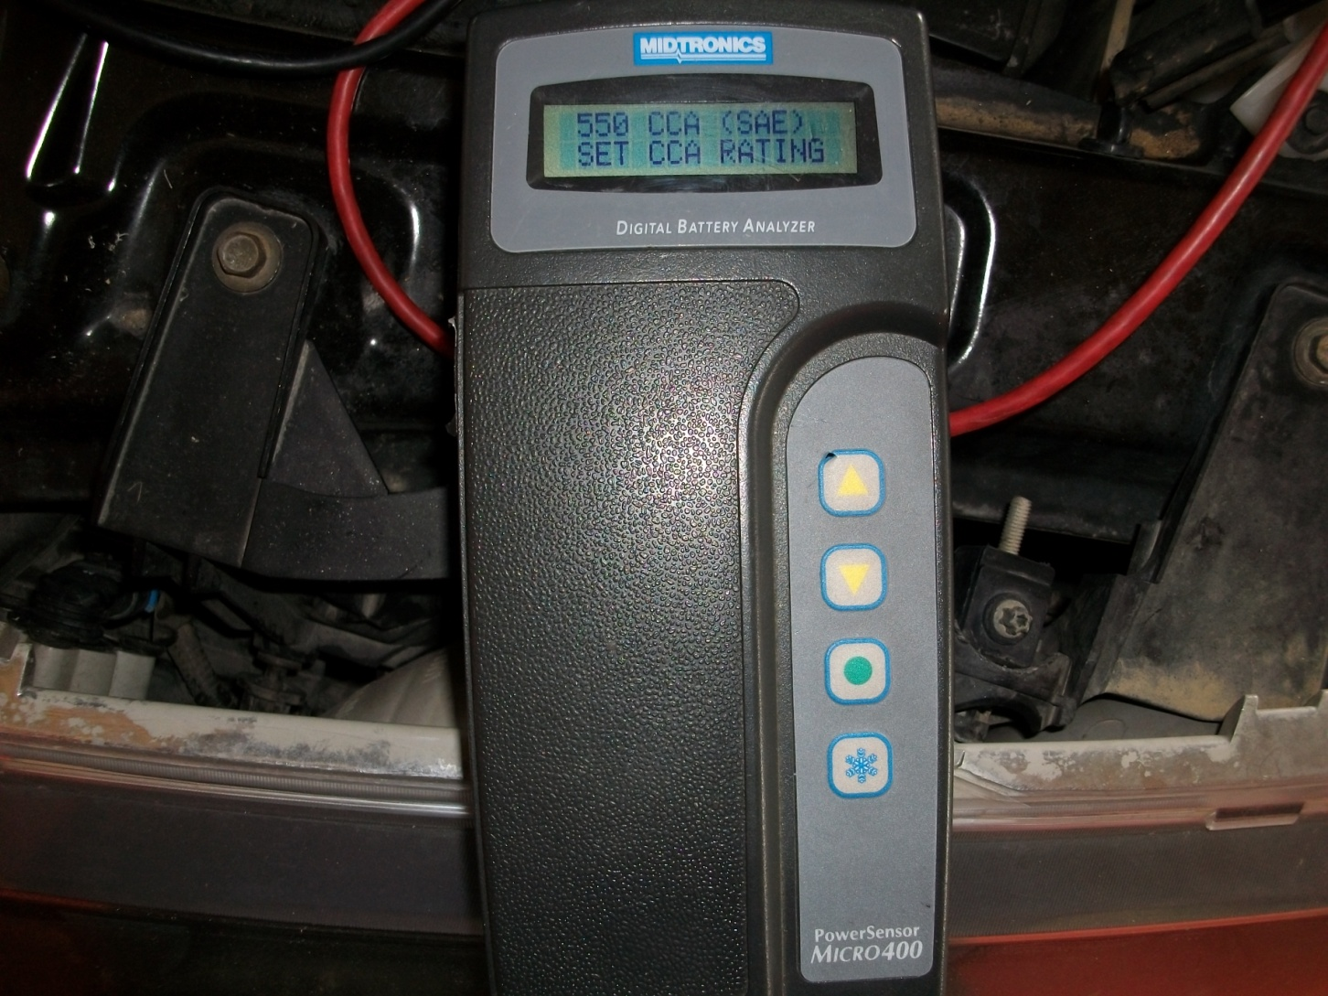
Battery Conductance Tester

Slide 6
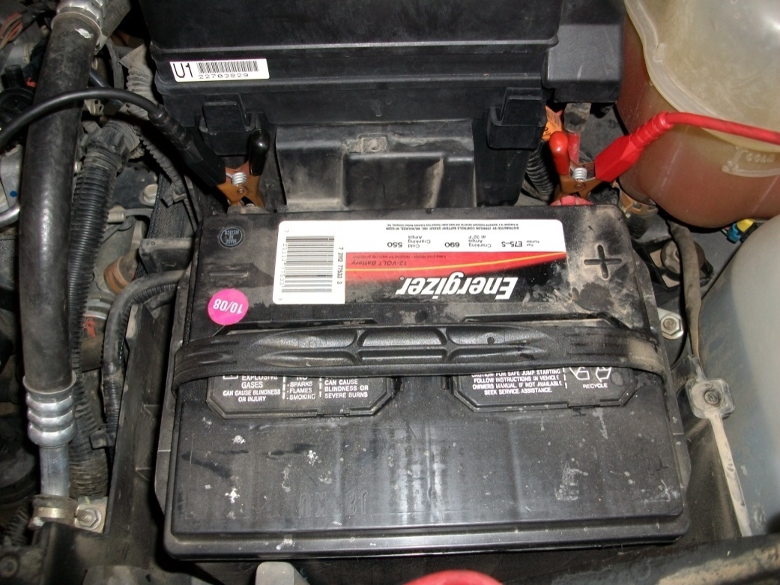
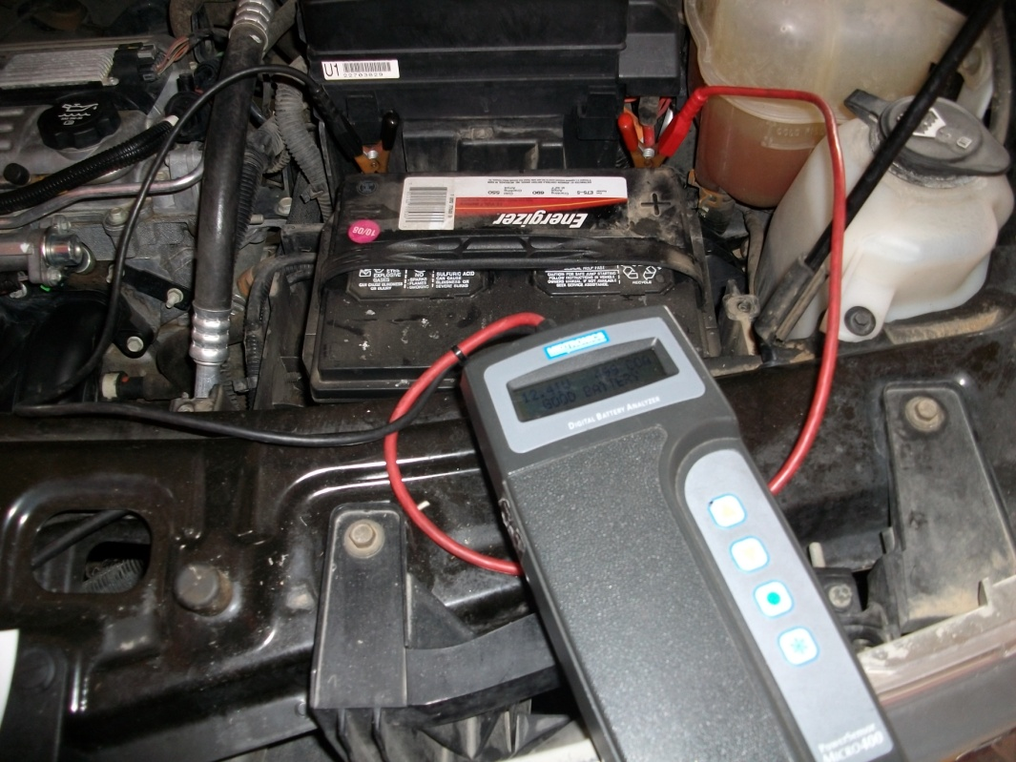
Connect positive cable (red) to positive post, then negative cable (black) to negative post and set CCA to battery specifications.
(it’s on the battery label)
CCA

Slide 7
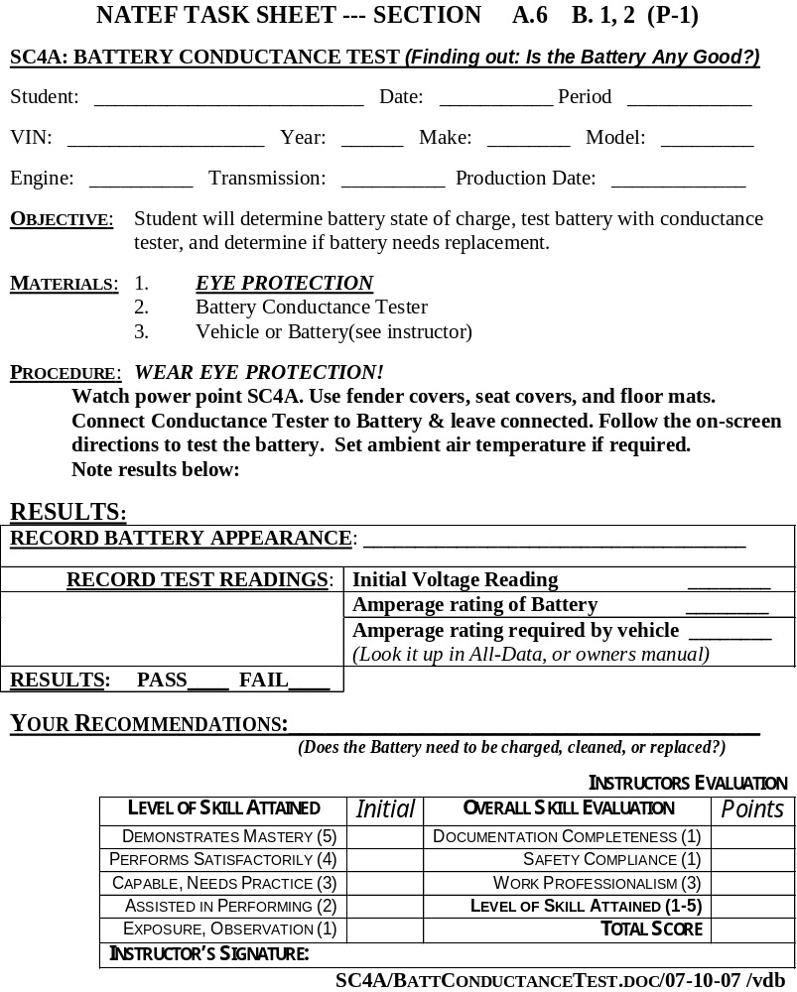
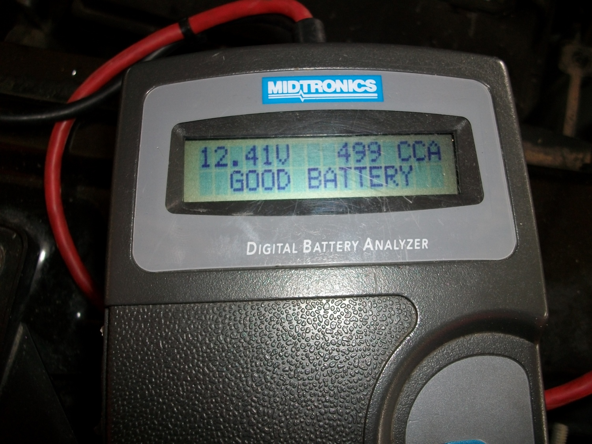
Is the battery good?
Record your results.

Slide 8
Any Questions?
Read the Task Sheet again,
Then ask two other students,
Finally… Ask your Instructor

