Slide 1
Load Testing a Battery
SC4B
By
Vance Bloom

Slide 2
Objective
    Student will determine the
    state of charge of a battery
    and load test a battery
    in or out of the vehicle.
    Do you need to buy a new battery?

Slide 3
MATERIALS REQUIRED
1. EYE PROTECTION
2. VOLT-OHM-METER
3. BATTERY LOAD TESTER
4. BATTERY

Slide 4
Procedure

Slide 5

CAUTION!
Never Make Sparks or Flame by Battery
The Hydrogen Gas Given Off by the Battery is
Explosive!

Slide 6

STEP 1
WEAR EYE PROTECTION!

Slide 7
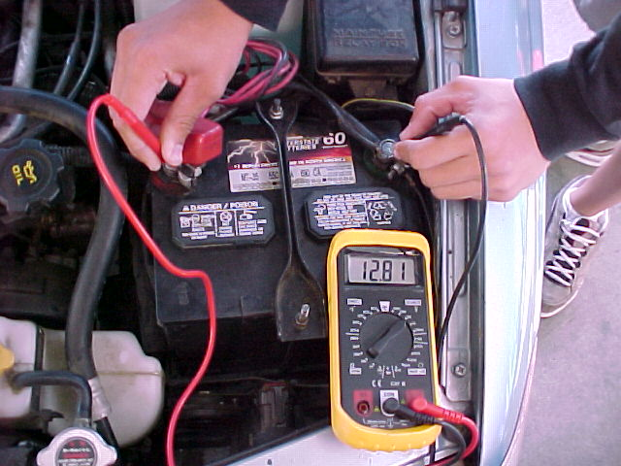
STEP 2
Determine battery voltage
(Use 20 Volt DC Scale)
Write It Down!

Slide 8
STEP 3
Determine State of Charge
Record Battery Voltage &
Estimate Percentage of Charge & Record
11.7 or Lower…………………0% Charge
12.0 ………………………………….25% Charge
12.2 ………………………………….50% Charge
12.4 ………………………………….75% Charge
12.6 or Higher …………….100% Charge
IF BATTERY VOLTAGE IS BELOW 12.4 VOLTS,
BATTERY MUST BE CHARGED TO PROCEED!
IF BATTERY VOLTAGE IS ABOVE 12.4 VOLTS,
YOU MAY PROCEED WITH TEST!

Slide 9
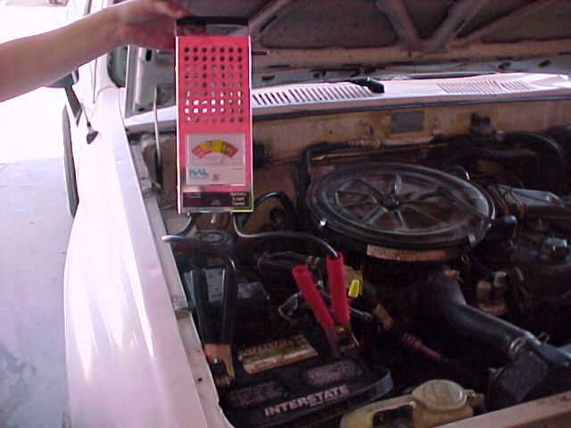
STEP 4
Hook Up Battery Load Tester
Red to Positive(+)
Black to Negative -

Slide 10
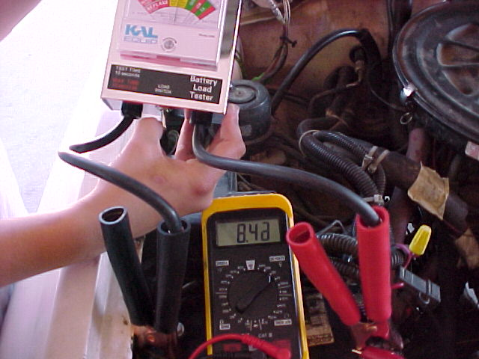
STEP 5
Load Test Battery for 10 Seconds
Note Voltage Reading @ 10 Seconds
While Still Pressing the Button !

Slide 11
STEP 6
Results
IF LOADED TEST VOLTAGE IS ABOVE 9.6 VOLTS
BATTERY PASSES TEST
IF LOADED TEST VOLTAGE IS BELOW 9.6 VOLTS
BATTERY FAILS TEST

Slide 12
NOW, CLEAN UP!
CLEAN, SHUT OFF
& PUT AWAY
VOLT-OHM-METER
AND BATTERY TESTER
FILL OUT YOUR
SKILL SHEET COMPLETELY
& GET IT SIGNED!

Slide 13
QUESTIONS?
CONTACT
VANCE BLOOM
@
1-909-696-1081
vbloom@murrieta.k12.ca.us

Slide 14
THE END

