Slide 1
Testing Alternator Output
SC6
By
Vance Bloom & Florante Boac

Slide 2
Materials Required

Slide 3
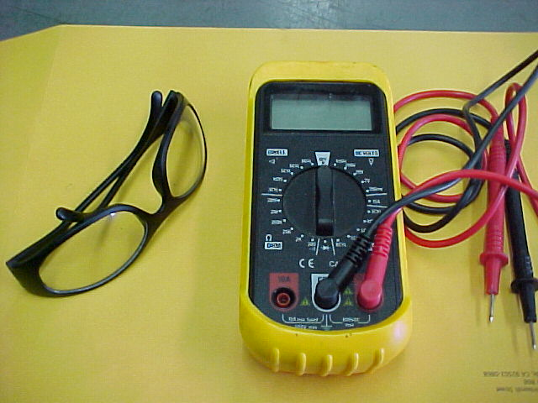
Safety Glasses
Digital Volt-Ohm-Meter

Slide 4

Vehicle

Slide 5

STEP 1 WEAR EYE PROTECTION!

Slide 6
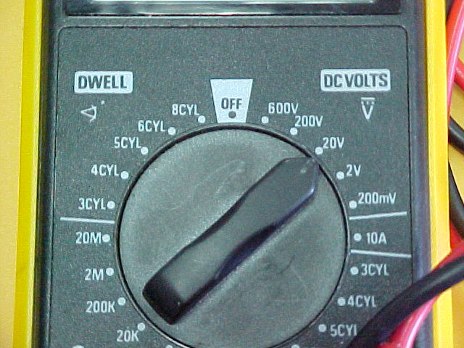
STEP 2
Put Volt-Ohm-Meter on
20Volt DC Scale

Slide 7
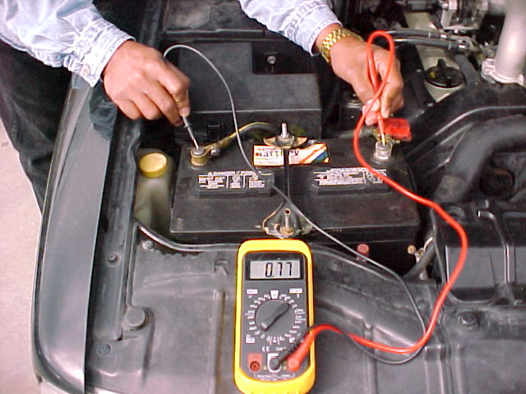
STEP 3
Test Battery Voltage with vehicle OFF
Write Down Reading on Skill Sheet

Slide 8
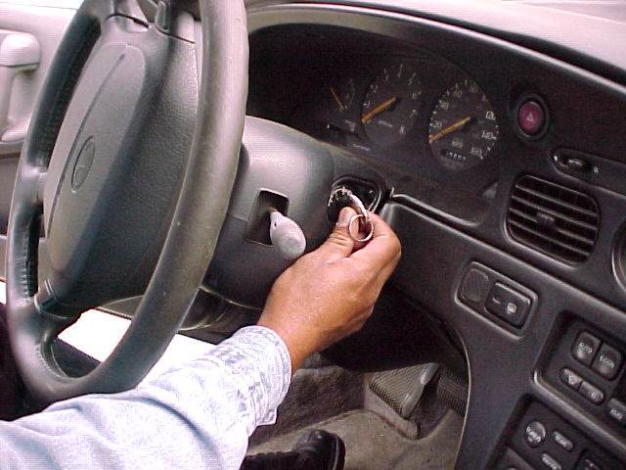
STEP 4
Start Vehicle

Slide 9
STEP 5
Test Battery Voltage with vehicle Idling
Write Down Reading on Skill Sheet
13.97

Slide 10
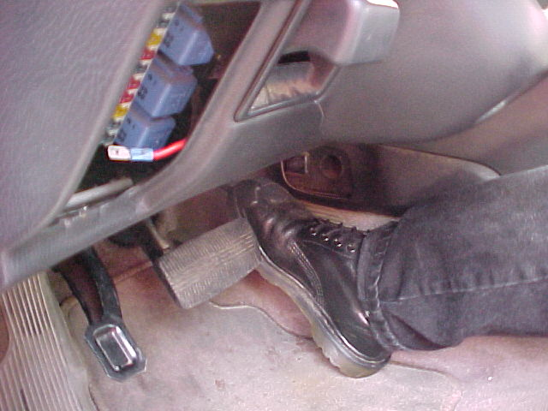
STEP 6
Increase Idle to 1800 RPM
Write Down Voltage Reading

Slide 11
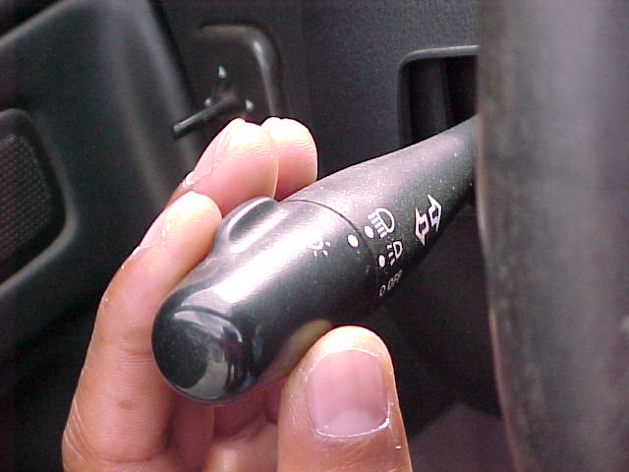
STEP 7
Turn On Headlamps
Record Voltage Reading

Slide 12
If All Readings Are
Above OFF Voltage
Alternator PASSES Test

Slide 13
If Any Readings Are
Below OFF Voltage
Alternator FAILS Test

Slide 14
Clean Up Your Mess!
Put Away All Tools

Slide 15
QUESTIONS ?
CONTACT
Vance Bloom
1-951-765-5150
vbloom@hemetusd.org

Slide 16
THE END

