Slide 1
STARTER DRAW TEST
SC8
By
Vance Bloom

Slide 2
Objective
Student will determine the condition
and amperage draw of a starter motor.

Slide 3
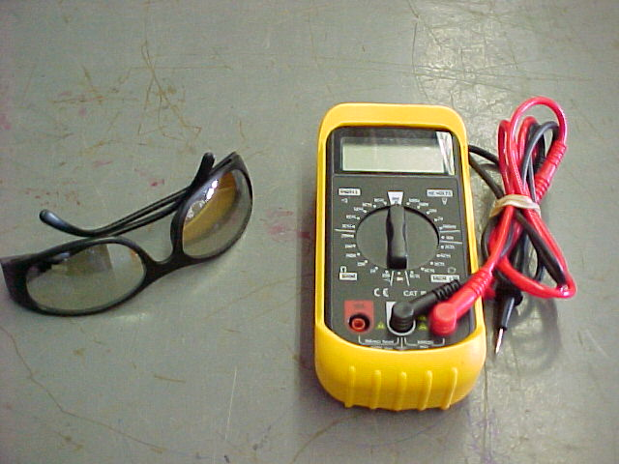
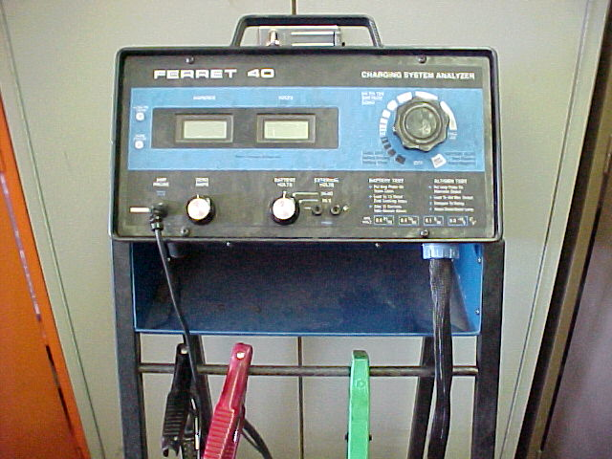
MATERIALS REQUIRED
1. EYE PROTECTION
2. VOLT-OHM-METER
3. HAND TOOLS
4. FERRET 40 OR EQUIVALENT TESTER
5. VEHICLE WITH GOOD BATTERY

Slide 4
Procedure

Slide 5

STEP 1
WEAR EYE PROTECTION!

Slide 6
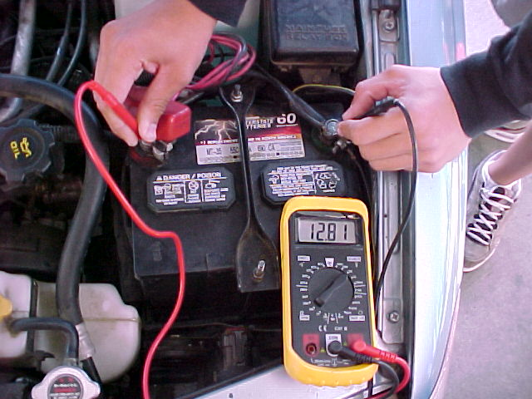
STEP 2
Determine battery voltage
If Above 12.4 Volts, Then Proceed
If Below 12.4 Volts,
Then Charge Battery.
Recheck Battery Voltage.
If Still Below 12.4 Volts,
Replace Battery, Then Proceed

Slide 7
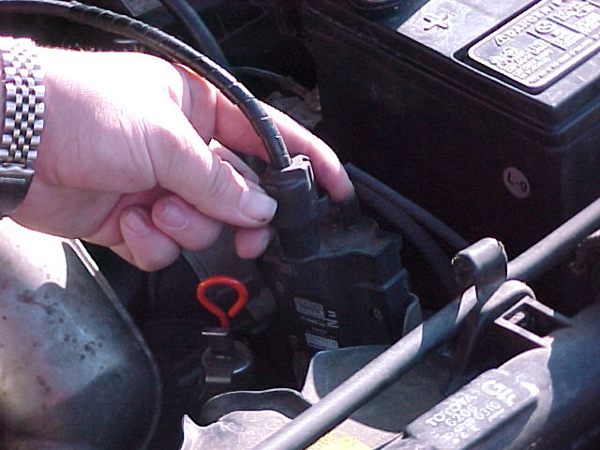
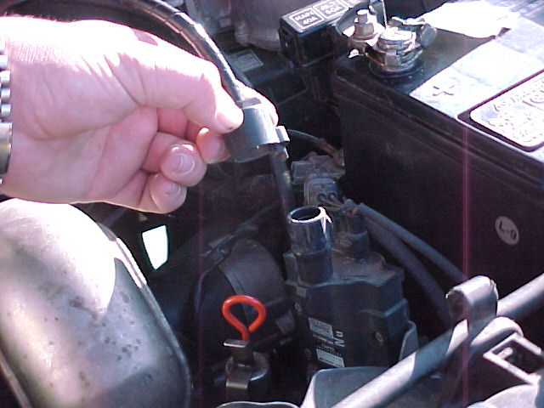
STEP 3
DISABLE IGNITION SYSTEM
Disconnect Power at COIL

Slide 8
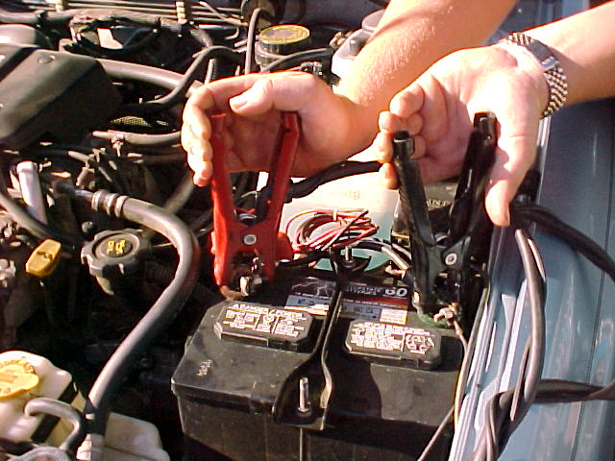
STEP 4
CONNECT TESTER
Hook up clamps to battery posts
Red to Positive
Black to Negative

Slide 9
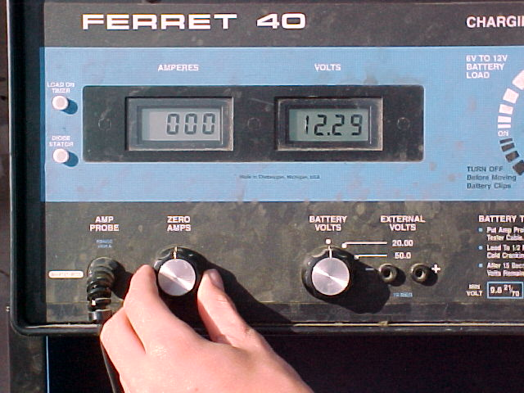
STEP 4
(Continued)
Adjust Amps To Zero

Slide 10
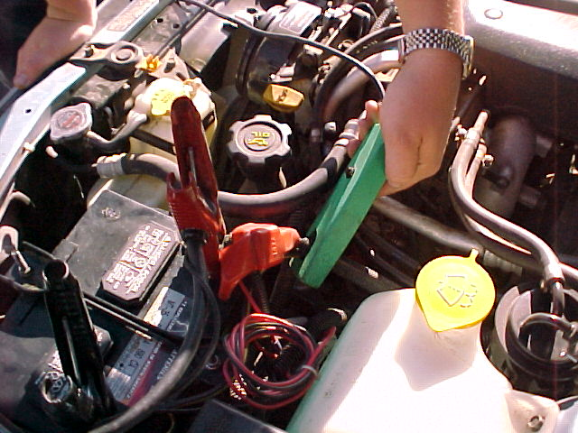
STEP 4
(Continued)
Arrow Towards Positive
Hook up GREEN Inductive Pick-up
Around Positive or Negative Battery Cable
Make Sure Arrow Points to Positive Post

Slide 11
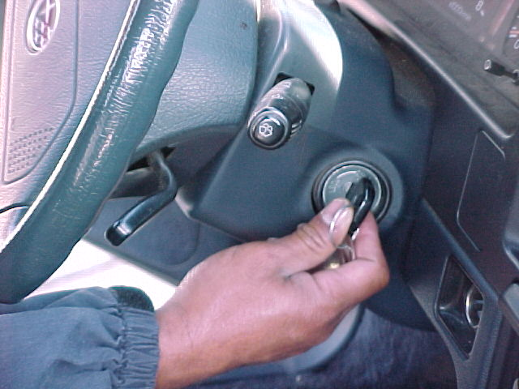
STEP 5
CRANK STARTER
FOR 15 SECONDS
While Still Cranking (at 15 Seconds),
Note & Record Voltage &
Amperage Readings on Skill Sheet

Slide 12
STEP 6
RESULTS
Voltage Readings:
9.6 Volts or Higher = PASS
9.5 Volts or Lower = FAIL
Average Amperage Draws:
4 Cylinder Engine ~100Amps
6 Cylinder Engine ~150Amps
8 Cylinder Engine ~200Amps

Slide 13
STEP 7
Record Your Data
Is the Amperage Reading
Consistent for the
No. of Cylinders?
Is the Voltage Reading
PASS or FAIL ?
Record Your Results

Slide 14
STEP 8
Recommendations?
Is the Starter Working Properly?
Should the Starter Be Replaced?
Record Your Recommendation
On Your Skill Sheet!

Slide 15
NOW,
CLEAN UP YOUR MESS!
CLEAN & PUT AWAY
ALL TOOLS & EQUIPMENT
FILL OUT YOUR
SKILL SHEET COMPLETELY
& GET IT SIGNED!

Slide 16
QUESTIONS?
CONTACT
VANCE BLOOM
@
1-909-696-1081
vbloom@murrieta.k12.ca.us

Slide 17
THE END

