Slide 1
Simple Circuits
You build the following circuits

Slide 2
Simple Circuits Worksheet l

Slide 3
Simple Circuits Worksheet l
Circuit #1-Series lights (Christmas lights)
Simple series circuit w/ switch, 3 bulbs, fuse, and power supply

Slide 4
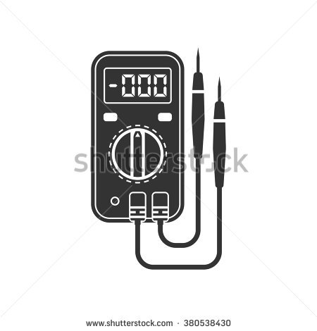
Simple Circuits Worksheet l
Circuit #1-Series lights (Christmas lights)
Measure the voltage drop across each light bulb (x3)
Write the voltage measured for each bulb on your task sheet

Slide 5
Simple Circuits Worksheet l
Circuit #2
Simple parallel circuit w/ switch, 3 bulbs, fuse, and power supply

Slide 6
Simple Circuits Worksheet l
Circuit #2
Simple parallel circuit w/ switch, 3 bulbs, fuse, and power supply
Measure the voltage drop across each light bulb (x3)
Write the voltage measured for each bulb on your task sheet

Slide 7
Simple Circuits Worksheet l
Circuit #3-Flashing light
X
L
Simple light circuit using flasher, fuse, switch, bulb, and power supply

Slide 8
Simple Circuits Worksheet l
Circuit #4-Bathroom light and fan
M
Simple circuit using motor, fuse,
switch, bulb, and power supply

Slide 9
Simple Circuits Worksheet lI

Slide 10
Simple Circuits Worksheet lI
Circuit #1
parallel circuit
Simple parallel circuit w/ switch, 2 bulbs, fuse, and power supply

Slide 11
Simple Circuits Worksheet lI
Circuit #2
parallel circuit-Interior lights(2)
Simple parallel circuit w/ momentary contact
switch, 2 bulbs, fuse, and power supply

Slide 12
Simple Circuits Worksheet lI
Circuit #3
parallel circuit- Interior lights (4)
Simple parallel circuit
w/ momentary contact
switch, 4 bulbs, fuse,
and power supply

Slide 13
Simple Circuits Worksheet lI
Circuit #4
parallel circuit
Simple parallel circuit
w/ switch, 4 bulbs, fuse, and power supply

Slide 14
Simple Circuits Worksheet lII

Slide 15
Simple Circuits Worksheet lII
Circuit #1
Relays-Relay controlled light
30
Simple light circuit using relay, fuse, switch, bulb, and power supply
87
86
85

Slide 16
Simple Circuits Worksheet lII
Circuit #2 Relays- Reverse relay controlled light
87A
30
Simple light circuit using relay, fuse, switch, bulb, and power supply
87
86
85

Slide 17
Simple Circuits Worksheet lII
Circuit #3 Relays-Why doesn’t the second bulb light?
87A
30
Simple light circuit using relay, fuse, switch, 2 bulbs, and
a power supply
87
86
85

Slide 18
Simple Circuits Worksheet lII
Circuit #4 Relays-One or the other lights
30
87A
Simple light circuit using relay, fuse, switch, 2 bulbs, and
a power supply
87
86
85

Slide 19
Simple Circuits Worksheet lV

Slide 20
Simple Circuits Worksheet lV
Circuit #1
More complex circuits
Simple turn signals
X
L
30
87A
87
Circuit using relay, fuse, switch, 2 bulbs, flasher, and
a power supply
86
85
Tell the instructor what is going to happen in this circuit before you turn it on!

Slide 21
Simple Circuits Worksheet lV
Circuit #2
More complex circuits
Wig-wag flashing emergency lights
X
L
86
87A
Circuit using relay, fuse, switch, 2 bulbs, flasher, and
a power supply
30
85
87
Tell the instructor what is going to happen in this circuit before you turn it on!

Slide 22
Simple Circuits Worksheet lV
Circuit #3
More complex circuits
Simple alarm system
X
L
86
87A
Circuit using relay, fuse, switch, bulb, horn, flasher, and
a power supply
30
85
87
Tell the instructor what is going to happen in this circuit before you turn it on!

Slide 23
Simple Circuits Worksheet lV
Circuit #4
More complex circuits
Fog lights-Use the next page as a starting place
You make the drawing!
Draw a circuit for fog lamps using a relay that only allows the lamps to turn on when low beam headlamps are on. Calculate what size fuse that you will need assuming the fog lamp bulbs are 60 watts each. Use Ohm’s law to make you calculations:
V = I x R or Volts = Amps x Resistance
W = V x I or Watts = Volts x Amps

Slide 24
Simple Circuits Worksheet lV
Circuit #4
More complex circuits
Just add the wires
Check with teacher before wiring this one
Low beam headlamp
30
87A
60w Fog Lamps
87
86
Complete the circuit for fog lamps using a relay that only
allows the lamps to turn on when low beam headlamps are on.
Calculate what size fuse that you will need assuming the
fog lamp bulbs are 60 watts each. Use Ohm’s law to
make you calculations:
V = I x R or Volts = Amps x Resistance
W = V x I or Watts = Volts x Amps
85

