Slide 1
Simple Circuits
You build the following circuits

Slide 2
Simple Circuits Worksheet V
Even More Complex Circuits

Slide 3
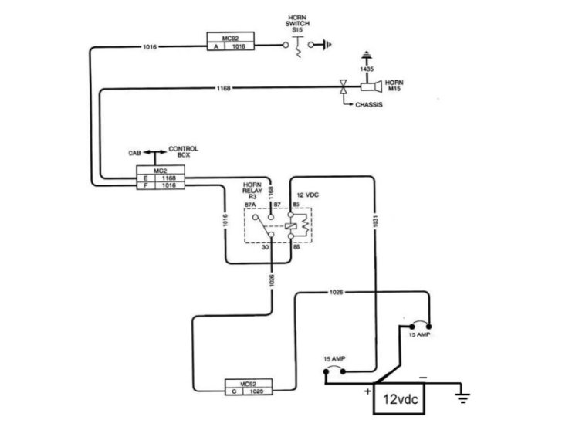
Simple Circuits Worksheet V
Circuit 1 (Horn Circuit) GM

Slide 4
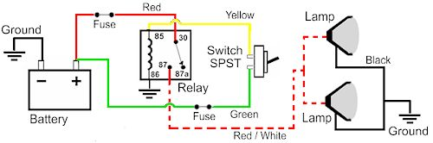
Simple Circuits Worksheet V
Circuit 2 (Fog Lamps Circuit) Bosch

Slide 5
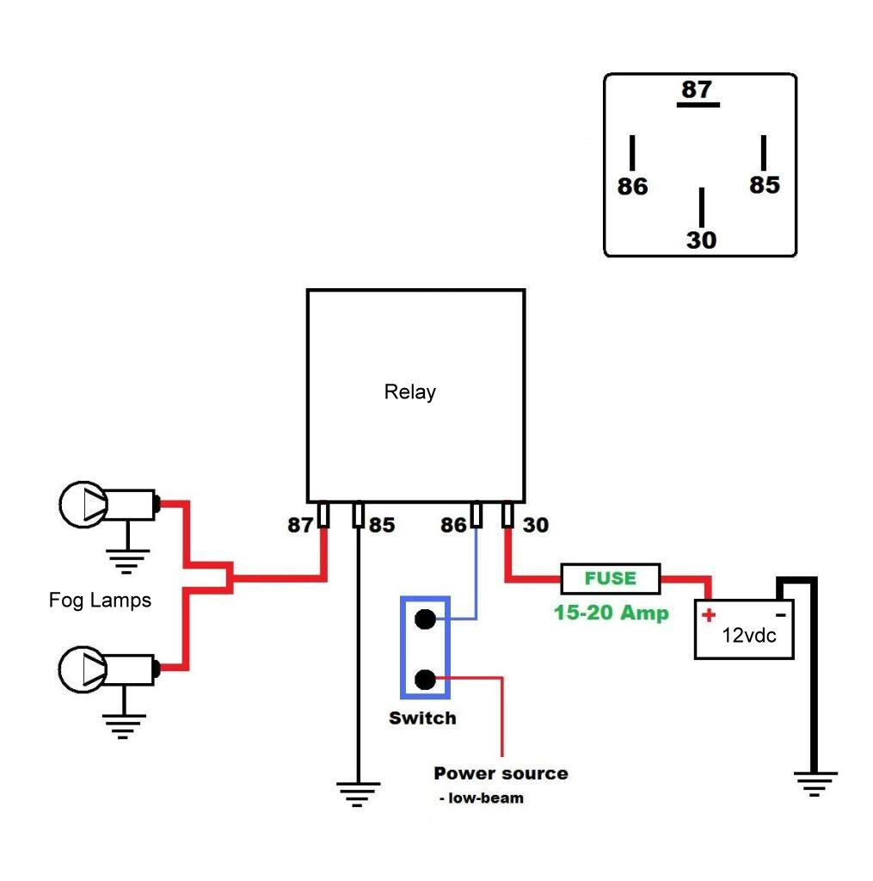
Simple Circuits Worksheet V
Circuit 3 (Fog Lamps Circuit #2)

