Slide 1
Tire Rotation
NATEF TASK A4 E.1,2,4,9 P-1

Slide 2

Before you start
Think!
Why are you performing this task?
On which vehicle are you going to perform this task?
What tools will you need?
What is the lug nut torque specification?
What is the recommended tire rotation pattern?
What are the recommended tire pressures?
Are there any unusual tire wear patterns?

Slide 3
Why are you performing this task?
Tire rotation involves changing the location of the tires on the vehicle to ensure maximum tire life.
Normally the front and rear tires wear differently.
Rotation helps even out tire wear and prevents premature failure of any one tire.
Generally, tires should be rotated at intervals suggested by the tire manufacturer
(typically every 5,000 miles).
Refer to your textbook page 1247

Slide 4
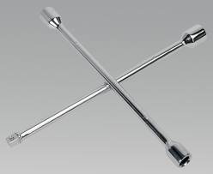

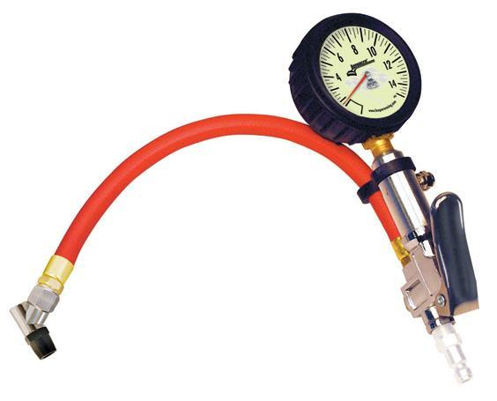
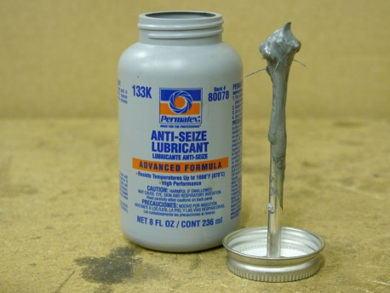
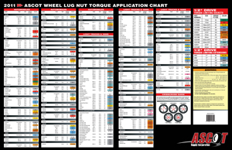
What tools will you need?
Lug wrench
Torque wrench/socket
Tire pressure gauge
Anti-seize compound
Lug nut torque chart or service information

Slide 5
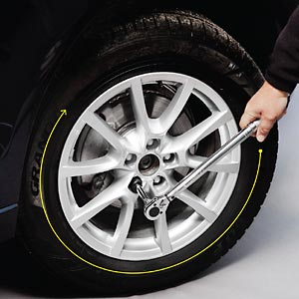
What is the lug nut torque?
Lug nut torque (tightening force) is very important, especially on vehicles equipped with mag wheels and lightweight hubs.
Over-torquing can cause wheel or hub distortion, excessive run-out, and vibration.
Under-torquing might allow the lug nuts to loosen and the wheel to fall off.
Where to find lug nut torque:
All-Data or other on-line service information system
Owner’s manual or service manual
Wheel torque application chart

Slide 6
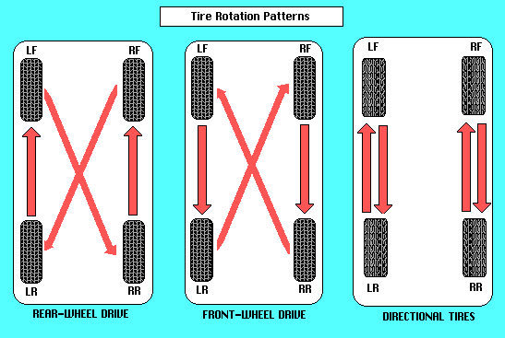
What is the recommended tire rotation pattern?
Radial and directional tires are rotated front to back
Bias tires are rotated in a crisscross pattern
On vehicles with different sized tires front and rear, the tires cannot be rotated

Slide 7
What are the recommended tire pressures?
Most tire manufacturers recommend a cold inflation pressure that is 1-3 psi below the maximum listed air pressure. This allows for tire heating, air expansion, and pressure increase without exceeding the maximum pressure limits
Tire inflation pressure on the sidewall is the MAXIMUM recommended pressure. The ideal tire pressure for the vehicle, which is usually much lower, is given in the owner’s manual or is on the driver’s door post sticker. This pressure is determined by several variables, such as tire size, vehicle weight, and suspension stiffness.

Slide 8
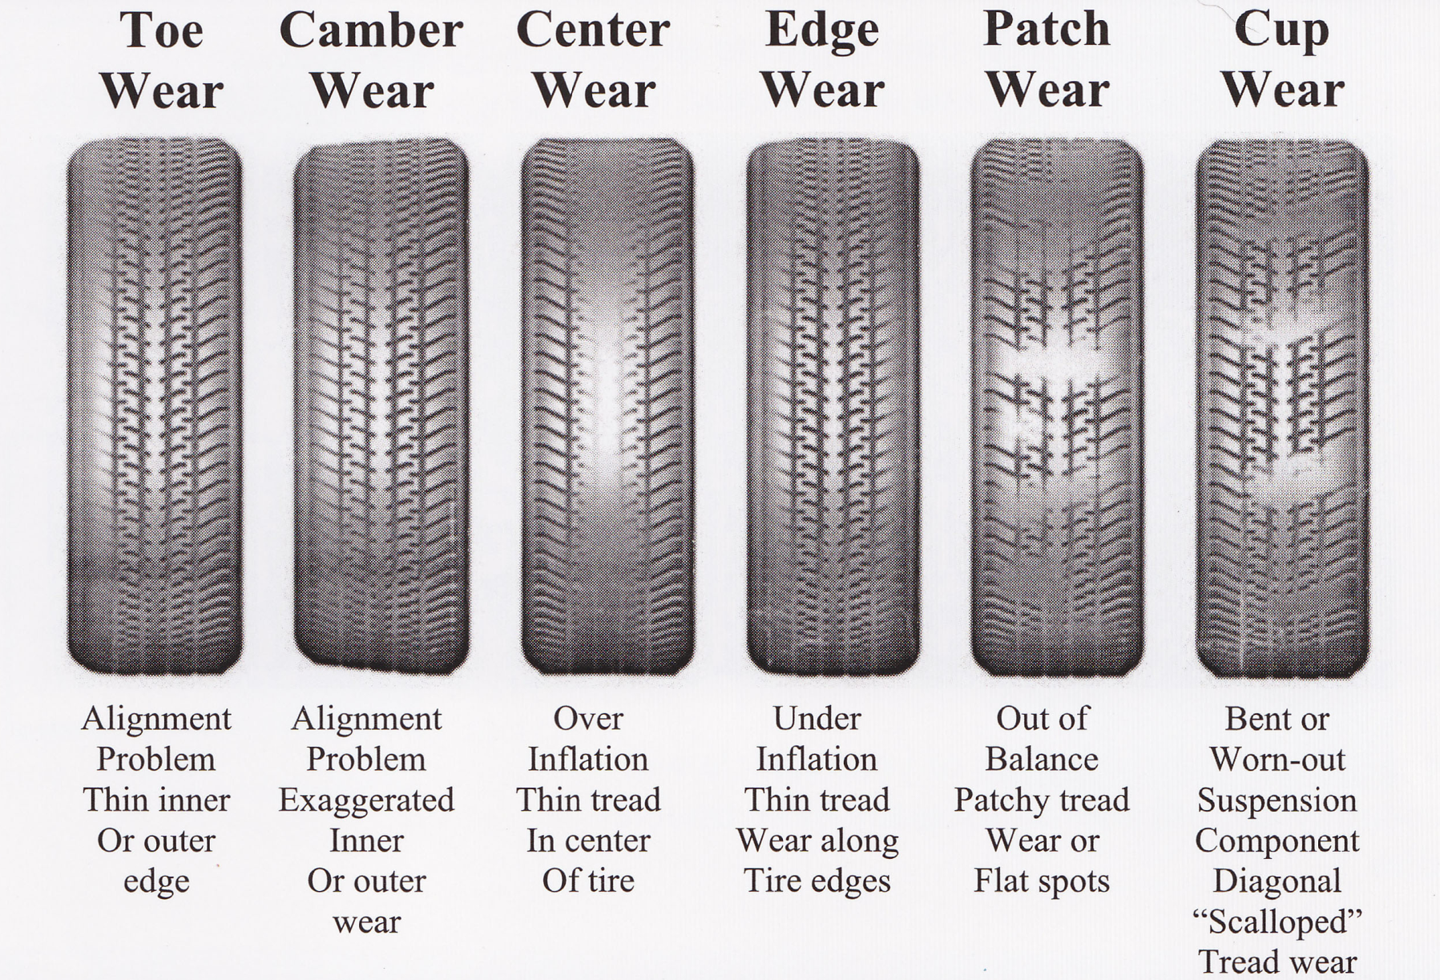
Are there any unusual tire wear patterns?

Slide 9

Documentation
Have your service writer print out the task sheets for your group
Look up lug nut torque specifications
Look up tire pressure specifications
Look up tire rotation pattern for the vehicle assigned to your group

