Slide 1
TUNE UP
SKILL T-1
AIR FILTER
Removal, Installation and Evaluation
By
Vance Bloom
ROP Automotive Technology
Hemt High School

Slide 2
Why Do I Want To Know How To Do This ?
What Are The Benefits of Knowing How to do it myself?

Slide 3
Inspecting & Replacing the AIR FILTER
Is an important part of a TUNE UP
It only takes a few minutes
A clogged AIR FILTER can cause poor performance & poor fuel economy
A damaged or missing AIR FILTER can cause excessive engine wear & damage

Slide 4
MATERIALS REQUIRED
1. EYE PROTECTION
2. Hand Tools (if needed)
3. Vehicle

Slide 5

WEAR EYE PROTECTION!

Slide 6
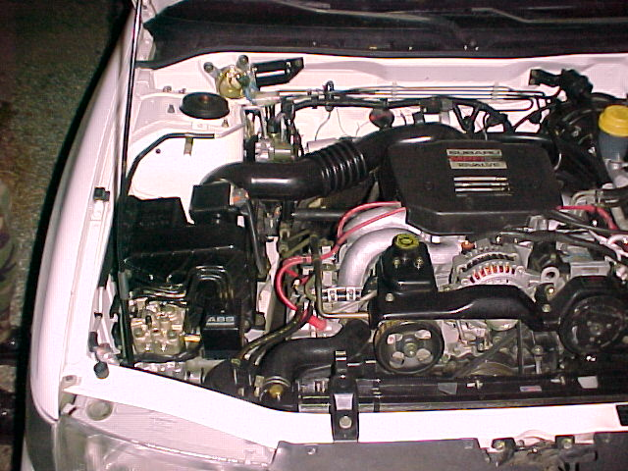
STEP 1
LOCATE AIR FILTER ON ENGINE

Slide 7
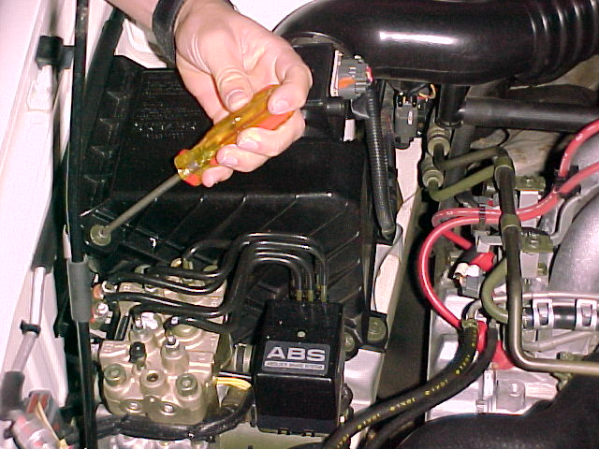
STEP 2
REMOVE WING NUT OR OTHER MEANS OF SECURING AIR CLEANER HOUSING

Slide 8
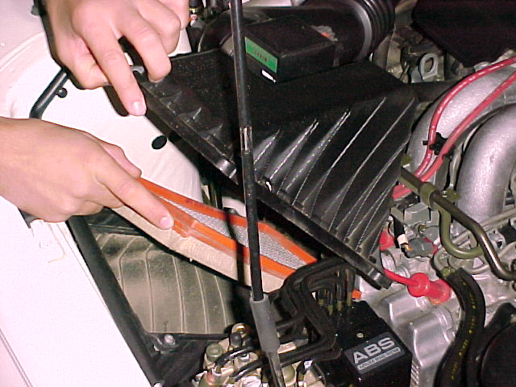
STEP 3
REMOVE AIR CLEANER COVER

Slide 9
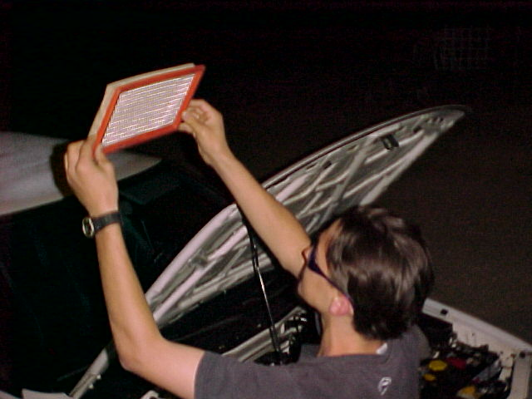
STEP 4
INSPECT AIR FILTER ELEMENT FOR DAMAGE Note damage on skill sheet
HOLD ELEMENT UP TO THE LIGHT Light should shine through
DOES THE AIR FILTER LOOK DIRTY? Document your findings on skill sheet

Slide 10
STEP 5
?
DO YOU RECOMMEND “REPLACING” THE AIR FILTER ELEMENT OR “LEAVING IT ALONE”?

Slide 11
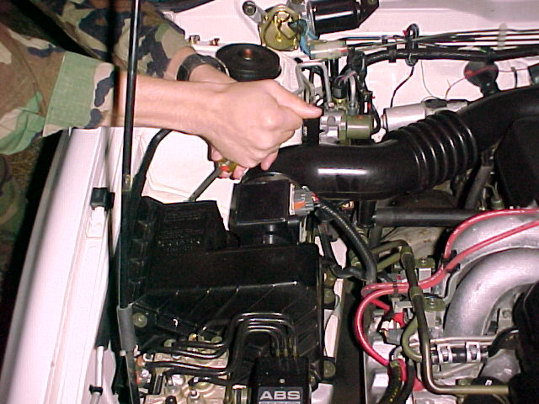
STEP 6
RE INSTALL AIR FILTER AND SECURE AIR CLEANER HOUSING COVER

Slide 12
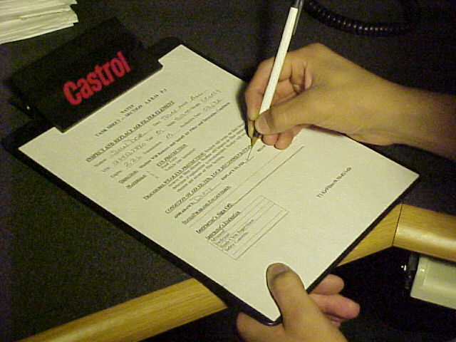
STEP 7
FILL OUT ALL INFORMATION ON SKILL SHEET AND GET IT SIGNED!

Slide 13
Now clean up your mess!
Clean and put away tools used
Throw away old air filter
Perform the other 5 tune up skills
Enjoy Better Fuel Economy!

Slide 14
QUESTIONS?
CONTACT
VANCE BLOOM
1-951-765-5150
vbloom@hemetusd.k12.ca.us

