Slide 1
TUNE UP
SKILL T-2
PCV VALVE
Removal, Installation and Testing Operation
By
Vance Bloom
CTE Automotive Technology
Hemet High School

Slide 2
Why Do I Want To Know How To Do This ?
What Are The Benefits of Knowing How to do it myself?

Slide 3
Testing the PCV VALVE
(Positive Crankcase Ventilation)
Is an important part of a TUNE UP
It takes about 2-3 minutes to test
A stuck “closed” valve can cause the engine to leak oil from everywhere!
A stuck “open” valve can cause the engine to idle very rough and stall!

Slide 4
MATERIALS REQUIRED
1. Eye Protection
2. Hand Tools (if needed)
3. Vehicle to test

Slide 5
WEAR EYE PROTECTION!
WEAR EYE PROTECTION!
WEAR EYE PROTECTION!

Slide 6
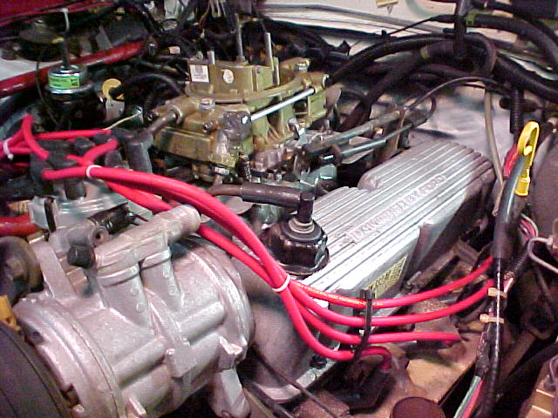
STEP 1
LOCATE PCV VALVE ON ENGINE

Slide 7
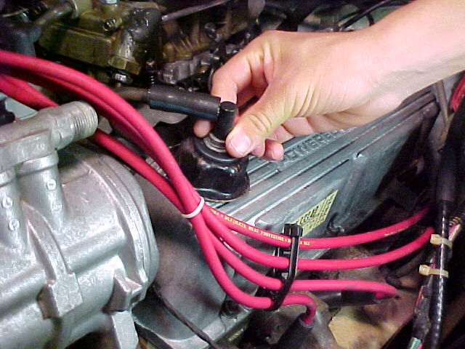
STEP 2
GENTLY ROCKING, REMOVE PCV VALVE,
BEING CAREFUL NOT TO DAMAGE GROMMET

Slide 8
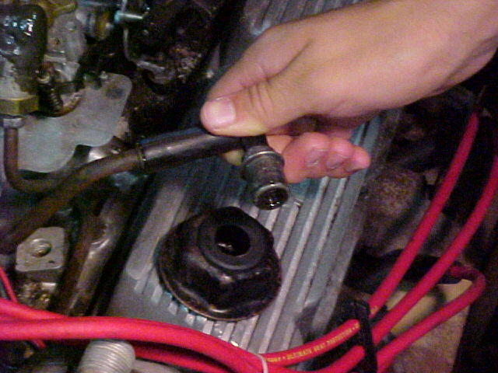
STEP 3
PCV VALVE REMOVED

Slide 9
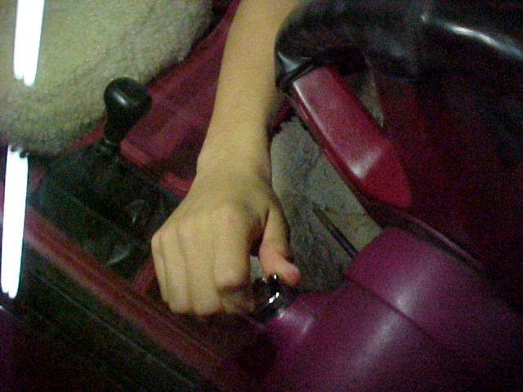

STEP 4
WITH THE HAND BRAKE SET, TRANSMISSION IN NEUTRAL, AND ENGINE AREA CLEAR, START THE ENGINE

Slide 10
STEP 5
WITH ENGINE IDLEING, CHECK
AND SEE IF AIR IS SUCKING-IN
AT THE OPENING IN THE BOTTOM
OF THE PCV VALVE

Slide 11
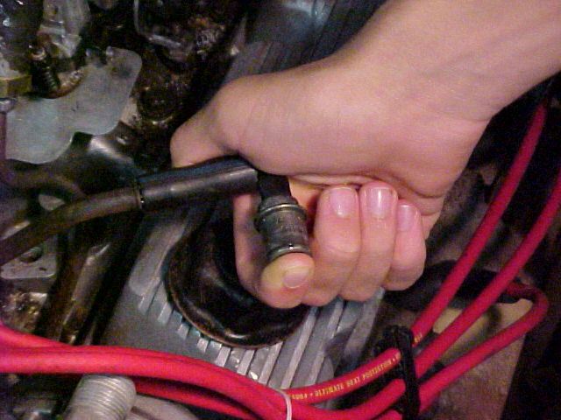
STEP 6
Place Finger over opening closing off vacuum. Listen and feel for a “clicking” sound as vacuum is shut off. Repeat this “testing” several times to verify results.

Slide 12
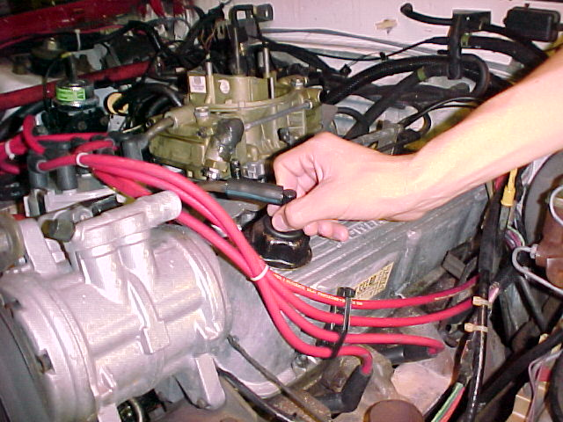
STEP 7
REINSTALL PCV VALVE

Slide 13
STEP 8
SHUT OFF THE ENGINE

Slide 14
TEST RESULTS
IF THE PCV VALVE MADE THE “CLICKING” SOUND, THE VALVE IS GOOD
IF THE PCV VALVE DID NOT MAKE THE “CLICKING” SOUND, THE VALVE IS BAD IT SHOULD BE REPLACED

Slide 15
Now clean up your mess!
Clean and put away tools used
Throw away old parts and trash
Perform the other 5 tune up skills

Slide 16
QUESTIONS?
CONTACT
VANCE BLOOM
1-951-765-5150
vbloom@hemetusd.k12.ca.us

