Slide 1
Spark Plug Replacement
TUNE UP
TUNE 3
By
Vance Bloom
ROP Automotive Technology
Hemet High School

Slide 2
Why Do I Want To Know How To Do This ?
What Are The Benefits of Knowing How to do it myself?

Slide 3
The average Tune up costs between $125.00 and $175.00
70% of The Cost is Labor
A Tune up Takes About an Hour of “Your” Time
This Calculates to About $90 per Hour in Savings (How much do you make per hour?)

Slide 4
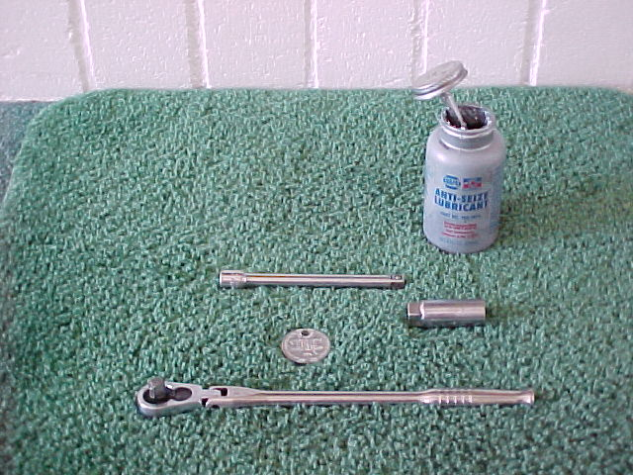
Tools Required:
Anti-Seize Compound >
3/8” Extension
Spark Plug Socket >
Spark Plug Gapper
3/8” Drive Ratchet

Slide 5
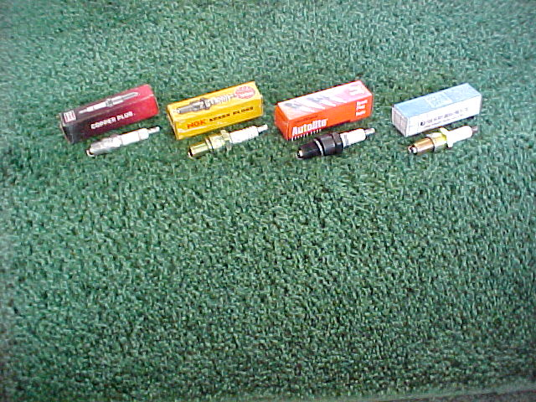
Materials Needed:
Spark plugs specific for your vehicle
Brand is NOT as important as “type”
Choose a double platinum electrode plug
Platinum electrodes have 200% longer life

Slide 6
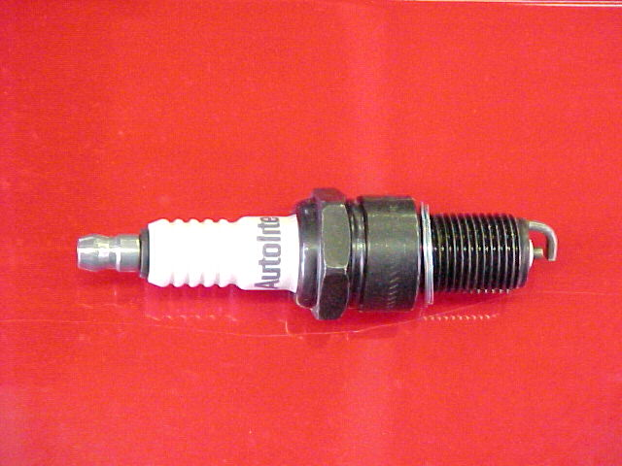
Parts of the spark plug
Steel shell
Insulator
Nut
Gasket
Electrodes

Slide 7
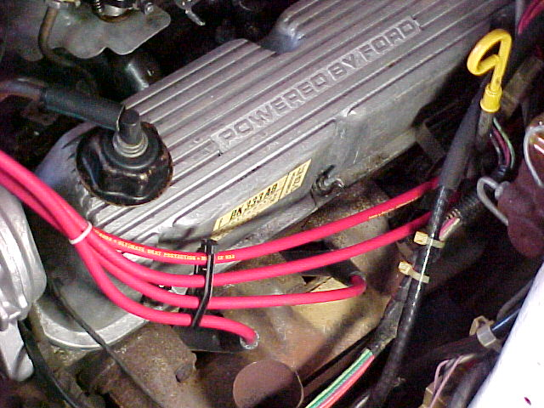
STEP 1
Locate the spark plugs

Slide 8
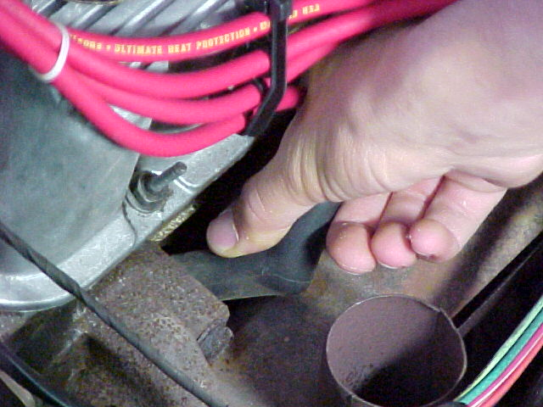
STEP 2
Grasp “spark plug wire boot” firmly and twist side-to-side to loosen “boot” and then pull gently to remove plug wire

Slide 9
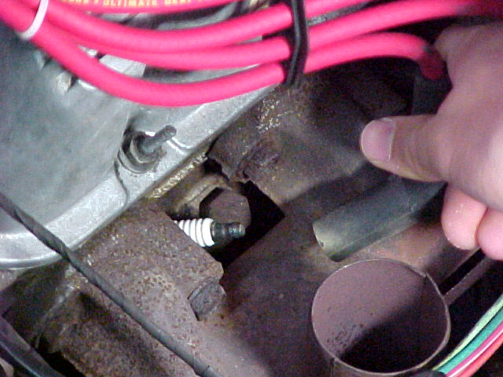
STEP 3
Remove spark plug wire

Slide 10
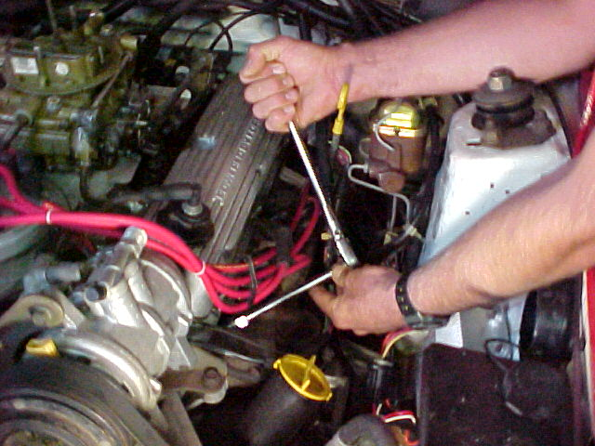
STEP 4
Loosen spark plug counterclockwise using ratchet, extension (when necessary), and socket

Slide 11
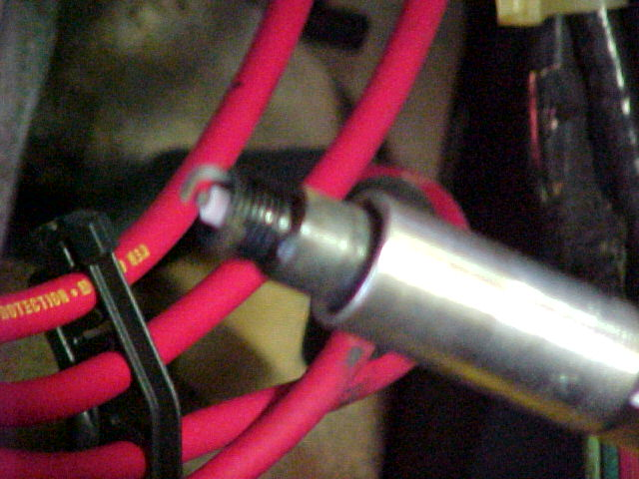
STEP 5
Remove spark plug

Slide 12
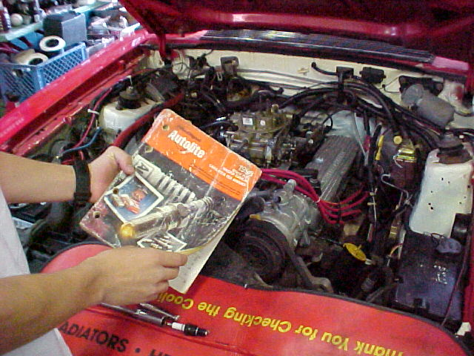
STEP 6
Look up spark plug gap setting

Slide 13
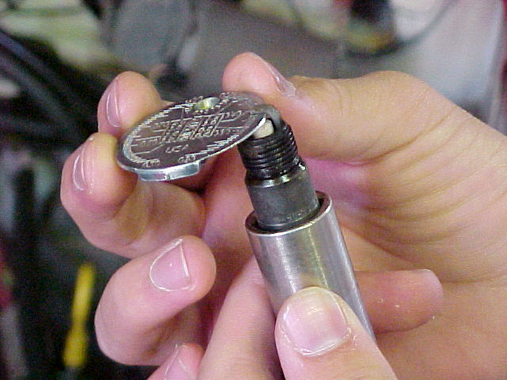
STEP 7
Set new spark plug gap to specifications
by bending upper electrode up or down

Slide 14
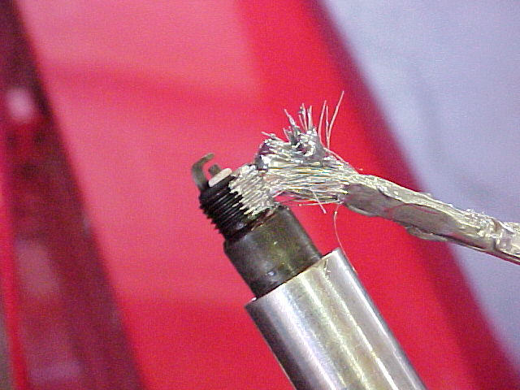
STEP 8
Apply anti-seize compound to the threads
of the spark plug, being careful not to
get any on the electrodes or insulator

Slide 15
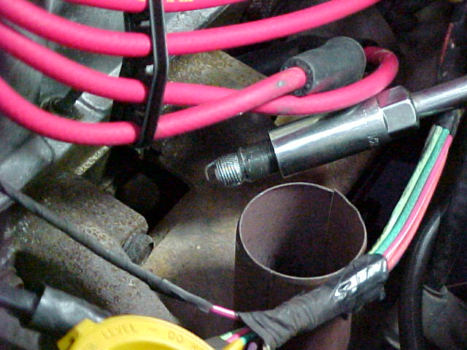
STEP 9
Using extension and socket, install spark plug
by hand-tightening the first 5 or 6 turns

Slide 16
STEP 10
Tighten spark plug clockwise until snug, using ratchet, extension, and socket. Torque to specs

Slide 17
STEP 11
Reinstall spark plug wire and
press firmly until you feel a “click”

Slide 18
STEP 12
Repeat procedure for each spark plug

Slide 19
Now clean up your mess!
Clean and put away tools
Throw away old parts and trash
Perform the other 5 tune up skills
Figure out how to spend the $70 you saved!

Slide 20
QUESTIONS?
CONTACT
VANCE BLOOM
1-951-765-5150
vbloom@hemetusd.k12.ca.us

