Slide 1
Remove, Inspect, and Install Distributor Cap and
Ignition Rotor
Section:A.8,A.6,8,P-2
T4Cap&Rotor/9-30-01/vdb

Slide 2
Materials Needed
1.Eye protection
2.Basic hand tools
3.Vehicle (see instructor)

Slide 3
Procedure
1.Locate distributor cap
2.Mark and remove spark plug wires
3.take off clips on distributor cap
4.inspect condition of distributor cap
5.Inspect ignition rotor for :cracks,corrosion,and rust.

Slide 4
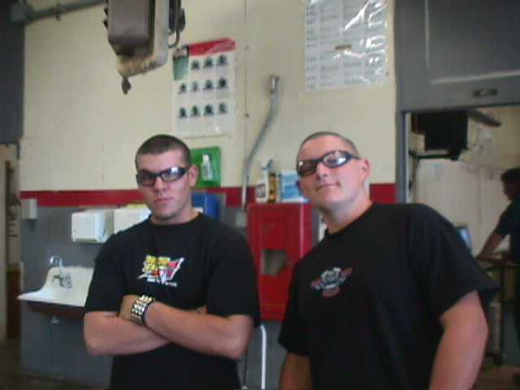
WEAR EYE PROTECTION

Slide 5
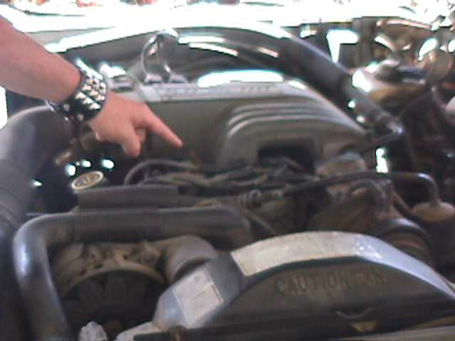
Locate Cap

Slide 6
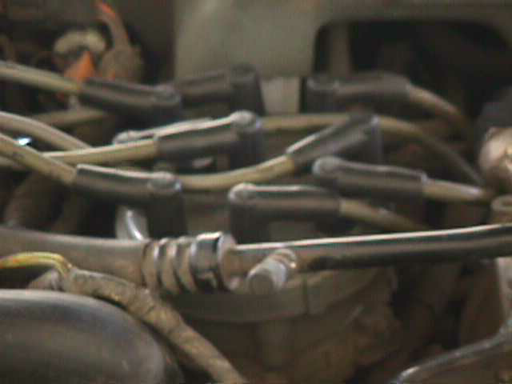
Remove and Mark Spark Plug Wires

Slide 7
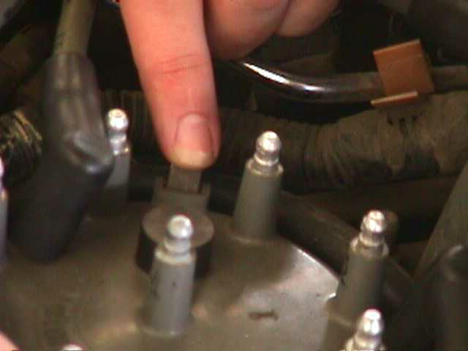
Locate and Remove Clips on Cap

Slide 8
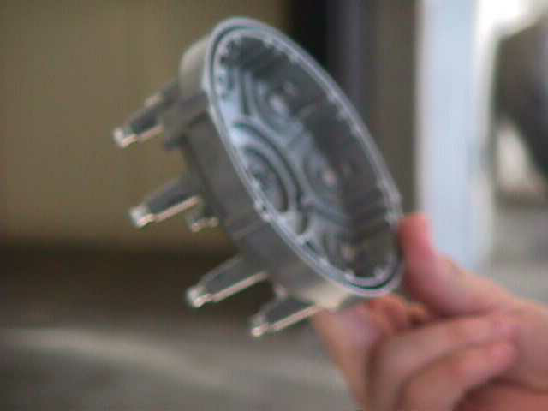
Check Condition of Cap: For Cracks, Rust, and Corrosion

Slide 9
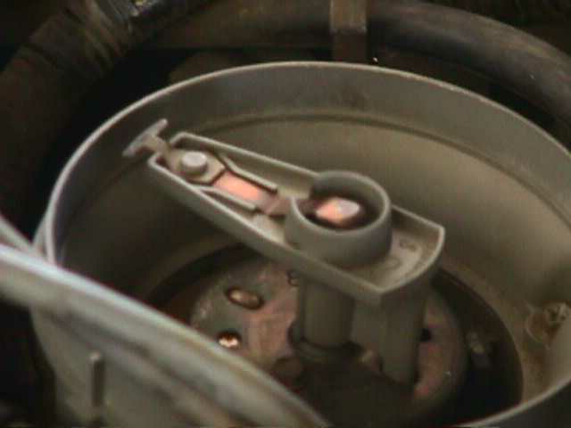
Inspect Ignition Rotor For
Cracks, Corrosion, and Rust

Slide 10
By Xavier Ramirez,
Chad Brehm-Steiner,
Tony Carratello

Slide 11
THE END

