Slide 1
Check Spark Plug Wires
Tune 5
Kurtis, Chris, Rosie, And Ryan

Slide 2
Objectives
Student will visually inspect and test with ohmmeter, spark plug wires, evaluate, then recommend if replacement is necessary.

Slide 3
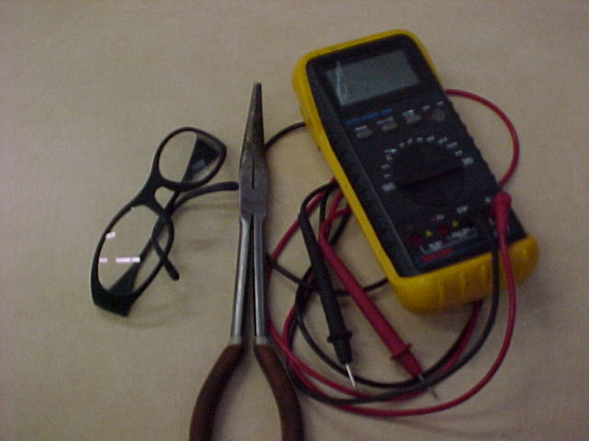
Materials
Safety Glasses
Hand tools
Digital Multi-Meter (D.M.M.)
Vehicle(see instructor)

Slide 4


Wear Eye Protection!

Slide 5
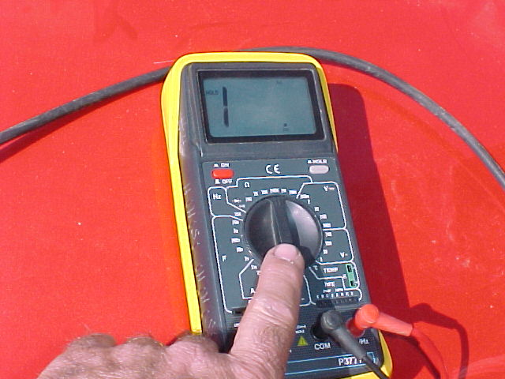
Procedure, Step 1
Set D.M.M on
200k Ohms Scale
Touch leads together to insure DMM is working correctly, (Reading should go to zero)

Slide 6
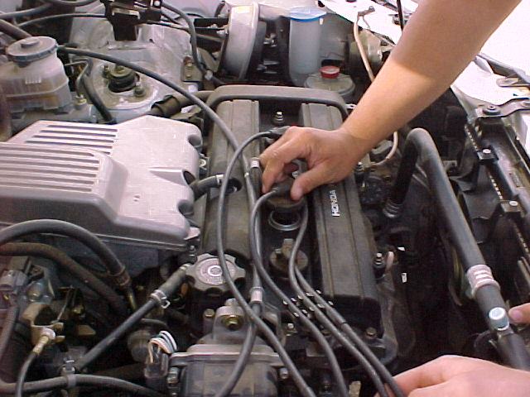
Step 2
One at a time, remove spark plug wires and test resistance.
Write down Ohm reading on task sheet

Slide 7
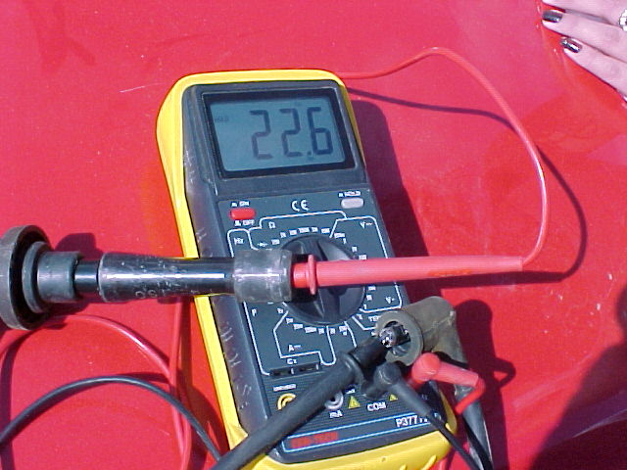
Step 3

Slide 8
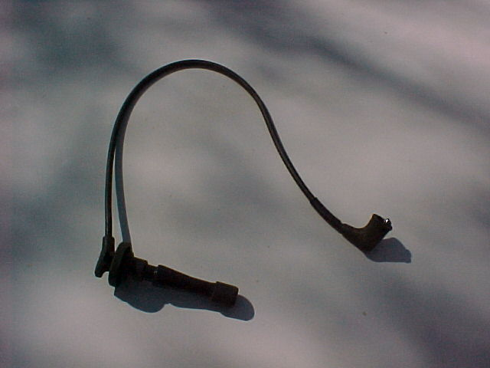
Spark Plug Wire

Slide 9
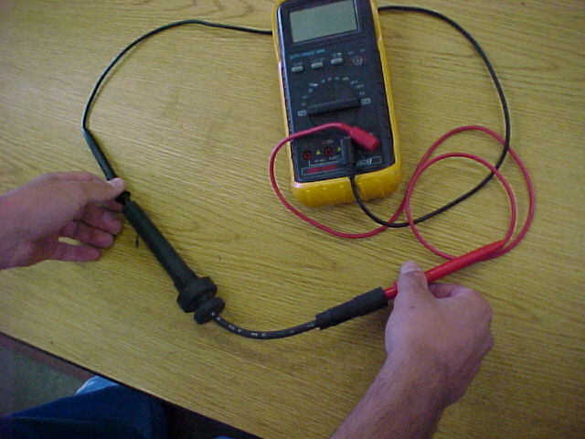
Step 4
Measure the resistance through each plug wire using the ohms scale.

Slide 10
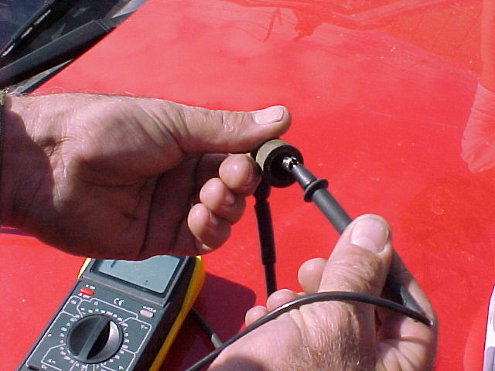
Hold the wires so that your fingers do not touch the meter leads on the metal ends.
This will ensure an accurate reading

Slide 11
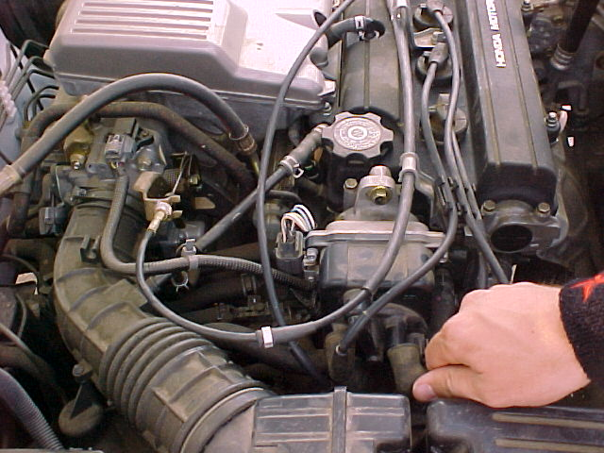
Step 5
Re-install plug wire and repeat procedure for each plug wire.

Slide 12
Record Your Results
Compare the Ohms value for each plug wire
Does the Ohms value match with the wire length?
Inspect each wire as you test it.
Are the wires dirty, cracked, or burned?
Are the wire ends corroded?
Do the wires need replacement?
(Remember, if any wire is bad, you need to replace the entire set.)

Slide 13
NOW
Clean up!!!
Put away the DMM
Make sure the vehicle runs smoothly when you finish installing the wires

Slide 14
Got Questions?
If you have any questions contact
Vance Bloom
v.bloom@verizon.net

