Slide 1



Job Finder
Members: Anthony Gallardo Llamo
Joselito S. Pechares
Mark Tristan A. Sicalag
Jhon Lloyd L. Raut-Raut
Sebastian Anthony Acierto
PRESENTER 8
Designation

Slide 2

INTRODUCTION
Finding jobs online is hard because listings are spread out across many websites. This makes it tough for people looking for work and businesses looking for workers. The Job Finder app solves this problem by putting all job listings in one place, making it easier for everyone. It has tools to help people find jobs that fit them and get alerts when new jobs open up. Businesses can also easily post their job openings and find local workers. By focusing on local jobs, the app helps communities grow and reduces unemployment, making the job market better for everyone.

Slide 3
Achievements to Date
On September 25, 2024, we began developing the user interface (UI) using Apache NetBeans IDE and completed the login and sign-up UI. Then, on October 6, 2024, we continued designing the login and sign-up UI and starting adding functionalities. On October 14, 2024, we finished designing the UI for login and sign-up and we are in progress to complete the sign-up and login functionalities. We are also starting to work on our dashboard.

Slide 4
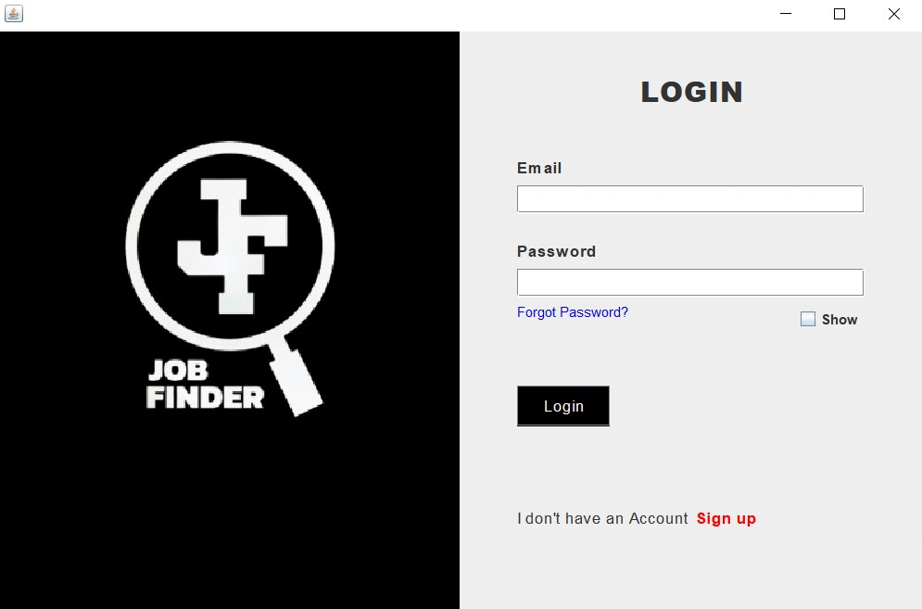
Achievements to Date

Slide 5
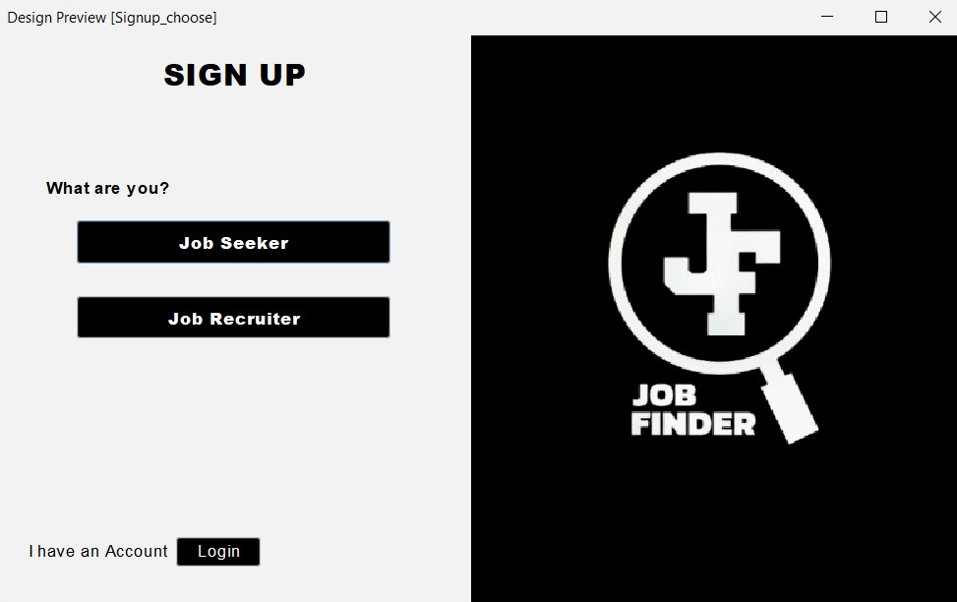
Achievements to Date

Slide 6
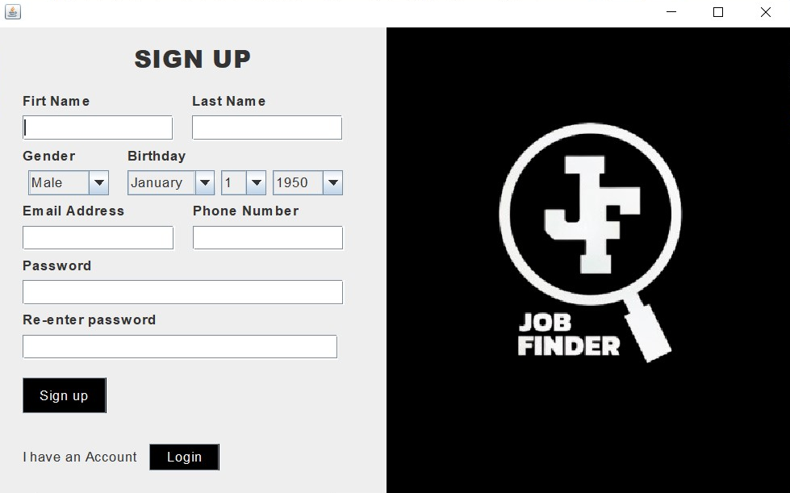
Achievements to Date
SEEKER

Slide 7
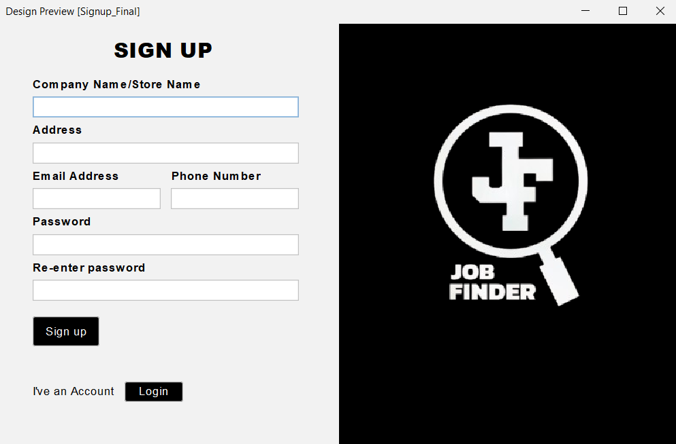
Achievements to Date

Slide 8
Current Activities
Currently we are developing the Login an Sign-up functionalities, which is pretty far from the goal, but we're doing our best to finish it slowly but surely. Also we are starting up the work for our dashboard UI and the Database. For now, the lack of time management, busy schedule, and other of our miscellaneous tasks are our challenges that we need to face. Also the availability of the laptop (which we borrowed).

Slide 9
Upcoming Plans
Our next objective is to add more features and refine the design of our user interface (UI). We will also focus on improving the performance and overall user experience of our UI.

Slide 10
Key Metrics and Performance
The Job Fnder is making great progress. The user interface for key features like login and sign-up is already designed, ensuring a smooth and intuitive user experience. Our team is currently focused on implementing the login and sign-up functionalities, building the backend logic that allows users to create accounts and securely authenticate themselves. This stage is crucial for establishing the foundation for user access to the app. Once complete, users will be able to create profiles and manage their job search preferences.

Slide 11
Challenges and Solutions
The development of our program faces several challenges, including limited resources, insufficient time management, and technical expertise slows our development progress.
To address these challenges, our group is going to prioritize the system development to make some significant progress. We will also make sure to make time for our system development, so that the development is consistent and won't fall into a stagnant state.

Slide 12
Conclusion
The Job Finder has made only small progress because of the challenges we've mentioned, but the user interface for login and sign-up are already designed. We are currently focused on implementing the login and sign-up features, which are essential for user access and engagement. Our next step is to refine the user experience and add features that cater to both job seekers and employers. We aim to enhance performance and usability.

Slide 13
Recommendations
To further enhance the Job Finder, we recommend conducting user research to understand user needs and preferences. We will also research about different UI designs to implement in our system and also the features.

