Slide 1



Job Finder
Anthony G. Llamo
Jhon Loyd L. Raut-Raut
Joselito S. Pechares
Mark Tristan A. Sicalag
Sebastian Anthony G. Acierto

Slide 2

INTRODUCTION
The Job Finder App tackles the problem of fragmented job listings online by offering a unified platform that consolidates job postings into a single, user-friendly interface. This streamlines the job search for applicants, improves recruitment efficency for employers, and supports local job opportunities, ultimately enhancing the overall job market experience and reducing the wasted time and frustration currently faced by both job seekers and employers.

Slide 3
Objectives
To Make it easier and more efficient for job seekers to find suitable job listings without having to navigate multiple websites.
To Provide employers with a more effective way to reach qualified candidates, reducing the time and effort spent on recruitment.
To Focus on local job openings to promote community growth and help reduce unemployment.
To Offer a streamlined experience for both job seekers and employers, ultimately enhancing the overall job market experience.

Slide 4
Scope and Delimitation
This study will thoroughly investigate the efficacy and usability of the Job Finder App within the specific context of the municipality of Claveria. The research will be carefully delimited to ensure a focused and manageable scope, allowing for a robust analysis of the app's impact within this particular geographical and demographic setting. The findings will provide valuable insights into the app's potential for success and areas for future improvement

Slide 5
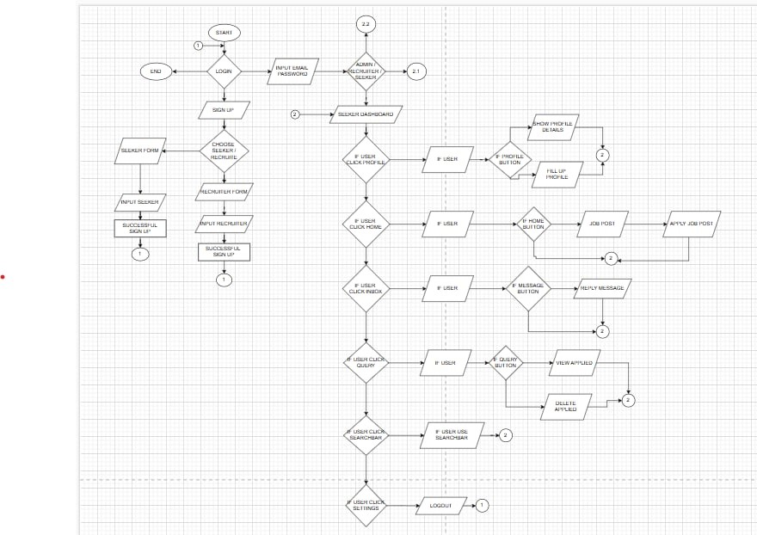
FLOWCHART

Slide 6
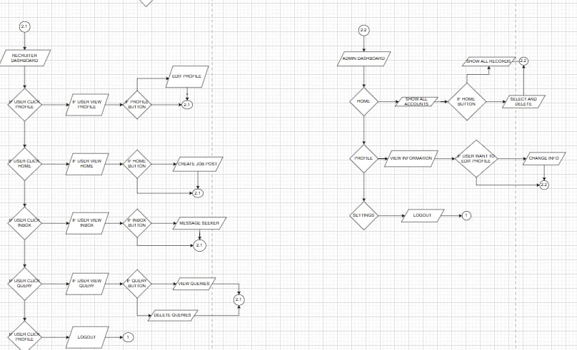
FLOWCHART

Slide 7
GANTT CHART

Slide 8
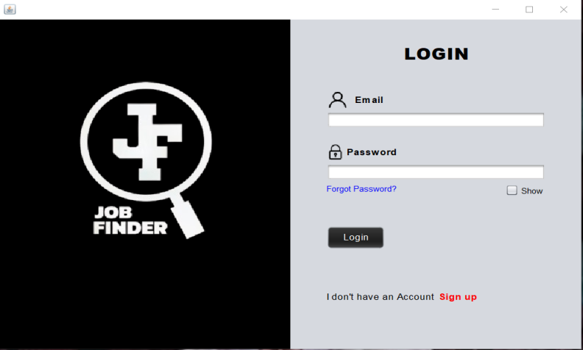
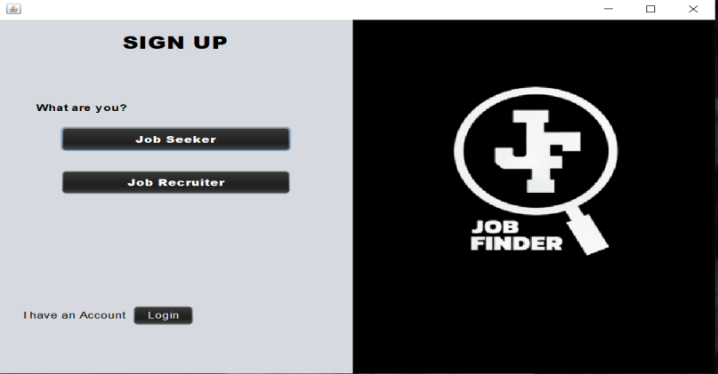
SYSTEM DESIGN
This is the login form where the seeker, recruiter, and admin log in to their accounts.
This is the form where the user chooses whether to be a seeker or a recruiter in order to create an account or sign up.

Slide 9
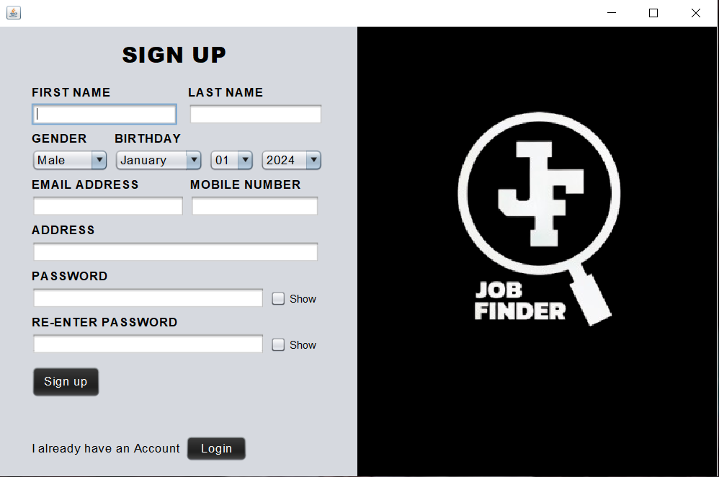
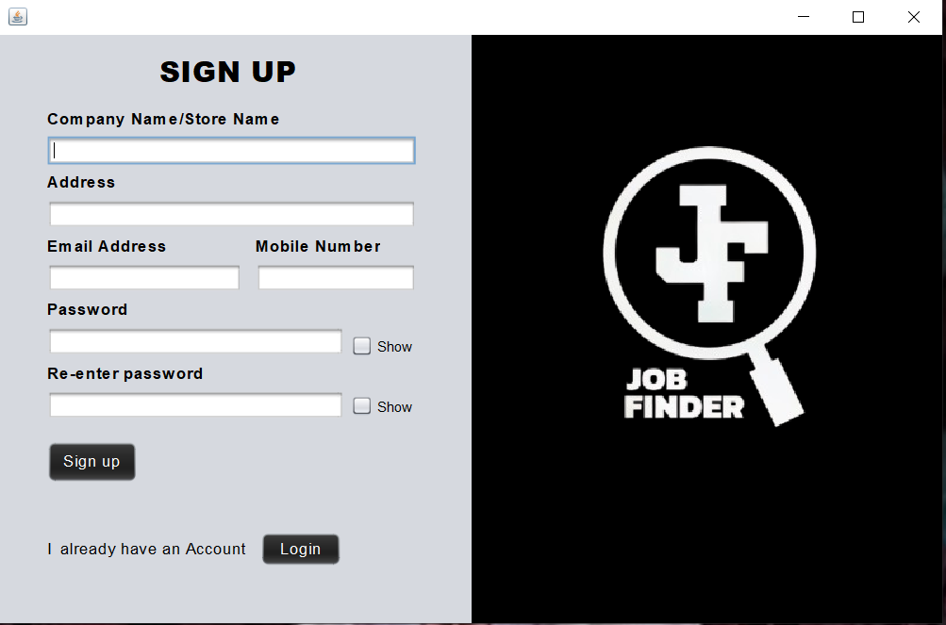
SYSTEM DESIGN
This form is for the Seeker sign up.
This form is for the recruiter sign up.

Slide 10
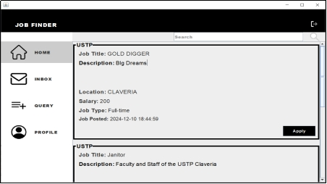
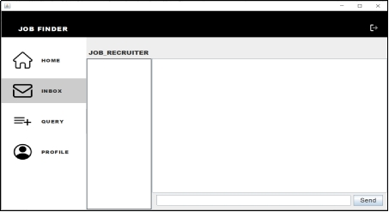
SYSTEM DESIGN
SEEKER DASHBOARD
HOME
INBOX

Slide 11
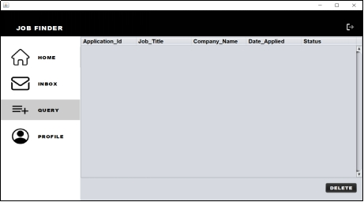
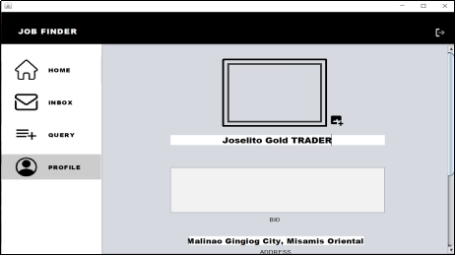
SYSTEM DESIGN
SEEKER DASHBOARD
QUERY
PROFILE

Slide 12
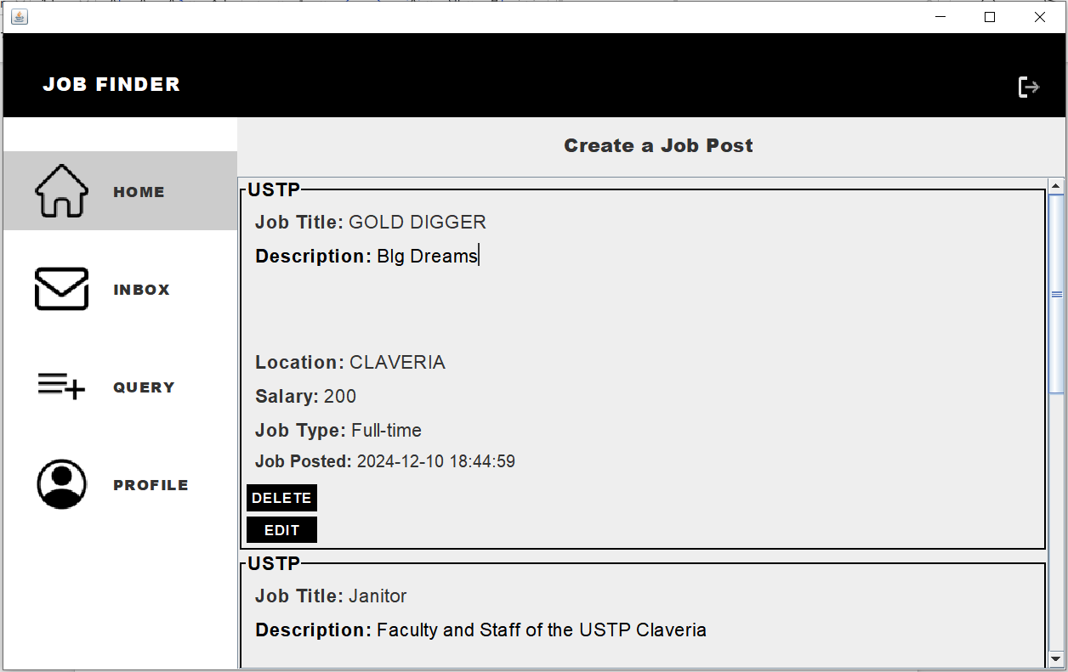
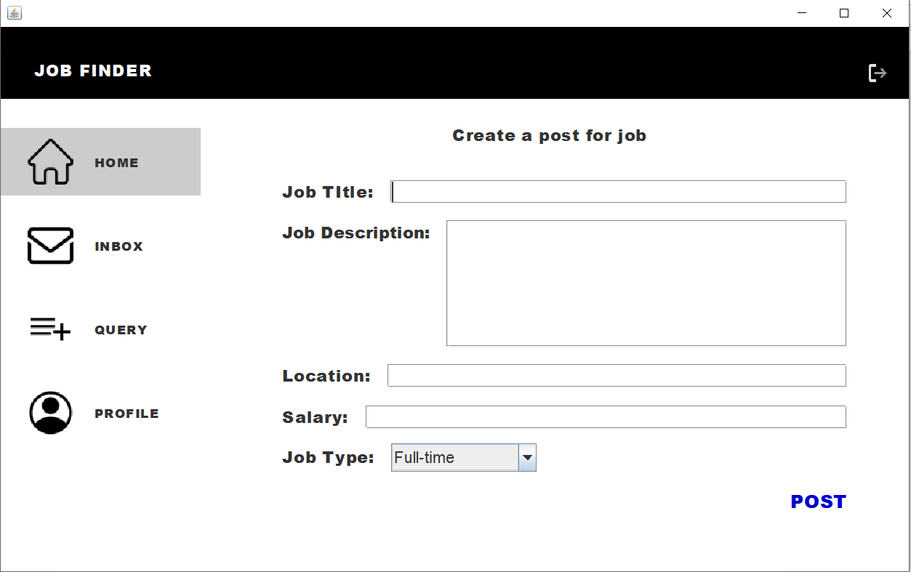
SYSTEM DESIGN
RECRUITER DASHBOARD
HOME
CREATE POST

Slide 13
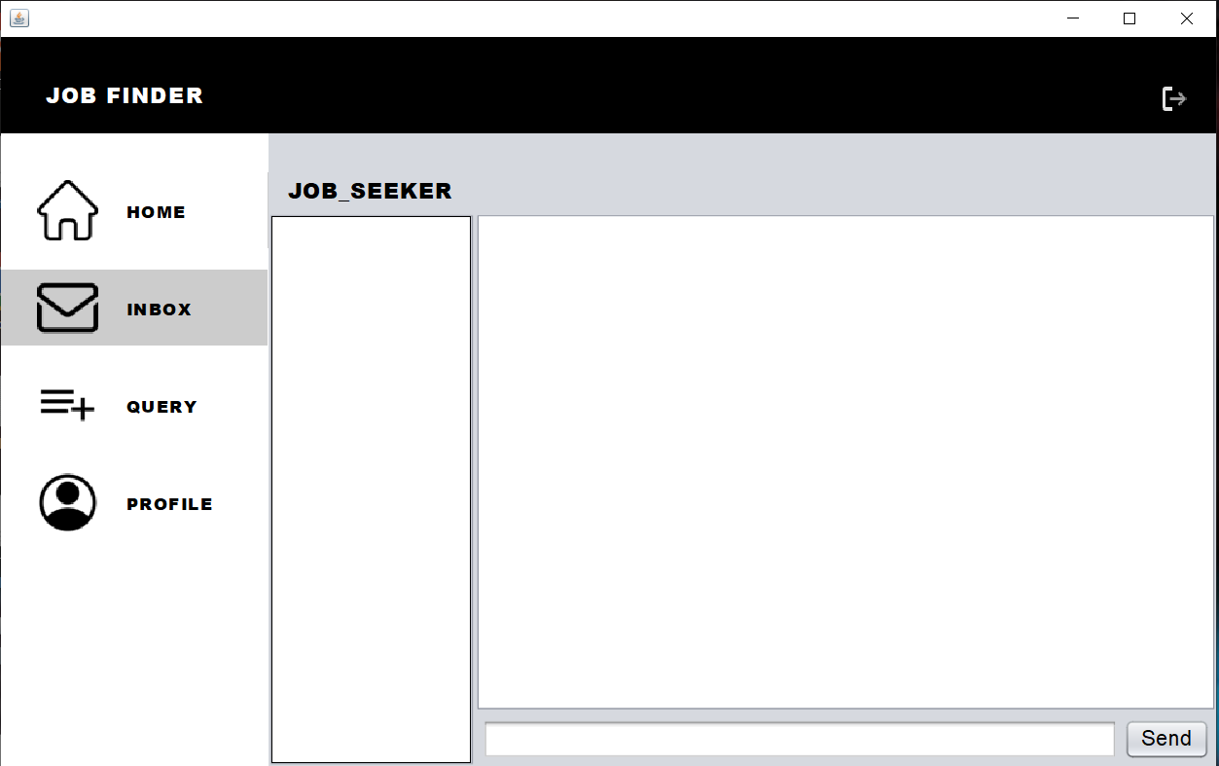
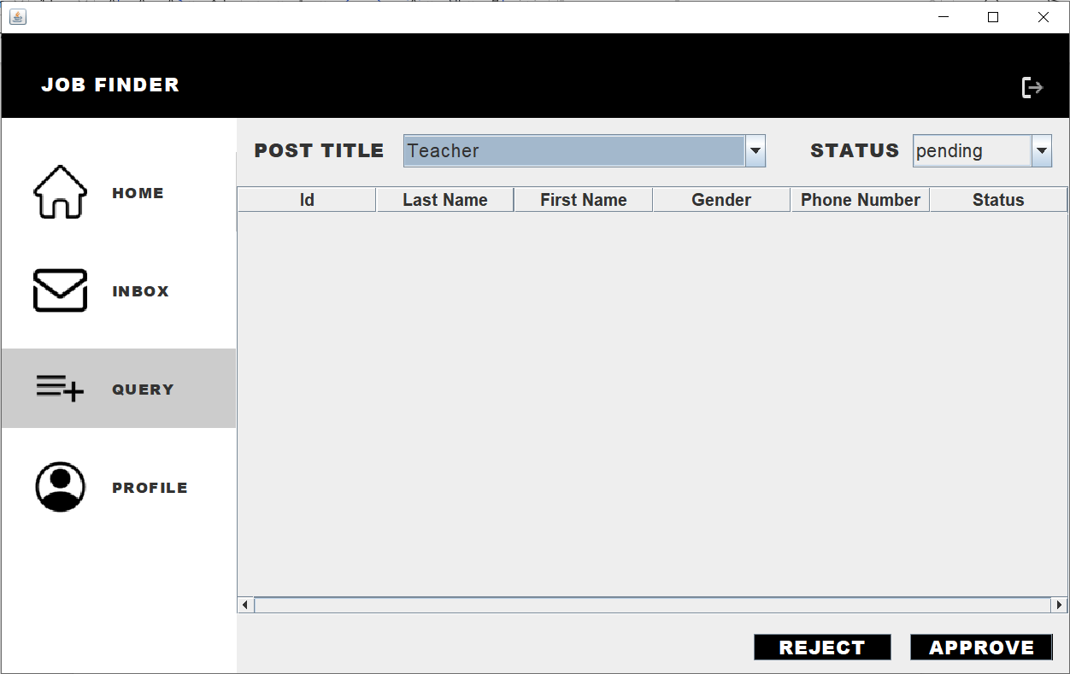
SYSTEM DESIGN
RECRUITER DASHBOARD
INBOX
QUERY

Slide 14
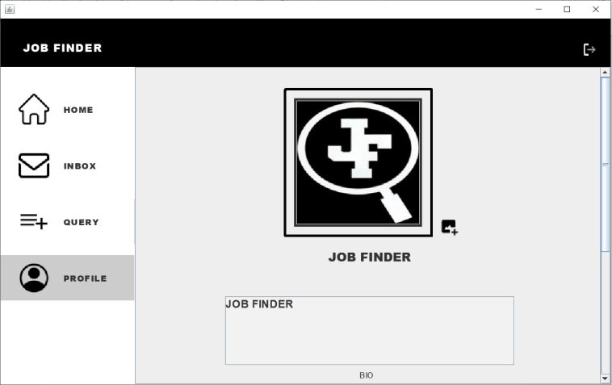
SYSTEM DESIGN
RECRUITER DASHBOARD
PROFILE

Slide 15
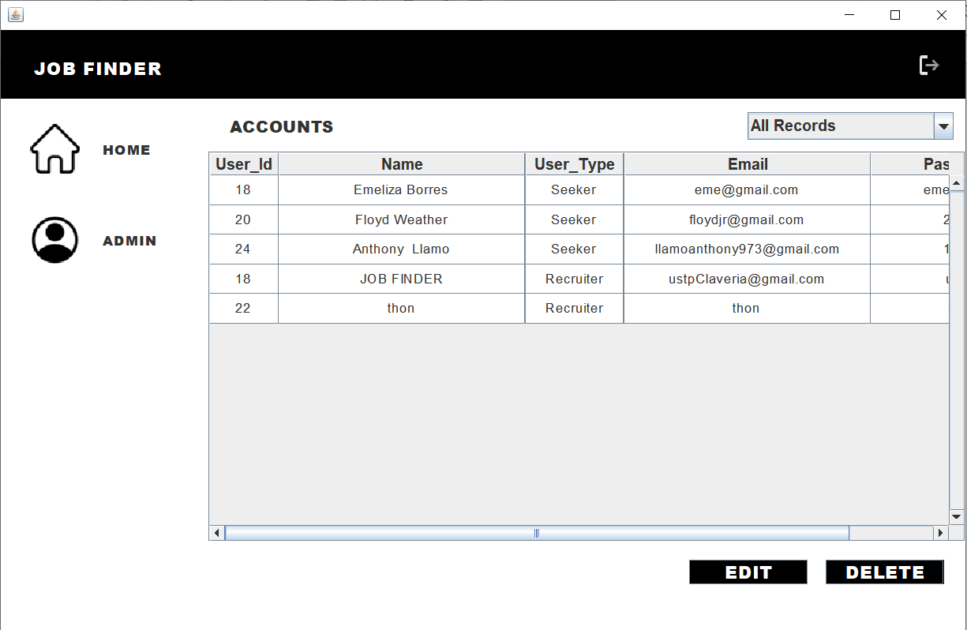
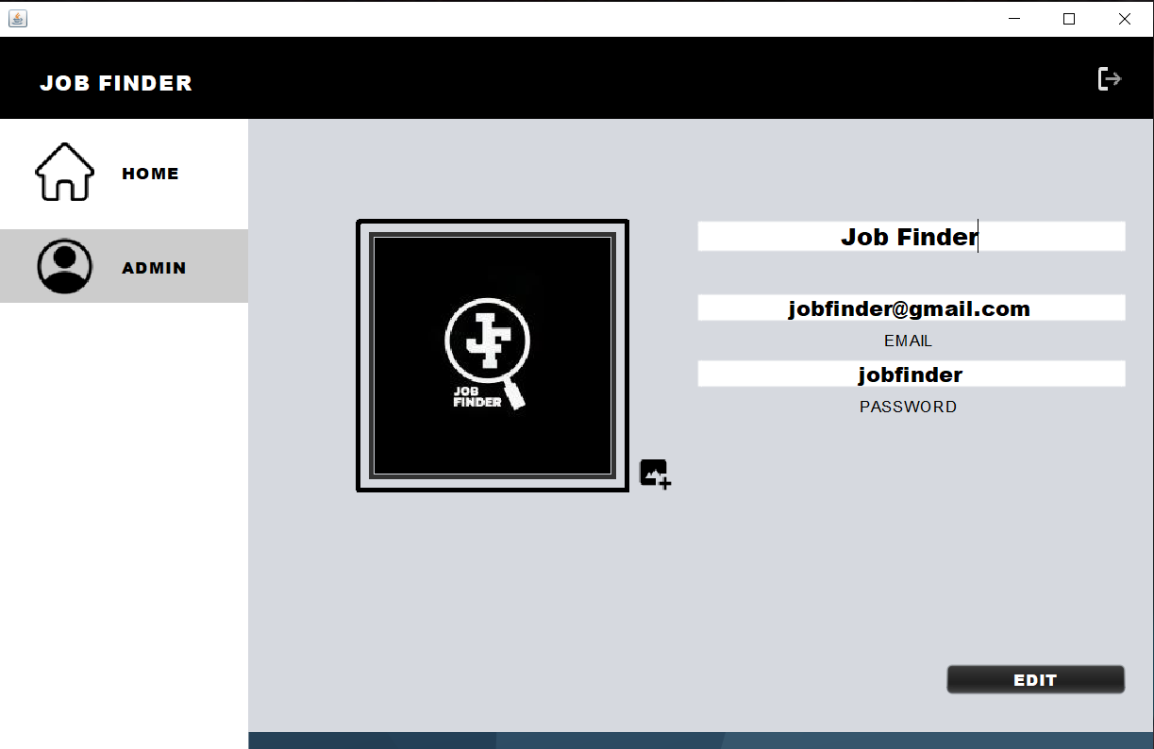
SYSTEM DESIGN
ADMIN DASHBOARD
HOME
PROFILE

Slide 16
CONCLUSION
The Job Finder App addresses the issue of scattered job listings in Claveria by providing a user-friendly platform that simplifies the job search for applicants and helps employers connect with qualified candidates.
This study aims to enhance the job search experience, improve user engagement, and support local job opportunities. By focusing on Claveria, it provides valuable insights into the app's effectiveness in meeting community needs.
The findings will highlight the app's potential success while identifying areas for improvement. Overall, the Job Finder App is expected to reduce unemployment and promote local economic growth by creating a more efficient job-matching process for both job seekers and employers.

