Slide 1
TrueRehab-RF
Contactless movement monitoring
AEII 2026
Notes:
MAIN PRESENTATION
Begin facing the audience. Pause briefly after the project name. Advance on the final sentence.
SPOKEN SCRIPT
Hello. We are the team behind TrueRehab-RF. We are developing a contactless approach to movement monitoring during rehabilitation, using millimeter-wave radar. Our long-term aim is to help people and their therapists understand how an exercise is performed. To explain the idea, let us begin with one familiar movement: a biceps curl.
Sources and evidence limits
CLAUDE/PROJECT.md
presentation/TrueRehab_RF_Poster_Speaking_Script_Expanded.docx

Slide 2
10
repetitions
Illustrative example
Notes:
MAIN PRESENTATION
Let the number register for two seconds. Do not point at the figure. Advance after the last question.
SPOKEN SCRIPT
Imagine someone completing ten repetitions. A counter can record all ten, and the weight may reach the expected height each time. That is useful information. But the number alone leaves something unanswered. Did the person keep using the intended arm movement throughout the set, or did the way they lifted the weight begin to change?
Sources and evidence limits
Illustrative example, not a participant result.
https://pubmed.ncbi.nlm.nih.gov/19118128/

Slide 3
How the curl is performed
Arm movement
Shoulder and trunk movement
Concept illustration
Levin et al. 2009
Notes:
MAIN PRESENTATION
Allow the second pose to make the contrast. Keep your gaze mostly on the audience. No laser pointer is needed.
SPOKEN SCRIPT
A person might raise their shoulder or move their trunk while still completing the curl. The task is completed, but the movement strategy has changed. Compensation can help a person finish a task, so its meaning depends on their condition and rehabilitation goals. Our research focuses on observing these changes during biceps curls, then testing whether radar measurements can describe them reliably. Fatigue is a separate question that also needs independent evidence.
Sources and evidence limits
https://pubmed.ncbi.nlm.nih.gov/19118128/
CLAUDE/output/2026-11-05-evidence-review-and-presentation-options.md
Diagrams are conceptual, not measured body tracking.

Slide 4
Radar reflections
Distance
Direction
Speed
Conceptual sensing view
Notes:
MAIN PRESENTATION
Say distance, direction and speed at an even pace. Let the diagram carry the explanation without tracing the waves.
SPOKEN SCRIPT
Radar sends radio signals and receives reflections from the person and surrounding objects. Processing those reflections gives us information about distance, direction and speed. We can then investigate how the measurements change across repetitions. Our final design aims to monitor movement without requiring a camera or sensors attached to the user. Whether the radar features can support useful rehabilitation estimates is what we need to test.
Sources and evidence limits
CLAUDE/PROJECT.md
CLAUDE/output/2026-11-02-local-live-radar-viewer.md
Conceptual sensing diagram; no anatomical tracking is implied.

Slide 5
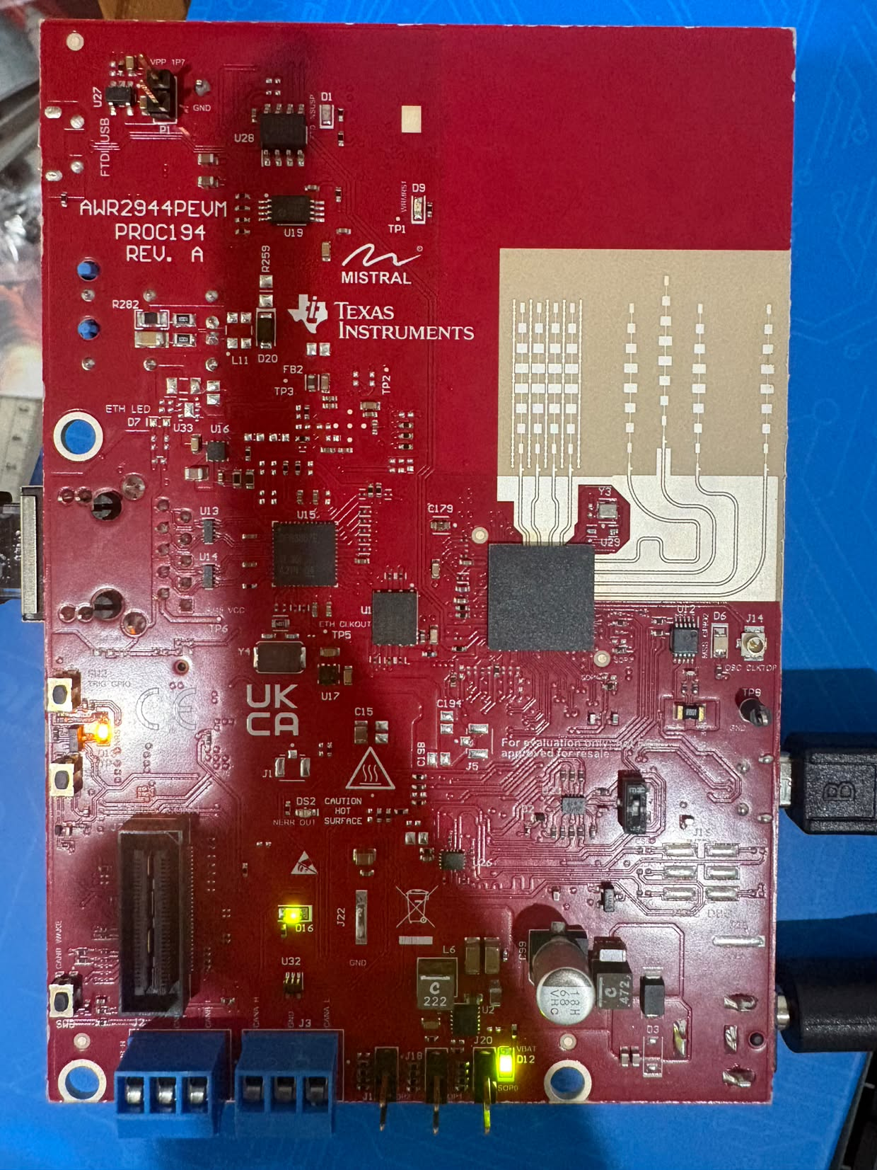
The current
prototype
AWR2944PEVM
Onboard processing
USB to notebook
No DCA1000
Submitted: AWR1843BOOST + DCA1000EVM
Notes:
MAIN PRESENTATION
Name the replacement once, clearly. If the board is on the table, briefly acknowledge it without interrupting the story.
SPOKEN SCRIPT
This is our actual radar board, the TI AWR2944PEVM. It performs the initial radar processing onboard and sends processed measurements to a notebook through USB. There is an important update from our submitted poster. The poster names AWR1843BOOST and DCA1000EVM. Hardware availability led us to the current board, and our present setup does not use DCA1000. We disclose that change because processed measurements are different from a raw ADC capture workflow.
Sources and evidence limits
CLAUDE/PROJECT.md
CLAUDE/CONTEXT.md
Original user photograph of AWR2944PEVM, 2 November 2026.

Slide 6
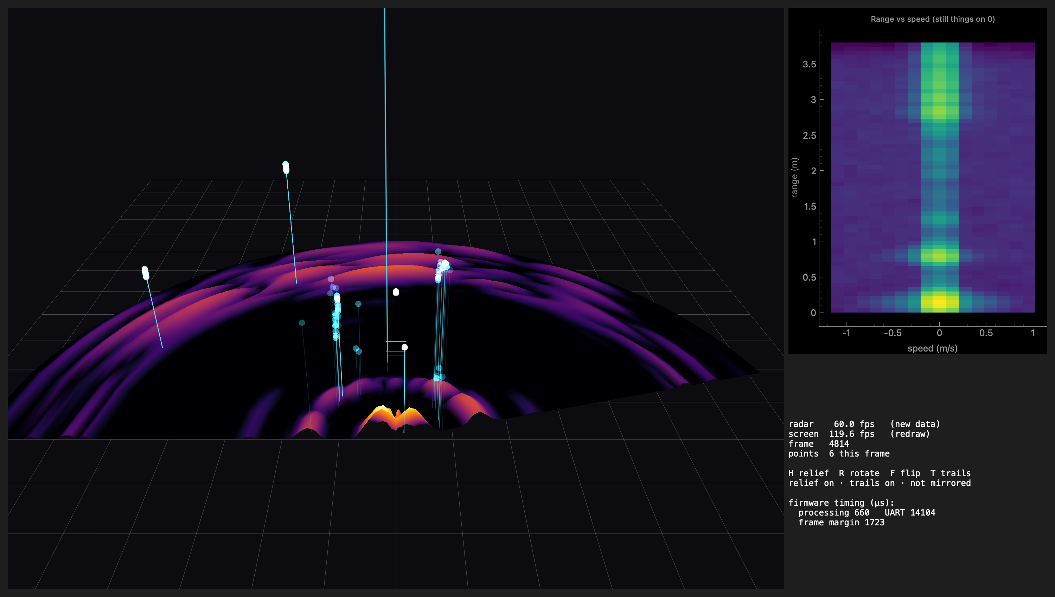
Real radar measurements
Recorded prototype view · no clinical inference
Notes:
MAIN PRESENTATION
Pause so the audience can inspect the recorded view. If the live demo is unavailable, continue using this image. Do not call it a live screen.
SPOKEN SCRIPT
This recorded view comes from our working radar visualization. It contains measured reflection points and a heatmap showing signal strength across range and speed. These displays help us inspect the sensor output and check the acquisition process. The colored surface is a display of radar intensity, not a measured model of the room's physical height. These are real radar measurements, while identifying body movements or estimating fatigue still requires further validation.
Sources and evidence limits
radar-lab/real_room3d.png
radar-lab/README.md
CLAUDE/output/2026-11-03-2214-radar-lab-fullmap-3d.md

Slide 7
Synchronized reference recordings
Next experiment
Radar
Muscle activity
IMU motion
Video labels
Shared timing
Illustrative recording plan
Notes:
MAIN PRESENTATION
Let the shared timing line connect the four rows visually. Explain the relationship rather than reading the labels in order.
SPOKEN SCRIPT
To understand what the radar is observing, we need references recorded during the same movement. Our development setup includes MyoWare for muscle activity, an IMU for motion, and video for independent movement annotations. Each source answers a different question. The next experiment is to align these recordings, check their quality, and mark repetitions and visible movement changes. Muscle activity alone is not a validated fatigue percentage, and matching the timelines is a prerequisite for comparing the signals.
Sources and evidence limits
recorder/README.md
CLAUDE/CONTEXT.md
CLAUDE/output/2026-11-05-evidence-review-and-presentation-options.md
Timeline is an illustrative recording plan, not a synchronized result.

Slide 8
Detection before prediction
Detect
Predict
Movement changes
Earlier warnings
First validation target
Later research
No validated fatigue or prediction score yet
Notes:
MAIN PRESENTATION
Pause after describing detection. Give the later prediction goal less emphasis. Advance without promising a warning lead time.
SPOKEN SCRIPT
Our first model target is to detect movement changes against independent labels. We would evaluate that on participants or sessions kept separate from training, and report false alerts as well as missed events. Only after establishing detection should we investigate earlier warnings. The fatigue percentages and two-to-three-repetition predictions in the proposal are illustrative research goals. They are not measured performance of the current prototype.
Sources and evidence limits
T-Proposal-Radar (1).docx, sections 7, 8 and 13, read-only.
CLAUDE/output/2026-11-05-evidence-review-and-presentation-options.md

Slide 9
Current evidence
Radar
acquisition
Diagnostic
views
Individual
sensor tests
Next: aligned data, validated models, Raspberry Pi
Fatigue and compensation models remain unvalidated
Notes:
MAIN PRESENTATION
Keep the delivery factual. This slide establishes credibility by distinguishing completed sensor work from the next experiment.
SPOKEN SCRIPT
We have demonstrated real radar acquisition and diagnostic views, and we have tested individual reference-sensor components. That establishes a foundation for collecting data. It does not yet establish a synchronized rehabilitation dataset or a validated fatigue and compensation model. Our immediate milestone is one usable set of aligned biceps-curl recordings. Model evaluation follows that evidence, with Raspberry Pi deployment after we measure the model's performance and computing requirements.
Sources and evidence limits
CLAUDE/CONTEXT.md as of 5 November 2026.
CLAUDE/output/2026-11-05-0012-imu-wifi-link.md
MyoWare recording sketch is compiled-only; earlier demo was tested. No integrated recording result is claimed.

Slide 10
Our goal
Contactless feedback
for rehabilitation
Understand how an exercise is performed
TrueRehab-RF
Notes:
MAIN PRESENTATION
Slow down for the final aim. Stop on this slide for questions; slides 11 and 12 are optional Q&A references.
SPOKEN SCRIPT
Our goal is contactless feedback that helps people and therapists understand how an exercise is performed. A future system could summarize meaningful movement changes during a session and support a therapist's review. TrueRehab-RF begins with a simple question about one exercise, then builds toward that goal through measured signals and careful validation. Thank you. We would be happy to show the prototype and answer your questions.
Sources and evidence limits
CLAUDE/PROJECT.md
Expected use is a research goal; clinical benefit has not been established.

Slide 11
Hardware update
Q&A reference
 | Submitted poster | Current prototype
Radar | AWR1843BOOST | AWR2944PEVM
Acquisition | DCA1000EVM | Onboard processing + USB
Data workflow | Raw ADC / I-Q | Processed points / heatmaps
Availability-driven substitution · submitted poster unchanged
Notes:
OPTIONAL Q&A
Open only if asked about the submitted poster or acquisition hardware.
SPOKEN SCRIPT
The submitted design uses AWR1843BOOST with DCA1000EVM. Our current implementation uses AWR2944PEVM, onboard processing and USB serial output. The poster remains unchanged, and we explain the availability-driven substitution. Current points and heatmaps are processed representations; they are not interchangeable with the original full raw ADC or I/Q workflow.
Sources and evidence limits
CLAUDE/PROJECT.md
CLAUDE/CONTEXT.md
TrueRehub-RF .pdf, submitted poster, read-only.

Slide 12
Evidence and research limits
Movement strategy matters
Levin, Kleim and Wolf · 2009
Independent labels before model claims
Proposal percentages are illustrative
Clinical benefits require future evaluation
Notes:
OPTIONAL Q&A
Use for questions on recovery, compensation, medical statistics or the evidence behind the concept.
SPOKEN SCRIPT
The distinction between completing a task and the movement strategy used is supported by rehabilitation literature, including Levin, Kleim and Wolf. External studies motivate our question, but their outcomes are not results for this device. We have not established improved recovery, injury prevention, adherence gains or fewer clinical visits. We also do not treat the proposal's example percentages as measured accuracy or clinical thresholds.
Sources and evidence limits
Levin MF, Kleim JA, Wolf SL. What do motor recovery and compensation mean in patients following stroke? Neurorehabil Neural Repair. 2009;23(4):313-319. https://pubmed.ncbi.nlm.nih.gov/19118128/ DOI: 10.1177/1545968308328727
CLAUDE/output/2026-11-05-evidence-review-and-presentation-options.md
T-Proposal-Radar (1).docx, sections 7, 8 and 13, read-only.

