Slide 1
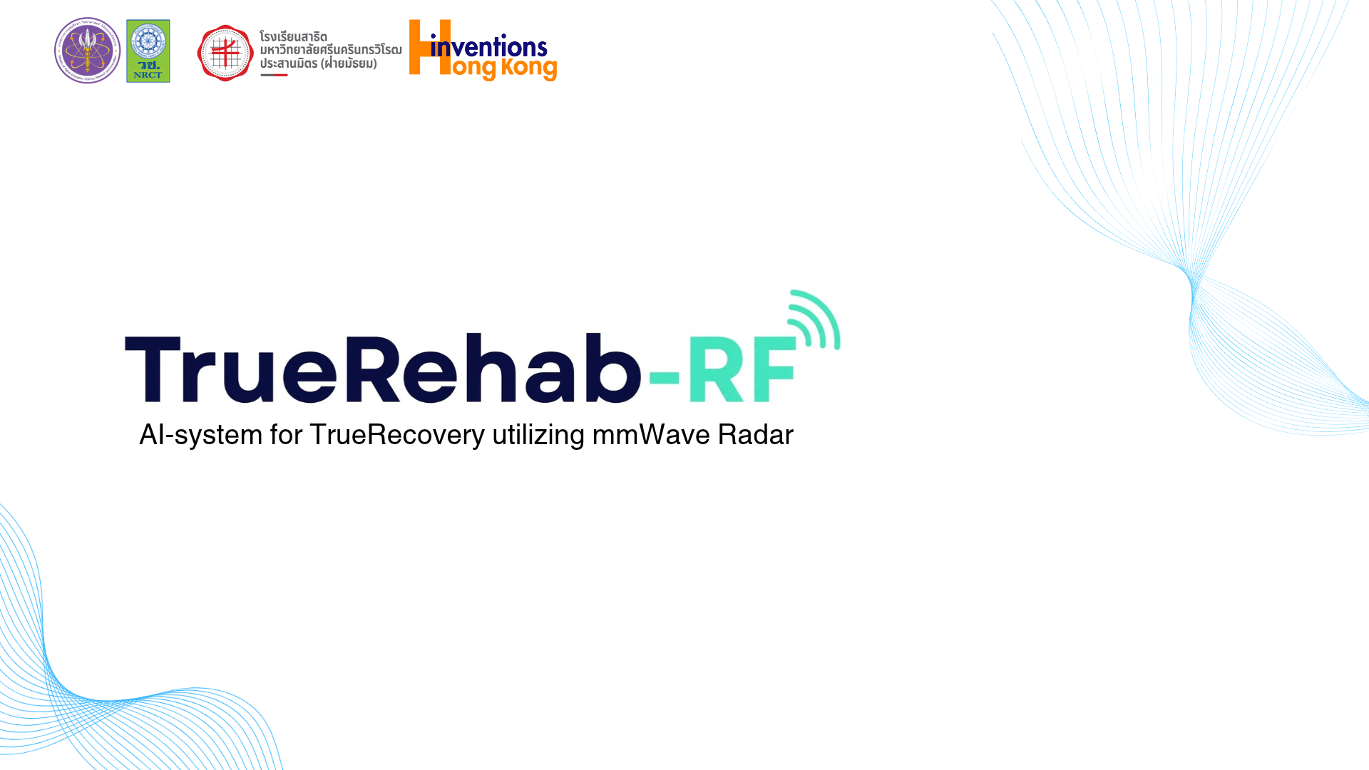
TrueRehab-RF
Contactless movement monitoring
AEII 2026
Notes:
Short introduction | Presenter
Begin facing the audience. Pause after the project name, then move naturally into the team introduction.
SPOKEN SCRIPT
Hello, and welcome to TrueRehab-RF. We are developing a contactless approach to monitoring movement during rehabilitation using millimeter-wave radar. Our starting question is simple: when someone completes an exercise, what can we learn about how they performed it? Today, we will explain the problem, our concept, and the prototype we are building.
Sources and evidence limits
CLAUDE/PROJECT.md
presentation/TrueRehab_RF_Poster_Speaking_Script_Expanded.docx

Slide 2

Our team
Team TrueRehab-RF · Thailand
Notes:
Background and problems | Presenter
Introduce the school clearly. Let the institution name remain visible rather than reading every line on screen.
SPOKEN SCRIPT
We are a student team from Prasarnmit Demonstration School (Secondary), Srinakharinwirot University, in Thailand. We are bringing together sensing, software, and AI development around one rehabilitation question. We began with a biceps curl because one familiar exercise gives us a manageable starting point for studying movement changes across repetitions.
Sources and evidence limits
TrueRehub-RF .pdf, submitted poster, read-only
User-confirmed current exercise scope: biceps curl

Slide 3
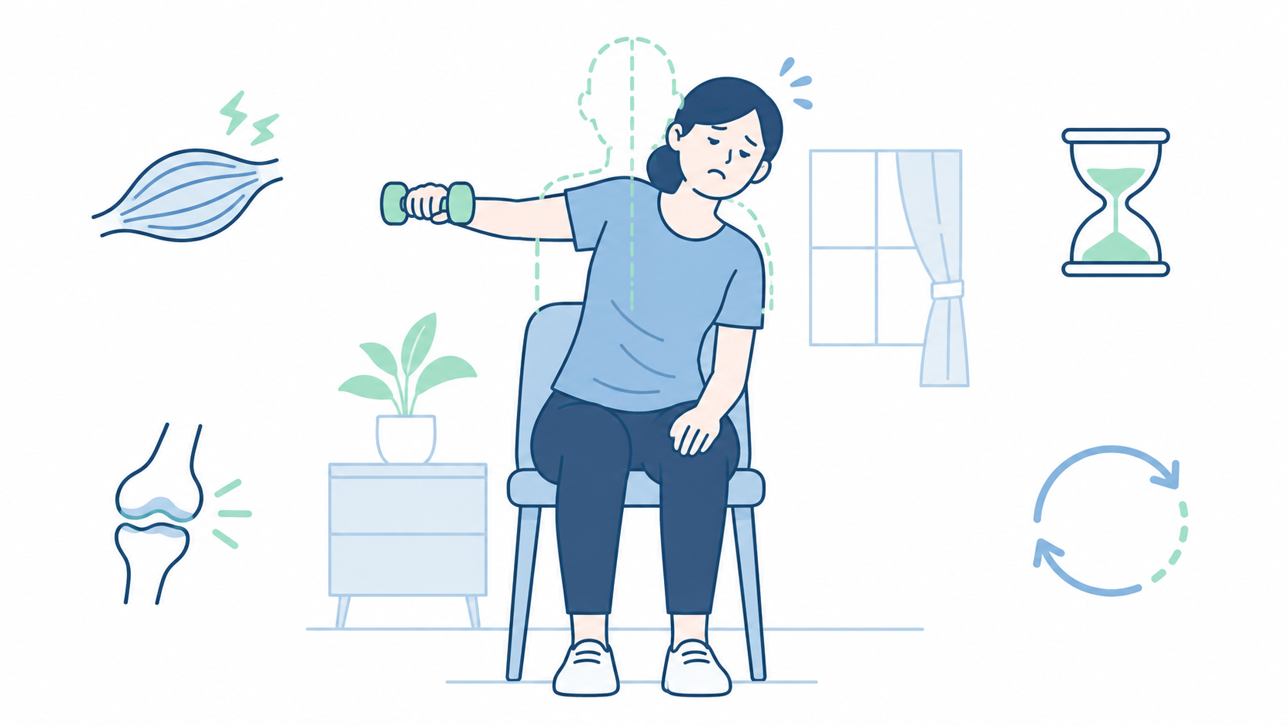

Slide 4
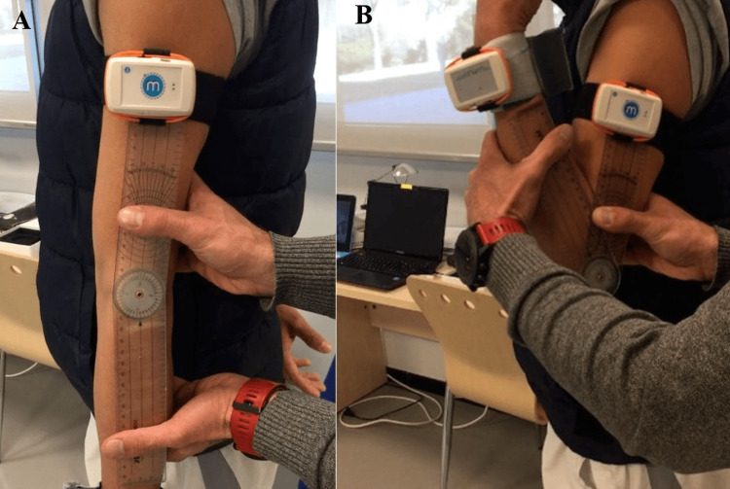
Measuring movement today
Elbow range
of motion
Goniometer
and IMUs
Costa et al. 2020 · PeerJ 8:e9687 · Fig. 4 · CC BY 4.0
Notes:
Background and problems | Presenter
Give the measurement photograph a moment to register. Acknowledge the value of clinical assessment before discussing its scope.
SPOKEN SCRIPT
Clinicians already have useful ways to assess movement. A goniometer measures a joint's range of motion, while wearable sensors can record motion or muscle activity. This photograph shows a clinician aligning a goniometer at the elbow, alongside inertial sensors. These tools provide valuable reference measurements. Our question concerns the observations available when a person continues exercising away from an assessment.
Sources and evidence limits
https://peerj.com/articles/9687/
https://cdn.ncbi.nlm.nih.gov/pmc/blobs/cc73/7427560/fc9120391fa6/peerj-08-9687-g004.jpg
Image credit: Costa et al., 2020, PeerJ 8:e9687, Figure 4, CC BY 4.0

Slide 5
Here's the thing about
traditional measuring
A manual reading captures a moment
Notes:
Background and problems | Presenter
Pause after the opening bridge. Let the visual shift from one assessment moment to a sequence of repetitions.
SPOKEN SCRIPT
Here’s the thing about traditional measuring: an angle recorded during an assessment describes that measurement moment. It does not automatically describe every repetition performed later at home. A person may still lift the weight while changing their shoulder or trunk movement. We want to investigate those changes across a set, alongside the information a clinician already collects.
Sources and evidence limits
https://peerj.com/articles/9687/
https://pubmed.ncbi.nlm.nih.gov/19118128/
Workflow distinction, not a claim that all traditional instruments are inaccurate

Slide 6
Practical measurement constraints
Alignment
Attachment
Sampling
Manual joint angles
Body-worn sensors
Selected manual readings
Different tools have different constraints
Notes:
Background and problems | Presenter
Explain the practical steps in one connected thought. Avoid suggesting that all contact measurements are uncomfortable or unreliable.
SPOKEN SCRIPT
Different measurements require different preparation. Manual goniometry needs careful positioning and alignment. Wearable motion sensors need consistent attachment, and surface EMG needs suitable electrode placement and skin contact. Those steps are reasonable in an assessment, but repeating them can add work to a home routine. This led us to explore whether some movement observations could be collected without attaching sensors.
Sources and evidence limits
https://peerj.com/articles/9687/
https://learn.sparkfun.com/tutorials/getting-started-with-the-myoware-20-muscle-sensor-ecosystem/hardware-hookup

Slide 7
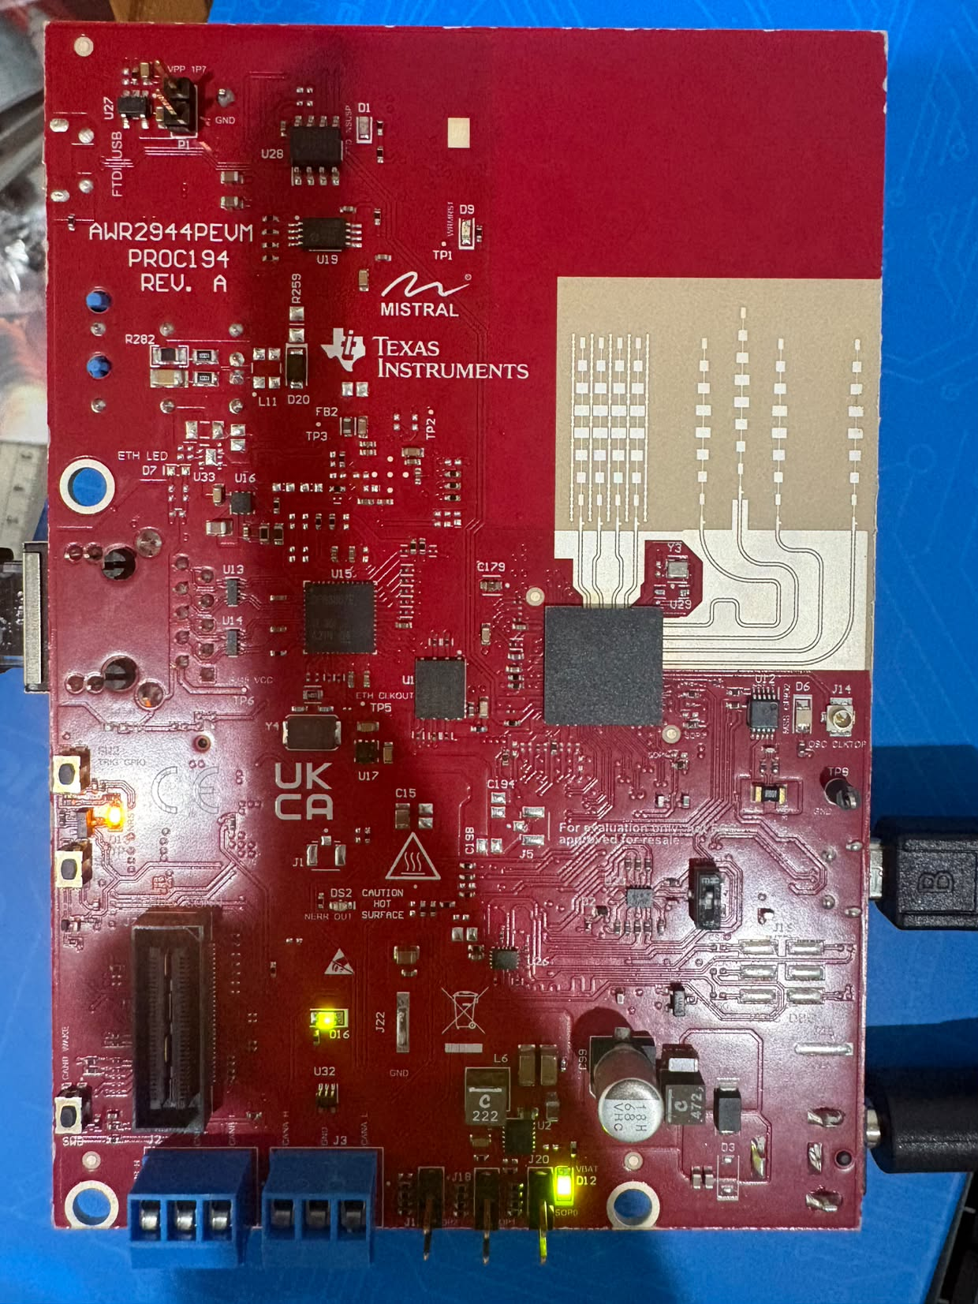
TrueRehab-RF
Contactless
movement monitoring
Research prototype
Current prototype: AWR2944PEVM · no DCA1000
Notes:
Background and problems | Presenter
Allow the board image to introduce the alternative. Keep the delivery conversational rather than announcing a product launch.
SPOKEN SCRIPT
That is the idea behind TrueRehab-RF: use reflected radio signals to study movement from a fixed radar nearby. This is our actual TI AWR2944PEVM board. We selected it because of hardware availability. It replaces the AWR1843BOOST and DCA1000EVM arrangement shown in our submitted poster, with onboard processing and USB output in the current prototype.
Sources and evidence limits
CLAUDE/PROJECT.md
CLAUDE/CONTEXT.md
Actual user-supplied AWR2944PEVM photograph, 2 November 2026

Slide 8
Contactless by design
Nothing attached
No optical video
Repeated observations
Intended everyday setup · reference sensors remain part of development
Notes:
Background and problems | Presenter
Let the space between the person and radar convey contactless sensing. Keep design aims distinct from validated rehabilitation outcomes.
SPOKEN SCRIPT
In the intended everyday design, the user would not need electrodes or straps for radar sensing, and the system would not require optical video. The aim is to observe repeated movement with less preparation on the body. We still use reference sensors and video during development to understand the radar signals. Ease of setup and useful movement interpretation must be tested.
Sources and evidence limits
CLAUDE/PROJECT.md
CLAUDE/output/2026-11-05-evidence-review-and-presentation-options.md

Slide 9
Rehabilitation at home
Prescribed practice
between supervised
sessions
Continued practice
with clinician oversight
NICE NG236 · clinician-led, tailored rehabilitation
Notes:
Background and problems | Presenter
Move from the sensing concept to the reason it could matter between appointments. Avoid implying that home practice replaces clinical care.
SPOKEN SCRIPT
Rehabilitation can continue after a person leaves hospital, and a clinician may prescribe practice at home as part of their plan. Travel and access also matter when planning care. This creates a reason to study observations between appointments. Our goal is to support an appropriate home routine and a therapist's review, while exercise choice and professional guidance remain part of the care plan.
Sources and evidence limits
https://www.nice.org.uk/guidance/ng236/chapter/Recommendations
NICE NG236 recommendations 1.1.8, 1.2.22, 1.13.7 and 1.13.8
No measured visit reduction or clinical benefit is claimed for TrueRehab-RF

Slide 10
The movement behind each repetition
Arm movement
Shoulder / trunk movement
Concept illustration · independent movement labels still needed
Notes:
Background and problems | Presenter
Let the two movement strategies carry the comparison. Turn toward the developer only for the final handoff sentence.
SPOKEN SCRIPT
Our concept focuses on the movement behind each repetition. Completing a curl and maintaining the intended movement are related questions, but they are not identical. We first want to identify observable movement changes, then investigate their relationship with fatigue. Reliable earlier warnings are a later research goal. I will now hand over to our developers to explain the system.
Sources and evidence limits
https://pubmed.ncbi.nlm.nih.gov/19118128/
CLAUDE/PROJECT.md
CLAUDE/output/2026-11-05-evidence-review-and-presentation-options.md

Slide 11
Radar to screen
Current data path
Radar
reflections
Onboard
processing
USB to
notebook
Points +
heatmaps
AWR2944PEVM
Processed radar outputs · no DCA1000
Notes:
How it works | Developer
Follow the flowchart through the spoken sequence without tracing every connector. Explain the working acquisition path first.
SPOKEN SCRIPT
The working data path begins at the AWR2944PEVM. Its firmware performs the initial radar processing onboard. Processed points and heatmaps travel through USB to the notebook, where our software parses the data and displays it. These representations describe radar reflections. They are different from full raw ADC capture, and they do not automatically identify a body joint or establish fatigue.
Sources and evidence limits
CLAUDE/CONTEXT.md
radar-lab/README.md
sandbox/radar-live-viewer/README.md
CLAUDE/output/2026-11-03-2214-radar-lab-fullmap-3d.md

Slide 12
Developing the models
Research workflow
Record
together
Align +
label
Train +
evaluate
Movement
models
Later: Raspberry Pi inference and session feedback
Fatigue and compensation models remain unvalidated
Notes:
How it works | Developer
Identify this flowchart as the research path. Finish by handing over to the demo lead.
SPOKEN SCRIPT
The model-development path starts with synchronized radar and reference recordings, independent movement labels, and data-quality checks. We would train candidate models and evaluate them on participants or sessions held apart from training. Compensation and fatigue estimates need this validation before use. Raspberry Pi deployment follows measured performance. Our full synchronized dataset and validated models are still ahead. Our demo lead will now show the interface and measurement setup.
Sources and evidence limits
recorder/README.md
CLAUDE/PROJECT.md
CLAUDE/CONTEXT.md
CLAUDE/output/2026-11-05-evidence-review-and-presentation-options.md

Slide 13
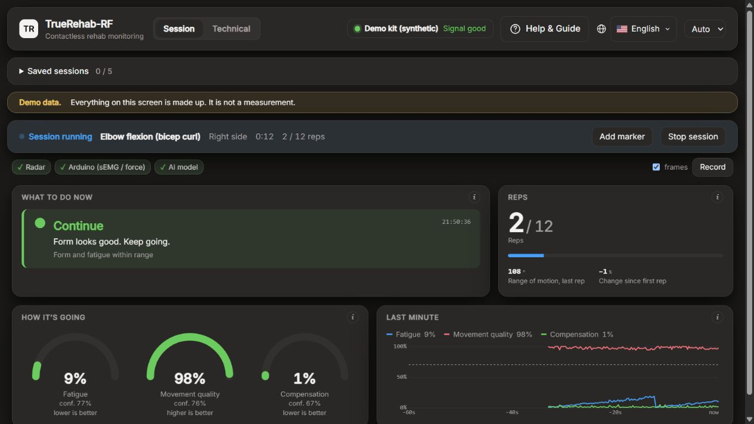
The dashboard
Software demonstration · all scores are simulated
Notes:
Showcase | Demo lead
Introduce the actual interface image. State the synthetic-score label clearly before describing the intended experience.
SPOKEN SCRIPT
This is our dashboard interface. It illustrates the session information and feedback we aim to provide, including movement quality, fatigue-related estimates, and a session summary. The scores shown here are synthetic demonstration values, not validated radar inference. We use the interface to explore how information could be presented, while the real radar diagnostic views help us inspect the measured sensor output.
Sources and evidence limits
frontend/README.md
CLAUDE/CONTEXT.md
Dashboard screenshot from the repository's actual frontend; synthetic demo scores

Slide 14
In practice
Demonstration setup
Position the radar
Perform a curl
Inspect the stream
Setup illustration · measured reflections on the next slide
Notes:
Showcase | Demo lead
Use the setup diagram as a guide. Allow time for a demonstration if the prepared hardware is available; otherwise continue with the recorded output.
SPOKEN SCRIPT
For the demonstration, we keep the radar fixed and use the biceps curl as our initial task. We inspect the incoming measurements as the person moves. During future synchronized recording sessions, reference sensors and annotations will help us compare the radar signal with the observed movement. Today, the demonstration shows acquisition and visualization, without claiming a completed clinical assessment or validated prediction.
Sources and evidence limits
CLAUDE/CONTEXT.md
CLAUDE/PROJECT.md
recorder/README.md
Conceptual setup diagram; no integrated recording result asserted

Slide 15
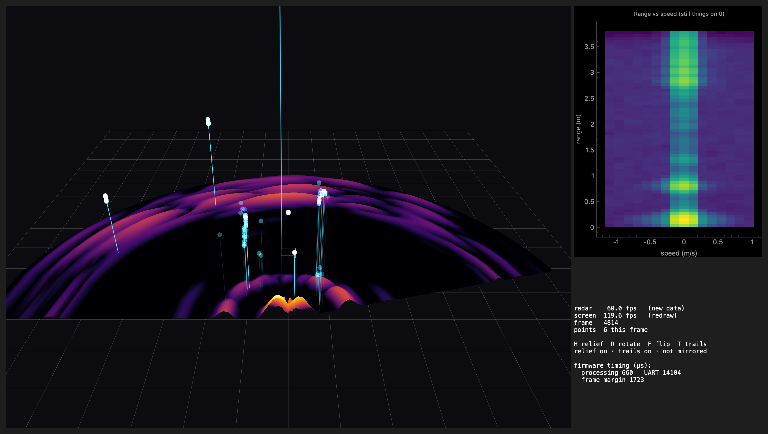
Real radar output
Recorded radar view · no body or clinical inference
Notes:
Showcase | Demo lead
Pause for the recorded data view. Describe measured reflections without assigning them to anatomy or calling this image live.
SPOKEN SCRIPT
This recorded radar-lab view shows real reflection points and a range-speed heatmap. The colors represent signal intensity, and the raised display surface is not a measurement of physical object height. We can use these views to inspect the data before selecting model inputs. Interpreting specific movement patterns and estimating fatigue require the next stage of labeled recording and validation.
Sources and evidence limits
radar-lab/real_room3d.png
radar-lab/README.md
CLAUDE/output/2026-11-03-2214-radar-lab-fullmap-3d.md

Slide 16
TrueRehab-RF
Contactless insight into movement
Research prototype
Notes:
Showcase | Presenter
Return to the audience. Slow down for the final aim and leave this slide visible for questions.
SPOKEN SCRIPT
TrueRehab-RF aims to help people and therapists understand how an exercise is performed through contactless movement observations. We now have working radar acquisition and visualization. Our next milestone is a usable synchronized dataset, followed by model evaluation. That is the path from our current prototype toward meaningful feedback for home rehabilitation. Thank you, and we welcome your questions.
Sources and evidence limits
CLAUDE/PROJECT.md
CLAUDE/CONTEXT.md
Future clinical benefits remain unvalidated

