Slide 1
SQL Project :
Chinook Music Store

Slide 2
Harmonizing Sales : Insights from Chinook
Maddu Thoraha Raju
26-06-2024

Slide 3
Introduction:.
The Chinook database is a well-organized collection of multiple interrelated tables designed to store a wide array of information pertinent to a music store. The key tables in the Chinook database include:
Album: Contains information about music albums, including album IDs, titles, and the artist associated with each album.
Artist: Stores data about artists, including artist IDs and names, providing a reference for the albums and tracks they have created.
Customer: Holds detailed information about customers, such as customer IDs, first and last names, company names, contact details, and address information.
Employee: Contains employee data, including employee IDs, names, job titles, and contact information, allowing the management of staff within the music store.
Genre: Provides a list of music genres, each with a unique identifier and name, categorizing the types of music available.
Invoice: Records sales transactions, including invoice IDs, customer IDs, dates, billing addresses, and total amounts for each purchase.

Slide 4
Invoice Line: Details individual items within invoices, including invoice line IDs, invoice IDs, track IDs, unit prices, and quantities.
Media Type: Lists the different media formats available, each with a unique identifier and name, such as MP3, AAC, etc.
Playlist: Contains playlist information, with each playlist having a unique identifier and name, providing collections of tracks grouped by users or predefined criteria.
Playlist Track: Links tracks to playlists, detailing which tracks are included in each playlist by referencing playlist IDs and track IDs.
Track: Stores comprehensive information about individual music tracks, such as track IDs, names, album IDs, media type IDs, genre IDs, composers, durations, and file sizes.
This relational structure of the Chinook database allows for an in-depth analysis of various aspects of the music store's operations, from customer demographics and sales transactions to track popularity and genre preferences.

Slide 5
Problem Statement
Analyze the Chinook data to provide insights and recommendations for promoting new albums. This problem statement encompasses data analysis and decision-making based on the music store's performance, customer demographics, and purchasing behavior to enhance the effectiveness of album promotions and marketing efforts.

Slide 6
Objectives
Data Quality Assessment
Sales Performance Analysis
Customer Demographic Analysis
Revenue Analysis
Customer Revenue Analysis
Customer Purchase Pattern
Purchasing Behaviour Analysis
Customer Churn Analysis
Genre Sale Analysis
Product Affinity Analysis
Regional Market Analysis
Campaign Impact Analysis

Slide 7
Sales Performance Analysis
By leveraging SQL queries, we were able to identify the top-performing tracks, artists, and genres based on the number of sales.
Track_name
War Pigs
You Know I'm No Good (feat. Ghostface Killah)
Violent Pornography
I Looked At You
Scentless Apprentice
Artist name
Van Halen
R.E.M.
The Rolling Stones
Nirvana
Foo Fighters
Genre Name
Rock
Alternative & Punk
Metal
R&B/Soul
Blues

Slide 8
Customer Demographic Analysis
The chart below illustrates the distribution of customers across different countries as recorded in the Chinook database. This visualization helps in understanding the geographical spread of Chinook's customer base and identifying key markets.

Slide 9
Revenue Analysis
The chart below illustrates the number of invoices and total revenue generated for each country present in the Chinook database. This visualization provides insights into the sales performance across different geographical regions.

Slide 10
Temporal Analysis
Temporal analysis is crucial for understanding sales trends over time. By calculating quarterly and yearly sales, we can identify patterns and determine which quarters experienced sales increases and assess overall yearly performance.

Slide 11
Churn Rate Analysis:
For any comprehensive analysis of a customer database, performing churn analysis is essential. Churn analysis provides valuable insights into customer retention by identifying how many active customers remain at the end of a given period. This analysis helps businesses understand customer behavior, assess the effectiveness of retention strategies, and identify areas for improvement.
Customer Retention: Understanding churn rates allows businesses to measure the effectiveness of their customer retention strategies and identify segments at risk of leaving.
Revenue Impact: By identifying and addressing factors that contribute to customer churn, businesses can reduce revenue loss and improve overall profitability.
Customer Engagement: Churn analysis helps in understanding customer engagement levels, allowing businesses to tailor their marketing and customer service efforts to retain valuable customers.
Forecasting: Predicting future churn rates can help businesses in planning and resource allocation, ensuring that they are better prepared to address potential declines in customer numbers.
For the given Chinook Database Churn Rate is 38%.

Slide 12
Genre Sales Analysis
The Chinook database contains approximately 25 different genres. Understanding the sales distribution across these genres is crucial for strategic decision-making. The table below provides a breakdown of the percentage of total sales attributed to each genre.
Genre Name | Sales Percent (%)
Rock | 53.38
Alternative & Punk | 12.37
Metal | 11.8
R&B/Soul | 5.04
Blues | 3.43
Alternative | 3.33
Latin | 2.09
Pop | 2.09
Hip Hop/Rap | 1.9
Jazz | 1.33
Easy Listening | 1.24
Reggae | 0.57
Electronica/Dance | 0.48
Classical | 0.38
Heavy Metal | 0.29
Soundtrack | 0.19
TV Shows | 0.1

Slide 13
Integrated Analysis
To provide comprehensive recommendations, it's important to analyze the top-performing artists, genres, and albums collectively. This integrated analysis helps in understanding the interplay between these elements and guides strategic decisions for marketing and promotions. The table below combines data on the top artists, genres, and albums based on sales performance.
Artist Name | Genre Name | Album Title
Jimi Hendrix | Rock | Are You Experienced?
Godsmack | Metal | Faceless
System Of A Down | Metal | Mezmerize
JET | Alternative & Punk | Get Born
The Doors | Rock | The Doors
Queen | Rock | Greatest Hits I
Aerosmith | Rock | Big Ones
The Police | Rock | The Police Greatest Hits
Nirvana | Rock | From The Muddy Banks Of The Wishkah [live]
The Who | Rock | My Generation - The Very Best Of The Who

Slide 14
Album Recommendation
Given that the majority of Chinook's customer base is located in the US, and based on regional analysis and sales performance, we have identified three albums that are likely to boost sales. These recommendations are based on their popularity, genre performance, and artist reputation.
1 | Are You Experienced?
2 | From the Muddy Banks of Wishkah(live)
3 | The Doors

Slide 15
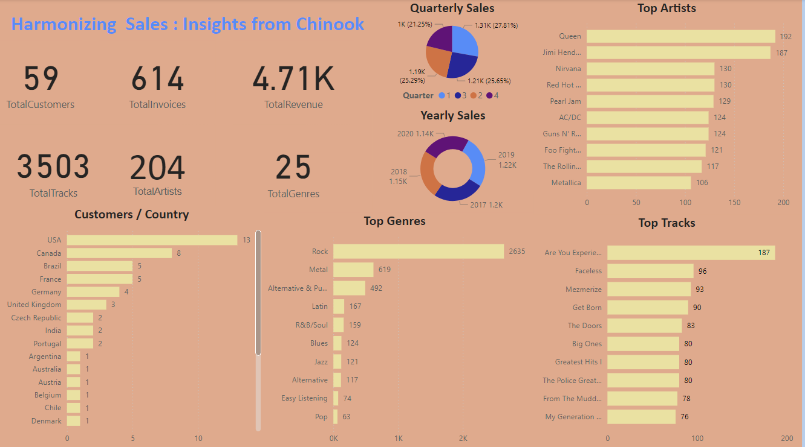
A PowerBi report based on our analysis

Slide 16
Insights and Suggestions
Understanding the regional market is crucial for effective marketing strategies.
Despite music's global appeal, integrating local elements is essential to maintain relevance.
Advertising campaigns are indispensable in today's market for effectively promoting our best-selling or top products.
Improving our temporal analysis involves strategizing for low-performing months.
Understanding customer acquisition and retention is critical for identifying reasons behind customer attrition.
In the era of dominant online music platforms, reviewing our pricing strategies is essential to remain competitive.
We should pursue aggressive marketing within a defined budget.
Evaluating underperforming tracks allows us to decide between discontinuation or offering discounts to revitalize interest.
While focusing on a limited set of tracks per region, prioritizing those with the best performance ensures long-term success.

