Slide 1
Web Services Choreography
Description Language
(WS-CDL)
Jacek Kopecký
June 2004

Slide 2
What is WS-CDL?
Web Services Choreography Description Language
Early draft by W3C WS-Chor Working Group
  No support from IBM, MS
  Apparently initially from Oracle
  Wild guess at Last Call sometime in 2005
Main editor working on formalization

Slide 3
WS-CDL Overview
Global view of the observable behavior of a set of Web Services
  Modeling as documentation
  Central, top-down approach
  Not executable process
Local choreographies can be generated from WS-CDL
  Also skeletons for orchestration

Slide 4
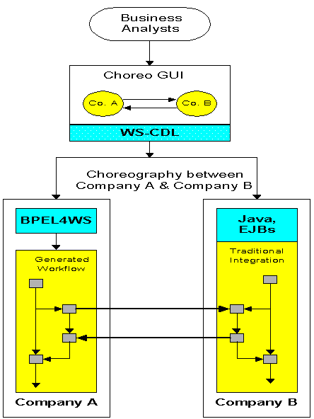
WS-CDL Usage Picture

Slide 5
WS-CDL Package
Package root element
Sets target namespace
Allows importing
Contains all further definitions
Especially one or more choreographies
<package
name="ncname"
author="xsd:string"?
version="xsd:string"
targetNamespace="uri"
xmlns="http://www.w3.org/2004/04/
ws-chor/cdl">
importDefinitions*
informationType*
token*
tokenLocator*
role*
relationship*
participant*
channelType*
Choreography-Notation*
</package>

Slide 6
Data Concepts
Information type
Independence of schema
Token, token locators
Accessing same information in diverse sources
vars
tokens
type
informationType
ref
XML Schema
Other type
System
Token
orderID
messages
locators

Slide 7
Data Concepts (2)
Channel
  For communication with a participant
  Dynamic, actual endpoint in data
  Can be passed around
Variables
  Information exchange, state, channel variables
  Reside in Roles

Slide 8
Participants & Roles
Roles
  Enumerate behaviors, optionally linked to WSDL interfaces
Participants
  Play one or more roles
  Apparently not used in WS-CDL
Relationships
  Associate specific behaviors of two roles
  “for a purpose”
  Complex relationships broken down to pairs

Slide 9
Participants & Roles Figure
Participant
I
Participant
II
Play role(s)
Role 1
Role 2
Behavior A
Behavior X
relationships

Slide 10
Choreography
The main thing WS-CDL defines
Scoping variables, exception handling and finalization
  Finalization unclear
Contains a single activity
Initiated by a message

Slide 11
Choreography Syntax
<choreography name="ConsumerRetailerChoreo"
root="true">
<relationship ... /> *
<variableDefinitions>
<variable ... /> *
</variableDefinitions> ?
... <!–- local choreographies -->
<interaction initiateChoreography="true">
...
</interaction>
<exception> ... </exception> ?
<finalizer> ... </finalizer> ?
</choreography>

Slide 12
Activities
Perform actual work
Ordering structures (complex activities)
  Sequence, parallel
  Choice – implicit selection by incoming message
WorkUnits (guarded activities)
  Condition and repetition for activity
  Optionally blocking on data availability
  Example on next slide
Variable assignment
  Create or update a variable in a role
NoAction
  non-observable effects

Slide 13
WorkUnit Example
<workunit name="POProcess"
guard="cdl:getVariable(
‘POAcknowledgement’,
‘tns:customer’)"
block="true">
... <!--some PO processing activity -->
</workunit>

Slide 14
Activities (2)
Interaction
  Roles within a relationship communicate/align information and state
  Time-to-complete timeout mechanism
  Can initiate choreography
Performing a choreography
  Choreography composition
  Including variable and role aliasing

Slide 15
Interaction Example
<interaction channelVariable="tns:retailer-channel"
operation="handlePurchaseOrder" align="true">
<participate relationship="tns:ConsumerRetailerRelationship"
fromRole="tns:Consumer" toRole="tns:Retailer"/>
<exchange messageContentType="tns:purchaseOrderType"
action="request">
<use variable="cdl:getVariable(tns:purchaseOrder, tns:Consumer)"/>
<populate variable="cdl:getVariable(tns:purchaseOrder,
tns:Retailer)"/>
</exchange>
<exchange messageContentType="purchaseOrderAckType“
action="respond">
...
</exchange>
<record role="tns:Retailer" action="request">
<source variable="cdl:getVariable(tns:purchaseOrder, PO/CustomerRef, tns:Retailer)"/>
<target variable="cdl:getVariable(tns:consumer-channel, tns:Retailer)"/>
</record>
</interaction>

Slide 16
Perform Syntax
<perform choreographyName="qname">
<alias name="ncname">
<this variable="XPath-expression"
| role="qname" />
<free variable="XPath-expression"
| role="qname" />
</alias>+
</perform>

Slide 17
Q&A
Questions, answers
Thanks for your attention

