Slide 1

BA Predicting Purchases
By Rohit Pawar (BSc Data Science at Exeter Uni, UK)

Slide 2
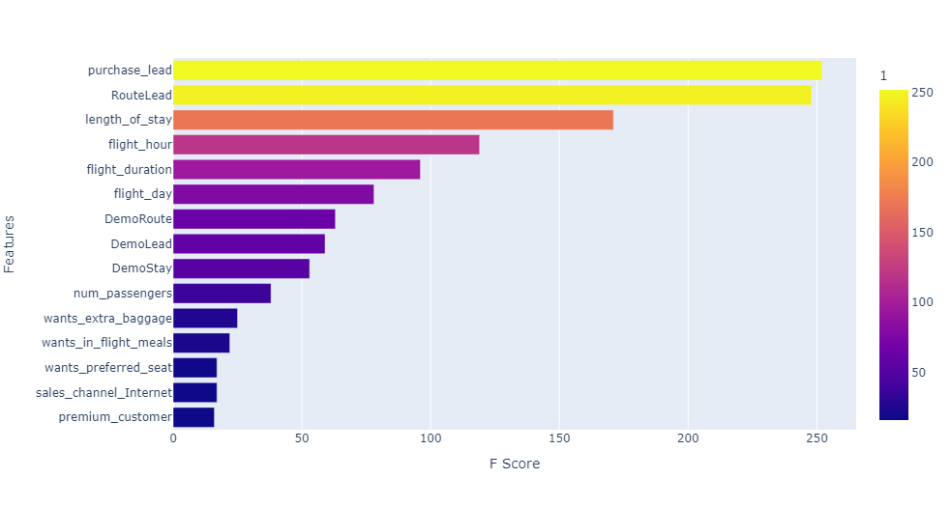
Predicting Customer Buying Behaviour
The data and the model significantly signifies customer purchasing behaviors.
The best model was Random Forest with an accuracy score of 85%.
The Most important features were purchase_lead, RouteLead and length_of_stay . RouteLead is the combination of the route and purchase_lead features.
Therefore, we can evidently say customers are more dependent on the route, length of stay and the time between buying and travelling for purchasing tickets.
To increase model performance more demographic and psychologic features need to be added.

