Slide 1
Game Programming Fundamentals
F5064964 | Hayden Thorpe

Slide 2
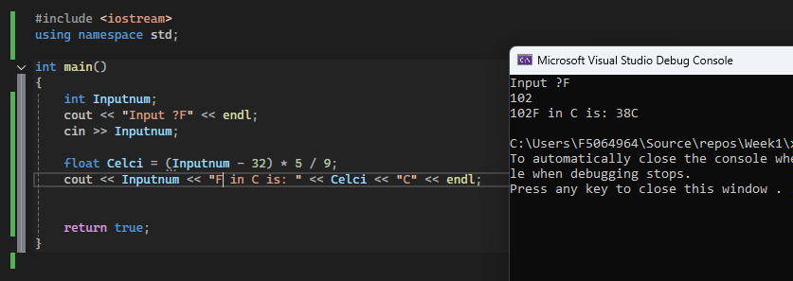
Week 1 – Types and Variables
Types & Variables
Through week one the idea of types and variables were explored, we learnt about int, floats, num & other variables and their applications.
We also learnt how to utilise <iostream> and outputting to console, aswell as how to state a namespace to avoid putting "std::" Infront of every cout & cin
We also learnt how data is stored within RAM, and how different types of variables take up different amounts of RAM
Doing mathematical sums including +, -, /, * and also using () to state priority were also taught and learnt during this week
Example of learning!
^ Here is some code that takes a Fahrenheit input and gives out a Celsius output
It creates an intager to store the number given by the user, prints the text "Input ?F" using the "cout" function granted to us by iostream, then recieves input from the user in the console using "cin", we than use another value to use the "celci" int variable, minus 32, times 5 then devided by nine. The brackets are used as a part of the mathematical equation to ensure the correct order of operations is followed, the result of this Is then outputted to the user using cout.

Slide 3
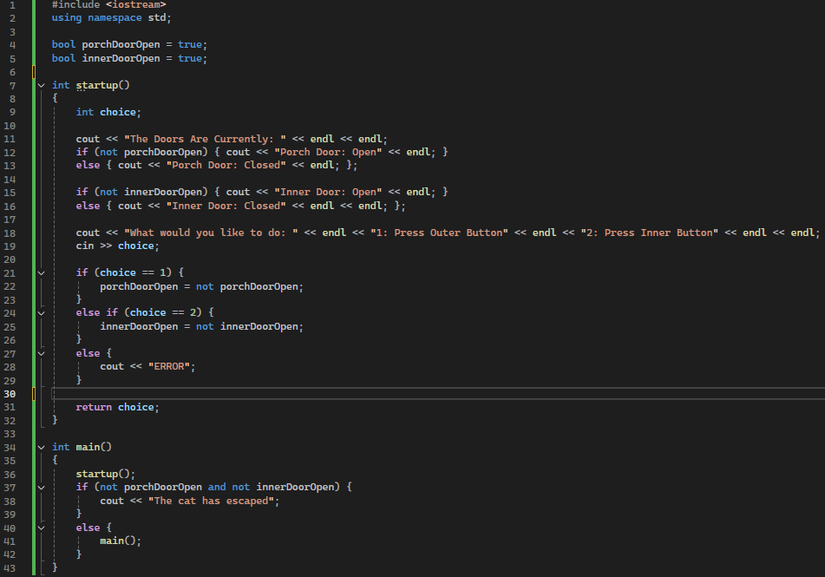
Week 2 – Boolean Logic & Comparisons
Boolean Logic
This week we learnt about Boolean logic and how it's used within C++, for example, when using an if statement it will check if an inputted statement (e.g. 1+1=2) is true or not, this is Boolean logic.
Comparisons (if)
Comparisons (mainly if statements) were taught this week as they are they are fundamental to programming, 90% of this week's project was just if statements, as it allows for nonlinear programming, allowing code to check for changes!
Example of learning!
This piece of code states the current state of both the inner and outer door values, then asks if you would like press the inner or outer buttons. Pressing these buttons by entering the number and pressing enter will change the value of each door, when both doors are valued as open, the cat will escape!

Slide 4
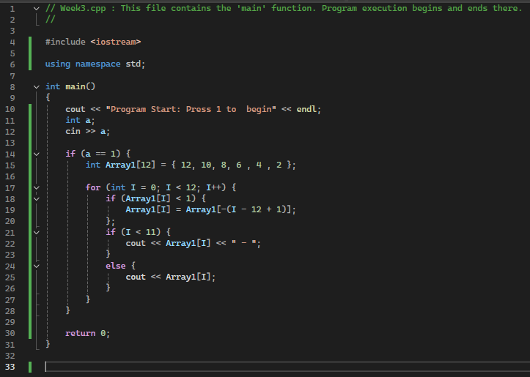
Week 3 – Loops & Arrays
Loops & Loop Types
This week we studied loops and loop types, such as for loops, while loops & do.. While loops, these are all used in different use cases such as a do.. While loop being used if the "while" part is not defined before the loop
Arrays
We also learnt about arrays, simple ways of storing multiple values within one variable, within C++ you must predefine the amount of storage an array can hold before applying unlike other languages like C#
Example of learning!
This piece of code takes a defined array, starts a for loop with the same value as the array, checks to see if the arrays value is less than 1, if it is the code will do math "-(I – 12 + 1)", this sets the value to a negative and adds 1, finding the "Mirror" value and setting it into the array, before printing to the console.

Slide 5
Week 4 – Loops & Arrays
Loops & Loop Types
This week we studied loops and loop types, such as for loops, while loops & do.. While loops, these are all used in different use cases such as a do.. While loop being used if the "while" part is not defined before the loop
Arrays
We also learnt about arrays, simple ways of storing multiple values within one variable, within C++ you must predefine the amount of storage an array can hold before applying unlike other languages like C#
Example of learning!
This piece of code takes a defined array, starts a for loop with the same value as the array, checks to see if the arrays value is less than 1, if it is the code will do math "-(I – 12 + 1)", this sets the value to a negative and adds 1, finding the "Mirror" value and setting it into the array, before printing to the console.

Slide 6
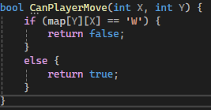
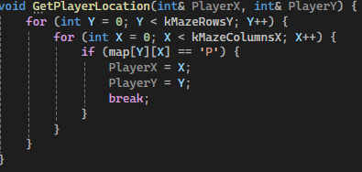
Week 6 – Functions & Maze Game
Example of learning!
Functions
Functions are used in C++ to separate pieces of code, specifically code that needs to be ran more than once, they help with organisation and cut down the lines of code you must write.
Here is an example of how I use functions within my maze game, this function returns a boolean value, meaning that rather than running this within the main script, I can just call this function, and have it return a value, this checks the 2D table for the position the player is trying to move into, if that position returns 'W' it will return false as the player cannot move into that position (W = Wall)
Here Is Another example of how to use functions in C++. This is a void function, void functions do not return anything, this means you do not have to return a value back to the place it was called!

Slide 7
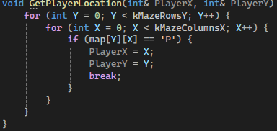
Week 7 – Pointers & References
Pointers
Pointers allow you to access specific memory locations. Unlike References they can be null, This could be usefull in some situations, but I am still not fully sure on when and how
References
On the other hand references are incredibly useful, when sending values to a function you tend to create copies of the values within that function, a reference (called with an & symbol) creates a direct REFERENCE to the original variable (bool, int, etc) allowing for functions to edit values that are within the main script without forcing them to be initialised earlier
Example of learning!
You can see how references are used in this piece of code I used in last week's portfolio, I use references to allow this void function to change the players location values, despite the values being initialised lower in the code!

Slide 8
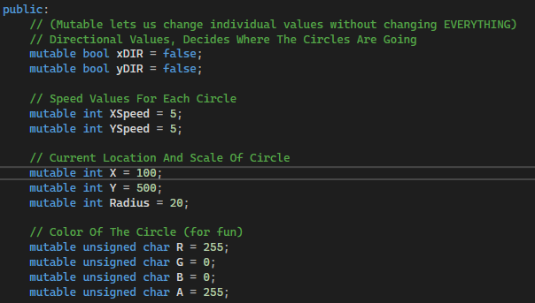
Week 10 – Classes (P1)
Classes are quite a big topic within C, they allow for you to create your own types within C++, You can define data requirements, Aswell as add functions to them. I am not too sure how to describe classes in words so I am going to use screenshots to support my description
Here is how I define my variables within my class in the (Advanced Circles) code, as you can see all the values that previously would have been scattered around the script are now neatly within the class. I also use mutable here (something I do not think we were taught) that I believe allows for the variables to be there but not forced to be changed every time the class is called!

Slide 9
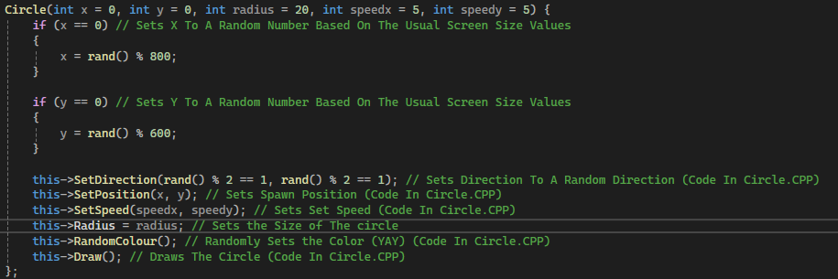

Week 10 – Classes (P2)
This is the function that is ran whenever the class is called, it gets all needed values, sets X and Y to random positions within the 800 x 600 screen size, calls the SetDirection Function from the circles.cpp file (and does this with all the other this-> statements).
As an example of what is going on in the circles.cpp file, these are the functions being called within the header file, they are run when either the class or the this-> statement is used!

