Slide 1
SearchEngine - a universal linkage tool
Thorsten Doherr
https://github.com/ThorstenDoherr/searchengine

Slide 2
Main application: firm data linkage
Patent portfolio on firm level
Technological orientation, change over time (e.g. adaption “Industry 4.0”)
Citation networks among firms
Proxy for innovation
…
Publication portfolio on firm level
Substitution of patents (strategical publications)
Cooperation with research institutions or universities
…
Subsidy data on firm level
Evaluation of subsidy programs regarding firm parameters, patents, publications, cooperation, …
Person data on firm level
Relating performance of startups with the educational background of the founder teams
Impact of inventor mobility among firms
…
…

Slide 3
Other applications
Disambiguation: identifying similar entries within a database
Removing duplicate firm entries
Clustering of applicants in patent data
Clustering of titles or abstracts
Inventor name disambiguation
…
Removing overlap
Cleaning a control group from treated entries, e.g. subsidized firms
Removing duplicates in a sample extension for the next wave of a panel survey
…

Slide 4
The problem: no mutual firm-ID
Provider with dedicated firm focus
„Clean“ data is business model or statutorily necessary
Proprietary provider IDs but also statutory numbers, i.e. VAT-ID
Active avoidance of ambiguous entries by manual and/or automatic examination
Provider without dedicated firm focus
Administer other contents (e.g. patents, publications, subsidies) degrading firms to mere appendages
Firms don’t have separate IDs. They are an attachment to the main context key usually identifying a document.
The authentic reproduction of the document is the focus which entails the diligent transfer of misspellings and inconsistent wording (and introduction of new ones)
Linkage: firm name and available address
Different wording: abbreviations, word positioning, redundancy
Different context: firms vs. departments vs. branches
Incompatible fields: one sweeping address field vs. distinct fields for street, zip, city
Misspellings

Slide 5
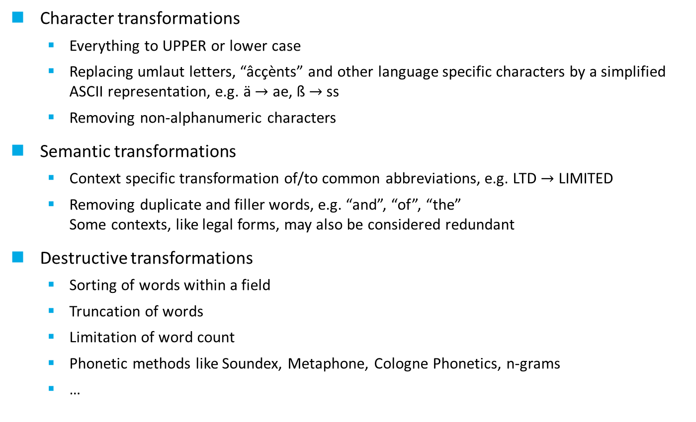
Harmonization
Reducing variation by applying normative functions
Character transformations
Everything to UPPER or lower case
Replacing umlaut letters, “âcçènts” and other language specific characters by a simplified ASCII representation, e.g. ä $→$ ae, ß $→$ss
Removing non-alphanumeric characters
Semantic transformations
Context specific transformation of/to common abbreviations, e.g. LTD $→$ LIMITED
Removing duplicate and filler words, e.g. “and”, “of”, “the” Some contexts, like legal forms, may also be considered redundant
Destructive transformations
Sorting of words within a field
Truncation of words
Limitation of word count
Phonetic methods like Soundex, Metaphone, Cologne Phonetics, n-grams
…

Slide 6
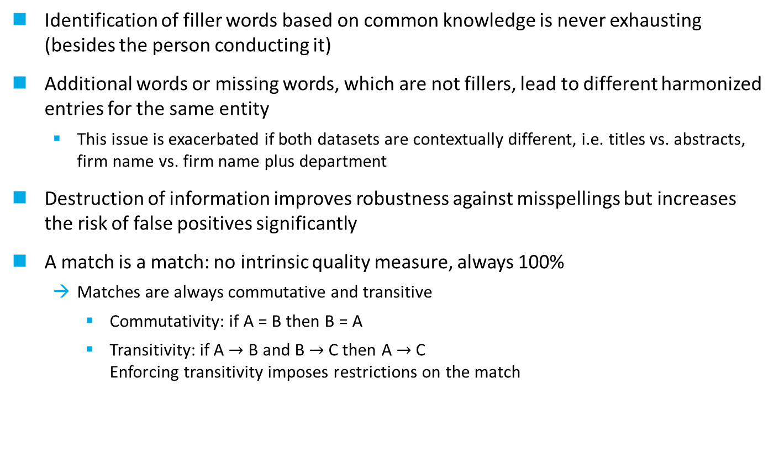
Limitations of harmonization
Matching datasets after harmonization by simple joins
Identification of filler words based on common knowledge is never exhausting (besides the person conducting it)
Additional words or missing words, which are not fillers, lead to different harmonized entries for the same entity
This issue is exacerbated if both datasets are contextually different, i.e. titles vs. abstracts, firm name vs. firm name plus department
Destruction of information improves robustness against misspellings but increases the risk of false positives significantly
A match is a match: no intrinsic quality measure, always 100%
Matches are always commutative and transitive
Commutativity: if A = B then B = A
Transitivity: if A $→$ B and B $→$ C then A $→$ C Enforcing transitivity imposes restrictions on the match

Slide 7
The challenge of harmonization
Do you know all Japanese legal forms?
KATO HATSUJO KAISHA LTD
KATOU HATSUJO KAISHA LTD
KATO HATSUJO KAISHA LIMITED
KATO HATSUJO COMPANY LIMITED
KATO HATSUJI KAISHA LTD
KATO HATSUJO COMPANY LTD
KATO HATSUJO KABUSHIKI KAISHA
THE COMMONWEALTH OF AUSTRALIA DEPARTMENT OF DEFENCE
COMMONWEALTH OF AUSTRALIA DEPARTMENT OF DEFENCE
THE COMMONWEALTH OF AUSTRALIA CO THE SECRETARY DEPARTMENT OF DEFENCE
THE COMMONWEALTH OF AUSTRALIAA DEPARTMENT OF DEFENCE
CO THE SECRETARY COMONWEALTH OF AUSTRALIA DEPARTMENT OF DEFENCE
THE COMMONWEALTH OF AUSTRALIA THE SECRETARY DEPARTMENT OF DEFENCE
HUHTAMAKI FORCHHEIM ZWEIGNIEDERLASSUNG DER HUHTAMAKI DEUTSCHLANG GMBH CO KG
HUHTAMAKI FORCHEIM ZWEIGNIEDERLASSUNG DER HUHTAMAKI DEUTSCHLAND GMBH CO KG
4P FOLIE FORCHHEIM ZWEIGNIEDERLASSUNG DER HUHTAMAKI VAN LEER DEUTSCHLAND GMBH CO KG
4P FOLIE FORCHHEIM GMBH
HUHTAMAKI FORCHHEIM ZWEIGNIEDERLASSUNG DER HUHTAMAKI DEUTSCHLAND GMBH CO KG
4P FOLIE FORCHHEIM ZWEIGNIEDERLASSUNG DER VAN LEER DEUTSCHLAND GMBH CO KG
Is “SECRETARY” a filler word?
Reordering of words might help!
Good luck finding a harmonization for the last one!
Source: USPTO patent applicants

Slide 8
In the eyes of the SearchEngine
KATO HATSUJO KAISHA LTD
KATOU HATSUJO KAISHA LTD
KATO HATSUJO KAISHA LIMITED
KATO HATSUJO COMPANY LIMITED
KATO HATSUJI KAISHA LTD
KATO HATSUJO COMPANY LTD
KATO HATSUJO KABUSHIKI KAISHA
THE COMMONWEALTH OF AUSTRALIA DEPARTMENT OF DEFENCE
COMMONWEALTH OF AUSTRALIA DEPARTMENT OF DEFENCE
THE COMMONWEALTH OF AUSTRALIA CO THE SECRETARY DEPARTMENT OF DEFENCE
THE COMMONWEALTH OF AUSTRALIAA DEPARTMENT OF DEFENCE
CO THE SECRETARY COMONWEALTH OF AUSTRALIA DEPARTMENT OF DEFENCE
THE COMMONWEALTH OF AUSTRALIA THE SECRETARY DEPARTMENT OF DEFENCE
HUHTAMAKI FORCHHEIM ZWEIGNIEDERLASSUNG DER HUHTAMAKI DEUTSCHLANG GMBH CO KG
HUHTAMAKI FORCHEIM ZWEIGNIEDERLASSUNG DER HUHTAMAKI DEUTSCHLAND GMBH CO KG
4P FOLIE FORCHHEIM ZWEIGNIEDERLASSUNG DER HUHTAMAKI VAN LEER DEUTSCHLAND GMBH CO KG
4P FOLIE FORCHHEIM GMBH
HUHTAMAKI FORCHHEIM ZWEIGNIEDERLASSUNG DER HUHTAMAKI DEUTSCHLAND GMBH CO KG
4P FOLIE FORCHHEIM ZWEIGNIEDERLASSUNG DER VAN LEER DEUTSCHLAND GMBH CO KG

Slide 9

Two sides of the same coin
How to identify filler words
How to identify important words
high occurrence in data
low occurrence in data
?
?

Slide 10
Components of the SearchEngine
preparer
gateway
registry
base table
record
type
entry
occurs
record
name
city
10187↔
1
5
9766
+1
1
GMBH
9765
…
10185
10187↔
93
1
TECHNIK
124
+1
10186
123
10187
BMW Technik GmbH
München
10188
10189
1201
+1
10187↔
718
2
MUENCHEN
1200
10190
…
10187↔5784 record linkage
1
BMW
1
+1

Slide 11
SearchEngine components
Preparer gateway
Obligatory base line harmonization: character transformation
Optional harmonization by so called preparer: semantic and destructive transformation
Tokenizing
Registry
Counts words of the base table
Base table is the largest table or the most noisy one providing the candidates of a search
Search tables are all other tables, usually smaller ones or with less noise because noise dilutes the context causing more harm in a search term than in the candidates
Relevant search fields in the base table are represented by chapters in the registry, called search types. Different combinations of search fields and preparer create new search types.
Generates summary statistics per search type like maximum and average occurrence. The latter is used to impute unknown words.
Record linkage
Fast access to all registry entries belonging to a given base table record
Fast access to all base table records sharing a specific registry entry

Slide 12
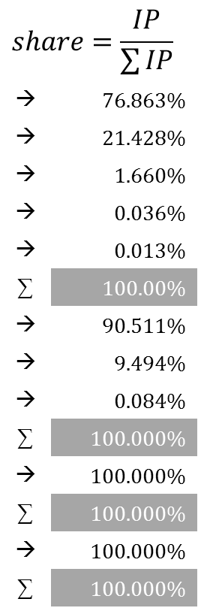
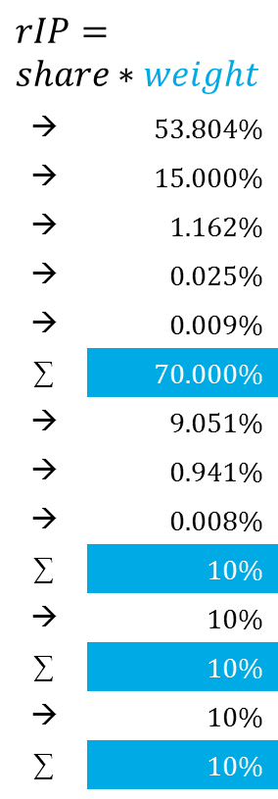
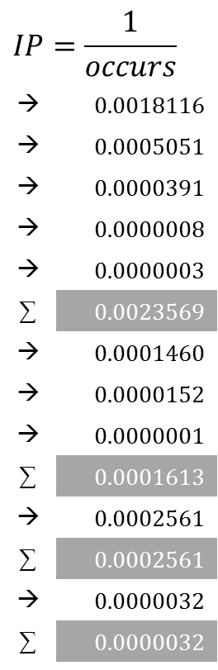
Basic heuristic
name | 1 | street | 2 | zip | 3 | city | 4
BMW FORSCHUNG UND TECHNIK GMBH |  | HANAUER STRASSE 46 |  | 80992 |  | MUENCHEN
type | entry | occurs
… | … | …
1 | BMW | 552
1 | FORSCHUNG | 1980
1 | TECHNIK | 25552
1 | UND | 1190073
1 | GMBH | 3353864
… | … | …
2 | HANAUER | 6851
2 | 46 | 65931
2 | STRASSE | 7410645
… | … | …
3 | 80992 | 3905
… | … | …
4 | MUENCHEN | 316874
… | … | …
$$IP=\frac{1}{occurs}$$
→ | 0.0018116
→ | 0.0005051
→ | 0.0000391
→ | 0.0000008
→ | 0.0000003
∑ | 0.0023569
→ | 0.0001460
→ | 0.0000152
→ | 0.0000001
∑ | 0.0001613
→ | 0.0002561
∑ | 0.0002561
→ | 0.0000032
∑ | 0.0000032
$$share=\frac{IP}{\sum{IP}}$$
→ | 76.863%
→ | 21.428%
→ | 1.660%
→ | 0.036%
→ | 0.013%
∑ | 100.00%
→ | 90.511%
→ | 9.494%
→ | 0.084%
∑ | 100.000%
→ | 100.000%
∑ | 100.000%
→ | 100.000%
∑ | 100.000%
$$rIP= \\ share∗weight$$
→ | 53.804%
→ | 15.000%
→ | 1.162%
→ | 0.025%
→ | 0.009%
∑ | 70.000%
→ | 9.051%
→ | 0.941%
→ | 0.008%
∑ | 10%
→ | 10%
∑ | 10%
→ | 10%
∑ | 10%

Slide 13
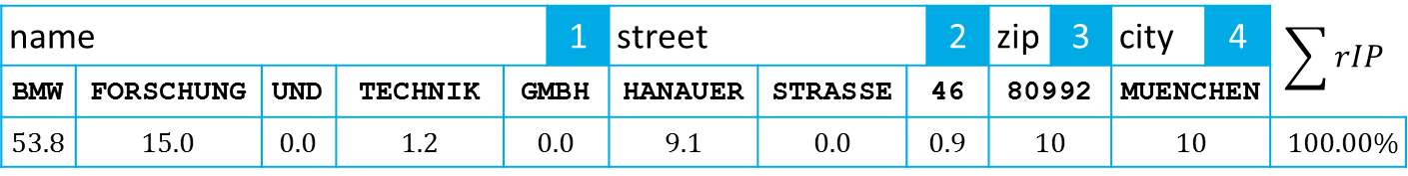
Relative Identity
name |  |  |  |  | 1 | street |  |  | 2 | zip | 3 | city | 4 | $$\sum{rIP}$$
BMW | FORSCHUNG | UND | TECHNIK | GMBH |  | HANAUER | STRASSE | 46 |  | 80992 |  | MUENCHEN
53.8 | 15.0 | 0.0 | 1.2 | 0.0 |  | 9.1 | 0.0 | 0.9 |  | 10 |  | 10 |  | 100.00%
BMW FORSCHUNG UND TECHNIK GMBH | HANAUER STRASSE 46 | 80992 | MUENCHEN | 100.00%
BMW FORSCHUNG U TECHNIK GMBH | HANAUER STRASSE 46 | 80992 | MUENCHEN | 99.98%
BMW TECHNIK UND SERVICE GMBH | HANAUER STRASSE 48 | 80992 | MUENCHEN | 84.06%
BMW STIFTUNG HERBERT QUANDT | HANAUER STRASSE 46 | 80992 | MUENCHEN | 83.80%
BMW MAENNERCHOR MUENCHEN EV | DACHAUER STRASSE 371 | 80992 | MUENCHEN | 73.81%
Threshold: 70%

Slide 14

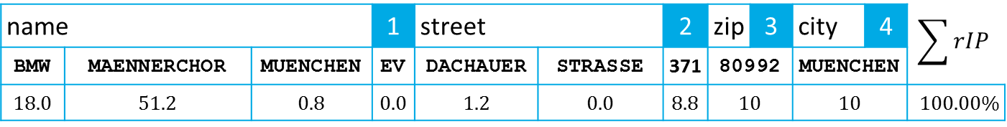
Not commutative $\left(a→b≠b→a\right)$
name |  |  | 1 | street |  | 2 | zip | 3 | city | 4 | $$\sum{rIP}$$
BMW | MAENNERCHOR | MUENCHEN | EV | DACHAUER | STRASSE | 371 | 80992 |  | MUENCHEN
18.0 | 51.2 | 0.8 | 0.0 | 1.2 | 0.0 | 8.8 | 10 |  | 10 |  | 100.00%
BMW MAENNERCHOR MUENCHEN EV | DACHAUER STRASSE 371 | 80992 | MUENCHEN | 100.00%
MANNERCHOR RIESENFELD EV | ABBACH STRASSE 27 A | 80992 | MUENCHEN | 71.23%
Threshold: 70%

Slide 15
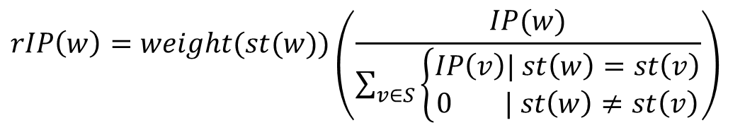

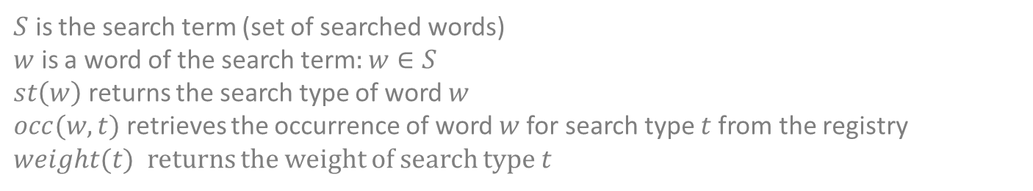
Heuristic: relative identification potential rIP
$$IP\left(w\right)= {occ\left(w,st\left(w\right)\right)}^{−1}$$
$$rIP\left(w\right)=weight(st(w))\left(\frac{IP(w)}{\sum_{v∈S}{\left\{\begin{aligned}IP\left(v\right)| st\left(w\right)=st\left(v\right) \\ 0 | st\left(w\right)≠st\left(v\right)\end{aligned}\right.}}\right)$$
$S$ is the search term (set of searched words)
$w$ is a word of the search term: $w∈S$
$st\left(w\right)$ returns the search type of word $w$
$occ(w,t)$ retrieves the occurrence of word $w$ for search type $t$ from the registry
$weight(t)$ returns the weight of search type $t$

Slide 16
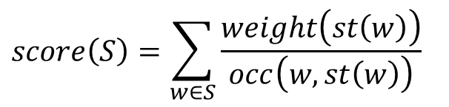
Heuristic: absolute identification potential score
An arbitrary measure of the absolute identification potential of a search term to rank candidates by the score of their search term
$$score\left(S\right)=\sum_{w∈S}{\frac{weight\left(st\left(w\right)\right)}{occ\left(w,st\left(w\right)\right)}}$$
$S$ is the search term (set of searched words)
$w$ is a word of the search term: $w∈S$
$st\left(w\right)$ returns the search type of word $w$
$occ(w,t)$ retrieves the occurrence of word $w$ for search type $t$ from the registry
$weight(t)$ returns the weight of search type $t$

Slide 17
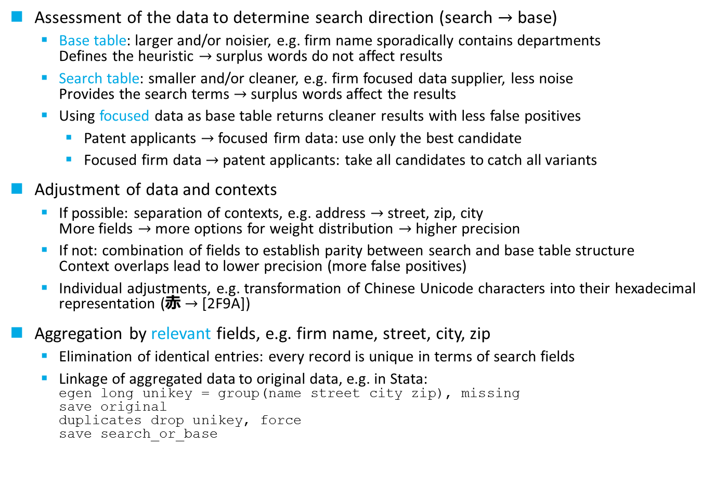
General data preparation
Assessment of the data to determine search direction (search $→$ base)
Base table: larger and/or noisier, e.g. firm name sporadically contains departments Defines the heuristic $→$ surplus words do not affect results
Search table: smaller and/or cleaner, e.g. firm focused data supplier, less noise Provides the search terms $→$ surplus words affect the results
Using focused data as base table returns cleaner results with less false positives
Patent applicants $→$ focused firm data: use only the best candidate
Focused firm data $→$patent applicants: take all candidates to catch all variants
Adjustment of data and contexts
If possible: separation of contexts, e.g. address $→$ street, zip, city More fields $→$ more options for weight distribution $→$ higher precision
If not: combination of fields to establish parity between search and base table structure Context overlaps lead to lower precision (more false positives)
Individual adjustments, e.g. transformation of Chinese Unicode characters into their hexadecimal representation (⾚ $→$ [2F9A])
Aggregation by relevant fields, e.g. firm name, street, city, zip
Elimination of identical entries: every record is unique in terms of search fields
Linkage of aggregated data to original data, e.g. in Stata: egen long unikey = group(name street city zip), missing save original duplicates drop unikey, force save search_or_base

Slide 18
Additional features
Missspellings
These aberrations have a large impact on the heuristic because they usually are rare enough to become dominant. We discuss methods to tame them.
Smoothing/Accentuating
Smoothing flattens the weight distribution per search type to provide a more balanced search behavior. Accentuating does the opposite.
Feedback
The basic heuristic ignores surplus words not corresponding with the search term in the candidates. Feedback introduces gradual commutativity.
Cutoff and activation
Retrieving a copious amount of candidates is an indicator for a weak search term prone to false positives. Cutoff and activation is a simple method to handle these hopeless cases.
Historical data and variants
Variants or identifiable historical versions of an entity in the data improve the success rate but also increase redundancy, which can be suppressed on the entity level.
Incremental search strategies
The “one search fits all” does not exists. Multiple search strategies have to be applied to a search task to collect all candidates without swamping the result table with false positives.
Disambiguation
When search and base table are the same.

Slide 19
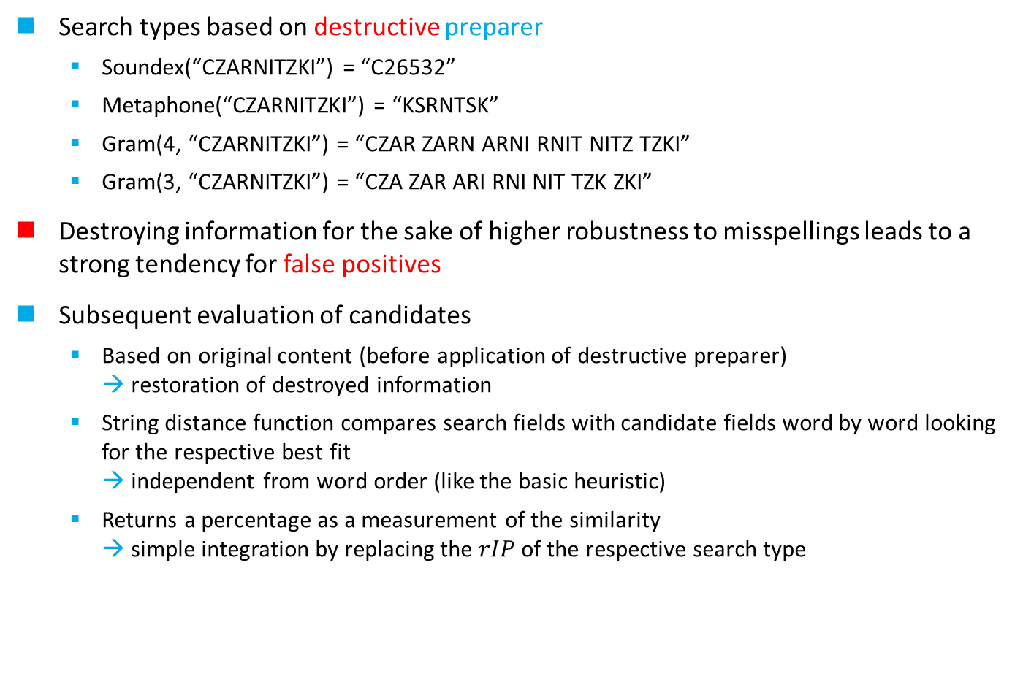
Misspellings
Search types based on destructive preparer
Soundex(“CZARNITZKI”) = “C26532”
Metaphone(“CZARNITZKI”) = “KSRNTSK”
Gram(4, “CZARNITZKI”) = “CZAR ZARN ARNI RNIT NITZ TZKI”
Gram(3, “CZARNITZKI”) = “CZA ZAR ARI RNI NIT TZK ZKI”
Destroying information for the sake of higher robustness to misspellings leads to a strong tendency for false positives
Subsequent evaluation of candidates
Based on original content (before application of destructive preparer) → restoration of destroyed information
String distance function compares search fields with candidate fields word by word looking for the respective best fit → independent from word order (like the basic heuristic)
Returns a percentage as a measurement of the similarity → simple integration by replacing the $rIP$ of the respective search type

Slide 20
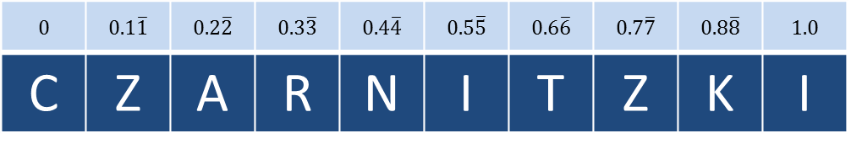

Least Relative Char Position Delta (LRCPD)
0 | 0.1$\overline{1}$ | 0.2$\overline{2}$ | 0.3$\overline{3}$ | 0.4$\overline{4}$ | 0.5$\overline{5}$ | 0.6$\overline{6}$ | 0.7$\overline{7}$ | 0.8$\overline{8}$ | 1.0
C | Z | A | R | N | I | T | Z | K | I
$$∆$$
+
+
0 | 0.63$\overline{8}$ | 0.02$\overline{7}$ | 0.041$\overline{6}$ | 0.05$\overline{5}$ | 0.069$\overline{4}$ | 1.0 | 0.02$\overline{7}$ | 0.013$\overline{8}$ | 0
=
+
+
+
+
+
+
+
=
1.875
C | H | A | R | N | I | Z | K | I
0 | 0.125 | 0.25 | 0.375 | 0.5 | 0.625 | 0.75 | 0.875 | 1.0
$$lrcpd\left(word1,word2\right)=1−\frac{∆(word1,word2)}{len(word1)}=1−\frac{1.875}{10}=0.8125$$
20

Slide 21
Phonetics vs. fragmentation
Phonetic methods
Efficient in terms of computational resources
High similarity of words sharing the same code
Encoding reflects particularities of the source language
English: metaphone, soundex
German: cologne (Kölner Phonetik)
Not suited for international data sources
Sensitive to separation or concatenation of words
Fragmentation into n-grams
High strain on computational resources
Retrieved candidates can be anagrams of the search term
Robust to truncation or concatenation of words
Language independent

Slide 22
Smoothing/Accentuating
Shift from nuanced weights to uniformly or distinctively weighted words
Applicable per search type
Smoothing
Enforcing a more conservative search behavior requiring a larger share of words to match
When the basic heuristic is inappropriate
Example: house numbers in street addresses High numbers have always a higher IP than low numbers because every street has a number 1, but only few have the number 999
Example: person names First names usually have less variation than last names, but still can not be considered filler words
Search types based on n-grams can still be vulnerable if a misspelling causes exotic grams
Accentuating
Strengthens dominant words to counter noise in search terms (caution: may backfire)
Methods
Offset
Logarithmic inverse word frequency ratio
Softmax

Slide 23
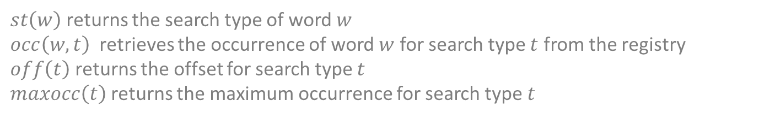
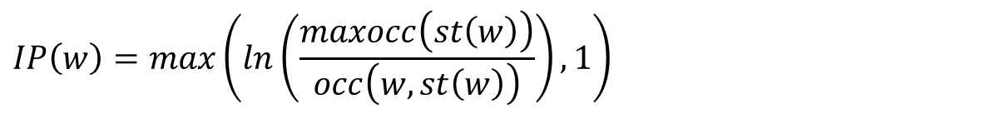
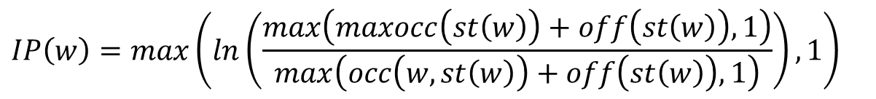
Smoothing methods
Offset
$$IP\left(w\right)=⁡{max\left(occ\left(w,st\left(w\right)\right)+off\left(st\left(w\right)\right),1\right)}^{−1}$$
Logarithmic inverse word frequency ratio
$$IP\left(w\right)=max\left(ln\left(\frac{maxocc\left(st\left(w\right)\right)}{occ\left(w,st\left(w\right)\right)}\right),1\right)$$
Combined
$$IP\left(w\right)=max\left(ln\left(\frac{max\left(maxocc\left(st\left(w\right)\right)+off\left(st\left(w\right)\right),1\right)}{max\left(occ\left(w,st\left(w\right)\right)+off\left(st\left(w\right)\right),1\right)}\right),1\right)$$
$st\left(w\right)$ returns the search type of word $w$
$occ\left(w,t\right)$ retrieves the occurrence of word $w$ for search type $t$ from the registry
$off\left(t\right)$ returns the offset for search type $t$
$maxocc\left(t\right)$returns the maximum occurrence for search type $t$

Slide 24
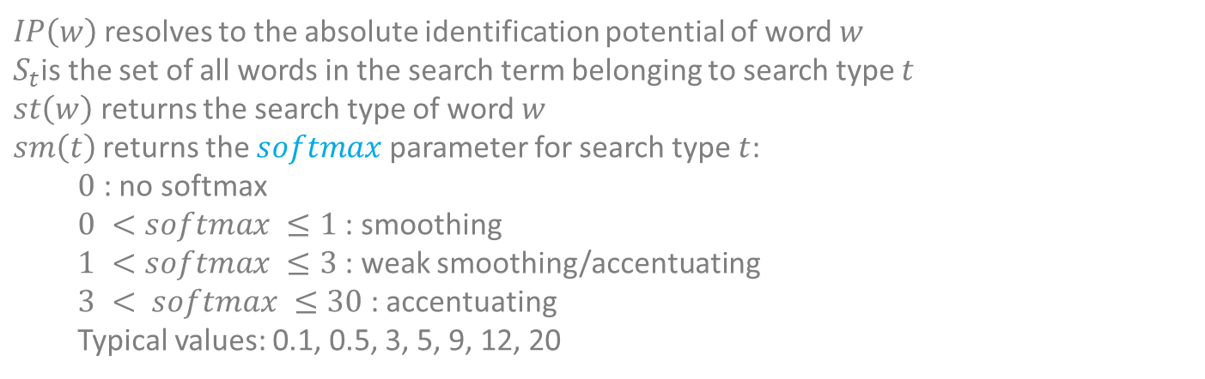
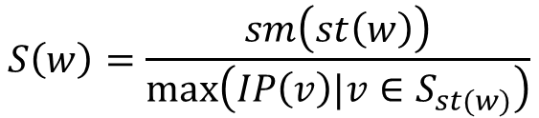
Softmax
Smooths or accentuates the distribution according to parameter $softmax$
$$sIP\left(w\right)=⁡e^{IP\left(w\right)S\left(w\right)}$$
$$S\left(w\right)=\frac{sm\left(st\left(w\right)\right)}{max\left(IP\left(v\right)|v∈S_{st(w)}\right)}$$
$IP\left(w\right)$ resolves to the absolute identification potential of word $w$
$S_{t}$is the set of all words in the search term belonging to search type $t$
$st\left(w\right)$ returns the search type of word $w$
$sm\left(t\right)$ returns the $softmax$ parameter for search type $t$:
$0$ : no softmax
$0 <softmax ≤1$: smoothing
$1 <softmax ≤3$: weak smoothing/accentuating
$3 < softmax ≤30$ : accentuating
Typical values: 0.1, 0.5, 3, 5, 9, 12, 20

Slide 25
Softmax effect
30
20
10
5
3
2
0 = no softmax
1
ln
0.5
0.1

Slide 26


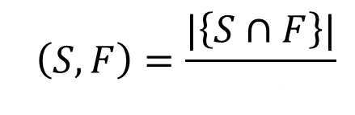



Paul Jaccard, 1868-1944, professor of botany and plant physiology, ETH Zurich
Searched Flower
F
ound Flower
$$I\left(S,F\right)=\frac{|\left\{S∩F\right\}|}{|\left\{S\right\}|}$$
$$I$$
$$J$$
$$\}|$$
$$|\left\{S\right.$$
$$∪F$$
4
|{
,
,
,
}|
|{
,
}|
,
,
,
,
,
,
,
,
7
+
3
feedback

Slide 27
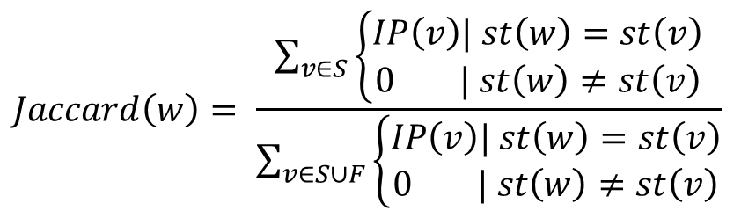
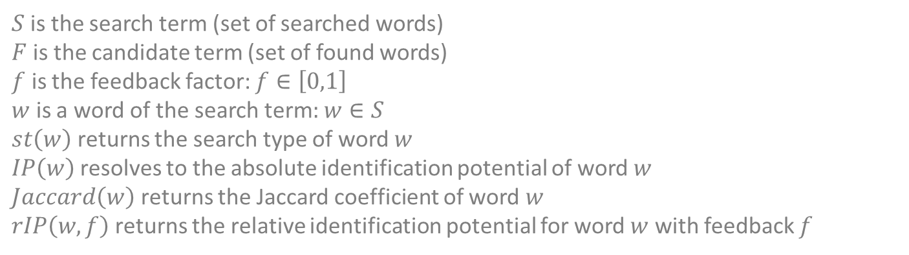
Feedback $f$ as a slide control
$$Jaccard\left(w\right)= \frac{\sum_{v∈S}{\left\{\begin{aligned}IP\left(v\right)| st\left(w\right)=st\left(v\right) \\ 0 | st\left(w\right)≠st\left(v\right)\end{aligned}\right.}}{\sum_{v∈S∪F}{\left\{\begin{aligned}IP\left(v\right)| st\left(w\right)=st\left(v\right) \\ 0 | st\left(w\right)≠st\left(v\right)\end{aligned}\right.}}$$
$$rIP\left(w,f\right)=rIP\left(w\right)\left(\left(1−f\right)+Jaccard\left(w\right)f\right)$$
$S$is the search term (set of searched words)
$F$is the candidate term (set of found words)
$f$ is the feedback factor: $f∈\left[0,1\right]$
$w$ is a word of the search term: $w∈S$
$st\left(w\right)$ returns the search type of word $w$
$IP\left(w\right)$ resolves to the absolute identification potential of word $w$
$Jaccard\left(w\right)$ returns the Jaccard coefficient of word $w$
$rIP\left(w,f\right)$returns the relative identification potential for word $w$ with feedback $f$

Slide 28
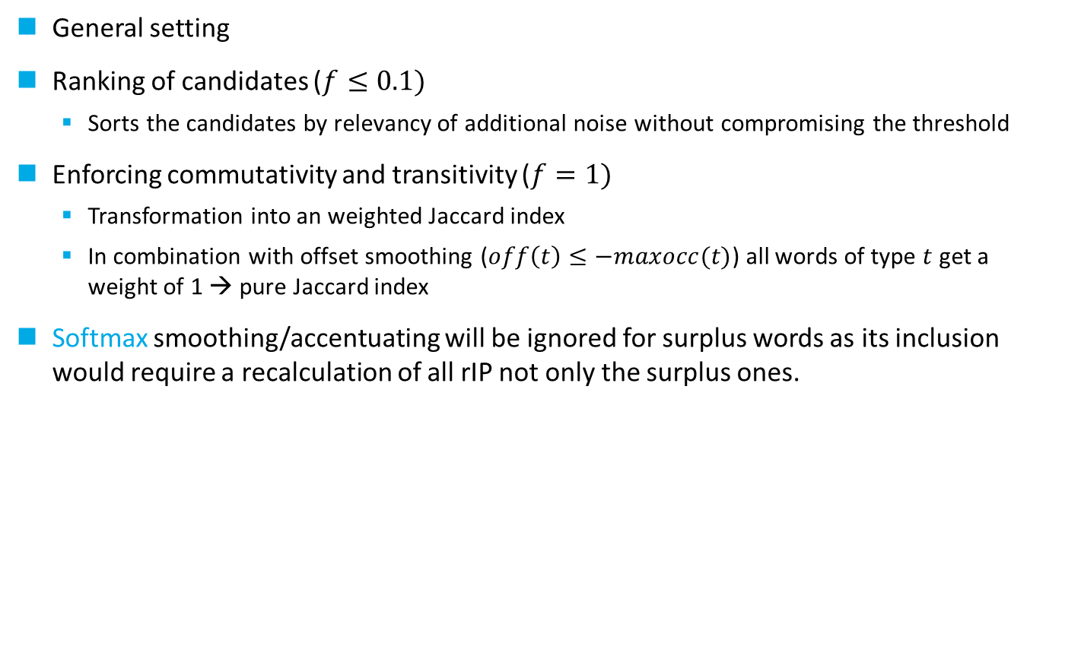
Feedback
Usually, feedback is applied subsequently on candidates retrieved by the basic heuristic
General setting
Ranking of candidates ($f≤0.1)$
Sorts the candidates by relevancy of additional noise without compromising the threshold
Enforcing commutativity and transitivity ($f=1)$
Transformation into an weighted Jaccard index
In combination with offset smoothing ($off\left(t\right)≤−maxocc(t)$) all words of type $t$ get a weight of 1 → pure Jaccard index
Softmax smoothing/accentuating will be ignored for surplus words as its inclusion would require a recalculation of all rIP not only the surplus ones.

Slide 29
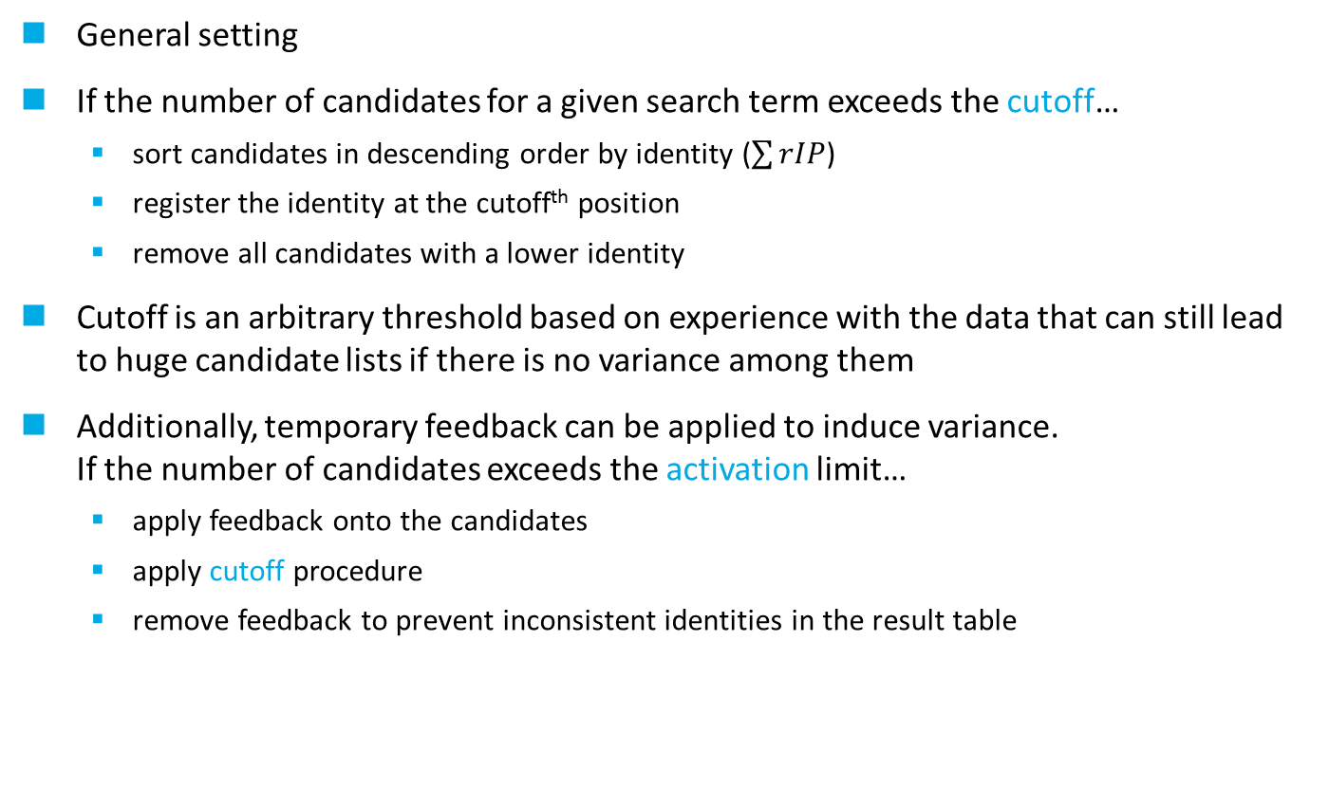
Cutoff and activation
A high number of candidates for a search term is an indicator for redundancy
General setting
If the number of candidates for a given search term exceeds the cutoff…
sort candidates in descending order by identity ($\sum{rIP}$)
register the identity at the cutoff^{th} position
remove all candidates with a lower identity
Cutoff is an arbitrary threshold based on experience with the data that can still lead to huge candidate lists if there is no variance among them
Additionally, temporary feedback can be applied to induce variance. If the number of candidates exceeds the activation limit…
apply feedback onto the candidates
apply cutoff procedure
remove feedback to prevent inconsistent identities in the result table

Slide 30
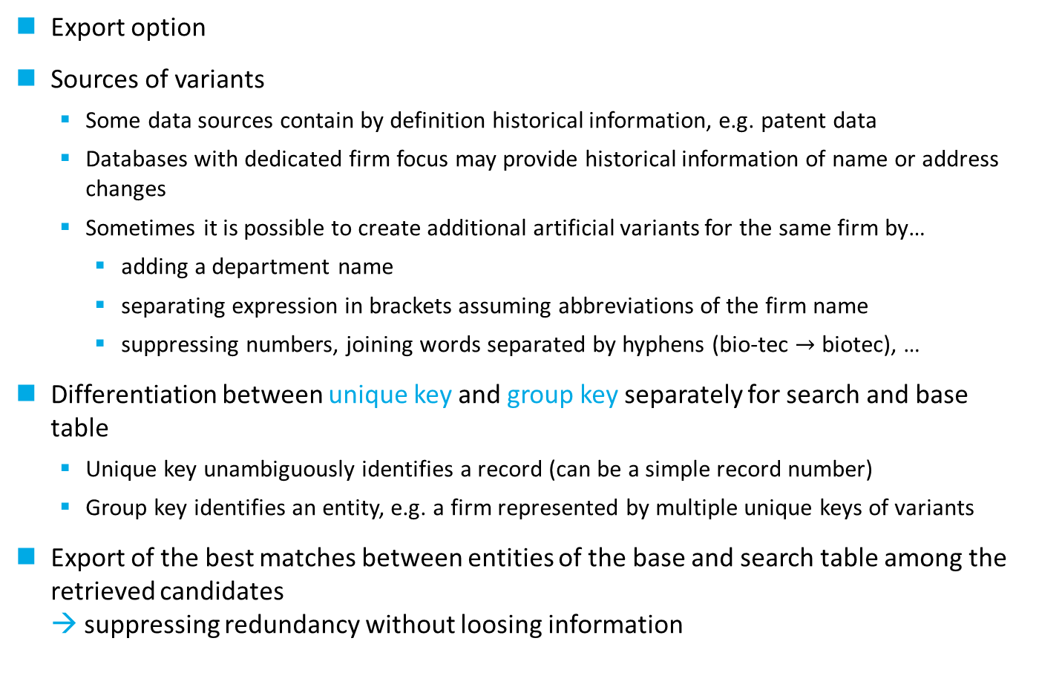
Historical data and variants
Export option
Sources of variants
Some data sources contain by definition historical information, e.g. patent data
Databases with dedicated firm focus may provide historical information of name or address changes
Sometimes it is possible to create additional artificial variants for the same firm by…
adding a department name
separating expression in brackets assuming abbreviations of the firm name
suppressing numbers, joining words separated by hyphens (bio-tec $→$ biotec), …
Differentiation between unique key and group key separately for search and base table
Unique key unambiguously identifies a record (can be a simple record number)
Group key identifies an entity, e.g. a firm represented by multiple unique keys of variants
Export of the best matches between entities of the base and search table among the retrieved candidates → suppressing redundancy without loosing information

Slide 31
Incremental search strategies
Develop search strategies based on multiple search runs
Search types with a weight of zero will be ignored
Concentrate the weights on search types linked to context defining search fields, like names, distributing the rest on the auxiliary types, like addresses (i.e. 70% name, 30% address)
First search steps should be without destructive preparer, playing with different weight distributions for the auxiliary types
followed by dedicated runs to hunt misspellings, setting the weights for corresponding non-destructive types to zero, e.g. 0% for basic name search type, 70% for name with gram-3 preparer
Destructive preparer should only be applied to main fields not to auxiliary fields to save resources (time)
Always have two runs to hunt misspellings: one with log smoothing for the destructive types and one without to account for the disruptive nature of these artefacts
Think about which weight combinations of search types will make it over the threshold

Slide 32
Disambiguation: search table = base table
searched | found | identity | equal | name | zip | city | street | country
203346 |  |  |  | SCHERING AKTIENGESELLSCHAFT PATENTE | 13342 | BERLIN | MUELLERSTRASSE 178 POSTFACH 65 03 11
203346 | 203346 | 100.00 |  | SCHERING AKTIENGESELLSCHAFT PATENTE | 13342 | BERLIN | MUELLERSTRASSE 178 POSTFACH 65 03 11 | DE
71132 |  |  |  | HOECHST SCHERING AGR EVO GMBH | 13342 | BERLIN | GERICHTSTRASSE 27
71132 | 71132 | 100.00 |  | HOECHST SCHERING AGR EVO GMBH | 13342 | BERLIN | GERICHTSTRASSE 27 | DE
71132 | 66486 | 95.00 |  | HOECHST SCHERING AGR EVO GMBH | 13347 | BERLIN | GERICHTSTRASSE 27 | DE
71132 | 73565 | 90.00 |  | HOECHST SCHERING AGR EVO GMBH | 13509 | BERLIN | MIRAUSTRASSE 54 | DE
323602 |  |  |  | SCHERING AG | 13342 | BERLIN | MUELLERSTRASSE 170 178
323602 | 323602 | 100.00 |  | SCHERING AG | 13342 | BERLIN | MUELLERSTRASSE 170 178 | DE
323602 | 389129 | 99.57 |  | BAYER SCHERING PHARMA AKTIENGESELLSCHAFT | 13342 | BERLIN | MUELLERSTRASSE 170 178 | DE
323602 | 199658 | 99.29 |  | SCHERING AKTIENGESELLSCHAFT | 13342 | BERLIN | PATENTE MUELLERSTRASSE 178 POSTFACH 65 03 11 | DE
323602 | 203346 | 99.29 |  | SCHERING AKTIENGESELLSCHAFT PATENTE | 13342 | BERLIN | MUELLERSTRASSE 178 POSTFACH 65 03 11 | DE
323602 | 402998 | 95.00 |  | BAYER SCHERING PHARMA AG | 13353 | BERLIN | MUELLERSTRASSE 170 178 | DE
323602 | 180193 | 94.73 |  | SCHERING AG | 13353 | BERLIN | MUELLERSTRASSE 178 | DE
323602 | 303857 | 94.73 |  | SCHERING AG | 13353 | BERLIN WEDDING | MUELLERSTRASSE 178 | DE
323602 | 397563 | 94.73 |  | BAYER SCHERING PHARMA AG | 13353 | BERLIN | MUELLERSTRASSE 178 | DE
323602 | 264 | 94.57 |  | SCHERING AKTIENGESELLSCHAFT | 13342 | BERLIN |  | DE
323602 | 71132 | 94.57 |  | HOECHST SCHERING AGR EVO GMBH | 13342 | BERLIN | GERICHTSTRASSE 27 | DE
323602 | 171208 | 94.29 |  | SCHERING AKTIENGESELLSCHAFT | 13353 | BERLIN | MUELLERSTRASSE 178 | DE
323602 | 435123 | 94.29 |  | BAYER SCHERING PHARMA AKTIENGESELLSCHAFT | 13353 | BERLIN | PATENTS LICIENSING MUELLERSTRASSE 178 | DE
402998 |  |  |  | BAYER SCHERING PHARMA AG | 13353 | BERLIN | MUELLERSTRASSE 170 178
402998 | 402998 | 100.00 |  | BAYER SCHERING PHARMA AG | 13353 | BERLIN | MUELLERSTRASSE 170 178 | DE
402998 | 397563 | 99.73 |  | BAYER SCHERING PHARMA AG | 13353 | BERLIN | MUELLERSTRASSE 178 | DE
402998 | 435123 | 99.40 |  | BAYER SCHERING PHARMA AKTIENGESELLSCHAFT | 13353 | BERLIN | PATENTS LICIENSING MUELLERSTRASSE 178 | DE
402998 | 389129 | 94.68 |  | BAYER SCHERING PHARMA AKTIENGESELLSCHAFT | 13342 | BERLIN | MUELLERSTRASSE 170 178 | DE
518249 |  |  |  | BAYER PHARMA AG | 13353 | BERLIN | MUELLERSTRASSE 178
518249 | 518249 | 100.00 |  | BAYER PHARMA AG | 13353 | BERLIN | MUELLERSTRASSE 178 | DE
518249 | 397563 | 100.00 |  | BAYER SCHERING PHARMA AG | 13353 | BERLIN | MUELLERSTRASSE 178 | DE
518249 | 402998 | 100.00 |  | BAYER SCHERING PHARMA AG | 13353 | BERLIN | MUELLERSTRASSE 170 178 | DE
518249 | 435123 | 98.76 |  | BAYER SCHERING PHARMA AKTIENGESELLSCHAFT | 13353 | BERLIN | PATENTS LICIENSING MUELLERSTRASSE 178 | DE
518249 | 441578 | 98.76 |  | BAYER PHARMA AKTIENGESELLSCHAFT | 13353 | BERLIN | MUELLERSTRASSE 178 | DE
518249 | 543908 | 94.52 |  | BAYER PHARMA AKTIENGESELLSCHAFT | 13353 | BERLIN | MUELLER STRASSE 178 | DE
518249 | 389129 | 93.76 |  | BAYER SCHERING PHARMA AKTIENGESELLSCHAFT | 13342 | BERLIN | MUELLERSTRASSE 170 178 | DE
203346
71132
203346
402998
71132
402998
402998

Slide 33
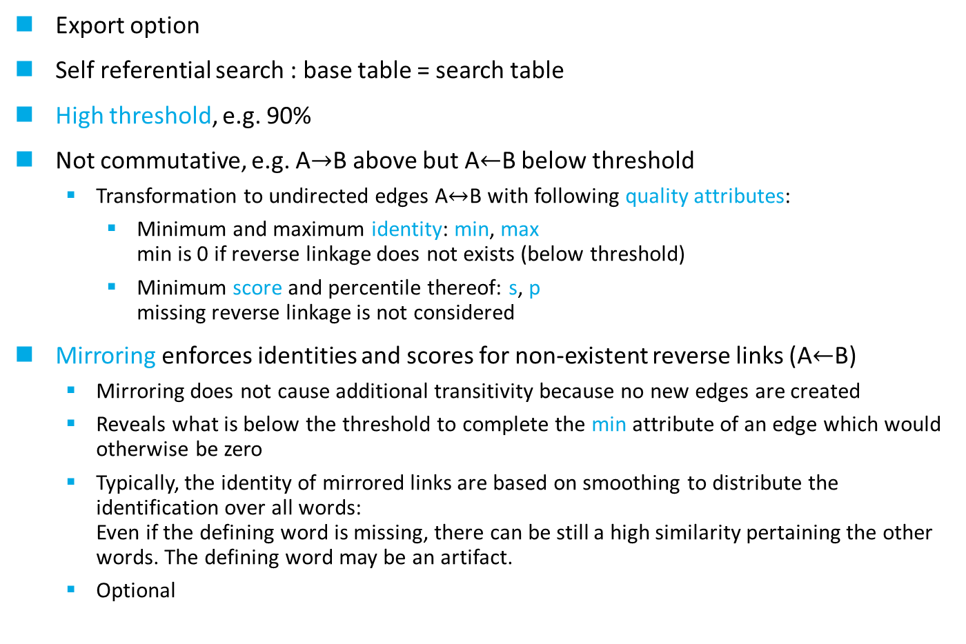
Disambiguation
Export option
Self referential search : base table = search table
High threshold, e.g. 90%
Not commutative, e.g. A$→$B above but A$←$B below threshold
Transformation to undirected edges A$↔$B with following quality attributes:
Minimum and maximum identity: min, max min is 0 if reverse linkage does not exists (below threshold)
Minimum score and percentile thereof: s, p missing reverse linkage is not considered
Mirroring enforces identities and scores for non-existent reverse links (A$←$B)
Mirroring does not cause additional transitivity because no new edges are created
Reveals what is below the threshold to complete the min attribute of an edge which would otherwise be zero
Typically, the identity of mirrored links are based on smoothing to distribute the identification over all words: Even if the defining word is missing, there can be still a high similarity pertaining the other words. The defining word may be an artifact.
Optional

Slide 34
Graph before transformation
Blue lines are mirrored (reverse identity below threshold of 90%)
ABY
100%
BY
43%
94%
71%
XZ
100%
AXYZ
71%
95%
95%
100%
23%
100%
100%
98%
98%
AXY
BYZ
98%
AXYV
100%

Slide 35
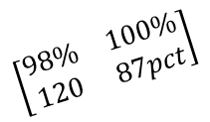


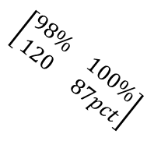



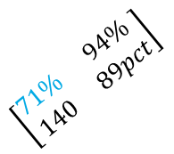
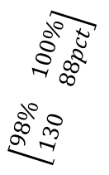
Traversal
Find all reachable nodes from a given starting node to define a cluster
Intransitive transitions have a min below the threshold, either zero or mirrored
ABY
BY
$$\left[\begin{matrix}43\% & 100\% \\ 60 & 37pct\end{matrix}\right]$$
$$\left[\begin{matrix}71\% & 94\% \\ 140 & 89pct\end{matrix}\right]$$
XZ
$$\left[\begin{matrix}23\% & 100\% \\ 30 & 13pct\end{matrix}\right]$$
AXYZ
$$\left[\begin{matrix}71\% & 95\% \\ 120 & 87pct\end{matrix}\right]$$
$$\left[\begin{matrix}95\% & 100\% \\ 64 & 38pct\end{matrix}\right]$$
$$\left[\begin{matrix}98\% & 100\% \\ 120 & 87pct\end{matrix}\right]$$
$$\left[\begin{matrix}98\% & 100\% \\ 130 & 88pct\end{matrix}\right]$$
AXY
BYZ
$$\left[\begin{matrix}min & max \\ s & p\end{matrix}\right]$$
AXYV
$$\left[\begin{matrix}98\% & 100\% \\ 120 & 87pct\end{matrix}\right]$$
quality attributes

Slide 36
Clusters of unusual size
Black holes
Data artefacts lead to suspiciously large number of connections
Cutoff and activation reduce impact
Artefact threshold as part of cascaded traversal curtails all connections
Thickets
Only detectable during traversal
Thinning out the thicket by cutting weak connections: cascaded traversal

Slide 37
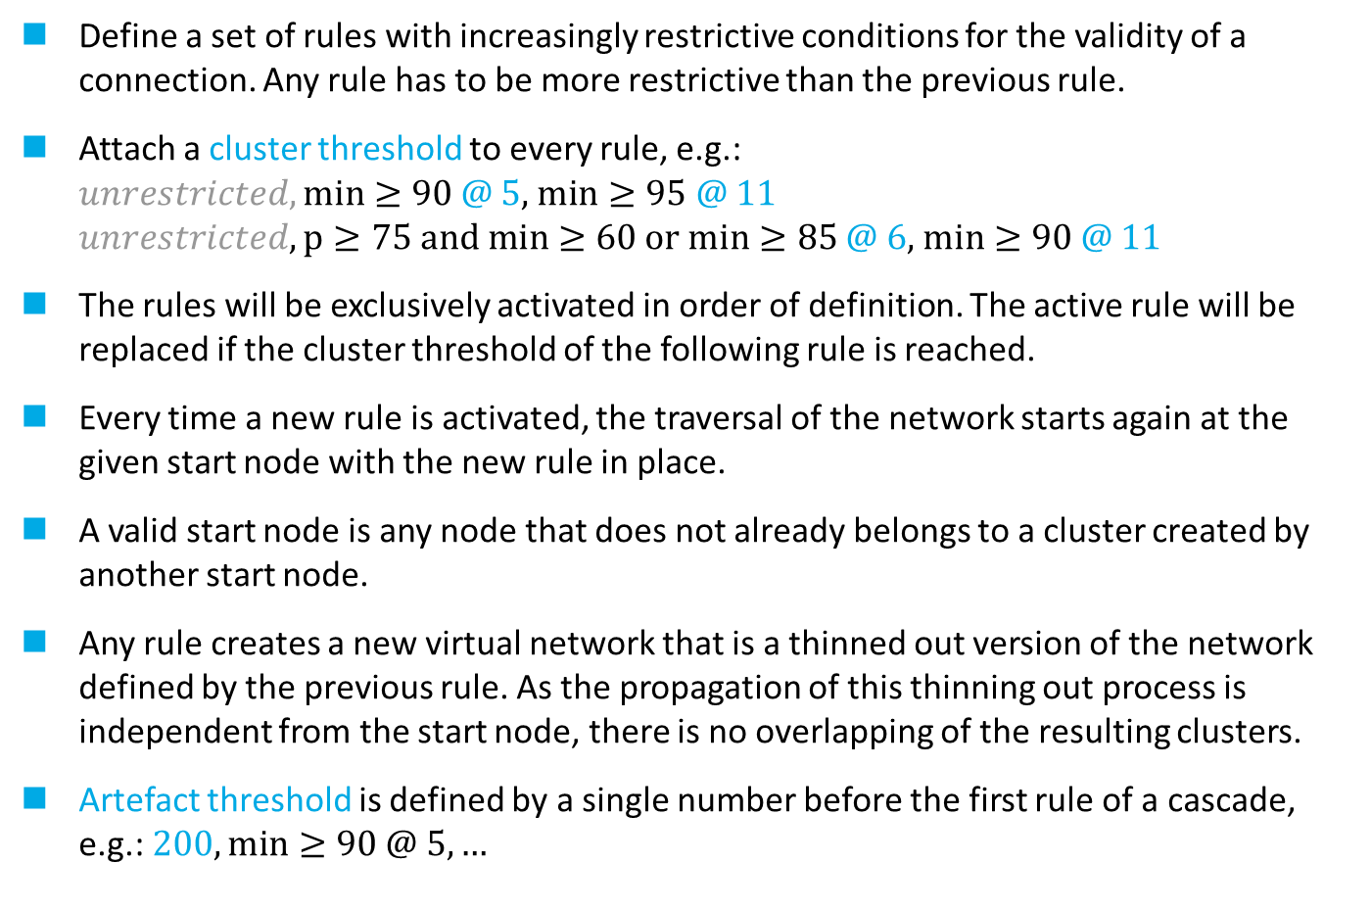
Cascaded traversal
Define a set of rules with increasingly restrictive conditions for the validity of a connection. Any rule has to be more restrictive than the previous rule.
Attach a cluster threshold to every rule, e.g.: $unrestricted, min≥90$@ 5, $min≥95$ @ 11 $unrestricted, p≥75 and min≥60 or min≥85$ @ 6, $min≥90$ @ 11
The rules will be exclusively activated in order of definition. The active rule will be replaced if the cluster threshold of the following rule is reached.
Every time a new rule is activated, the traversal of the network starts again at the given start node with the new rule in place.
A valid start node is any node that does not already belongs to a cluster created by another start node.
Any rule creates a new virtual network that is a thinned out version of the network defined by the previous rule. As the propagation of this thinning out process is independent from the start node, there is no overlapping of the resulting clusters.
Artefact threshold is defined by a single number before the first rule of a cascade, e.g.:$200,\min{≥90 @ 5,…}$

Slide 38
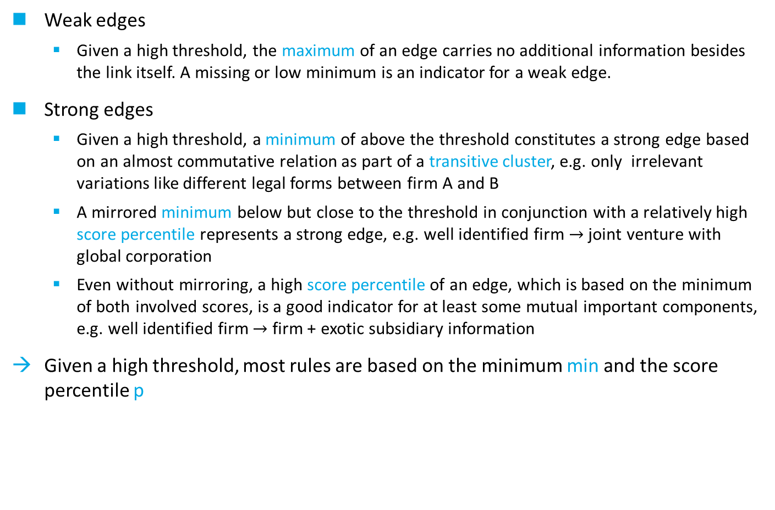
Edge types
Weak edges
Given a high threshold, the maximum of an edge carries no additional information besides the link itself. A missing or low minimum is an indicator for a weak edge.
Strong edges
Given a high threshold, a minimum of above the threshold constitutes a strong edge based on an almost commutative relation as part of a transitive cluster, e.g. only irrelevant variations like different legal forms between firm A and B
A mirrored minimum below but close to the threshold in conjunction with a relatively high score percentile represents a strong edge, e.g. well identified firm $→$ joint venture with global corporation
Even without mirroring, a high score percentile of an edge, which is based on the minimum of both involved scores, is a good indicator for at least some mutual important components, e.g. well identified firm $→$ firm + exotic subsidiary information
Given a high threshold, most rules are based on the minimum min and the score percentile p

Slide 39
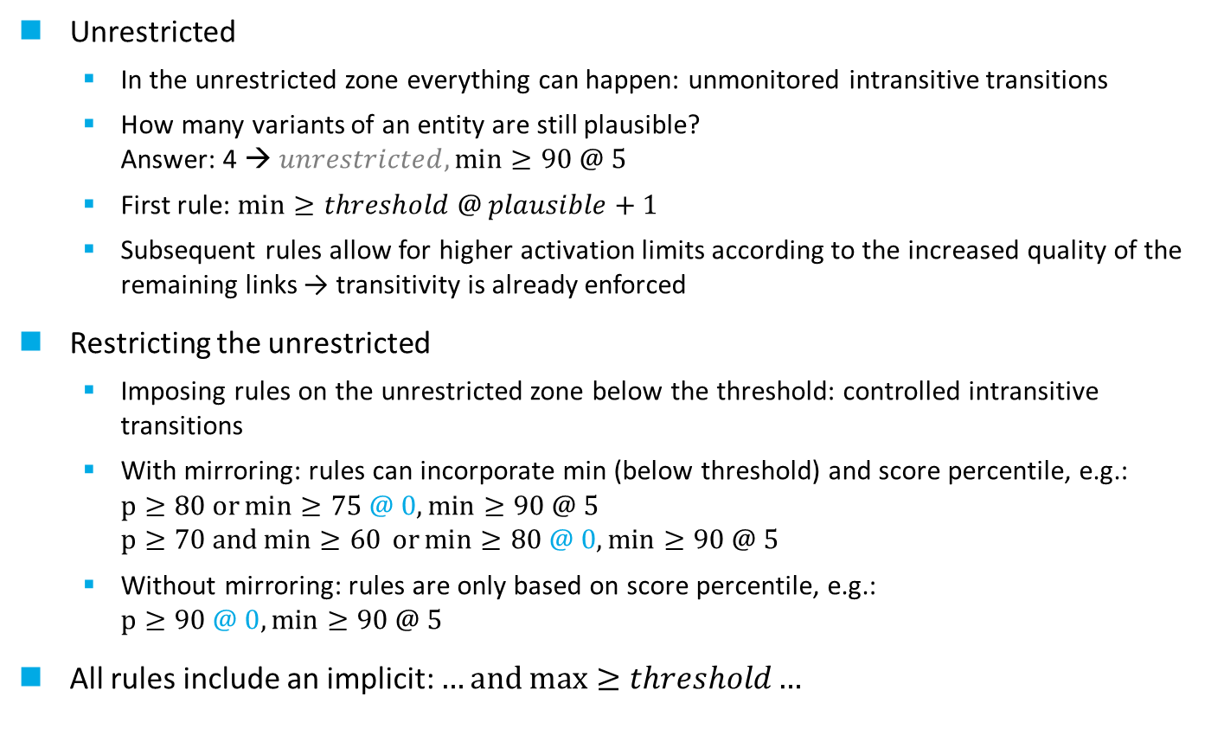
Defining a cascade
Assessment of the variation of an entity in the data
Unrestricted
In the unrestricted zone everything can happen: unmonitored intransitive transitions
How many variants of an entity are still plausible? Answer: 4 → $unrestricted,\min{≥90 @ 5}$
First rule: $\min{≥threshold @ plausible+1}$
Subsequent rules allow for higher activation limits according to the increased quality of the remaining links → transitivity is already enforced
Restricting the unrestricted
Imposing rules on the unrestricted zone below the threshold: controlled intransitive transitions
With mirroring: rules can incorporate min (below threshold) and score percentile, e.g.: $p≥80 or\min{≥75 @ 0,min≥90 @ 5}$ $p≥70 and\min{≥60 }or\min{≥80 @ 0,\min{≥90 @ 5}}$
Without mirroring: rules are only based on score percentile, e.g.: $p≥90 @ 0,min≥90 @ 5$
All rules include an implicit: $…and max≥threshold…$

Slide 40
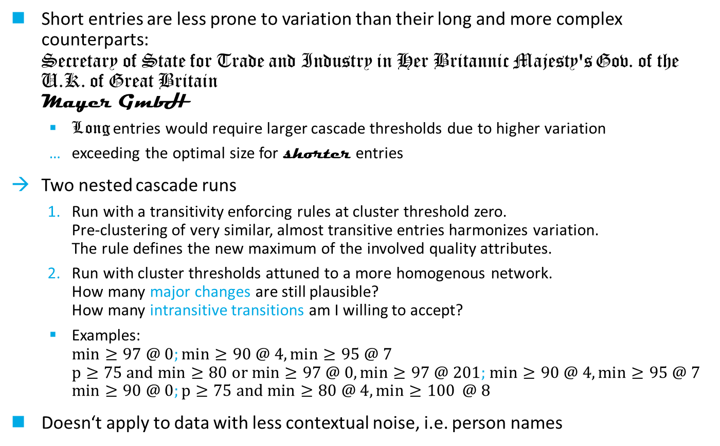
Nested cascaded traversal
Heterogeneous structure in the data leads to conflicting interests
Short entries are less prone to variation than their long and more complex counterparts: Secretary of State for Trade and Industry in Her Britannic Majesty's Gov. of the U.K. of Great Britain Mayer GmbH
Long entries would require larger cascade thresholds due to higher variation
exceeding the optimal size for shorter entries
Two nested cascade runs
Run with a transitivity enforcing rules at cluster threshold zero. Pre-clustering of very similar, almost transitive entries harmonizes variation. The rule defines the new maximum of the involved quality attributes.
Run with cluster thresholds attuned to a more homogenous network. How many major changes are still plausible? How many intransitive transitions am I willing to accept?
Examples: $min≥97 @ 0;min≥90 @ 4, min≥95 @ 7$ $p≥75 and min≥80 or min≥97 @ 0, min≥97 @ 201$; $min≥90 @ 4, min≥95 @ 7$ $\min{≥90 @ 0;p≥75 and min≥80 @ 4,\min{≥100}} @ 8$
Doesn‘t apply to data with less contextual noise, i.e. person names

Slide 41
Nested cascade (before pre-clustering)
4P FOLIE FORCHHEIM ZWEIGNIEDERLASSUNG DER HUHTAMAKI VAN LEER DEUTSCHLAND GMBH CO KG
HUHTAMAKI VAN LEER FORCHHEIM DEUTSCHLAND GMBH CO KG
4P FOLIE FORCHHEIM GMBH

Slide 42
Nested cascade (after pre-clustering)
Aggregation: maximizing quality attributes of connections

Slide 43
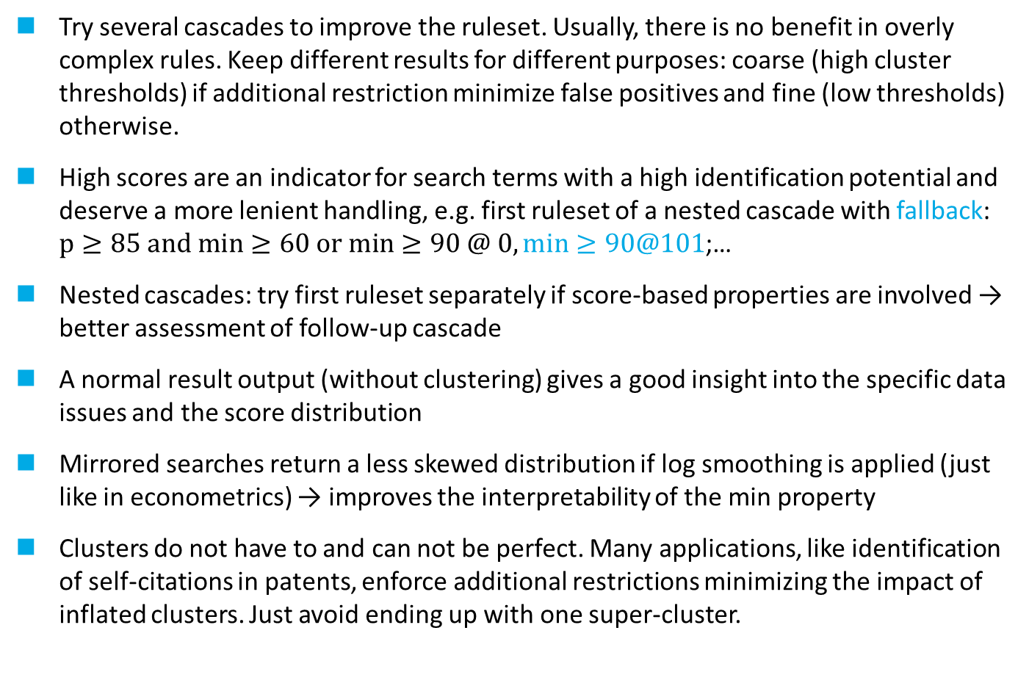
A short cascade guide
Try several cascades to improve the ruleset. Usually, there is no benefit in overly complex rules. Keep different results for different purposes: coarse (high cluster thresholds) if additional restriction minimize false positives and fine (low thresholds) otherwise.
High scores are an indicator for search terms with a high identification potential and deserve a more lenient handling, e.g. first ruleset of a nested cascade with fallback: $p≥85 and min≥60 or min≥90 @ 0, min≥90@101$;…
Nested cascades: try first ruleset separately if score-based properties are involved → better assessment of follow-up cascade
A normal result output (without clustering) gives a good insight into the specific data issues and the score distribution
Mirrored searches return a less skewed distribution if log smoothing is applied (just like in econometrics) → improves the interpretability of the min property
Clusters do not have to and can not be perfect. Many applications, like identification of self-citations in patents, enforce additional restrictions minimizing the impact of inflated clusters. Just avoid ending up with one super-cluster.

Slide 44
https://github.com/ThorstenDoherr/searchengine
Use at your own risk.
Thank you for your attention.

