Slide 1
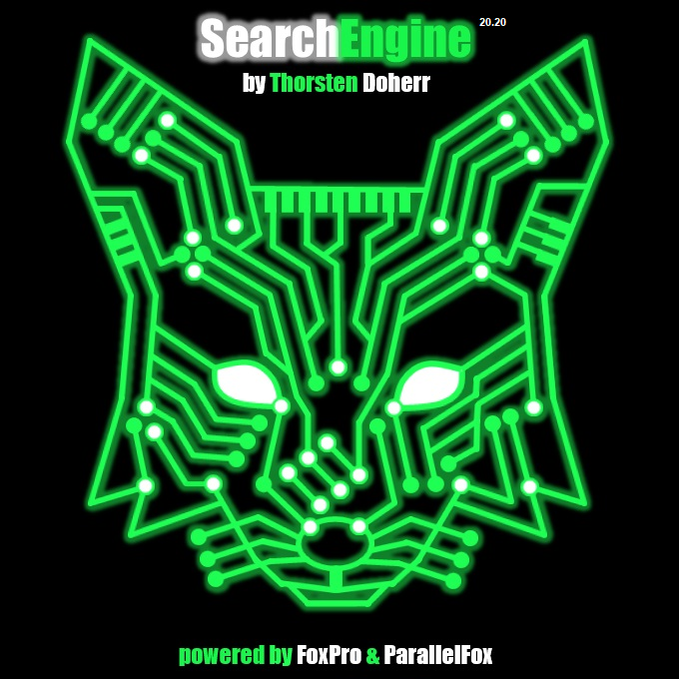
20.219
https://github.com/ThorstenDoherr/searchengine

Slide 2
SearchEngine installation and legend
Installation
On the GitHub page click on [Code] →[Download ZIP] to get a zip container. The code directory contains the source code.
Just copy the contents of the “SE” sub-directory from the zip container into an empty directory of your choosing. This directory is called SearchEngine directory.
The directory “preparer” contains special country or content specific preparer. Copy the respective “SearchEngine.xml” file into your SearchEngine directory to activate them. Naturally, only one special preparer file can be active per SearchEngine.
Because the SearchEngine itself will create many additional files, it is advised to keep it separate from the base, search and result tables in an exclusive directory (traditionally called “SE”, residing at the level of the associated base table).
As the base table constitutes the SearchEngine, every base table requires a separate SearchEngine directory. Different preparer/search type setups for the same base table also require separate directories.
Result tables should reside close to the search table they are linked to.
Legend
Basic information
Best practice suggested by the developer
Potential source for misconduct

Slide 3
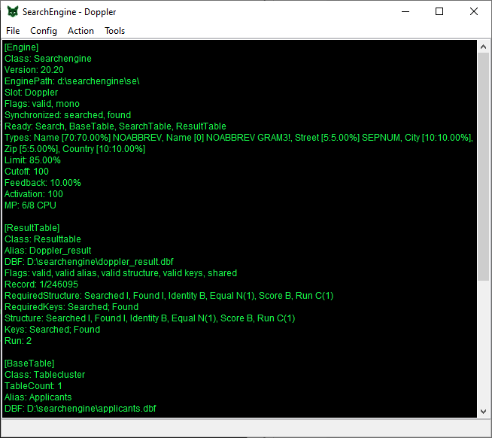
SearchEngine main window
Main window
Main window shows the so called structure string representing all settings.
The structure string is also the save format of the SE.
The string can be marked and copied to the clipboard, e.g. in case of a support request.
20.219

Slide 4
SearchEngine menu structure
Menu [suggested order]
File
Save settings [8]
Load Settings [9]
Export
Export [10]
Extended Export [11]
Grouped Export [12]
Result Export
Meta Export
Exit
Config
File Locations [1]
Join SearchFields [3]
SearchTypes [4]
Settings [5]
Preferences
Action
Search [6]
Research
Refine
Create [2]
Recreate
Expand
Mirror
Tools
QuickSearch
ResultChecker [7]
Notes
Browser
20.219

Slide 5
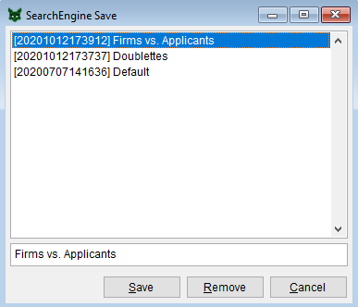
SearchEngineFileSave
Save
Saves the current SearchEngine structure string (all settings) into a named save slot.
On startup the most recently saved slot will be used to instantiate the SearchEngine.
Save slots not required anymore can be selected and then removed.
The “Default” slot can never be removed because the SearchEngine references it for the search type structure → the “create”, “recreate” and “expand” functions always refresh the “Default” slot.
It is easy to accidentally overwrite a save slot, therefore it is best practice to first create a fresh save slot for every new project before making changes → the new slot, having the most recent timestamp, is used by default.

Slide 6
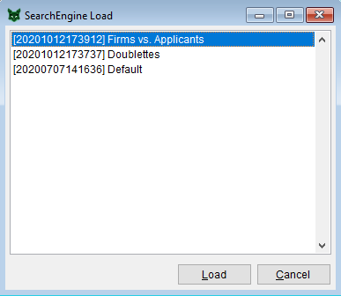
SearchEngineFileLoad
Load
Loads the structure string of the selected slot to instantiate a new SearchEngine.
On startup the most recently saved slot will be used to instantiate the SearchEngine.
If you plan a new search project, which is similar to an existing one, load the similar project and save it immediately under a new name to save time and avoid accidental overwriting.

Slide 7
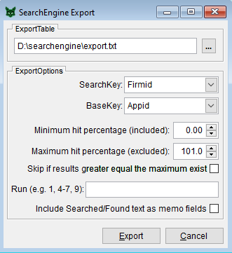
SearchEngineFileExportExport
1
Export
The format contains all information contained in the result table.
The record numbers of the result table can be replaced by primary (unique) keys of the associated base and search table records.
By specifying the extension “.txt”, the export table will be a tab delimited text file.
The option “SearchKey” specifies the unique key of the search table.
The option “BaseKey” specifies the unique key of the base table.
Choosing RECORD as “BaseKey” or “SearchKey” references the record number of the corresponding table instead of key fields → the tables do not need unique keys.
If key fields are used, they have to be unique. If you are using a search field, e.g. firm name or person name, something is wrong.
The range of exported results can be selected by the option “Lowest hit percentage” and “Highest hit percentage” (the later will be excluded from the selection) in regard of the candidate identity.
The option “Skip if results greater equal the maximum exists” excludes candidates within the respective range for search records having already candidates in a higher range.
The “Run” option allows for selecting specific search runs similar to the pages selection syntax for printing, i.e. 1-3, 7, 8 would select run 1, 2, 3, 7, 8.
“Include Searched/Found text…” appends the contents of the respective search and base table fields as long text fields separated by pipes “|”. This function is deprecated (see Extended Export).

Slide 8
SearchEngineFileExportExport
2
Export
Run selection is an efficient way to evaluate search strategies
By selecting ranges and skipping lower alternative candidates, the results can be separated into confidence groups, i.e. 101-100, 100-95, 95-90, 90-80 and so on, where every search key will only be reported within the group that belongs to its highest ranked candidates.
The identity and score are reported with a higher precision than in the other export formats.
This function provides a simple, space efficient format for further handling by external tools or methods.
It is applicable if manual checking (eyeballing) is not intended.
Including the search fields can be appropriate if subsequent string comparison/manipulation with external programs is intended.
Do not use the option “Skip if results greater equal…” if the base table contains unidentified duplicate entries, like variants of a patent assignee. This is the case if the base table does not have a proper focus (see SearchEngine presentation).

Slide 9
SearchEngineFileExportExport
3
searched | found | identity | equal | score | run
1 | 4 | 100 | 0 | 5.332523637693407 | 1
1 | 2 | 99.568468 | 0 | 5.332523637693407 | 1
1 | 3 | 99.568468 | 0 | 5.332523637693407 | 1
1 | 80415 | 90 | 0 | 5.332523637693407 | 1
1 | 27269 | 90 | 0 | 5.332523637693407 | 1
1 | 27267 | 90 | 0 | 5.332523637693407 | 1
1 | 27270 | 90 | 0 | 5.332523637693407 | 1
1 | 27271 | 90 | 0 | 5.332523637693407 | 1
1 | 27268 | 90 | 0 | 5.332523637693407 | 1
1 | 27272 | 89.568468 | 0 | 5.332523637693407 | 1
2 | 2 | 99.90073099999999 | 0 | 5.506045795888449 | 1
2 | 3 | 99.90073099999999 | 0 | 5.506045795888449 | 1
2 | 4 | 97.183803 | 0 | 5.506045795888449 | 1
2 | 80415 | 87.28307199999999 | 0 | 5.506045795888449 | 1
2 | 27269 | 87.28307199999999 | 0 | 5.506045795888449 | 1
2 | 27267 | 87.28307199999999 | 0 | 5.506045795888449 | 1
2 | 27270 | 87.28307199999999 | 0 | 5.506045795888449 | 1
2 | 27272 | 87.28307199999999 | 0 | 5.506045795888449 | 1
2 | 27271 | 87.28307199999999 | 0 | 5.506045795888449 | 1
2 | 27268 | 87.28307199999999 | 0 | 5.506045795888449 | 1
3 | 15 | 95 | 0 | 2.731191135223984 | 1
3 | 16 | 95 | 0 | 2.731191135223984 | 1
3 | 14 | 95 | 0 | 2.731191135223984 | 1
3 | 55181 | 90 | 0 | 2.731191135223984 | 1
3 | 13 | 90 | 0 | 2.731191135223984 | 1
3 | 55182 | 90 | 0 | 2.731191135223984 | 1
3 | 55180 | 90 | 0 | 2.731191135223984 | 1
3 | 71467 | 88.809524 | 0 | 2.731191135223984 | 1
3 | 71465 | 88.809524 | 0 | 2.731191135223984 | 1
3 | 1920 | 88.809524 | 0 | 2.731191135223984 | 1

Slide 10
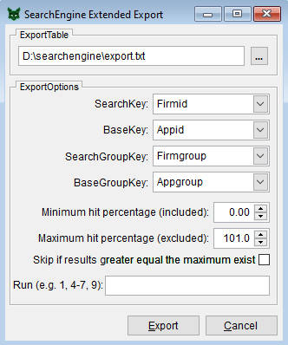
SearchEngineFileExportExtended Export
1
Extended Export
This format is suited for manual checking as the content for the linked search fields of the base table and the search table will get reported in a clear layout.
The format additionally contains all information provided by the result table.
By specifying the extension “.txt”, the export table will be a tab delimited text file.
The options “SearchKey”, “BaseKey”, the range selection and run filtering are equivalent to the (simple) Export dialog.
The range selection is a good way to reduce and structure the output without loosing substantial information.
“SearchGroupKey” designates an entity key within the search table, which has the same value for a group of records referencing a specific entity, i.e. different historic variants of a firm name.
“BaseGroupKey” does the same as “SearchGroupKey” for the base table.
Using one or both of these group keys instructs the SearchEngine to aggregate the candidates with a prior on quality on the respective entity key as the actual “key of interest”.
It is not required to specify unique keys for SearchKey and BaseKey as the record number is always “unique”, but sometimes it is nice to have them reported instead of record numbers.
The “group” field in the export format reports the “SearchGroupKey” while the candidates are distributed among the associated “SearchKeys” or record numbers by best fit.
GroupKeys in rectangular brackets (further down the lists) group only but will not be reported. This is useful in conjunction with Meta Export.
If reliable group keys exists, they reduce the output by focusing on the actual keys of interest.

Slide 11
SearchEngineFileExportExtended Export
2
Extended Export
Range selection greatly reduces the effort of eyeballing especially for high quality groups, which can directly be used for preliminary analysis. Range selection with range exclusivity (“Skip results…”) brings candidates of the same quality level together, which eases the burden on eyeballing by leveling the shortcomings of the candidates within each range.
The sorting of ExtendedExport tables by candidate size (descending) and score (ascending) brings the worst results with the lowest identification potential on top while the best can be found at the bottom.
Look at the bottom of ExtendedExport tables for still valid results even in low quality ranges. If completeness is not required, go upwards until the diminishing returns aren’t worth the effort anymore.
Even though unchecked ranges respectively records cannot be considered quality matches, they still can be excluded from potential control groups.
The “equal” column is reserved for manual marking of valid matches by comparing the top line of every block displaying the search term with the following candidate lines.
Use the top line of a block to designate the default value for the whole block: 1 = match, 9 = no match. Mark all exceptions of the default assessment of a block with the opposing value (default = 9, exception = 1, or other way round).
Think about other efficient ways to organize the manual checking like only marking non-matches in high quality ranges and only marking matches in low quality ranges or using other codes to signal uncertainty.

Slide 12
SearchEngineFileExportExtended Export
3
GROUP | SEARCHED | FOUND | IDENTITY | EQUAL | FIRM | ADDRESS | CITY | ZIP | COUNTRY | SCORE | CNT | RUN
3861 | 3862 |  |  |  | Hitachi, Ltd. | 12th Floor, Marunouchi Center Building, 6-1, Marun | Tokyo | 100-8220 | JP | 6.11 | 16
3861 | 3862 | 36165 | 95.03 |  | Hitachi, Ltd. | 6-6, Marunouchi 1-chome Chiyoda-ku | Tokyo | 100-8220 | JP | 6.11 | 16 | 1
3861 | 3862 | 50034 | 90.10 |  | Kabushiki Kaisha Hitachi Seisakusho(Hitachi, Ltd.) | 6-6, Marunouchi 1-chome | Chiyoda-ku,Tokyo | 100-8280 | JP | 6.11 | 16 | 1
3861 | 3862 | 43819 | 90.08 |  | Hitachi, Ltd. | 6 Kanda Surugadai 4-chome | Chiyoda-ku, Tokyo | 100-8010 | JP | 6.11 | 16 | 1
3861 | 3862 | 45426 | 90.08 |  | Hitachi, Ltd. | 6 Kanda Surugadai 4-chome Chiyoda-ku | Tokyo | 100-8010 | JP | 6.11 | 16 | 1
3861 | 3862 | 50255 | 90.08 |  | HITACHI CONSTRUCTION MACHINERY CO., LTD. | 6-2, Ohtemachi 2-chome Chiyoda-ku | Tokyo | 100-0004 | JP | 6.11 | 16 | 1
3861 | 3862 | 86988 | 90.08 |  | Hitachi Consumer Electronics Co., Ltd. | 2-1, Otemachi 2-chome Chiyoda-ku | Tokyo | 100-0004 | JP | 6.11 | 16 | 1
3861 | 3862 | 56291 | 90.02 |  | Hitachi Building Systems Co., Ltd. | 6, 1-chome, Kandanishiki-cho, Chiyoda-ku | Tokyo | 101-0054 | JP | 6.11 | 16 | 1
3861 | 3862 | 2358 | 90.00 |  | HITACHI CHEMICAL CO., LTD. | Shinjyuku-Mitsui Building,1-1, 2-chome Nishishinju | Shinjuku-ku,Tokyo | 163 | JP | 6.11 | 16 | 1
3861 | 3861 |  |  |  | Hitachi, Ltd. | 6, Kanda Surugadai 4-chome Chiyoda-ku | Tokyo | 101 | JP | 0.57 | 16
3861 | 3861 | 36165 | 100.00 |  | Hitachi, Ltd. | 6, Kanda Surugadai 4-chome, Chiyoda-ku | Tokyo | 101-8220 | JP | 0.57 | 16 | 1
3861 | 3861 | 45426 | 100.00 |  | Hitachi, Ltd. | 6 Kanda Surugadai 4-chome, Chiyoda-ku | Tokyo | 101-8010 | JP | 0.57 | 16 | 1
3861 | 3861 | 14527 | 99.95 |  | HITACHI TECHNO ENGINEERING CO., LTD. | 3, Kanda Surugadai 4-chome,Chiyoda-ku | Tokyo | 101 | JP | 0.57 | 16 | 1
3861 | 3861 | 16176 | 99.75 |  | Hitachi, Ltd. | 6 Kanda Surugadai 4-chome | Chiyoda-ku,Tokyo | 101-0062 | JP | 0.57 | 16 | 1
3861 | 3861 | 43819 | 99.75 |  | Hitachi, Ltd. | 6, Kanda Surugadai 4-chome | Chiyoda-ku,Tokyo | 101-8010 | JP | 0.57 | 16 | 1
3861 | 3861 | 56291 | 96.11 |  | Hitachi Building Systems Co., Ltd. | 6 Nishiki-cho 1-chome Kanda,Chiyoda-ku | Tokyo | 101-0054 | JP | 0.57 | 16 | 1
3861 | 3861 | 86309 | 96.04 |  | Hitachi Industrial Equipment Systems Co., Ltd. | 3, Kanda Neribei-cho Chiyoda-ku | Tokyo | 101-0022 | JP | 0.57 | 16 | 1
3861 | 3861 | 67698 | 95.28 |  | Hitachi Plant Technologies, Ltd. | 1-14, Uchikanda 1-chome Chiyoda-ku | Tokyo | 101-0047 | JP | 0.57 | 16 | 1
4617 | 4617 |  |  |  | Delphi Technologies, Inc. | Legal Staff, 1450 W. Long Lake Road, P.O. Box 5052 | Troy | MI 48007-5052 | US | 3.89 | 11
4617 | 4617 | 55132 | 100.00 |  | Delphi Technologies, Inc. | Legal Staff,1450 W. Long Lake Road,P.O. Box 5052 | Troy | MI 48007-5052 | US | 3.89 | 11 | 1
4617 | 4618 |  |  |  | Delphi Technologies Inc. | Legal Staff- Mail Code:480-410-202, P.O. Box 5052 | Troy | MI 48007-5052 | US | 3.97 | 11
4617 | 4618 | 55132 | 99.44 |  | Delphi Technologies, Inc. | Legal Staff Mail Code: 480-400-402 P.O. Box 5052 | Troy | MI 48007-5052 | US | 3.97 | 11 | 1
4617 | 4618 | 83029 | 92.64 |  | Delphi Technologies, Inc. | Legal Staff: M/C 480-410-202 5825 Delphi Drive | Troy | MI 48098-2815 | US | 3.97 | 11 | 1
4617 | 4619 |  |  |  | Delphi Technologies, Inc. | Legal Staff - MC 480-414-420 1450 W. Long Lake Roa | Troy | MI 48007-5052 | US | 4.14 | 11
4617 | 4619 | 55132 | 98.07 |  | Delphi Technologies, Inc. | Legal Staff, Mail Code: 480-414-420, P.O. Box 5052 | Troy | MI 48007-5052 | US | 4.14 | 11 | 1
4617 | 4619 | 62207 | 92.16 |  | Delphi Technologies, Inc. | S725 Delphi Drive, M/C 483-400-603 | Troy | MI 48007 | US | 4.14 | 11 | 1
4617 | 4619 | 45307 | 92.06 |  | Delphi Technologies, Inc. | 5725 Delphi Drive | Troy | MI 48007 | US | 4.14 | 11 | 1
4617 | 4619 | 85519 | 92.02 |  | Delphi Technologies, Inc. |  | Troy, Michigan | 48007 | US | 4.14 | 11 | 1
4617 | 4620 |  |  |  | Delphi Technologies, Inc. | Post Office Box 5052 | Troy | MI 48007-5052 | US | 3.32 | 11
4617 | 4620 | 55132 | 99.52 |  | Delphi Technologies, Inc. | P.O. Box 5052, M/C: 483-400-402 | Troy | MI 48007-5052 | US | 3.32 | 11 | 1
4617 | 4620 | 45307 | 96.54 |  | Delphi Technologies Inc. | 5725 Delphi Drive, P.O. Box 5052 | Troy,Michigan | 48007 | US | 3.32 | 11 | 1

Slide 13
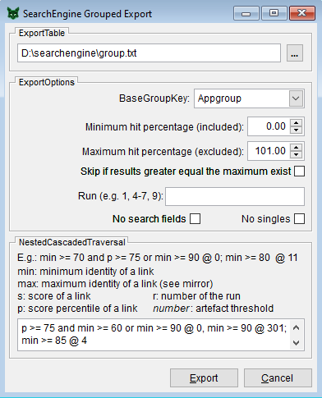
SearchEngineFileExportGrouped Export
1
Grouped Export
This format is only available for self-referential searches (disambiguation) and applies (nested) cascaded traversal.
It reports the clusters defined by the cascades without any search metrics, because cluster membership is not based on hierarchy.
By specifying the extension “.txt”, the export table will be a tab delimited text file.
The “BaseGroupKey” can be a unique key or an entity key, if applicable, implementing variant aggregation → in case of the latter the links will be aggregated to the maximum.
For reasons of consistency, range selection is available but only the option “Minimum hit…” should be used, as separation in confidence groups would yield inconsistent results.
Run selection should only be used to exclude unwanted search runs but not for quality assessment as search metrics get lost during the clustering.
The option “No singles” reduces the output to clusters with at least two members foregoing single unit clusters.
The option “No search fields” suppresses the output of the contents of the search fields if scrutinizing of the results is not required.
Output: the “group” variable in the export designates the cluster id, which is always the smallest “member” id.
Output: the “subgroup” can be used to manually separate clusters by giving each subgroup a different identifier. New cluster ids can be constructed by concatenation, i.e. 67121_1, 67121_2, or multiplication, i.e. 67121001.

Slide 14
SearchEngineFileExportGrouped Export
2
Nested Cascaded Traversal
Syntax: cascade [; cascade …]
Syntax cascade: [artefact,] rule @ cascade_limit [, rule @ cascade_limit …]
Syntax rule: logical expression using “min”, “s” (score), “p” (score percentile) “r” (run) and rarely “max”
Due to the fact that search results are not commutative, a linkage between two entities has a maximum (max) and a minimum (min) identity. Given the recommendation of high thresholds the minimum can be zero while the maximum is above the threshold. By mirroring the missing results (see function Mirror) it is possible to obtain an identity for the cases blow the threshold. Use this in conjunction with the score percentile to define more complex rules if necessary.
Syntax artefact: if this number is exceeded, the link is considered an artefact and connections will be trimmed.
A Semicolon separates nested cascades.
Nesting is advised if heterogeneous data structure in regard of variation per entity is suspected.
If nesting is applied, the first cascade always should have a cascade limit of zero → direct activation of the rule.
There is no limit to the nesting of cascades but implementing more than two barely provides any benefits.
The first cascade should define reliable clusters by strict rules with a low risk for false positives. The second cascade defines the arbitrary level of tolerated intransitivity.
Artefact thresholds should be applied after examination of the basic export (see Extended Export), which is also helpful to assess limits when using the absolute score “s”.

Slide 15
SearchEngineFileExportGrouped Export
3
GROUP | MEMBER | SUBGROUP | NAME | STREET | CITY | ZIP | COUNTRY | CNT
42122 | 42122 |  | Panavision, Inc. | 6219 De Soto Avenue | Woodland Hills | CA 91367 | US | 5
42122 | 42123 |  | Panavision Inc. | 6219 De Soto Avenue | Woodland Hills | CA 91367 | US | 5
42122 | 42124 |  | Panavision Federal Systems, Llc | 6219 De Soto Avenue | Woodland Hills | CA 91367 | US | 5
42122 | 47555 |  | Panavision Inc.A Corporation of the State of Delaware,U.S.A. | 6219 De Soto Avenue | Woodland Hills, California | 91367,U.S.A. | US | 5
42122 | 47556 |  | Panavision Inc.A Corporation of the State of Delaware,U.S.A. | 6219 De Soto Avenue | Woodland Hills, California | 91367 | US | 5
43951 | 43951 |  | Liebherr-Werk Biberach GmbH | Hans-Liebherr-Strasse 45 | Biberach an der Riss | 88400 | DE | 5
43951 | 43952 |  | Liebherr-Werk Biberach GmbH | Hans-Liebherr-Strasse 45 | Biberach | 88400 | DE | 5
43951 | 43953 |  | Liebherr-Components Biberach GmbH | Hans-Liebherr-Strasse 45 | Biberach/Riß | 88400 | DE | 5
43951 | 43954 |  | Liebherr-Werk Biberach GmbH | Memminger Straße 120 Postfach 1663 | Biberach/Riß | 88400 | DE | 5
43951 | 43955 |  | Liebherr-Components Biberach GmbH | Hans-Liebherr-Strasse 45 | Biberach an der Riß | 88400 | DE | 5
45375 | 45375 |  | NOVASEP | Site EIFFEL,Boulevard de la Moselle,BP 50 | Pompey | 54340 | FR | 5
45375 | 45376 |  | Novasep | Site EIFFEL, Boulevard de la Moselle, BP 50 | Pompey | 54340 | FR | 5
45375 | 45377 |  | Groupe Novasep | Site Eiffel Boulevard de la Moselle | Pompey | 54340 | FR | 5
45375 | 45378 |  | Novasep | Site EIFFEL Boulevard de la Moselle | Pompey | 54340 | FR | 5
45375 | 45379 |  | Groupe Novasep SAS | 82 Boulevard de la Moselle Site Eiffel BP50 | Pompey | 54340 | FR | 5
45716 | 45716 |  | Karl Storz Imaging Inc. | University Business Center,175 Cremona Drive | Goleta | CA 93117 | US | 5
45716 | 45717 |  | Karl Storz Development Corp. | 175 Cremona Drive | Goleta | CA 93117 | US | 5
45716 | 45718 |  | Karl Storz Development Corp. | 175B Cremona Drive | Goleta | CA 93117 | US | 5
45716 | 45719 |  | Karl Storz Imaging, Inc. | University Business Center 175 Cremona Drive | Goleta | CA 93117 | US | 5
45716 | 45720 |  | Karl Storz Imaging Inc. | 175 Cremona Drive | Goleta | CA 93117 | US | 5
45875 | 45875 |  | Kabushiki Kaisha Takeuchi Seisakusho | 9347, Ooaza Sakaki,Sakaki-machi | Hanishina-gun,Nagano-ken |  | JP | 5
45875 | 45876 |  | Takeuchi Mfg, Co., Ltd | 9347 Sakaki Sakaki-machi Hanishina-gun | Nagano |  | JP | 5
45875 | 45877 |  | Takeuchi MFG.Co.,Ltd. | 9637, Sakaki, Sakaki-machi | Hanishina-gun,Nagano | 389-0601 | JP | 5
45875 | 45878 |  | Takeuchi Mfg, Co., Ltd | 9347 Oaza Sakaki Sakaki-machi | Hanishina-gun, Nagano | 389-0601 | JP | 5
45875 | 45879 |  | Takeuchi Mfg. Co. Ltd. | 9347 Oaza Sakaki Sakakimachi Hanishina-gun | Nagano | 389-0601 | JP | 5
843 | 843 |  | SKF Industrial Trading & Development Company B.V. | Kelvinbaan 16 P.O. Box 50 | Nieuwegein | NL-3430 AB | NL | 4
843 | 844 |  | S.K.F. INDUSTRIAL TRADING & DEVELOPMENT COMPANY B.V. | Kelvinbaan 16 | Nieuwegein |  | NL | 4
843 | 46769 |  | SKF Engineering & Research Centre B.V. | Kelvinbaan 16 | Nieuwegein | 3439 MT | NL | 4
843 | 46770 |  | SKF BV | P.O. Box 2350 | Nieuwegein | 3430 DT | NL | 4

Slide 16
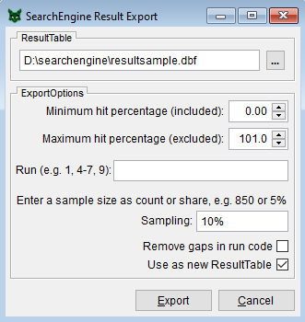
SearchEngineFileExportResult Export
Result Export
This function creates a fully functional subset respectively sample of the result table. It can be used to remove unwanted runs, curtail the identities or to draw a random sample for further exports.
The export format will always be “.dbf”. Text format is not supported.
The range selection and run filtering is equivalent to the (simple) Export dialog. The “Skip” option is not supported.
With “Sampling”, a random sample of the result table can be drawn. The entered number is considered a share if it is smaller than 1, e.g. 0.25. Alternatively, a percentage sign can be used, e.g. 25%. A number greater equal 1 designates the absolute number of cases to be drawn. A case consists of all candidates of a drawn searched entry.
Gaps that are caused by filtered runs can be removed by compressing the run order.
The exported result table can be manually assigned as the new result table in the “File Locations” dialog or directly by ticking the corresponding option on this dialog.
The sampling function is intended to be used in conjunction with “Meta Export”. It provides a training dataset for machine learning approaches to reduce the workload of manual checking. By temporarily replacing the original result table, an extended export file and the corresponding meta file can be created.
If you have switched the result table with a sample, don’t forget to revert to the original in the “File Location” dialog after the exports.

Slide 17
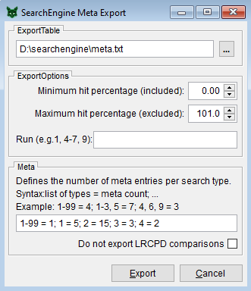
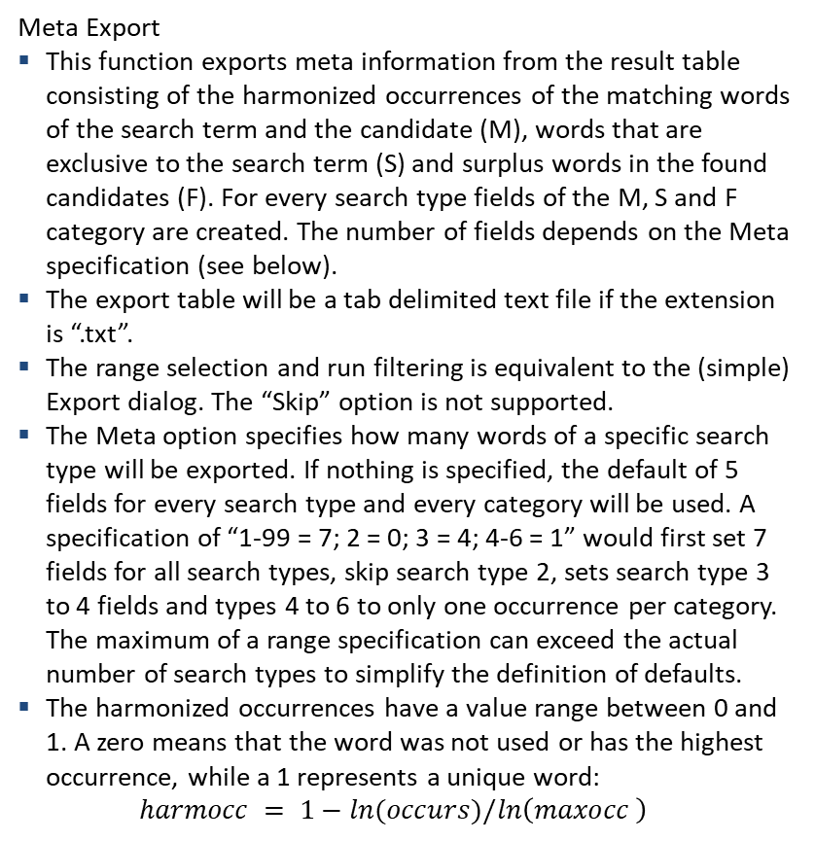
SearchEngineFileExportMeta Export
1
Meta Export
This function exports meta information from the result table consisting of the harmonized occurrences of the matching words of the search term and the candidate (M), words that are exclusive to the search term (S) and surplus words in the found candidates (F). For every search type fields of the M, S and F category are created. The number of fields depends on the Meta specification (see below).
The export table will be a tab delimited text file if the extension is “.txt”.
The range selection and run filtering is equivalent to the (simple) Export dialog. The “Skip” option is not supported.
The Meta option specifies how many words of a specific search type will be exported. If nothing is specified, the default of 5 fields for every search type and every category will be used. A specification of “1-99 = 7; 2 = 0; 3 = 4; 4-6 = 1” would first set 7 fields for all search types, skip search type 2, sets search type 3 to 4 fields and types 4 to 6 to only one occurrence per category. The maximum of a range specification can exceed the actual number of search types to simplify the definition of defaults.
The harmonized occurrences have a value range between 0 and 1. A zero means that the word was not used or has the highest occurrence, while a 1 represents a unique word: $harmocc = 1−ln(occurs)/ln\left(maxocc \right)$
For the F category two harmonized occurrences will be evaluated. One is based on a Registry of the search table, while the other uses the occurrence and maximum occurrence of the base Registry. The lower of both normalized values will be used. Because of the different bases in the F category, all occurrences are harmonized.

Slide 18
SearchEngineFileExportMeta Export
2
Meta Export
Besides the occurrence fields and the string comparison, a run dummy vector (run1, run2…), the identity, the score, the number of candidates for a search term (cnt), the number of distinct identities (icnt) and the relative position within these identities (ipos) are reported. Furthermore, the “R” category specifies the overlap between non-destructive search types.
Additionally, the meta format includes LRCPD string comparisons for all search fields for both directions (CFS#, CSF#). This output can be deactivated in case of long text fields, which would bog down performance for little gain.
The Registry of the SearchTable required for the “F” category will be created only once per SearchTable to speed up subsequent exports, i.e. in the case of samples (see Result Export). The files are located in the SearchTable directory with the postfixes “*_registry.dbf” and “*_registry.cdx”.
The Meta Export is intended to be used for machine learning (ML) approaches. Only a sample of the results needs to be manually scrutinized. The meta information of the sample can be used to train a probabilistic model, i.e. Neural Network, Logit, Random Forest etc. The model predicts the outcome of the matches for the whole data. The SearchEngine provides a method to block the data efficiently, while the final match is done by the ML approach.
The directory SEML contains sample programs based on the STATA package “brain”: https://github.com/ThorstenDoherr/brain
The Result Export with the Sampling option can be used to draw a random selection as a temporary Result table to export the corresponding Meta information and Extended Export file as training data. The Meta information of the sample is compatible to the corresponding Meta information of the complete data.

Slide 19
SearchEngineFileExportMeta Export
3
…
SEARCHED | FOUND | IDENTITY | SCORE | CNT | ICNT | IPOS | RUN1 | RUN2 | CSF1 | CFS1 | CSF2 | CFS2 | CSF3 | CFS3 | CSF4 | CFS4 | CSF5 | CFS5 | SCNT | RCNT | R1 | R2 | R3 | R4 | R5 | M1_1
1 | 4 | 100 | 5.737590009 | 1 | 4 | 1 | 1 | 0 | 1 | 1 | 1 | 1 | 1 | 1 | 1 | 1 | 1 | 1 | 10 | 0 | 0 | 0 | 0 | 0 | 0 | 0.63547483
1 | 2 | 99.5352737 | 5.737590009 | 1 | 4 | 0.75 | 1 | 0 | 0.897966594 | 0.606837607 | 1 | 1 | 1 | 1 | 1 | 1 | 1 | 1 | 10 | 0 | 0 | 0 | 0 | 0 | 0 | 0.63547483
1 | 3 | 99.5352737 | 5.737590009 | 1 | 4 | 0.75 | 1 | 0 | 0.897966594 | 0.606837607 | 1 | 1 | 1 | 1 | 1 | 1 | 1 | 1 | 10 | 0 | 0 | 0 | 0 | 0 | 0 | 0.63547483
1 | 27268 | 90 | 5.737590009 | 1 | 4 | 0.5 | 1 | 0 | 1 | 1 | 0.306937799 | 0.306937799 | 1 | 1 | 0.666666667 | 0.666666667 | 1 | 1 | 10 | 0 | 0 | 0 | 0 | 0 | 0 | 0.63547483
1 | 27269 | 90 | 5.737590009 | 1 | 4 | 0.5 | 1 | 0 | 1 | 1 | 0.248834499 | 0.248834499 | 1 | 1 | 0.666666667 | 0.666666667 | 1 | 1 | 10 | 0 | 0 | 0 | 0 | 0 | 0 | 0.63547483
1 | 27267 | 90 | 5.737590009 | 1 | 4 | 0.5 | 1 | 0 | 1 | 1 | 0.259330144 | 0.262053571 | 1 | 1 | 0.666666667 | 0.666666667 | 1 | 1 | 10 | 0 | 0 | 0 | 0 | 0 | 0 | 0.63547483
1 | 27271 | 90 | 5.737590009 | 1 | 4 | 0.5 | 1 | 0 | 1 | 1 | 0.306937799 | 0.306937799 | 1 | 1 | 0.666666667 | 0.666666667 | 1 | 1 | 10 | 0 | 0 | 0 | 0 | 0 | 0 | 0.63547483
1 | 80415 | 90 | 5.737590009 | 1 | 4 | 0.5 | 1 | 0 | 1 | 1 | 0.259330144 | 0.262053571 | 1 | 1 | 0.666666667 | 0.49537037 | 1 | 1 | 10 | 0 | 0 | 0 | 0 | 0 | 0 | 0.63547483
1 | 27270 | 90 | 5.737590009 | 1 | 4 | 0.5 | 1 | 0 | 1 | 1 | 0.306937799 | 0.306937799 | 1 | 1 | 0.666666667 | 0.666666667 | 1 | 1 | 10 | 0 | 0 | 0 | 0 | 0 | 0 | 0.63547483
1 | 27272 | 89.5352737 | 5.737590009 | 1 | 4 | 0.25 | 1 | 0 | 0.94017094 | 0.944444444 | 0.306937799 | 0.306937799 | 1 | 1 | 0.666666667 | 0.666666667 | 1 | 1 | 10 | 0 | 0 | 0 | 0 | 0 | 0 | 0.63547483
2 | 3 | 99.90073145 | 5.924049988 | 1 | 3 | 1 | 1 | 0 | 1 | 1 | 1 | 1 | 1 | 1 | 0.666666667 | 1 | 1 | 1 | 11 | 1 | 0 | 0 | 0 | 0.18262705 | 0.203715317 | 0.63547483
2 | 2 | 99.90073145 | 5.924049988 | 1 | 3 | 1 | 1 | 0 | 1 | 1 | 1 | 1 | 1 | 1 | 0.666666667 | 1 | 1 | 1 | 11 | 1 | 0 | 0 | 0 | 0.18262705 | 0.203715317 | 0.63547483
2 | 4 | 96.97480863 | 5.924049988 | 1 | 3 | 0.666666667 | 1 | 0 | 0.606837607 | 0.897966594 | 1 | 1 | 1 | 1 | 0.666666667 | 1 | 1 | 1 | 11 | 1 | 0 | 0 | 0 | 0.18262705 | 0.203715317 | 0.63547483
2 | 27269 | 87.07407718 | 5.924049988 | 1 | 3 | 0.333333333 | 1 | 0 | 0.606837607 | 0.897966594 | 0.248834499 | 0.248834499 | 1 | 1 | 0.444444444 | 0.666666667 | 1 | 1 | 11 | 1 | 0 | 0 | 0 | 0.18262705 | 0.203715317 | 0.63547483
2 | 27270 | 87.07407718 | 5.924049988 | 1 | 3 | 0.333333333 | 1 | 0 | 0.606837607 | 0.897966594 | 0.306937799 | 0.306937799 | 1 | 1 | 0.444444444 | 0.666666667 | 1 | 1 | 11 | 1 | 0 | 0 | 0 | 0.18262705 | 0.203715317 | 0.63547483
2 | 27267 | 87.07407718 | 5.924049988 | 1 | 3 | 0.333333333 | 1 | 0 | 0.606837607 | 0.897966594 | 0.259330144 | 0.262053571 | 1 | 1 | 0.444444444 | 0.666666667 | 1 | 1 | 11 | 1 | 0 | 0 | 0 | 0.18262705 | 0.203715317 | 0.63547483
2 | 27268 | 87.07407718 | 5.924049988 | 1 | 3 | 0.333333333 | 1 | 0 | 0.606837607 | 0.897966594 | 0.306937799 | 0.306937799 | 1 | 1 | 0.444444444 | 0.666666667 | 1 | 1 | 11 | 1 | 0 | 0 | 0 | 0.18262705 | 0.203715317 | 0.63547483
2 | 27272 | 87.07407718 | 5.924049988 | 1 | 3 | 0.333333333 | 1 | 0 | 0.633760684 | 0.944444444 | 0.306937799 | 0.306937799 | 1 | 1 | 0.444444444 | 0.666666667 | 1 | 1 | 11 | 1 | 0 | 0 | 0 | 0.18262705 | 0.203715317 | 0.63547483
2 | 80415 | 87.07407718 | 5.924049988 | 1 | 3 | 0.333333333 | 1 | 0 | 0.606837607 | 0.897966594 | 0.259330144 | 0.262053571 | 1 | 1 | 0.444444444 | 0.453703704 | 1 | 1 | 11 | 1 | 0 | 0 | 0 | 0.18262705 | 0.203715317 | 0.63547483
2 | 27271 | 87.07407718 | 5.924049988 | 1 | 3 | 0.333333333 | 1 | 0 | 0.606837607 | 0.897966594 | 0.306937799 | 0.306937799 | 1 | 1 | 0.444444444 | 0.666666667 | 1 | 1 | 11 | 1 | 0 | 0 | 0 | 0.18262705 | 0.203715317 | 0.63547483
3 | 14 | 95 | 3.062546278 | 12 | 3 | 1 | 1 | 0 | 1 | 1 | 1 | 1 | 1 | 1 | 1 | 1 | 1 | 1 | 5 | 0 | 0 | 0 | 0 | 0 | 0 | 0.619601713
3 | 16 | 95 | 3.062546278 | 12 | 3 | 1 | 1 | 0 | 1 | 1 | 0 | 0 | 1 | 1 | 1 | 1 | 1 | 1 | 5 | 0 | 0 | 0 | 0 | 0 | 0 | 0.619601713
3 | 15 | 95 | 3.062546278 | 12 | 3 | 1 | 1 | 0 | 1 | 1 | 0 | 0 | 1 | 1 | 1 | 1 | 1 | 1 | 5 | 0 | 0 | 0 | 0 | 0 | 0 | 0.619601713
3 | 55180 | 90 | 3.062546278 | 12 | 3 | 0.666666667 | 1 | 0 | 1 | 1 | 1 | 1 | 1 | 1 | 0.75 | 0.75 | 1 | 1 | 5 | 0 | 0 | 0 | 0 | 0 | 0 | 0.619601713
3 | 55181 | 90 | 3.062546278 | 12 | 3 | 0.666666667 | 1 | 0 | 1 | 1 | 0 | 0 | 1 | 1 | 0.75 | 0.75 | 1 | 1 | 5 | 0 | 0 | 0 | 0 | 0 | 0 | 0.619601713
3 | 13 | 90 | 3.062546278 | 12 | 3 | 0.666666667 | 1 | 0 | 1 | 1 | 0 | 0 | 1 | 1 | 0.75 | 0.75 | 1 | 1 | 5 | 0 | 0 | 0 | 0 | 0 | 0 | 0.619601713
3 | 55182 | 90 | 3.062546278 | 12 | 3 | 0.666666667 | 1 | 0 | 1 | 1 | 1 | 1 | 1 | 1 | 0.75 | 0.75 | 1 | 1 | 5 | 0 | 0 | 0 | 0 | 0 | 0 | 0.619601713
3 | 71467 | 88.33333333 | 3.062546278 | 12 | 3 | 0.333333333 | 1 | 0 | 0.376190476 | 0.703703704 | 0 | 0 | 1 | 1 | 1 | 1 | 1 | 1 | 5 | 0 | 0 | 0 | 0 | 0 | 0 | 0.619601713
3 | 71465 | 88.33333333 | 3.062546278 | 12 | 3 | 0.333333333 | 1 | 0 | 0.376190476 | 0.703703704 | 0 | 0 | 1 | 1 | 1 | 1 | 1 | 1 | 5 | 0 | 0 | 0 | 0 | 0 | 0 | 0.619601713
3 | 1919 | 88.33333333 | 3.062546278 | 12 | 3 | 0.333333333 | 1 | 0 | 0.376190476 | 0.703703704 | 1 | 1 | 1 | 1 | 1 | 1 | 1 | 1 | 5 | 0 | 0 | 0 | 0 | 0 | 0 | 0.619601713
3 | 1920 | 88.33333333 | 3.062546278 | 12 | 3 | 0.333333333 | 1 | 0 | 0.376190476 | 0.703703704 | 1 | 1 | 1 | 1 | 1 | 1 | 1 | 1 | 5 | 0 | 0 | 0 | 0 | 0 | 0 | 0.619601713
3 | 71464 | 88.33333333 | 3.062546278 | 12 | 3 | 0.333333333 | 1 | 0 | 0.376190476 | 0.703703704 | 0 | 0 | 1 | 1 | 1 | 1 | 1 | 1 | 5 | 0 | 0 | 0 | 0 | 0 | 0 | 0.619601713
4 | 16 | 100 | 8.062546278 | 12 | 5 | 1 | 1 | 0 | 1 | 1 | 1 | 1 | 1 | 1 | 1 | 1 | 1 | 1 | 7 | 0 | 0 | 0 | 0 | 0 | 0 | 0.619601713
4 | 15 | 95 | 8.062546278 | 12 | 5 | 0.8 | 1 | 0 | 1 | 1 | 0.242332831 | 0.242332831 | 1 | 1 | 1 | 1 | 1 | 1 | 7 | 0 | 0 | 0 | 0 | 0 | 0 | 0.619601713
4 | 14 | 95 | 8.062546278 | 12 | 5 | 0.8 | 1 | 0 | 1 | 1 | 0 | 0 | 1 | 1 | 1 | 1 | 1 | 1 | 7 | 0 | 0 | 0 | 0 | 0 | 0 | 0.619601713
4 | 71467 | 93.33333333 | 8.062546278 | 12 | 5 | 0.6 | 1 | 0 | 0.376190476 | 0.703703704 | 1 | 0.519762731 | 1 | 1 | 1 | 1 | 1 | 1 | 7 | 0 | 0 | 0 | 0 | 0 | 0 | 0.619601713
4 | 55182 | 90 | 8.062546278 | 12 | 5 | 0.4 | 1 | 0 | 1 | 1 | 0 | 0 | 1 | 1 | 0.75 | 0.75 | 1 | 1 | 7 | 0 | 0 | 0 | 0 | 0 | 0 | 0.619601713
4 | 13 | 90 | 8.062546278 | 12 | 5 | 0.4 | 1 | 0 | 1 | 1 | 0.242332831 | 0.242332831 | 1 | 1 | 0.75 | 0.75 | 1 | 1 | 7 | 0 | 0 | 0 | 0 | 0 | 0 | 0.619601713
4 | 55180 | 90 | 8.062546278 | 12 | 5 | 0.4 | 1 | 0 | 1 | 1 | 0 | 0 | 1 | 1 | 0.75 | 0.75 | 1 | 1 | 7 | 0 | 0 | 0 | 0 | 0 | 0 | 0.619601713
4 | 55181 | 90 | 8.062546278 | 12 | 5 | 0.4 | 1 | 0 | 1 | 1 | 0.250211327 | 0.265906933 | 1 | 1 | 0.75 | 0.75 | 1 | 1 | 7 | 0 | 0 | 0 | 0 | 0 | 0 | 0.619601713
4 | 71464 | 88.33333333 | 8.062546278 | 12 | 5 | 0.2 | 1 | 0 | 0.376190476 | 0.703703704 | 0.242332831 | 0.242332831 | 1 | 1 | 1 | 1 | 1 | 1 | 7 | 0 | 0 | 0 | 0 | 0 | 0 | 0.619601713
4 | 71465 | 88.33333333 | 8.062546278 | 12 | 5 | 0.2 | 1 | 0 | 0.376190476 | 0.703703704 | 0.242332831 | 0.242332831 | 1 | 1 | 1 | 1 | 1 | 1 | 7 | 0 | 0 | 0 | 0 | 0 | 0 | 0.619601713
4 | 1920 | 88.33333333 | 8.062546278 | 12 | 5 | 0.2 | 1 | 0 | 0.376190476 | 0.703703704 | 0 | 0 | 1 | 1 | 1 | 1 | 1 | 1 | 7 | 0 | 0 | 0 | 0 | 0 | 0 | 0.619601713
4 | 1919 | 88.33333333 | 8.062546278 | 12 | 5 | 0.2 | 1 | 0 | 0.376190476 | 0.703703704 | 0 | 0 | 1 | 1 | 1 | 1 | 1 | 1 | 7 | 0 | 0 | 0 | 0 | 0 | 0 | 0.619601713
5 | 22 | 100 | 8.642489469 | 8 | 6 | 1 | 1 | 0 | 1 | 1 | 1 | 1 | 1 | 1 | 1 | 1 | 1 | 1 | 15 | 0 | 0 | 0 | 0 | 0 | 0 | 0.766759858

Slide 20
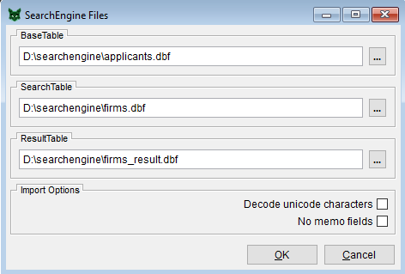
SearchEngineConfigFile Locations
1
BaseTable
It is usually a large (largest) table or the table that encompasses the most noise.
It constitutes the heuristic (registry) and should not be exchanged.
Harmonization is not required but good practice.
Should be free of duplicate records regarding the search fields.
Accepts tab-delimited text files (*.txt), which will be transferred to Foxpro (*.dbf).
Unique keys are not required if record numbers suffice as reference.
SearchTable
Usually a smaller table (or with less noise).
Can be exchanged.
Besides these points: same as above.
Import Options
Options for importing tab-delimited text files with header (*.txt).
No memo fields: max field size of 254 chars (ticked) → Faster execution of all functions but loss of information.
Decode single unicode characters: transformation of 2 byte chars to extended ASCII chars.
Unicode files are not supported. UTF-8 is supported.
ResultTable
Container for the candidates.
Should reside in the same directory as the SearchTable because it only contains candidates of one SearchTable.
Is always a Foxpro table (*.dbf).
For internal purposes only. Use export functions to access the search results.

Slide 21
SearchEngineConfigFile Locations
2
TableCluster
Foxpro tables have a maximum size of 2GB.
TableCluster are Foxpro tables with the same name template containing a sequence number, i.e. firms2017_1.dbf, firms2017_2.dbf, firms2017_3.dbf, …
A sequence is always the rightmost separated number of a table name, starts always with 1 and has no leading zeros.
All tables within a cluster have the same structure as they represent a virtual table that can be much larger than 2GB.
Tab-delimited text files (*.txt)
Imported text files may compile into several cluster tables with a sequence number.
As long as the imported Foxpro tables exists, they will be used instead of a repeated import. If a re-import is required, delete the corresponding Foxpro tables manually.
Associated with a Foxpro table are all similar named files with the extensions: *.dbf, *.cdx, *.fpt, *.bak, *.fbk. The extensions *.bak and *.fbk are reserved for restoration after structural changes to a table and can be deleted without consequences.
The text file should only contain fields required for the search, i.e. unique identifier plus search fields.
Make sure that the tab-delimited text files do not contain tabulators and other control characters in the data itself, for example by applying the following STATA code: replace var = subinstr(var,char(9)," ",.) if strpos(var,char(9)) > 0 replace var = subinstr(var,char(13)," ",.) if strpos(var,char(13)) > 0 replace var = subinstr(var,char(10)," ",.) if strpos(var,char(10)) > 0 replace var = subinstr(var,`"""'," ",.) if strpos(var,`"""') > 0 replace var = subinstr(var,`"'"'," ",.) if strpos(var,`"'"') > 0

Slide 22
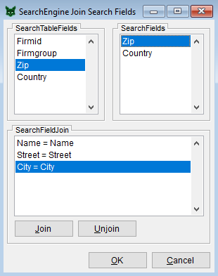
SearchEngineConfigJoin Search Fields
SearchTableFields
Lists all fields of the search table.
The context of the selected field should be fully contained in the context of the correspondingly selected search field, i.e. city → address field including street, zip and city.
Lowered identities are the consequence, if the context of a search table field exceeds the context of its search field.
If necessary, adjust fields of the search table according to the search fields by joining or separating contents
SearchFields
Lists all base table fields used to define search types.
A search type is just a specific way to harmonize a search field, therefore only the parent field can be linked but not the type.
SearchFieldJoin
Lists all linked search and base table fields.
Not every search field needs to be linked, as the search table may not have a matching field for every one, e.g. zip missing.
“Join” links fields, “Unjoin” removes a link (removed fields are appended to the end of the respective list).
The order of the links determines also the field order of some export formats and can be changed accordingly without further consequences for the search process.
Sometimes it is helpful to create empty search table fields to be able to link them before conducting an export. As a result, at least the base field contents will be reported.

Slide 23
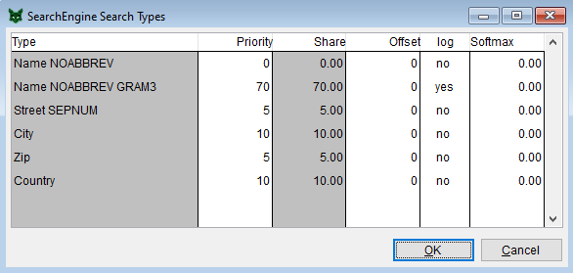
SearchEngineConfigSearch Types
SearchTypes
List of all search types with the current setting for the weight (share), offset, logarithmic and softmax smoothing.
The priority will be redistributed to shares, which are the weights for the search types (chapters of the registry).
The offset accepts negative values.
Click in the “log” column switches log smoothing off/on (yes/no).
Search strategies
The SearchEngine supports incremental search runs with different settings, which will be merged into the result table.
Do not try to find everything with one go.
Concentrate the weights on the identifying search field(s) (priority field), i.e. firm name, and play around with the weights for the remaining fields.
Take the impact of the threshold for the candidate identities into account: a threshold equal to the weight of the priority field means that a perfect match for this field is good enough, but if the supporting fields also contribute to the result, the constrains for the priority field are relaxed.
The first couple of runs should be based on non-destructive preparer by setting the weights of destructive types (gram, soundex, …) to zero (see screen capture).
Follow the basic runs with destructive runs to catch the misspellings by switching the priorities.
When using grams, conduct one run with and one without logarithmic smoothing (or softmax < 1).
Every candidate in the result table is designated with a sequential run number to retrace the impact of different settings in the export files.
See Presentation for more information about Softmax.

Slide 24
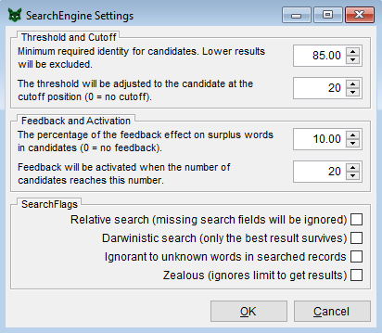
SearchEngineConfigSettings
Limit and Cutoff
Limit defines the threshold for the candidate identities.
The cutoff allows to reduce excessive candidate lists by adjusting the threshold to the identity of the candidate at the cutoff position.
Adjust the cutoff according to the amount of expected duplicates in the base data.
Think about which weight combinations of search types would make it to the limit.
Feedback and Activation
Feedback regulates how much the candidate identities resemble a Jaccard index.
Only if the number of candidates reaches the activation limit, feedback will be applied.
If both, cutoff and activation, are greater than zero, the feedback introduces variation into the candidate list to bring the candidates with the least amount of relevant noise on top. This is only used for temporary ranking and does not change the final candidate identities.
Ignorant gives words not found in the registry an identification potential of zero instead of the average IP, potentially leading to matching with very weak terms like legal forms → overblown candidate lists.
Zealous picks the next best candidates, if none would regularly reach the threshold → unexpected results.
SearchFlags
Relative Search redistributes the weights if search fields are missing in a search term.
Darwinistic keeps only the candidates with the highest identities → clean base table required.

Slide 25
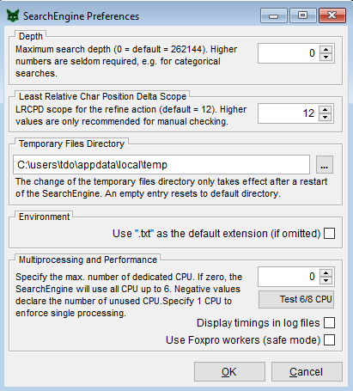
SearchEngineConfigPreferences
Preferences
Default values: depth = 0, LRCPD scope = 12
Depth
Depth defines the size of an internal buffer of up to 8388608 entries.
The default depth of 262144 is selected when no depth is explicitly specified (depth = 0), which is suitable for most applications.
If there is no word in a search term with an occurrence lesser equal this number, the SearchEngine will not be able to retrieve candidates.
Lower numbers speed up the search considerably but may lead to missed candidates. Higher numbers slow down the search but may be beneficial if weak search terms are expected, e.g. only one search field with low variation.
Least Relative Char Position Delta Scope
The LRCPD algorithm overstates the similarity for long strings as the deltas decrease with the string size.
The LRCPD scope defines the maximum distance the algorithm is looking for a matching character and adjusts the deltas accordingly.
Larger scopes increase the tolerance of the string comparison algorithm.

Slide 26
SearchEngineConfigPreferences
Temporary Files Directory
The location for the temporary work space can be changed in case of right issues or insufficient space at the default directory. The change will take effect after a restart of the SearchEngine.
Environment
If the “.txt” option is checked, the SearchEngine will consider text files as the default format making imports and exports more convenient.
Multiprocessing
A positive number determines how many CPUs (cores) will be dedicated to the SearchEngine process. A negative number determines how many CPUs stay free for other tasks. The default is zero, which reserves up to 6 CPUs to the SearchEngine.
The efficiency of multiprocessing (MP) can be assessed by a benchmark test. MP has diminishing returns to performance caused by the file system.
Benchmark timings can be displayed as comments in the log file “searchengine.log” or a log file assigned to a script (see Batch mode).
The multiprocessing is based on workers, which show as “parallelfox.exe” in the task manager. These will be registered in the Windows registry on startup of the SearchEngine. If that is not possible because of missing admin rights, Foxpro workers are used which appear in the task bar. This behavior can be manually enforced. The disadvantage of Foxpro workers is that they can be accidentally closed.

Slide 27
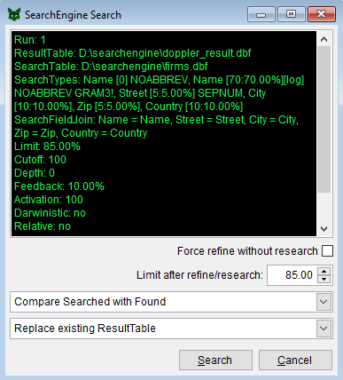
SearchEngineActionSearch
1
Search
Shows information relevant for the search.
“Force refine”, “Limit after refine” and “Compare” options will be explained in Search [2].
“Replace existing ResultTable” erases the existing results and starts a fresh result table → run counter reset to one.
“Complete with results for unmatched search records” conducts the search only for search table records that have no candidates yet in the result table → filling the gaps.
“Merge results with existing ResultTable” conducts a complete search and creates a union of existing and new results → enriching the results.
“Continue a canceled search” looks for the candidate with the highest search record number for the current run and continues from there → after canceling a search midways.
“Complete by replacing last run” deletes all results of the last run and “fills the gaps”.
“Merge by replacing last run” deletes all results of the last run and “enriches the results”.
Every result table has its own run counter which will be incremented with every search using the “Complete…” or “Merge…” option
All candidates found during a match are marked with the corresponding run number.
Some functions like Export or Research can be restricted to specific runs using the same syntax as the page selection in word, i.e. 1, 2, 4-7.
Use [ESC] to prematurely cancel the search to assess the quality of the matches and the search strategy before a long run → continue or replace by using the respective option.

Slide 28
SearchEngineActionSearch
2
Refine and Research
When destructive preparer are involved (weight > 0) additional options become available.
Similarity index of a string comparison of “destroyed” search fields replaces the corresponding components of the candidate identity based on the relative identification potential (rIP). Because it is not possible to subsequently disentangle the candidate identities, they will be set to zero followed by a “refine” step adding the string comparison component and a “research“ step adding the rIP component according to the corresponding search type weights.
With “Force refine without research” the refine step will be conducted for all fields making the research step obsolete.
The refine process, like the main heuristic, is not commutative, therefore the direction of the comparison has to be specified:
“Compare Searched with Found” is the default direction and mimics the general SearchEngine behavior.
“Dynamic compare” compares in both directions and uses the lowest result → suitable for person names.
“Compare Found with Search” reverses the default direction → more noise in the base table.
After refine and research a new limit for the candidate identities can be specified to separate the candidate selection from the final evaluation.
In most cases, the default settings regarding refine and research should be fine.

Slide 29
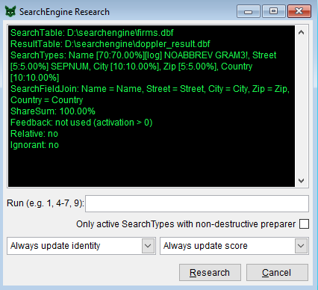
SearchEngineActionResearch
Research
This function can be used to harmonize the candidate identities of several search runs based on one general search parametrization. It recalculates the candidate identities for selected runs according to the current parameters like weights, offsets, logarithmic smoothing, feedback and the “relative” and “ignorant” settings → no new results will be generated.
Runs can be selected using the same syntax as the page selection before printing, e.g. 1-3,5,7.
“Always update identity”, “Never update identity”, “Maximize identity”, “Minimize identity”, “Increment identity” and “Average identity” define how the new identities interact with the existing identities.
Always update score”, “Never update score”, “Maximize score” and “Minimize score” define how the new scores interact with the existing scores.
Identities will be truncated at 100%.
To replicate the refine and research steps of a search using destructive preparer choose the option “Only active SearchTypes…” to exclude search types containing destructive preparer and “Always update identity”. A subsequent Refine step is required (see Refine).

Slide 30
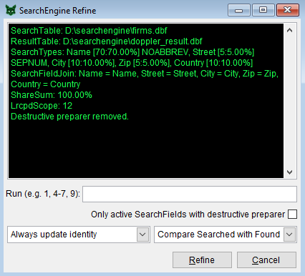
SearchEngineActionRefine
Research
This function can be used to replace the frequency based heuristic of the candidate identities with a string comparison based similarity index. It recalculates the candidate identities for selected runs using the LRCPD string comparison method → no new results will be generated.
Runs can be selected using the same syntax as the page selection before printing, e.g. 1-3,5,7.
To guarantee a comparison close to the original data all destructive preparer will be deactivated.
“Always update identity”, “Never update identity”, “Maximize identity”, “Minimize identity”, “Increment identity” and “Average identity” define how the new identities interact with the existing identities.
“Compare Searched with Found”, “Dynamic compare” and “Compare Searched with Found” specifies the direction of the non-commutative comparison.
Identities will be truncated at 100%.
To replicate the refine and research steps of a search using destructive preparer choose the option “Only active SearchFields…” to exclude search fields containing only non-destructive preparer and “Increment identity” to combine both identity components (see Research).

Slide 31
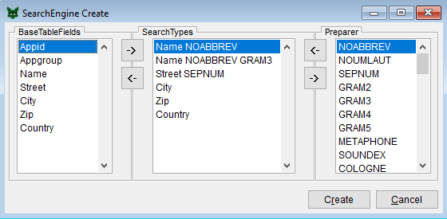
SearchEngineActionCreate
BaseTableFields
Lists all field names of the base table, ready to be declared as search field (arrow right).
SearchTypes
Combination of a search field and a preparer is called search type.
A search field can occur more than once with different preparer combination.
Plan search strategies ahead: you can mix and merge multiple search runs on the same search table into one result table.
It is advised to link n-gram preparer only to search fields that will get a high weight, because they slow the search down and should therefore be worth it.
Not any preparer combination will work, but you will get no warning.
Preparer
Basic harmonization (upper case and so on) always takes place.
Left arrow to link it, right arrow to remove it from search type.
NOABBREV: gather single letters into one word (B A S F → BASF)
NOUMLAUT: change normal German umlaut transformation into a simplified one, typical for US data (Ä→AE →A).
SEPNUM: separate numbers from letters (house numbers).
GRAMn: implements the n-gram method (effective but inefficient).
METAPHONE, SOUNDEX, COLOGNE: implements these methods.
MAXLENGTHn: truncate all words to length n.
MAXWORDSn: ignore all words after word n, e.g. selecting first name.
SKIPWORDSn: ignore the leftmost n words, e.g. selecting last name.
Red bullet points mark destructive preparer, green are non-destructive.

Slide 32
SearchEngineActionRecreate
Recreate
Deletes the current registry and all associated tables to replace it with a new registry.
Shows the current search types.
For details see Create function.

Slide 33
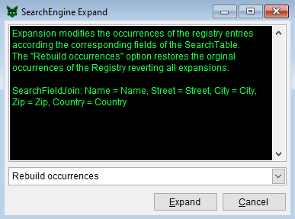
SearchEngineActionExpand
Expand
This function creates a registry of the search table and merges it with base registry changing its occurrences.
The following interactions between the occurrences of the base registry and the occurrences of the corresponding entries of the search table are available: replace, minimize, maximize, increment and average.
The base registry can be restored to its original form by the rebuild option, which does not require a specified search table.
No new registry entries will be created.
All expansions are permanent and affect further searches with different search tables until rebuilt.
Can be used to harmonize the registry in regard of systematic differences like legal forms or usage of appreviations, i.e. “University” vs “Univ”, which otherwise would distort the heuristic (maximize, increment).
If the search table has a different focus (i.e. wine producing firms) than the base table (i.e. patent assignees) the search may loose its focus (all options but minimize) because the specific words are getting a low identification potential (“wine” becomes a filler word) → candidates outside the focus will be preferred.
Given the experimental character of expansions, it is advised to examine candidates retrieved after an expansion using the run option of the export function.
Rebuild – undo all expansions.
Replace – imposes the distribution of the search table.
Minimize – accentuates the words of the search table with a low occurrence.
Maximize – levels systematic differences between search and base table.
Increment – levels systematic differences between search and base table.
Average – effect depends on the size difference of the search table to the base table.

Slide 34
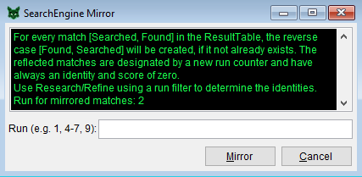
SearchEngineActionMirror
Mirror
This function is only available for self-referential searches (disambiguation). It mirrors matches [Searched, Found] that have no reverse case [Found, Searched] because its identity was below the threshold during the search.
The generated matches have always an identity and score of zero and get a new run counter, which is reported in the dialog.
The mirror process can be restricted to specific runs by using the same syntax as the page selection before printing, e.g. 1-3,5,7.
The identities of the generated matches can be defined by using the Research and/or Refine function on the specified run.
Although not a requirement for cascaded traversal (see GroupedExport), mirroring allows to assess the similarity below the limit without needlessly inflating the result table with hopeless cases.
By mirroring, very large result tables (close to 2GB or 79 Million records) can exceed system limits.
Self-referential searches have the tendency to inflate the result table → try cutoff/activation (see Search) to reduce the impact of large clusters (1000 similar entries generate 1000*1000 matches) without loosing too much information as the truncated candidate lists are highly interconnected.

Slide 35
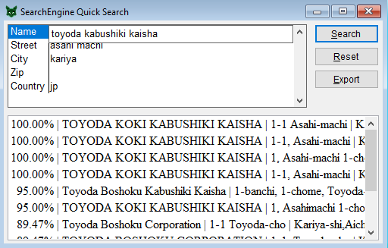
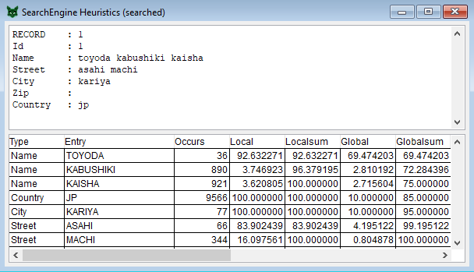
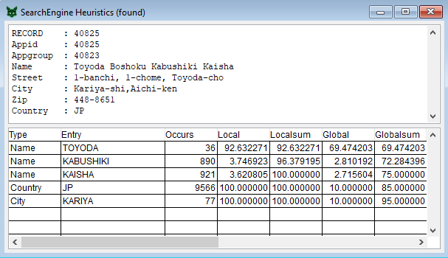
SearchEngineToolsQuick Search
Quick Search
Entered fields will be searched according to the current settings (no refine step).
Candidate list can be exported (see Extended Export).
Right-clicking on a candidate opens windows displaying the heuristics for the search term and the active candidate.
Heuristic
Shows the fields of the selected record and the words of active search types along with the respective heuristic information like occurrence (incl. offset, log, softmax), local and global share of the rIP.

Slide 36
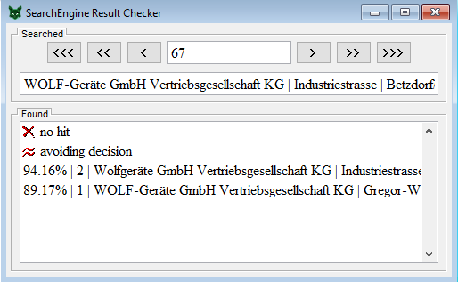
SearchEngineToolsResult Checker
Result Checker
Displays the contents of the result table enriched with the contents of the joined search fields of the base (found) and the search (searched) table (separated by “|”).
This is the first station to assess the quality of a search .
Right-clicking on the search term or an found entry opens the respective heuristic window (see Quick Search).
The heuristic is based on the current settings and not on the parametrization of the search run
The Result Checker can also be used for manual checking by marking valid candidates. This function is depreciated by Extended Export.
Found
Shows the candidate identity, the run number and content of the search fields in the base table.
Use simple clicking, SHIFT-clicking or CTRL-clicking to switch candidates between selected (match) and unselected (no match).
CTRL-clicking on “avoiding decision” marks the assessment as uncertain.
Clicking on “no hit” removes all selections and declares all candidates as non-matching.
The checking functionality is depreciated because it is less efficient than working with Extended Export files.
Searched
Shows the record number of the search table and the associated search term.
“<“ or “>” moves to the next/previous search table record with candidates.
“<<“ or “>>” moves to the next/previous record with uncertain candidates.
“<<<“ or “>>>” moves to the next/previous record with unchecked candidates.

Slide 37
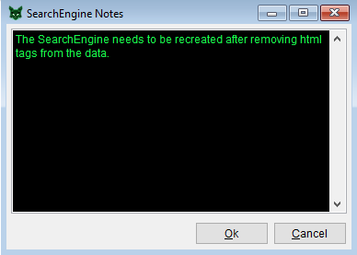
SearchEngineToolsNotes
Notes
Free text can be appended to the SearchEngine structure string following the tag “[info]”.
Every save slot of the SearchEngine has its own notes section.
Can be used to make notes about the data, search strategies and other stuff related (and unrelated) to the current SearchEngine.
The file “searchengine.log” in the SearchEngine directory reports all activities of the SearchEngine making the main reason for notes obsolete.

Slide 38
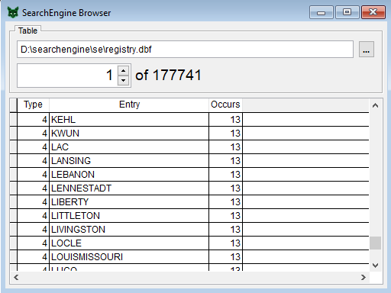
SearchEngineToolsBrowser
Browser
Opens a browser window to any selected Foxpro table (*.dbf).
The browser window can be navigated by entering a record number, skipping records or by scrolling.
Can be used to take a peek into the internal SearchEngine tables like registry.dbf or control.dbf.
Allows to scrutinize imported search and base tables, originating from tab-delimited text files, for invalid characters or messed up field separation.

Slide 39
Batch mode and searchengine.log
All actions performed using the GUI of the SearchEngine are logged into the file searchengine.log in the SearchEngine directory.
The entries are identical to the commands of the SearchEngine batch mode to facilitate easy setup of batch scripts.
Command line parameter of SearchEngine.exe: > searchengine.exe batch_file [output_file [append]] [[para1=content] [para2=content] …]
Output generated from the script is written into the optional output file.
If option “append“ is specified, the existing output file will be complemented.
Parameters followed by an equal sign are placeholders. In the script file, placeholder are enclosed by rectangular brackets, e.g. importBase(“[basefile]”) and will be replaced by the contents of a parameter of the same name
Syntax of batch scripts: [* comment] [silent|loud] [catch] [force] [silent] [loud] command [exit]
Command parameters have different types which are represented by the first uppercase letters of the placeholder: I = Integer N = Numeric L = Logic: .t. equals true, .f. equals false S = String in quotes: ”…”
Command parameters can be omitted if designated as optional (rectangular brackets) and will be replaced with default values. Commands reported in the searchengine.log always show the abridged version omitting default settings.

Slide 40
SearchEngine keywords
silent activates silent mode suppressing the output of the executed commands. Can be put in front of a command or separately as global setting. Other output is not affected.
loud writes the executed commands to output file. Can be put in front of a command or separately as global setting to cancel silent mode.
force the following command has the permission to overwrite files or show other reckless behavior for the sake of undisturbed execution.
catch the script does not stop if the following command generated an error. Can be used instead of force to assure the existence of a file or condition without recreating it.
exit terminates the execution of the script.

Slide 41
SearchEngine commands
1
activation(Iactivation) sets activation limit for feedback to get triggered. Enforces ordering of candidates by least relevant noise. Has no impact on actual results unless cutoff is zero. [Settings]
benchmark() runs the benchmark based on current MP settings and reports the results. [Preferences]
cancel() stops the current script.
configtmp([Spath]) defines the default path for temporary files. If Spath is omitted, the default directory will be used. [Preferences]
create(Ssearchtypes) creates the SearchEngine. The search types are separated by commas. A search type consists of the name of the search field followed the preparer names, separated by blanks. Can be forced to overwrite existing SearchEngine. [Create]
cutoff(Icutoff) sets the cutoff limit. The SearchEngine will try to keep the number of candidates per search term below this value. Works in conjunction with activation. [Settings]
darwinistic(Ldarwin) defines whether the SearchEngine keeps only the best candidates (.t) or transfers all candidates with an identity equal or greater than the limit into the results (.f. = default). [Settings]
depth(Idepth) sets the search depth, which can be a number between 0 and 8388608 (0 = default = 262144). [Preferences]

Slide 42
SearchEngine commands
2
erase() erases the internal SearchEngine files. Base, search and result table are not affected.
expand(expandMode) expands the SearchEngine by merging a virtual registry of the search table with the registry adjusting the occurrences. No new entries will be created. The parameter expandMode defines how the occurrences will be merged: 0 = restore original occurrences (default), 1 = replace with search table occurrence, 2 = use the maximum, 3 = use the minimum, 4 = increment by search table occurrence, 5 = use the average of both occurrences. [Expand]
exportExtended(Stable [, Ssearchkey, Sfoundkey [, Ssearchgroupkey, Sfoundgroupkey]] [, Nlow, Nhigh [, Lexclusive]] [, Srunfilter]) exports the result table using the extended format. If Stable has “.txt” as extension, the file format will be tab-delimited. Ssearchkey and Sfoundkey have to be specified if groupkeys are used. If they are empty, record numbers replace the keys. If a groupkey is specified in rectangular brackets ([key]), the key will be used for grouping but will not be reported (useful in conjunction with exportMeta). Can be forced to overwrite existing Stable. [Extended Export]
exportGrouped(Stable [, Scascade] [, Sbasekey ] [, Nlow, Nhigh [, Lexclusive]] [, Srunfilter] [, Lnotext [, Lnosingles]]) exports the result table using the grouped format. If Stable has “.txt” as extension, the file format will be tab-delimited. Can be forced to overwrite existing Stable. [Grouped Export]
exportResult(Stable [, Nshuffle] [, Nlow, Nhigh] [, Srunfilter] [, Lnewrun]) extracts a filtered copy/sample of the result table. If Nshuffle is not omitted or zero, a sample is drawn. The size is either a defined as share (Nshuffle < 1) or absolute number (Nshuffle ≥ 1) . If Lnewrun is .t., the run field in the new table will be without gaps. Tab-delimited export is not supported. Can be forced to overwrite existing Stable. [Result Export]
exportMeta(Stable [, Smeta] [, Lnocomp] [, Nlow, Nhigh] [, Srunfilter]) exports meta data of the result table. If lnocomp is .t., LRCPD comparisons are omitted. [Meta Export]
feedback(Nfeedback) sets the feedback, which can be a number between 0 and 100. [Settings]

Slide 43
SearchEngine commands
3
ignorant(Lignorant) defines whether the SearchEngine is ignoring words not represented in the Registry (.t.) or is giving them the average identification potential of the corresponding search type (.f. = default). [Settings]
getpara([Spara]) displays the content of placeholder Spara or of all placeholders, if Spara is omitted or empty (see getpara).
importBase(Sfile [, Ldecode [, Lnomemos [, Lfast]]]) imports respectively declares the base table. If the file extension is “.txt”, the file is imported into Foxpro format. If it is already imported, the existing file will be used. Parameters can be omitted from right to left. [File Locations]
importSearch(Sfile [, Ldecode [, Lnomemos [, Lfast]]]) imports respectively declares the search table. If the file extension is “.txt”, the file is imported into Foxpro format. If it is already imported, the existing file will be used. Parameters can be omitted from right to left. [File Locations]
info(Sinfo) sets the notes in the info section of the SearchEngine structure string. The tag “<br>” will be translated to a line break. [Notes]
join(Sfield [, Ssearchfield]) links a field of the search table (Sfield) to a search field (Ssearchfield). If both have the same name, the search field can be omitted. [Join Search Fields]
limit(Nlimit) set the threshold for the identity of the candidates. Can be a number between 0 and 100. Identical to threshold. [Settings]
load([Sslot]) loads the specified SearchEngine slot. If omitted or empty, the current slot will be reloaded. [Load]

Slide 44
SearchEngine commands
4
message(Stext) opens a message box showing Stext. Program halts until confirmation.
mirror([Srunfilter]) mirrors the matches without a reverse entry to enforce symmetry. Can be restricted by a run filter. Can be forced to always increment run counter, even if no new matches were created. [Mirror]
mp([Icpu]) dedicates Icpu number of CPUs to SearchEngine actions. Negative numbers determine the CPUs not used by the SearchEngine. Omitting Icpu returns the current setting and a zero reserves up to 6 CPUs (initial setting). [Preferences]
note(Snote) appends a new line to the notes in the info section of the SearchEngine structure string. The tag “<br>” will be translated to a line break. [Notes]
output(Slogfile [, Lappend]) defines a new log file for the SearchEngine output. If Lappend is .t., an existing file will be complemented instead of overwritten. This command can be used instead of the SearchEngine parameter.
refine([Iidentitymode, Icomparemode] [, Srunfilter] [, Ldestructiveonly]) refines the existing matches in the result table. Iidentitymode defines how the refined identity relates to the existing identity of the respective match: 1 = replace, 2 = maximize, 3 = minimize, 4 = additive, 5 = average. Icomparemode defines the direction on the LRCPD comparison: 1 = searched in found, 2 = dynamic, 3 = found in searched. If Ldestructiveonly is .t., only search types containing destructive preparer are included renouncing the priorities of the other search types. This option should be used in conjunction with research and additive identity mode. [Refine]

Slide 45
SearchEngine commands
5
relative(Lrelative) defines whether the SearchEngine redistributes the priorities of missing search fields (.t.) or leaves them missing reducing the maximum identity by the corresponding priorities (.f. = default). [Settings]
remove(Sslot) removes the specified save slot. [Save]
research([Iidentitymode, Iscoremode] [, Srunfilter] [, Lnondestructiveonly]) researches the existing matches in the result table. Iidentitymode defines how the researched identity relates to the existing identity of the respective match: 1 = replace, 2 = maximize, 3 = minimize, 4 = additive, 5 = average. Iscoremode defines how the researched score relates to the existing score of the respective match: 1 = replace, 2 = maximize, 3 = minimize. If LnondestructiveOnly is .t., only search types not containing destructive preparer are included renouncing the priorities of the other search types. This option should be used in conjunction with refine and additive identity mode. [Research]
result(Sresult) sets the result table. Can be exchanged independently. Will be overwritten without warning, if a search is initiated. Every result table has its own run counter. [File Locations]
run([Spara]) writes the current run count of the active result table to the output file, optionally into placeholder Spara.
safemode([Lsafemode]) if Lsafemode is .t., the SearchEngine will use visible Foxpro workers instead of invisible Parallelfox workers. Safe mode will be automatically activated, if the SearchEngine cannot register the Parallelfox workers, which requires administrator rights. [Preferences]
save(Sslot) saves the current SearchEngine structure in the specified save slot. [Save]

Slide 46
SearchEngine commands
6
say(Ssomething) writes a comment line to the output file.
scope(Iscope) defines the width of the LRCPD scope (12 = default). [Preferences]
screen(Sproperty [, value]) sets various screen properties determining the look of the execution window: screen(“width”, 550) sets the screen with to 550 pixel. screen(“height”,400) sets the screen height to 400 pixel. screen(“left”,100) sets the screen coordinate of the top left corner to 100 pixel. screen(“top”,100) sets the screen coordinate of the top left corner to 100 pixel. screen(“hide”) hides the screen. screen(“maximize”) maximizes the screen. screen(“minimize”) minimizes the screen. screen(“normal”) switches the screen from maximized/minimized state into normal state . screen(“backcolor”, “0,0,0”) sets the back color of the screen in RGB format. screen(“forecolor”, “25,245,75”) sets the fore color of the screen in RGB format. screen(“font”, “Courier New”) sets the font. screen(“fontsize”, 9) sets the font size in points.
setpara(Spara [, value [, Lkeep]]) sets the value of the placeholder Spara to the value value (of any type). If Lkeep is .t. and the placeholder is already defined as command line parameter or by an earlier setpara call, the original value will not be changed.

Slide 47
SearchEngine commands
7
search([Iincrement] [, Icomparemode [, Lrefineforce] [, Nrefinelimit]]) executes a search. Iincrement determines the interaction with the existing results: 0 = replace existing results, 1 = complete for unmatched search records, 2 = merge results, 3 = continue canceled search, ˗1 = like 1, but removes last run, ˗2 = like 2, but removes last run. If destructive preparer are involved, candidates will be automatically refined. By default, only search fields with destructive preparer will be refined. All other fields will be researched. Icomparemode defines the direction on the LRCPD comparison: 1 = searched in found, 2 = dynamic, 3 = found in searched. If Lrefineforce = .t., all search fields will be refined regardless of the involvement of destructive preparer. If the results will be refined, a separate threshold can be defined with Nrefinelimit [0,100].[Search]
show() writes the SearchEngine structure string to the output file.
slot() writes the current save slot name to the output file.
threshold(Nthreshold) sets the threshold for the identity of the candidates. Can be a number between 0 and 100. Identical to limit. [Settings]
time() writes the current date and time to the output file.
timer([Ltimer]) if Ltimer is .t. or omitted, the run time of every action will be reported in the log file as a comment. This behavior can be deactivated with Ltimer = .f.. [Preferences]

Slide 48
SearchEngine commands
8
types(Ssearchtypes) determines the search types settings. Search types are separated by commas. A search type definition consists of the search type name, a priority, an optional offset (preceded with a plus or minus sign) , an optional softmax parameter (preceded with a hash #) and an optional “log” keyword to enable logarithmic smoothing. It is advised to always specify all search types in order of definition. Unused types have a priority of zero. A softmax value below 1 smooths while a value above 3 accentuates the search term distribution (max. accentuation = 30). Example: “firm 35 #10, firm 35 log, street 10 -5000, city 10, state 10”. [Search Types]
unjoin([Sfield]) removes the link between a field of the search table (Sfield) and a search field. If Sfield is omitted, all links will be cleared. It is best practice to first unjoin all links before joining them. [Join Search Fields]
version() writes the current version to the output file.
wait(Iseconds) halts execution for Iseconds seconds or until button press. if Iseconds is zero, execution will be continued after button press.
zealous(Lzealous) defines whether the SearchEngine is dynamically lowering the threshold to guarantee matches (.t.) or is complying to the threshold disposing all candidates below it (.f. = default). [Settings]

Slide 49
SearchEngine technical notes
Development Environment
Microsoft Visual Foxpro 9.0 SP2 (32-Bit)
Microsoft Visual C++ 6.0 (32-Bit)
Minimum Requirements
Windows, any Version from XP upwards
2 GB RAM
Limitations
Result table has a maximum size of 2GB
79,536,413 records
Foxpro export tables may not exceed 2GB
Text based export tables have no size limitation
Base/Search tables have no size limitation
internal representation as table clusters of 2GB tables

Slide 50
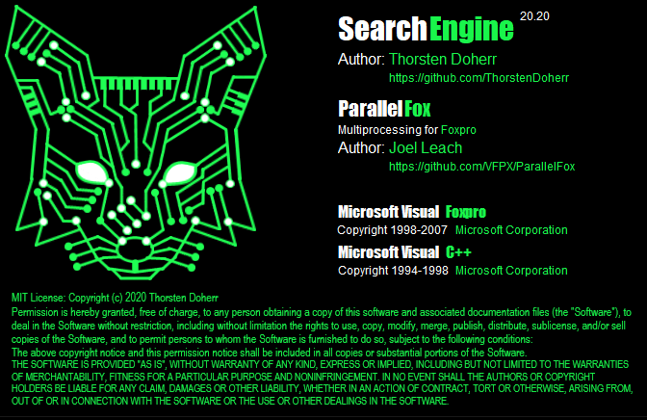
License agreement
Send bug reports to: doherr@zew.de

