Slide 1
PV Monitoring Platform
MVP delivery for Ingestion, Normalization, and AI-First UX
Presentation by Thösam Norlha-Tsang

Slide 2
Introduction

Slide 3
Scalable PV Monitoring & AI Analytics
Scope: 10–20 PV dataloggers (different vendors, structures, quirks)
Task - design and implement:
Ingestion Layer
Abstraction & Cleanup Layer
Monitoring View + AI Interaction
Deployment
Notes:
Prioritizing was most important

Slide 4
0. Road Map

Slide 5
Roadmap
High-Level Architecture
The Data Flow
Handling Messy Data (Ingestion)
The AI Agent (LangGraph)
AI-First User Experience
Demo
Learnings
Q&A

Slide 6
High-Level Architecture

Slide 7
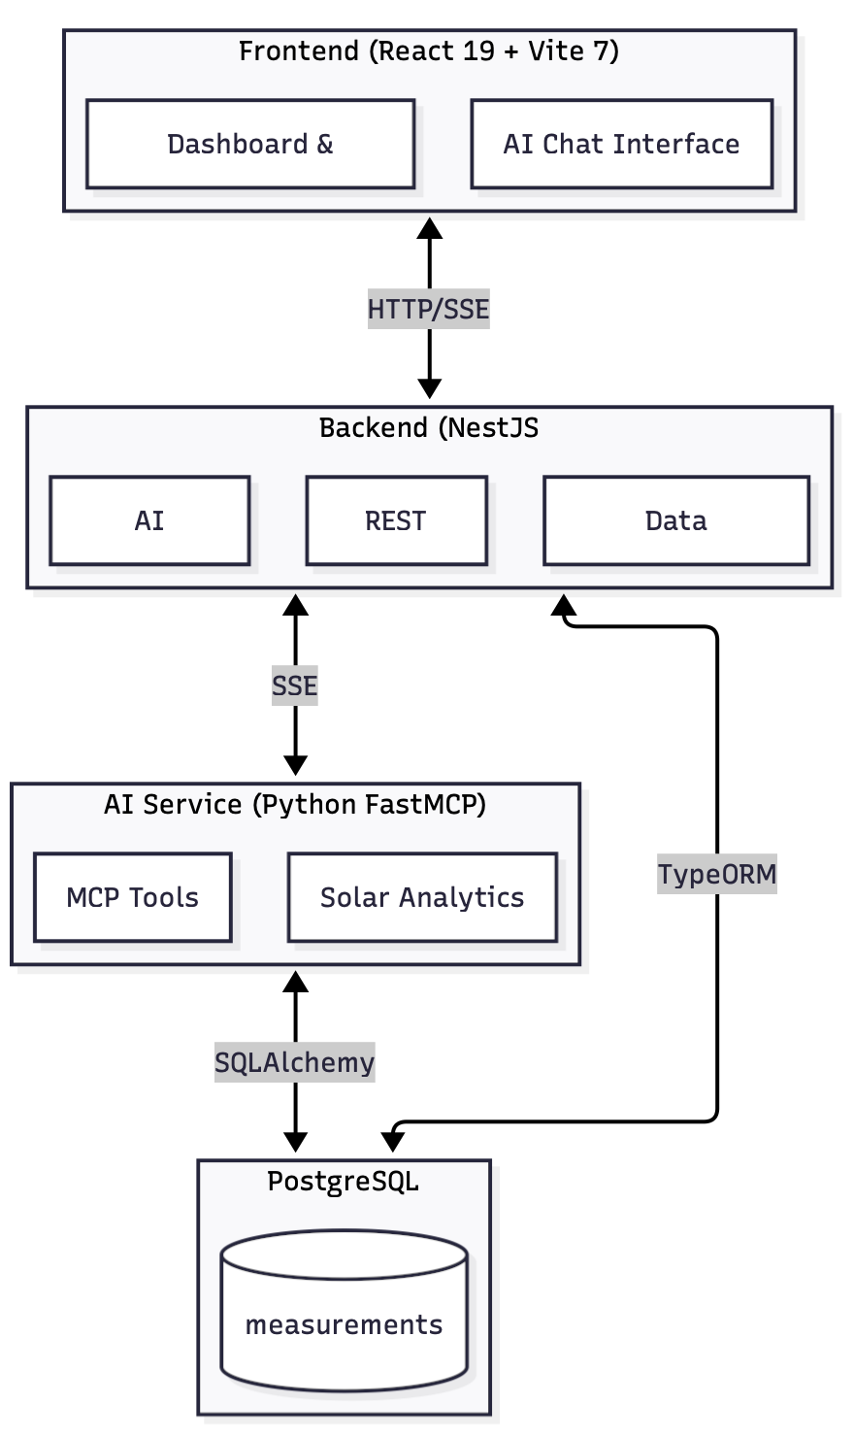
High-Level Architecture
Key Points:
Three-Tier Design: Clear separation of concerns
Backend (NestJS): Type safety, modularity, robust API
AI Service (Python/FastMCP): Dedicated environment for data science tools (Pandas/NumPy)
Frontend (React + Vite): Fast, reactive UX with shadcn/ui

Slide 8
2. The Data Flow

Slide 9
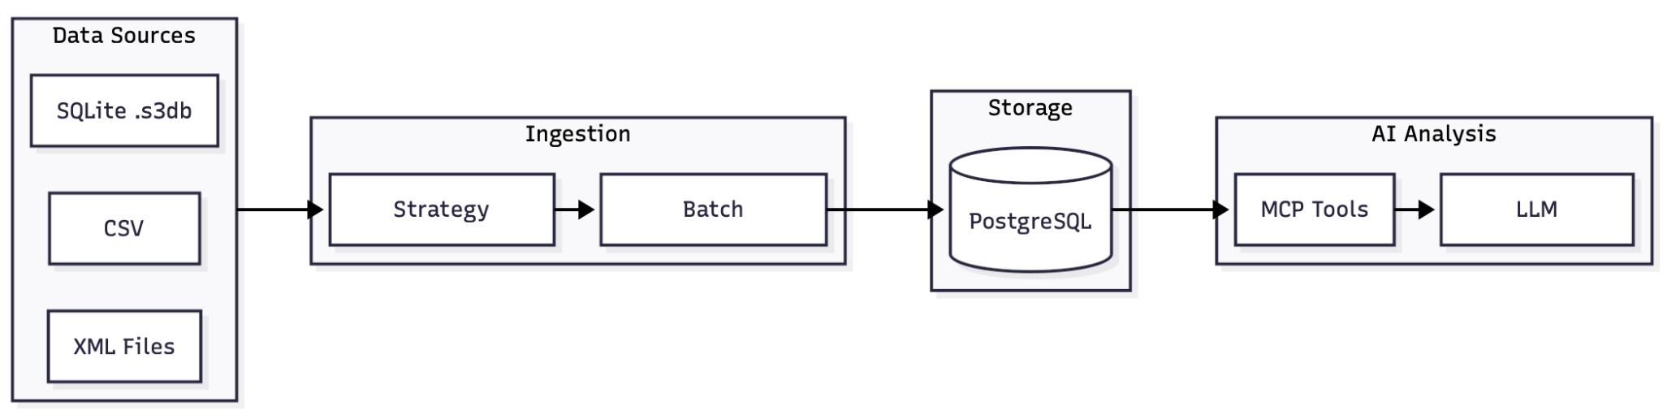
The Data Flow
Key Points:
Files → Ingestion Pipeline → Normalized Storage (PostgreSQL)
User → Chat Interface → LangGraph Orchestrator → Tools → Database
Design Decision: Real-time feedback via SSE (Server-Sent Events)

Slide 10
3. Handling Messy Data (Ingestion)

Slide 11
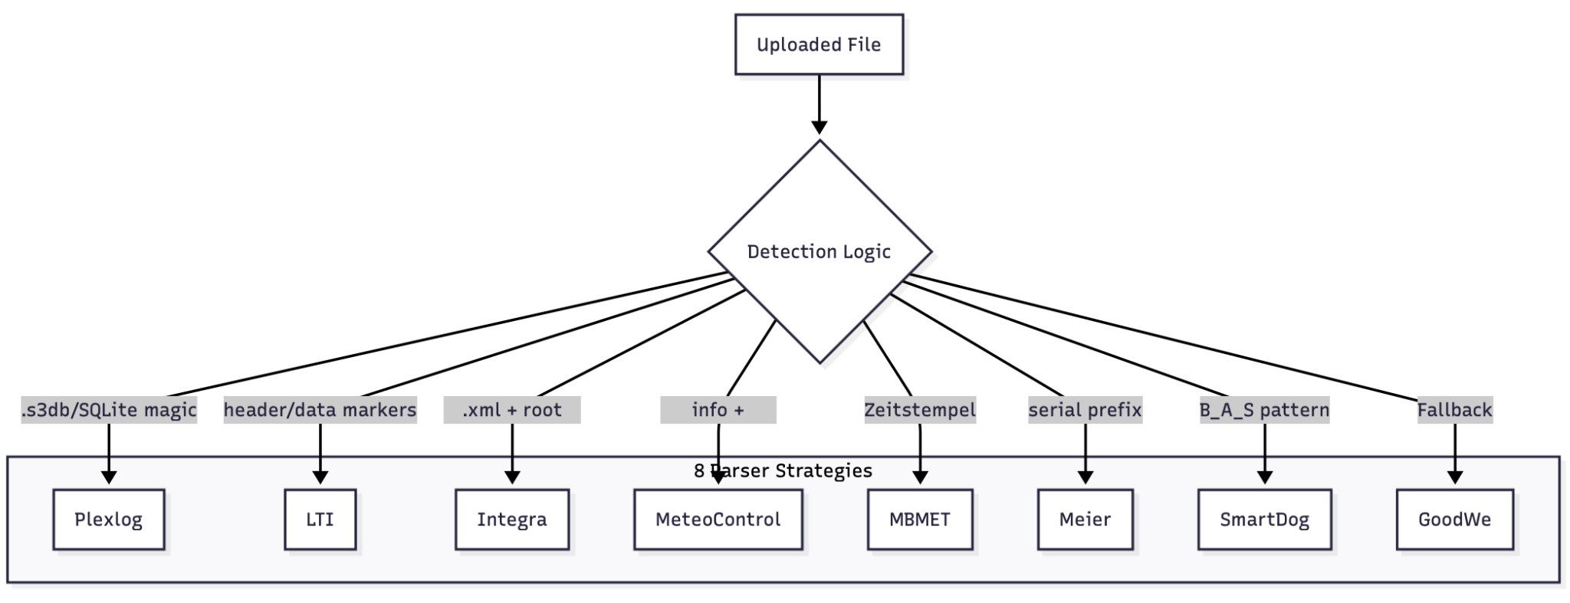
The Parsing Strategy
The Challenge: 8+ formats (XML, SQLite, CSV, Text), inconsistent headers.
The Solution: Specificity-First Strategy Pattern
  Detects file type by content (magic bytes), not just extension
  Easily extensible (Open-Closed Principle)

Slide 12
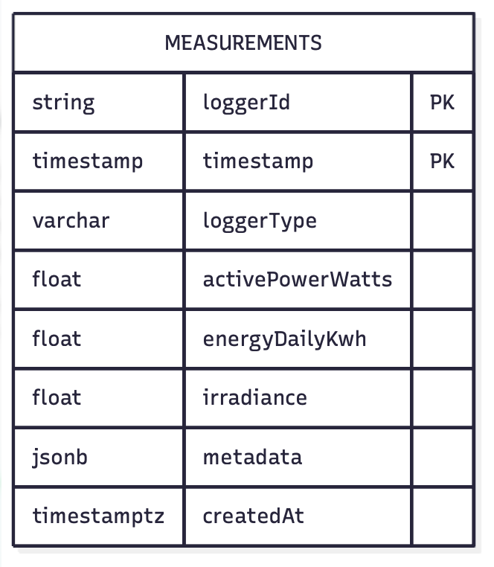
Data Abstraction & Storage
Design Decision: Hybrid Schema.
  Columns: "Golden Metrics" (Power, Energy) for fast SQL aggregation
  JSONB: Metadata column for vendor-specific quirks
MVP Implementation: Synchronous processing with `AsyncGenerator` (memory efficient)
Future Improvement: Message Queue (RabbitMQ/BullMQ) for asynchronous bulk processing

Slide 13
4. The AI Agent (LangGraph)

Slide 14
Orchestration vs. Chatbot
The Concept: Deterministic Graphs over probabilistic chaos
Structure:
  Explicit Flows: Morning Briefing, Financial Report (Strict steps)
  Free Chat: LLM Loop (Flexible fallback)

Slide 15
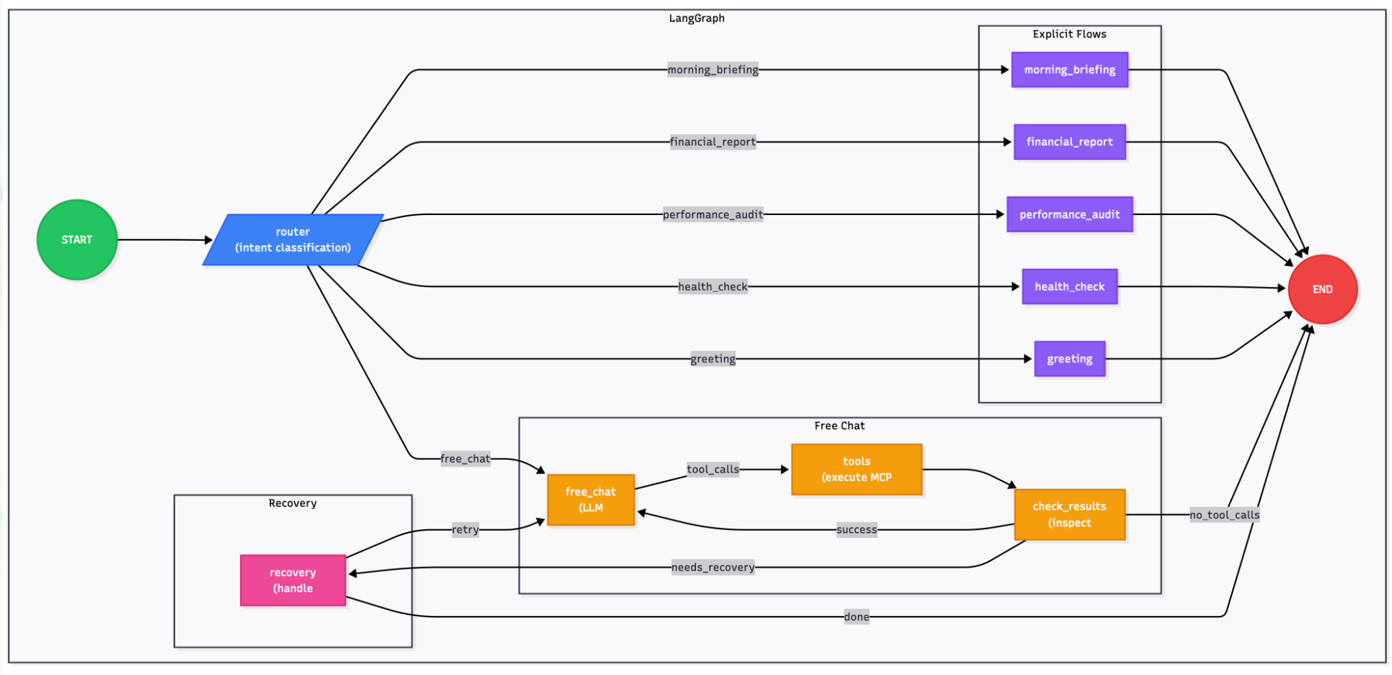
Orchestration vs. Chatbot

Slide 16
Intelligent Routing
Optimization: Two-Tier Classification
Regex (Tier 1): Zero latency for greetings/patterns
LLM (Tier 2): Semantic understanding for complex intents
Benefit: Reduces cost and latency; increases reliability

Slide 17
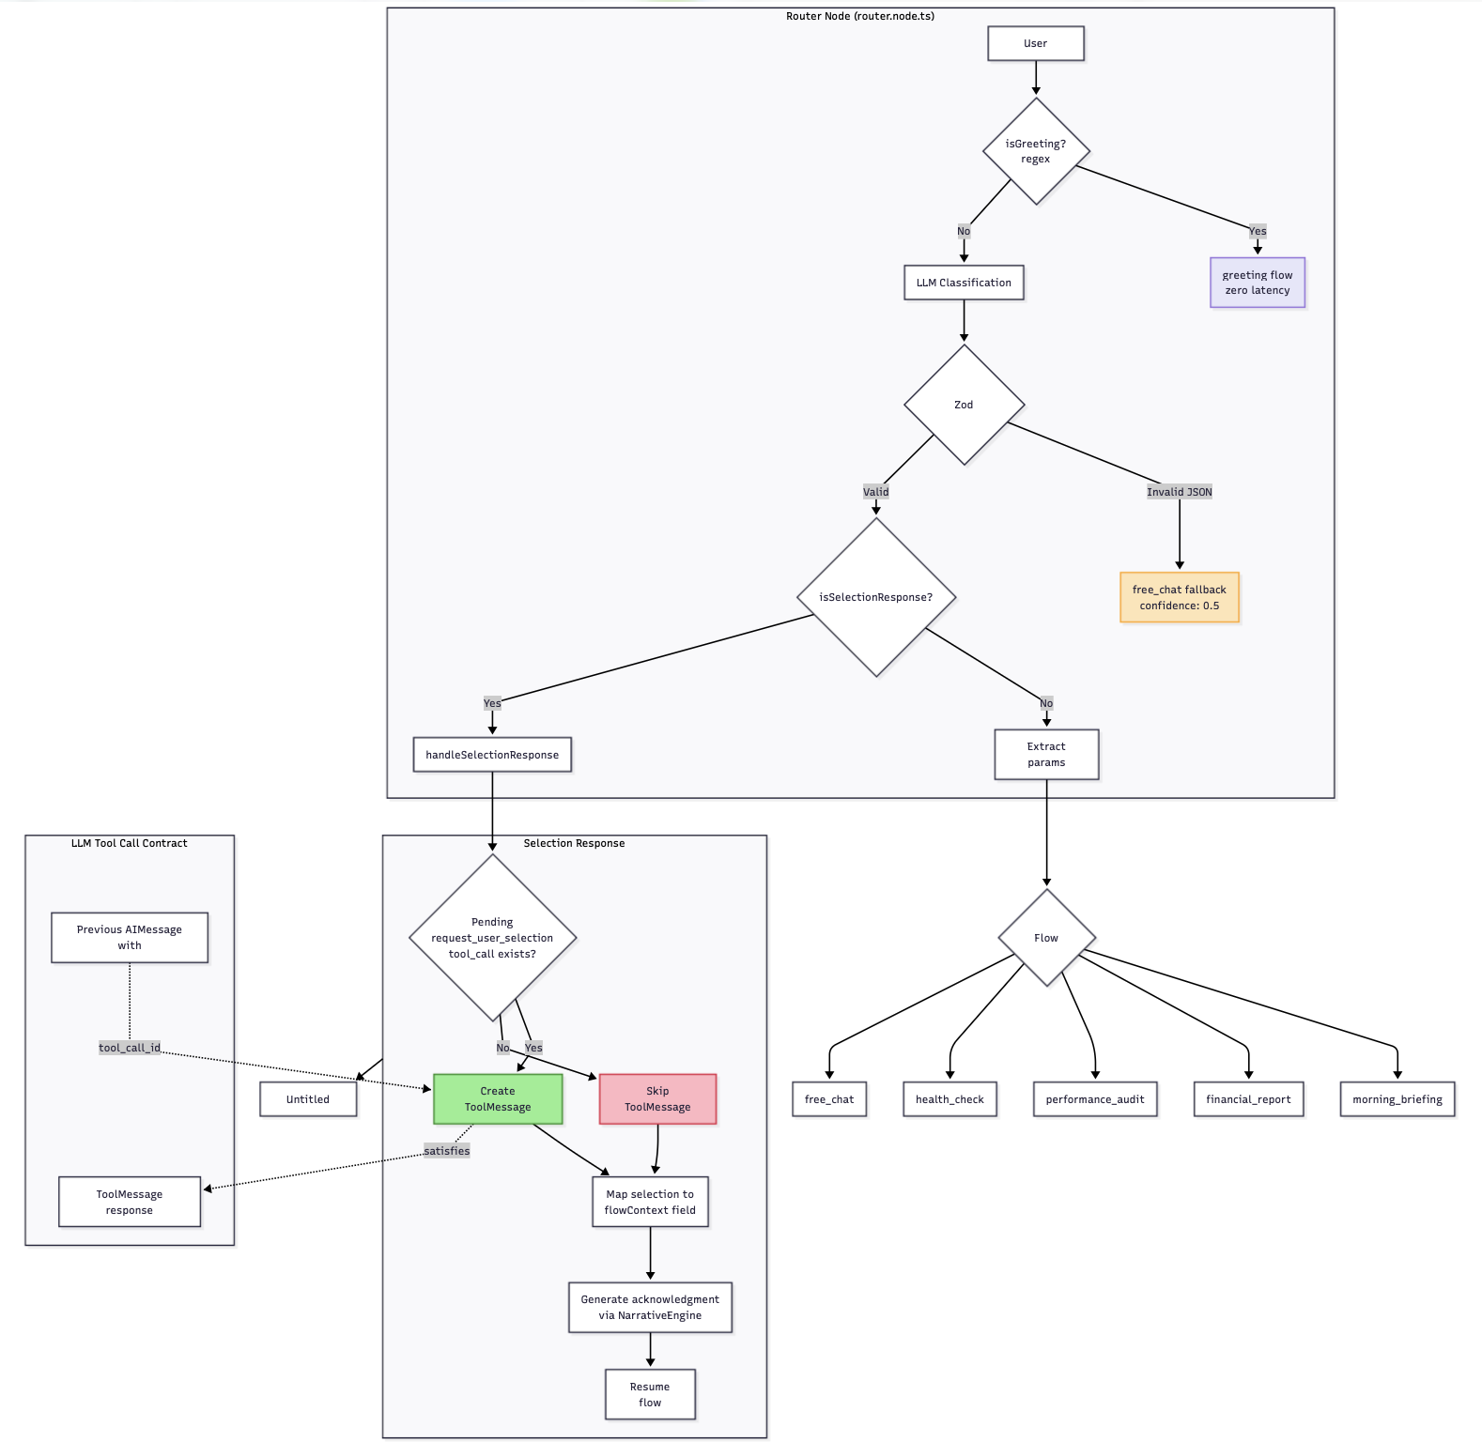
Intelligent Routing

Slide 18
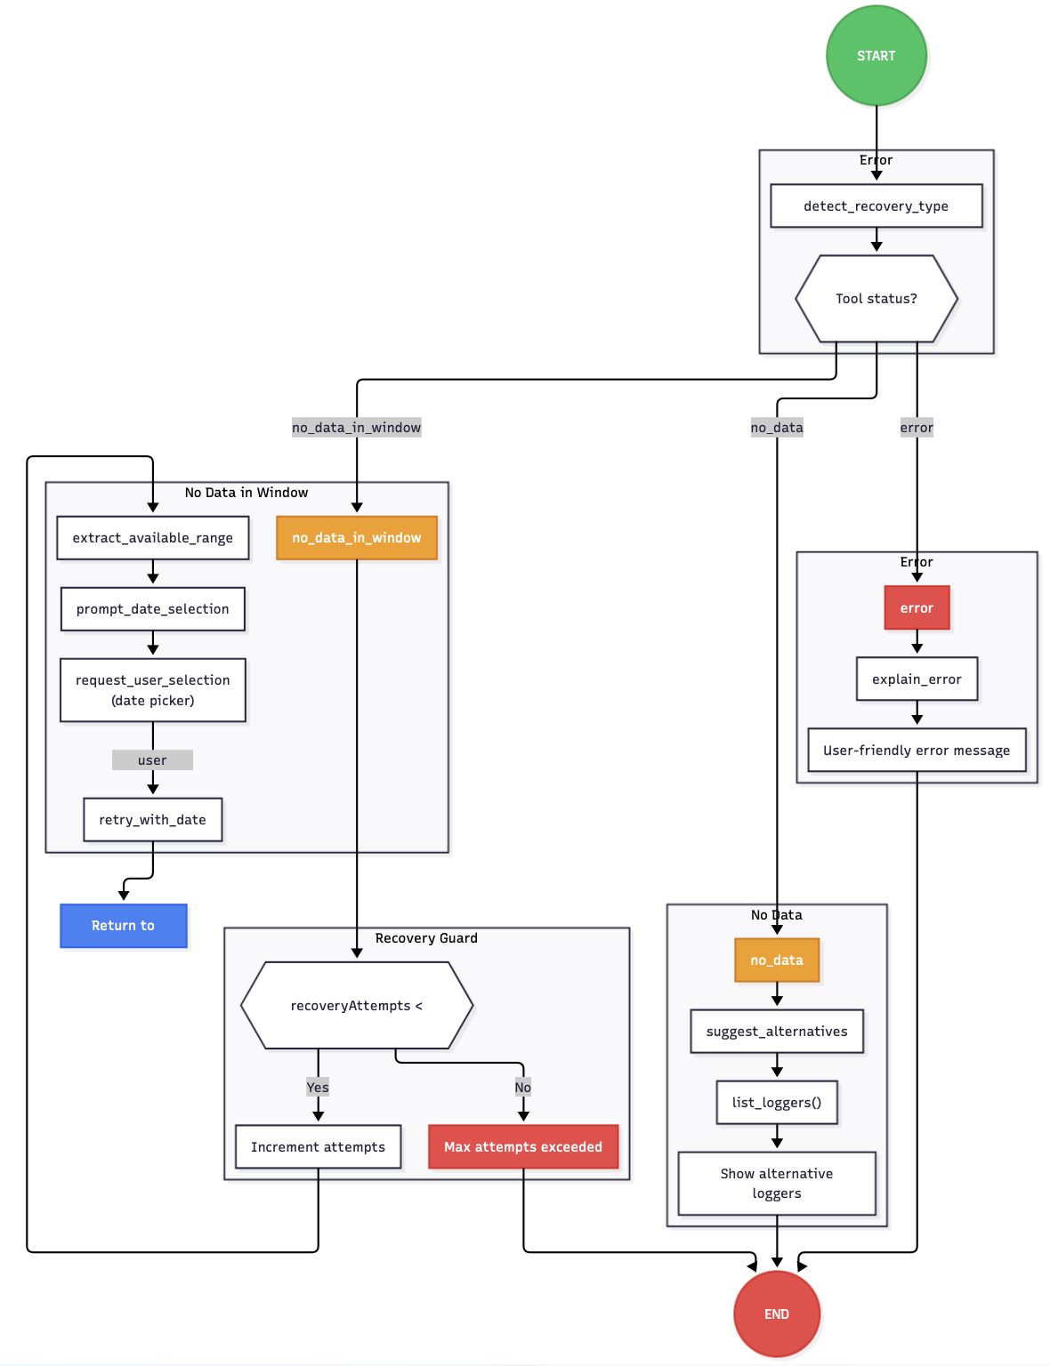
Resilience & Recovery
The Problem: LLMs hallucinate when data is missing
The Solution: Standardized Tool Status Codes (`no_data_in_window`, `error`)
  Agent triggers Interactive Recovery (e.g., rendering a Date Picker)
  Prevents "I don't know" dead-ends

Slide 19
5. AI-First User Experience

Slide 20
The "Glass Box" Approach
Philosophy: Don't hide the work. Show the user what the AI is doing.
Tool Categories:
  Hidden: Heavy math/data fetching (shown as status indicators)
  Visible: Charts, Selection Prompts, Reports (Rendered Inline)

Slide 21
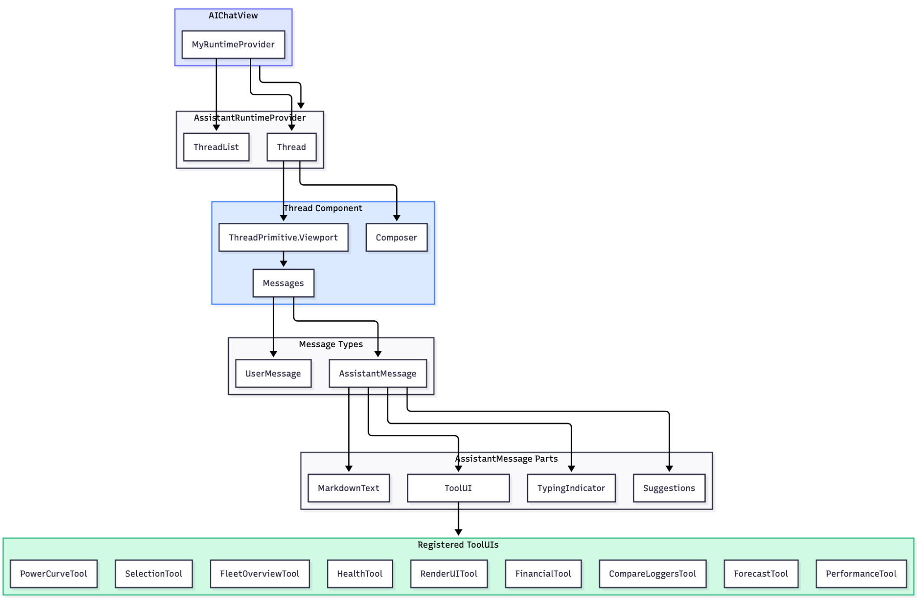

Slide 22
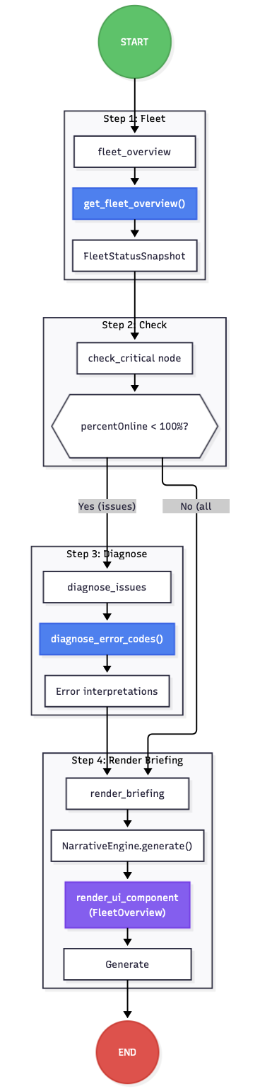
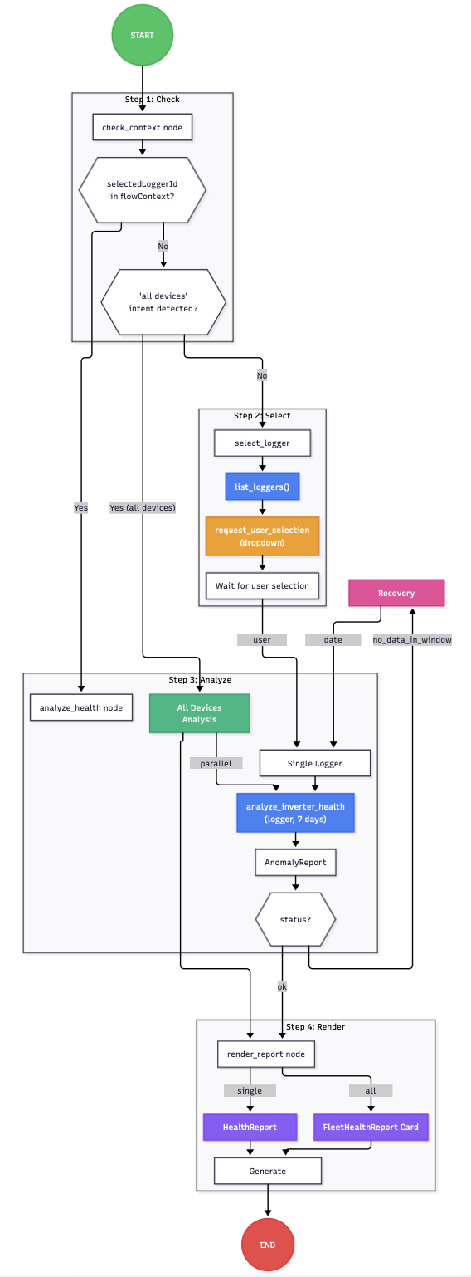
Explicit Flows UX
Morning Briefing
Health Check

Slide 23
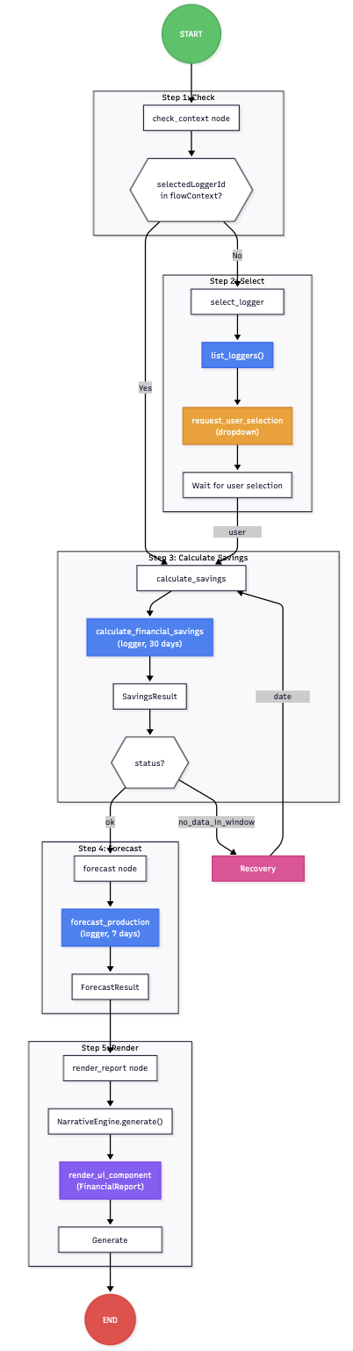
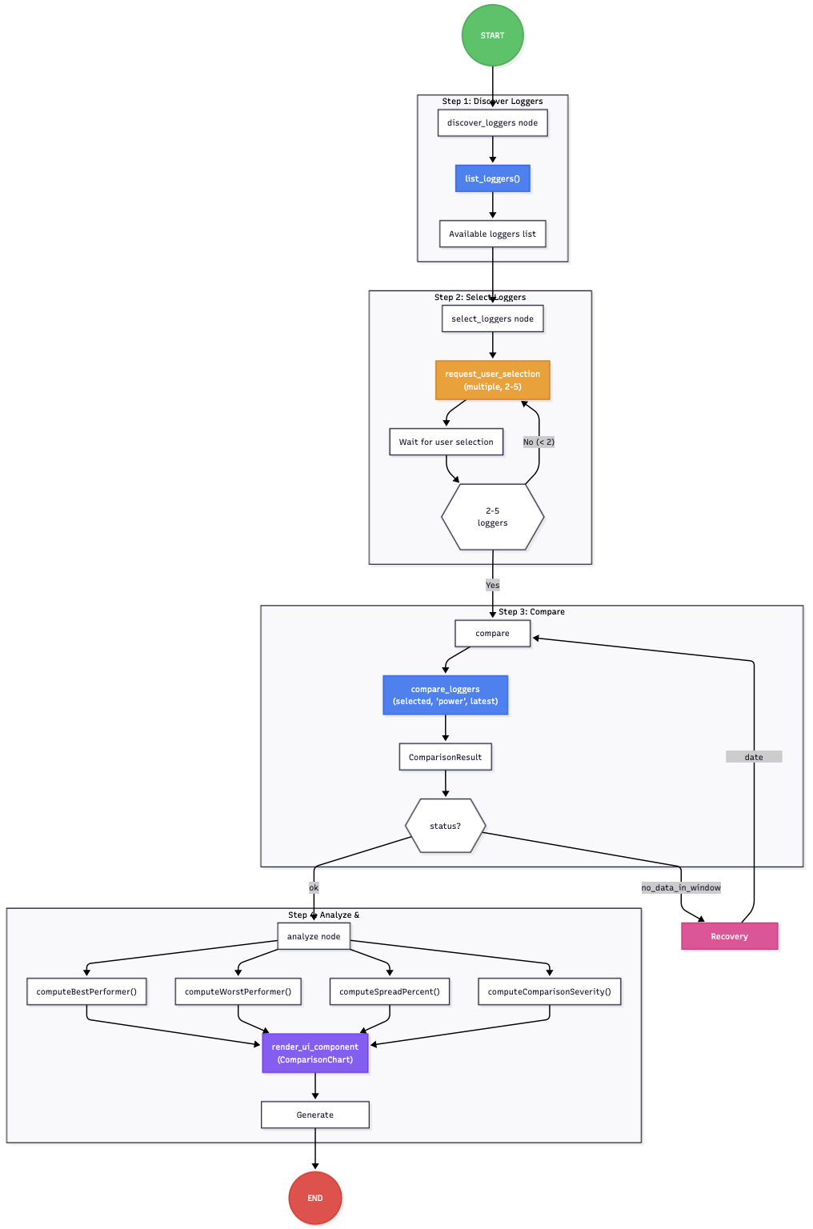
Explicit Flows UX
3. Financial Report
4. Performance Audit

Slide 24
6. Demo

Slide 25
Explicit Flows UX
Demo Checklist:
Ingest "messy" folder
Run "Morning Briefing" (See the graph action)
Trigger Error Recovery (Date Selection)
4. Perform "Performance Audit" (Multi-logger comparison)

Slide 26
7. Learnings

Slide 27
Learnings: Technologies & Workflow
Acceleration: Used Claude Code & MCP for rapid API integration
Quality: SonarQube for code quality checks
Flexibility: System supports swapping providers (Gemini, OpenAI, Ollama/Local) via simple ENV vars

Slide 28
7. Q&A

Slide 29
Thank you !
(and Q&A)

