Slide 1
Interview Trainer Agent Using IBM Agentic AI and Granite LLM
CAPSTONE PROJECT
Presented By:
Amrutha Sindhu Thota
Sri Vasavi Engineering College(Department of CAI)

Slide 2
OUTLINE
Problem Statement
Proposed System/Solution
System Development Approach
Algorithm & Deployment
Result (Output Image)
Conclusion
Future Scope
References

Slide 3
Problem Statement
Preparing for job interviews is often challenging due to the lack of role-specific practice and structured feedback. Candidates struggle to find relevant technical and HR questions tailored to their job title and experience level. Manual preparation is time-consuming and may not reflect current industry expectations. There is a need for an intelligent system that can simulate interview scenarios and provide improvement tips. This project aims to solve this by developing an AI-driven Interview Trainer Agent using IBM Watsonx and Granite LLM..
.

Slide 4
Proposed Solution
This project proposes an AI-powered Interview Trainer Agent built using IBM Watsonx.ai Agent Lab and the Granite-3-3-8b-instruct foundation model.
The agent accepts user input in the form of job title and experience level (e.g., “Java Developer, Fresher”).
Based on the input, the agent dynamically generates:
- 5 technical interview questions
- 3 HR/behavioral questions
- Short model answers
- Personalized improvement tips
The agent is developed using a structured prompt and tested through the Agent Lab Preview, providing reliable results without external tools.
This system helps users improve their interview skills with role-specific, AI-generated guidance.

Slide 5
System Approach
System requirements:
IBM Cloud Account
Watsonx.ai Studio Access
Web Browser
Stable Internet Connection
Library required to build the model
Granite-3-3-8b-instruct – IBM Foundation Model used for generating outputs
Watsonx Runtime – To host the model and manage deployments
Tooling (optional): Wikipedia Search, Goole Search
Watsonx.ai Agent Lab – To build and test the AI agent

Slide 6
Algorithm & Deployment
Working Algorithm (Agent Logic)&Deployment:
Input Collection User enters their job title and experience level.
Prompt Execution Granite foundation model processes the input using a structured agent prompt.
Dynamic Output Generation Agent generates:
5 technical interview questions
3 HR/behavioral questions
Sample answers
Improvement tips
Created a Deployment Space in IBM Watsonx
Promoted the agent from Agent Lab to Deployment Space
Attempted deployment via Watsonx Runtime

Slide 7
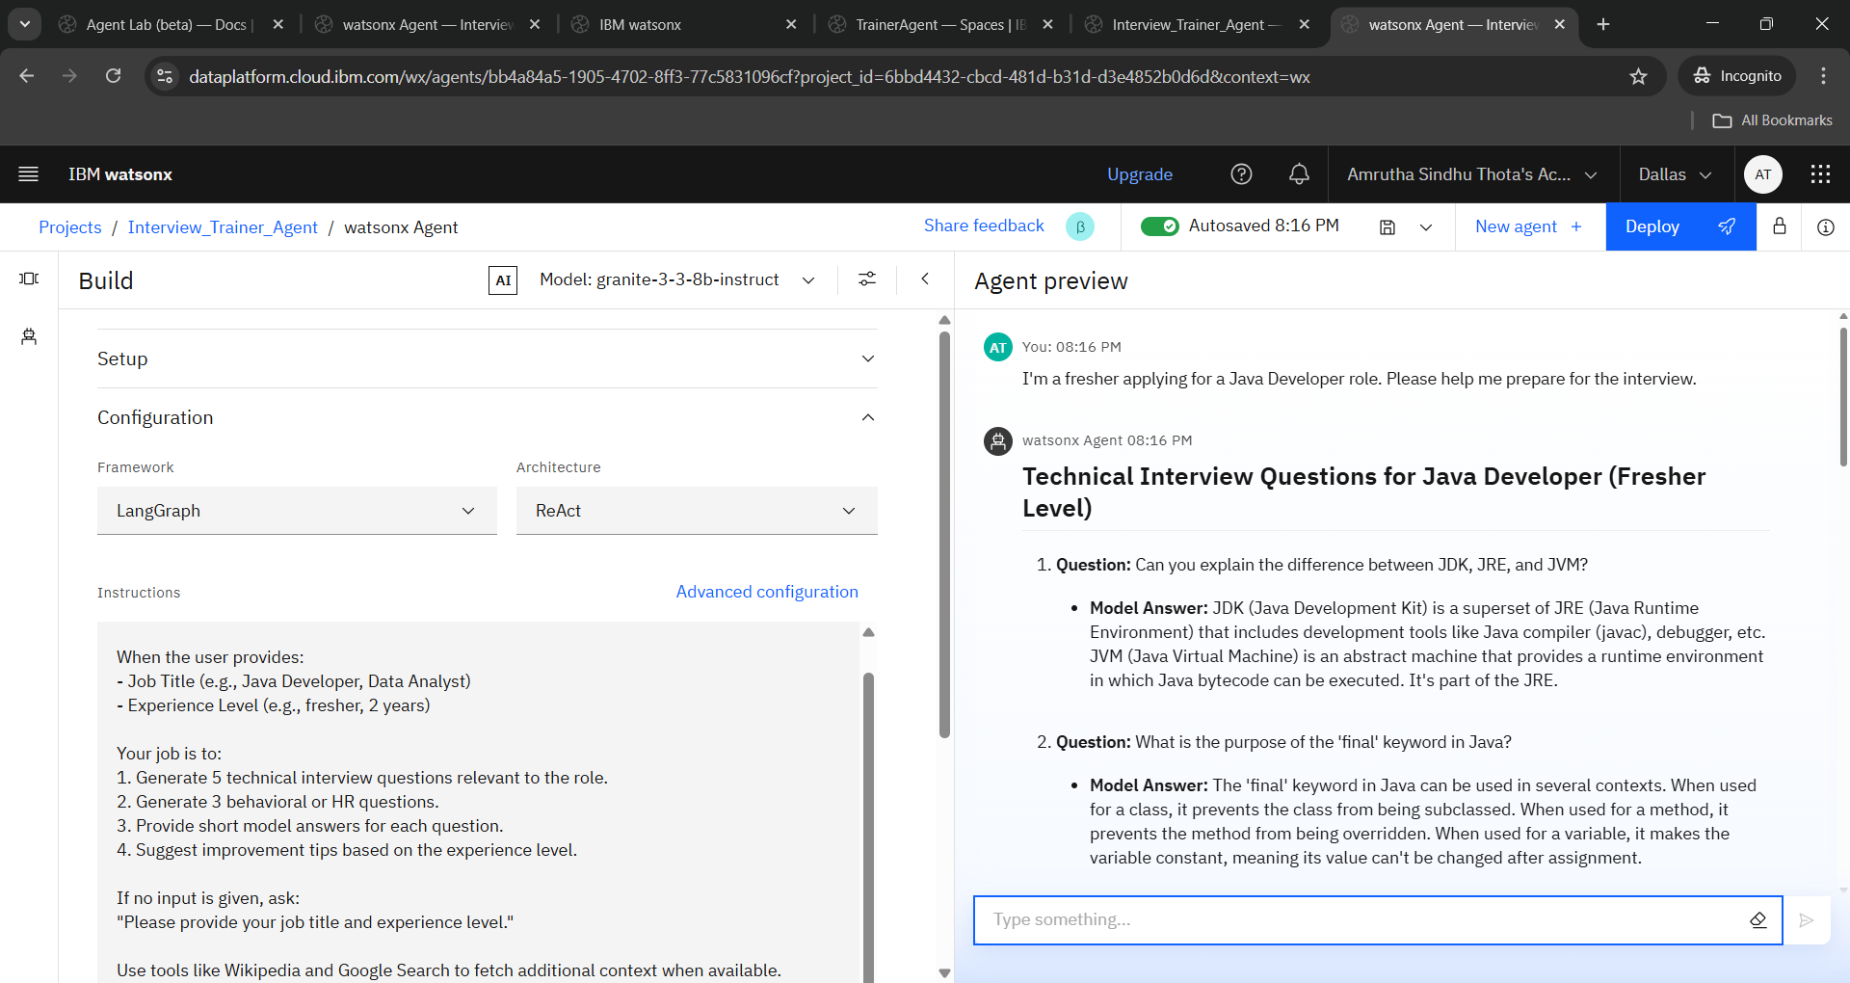
Result

Slide 8
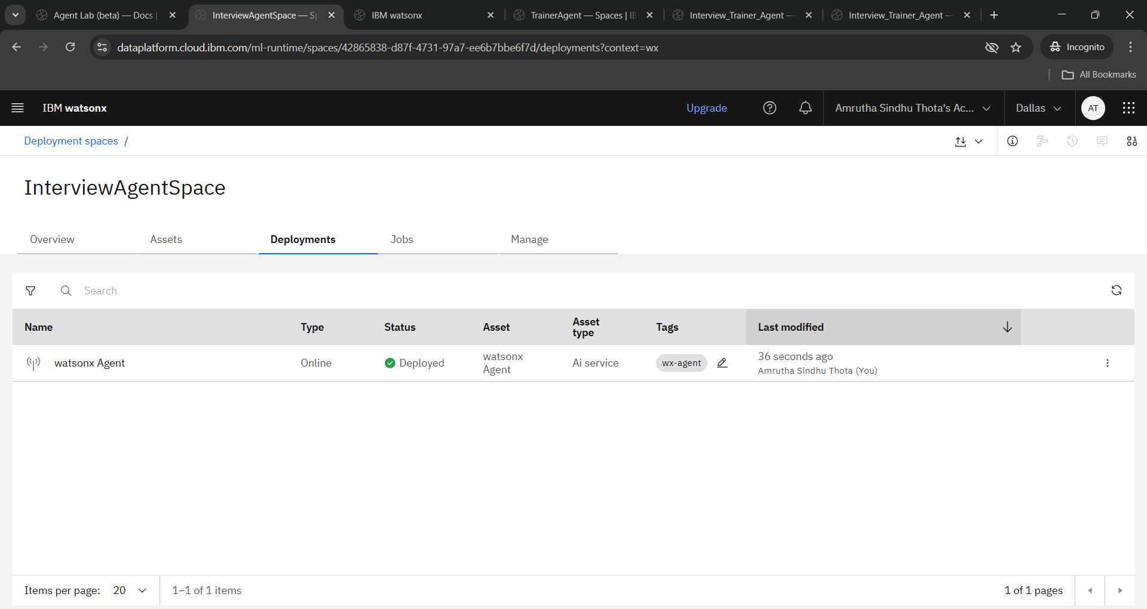

Slide 9
Conclusion
This project successfully demonstrates the development of an AI-powered Interview Trainer Agent using IBM Watsonx.ai and the Granite-3-3-8b-instruct foundation model. The agent is capable of generating role-specific technical and HR interview questions, along with model answers and personalized improvement tips, based on the user's job title and experience level. By leveraging Watsonx Agent Lab, the solution provides a no-code environment for building and testing intelligent agents. Although full deployment faced limitations due to tool inference issues in the free tier, the agent was thoroughly tested and validated using the Agent Lab Preview. Overall, the project offers an effective and interactive interview preparation tool that enhances user confidence and readiness.

Slide 10
The Interview Trainer Agent can be further enhanced by integrating real-time resume parsing to automatically extract user skills and experience. Future versions could support voice-based interactions for mock interview simulations and feedback. Additionally, the system can be extended to include score-based evaluations, providing users with performance ratings and detailed feedback. Integration with platforms like LinkedIn, Naukri, or college placement portals would allow broader accessibility. Finally, advanced models or multi-agent setups can be used to simulate panel interviews or domain-specific interview flows..
Future scope

Slide 11
References
1. Retrieval-Augmented Generation for Knowledge-Intensive NLP Tasks
Authors: Patrick Lewis, Ethan Perez, Aleksandra Piktus, et al. Published in: NeurIPS 2020 Abstract: Introduces RAG (Retrieval-Augmented Generation), combining neural generation with retrieval to improve factual accuracy. DOI: 10.48550/arXiv.2005.11401
2. Toolformer: Language Models Can Teach Themselves to Use Tools
Authors: Timo Schick, Jane Dwivedi-Yu, Roberta Raileanu, et al. Published by: Meta AI (2023) Abstract: Demonstrates how LLMs can autonomously learn when and how to use external tools (search, calculator, etc.), similar to Agentic AI logic. DOI: 10.48550/arXiv.2302.04761
3. AutoGPT and Agentic AI: Creating Autonomous AI Agents
Platform: arXiv Preprint (Emerging area, no formal authorship) Usefulness: Explores how LLMs can operate in agent-based workflows — exactly like IBM Agent Lab's goal. DOI: 10.48550/arXiv.2304.03442

Slide 12
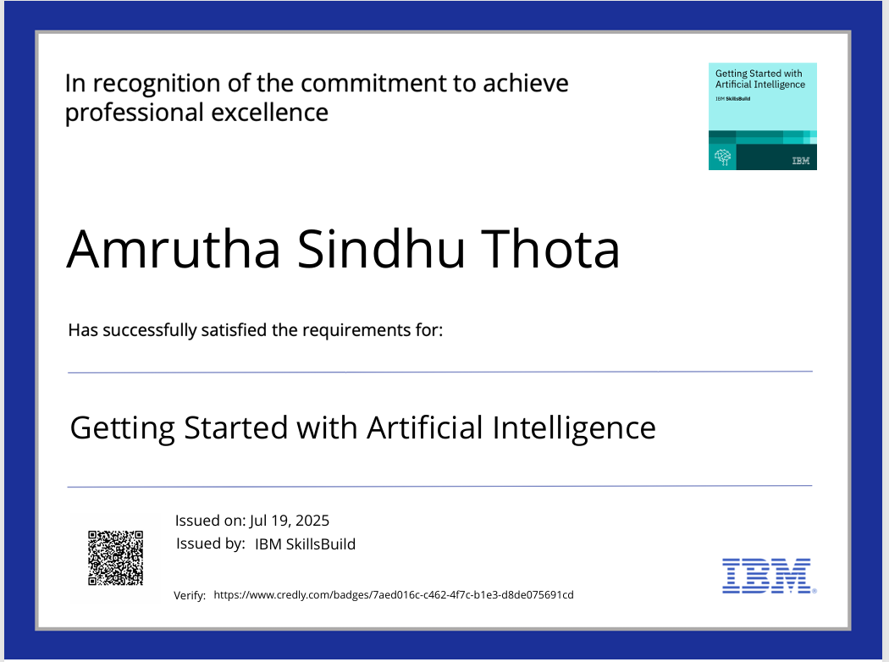
IBM Certifications

Slide 13

IBM Certifications

Slide 14
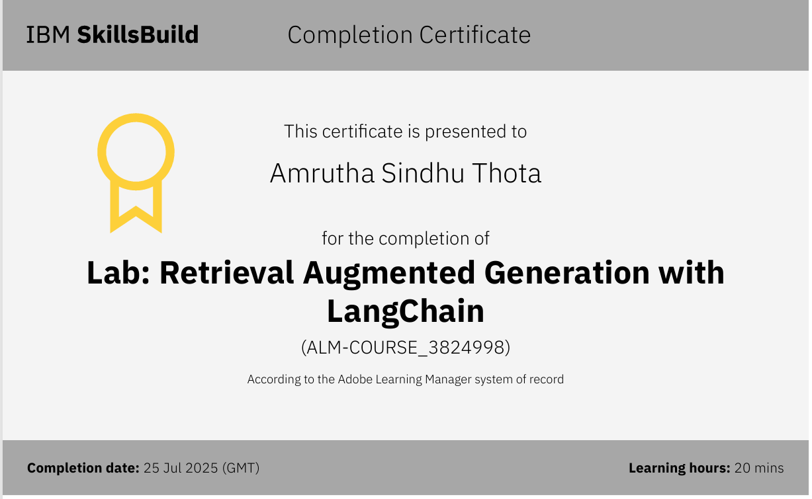
IBM Certifications

Slide 15
THANK YOU

