Slide 1

DATA ANALYSIS ON
AMCAT Analysis

Slide 2
About Me
Name: Thota Chandra Sekhar
Education : Bachelor of Science degree in both Computer Science and Statistics
Any work experience: Fresher
LinkedIn : https://www.linkedin.com/in/thota-chandra-sekhar/
Git Hub : https://github.com/Thotachandrasekhar1

Slide 3
Problem Statement:
Analyse AMCAT test data to identify candidate performance trends, pinpoint strengths and weaknesses, and explore correlations with job success. Optimize the use of AMCAT scores in the hiring process for more effective candidate selection.
Objective of the Project:
Analyse AMCAT test data to identify candidate performance trends, pinpoint strengths and weaknesses, and explore correlations with job success. Optimize the use of AMCAT scores in the hiring process for more effective candidate selection.

Slide 4
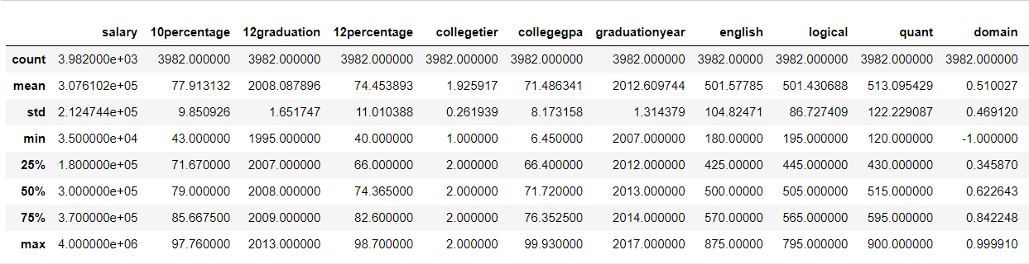
Statistical Analysis(Non-Viz) :

Slide 5
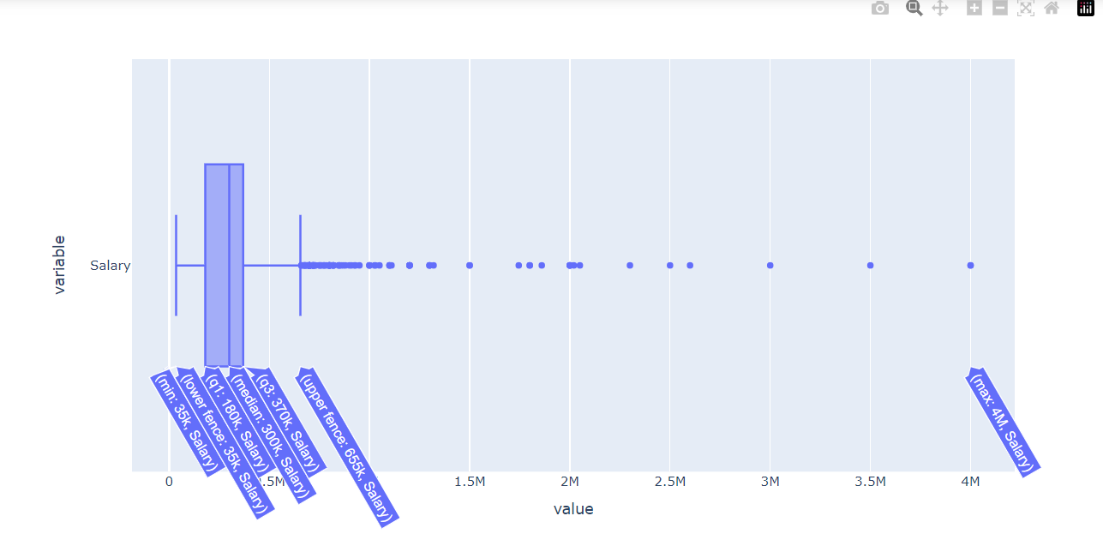
Univariate Analysis :
- Most of the salaries range between 180000 to 370000.
- The highest salary is 4000000

Slide 6
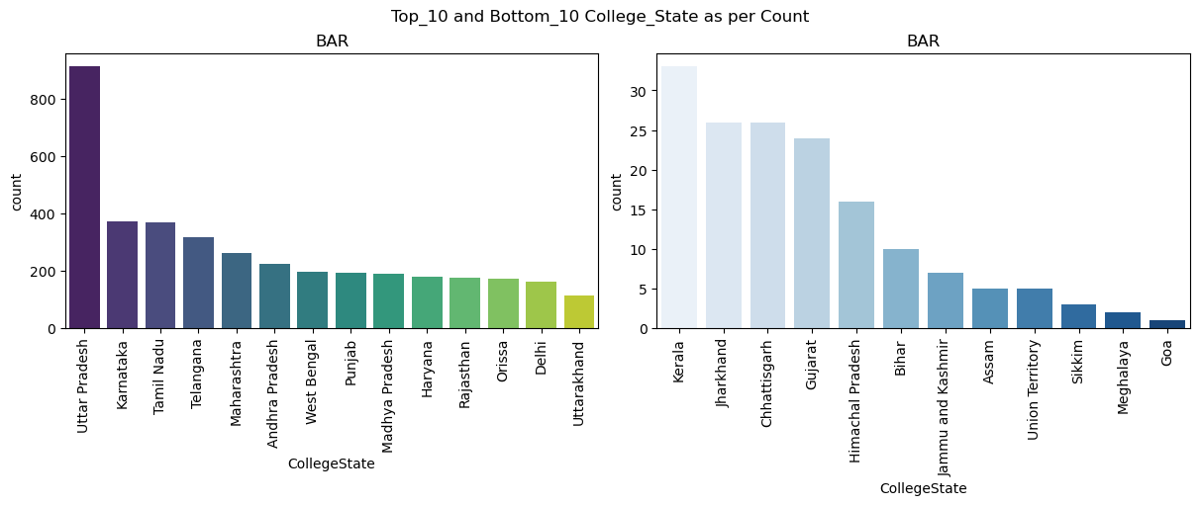
Approximately 50% of candidates have done their graduation from 4 states, with 1/4th of total candidates from Uttar pradesh..

Slide 7
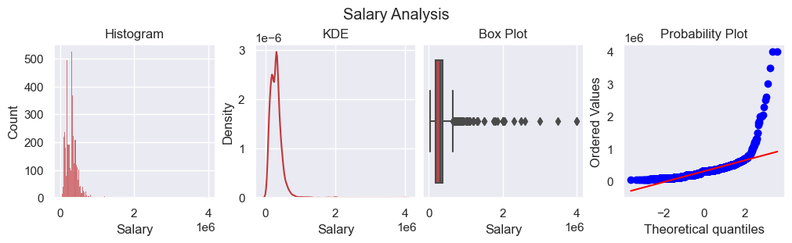
As salary is True data outliers are retained. Salary is not normally distributed, it is right skewed, which tell that there are candidates earning high income per annum.

Slide 8
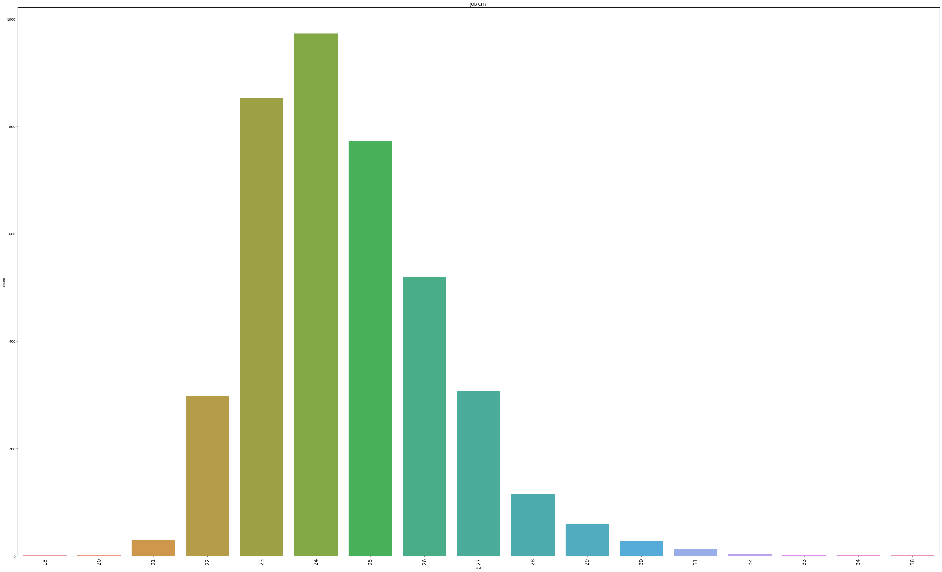
- Most of the ages range between 22 to 27.
- The 24 years of age is more.

Slide 9

THANK YOU

