Slide 1


IPL Winning Team Prediction
Thota Chandra Sekhar

Slide 2
About me
Name :- Thota Chandra Sekhar
Batch :- Ai Elite-16
Qualification :- Bachelor of Science (Statistics)
Why Data Science ?
LinkedIn :- https://www.linkedin.com/in/thota-chandra-sekhar/
GitHub :- https://github.com/Thotachandrasekhar1
With a BSc in statistics, moving into data science opens up a world of professional opportunities. You may use your solid statistical education to solve challenging real-world issues. Data science offers a great way to maximize your skills and make meaningful contributions in the data-driven world because of its high demand, multidisciplinary appeal, and chances for lifelong learning.

Slide 3
Machine Learning Project Description
Titles | Description
Project Title | IPL Winning Team Prediction
Project Domain | Sports Analysis
Type of Machine Learning | Supervised Machine Learning
Type of Problem | Classification Problem
Project Methodology | CRISP ML-Q Methodology
Project Deployment | Streamlit

Slide 4
Workflow based on CRISP ML-Q methodology
Business problem understanding
Data collection and understanding
Data Preparation
Exploratory data analysis
Data cleaning
Feature Engineering
Machine leaning model building
Machine learning model evaluation
Machine learning model deployment using streamlit

Slide 5
Business Problem:
The business problem for IPL winning team prediction involves developing accurate models that utilize historical match data, player statistics, and various contextual factors to forecast match outcomes and determine the most likely winning team in upcoming IPL matches. This aims to provide valuable insights to teams, coaches, and stakeholders, aiding in strategic decision-making, team selection, and resource allocation to maximize their chances of success in the tournament and capitalize on the lucrative opportunities associated with winning the IPL..
Objectives:
This project is to develop a Random forest predictive model for IPL winning team prediction, leveraging historical match data and player statistics. This model aims to accurately forecast match outcomes for upcoming IPL matches, providing valuable insights to teams, coaches, and stakeholders to inform strategic decisions and maximize their chances of success in the tournament. Through comprehensive data analysis, model training, and evaluation, the objective is to create a reliable tool that enhances the competitive advantage of IPL teams and enables them to capitalize on the dynamic and highly competitive nature of the tournament.

Slide 6
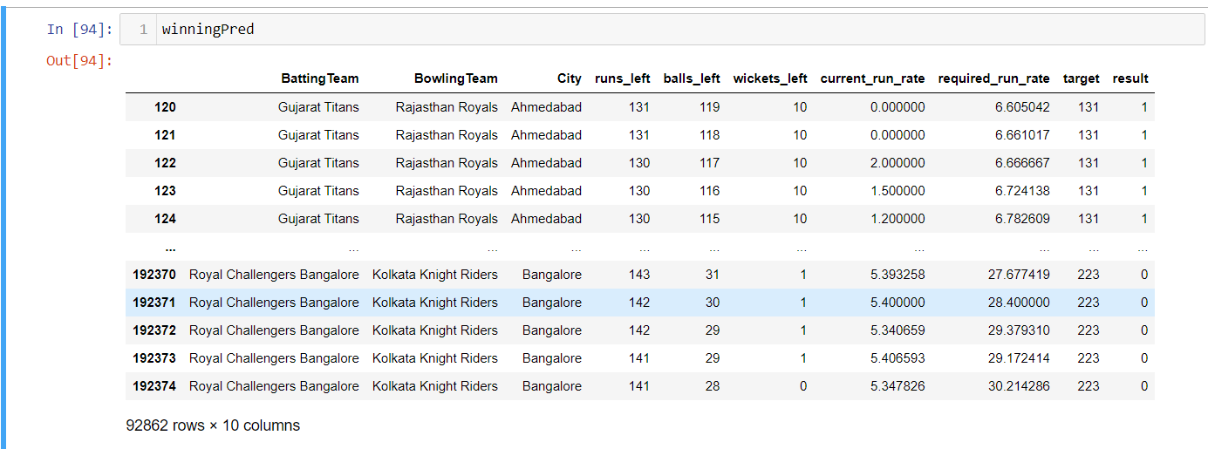
Summary Of the Data and Understanding
A more thorough analysis of the dataset's characteristics, including its statistical makeup and any possible ramifications for data science projects, is necessary to fully comprehend the data. Understanding of concepts like characteristics, statistical summary, possible preprocessing processes, and insights from the analysis are covered in detail in this part.
A more thorough analysis of the dataset's characteristics, including its statistical makeup and any possible ramifications for data science projects, is necessary to fully comprehend the data
Understanding of concepts like characteristics, statistical summary, possible preprocessing processes, and insights from the analysis are covered in detail in this part.

Slide 7
Dataset’s Features Description
I have collected data from powerful data collection source known as Kaggle. Dataset contains 92862 records and 10 features.
Features involved:-
Batting Team:- After Toss According to the decision by toss winning team Batting Team will be decided.
Bowling Team:- After Toss According to the decision by toss winning team Bowling Team will be decided.
City:- According to the match stadium will be decided in the city.
Runs left:- According to Innings-2 the runs left from the target.
Balls left:- According to Innings-2 the balls left according to remaining Overs.
Wickets left:- According to the Innings-2 the wickets left according to Batters.
Current Run Rate:- According to the innings the current run rate.
Required Run Rate :- According to the Innings-2 the required run rate.
Target :- Targeted runs according to First Innings.
Result(Output) :- The Target Variable was result according to the dataset ,it is the Winning Team .

Slide 8
Data Preparation
Exploratory data analysis:-
S No | Type | Feature Names | Observation
1 | Missing Values | City, Margin, method | The dataset carefully examine and found to contain 51,14,927 missing values. These completeness ensure accurate and reliable analysis.
2 | Duplicates | NA | The dataset reveals no instances of duplicates records. Its reliability for analytical purpose.
3 | Outliers | All features | It has been identified, Outliers is not exist in each feature.
4 | Distributions | Bar Plot used for Player of Match, Runs, Wickets | This Bar plot help me to identify Number of runs and wickets scored by different players and they get Player of Match.
5 | Distributions | Count plot used for player of the match | Analysis on status of the player according to his bowling and batting.
6 | Relationships | Between input and input features | Scatter Plot reveals that the relation ship between the input features and input are dependent.

Slide 9
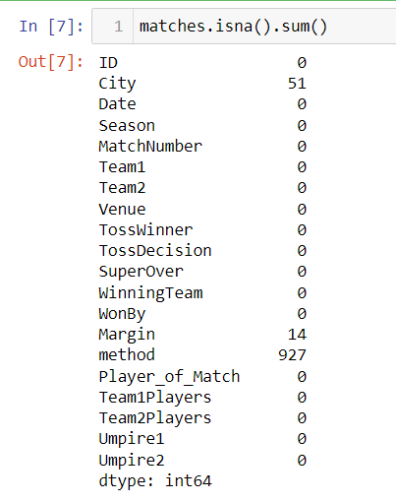
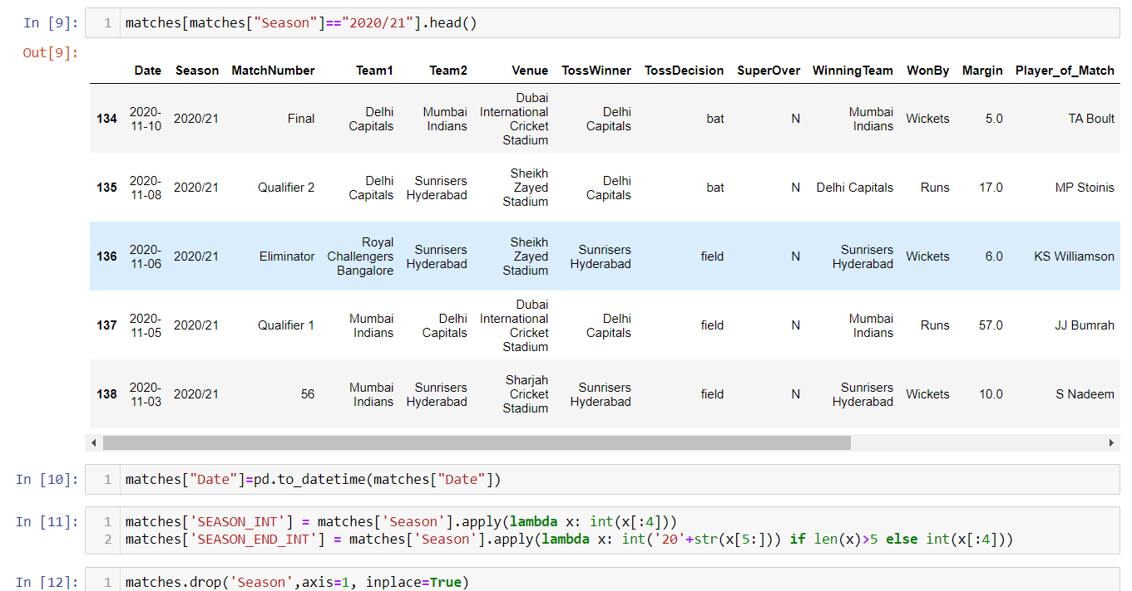
b) Data Cleaning:
Data cleaning involves crucial steps for better analysis and accurately performing machine learning model. Data cleaning contains missing values treatment, outliers treatment, duplicates record treatment , normalization, scaling, encoding etc. In this case, I found some treatment that should be done, I have performed encoding for the result column(target variables) and the missing values columns are unwanted columns of the usage so we remove the columns and we did Type casting for Date column.
c) Feature Engineering:
I have performed different feature engineering techniques such as variance score, variance threshold so it reveals there is all feature are important for prediction excepts one .There was only one feature that is not useful for analysis, I dropped that feature 'Unnamed: 0‘, and merge the Data according to the input variables and we select specific columns for the model building.

Slide 10
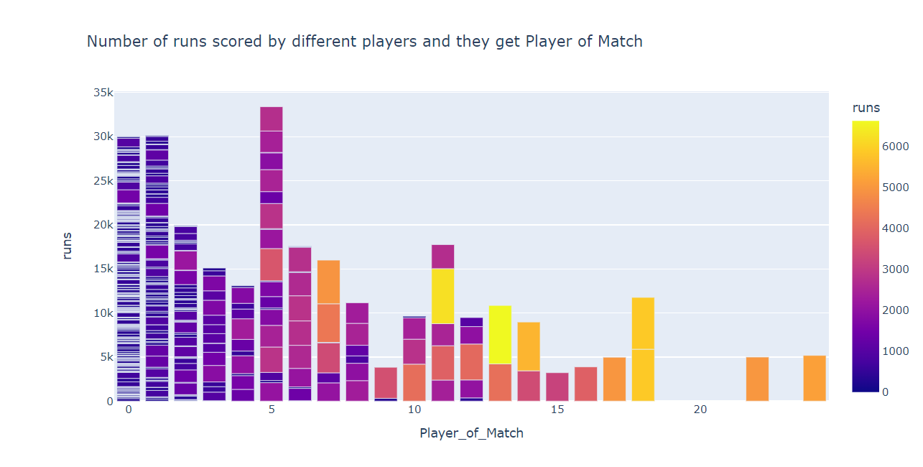
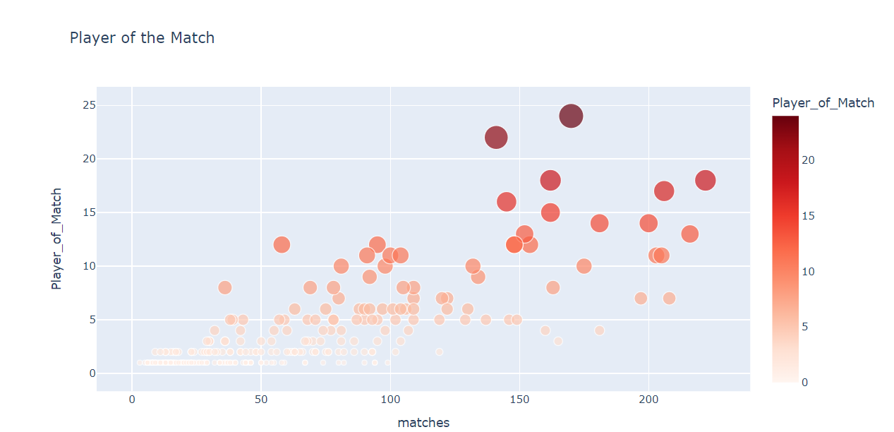
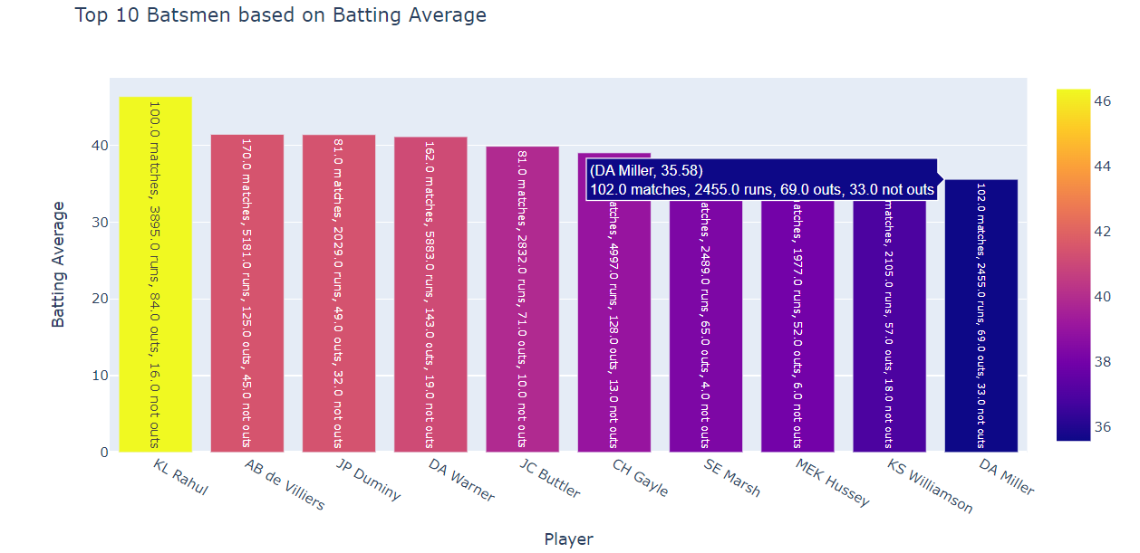
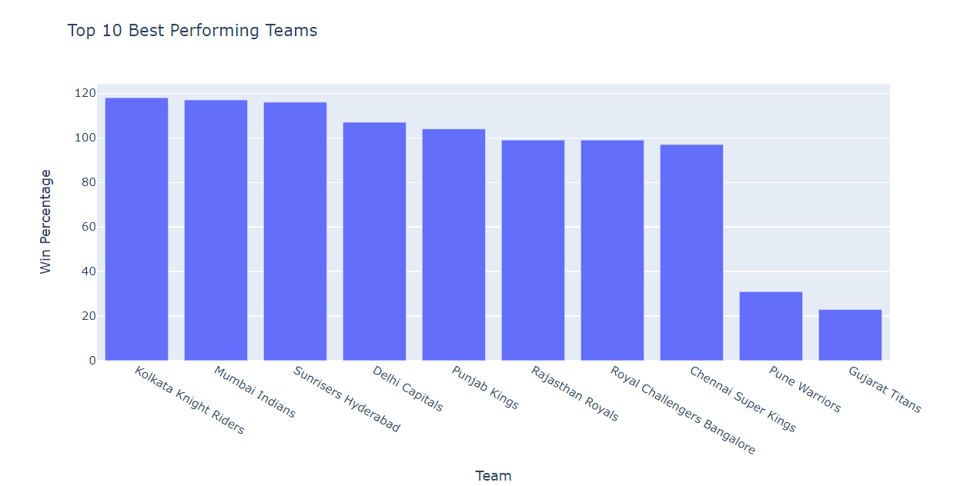
d)Data Visualization:

Slide 11
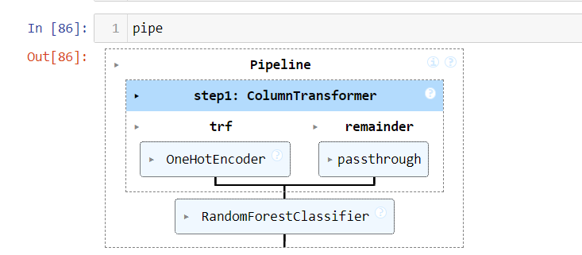
Machine Learning Model Building
Selection of machine learning algorithm is crucial and confusing task, based on my problem statement my data was normally distributed and target is categorical variable, so I have used Random Forest, also I developed pipeline and in that pipeline and based on their performance.
I split the data into x as inputs and y as Output and then split inputs and output into train and test after splitting looks as x_train , x_test , y_train , y_test. Because splitting the data is important thing to build machine learning model.
After splitting I trained my model using x_train and y_train.

Slide 12
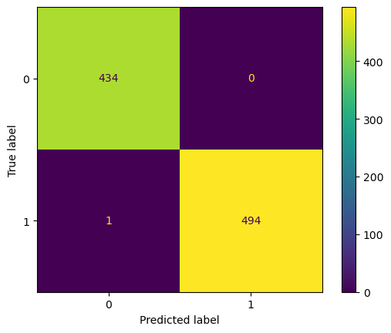
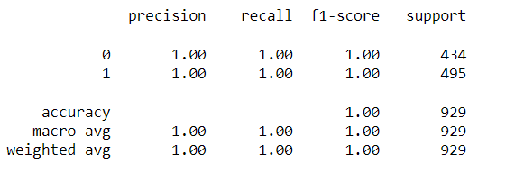
Machine Learning Model Evaluation
In machine learning model evaluation, I used different evaluation matrix such as Accuracy score, F-1 score, Confusion matrix. Accuracy shows how often model is predicting accurately and Confusion matrix shows how much it predicted correctly as well as incorrectly.
We can see in image Random Forest is best performer as per accuracy score.
Confusion Matrix:-

Slide 13
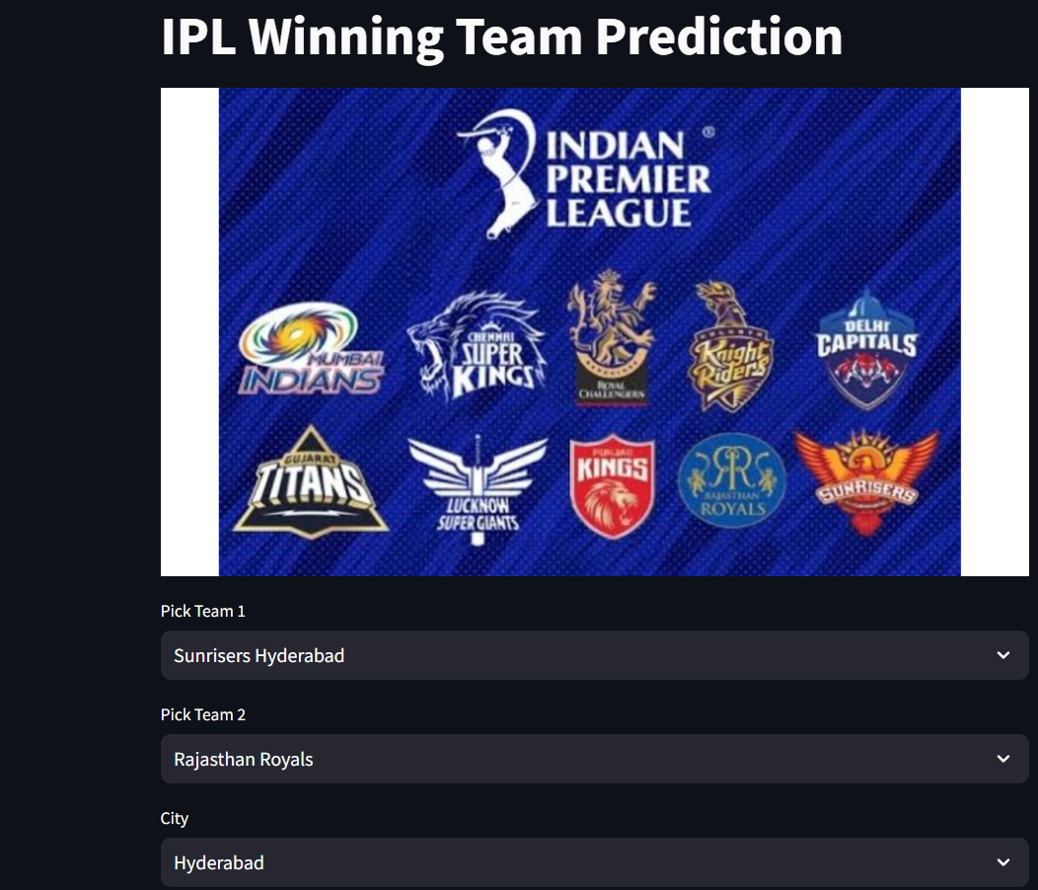
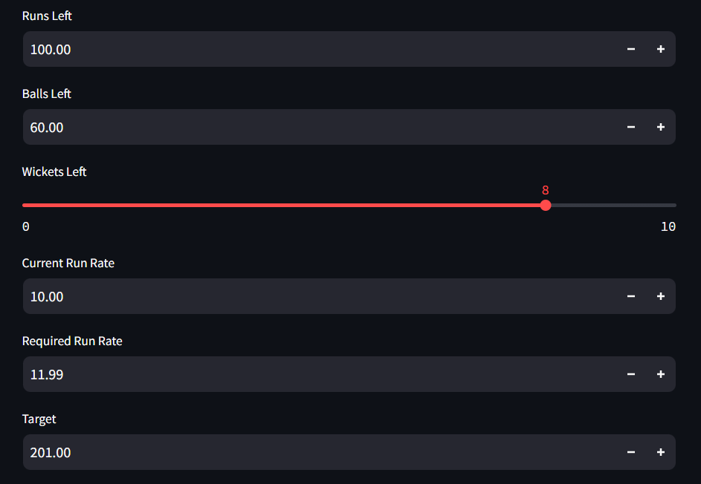
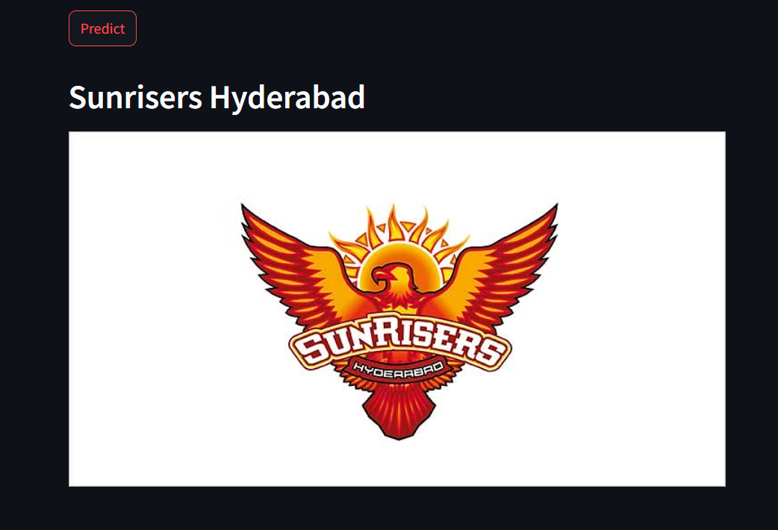
Machine Learning Model Deployment

Slide 14
Application of Prediction Web Application
This web application can be used to identify the Winning team based on the Probability of the model.
The another use of this web application is it can be used to find the man of the match.
This web application can be used to analyze (or) predict the required run rate (or) to find projected score according to Overs.
Conclusion
In conclusion, journey through the analysis and model development of personality dataset with Random forest has been insightful and productive. I understand the problem statements, and I collect the data and understand that data to perform better analysis and prepare the data perform necessary data cleaning steps.
In modeling I chosen Random Forest Algorithm based on its performance over others, Evaluate the machine learning model based on different evaluation matrix. I chosen that model that are predicting perfect with correctly predictions, after this I successfully deploy my web application using streamlit platform, so user can use that application and predict anyone’s personality based on behavior traits.
Machine learning holds significant potential for predicting IPL winning teams by leveraging historical match data, player statistics, and contextual factors. Through advanced algorithms and predictive modeling techniques, teams, coaches, and stakeholders can gain valuable insights to inform strategic decisions, optimize team selection, and maximize their chances of success in the tournament. However, successful prediction requires careful consideration of feature selection, model evaluation, and continuous refinement to account for the dynamic nature of cricket and evolving team dynamics. Overall, machine learning offers a powerful tool for enhancing competitive advantage and capitalizing on the opportunities presented by the IPL tournament.

Slide 15


