Slide 1


Deepfakes: A Review of Creation and Research Trends
Authors: Thota Neha, Napa. Sai Gopi, R. Aarthi (Corresponding Author)
Presented by: Thota Neha
Affiliation: Department of Computer Science and Engineering, Amrita School of Computing, Amrita Vishwa Vidyapeetham, Coimbatore, India.
Conference: ICTIS-2026, Thailand.
Paper ID: 1552

Slide 2

Introduction & Motivation
What are Deepfakes?
Why Does It Matter?
AI-generated synthetic media — images, videos, audio
Term coined in 2017 on Reddit: "Deep Learning" + "Fake"
Powered by advanced deep learning architectures
Deepfake content online has grown 550%+ since 2019.
~98% of online deepfakes involve non-consensual explicit content.
Cybersecurity attacks using deepfakes rose 1,300% annually.
Deepfake market: ~$805M (2023) → projected $6.22B by 2033.
Research Gap:
Detection methods struggle to keep up with generation advances.
This paper: a comprehensive survey of creation, detection & trends.
Notes:
Deepfakes are AI-generated synthetic media - images, videos, or audio that look real but are fake. The term was coined in 2017. Why does this matter? Deepfake content online has grown 550% since 2019. 98% involve non-consensual explicit content. Cybersecurity attacks using deepfakes rose 1,300% annually. The market is growing from $805M in 2023 to projected $6.22B by 2033. Our paper surveys creation methods, detection techniques, and research trends in this rapidly evolving field.

Slide 3
Deepfake Types & Creation Methods
Types of Deepfake Manipulation
Three Core Generation Architectures
Face Swapping — replacing one person's face with another's
Voice Cloning — synthetic speech mimicking real voices
Lip Synchronisation — matching mouth movements to audio
Full Facial Synthesis — entirely AI-generated faces
GANs (Generative Adversarial Networks) → Generator vs Discriminator — iteratively improves realism
Autoencoders → Learn compact facial features → reconstruct/swap identities
Diffusion Models (latest) → Denoising-based generation → higher fidelity, fewer artefacts → Hardest to detect
Notes:
There are four main types of deepfake manipulation: Face swapping replaces one person's face with another. Voice cloning creates synthetic speech mimicking real voices. Lip sync matches mouth movements to audio. Full facial synthesis creates entirely AI-generated faces. These use three core architectures: GANs - where a generator and discriminator compete to improve realism. Autoencoders - which learn facial features and can swap identities. And Diffusion Models - the latest approach that produces higher quality results and is hardest to detect.

Slide 4
Societal Impact & Regulations
Key Abuse Areas:
Privacy violation — non-consensual explicit content; emotional and reputational harm
Political misinformation — fabricated videos of leaders manipulate public opinion and elections; psychological impact can persist after content deletion
Financial fraud and identity theft — deepfake audio and video can impersonate executives or family members; causes fund transfers, data leaks, and global economic risk
Regulatory Response:
India: MeitY issued IT Rules 2021 directives for deepfake removal
CERT-In: Recommends multi-factor authentication and public awareness
IT Rules 2025 Amendment: Mandatory labelling of synthetic media
Global: C2PA framework and blockchain-based media verification
Notes:
Deepfakes pose three major threats. First, privacy violation - non-consensual explicit content causes emotional and reputational harm. Second, political misinformation - fake videos of leaders can manipulate elections and public opinion, with psychological impact lasting even after deletion. Third, financial fraud - deepfake audio and video can impersonate executives or family members to steal funds and data. In response, India's MeitY issued IT Rules 2021 for deepfake removal. CERT-In recommends multi-factor authentication and public awareness. The 2025 IT Rules amendment requires mandatory labelling of synthetic media. Globally, frameworks like C2PA and blockchain-based verification are being developed.

Slide 5
Detection Techniques
1
2
3
Conventional Methods
Deep Learning
Multimodal
Identify visual artefacts, including face boundary inconsistencies, lighting irregularities, and shadow mismatches.
Use CNNs and Transformers to detect patterns that may indicate a deepfake.
Compare audio and video jointly to identify inconsistencies.
Notes:
Detection methods have evolved into three categories. Conventional methods look for visual artefacts like face boundaries, lighting, and shadow mismatches. Deep learning uses CNNs and Transformers to spot patterns indicating deepfakes. Multimodal detection compares audio and video together to check for mismatches. The most effective approach combines multiple modalities.

Slide 6

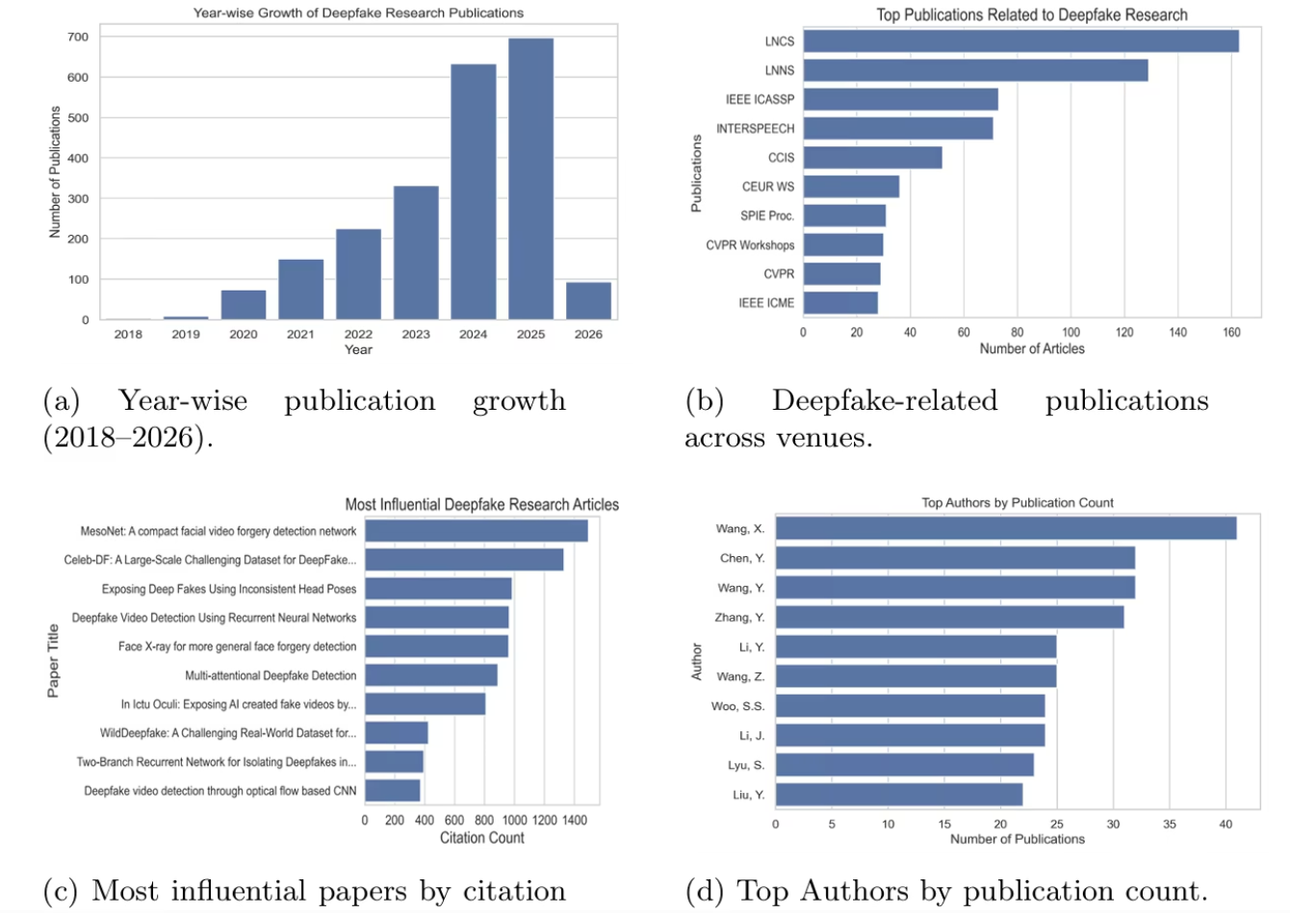
Research Trends (Bibliometric Analysis)
Data Source: Scopus | 2,214 English papers | 2018 – Jan 2026
Publication Growth (Fig. 1a):
2018–2019: ~8 papers (negligible).
2020: ~75 papers.
2025: ~700 papers → 9x growth in 5 years.
Driven by: open-source tools, GAN advances, public concern.
Top Publication Venues (Fig. 1b):
LNCS (163), LNNS (130), IEEE ICASSP (73), INTERSPEECH (71).
Most Cited Papers (Fig. 1c):
Top Authors (Fig. 1d):
MesoNet (1,450 citations) | Celeb-DF (1,350 citations).
Mid-tier: Head pose, recurrent, and face X-ray (~975 each).
Wang, X. (41 papers) | Chen, Y. & Wang, Y. (32 each).
Notes:
Our bibliometric analysis examined 2,214 papers from Scopus between 2018 and January 2026. Publication growth shows the field's explosive expansion - from negligible papers in 2018-2019, to 75 in 2020, to 700 in 2025. That's 9x growth in just 5 years. This growth is driven by open-source tools, GAN advances, and growing public concern. Top venues include LNCS, LNNS, IEEE ICASSP, and INTERSPEECH. The most cited papers are MesoNet and Celeb-DF, which introduced benchmark datasets and foundational detection methods. Leading authors like Wang, X. have published 41 papers, showing concentrated expertise in the field.

Slide 7
Future Research Directions
Current Limitations
Future Research Priorities
Existing datasets have demographic imbalance, affecting detection model fairness.
Diffusion-based synthesis has outpaced most detection methods.
Generalization remains limited across platforms, modalities, and unseen manipulation techniques.
Better detection for diffusion-generated synthetic media.
Multimodal deepfake detection across audio, video, and image.
Cross-sector collaboration between academia, industry, and government.
Notes:
Looking forward, there are two sides to the story. On the limitation side, current datasets can be demographically imbalanced, which can affect fairness in detection models, and diffusion-based synthesis is advancing faster than many existing detection methods. On the research side, the field should focus on better detection for diffusion-generated synthetic media, multimodal deepfake detection across audio, video, and image, and stronger cross-sector collaboration between academia, industry, and government.

Slide 8
Conclusion & Takeaways
Key Takeaways:
Deepfakes evolved from a niche tool (2017) to a global security threat.
Three main generation methods: GANs, autoencoders, and diffusion models.
Detection has shifted: Forensic → Deep Learning → Multimodal.
Research increased 9x in 5 years (2020–2025).
No single-modality detector is sufficient.
Multimodal and provenance-based approaches represent the future.
Final Statement: "As generative AI democratizes deepfake creation, detection must evolve faster — requiring collaboration across technology, policy, and society."
Notes:
In conclusion, deepfakes have evolved from a niche tool in 2017 to a global security threat. We've covered three main generation methods - GANs, autoencoders, and diffusion models. Detection has shifted from forensic methods to deep learning to multimodal approaches. Research has increased 9x in just 5 years. No single detection method is sufficient. The future lies in multimodal and provenance-based approaches. As generative AI democratizes deepfake creation, detection must evolve faster - requiring collaboration across technology, policy, and society. Thank you.

Slide 9

Thank You
Thank you for your time and attention.
Thota Neha- Paper ID: 1552

