Slide 1

NIMMI INTEGRATED VOICE ASSISTANCE
Karthikeyan C - 210701111
Thoufeeq Mohammed M - 210701503
Raja Sekar M - 210701512

Slide 2
1
ABSTRACT
NIMMI sounds like a truly innovative addition to the world of digital assistants! Its focus on advanced natural language processing and machine learning algorithms, coupled with its platform-agnostic design, sets it apart in a rapidly evolving landscape. The emphasis on privacy and security is also commendable, addressing important concerns that users have with digital assistants. As users increasingly rely on voice assistants for various tasks, innovations like NIMMI can enhance the overall user experience and make technology more accessible and user-friendly. It's exciting to see how NIMMI will continue to evolve and unlock new possibilities in how we interact with our digital environments. With ongoing advancements in natural language understanding and integration capabilities, there's certainly a lot of potential for NIMMI to shape the future of voice-activated technology.

Slide 3
2
INTRODUCTION
In the quickly changing environment of digital assistants, NIMMI stands out as a pioneering integrated voice assistant that is meant to flow smoothly into the fabric of daily life. NIMMI, created with the goal of improving user engagement using powerful natural language processing (NLP) and machine learning algorithms, provides a customized and intuitive user experience, establishing a new standard in the field of voice-activated technology.
At its heart, NIMMI is designed to interpret and process complicated inquiries with surprising precision, utilizing cutting-edge AI to provide solutions that are not just relevant but contextually aware.
This functionality means that NIMMI can assist with a wide range of activities, including smart home device management and real-time information, as well as personal productivity and entertainment options. This versatile capability distinguishes NIMMI as a significant instrument in modern life, capable of increasing productivity and enjoyment in a variety of daily activities.

Slide 4
3
PROBLEM STATEMENT
SCOPE OF THE WORK
In the fast-changing world of digital assistants, we really need one that can blend seamlessly into our daily lives while also offering advanced features and top-notch security.
A lot of the current voice assistants struggle with handling complex questions, giving relevant responses, and working smoothly across different platforms and systems.
On top of that, users are rightly worried about privacy and keeping their data safe. NIMMI steps in to tackle these problems by using cutting-edge natural language processing and machine learning to provide accurate and contextually relevant solutions
NIMMI's work covers a wide range of functions and integration capabilities, all aimed at seamlessly fitting into your daily life.
It uses advanced NLP and AI to understand and respond to complex questions, making various tasks more efficient and enjoyable.
NIMMI is designed to work with different ecosystems like smart homes, wearables, and car systems, ensuring consistent support across different devices.
To prioritize privacy and security, NIMMI uses strong encryption and anonymization to safeguard user data..

Slide 5
4
RESOURCES
MOTIVATION
In the fast-changing world of digital assistants, NIMMI stands out as a cutting-edge voice assistant that's designed to seamlessly fit into your daily life. By using advanced natural language processing (NLP) and machine learning, NIMMI aims to give you a personalized and user-friendly experience, raising the bar for voice-activated technology. It's really good at understanding and dealing with complex questions, thanks to its top-notch AI that provides contextually aware solutions. NIMMI can help with a wide range of tasks, like managing smart home devices, giving you real-time info, and boosting your productivity and entertainment.
NIMMI is all about staying ahead in the world of digital assistants. It's all about making your everyday life easier and more connected. NIMMI uses super smart language skills and learning from experience to set a whole new standard for voice-activated tech. It's all about giving you a personalized and easy experience. NIMMI can handle even the trickiest questions with total accuracy, giving you solutions that fit exactly what you need, making everything you do more efficient and fun. NIMMI is designed to work smoothly on any platform, whether it's your smart home, wearable tech, or in your car.

Slide 6
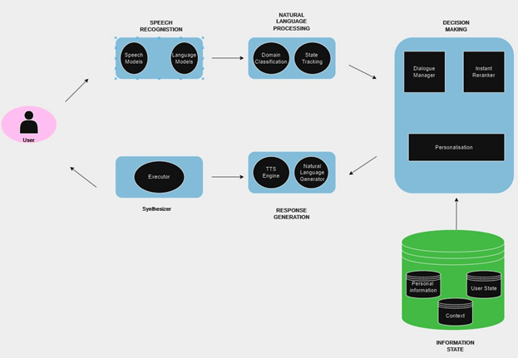
SYSTEM ARCHITECTURE
5
A new voice assistant like NIMMI could be focused on specific functionalities, integration capabilities, or user interfaces to distinguish itself in a competitive market.
If NIMMI is a recent development, it could incorporate advanced features beyond those found in earlier voice assistants, such as improved natural language understanding, more personalized responses, enhanced privacy features, or integration with a wider range of devices and services.
Startups and established tech companies alike are continually seeking ways to innovate in this space, making voice assistants more useful, intuitive, and integrated into our daily lives.

Slide 7
6
METHODOLODGY
The methodology outlined in the provided text involves the development and implementation of NIMMI, an integrated voice assistant. It incorporates powerful natural language processing (NLP) and machine learning algorithms to improve user engagement.
The process involves interpreting and processing complex inquiries with precision, utilizing cutting-edge AI for relevant and contextually aware solutions. NIMMI's versatility allows it to assist with various activities, including smart home device management, real-time information retrieval, personal productivity, and entertainment options.
Its platform-agnostic design ensures seamless integration across multiple ecosystems, including smart homes, wearables, and automobile systems. Additionally, NIMMI prioritizes privacy and security, employing strong encryption and anonymization techniques to safeguard user information, thus ensuring secure and private interactions.
The methodology underscores a commitment to innovation, aiming to incorporate advanced features and integration capabilities to distinguish NIMMI in the competitive voice assistant market and enhance its utility and integration into users' daily lives.

Slide 8
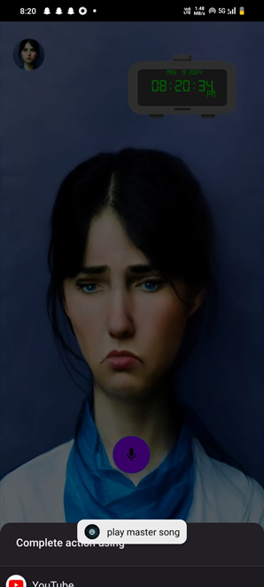
RESULTS AND DISCUSSIONS
7
NIMMI, as a pioneering integrated voice assistant, aims to seamlessly integrate into daily life, offering a customized user experience powered by advanced NLP and machine learning algorithms.
Its ability to interpret complex queries with precision enables assistance in various tasks, from managing smart home devices to enhancing personal productivity and entertainment options.
Larana University | 2024

Slide 9

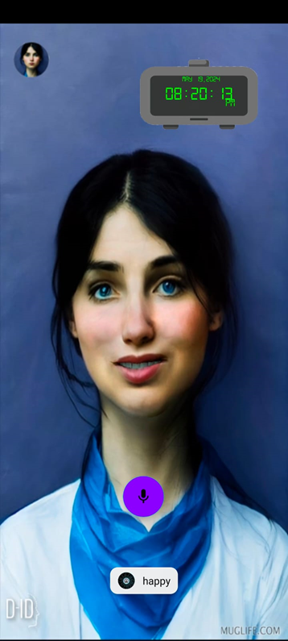
8
RESULTS AND DISCUSSIONS
NIMMI's integration flexibility across multiple platforms ensures consistent support, while prioritizing privacy and security through robust encryption and anonymization techniques fosters user trust.
Positioned as a leader in the voice assistant market, NIMMI sets new standards with its focus on security, usability, and integration, promising to revolutionize daily technology interactions with its advanced features and commitment to privacy.

Slide 10
9
CONCLUSION
In conclusion, NIMMI represents a significant advancement in the realm of voice-activated technology, offering unparalleled integration flexibility, privacy, and security. Its cutting-edge AI, precision in interpreting inquiries, and seamless operation across various platforms make it a pivotal tool in modern life. With a focus on user engagement, privacy, and personalized experiences, NIMMI sets a new standard for voice assistants. Its ability to adapt to different ecosystems and devices ensures consistent and reliable assistance for users, while its commitment to privacy and security instills confidence in its usage.

Slide 11
REFERENCES
10
1. Elghaish, F., Chauhan, J. K., Matarneh, S., Rahimian, F. P., & Hosseini, M. R. (2022, August 1). Artificial intelligence-based voice assistant for BIM data management. Automation in Construction. https://doi.org/10.1016/j.autcon.2022.104320
2. Liu, M., Wang, C., & Hu, J. (2023, November 1). Older adults’ intention to use voice assistants: Usability and emotional needs. Heliyon. https://doi.org/10.1016/j.heliyon.2023.e21932
3. Ye, W., & Li, M. (2024, March 1). Application of IoT Android voice assistant based on sensor networks in higher education network mode. Measurement. Sensors. https://doi.org/10.1016/j.measen.2024.101091
4. Szczuka, J. M., Strathmann, C., Szymczyk, N., Mavrina, L., & Krämer, N. C. (2022, September 1). How do children acquire knowledge about voice assistants? A longitudinal field study on children’s knowledge about how voice assistants store and process data. International Journal of Child-computer Interaction. https://doi.org/10.1016/j.ijcci.2022.100460

Slide 12
11
GITHUB
https://github.com/Thoufeeq503/210701503-GE19612-PRIEEeading

Slide 13
THANK YOU

