Slide 1
Neural Networks are Program, too.
By Marisa Kirisame

Slide 2
Main Idea
Neural Networks are Program
Apply PL/FP to Neural Network

Slide 3
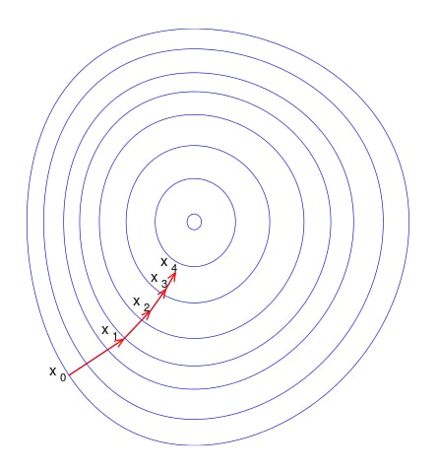
What is a Neural Network?
Contain implicit parameters (weight)
Find Best Weight
https://en.wikipedia.org/wiki/Gradient_descent

Slide 4
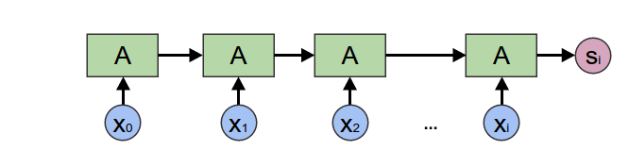
Quick Example
http://colah.github.io/posts/2015-09-NN-Types-FP/

Slide 5
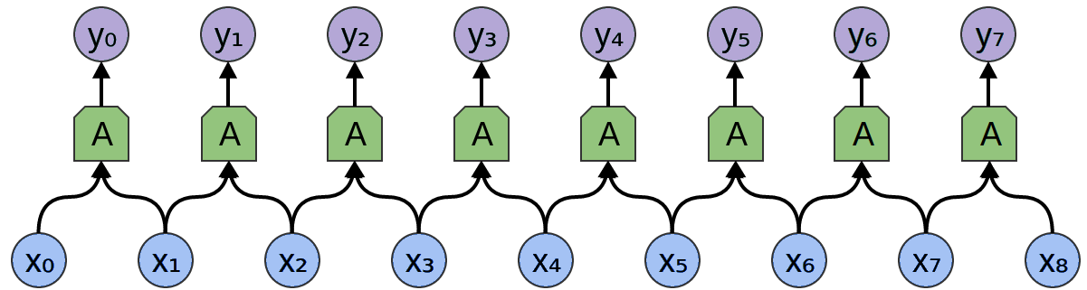
More Example
http://colah.github.io/posts/2015-09-NN-Types-FP/

Slide 6
Road map
Neural Network
Naive Automatic Differentiation(AD) – Quadratic
Forward Mode AD
Derivative of Multiple Variable
Derivative of More Variable
Impl NN
Meaning of AD on PL

Slide 7
Begging the question
Use high school calculus rule
dx/dx = 1
dy/dx = 0
d(f(x) + g(x))/dx = d(f(x))/dx + d(g(x))/dx
d(f(x) * g(x))/dx = d(f(x))/dx * g(x) + d(g(x))/dx * f(x)
d(f(g(x))/dx = (d(f(x))/dx*g(x))*d(g(x))/dx

Slide 8
Too young too simple
Naive approach doesn't scale!
Consider d(f(x)*g(x)*h(x))/dx
df(x)*g(x)*h(x)+*f(x)*dg(x)*h(x)+f(x)*g(x)*dh(x)

Slide 9
Road map
Neural Network
Naive Automatic Differentiation(AD) – Quadratic
Forward Mode AD
Derivative of Multiple Variable
Derivative of More Variable
Impl NN
Meaning of AD on PL

Slide 10
Simple Sharing Strategy
Interpret expression as pair
lit r → (lit r, lit 0)
(l, ldiff) + (r, rdiff) → (l + r, ldiff + rdiff)
(l, ldiff) * (r, rdiff) → (l * r, l * rdiff + r * ldiff)
Now linear time
Forward Mode Automatic Differentiation(AD)

Slide 11
Example
x * x + 2 * x + 3
(x, 1) * (x, 1) + (2, 0) * (x, 1) + (3, 0)
(x * x, 2 * x) + (2, 0) * (x, 1) + (3, 0)
(x * x, 2 * x) + (2 * x, 2) + (3, 0)
(x * x + 2 * x, 2 * x + 2) + (3, 0)
(x * x + 2 * x + 3, 2 x + 2)

Slide 12
Remember the talk title?
We don't want it to work on simple arithmetic
We want it to work on program
Trivial

Slide 13
Adding static typing
type Real = Double
type family DiffType (x: *): *
DiffType (a → b) = DiffType a → DiffType b
DiffType (a + b) = DiffType a + DiffType b
DiffType (a * b) = DiffType a * DiffType b
DiffType Real = (Real, Real)

Slide 14
Looking back
We archive the closure property
Do stuff with AST
Everything is typed

Slide 15
Road map
Neural Network
Naive Automatic Differentiation(AD) – Quadratic
Forward Mode AD
Derivative of Multiple Variable
Derivative of More Variable
Impl NN
Meaning of AD on PL

Slide 16
Differentiating wrt multiple variable?
Look carefully at the transformation
lit x → (lit x, lit 0)
+ → \(l, ld) (r, rd) → (l + r, ld + rd)
- → \(l, ld) (r, rd) → (l – r, ld – rd)
* → \(l, ld) (r, rd) → (l * r, l * rd + r * ld)
/ → \(l, ld) (r, rd) → (l / r, 1/r * ld - l/(r * r) * rd)
exp → \(x, xd) → let ex = exp x in (ex, ex * xd)

Slide 17
Vector Space!
() is a Vector Space, 0 weight
R is a Vector Space, 1 weight
(vl * vr) is a Vector Space, have added weight
V[1000] is a Vector Space
Minimal definition:
0: v
+: v → v → v
scale: R → v → v
DiffType now take an extra parameter v

Slide 18
Example
x * x + y * y + x * y
(x, (1, 0)) * (x, (1, 0)) + (y, (0, 1)) * (y, (0, 1)) + (x, (1, 0)) * (y, (0, 1))
(x * x, (2 * x, 0)) + (y * y, (0, 2 * y)) + (x * y, (y, x))
(x * x + y * y + x * y, (2 * x + y, 2 * y + x))

Slide 19
Road map
Neural Network
Naive Automatic Differentiation(AD) – Quadratic
Forward Mode AD
Derivative of Multiple Variable
Derivative of More Variable
Impl NN
Meaning of AD on PL

Slide 20
A slight problem
Suppose v is Real[10000]
It take ridiculous amount of work to do 0/+/scale
Accumulate the 'scale factor' in a parameter
Vector x => Vector (Real → x)
0 = const 0
l + r = \x → (l x + r x)
l `scale` r = \x → r (l * x)

Slide 21
Boom!
Exponential, now much worse
Consider b = (a + a); c = (b + b); c + c
We need to share the actual function as well
Cant compare function (Halting Problem)
But we can compare AST

Slide 22
Iso-Recursive Type
DiffType v (Fix f) = DiffWrapper [v] f (Fix f)
DiffType v (DiffWrapper a x) = DiffWrapper (v:: a) x
Wrapper for a term on (fold on DiffType and x)
Data Type A La Carte(DTALC) → ADT

Slide 23
Selecting Weight
Basis Unit = Void
Basis R = Unit
Basis (l, r) = Basis l + Basis r
FreeVector b = b → Real
FreeVectorBuilder b = Map b Real

Slide 24
Term Algebra
TermVector b =
Zero |
Basis b |
Plus (TermVector b) (TermVector b) |
Mult Real (TermVector b)
TermVectorF b f = Zero | Basis b | Plus f f | Mult Real f
TermVector b = Fix (TermVectorF b)

Slide 25
TermVector is a Vector
Rather Obvious: call the constructor
Still exponential in that example
But we reduce the problem to a simpler one

Slide 26
Hash Consing
Implementing Explicit and Finding Implicit Sharing in Embedded DSLs
State (Bimap (TermVectorF b Int) Int) Int

Slide 27
Forward Mode = Backward Mode
State (Bimap (TermVectorF b Int) Int)
Insert empty bimap, get a pair of bimap and int
Create Map Int Real
map each ast to 'accumulating scaling value'
wengert list.
recurse starting from nodeid, -1 everytime
return State (Map Int Real) (FreeVectorBuilder b)

Slide 28
Backward Mode = Back Propagation
match on (TermVectorF b Int) from the map
0 - return zero
Basis b - return it
l `plus` r - get sensitivity, add to sensitivity of l/r
l `mult` r - get sensitivity, scale l, add to r
Recurse and add the two Builder
Turn Builder into FreeVector

Slide 29
Road map
Neural Network
Naive Automatic Differentiation(AD) – Quadratic
Forward Mode AD
Derivative of Multiple Variable
Derivative of More Variable
Impl NN
Meaning of AD on PL

Slide 30
Finally, Neural Network
A NN of type x is just exists w, Term (w → x)
A Term is a NN: exists Unit
Term (x → y) → Term x → Term y
Finally Tagless

Slide 31
Road map
Neural Network
Naive Automatic Differentiation(AD) – Quadratic
Forward Mode AD
Derivative of Multiple Variable
Derivative of More Variable
Impl NN
Meaning of AD on PL

Slide 32
Drawing the Connection
Data Structure → Forward Mode AD
Semantic/Logical Relation → Meaning of AD
F Algebra, DataKinds → ADT
TypeClass → Generalized FWD mode AD
Term Algebra(DSL), Hash Consing → BWD mode AD
DTALC/FTG → typed, extensible framework
Higher Order Function → RNN(fold)
Partial Evaluation → Optimization (Tensorflow fold)
Program Synthesis → Optimization (Latte)
Existential Type → Neural Network
Higher Order Abstract Syntax → Pretty API

Slide 33
Meaning of differentiating higher order function
We need to step back
Denote to nonstandard language Term
Same as the old STLC
old lit: Real → Term Real
lit: (Real → Real) → Term Real
lit x → lit (\_ → x)
+ → +, but + have operational semantic of
lit l + lit r → lit (\x → l x + r x)

Slide 34
Back to the problem
LR: forall t, NonStdTerm (DiffType t) → Prop
LR (l * r) t = exists x y,
t eval to app (app (mkProd x) y), LR l x, LR r y
LR (l + r) t =
exists x, t eval to app left x, LR l x
or exists y, t eval to app right y, LR r y
LR (l → r) t = forall inp, LR l inp → LR r (app t inp)

Slide 35
The main part
LR Real t:
t eval to (lit orig, lit diff)
forall x, diff x = (newton diff of orig) on x
Denotational Semantic
LR (Real → Real)

Slide 36
Back to standard
stdify: forall t, Real → NonStdTerm t → Term t
app (stdify r f) (stdify r x) = stdify r (app f x)
Apply (\x → x, \x → 1) to Real → Real, apply x to rhs
Apply (x, 1) to Real → Real, take the rhs
Optimize away the function

Slide 37
Wrapping Up
deq relate Term t and Term (DiffType t)
Main theorem: forall t, deq t (diff t) /\ LR t (diff t)
Logical Relation
Operational Semantic
Denotational Semantic

Slide 38
Road map
Neural Network
Naive Automatic Differentiation(AD) – Quadratic
Forward Mode AD
Derivative of Multiple Variable
Derivative of More Variable
Impl NN
Meaning of AD on PL

Slide 39
Implementation Detail
Finally Tagless mode, generalized AD, NN
And more! (Infinite tower of diff, example)
https://github.com/ThoughtWorksInc/DeepDarkFantasy/
File DDF/Poly.lhs, DDF/Xor.lhs

Slide 40
Question?

