Slide 1
Closing the Digital Support Gap
Evaluating a Community Technology Pilot Through Public Data
Google Data Analytics Professional Certificate — Capstone Project
Aaron Spoonts · September 2026

Slide 2
Should a community organization fund a limited technology-support pilot?
The proposed pilot combines:
Device refurbishment and reuse
Hands-on technical training
Personalized digital support
Priority population: Older adults and other groups showing lower levels of digital engagement.
Decision standard: Does the available evidence show enough measurable need, repair potential, and public benefit to justify a limited pilot?

Slide 3
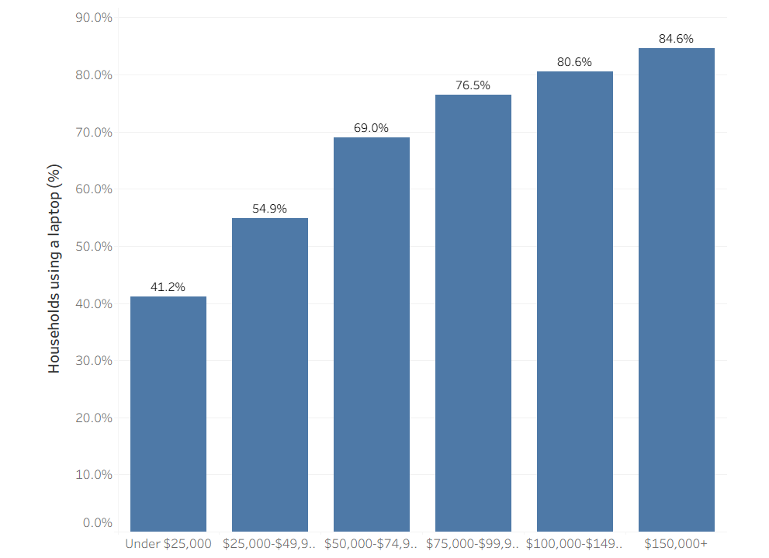
Laptop use rises sharply with household income
43.4 percentage-point gap
Laptop use rises from 41.2% among households under $25,000 to 84.6% among households earning $150,000 or more.
Source: National Telecommunications and Information Administration (NTIA), 2023 Internet Use Survey; author’s weighted analysis.

Slide 4
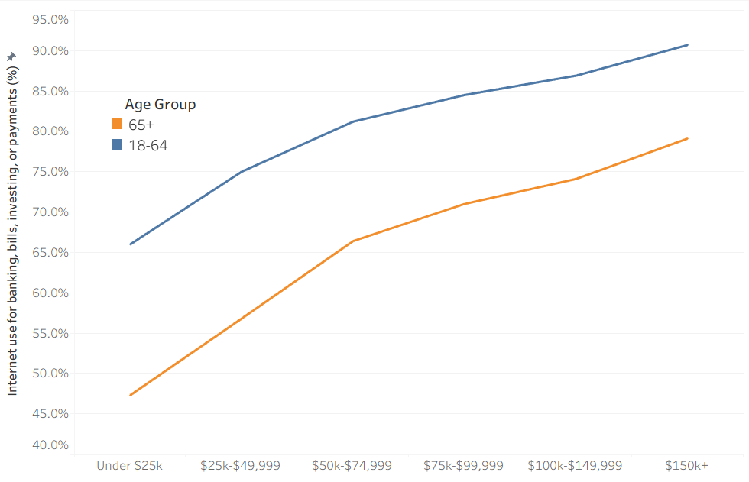
Older adults report lower use of internet-based financial services across income levels
63.2% vs 81.6%
Internet financial-services use was 63.2% among adults age 65+, compared with 81.6% among adults ages 18–64.
The age gap persists across every household-income group shown.
Source: National Telecommunications and Information Administration (NTIA), 2023 Internet Use Survey, Current Population Survey (CPS) Computer and Internet Use Supplement; author’s weighted analysis of internet-based financial-services use by age group and household income.

Slide 5
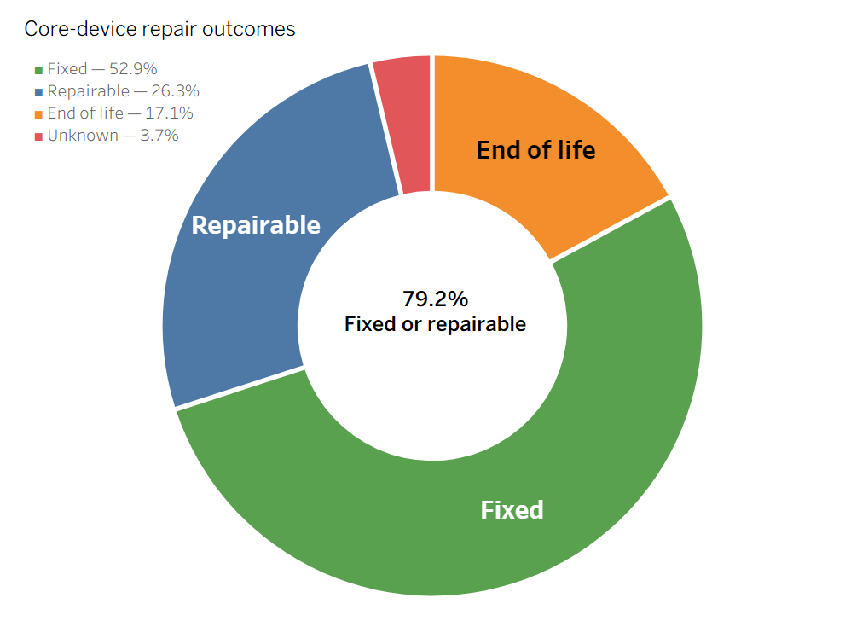
Most core-device records were fixed or remained repairable
52.9% of records were fixed and another 26.3% remained repairable.
“Repairable” does not mean the device was successfully repaired during the recorded attempt.
Source: Open Repair Alliance, Open Repair Data; author’s analysis. Repair status reflects outcomes of community repair attempts. “Repairable” means the item was considered repairable but was not necessarily fixed during the recorded repair attempt.

Slide 6
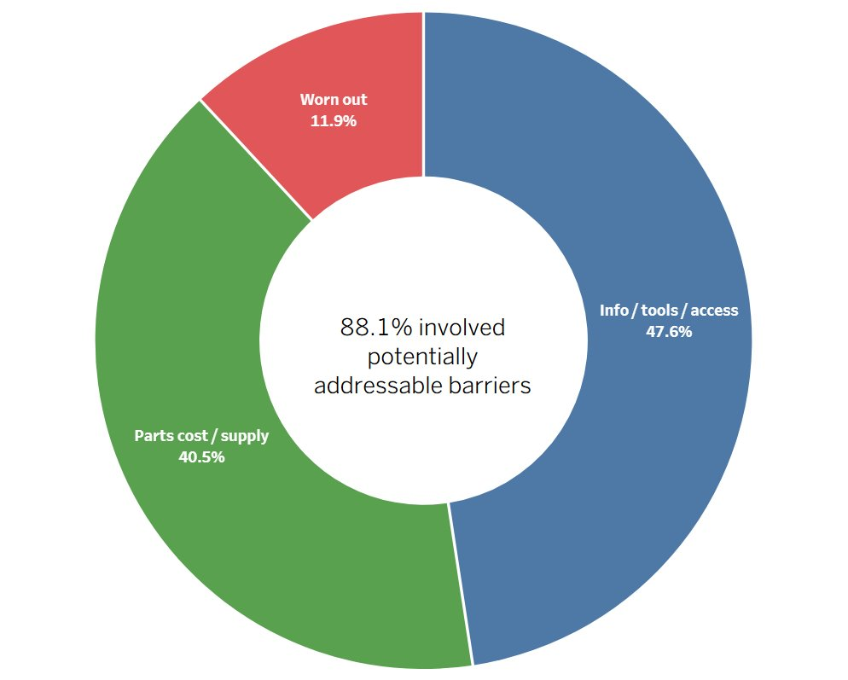
Most documented end-of-life barriers were potentially addressable
Most documented barriers involved information, tools, product access, parts cost, or parts availability rather than simple device wear-out.
Barrier information was documented for only 29.0% of core-device end-of-life records.
Source: Open Repair Alliance, Open Repair Data; author’s analysis. Note: Barrier data were available for 1,173 of 4,047 core-device end-of-life records (29.0%); percentages shown are among documented barriers only.

Slide 7
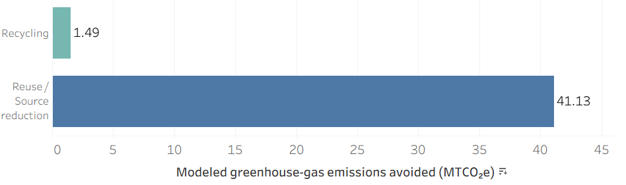
Reuse offers a much larger modeled emissions benefit than recycling
41.13 MTCO₂e
Reusing 500 portable devices instead of landfilling them produced a modeled benefit of 41.13 metric tons of carbon dioxide equivalent (MTCO₂e).
Recycling the same modeled device mass avoided 1.49 MTCO₂e.
These are scenario estimates, not measured program outcomes.
Source: U.S. Environmental Protection Agency (EPA), Waste Reduction Model (WARM), electronics factors; author’s scenario analysis. Assumes 500 portable electronic devices averaging 2.5 kg each. Results are modeled estimates, not observed program outcomes.

Slide 8
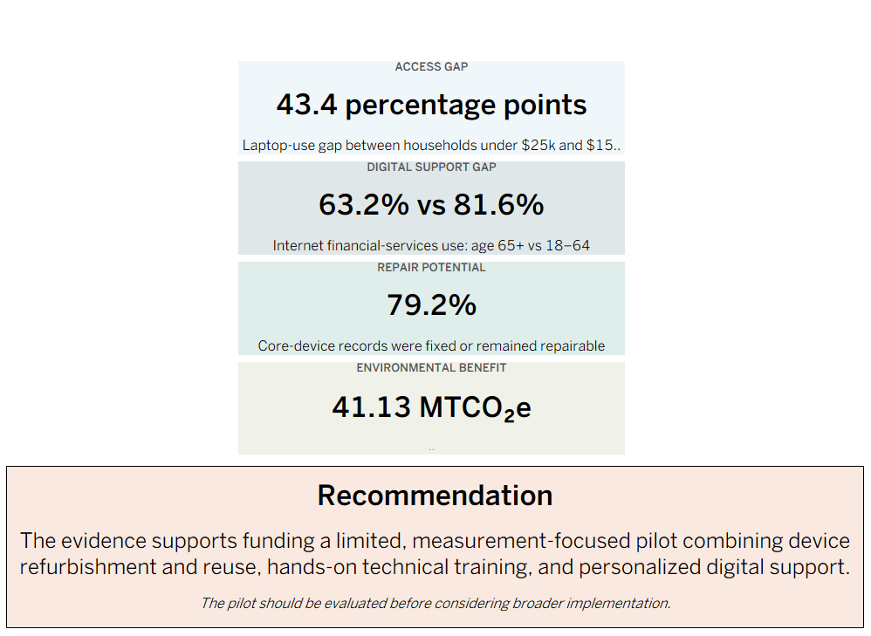
Integrated Evidence for a Community Technology Pilot
Sources: National Telecommunications and Information Administration (NTIA), 2023 Internet Use Survey; Open Repair Alliance, Open Repair Data; U.S. Environmental Protection Agency (EPA), Waste Reduction Model (WARM); author’s analysis. WARM result is a modeled scenario, not an observed program outcome.

Slide 9
Beyond This Pilot
Fraud-awareness support
Fraud-awareness support warrants its own pilot; evidence suggests intervention format (one-time vs. repeated/trusted contact) matters more than whether education happens at all, which this study didn't test.
Environmental impact
Environmental impact warrants better modeling, not a separate pilot; real WARM estimates should be calculated from the refurbishment pilot's actual device data once it exists, replacing the illustrative 500-device scenario.

Slide 10
Methodology, Limitations & AI-Assisted Workflow
METHOD
• National Telecommunications and Information Administration (NTIA) 2023 survey data analyzed using survey weights
• Open Repair records filtered to laptops, desktops, mobile phones, and tablets
• SQL used to independently validate key Python-derived results
• U.S. Environmental Protection Agency (EPA) Waste Reduction Model (WARM) used for a defined 500-device reuse scenario
• External evidence manually reviewed before inclusion
LIMITATIONS
• NTIA measures reported technology and internet use, not digital proficiency
• Open Repair data are self-selected and not nationally representative
• Repair-barrier information was available for only 29.0% of core-device end-of-life records
• WARM results are modeled estimates, not observed program outcomes
• Findings support a pilot test, not immediate full-scale implementation
AI USE
• Artificial intelligence tools assisted with source discovery, code drafting, workflow planning, summarization, and documentation.
• External sources and analytical outputs were manually reviewed and validated.
• Final decisions regarding data selection, methodology, interpretation, limitations, and recommendations were made by the analyst.
github.com/Thoughtformer/data-analytics-portfolio

