Slide 1
Smart parking
INTERNET OF THINGS
Team Members:
G.ATCHAYA-821021104012
A.THOUMIYA-821021104050
S.ROSHINI VINNARASI-821021104037
A.JOY RAMILA-821021104025
D.AARTHI-821021104002.

Slide 2
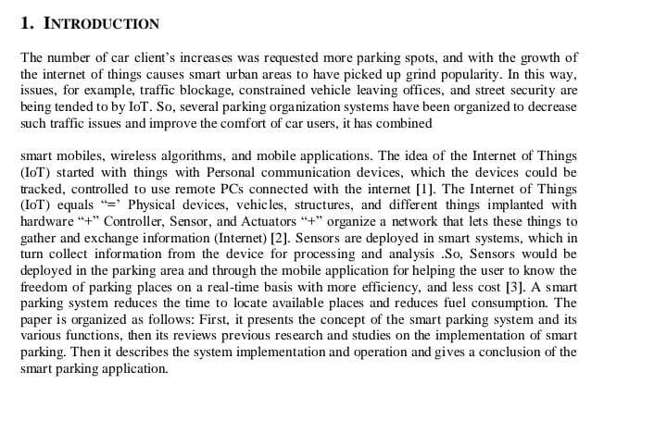

Slide 3
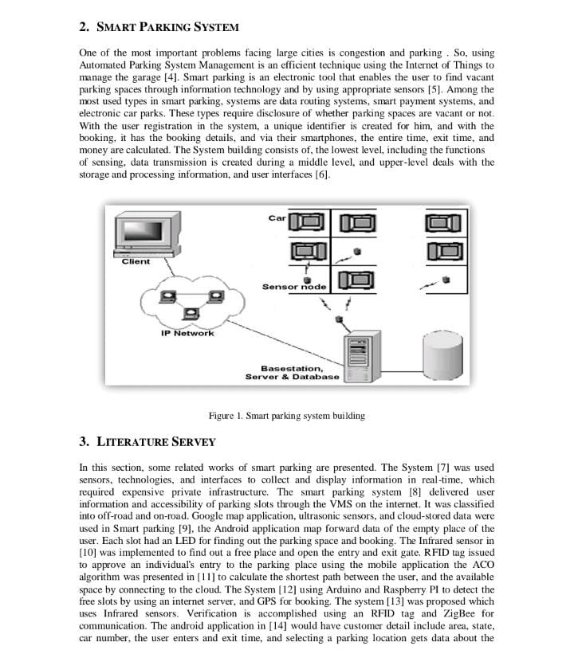

Slide 4
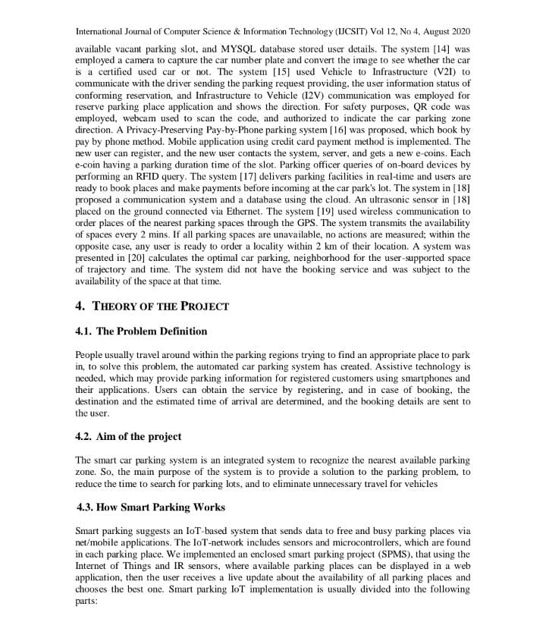

Slide 5
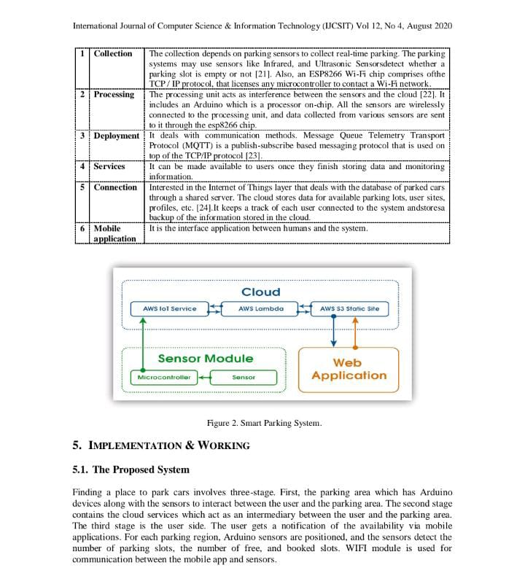

Slide 6
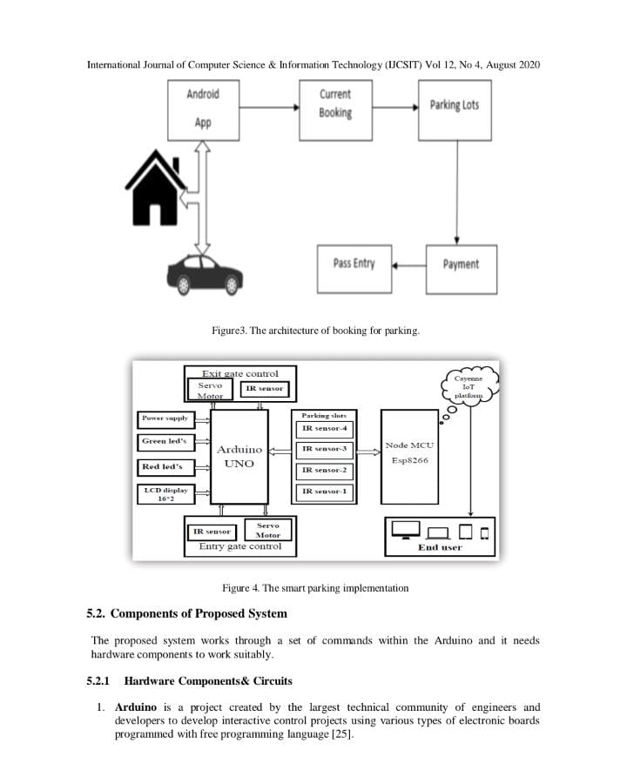

Slide 7
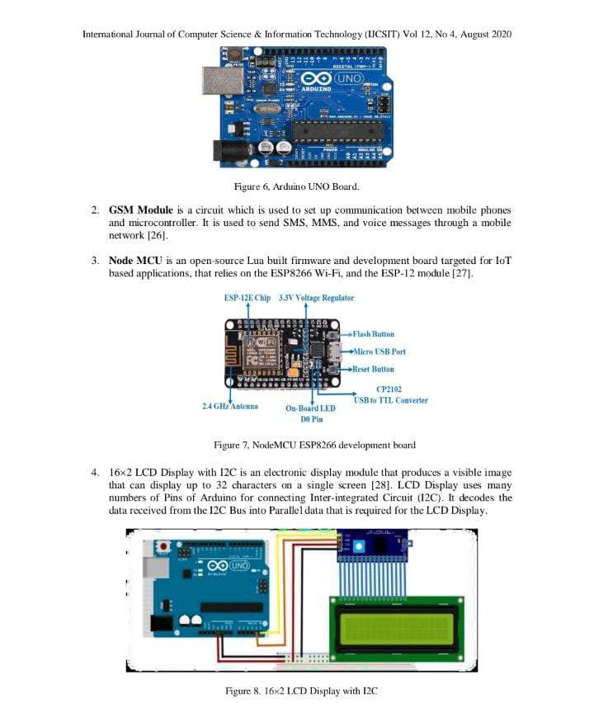

Slide 8
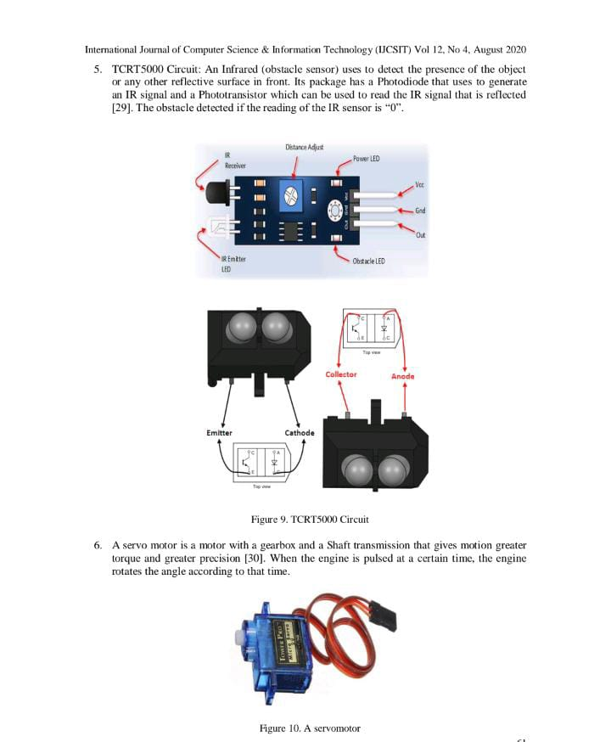

Slide 9
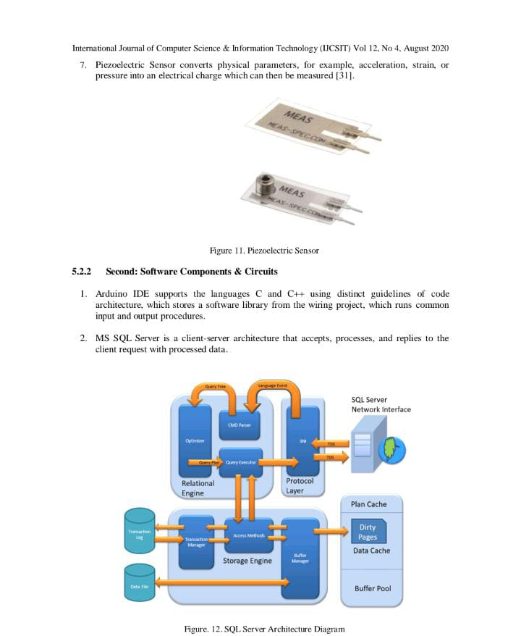

Slide 10
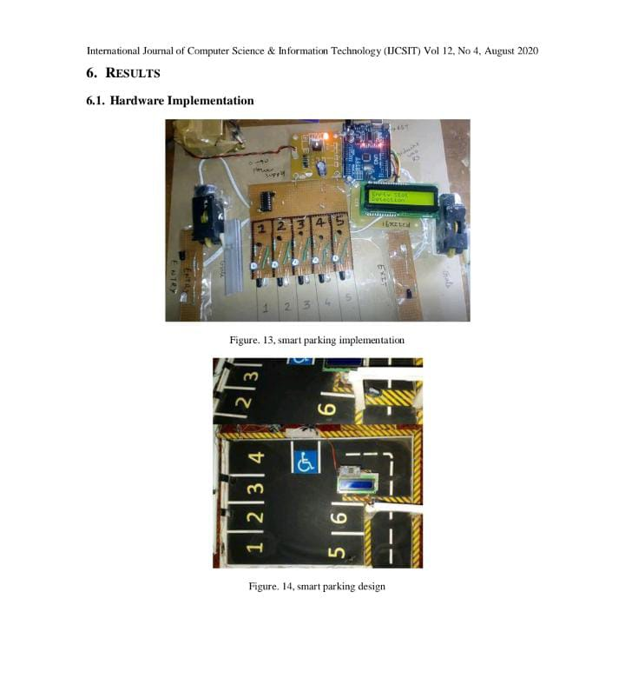

Slide 11
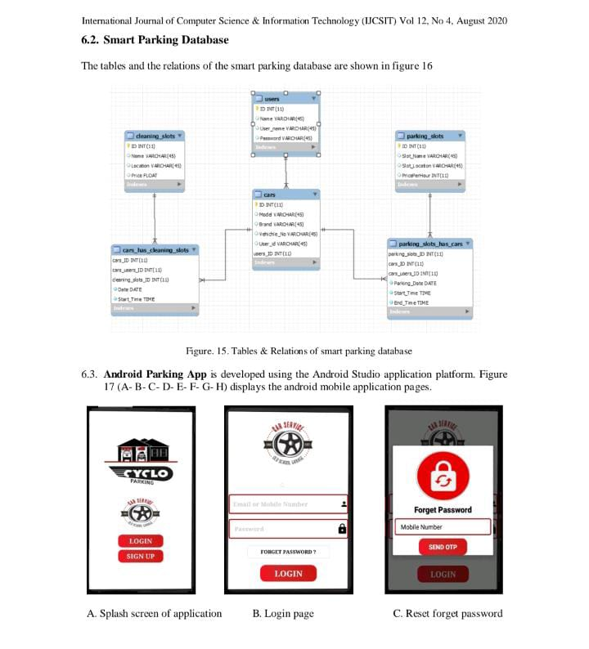

Slide 12
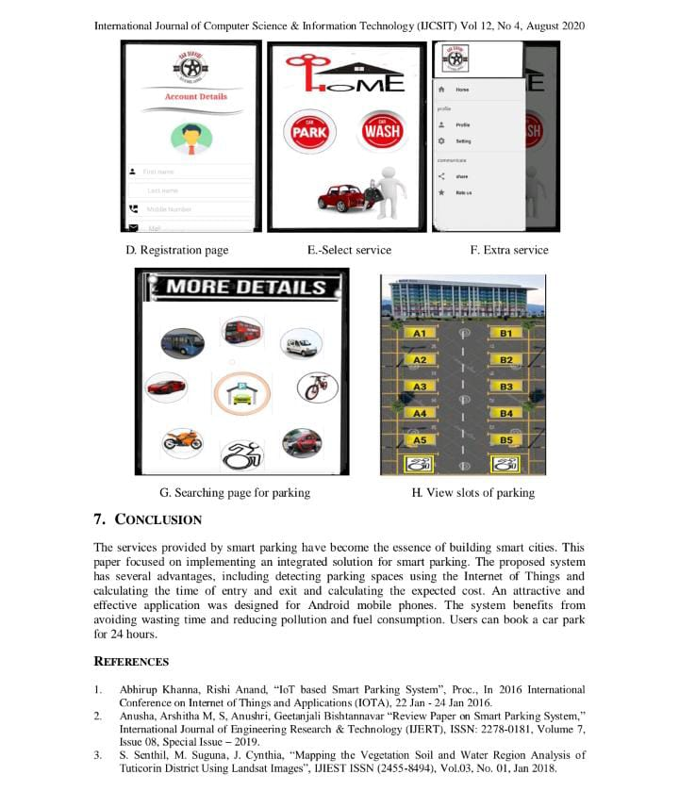

Slide 13
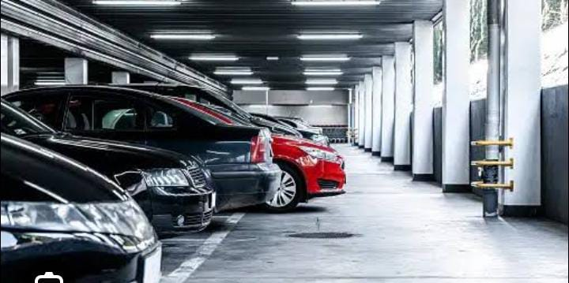
SMART PARKING SYSTEM
Thank You All…

